Slide 1
input()
上课老师：张老师

Slide 2
a = input() print(a) print(type(a))

Slide 3
print(“请输入：") a = input() print(a)
a = input(“请输入：") print(a)

Slide 4
a = input("请输入第一个数：") b = input("请输入第二个数：") print(a + b)

Slide 5
a = input("请输入第一个数：") a = int(a) b = input("请输入第二个数：") b = int(b) print(a + b)
a = int(input("请输入第一个数：")) b = int(input("请输入第二个数：")) print(a + b)

Slide 6
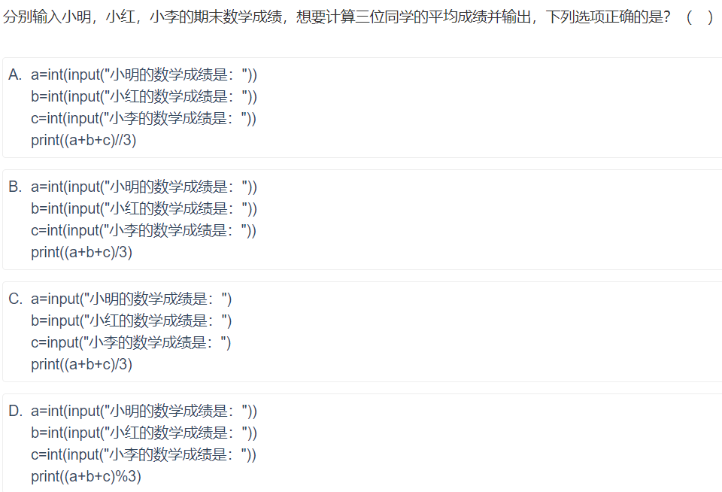

Slide 7
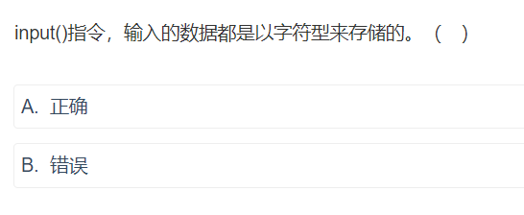
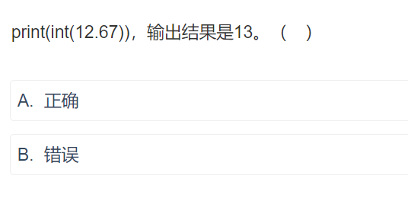

Slide 8
x1="11" x2="12" x3= x1 + x2 print(x3) x4 = int(x1) + int(x2) print(x4)

