Slide 1
运算符
上课老师：张老师

Slide 2
#算术运算符 # + - * / // % ** num1 = 10 num2 = 3 res1 = num1 / num2 #3.33333 res2 = num1 // num2 #3 res3 = num1 % num2 #1

Slide 3
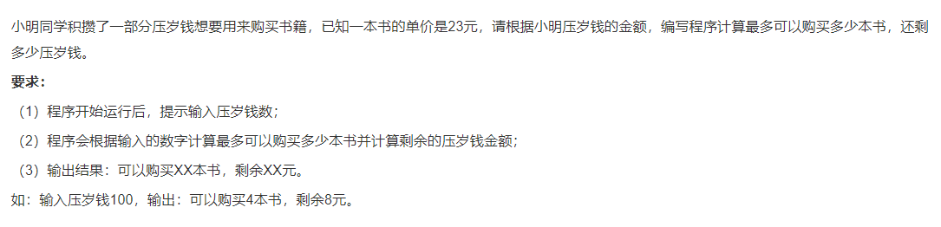

Slide 4
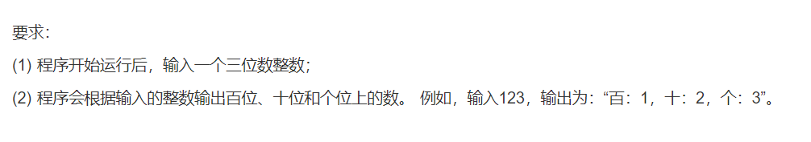

Slide 5
#比较运算符 #真 True 1 假 False 0 # > < >= <= == != num1 = 10 num2 = 3 res = num1 == num2 #False res = num1 != num2 #True

Slide 6
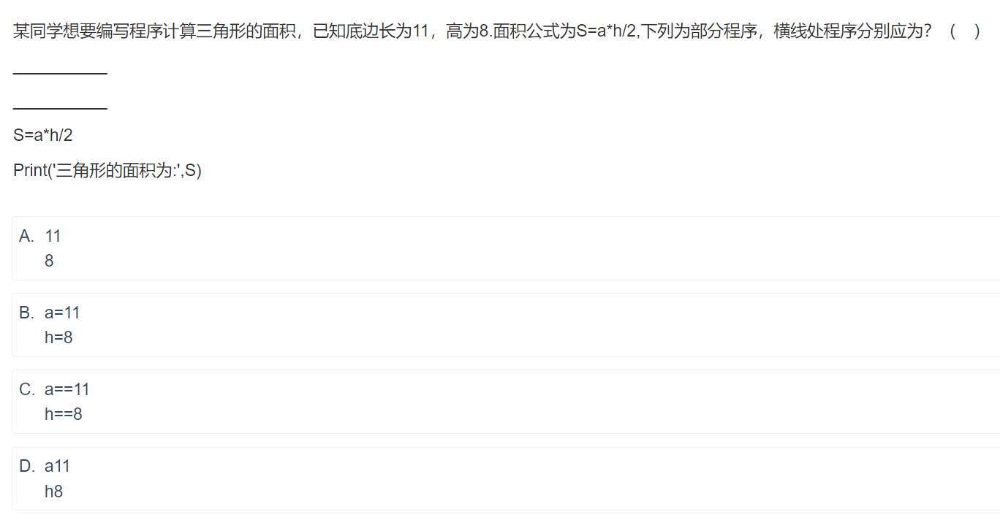

Slide 7
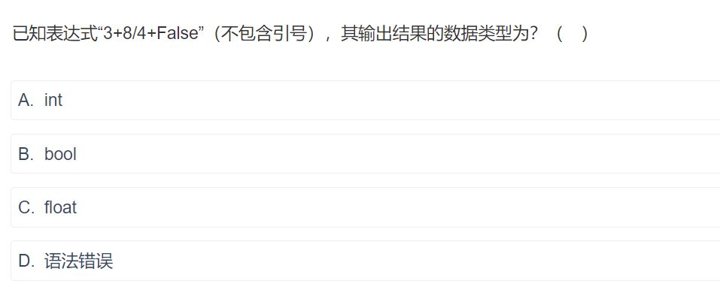

Slide 8
#逻辑运算符 # not(非,取反) and(与) or(或) res = True and True #True res = True and False #False res = True or False #True
res = False or False #False res = not Ture #False

Slide 9
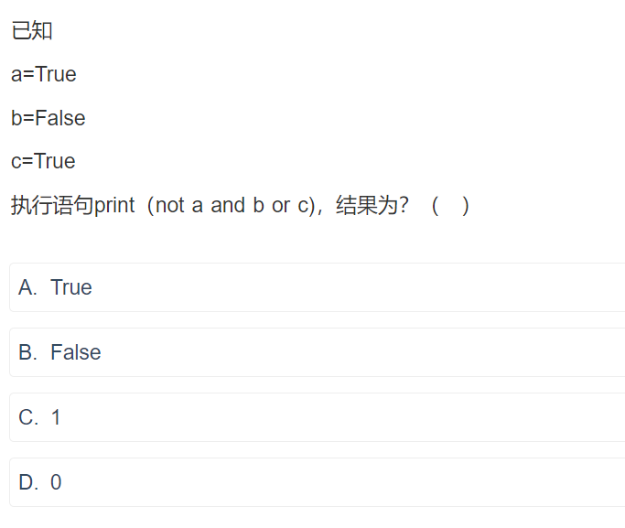

Slide 10
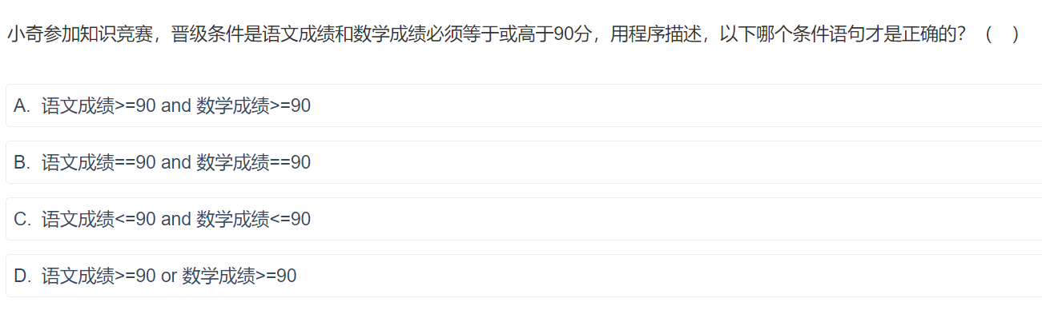

Slide 11
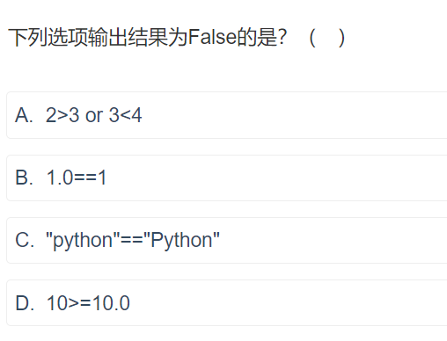

Slide 12
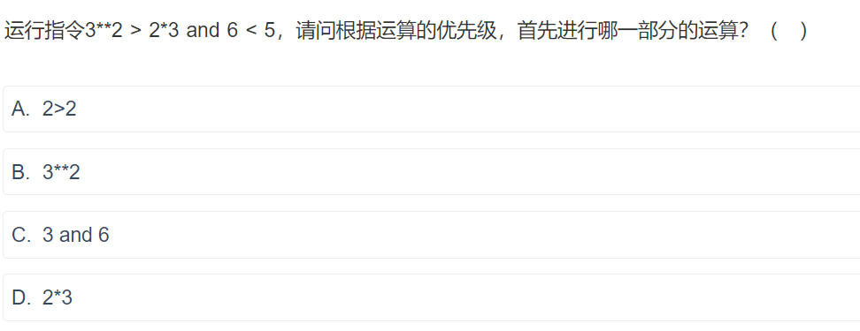

Slide 13
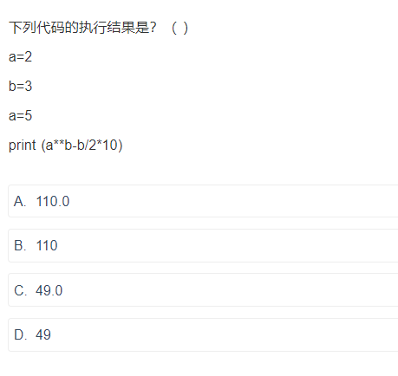

Slide 14
#赋值运算符 a = 2 b = 3 c = a a = b b = c
#赋值运算符 = a,b = 1,2 a,b = b,a

Slide 15
