Slide 1
turtle
https://docs.python.org/zh-cn/3/library/turtle.html#
上课老师：张老师

Slide 2
import turtle #导入画图工具 turtle.forward(100) #前进100 turtle.right(90) #右转90
turtle.backward(100) #后退100 turtle.done() #结束

Slide 3
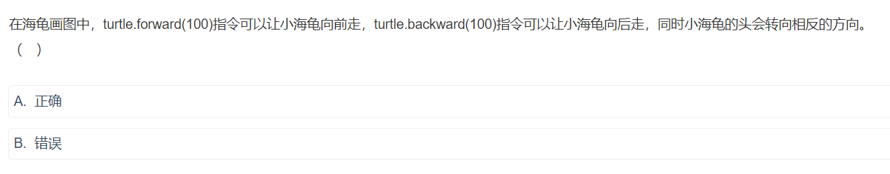

Slide 4
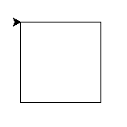
#导入画图工具 import turtle #画正方形 turtle.forward(100) #前进100 turtle.right(90) #右转90 turtle.forward(100) turtle.right(90) turtle.forward(100) turtle.right(90) turtle.forward(100) turtle.right(90) #结束 turtle.done()

Slide 5
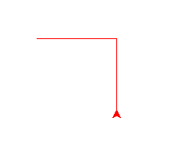
import turtle turtle.penup() #抬笔 turtle.goto(-100,0) #设置起点 turtle.pendown() #落笔 turtle.color("red") #设置画笔颜色为红色 turtle.forward(100) turtle.left(90) turtle.backward(100) turtle.done()

Slide 6
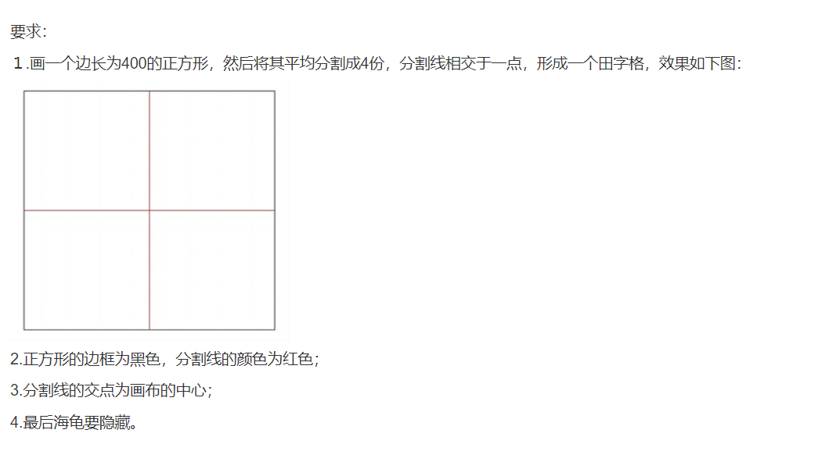
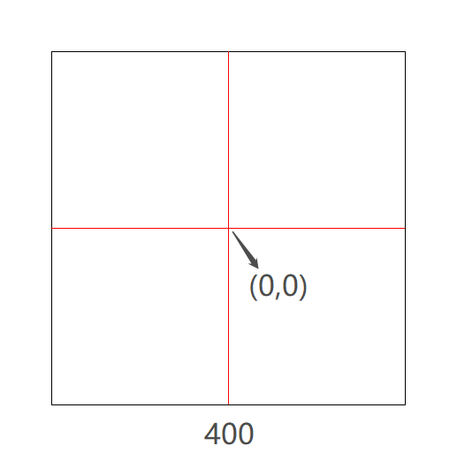

Slide 7
import turtle turtle.circle(100) #画一个半径为100的圆 turtle.done()

Slide 8
turtle.circle(100,90) turtle.circle(100,-90) turtle.circle(-100,90) turtle.circle(-100,-90)

Slide 9
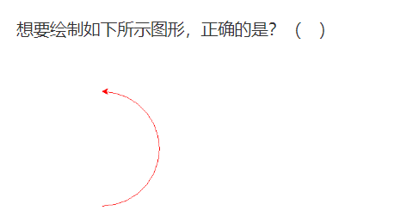
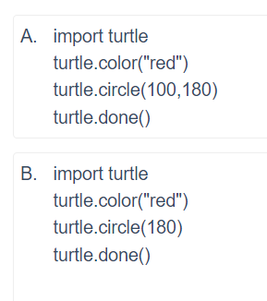
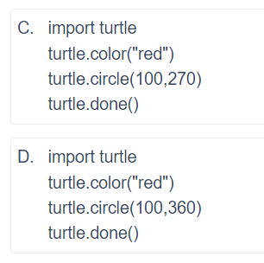

Slide 10
