Slide 1
利用循环画出复杂的图形

Slide 2
复习
走路
turtle.forward(100)
转体
turtle.left(90)
turtle.right(90)
画圆
turtle.circle(50)

Slide 3
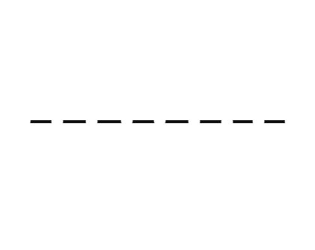
画虚线段

Slide 4
import turtle
for n in range(40):
turtle.pendown()
turtle.forward(5)
turtle.penup()
turtle.forward(5)
turtle.done()

Slide 5

画虚线圆

Slide 6
import turtle
for n in range(36):
turtle.pendown()
turtle.circle(100,5)
turtle.penup()
turtle.circle(100,5)
turtle.done()

Slide 7
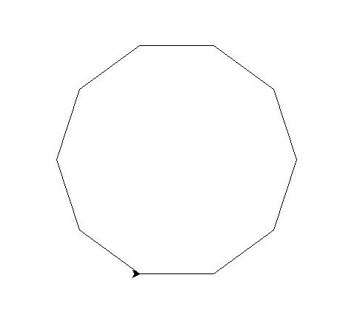
画任意多边形
多边形内角和公式：（N - 2）* 180

Slide 8
import turtle
N = 15
angle = 180 - (N - 2) * 180 / N
for n in range(N):
turtle.forward(50)
turtle.left(angle)
turtle.done()

Slide 9
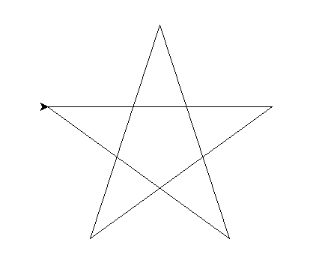
画五角星

Slide 10
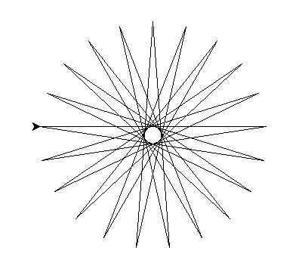
画N角星，N为奇数
N = 21

Slide 11
import turtle
turtle.bgcolor('#FFC0CB')
turtle.pencolor('red')
N = 5
angle = 180 / N
for n in range(N):
turtle.forward(300)
turtle.right(180 - angle)
turtle.done()

