Slide 1
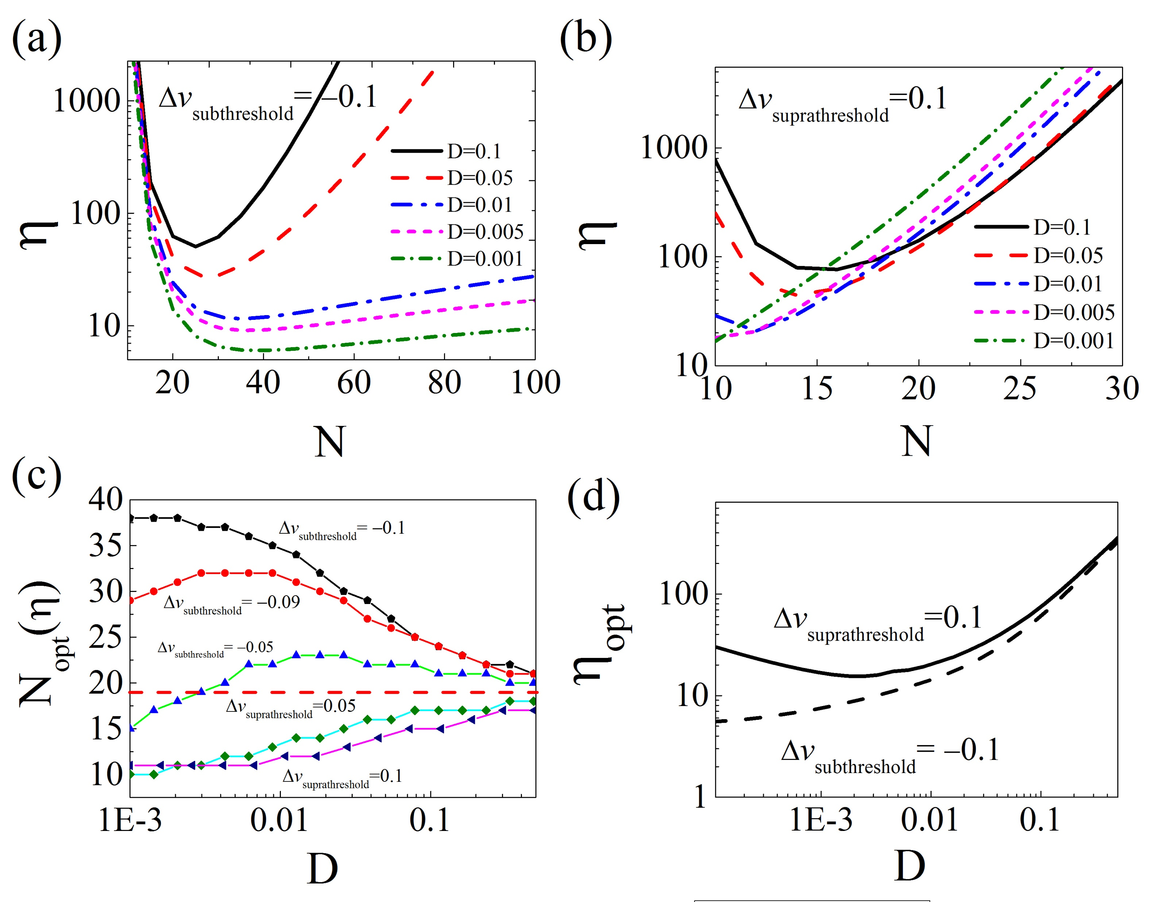
Publication: Energy-efficient population coding constrains network size of a neuronal array system

Slide 2
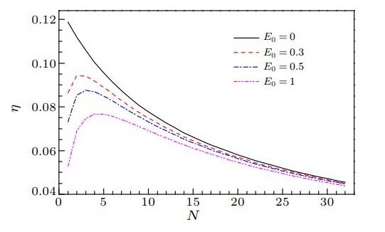
Publication: Optimal Size for Maximal Energy Efficiency in Information Processing of Biological Systems Due to Bistability

