Slide 1
patents
File created on: 2022-11-15 23:04:27

Slide 2
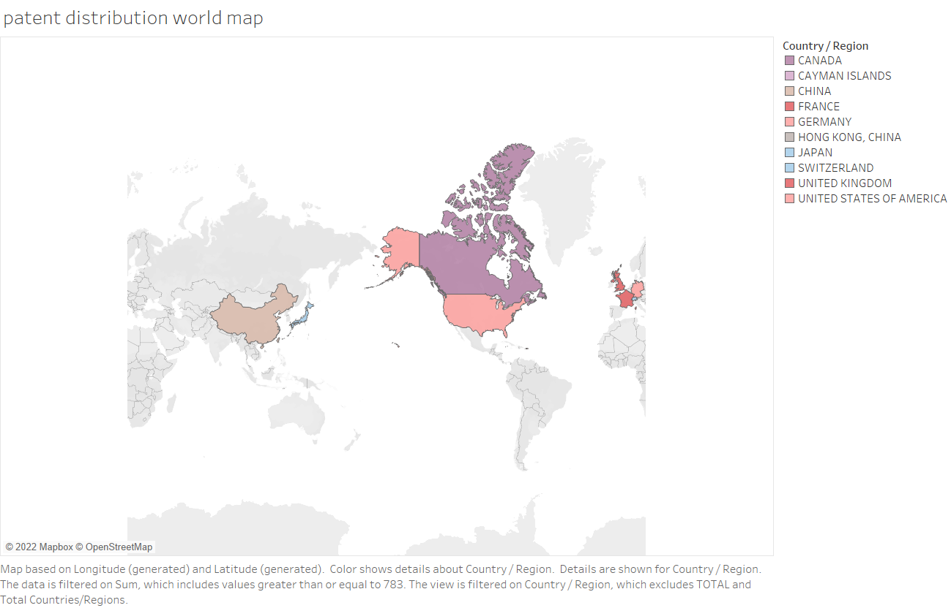

Slide 3
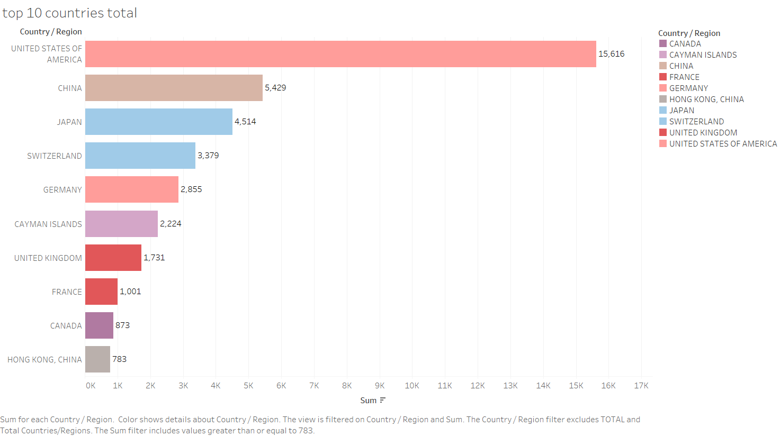

Slide 4
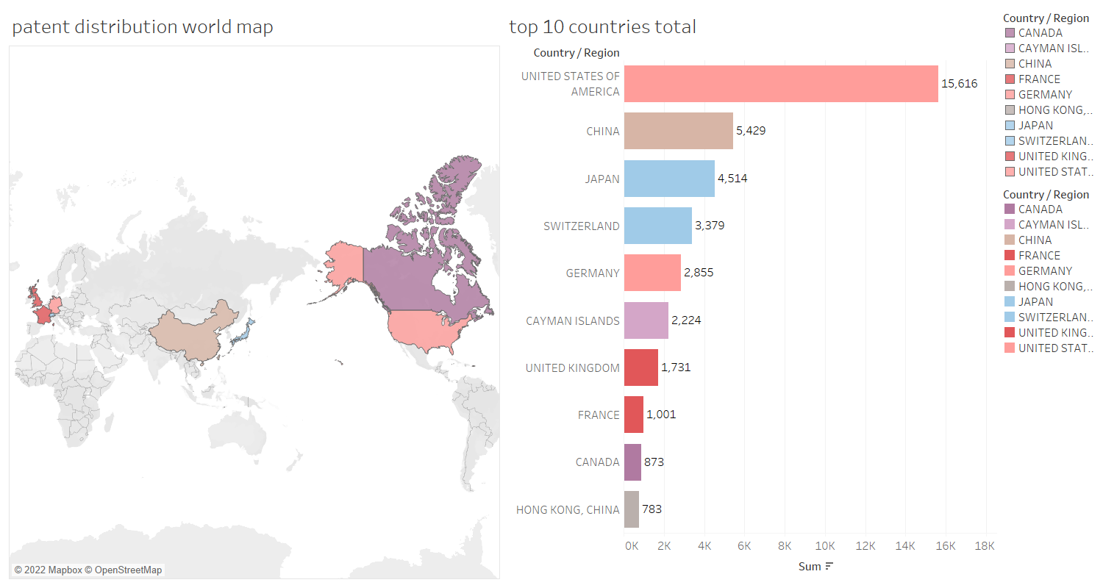

Slide 5
