Slide 1


Private Set Operations from Multi-Query Reverse Private Membership Test
$$A∩B$$
$$A∪B$$
A
B
A
B
Yu Chen¹, Min Zhang¹, Cong Zhang², MingLiang Dong¹, Weiran Liu³
¹School of Cyber Science and Technology, Shandong University
²Institute for Advanced Study, BNRist, Tsinghua University
³Alibaba Group

Slide 2
Outline
Background and Contribution
01
PSO Framework from mqRPMT
02
Constructions of our mqRPMT
03
Comparisons and Experiments
04
Summary of This Work
05

Slide 3
Outline
Background and Contribution
01

Slide 4


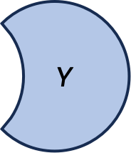

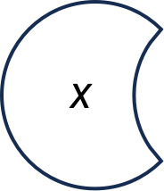
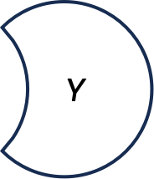




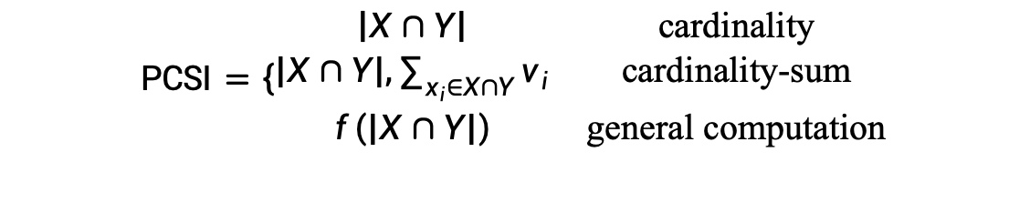

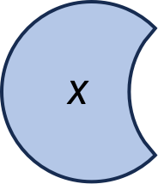
1.1 Private Set Operations
$$X=\left\{x_{1},…,x_{n_{1}}\right\}$$
$$Y=\left\{y_{1},…,y_{n_{2}}\right\}$$
PSO
$$V=\left\{v_{1},…,v_{n_{1}}\right\}$$
Sender
Receiver
$$X$$
$$Y$$
$$\text{PSI}=X∩Y$$
$$X$$
$$Y$$
$$\text{PCSI}=\left\{\begin{matrix}\left|X∩Y\right| & \text{cardinality} \\ \left|X∩Y\right|,\sum_{x_{i}∈X∩Y}{v_{i}} & \text{cardinality}\text{-}\text{sum} \\ f\left(\left|X∩Y\right|\right) & \text{general} \text{computation}\end{matrix}\right.$$
$$f$$
$$X$$
$$Y$$
$$\text{PSU}=X∪Y$$

Slide 5
1.2 Wide Applications of PSO
PSI
Privacy-preserving location sharing
Private contact discovery
DNA testing and pattern matching
PCSI
measuring the effectiveness of online advertising
PSU
IP blacklist and vulnerability data aggregation
private DB supporting full join
Private-ID
$$X$$
$$Y$$
$$X$$
$$Y$$
$$f$$
$$X$$
$$Y$$

Slide 6
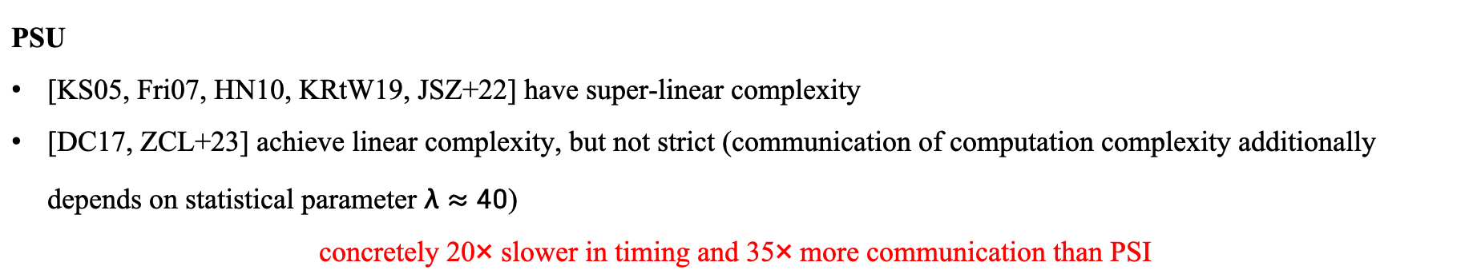
1.3 State-of-the-art PSO
PSI has been extensively studied in the last two decades.
balanced setting: [KKRT16, CM20, RR22] achieves linear complexity, and almost as efficient as insecure hash protocol.
unbalanced setting: [CLR17, CHLR18, CMdG+21] achieves sub-linear complexity of large set.
In sharp contract, the study of PCSI and PSU are not satisfying.
PCSI
[HFH99, IKN+20, PSTY19] achieve linear complexity
concretely 20× slower in timing and 30× more communication than PSI
PSU
[KS05, Fri07, HN10, KRtW19, JSZ+22] have super-linear complexity
[DC17, ZCL+23] achieve linear complexity, but not strict (communication of computation complexity additionally depends on statistical parameter $λ≈40$)
concretely 20× slower in timing and 35× more communication than PSI

Slide 7
1.4 Motivation
Different approaches for different private set operations → require much more engineering effort and maintain cost
Goal: a unified framework of PSO
There exists huge efficiency gap between PSI and other PSO protocols
Goal: efficient instantiations to close the gap¹
After ≈ 40 years, DH-PSI [Mea86] is still the most easily understood and implemented one among numerous PSI protocols. Surprisingly, no counterpart is known in the PSU setting yet. Existing protocols are very complicated.
Goal: build DDH-based PSU protocol as simple as DH-PSI
Is there a central building block that enables a unified framework for PSO?
How to give instantiations with optimal asymptotic complexity and good concrete efficiency?
Can the DDH assumption strike back with efficient PSU protocol?
¹[GMR+21] presented a PSO framework from permuted characteristic. However, oblivious shuffle is not necessary for PSO, and incurs supe-linear complexity.

Slide 8
Outline
PSO Framework from mqRPMT
02
Notes:
So, let’s start with Introduction and problem definition.

Slide 9



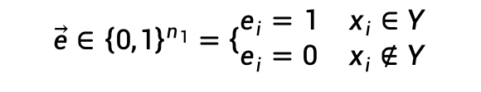


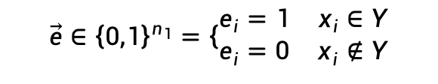
2.1 From mqPMT for PSI to mqRPMT for PSO
$$Y$$
mqPMT
$$X=\left\{x_{1},…,x_{n_{1}}\right\}$$
Sender
Server
Client
Receiver
$$\vec{e}∈{\left\{0,1\right\}}^{n_{1}}=\left\{\begin{matrix}e_{i}=1 & x_{i}∈Y \\ e_{i}=0 & x_{i}∉Y\end{matrix}\right.$$
Problem: the client learns both $x_{i}$ and $e_{i}$ → not suitable for protocols that should hide intersection, such as PCSI and PSU.
$$Y$$
mqRPMT
$$X=\left\{x_{1},…,x_{n_{1}}\right\}$$
Server
Client
$$\vec{e}∈{\left\{0,1\right\}}^{n_{1}}=\left\{\begin{matrix}e_{i}=1 & x_{i}∈Y \\ e_{i}=0 & x_{i}∉Y\end{matrix}\right.$$
Solution: The server learns $e_{i}$ while the client learns $x_{i}$. The intersection information is shared → suitable for all PSO protocols.

Slide 10





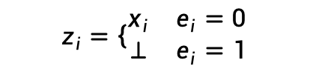


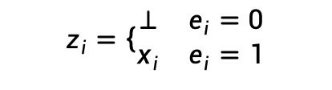
2.2 PSO from mqRPMT
$$Y$$
mqRPMT
$$X=\left\{x_{1},…,x_{n_{1}}\right\}$$
$$\vec{e}=\left(e_{1},…,e_{n_{1}}\right)$$
Receiver
Server
$$e_{i}$$
Client
Sender
OT
$$\left(⊥,x_{i}\right)$$
$$z_{i}=\left\{\begin{matrix}⊥ & e_{i}=0 \\ x_{i} & e_{i}=1\end{matrix}\right.$$
$$z_{i}$$
mqRPMT yields PSI coupled with OT: receiver obtains $X∩Y$.
$$Y$$
mqRPMT
$$X=\left\{x_{1},…,x_{n_{1}}\right\}$$
$$\vec{e}=\left(e_{1},…,e_{n_{1}}\right)$$
Receiver
Server
$$e_{i}$$
Client
Sender
OT
$$\left(⊥,x_{i}\right)$$
$$z_{i}=\left\{\begin{matrix}x_{i} & e_{i}=0 \\ ⊥ & e_{i}=1\end{matrix}\right.$$
$$z_{i}$$
mqRPMT yields PSU coupled with OT (flipping $\vec{e}$): receiver obtains $X−Y$.
Remark: When obtaining PSO with mqRPMT, the receiver acts as the server in mqRPMT; when obtaining PSI with mqPMT, the sender acts as the server in mqPMT.

Slide 11
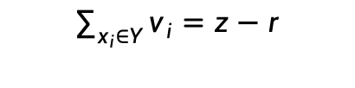





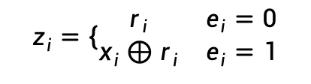

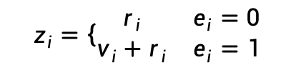

2.2 PSO from mqRPMT
$$Y$$
mqRPMT
$$X=\left\{x_{1},…,x_{n_{1}}\right\}$$
$$\vec{e}=\left(e_{1},…,e_{n_{1}}\right)$$
Receiver
Server
$$e_{i}$$
Client
Sender
OT
$$\left(r_{i},v_{i}+r_{i}\right)$$
$$z_{i}=\left\{\begin{matrix}r_{i} & e_{i}=0 \\ v_{i}+r_{i} & e_{i}=1\end{matrix}\right.$$
$$z_{i}$$
$$V=\left\{v_{1},…,v_{n}\right\}$$
$$r_{i}\underset{←}{R}ℤ_{q}$$
$$z=z_{1}+z_{2}+⋯z_{n_{1}}$$
$$\sum_{x_{i}∈Y}{v_{i}}=z−r$$
mqRPMT yields PSI-card-sum coupled with OT and masking trick.
$$Y$$
mqRPMT
$$X=\left\{x_{1},…,x_{n_{1}}\right\}$$
$$\vec{e}=\left(e_{1},…,e_{n_{1}}\right)$$
Receiver
Server
$$e_{i}$$
Client
Sender
OT
$$\left(r_{i},x_{i}⊕r_{i}\right)$$
$$z_{i}=\left\{\begin{matrix}r_{i} & e_{i}=0 \\ x_{i}⊕r_{i} & e_{i}=1\end{matrix}\right.$$
$$z_{i}$$
$$r_{i}\underset{←}{R}{\left\{0,1\right\}}^{l}$$
mqRPMT yields PSI-card-secret-share coupled with OT and masking trick.
Receiver has $z_{i}$
Sender has $r_{i}$

Slide 12





2.3 Private-ID from mqRPMT
$$Y=\left(y_{1},…,y_{n_{2}}\right)$$
Private-ID
$$X=\left\{x_{1},…,x_{n_{1}}\right\}$$
$$\left(id\left(y_{1}\right),…,id\left(y_{n_{2}}\right)\right)$$
$$\left(id\left(x_{1}\right),…,id\left(x_{n_{1}}\right)\right)$$
Receiver
Sender
$$id\left(X∪Y\right)$$
Buddhavarapu et al. [BKM+20] proposed private-ID:
assigns two parties a random identifier per item.
each party obtains identifiers to his own set, as well as identifiers of the union.
With private-ID, two parties can sort their private set with respect to a global set of identifies, and then can proceed any desired private computation item by item, being assured that identical items are aligned.

Slide 13












2.3 Private-ID from mqRPMT
[BKM+20] gave a concrete DDH-based protocol. [GMR+21] showed how to build private-ID from OPRF and PSU.
$$Y=\left(y_{1},…,y_{n_{2}}\right)$$
$$F:K×D→R$$
where $R$ is an Abelian group
$$X=\left\{x_{1},…,x_{n_{1}}\right\}$$
Receiver
OPRF
$$x_{i}$$
Sender
$$k_{1}$$
$$F_{k_{1}}\left(x_{i}\right)$$
$$y_{i}$$
OPRF
$$F_{k_{2}}\left(y_{i}\right)$$
$$k_{2}$$
run OPRF twice in reversed order: $id\left(z\right)≝F_{k_{1}}\left(z\right)⊕F_{k_{2}}\left(z\right)$
$$id\left(Y\right)$$
distributional
PSU
$$id\left(X\right)$$
$$id\left(X∪Y\right)$$

Slide 14




2.3 Private-ID from mqRPMT
$$Y=\left(y_{1},…,y_{n_{2}}\right)$$
$$G:K×D→R$$
where $K=K_{1}×K_{2}$
$$X=\left\{x_{1},…,x_{n_{1}}\right\}$$
Receiver
Sender
$$y_{i}$$
distributed
OPRF
$$x_{i}$$
$$k_{1},G_{k_{1},k_{2}}\left(y_{i}\right)$$
$$k_{2},G_{k_{1},k_{2}}\left(x_{i}\right)$$
Standard notion are defined with respect to any private inputs → arbitrary protocol composition
relaxed notion with respect to distribution of private inputs → efficiency improvement
$$id\left(Y\right)$$
distributional
PSU
$$id\left(X\right)$$
$$id\left(X∪Y\right)$$

Slide 15
Outline
Constructions of our mqRPMT
03
Notes:
So, let’s start with Introduction and problem definition.

Slide 16
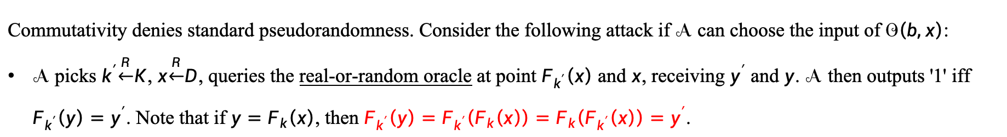
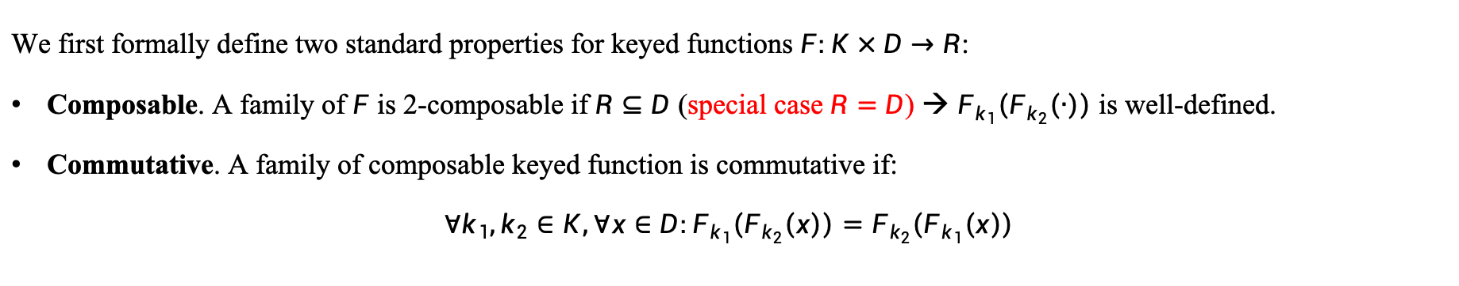
3.1 Commutative Weak PRF
We first formally define two standard properties for keyed functions $F:K×D→R$:
Composable. A family of $F$ is 2-composable if $R⊆D$ (special case $R=D$) → $F_{k_{1}}\left(F_{k_{2}}\left(∙\right)\right)$ is well-defined.
Commutative. A family of composable keyed function is commutative if:
$$∀k_{1},k_{2}∈K,∀x∈D:F_{k_{1}}\left(F_{k_{2}}\left(x\right)\right)=F_{k_{2}}\left(F_{k_{1}}\left(x\right)\right)$$
Definition: Communicative Weak PRF (cwPRF)
$F:K×D→D$ is cwPRF if it satisfies weak pseudorandomness ($k\underset{←}{R}K,x\underset{←}{R}D$) and commutative property simultaneously. When $F$ is a permutation, we say $F$ is cwPRP.
Commutativity denies standard pseudorandomness. Consider the following attack if $𝒜$ can choose the input of $𝒪\left(b,x\right)$:
$𝒜$ picks $k^{′}\underset{←}{R}K$, $x\underset{←}{R}D$, queries the real-or-random oracle at point $F_{k^{′}}\left(x\right)$ and $x$, receiving $y^{′}$ and $y$. $𝒜$ then outputs '1' iff $F_{k^{′}}\left(y\right)=y^{′}$. Note that if $y=F_{k}\left(x\right)$, then $F_{k^{′}}\left(y\right)=F_{k^{′}}\left(F_{k}\left(x\right)\right)=F_{k}\left(F_{k^{′}}\left(x\right)\right)=y^{′}$.
Remark: Weak pseudorandomness means that the inputs oracle $𝒪\left(b,x\right)$ are uniformly chosen from $D$ by the challenger instead of chosen by the adversary $𝒜$, where $𝒪\left(0,x\right)=F_{k}\left(x\right)$ and $𝒪\left(1,x\right)=H\left(x\right)$, $H$ is chosen uniformly at random from all the functions from $D$ to $R$. In the proof, the simulator can lazily answer with random chosen elements in $R$, while keeping track of the answers so that queries made repeatedly are answered consistently.

Slide 17



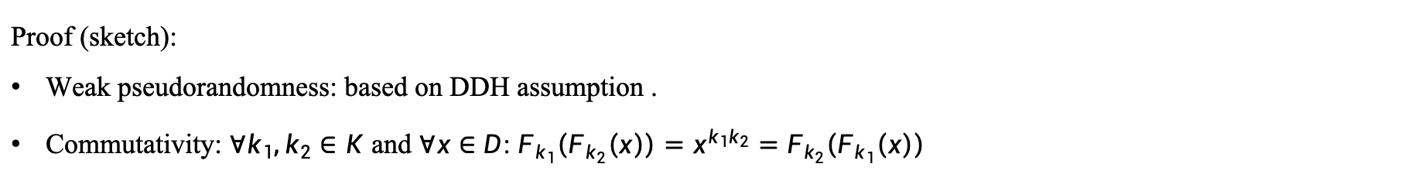
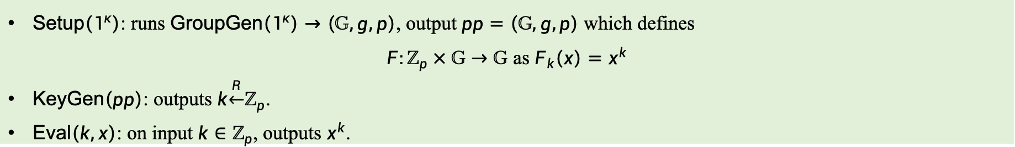
3.1 Build cwPRF from DDH
Construction: DDH-based cwPRF
$\text{Setup}\left(1^{κ}\right)$: runs $\text{GroupGen}\left(1^{κ}\right)→\left(𝔾,g,p\right)$, output $pp=\left(𝔾,g,p\right)$ which defines
$F:ℤ_{p}×𝔾→𝔾$ as $F_{k}\left(x\right)=x^{k}$
$\text{KeyGen}\left(pp\right)$: outputs $k\underset{←}{R}ℤ_{p}$.
$\text{Eval}\left(k,x\right)$: on input $k∈ℤ_{p}$, outputs $x^{k}$.
Proof (sketch):
Weak pseudorandomness: based on DDH assumption .
Commutativity: $∀k_{1},k_{2}∈K$ and $∀x∈D$: $F_{k_{1}}\left(F_{k_{2}}\left(x\right)\right)=x^{k_{1}k_{2}}=F_{k_{2}}\left(F_{k_{1}}\left(x\right)\right)$
cwPRF is the "right" cryptographic abstraction of the classic DH function.
What we need for mqRPMT is standard pseudorandomness. The solution is to amplify randomness via hash (hash-then-eval).
Standard PRF $F_{k}\left(\text{H}\left(∙\right)\right):K×X→R$
Random Oracle $\text{H}$
cwPRF $F_{k}\left(∙\right)$
$$X$$
$$D$$
$$R$$
Randomness Amplification

Slide 18








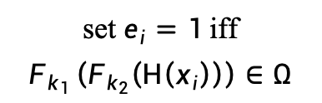
3.2 mqRMPT from cwPRF
mqPMT
(reversed roles)
$$Y=\left(y_{1},…,y_{n_{2}}\right)$$
$$X=\left\{x_{1},…,x_{n_{1}}\right\}$$
$${\left\{F_{k_{1}}\left(\text{H}\left(y_{i}\right)\right)\right\}}_{i∈\left[n_{2}\right]}$$
Server
$$k_{1}\underset{←}{R}K$$
Client
$${\left\{F_{k_{2}}\left(\text{H}\left(x_{i}\right)\right)\right\}}_{i∈\left[n_{1}\right]}$$
$$k_{2}\underset{←}{R}K$$
set $e_{i}=1$ iff
$$F_{k_{1}}\left(F_{k_{2}}\left(\text{H}\left(x_{i}\right)\right)\right)∈Ω$$
$$Ω←{\left\{F_{k_{2}}\left(F_{k_{1}}\left(\text{H}\left(y_{i}\right)\right)\right)\right\}}_{i∈\left[n_{2}\right]}$$
order-preserving encoding reveals intersection!
mqRPMT (reversed roles)
$$Y=\left(y_{1},…,y_{n_{2}}\right)$$
$$X=\left\{x_{1},…,x_{n_{1}}\right\}$$
$${\left\{F_{k_{1}}\left(\text{H}\left(y_{i}\right)\right)\right\}}_{i∈\left[n_{2}\right]}$$
Server
$$k_{1}\underset{←}{R}K$$
Client
$${\left\{F_{k_{2}}\left(\text{H}\left(x_{i}\right)\right)\right\}}_{i∈\left[n_{1}\right]}$$
$$k_{2}\underset{←}{R}K$$
$$Ω←{\left\{F_{k_{2}}\left(F_{k_{1}}\left(\text{H}\left(y_{π\left(i\right)}\right)\right)\right)\right\}}_{i∈\left[n_{2}\right]}$$
set $e_{i}=1$ iff
$$F_{k_{1}}\left(F_{k_{2}}\left(\text{H}\left(x_{i}\right)\right)\right)∈Ω$$
send encoding in permuted order
more space efficient: use BloomFilter

Slide 19






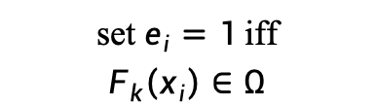




3.3 Permuted OPRF
$$Y=\left\{y_{1},…,y_{n_{2}}\right\}$$
OPRF
(reversed roles)
$$\left\{F_{k}\left(y_{1}\right),…,F_{k}\left(y_{n_{2}}\right)\right\}$$
$$k\underset{←}{R}K$$
Server
Client
order-preserving encoding
$$Y=\left\{y_{1},…,y_{n_{2}}\right\}$$
permuted OPRF
$${\left\{F_{k}\left(y_{π\left(i\right)}\right)\right\}}_{i∈\left[n_{2}\right]}$$
$$k\underset{←}{R}K,π\underset{←}{R}\text{Perm}\left[n_{2}\right]$$
Server
Client
permuted encoding
$$Y=\left\{y_{1},…,y_{n_{2}}\right\}$$
permuted OPRF
$$X=\left\{x_{1},…,x_{n_{1}}\right\}$$
$${Ω←\left\{F_{k}\left(y_{π\left(i\right)}\right)\right\}}_{i∈\left[n_{2}\right]}$$
$$k\underset{←}{R}K,π\underset{←}{R}\text{Perm}\left[n_{2}\right]$$
Server
Client
set $e_{i}=1$ iff
$$F_{k}\left(x_{i}\right)∈Ω$$
$$\left\{F_{k}\left(x_{1}\right),…,F_{k}\left(x_{n_{1}}\right)\right\}$$

Slide 20



3.4 Build pOPRF from DDH
Observe that DDH-based cwPRF is actually a cwPRP: $F:ℤ_{p}×𝔾→𝔾$.
DDH-based pOPRF
$$Y=\left(y_{1},…,y_{n_{2}}\right)$$
$${\left\{{\hat{y}}_{i}\right\}}_{i∈\left[n_{2}\right]}={\left\{\left({\text{H}\left(y_{i}\right)}^{s}\right)\right\}}_{i∈\left[n_{2}\right]}$$
$$s\underset{←}{R}K$$
Server
Client
$${\left\{{\check{y}}_{i}\right\}}_{i∈\left[n_{2}\right]}={\left\{{\hat{y}}_{i}^{k}\right\}}_{i∈\left[n_{2}\right]}$$
$${Ω←\left\{{\check{y}}_{i}^{s^{−1}}\right\}}_{i∈\left[n_{2}\right]}$$
$$k\underset{←}{R}K,π\underset{←}{R}\text{Perm}\left[n_{2}\right]$$
Primitive | Assumption | implied by X25519 (later) | Bloom Filter Optimization
cwPRF | DDH | Yes | Yes
pOPRF | DDH | No | NO
Therefore, pOPRF-based mqRMPT is more of theoretical interest.
It can be viewed as a counterpart of OPRF-based mqPMT construction.
So far, we only know how to build pOPRF based on assumptions with nice algebra structure, but not from fast primitives such as OT or VOLE. This somehow explains the efficiency gap between mqPMT and mqRMPT.

Slide 21




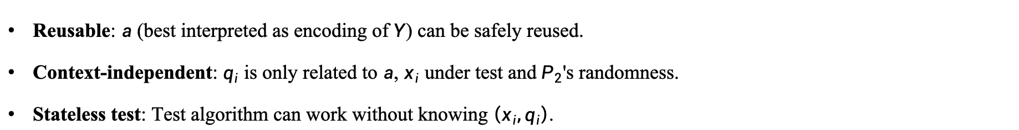

3.5 Sigma-mqPMT
Given the efficiency gap between PSI and other PSO, it is intriguing to study the connection between mqMPT and mqRMPT. Towards this goal, we first abstract a category of mqPMT called Sigma-mqPMT.
Sigma-mqPMT
$$Y=\left(y_{1},…,y_{n_{2}}\right)$$
$$X=\left(x_{1},…,x_{n_{1}}\right)$$
$$a$$
Server
$$a←\text{Encode}\left(Y\right)$$
Client
$$q={\left\{q_{i}\right\}}_{i∈\left[n_{2}\right]}$$
$$q_{i}←\text{GenQuery}\left(a,x_{i}\right)$$
$$z={\left\{z_{i}\right\}}_{i∈\left[n_{2}\right]}$$
$$z_{i}←\text{Response}\left(q_{i}\right)$$
$$e_{i}←\text{Test}\left({a,z}_{i}\right)$$
Reusable: $a$ (best interpreted as encoding of $Y$) can be safely reused.
Context-independent: $q_{i}$ is only related to $a$, $x_{i}$ under test and $P_{2}$'s randomness.
Stateless test: Test algorithm can work without knowing $\left(x_{i},q_{i}\right)$.

Slide 22







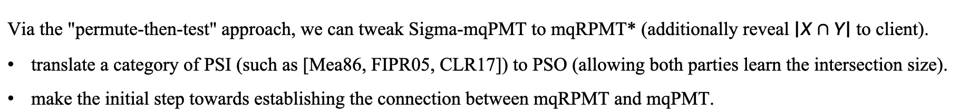




3.6 mqRPMT* from Sigma-mqPMT
mqRPMT*
$$Y=\left(y_{1},…,y_{n_{2}}\right)$$
$$X=\left(x_{1},…,x_{n_{1}}\right)$$
$$a$$
Server
$$a←\text{mqPMT}\text{.}\text{Encode}\left(Y\right)$$
Client
$$\vec{q}={\left\{q_{i}\right\}}_{i∈\left[n_{2}\right]}$$
$$q_{i}←\text{mqPMT}\text{.}\text{GenQuery}\left(a,x_{i}\right)$$
$$π\underset{←}{R}\text{Perm}\left[n_{2}\right]$$
$$z_{i}←\text{Response}\left(q_{i}\right)$$
$${\vec{z}}^{∗}={\left\{z_{π\left(i\right)}\right\}}_{i∈\left[n_{2}\right]}$$
$${\vec{e}}^{∗}={\left\{e_{π\left(i\right)}^{∗}\right\}}_{i∈\left[n_{2}\right]}$$
$$e_{i}^{∗}←\text{mqPMT}\text{.}\text{Test}\left({a,z}_{π\left(i\right)}^{∗}\right)$$
$$\vec{e}←{\left\{e_{π^{−1}\left(i\right)}^{∗}\right\}}_{i∈\left[n_{2}\right]}$$
Via the "permute-then-test" approach, we can tweak Sigma-mqPMT to mqRPMT* (additionally reveal $\left|X∩Y\right|$ to client).
translate a category of PSI (such as [Mea86, FIPR05, CLR17]) to PSO (allowing both parties learn the intersection size).
make the initial step towards establishing the connection between mqRPMT and mqPMT.

Slide 23
3.7 Summary of Main Results
PSI/PSU
PSI-card-[sum/ss]
PSI-card
OT
OT + SS
mqRPMT*
mqRPMT
permuted mqPMT
permute-then-test
enhanced version
cwPRF
permuted OPRF
Sigma-mqPMT

Slide 24
Outline
Comparisons and Experiments
04
Notes:
So, let’s start with Introduction and problem definition.

Slide 25
4.1 Cryptographic Engineering Matters
We implement our PSO framework via the following vein:
EC groups DDH-based cwPRF → mqPRMT → PSO framework
NIST P-256 (also known as secp256r1 and primve256v1, ▲ for no point compression, ▼ for point compression)
hash-to-point operation is expensive ≈ non-fixed Exponentiation.
point compression halves communication cost, but point decompression is expensive ≈ non-fixed Exponentiation.
OpenSSL provides assembly implementations for all platforms (x86_64, aarch64).
Curve25519 (de facto alternative of NIST P-256, ★)
numerous merits: no backdoor, fast exponentiation, immunity against side-channel attacks.
allow "exponentiation" with only X-coordinate → halve communication & no point decompression.
any 32-byte array corresponds to the X-coordinate of a valid EC point → hash-to-point operation is almost free.
For the first time, Curve25519 fully unleashes its power in PSO. Correct the prejudice "public-key operations are expensive".
By leveraging optimized implementation, their performances are comparable with symmetric-key operations.

Slide 26
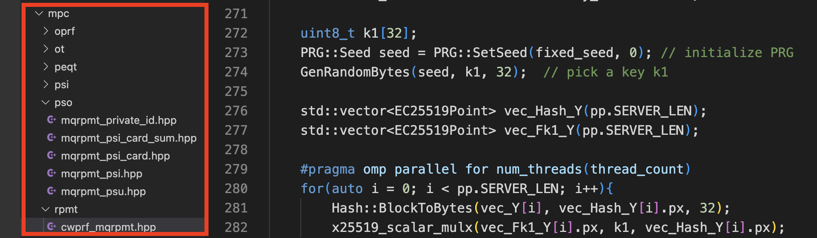
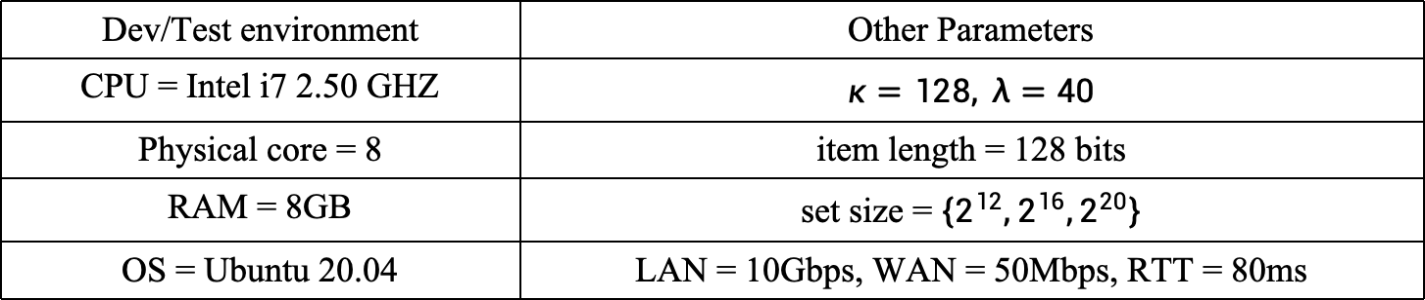
4.2 Implementation Features / Details
Modular design
Minimum dependency
Multi-platforms
Rich functionality
Highly parallelizable
Dev/Test environment | Other Parameters
CPU = Intel i7 2.50 GHZ | $$κ=128, λ=40$$
Physical core = 8 | item length = 128 bits
RAM = 8GB | set size = $\left\{2^{12},2^{16},2^{20}\right\}$
OS = Ubuntu 20.04 | LAN = 10Gbps, WAN = 50Mbps, RTT = 80ms
We test various PSO protocols (mqRPMT, PSI, PSI-card, PSI-card-sum, PSU, Private-ID).
Functionality, Computation cost: totally running time, Communication costs: sum of two parties

Slide 27
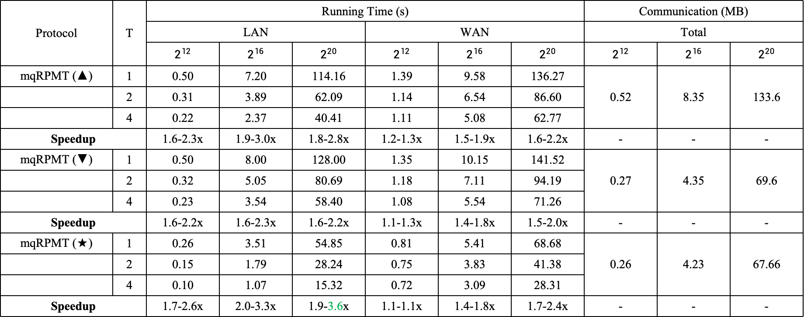
4.3 Core Protocol: mqRPMT
Protocol | T | Running Time (s) |  |  |  |  |  | Communication (MB)
 |  | LAN |  |  | WAN |  |  | Total
 |  | $$2^{12}$$ | $$2^{16}$$ | $$2^{20}$$ | $$2^{12}$$ | $$2^{16}$$ | $$2^{20}$$ | $$2^{12}$$ | $$2^{16}$$ | $$2^{20}$$
mqRPMT (▲) | 1 | 0.50 | 7.20 | 114.16 | 1.39 | 9.58 | 136.27 | 0.52 | 8.35 | 133.6
 | 2 | 0.31 | 3.89 | 62.09 | 1.14 | 6.54 | 86.60
 | 4 | 0.22 | 2.37 | 40.41 | 1.11 | 5.08 | 62.77
Speedup |  | 1.6-2.3x | 1.9-3.0x | 1.8-2.8x | 1.2-1.3x | 1.5-1.9x | 1.6-2.2x | - | - | -
mqRPMT (▼) | 1 | 0.50 | 8.00 | 128.00 | 1.35 | 10.15 | 141.52 | 0.27 | 4.35 | 69.6
 | 2 | 0.32 | 5.05 | 80.69 | 1.18 | 7.11 | 94.19
 | 4 | 0.23 | 3.54 | 58.40 | 1.08 | 5.54 | 71.26
Speedup |  | 1.6-2.2x | 1.6-2.3x | 1.6-2.2x | 1.1-1.3x | 1.4-1.8x | 1.5-2.0x | - | - | -
mqRPMT (★) | 1 | 0.26 | 3.51 | 54.85 | 0.81 | 5.41 | 68.68 | 0.26 | 4.23 | 67.66
 | 2 | 0.15 | 1.79 | 28.24 | 0.75 | 3.83 | 41.38
 | 4 | 0.10 | 1.07 | 15.32 | 0.72 | 3.09 | 28.31
Speedup |  | 1.7-2.6x | 2.0-3.3x | 1.9-3.6x | 1.1-1.1x | 1.4-1.8x | 1.7-2.4x | - | - | -
Strict linear complexity & high parallelism
$2^{20}$ scale: #time < 15s using 4 threads on laptop, #communication < 70M

Slide 28
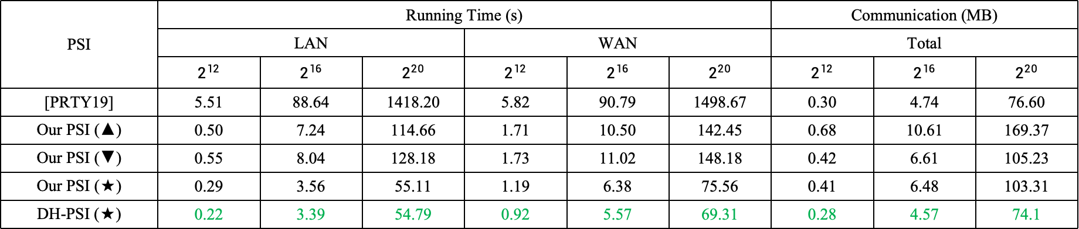
4.3 PSI: Performance and Comparison
We compare our mqRPMT-based protocol to DH-PSI reported in [PRTY19] and the one re-implemented by ourselves.
PSI protocols in comparison are not competitive to the state-of-the-art PSI protocols (based on batched OPRF / VOLE).
The performance gap between DH-PSI and state-of-the-art PSI (partially) reflects the gap between mqPMT and mqRPMT.
We include DH-PSI comparison merely for illustrative purpose and completeness.
PSI | Running Time (s) |  |  |  |  |  | Communication (MB)
 | LAN |  |  | WAN |  |  | Total
 | $$2^{12}$$ | $$2^{16}$$ | $$2^{20}$$ | $$2^{12}$$ | $$2^{16}$$ | $$2^{20}$$ | $$2^{12}$$ | $$2^{16}$$ | $$2^{20}$$
[PRTY19] | 5.51 | 88.64 | 1418.20 | 5.82 | 90.79 | 1498.67 | 0.30 | 4.74 | 76.60
Our PSI (▲) | 0.50 | 7.24 | 114.66 | 1.71 | 10.50 | 142.45 | 0.68 | 10.61 | 169.37
Our PSI (▼) | 0.55 | 8.04 | 128.18 | 1.73 | 11.02 | 148.18 | 0.42 | 6.61 | 105.23
Our PSI (★) | 0.29 | 3.56 | 55.11 | 1.19 | 6.38 | 75.56 | 0.41 | 6.48 | 103.31
DH-PSI (★) | 0.22 | 3.39 | 54.79 | 0.92 | 5.57 | 69.31 | 0.28 | 4.57 | 74.1
Compared to existing DH-PSI implementation: #time speeds up 4.9-25.7x
Remark: DH-PSI is incredibly simple, efficient and easy-to-explain (for non-experts who want to deploy PSI).
Remark: DH-based PSI reported in [PRTY19] is also built on Curve25519 (but not X25519). We directly run their implementations on our platform for fair comparison.
Notes:
We first compare our mqRPMT-based PSI protocol to the classical DH-PSI protocol reported in [PRTY19] and the one re-implemented by ourselves. We remark that the PSI protocols in comparison are not competitive to the state-of-the-art PSI protocol. We include them merely for illustrative purpose and completeness

Slide 29
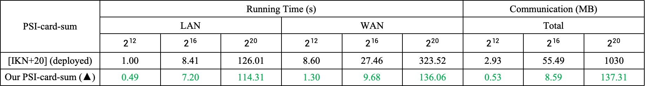
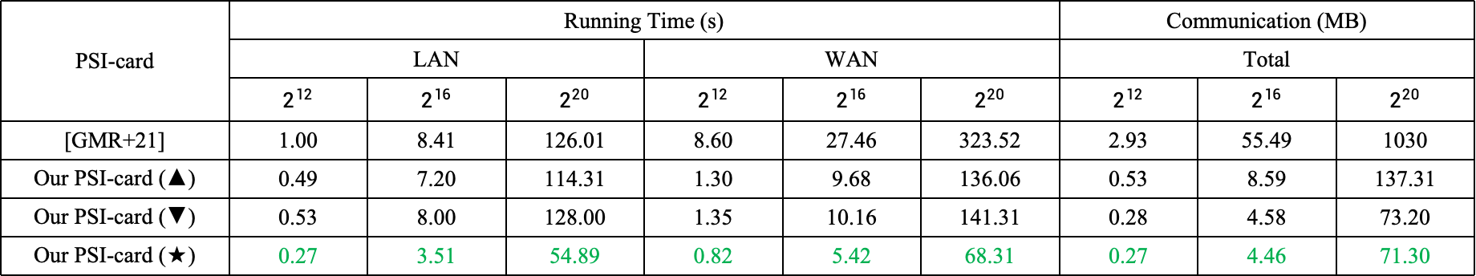
4.4 PSI-card[-sum]: Performance and Comparison
Our framework unifies and explains prior protocols.
DDH-cwPRF-based mqRPMT → PSI-card [HFH99] (BloomFilter), DDH-pOPRF-based mqRPMT → PSI-card [CGT12]
PSI-card | Running Time (s) |  |  |  |  |  | Communication (MB)
 | LAN |  |  | WAN |  |  | Total
 | $$2^{12}$$ | $$2^{16}$$ | $$2^{20}$$ | $$2^{12}$$ | $$2^{16}$$ | $$2^{20}$$ | $$2^{12}$$ | $$2^{16}$$ | $$2^{20}$$
[GMR+21] | 1.00 | 8.41 | 126.01 | 8.60 | 27.46 | 323.52 | 2.93 | 55.49 | 1030
Our PSI-card (▲) | 0.49 | 7.20 | 114.31 | 1.30 | 9.68 | 136.06 | 0.53 | 8.59 | 137.31
Our PSI-card (▼) | 0.53 | 8.00 | 128.00 | 1.35 | 10.16 | 141.31 | 0.28 | 4.58 | 73.20
Our PSI-card (★) | 0.27 | 3.51 | 54.89 | 0.82 | 5.42 | 68.31 | 0.27 | 4.46 | 71.30
Compared to the state-of-the-art PSI-card: #time speeds up 2.3-10.5x, #communication reduces 11.3-15.2x
PSI-card-sum | Running Time (s) |  |  |  |  |  | Communication (MB)
 | LAN |  |  | WAN |  |  | Total
 | $$2^{12}$$ | $$2^{16}$$ | $$2^{20}$$ | $$2^{12}$$ | $$2^{16}$$ | $$2^{20}$$ | $$2^{12}$$ | $$2^{16}$$ | $$2^{20}$$
[IKN+20] (deployed) | 1.00 | 8.41 | 126.01 | 8.60 | 27.46 | 323.52 | 2.93 | 55.49 | 1030
Our PSI-card-sum (▲) | 0.49 | 7.20 | 114.31 | 1.30 | 9.68 | 136.06 | 0.53 | 8.59 | 137.31
Compared to the state-of-the-art PSI-card-sum: #time speeds up 22.1-76.3x, #communication reduces 7.4-7.5x

Slide 30
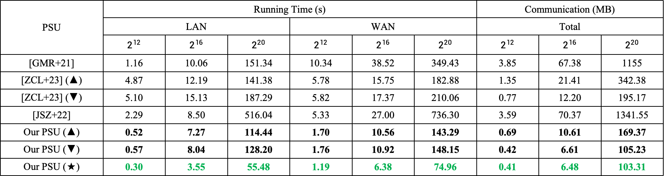
4.5 PSU: Performance and Comparison
PSU | Running Time (s) |  |  |  |  |  | Communication (MB)
 | LAN |  |  | WAN |  |  | Total
 | $$2^{12}$$ | $$2^{16}$$ | $$2^{20}$$ | $$2^{12}$$ | $$2^{16}$$ | $$2^{20}$$ | $$2^{12}$$ | $$2^{16}$$ | $$2^{20}$$
[GMR+21] | 1.16 | 10.06 | 151.34 | 10.34 | 38.52 | 349.43 | 3.85 | 67.38 | 1155
[ZCL+23] (▲) | 4.87 | 12.19 | 141.38 | 5.78 | 15.75 | 182.88 | 1.35 | 21.41 | 342.38
[ZCL+23] (▼) | 5.10 | 15.13 | 187.29 | 5.82 | 17.37 | 210.06 | 0.77 | 12.20 | 195.17
[JSZ+22] | 2.29 | 8.50 | 516.04 | 5.33 | 27.00 | 736.30 | 3.59 | 70.37 | 1341.55
Our PSU (▲) | 0.52 | 7.27 | 114.44 | 1.70 | 10.56 | 143.29 | 0.69 | 10.61 | 169.37
Our PSU (▼) | 0.57 | 8.04 | 128.20 | 1.76 | 10.92 | 148.15 | 0.42 | 6.61 | 105.23
Our PSU (★) | 0.30 | 3.55 | 55.48 | 1.19 | 6.38 | 74.96 | 0.41 | 6.48 | 103.31
Compared to the state-of-the-art PSU: first achieves strict linear complexity
#time speeds up 2.4-17x, #communication reduces 2x

Slide 31
Outline
Summary of our Work
05
Notes:
So, let’s start with Introduction and problem definition.

Slide 32
5 Summary of This Work
Unified PSO framework from mqRPMT
show mqRPMT is complete for all PSO protocols.
greatly reduce the deployment and maintaining costs of PSO.
Generic construction of mqRPMT
cwPRF: demonstrate that DDH assumption is truly a golden goose.
permuted OPRF: make the concept of OPRF more useful; somewhat explain inefficiency of PSU/PCSI.
mqRPMT* from Sigma-mqPMT: an initial step towards the connection to mqPMT.
Efficient implementation
identify expensive ECC operations in cheap disguise
find the perfect match: Curve25519
We do not take shame in the simplicity of our construction :-)
Simple is elegant and extremely efficient.

Slide 33
Thanks for You Attention!
Any Questions?
http://eprint.iacr.org/2022/652
Weiran Liu
weiran.lwr@alibaba-inc.com
Notes:
That is it. Thanks for listening.

