Slide 1
Design and implementation of application-layer data split and aggregation for mobile users
Purpose : Developing the application data can be splitted and aggregated across multiple interfaces in one terminal, even across multiple interfaces in different terminals.
Task: 1: Analysis of requirements of application layer data split and aggregation; 2: Design the feasible scheme of application layer data split and aggregation; 3: Software based on Linux/Android system.

Slide 2
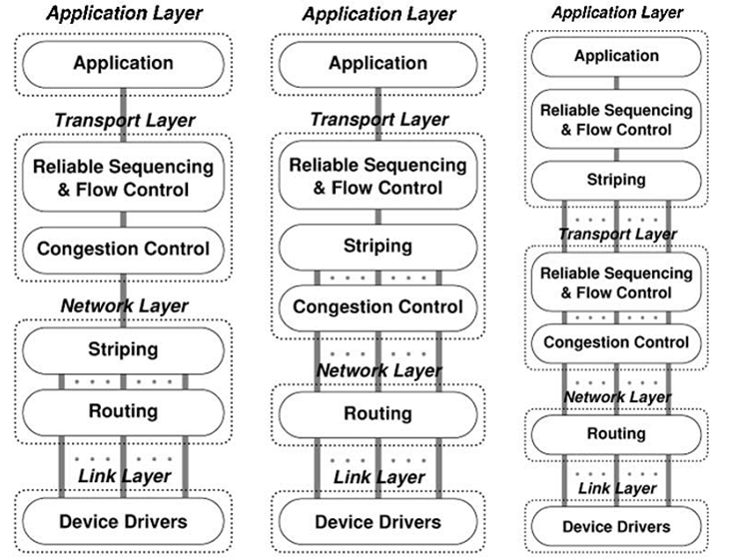
Background Reading
Network Layer Striping
b) Transport Layer Striping
3)Application Layer Striping

Slide 3
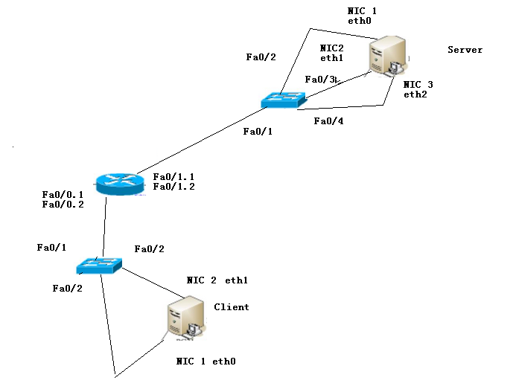
Researching on developing environment and method.
1.Vmaware
2. Dynamips
3.Libpcap, Libnids.

Slide 4
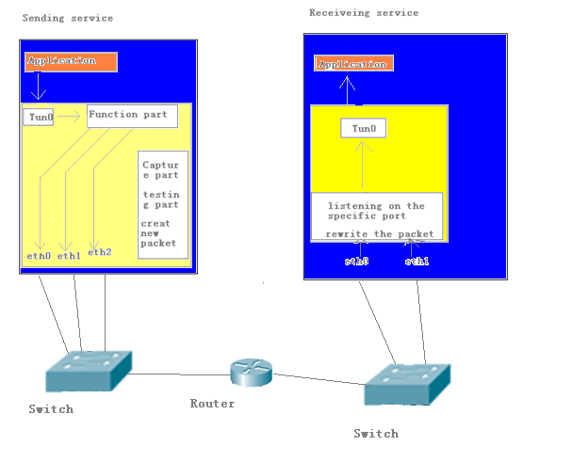
Design the structure of the program
1.Sending service:
Capture service
Create new packets
Testing service
2.Receiving service
Capture service
Rewrite the packets

Slide 5
Develop part of the final application
1.Tesing part : Using icmp test to test the quality of link
2. Capture part: capture packet on one interface

Slide 6
Work Schedule
Mid-term work – successfully finished!
Background Reading
Researching on developing environment and method.
Design the structure of the program
Develop part of the final application
Additional work
Develop the final application

