Slide 1
MongoDB CURD&Aggre
Amazon Xia

Slide 2
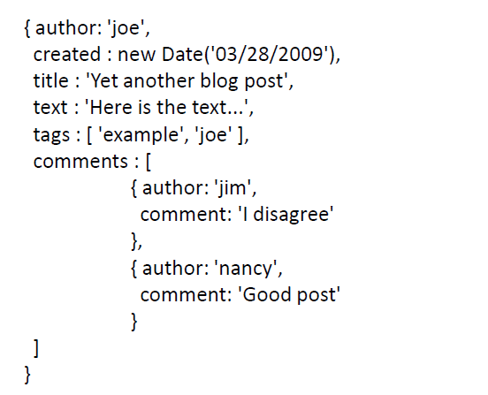
This document is a blog post, so we can store in a "posts" collection using the shell:
> doc = { author : 'joe', created : new Date('03/28/2009'), ... }
> db.posts.insert(doc);

Slide 3
Query
SELECT * FROM users WHERE age>33
db.users.find({age:{$gt:33}})
SELECT * FROM users WHERE age!=33
db.users.find({age:{$ne:33}})
SELECT * FROM users WHERE name LIKE "%Joe%"
db.users.find({name:/Joe/})
SELECT * FROM users WHERE a=1 and b='q'
db.users.find({a:1,b:'q'})
SELECT * FROM users WHERE a=1 or b=2
db.users.find( { $or : [ { a : 1 } , { b : 2 } ] } )
SELECT * FROM foo WHERE name=‘bob’ and (a=1 or b=2 )
db.foo.find( { name : "bob" , $or : [ { a : 1 } , { b : 2 } ] } )
SELECT * FROM users WHERE age>33 AND age<=40
db.users.find({'age':{$gt:33,$lte:40}})
- db.mycollection.find( { $where : function() { return this.a == 3 || this.b == 4; } } );

Slide 4
Comparion Query Operators
$eq/$ne
$gt/$gte
$lt/$lte
$in/$nin

Slide 5
Logical query operators
$and
$or
$nor
$not

Slide 6
Element query operators
$exists
$type

Slide 7
$where

Slide 8
Update operators
$inc
$set
$unset
$min
$max
$rename
$currentDate

Slide 9
Update array
$pull
$push
$addToSet
$pop
$pullAll
$each
$sort
$slice
$position

Slide 10
Aggregate
Aggregation Pipeline
Map-Reduce

Slide 11
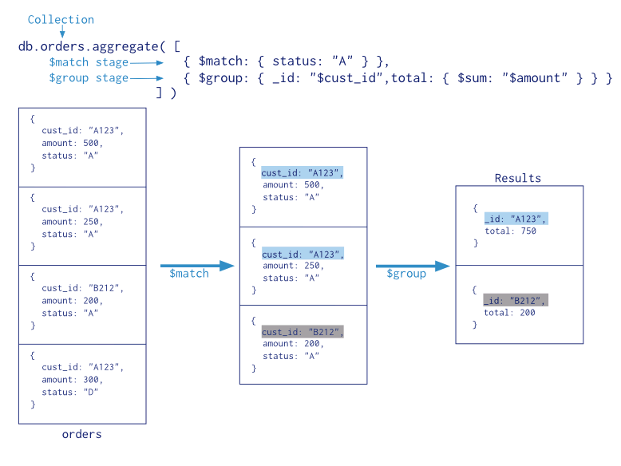

Slide 12
Aggregation Pipeline:
Project
Group
Sort
Limit
skip

Slide 13
Pipeline expression
$add/$subtract/$multiply/$divide/$mod
$year/$month/$week
$substr
$concat
$toLower/$toUpper
$cmp
$eq/$ne/$gt/$lt
$and/$or/$not
$cond

Slide 14
db.articles.aggregate({
"$project": {
"author": 1
}
},
{
"$group": {
"_id": "$author",
"count": {
"$sum": 1
}
}
},
{
"$sort": {
"count": -1
}
},
{
"$limit": 5
})

Slide 15
db.employees.aggregate({
"$project": {
"hired_month": {
"$month": "$hireDate"
}
}
})

Slide 16
db.employees.aggregate({
"$project": {
"tenure": {
"$subtract": [{
"$year": new Date()
},
{
"$year": "$hireDate"
}]
}
}
})

Slide 17
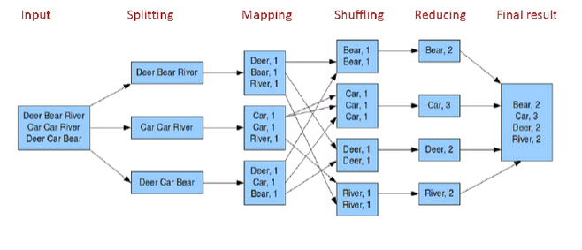
MapReduce

Slide 18
var mapFunction1 = function(){
for (var key in this){
emit(key,{count:1});
}
}
var reduceFunction1 = function(key,emits){
total = 0;
for (var i in emits){
total += emits[i].count;
}
return {count:total};
}
db.orders.mapReduce(mapFunction1,
reduceFunction1, {
out: {
merge: "map_reduce_example"
}
}
)

