Slide 1
Customer 3A

Slide 2
Outline
Architecture
Mode Transition
Timing Diagram

Slide 3
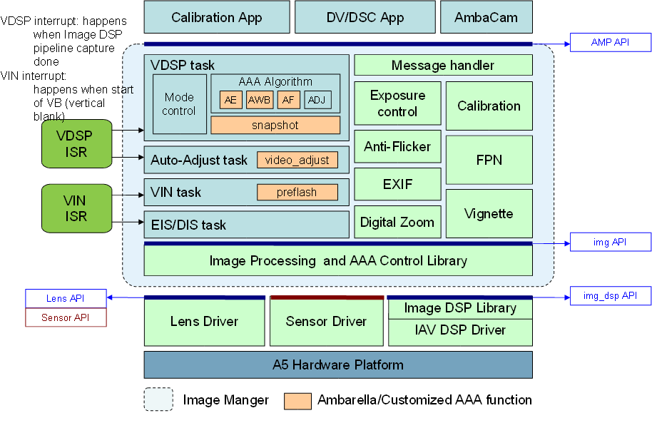
Architecture

Slide 4
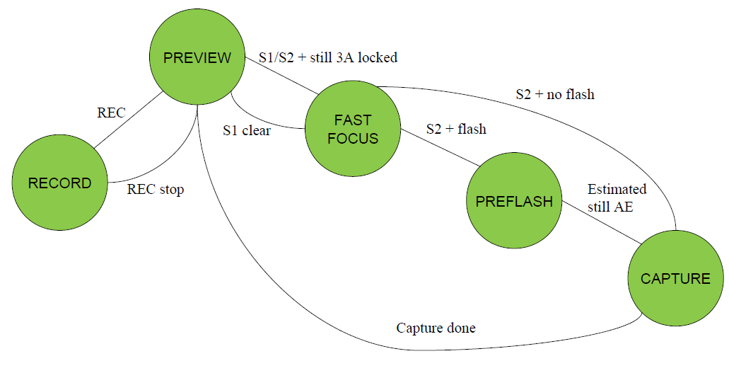
Mode Transition

Slide 5
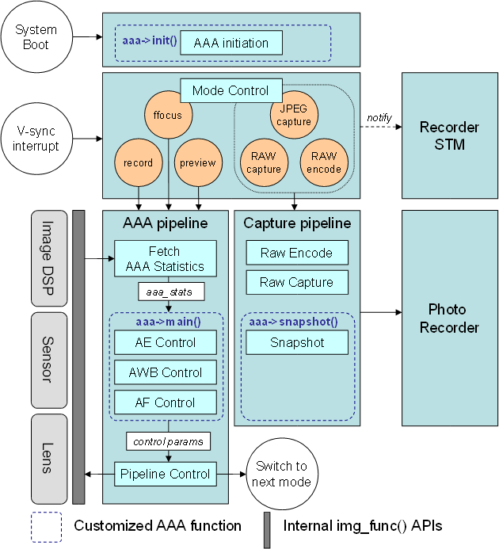
3A flow

Slide 6
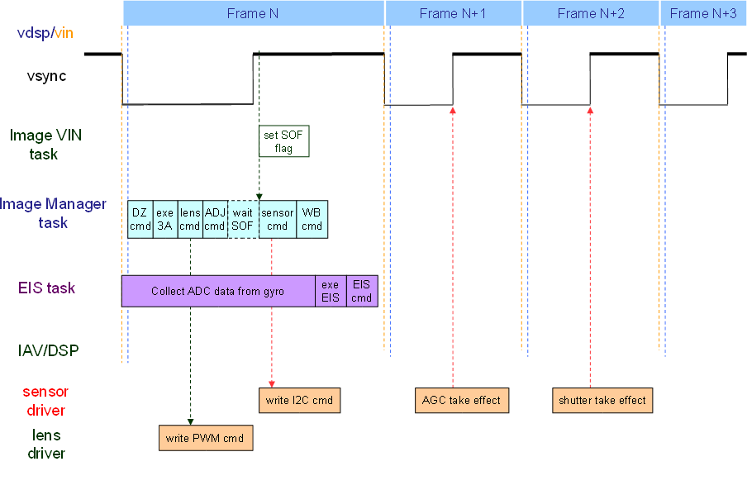
Timing Diagram
(IMG_PREVIEW_MODE/IMG_RECORD_MODE)
04/09/12
Page <number>

Slide 7
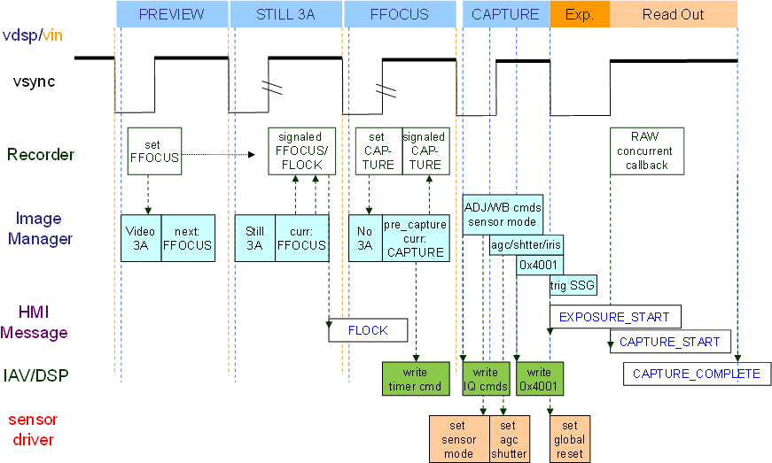
Timing Diagram – M-shutter + parallel sensor
(IMG_FFCOUS_MODE/IMG_CAPTURE_MODE)

Slide 8
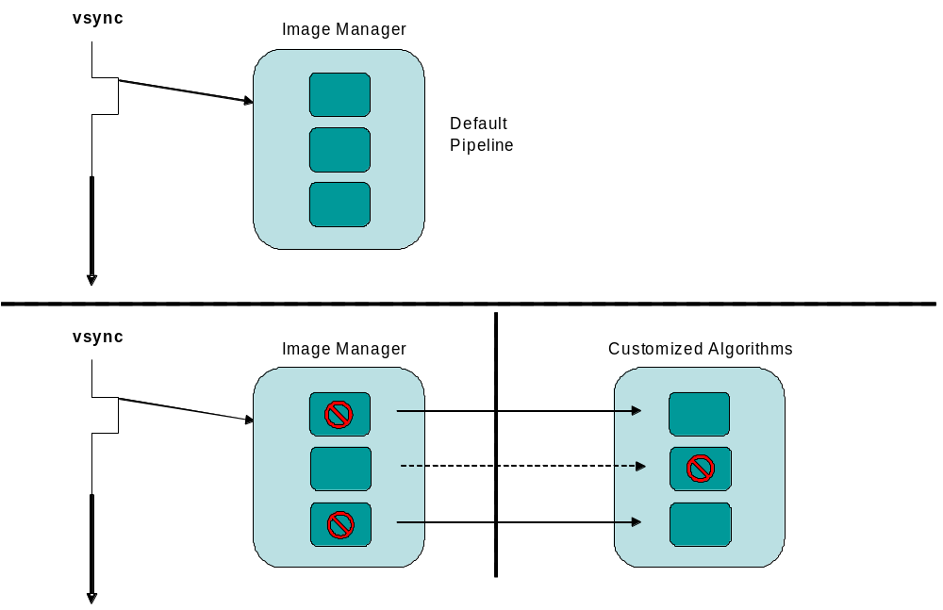
Register 3A

Slide 9
The End
Q&A

