Slide 1
DIA-NN QC
Zhang Dong
Dec. 26,2023

Slide 2
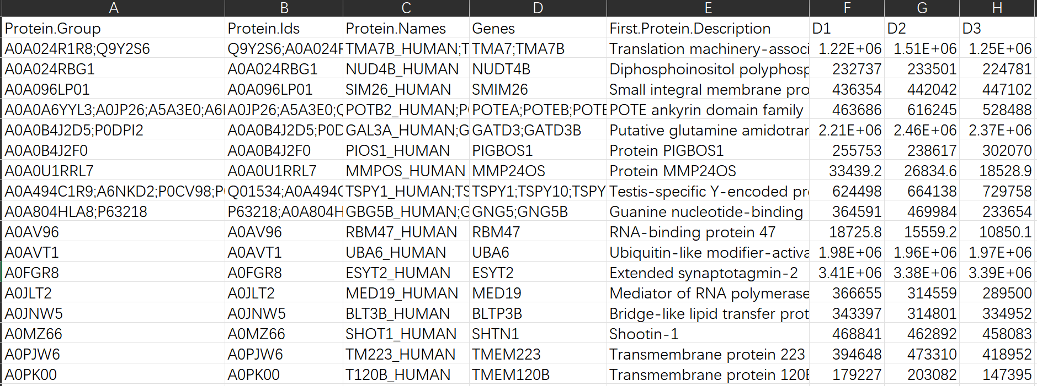
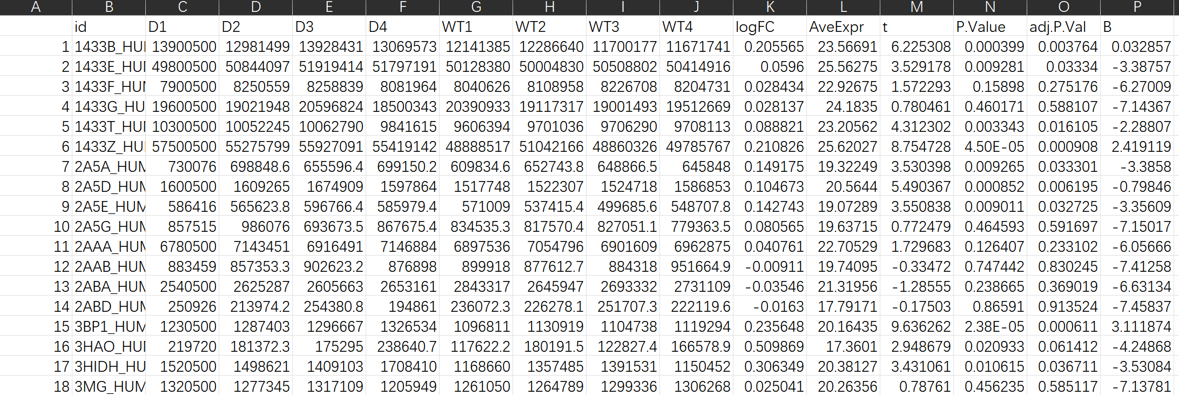
Summary
Boxplot
DIA-NN result
normalization
PCA
Heatmap
Volcano plot
DE analysis
Result matrix

Slide 3
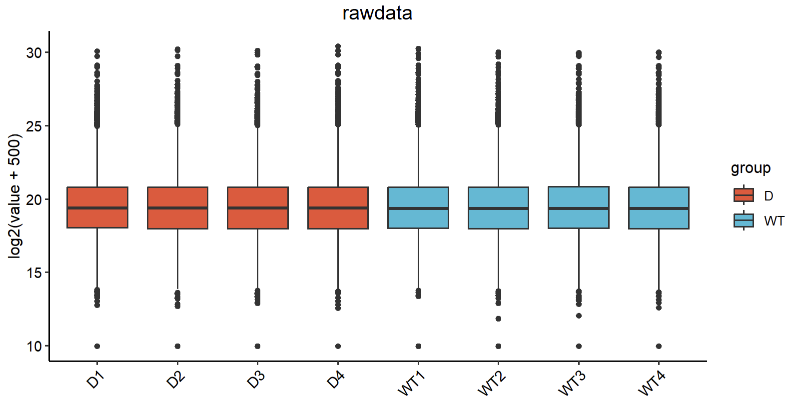
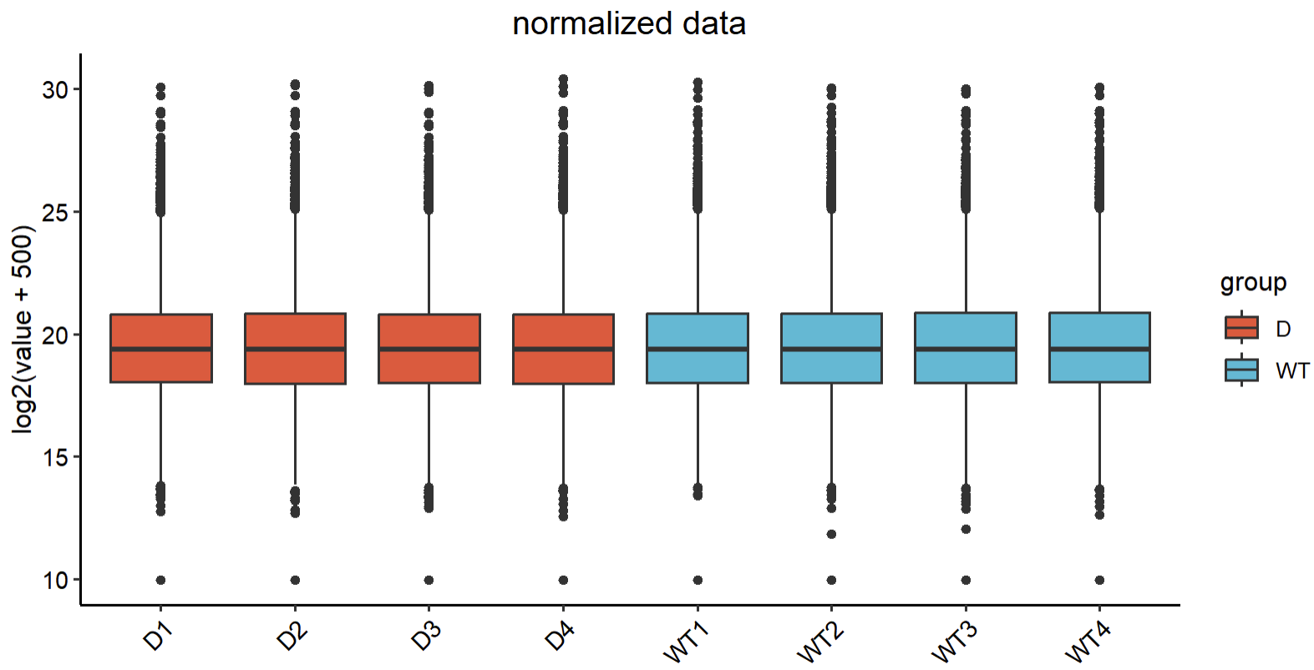
normalization
DIA-NN rawdata
①NA→0
②X + 500
③Intensity Correction(median)
DIA-NN normalized data

Slide 4
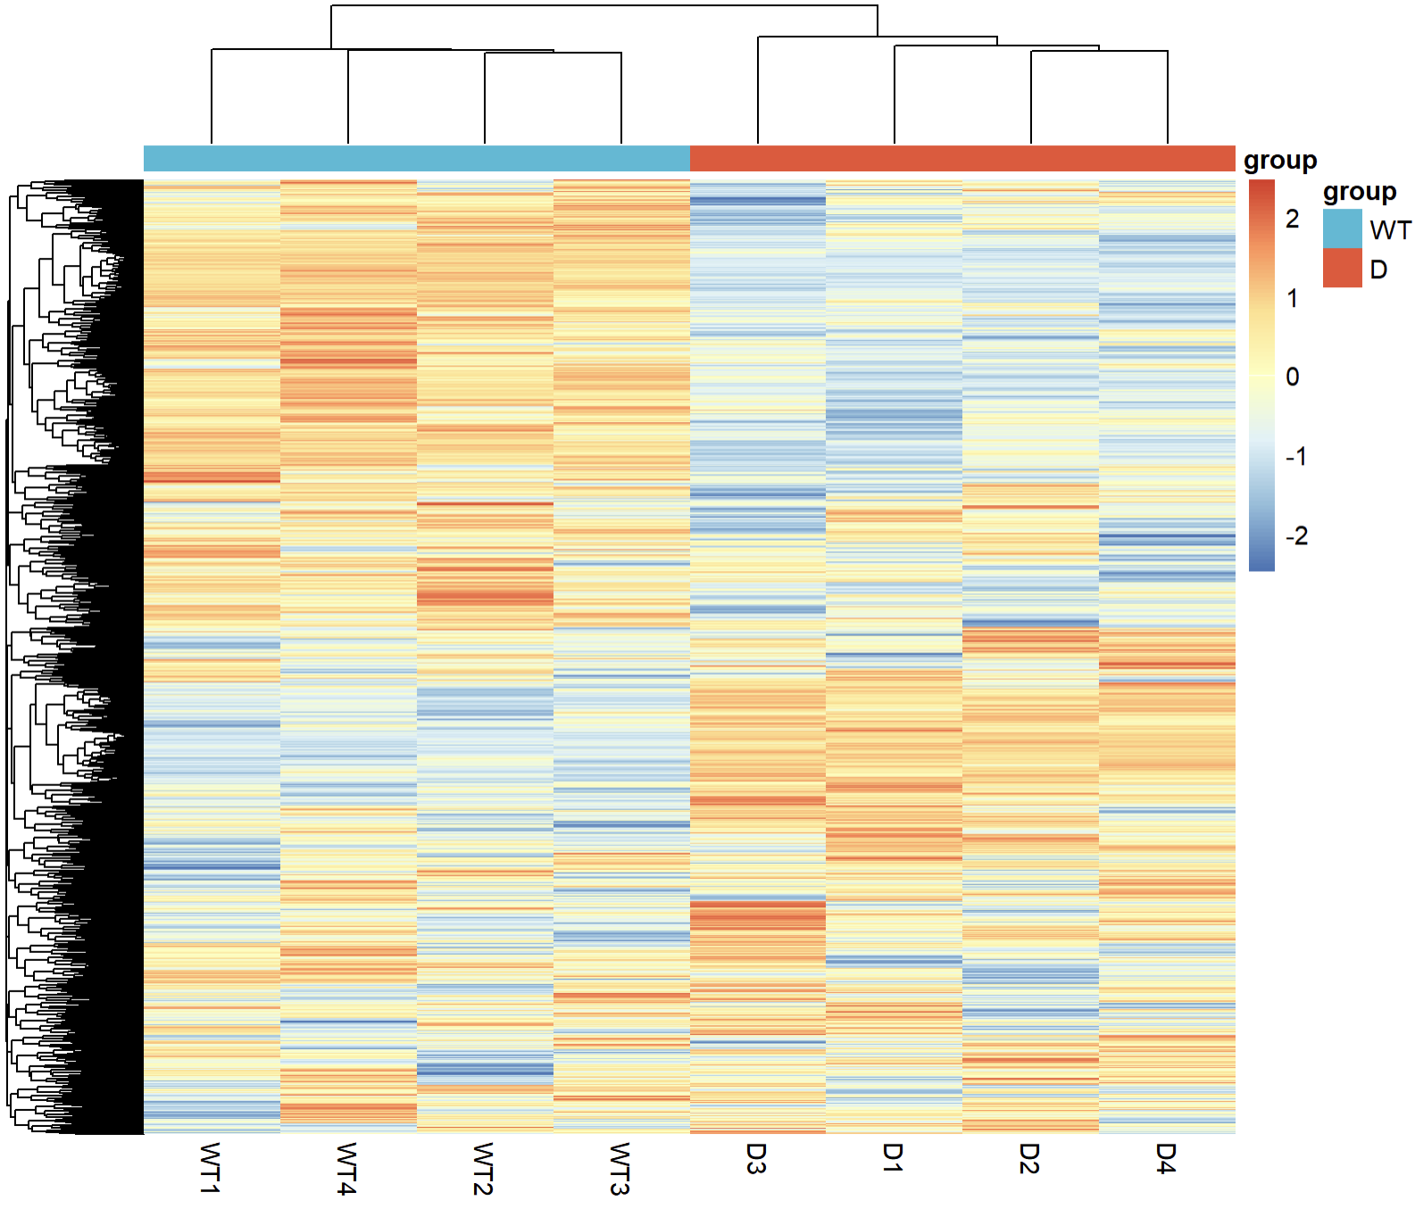
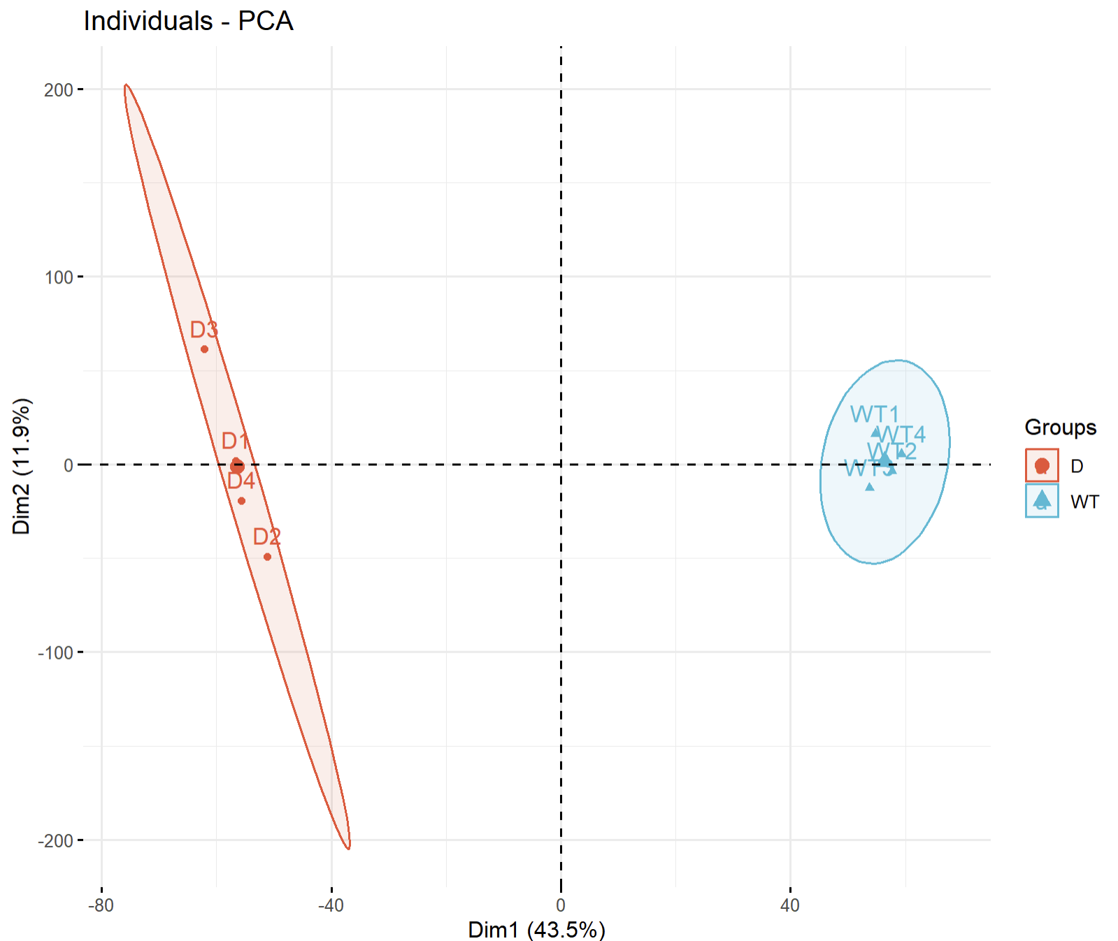
QC

Slide 5
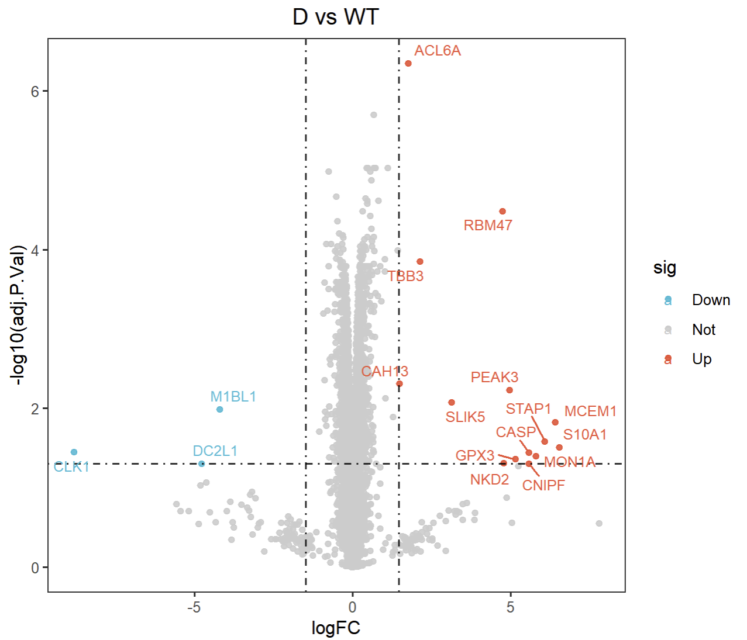
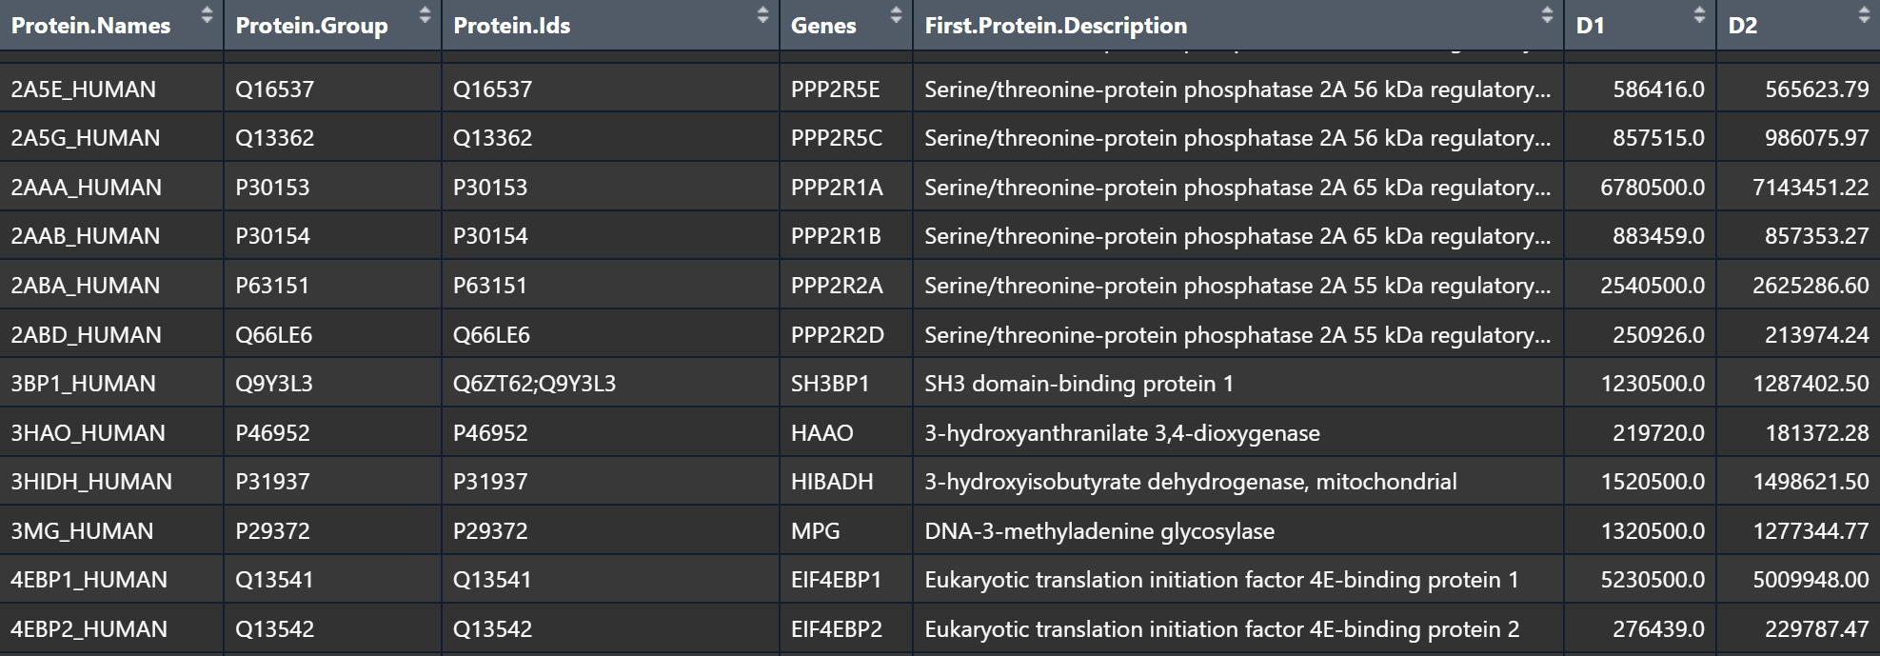
DE analysis
Method: limma
Cut off :
· adj.p.value < 0.05
· |log2FC| >3*sd

Slide 6
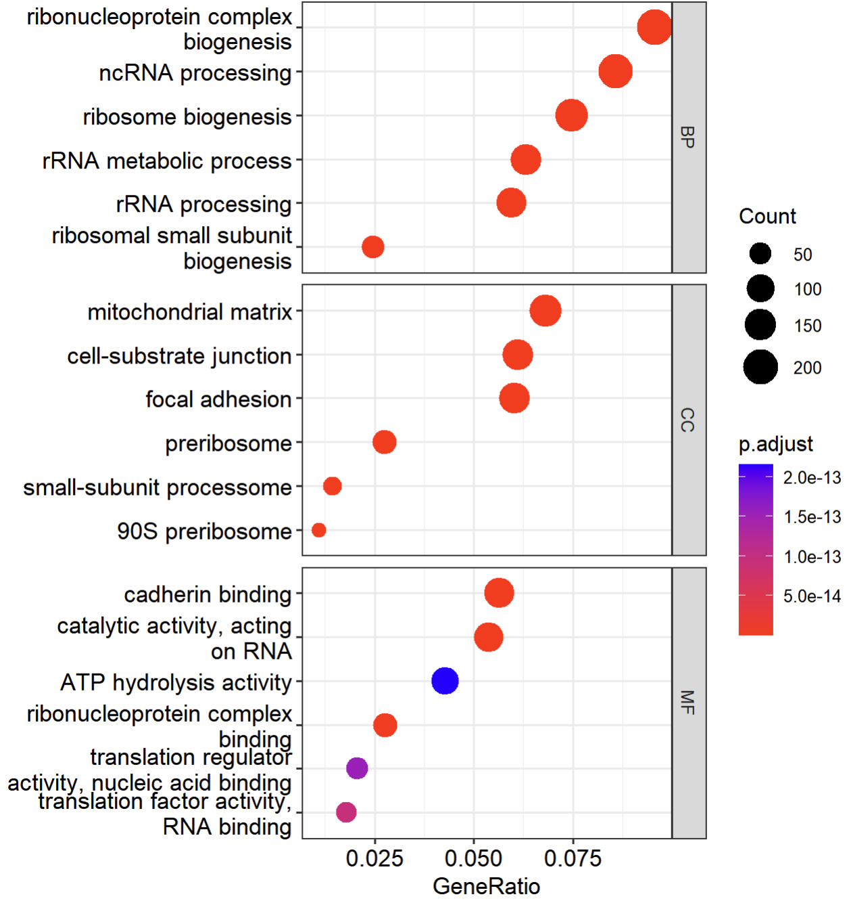
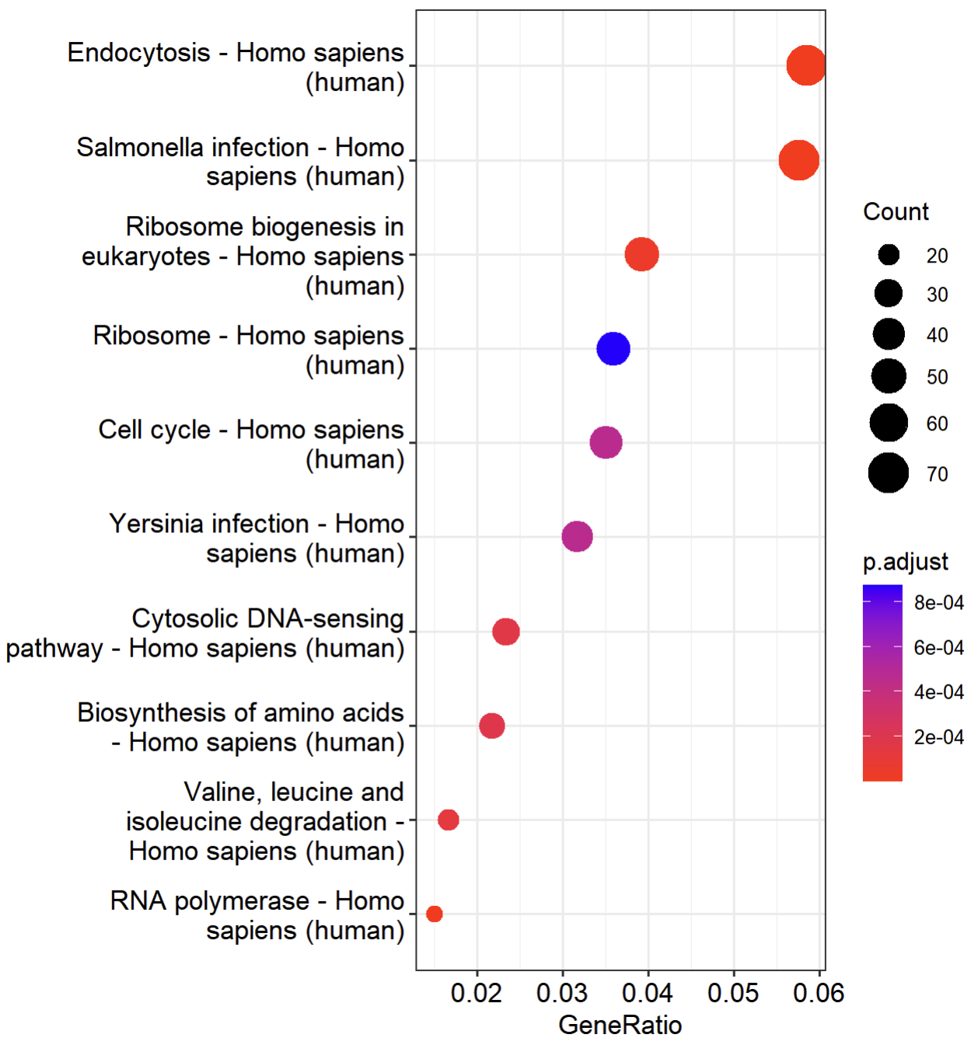
DE analysis
Method: KEGG & GO
Cut off :
· adj.p.value < 0.05
GO
KEGG

Slide 7
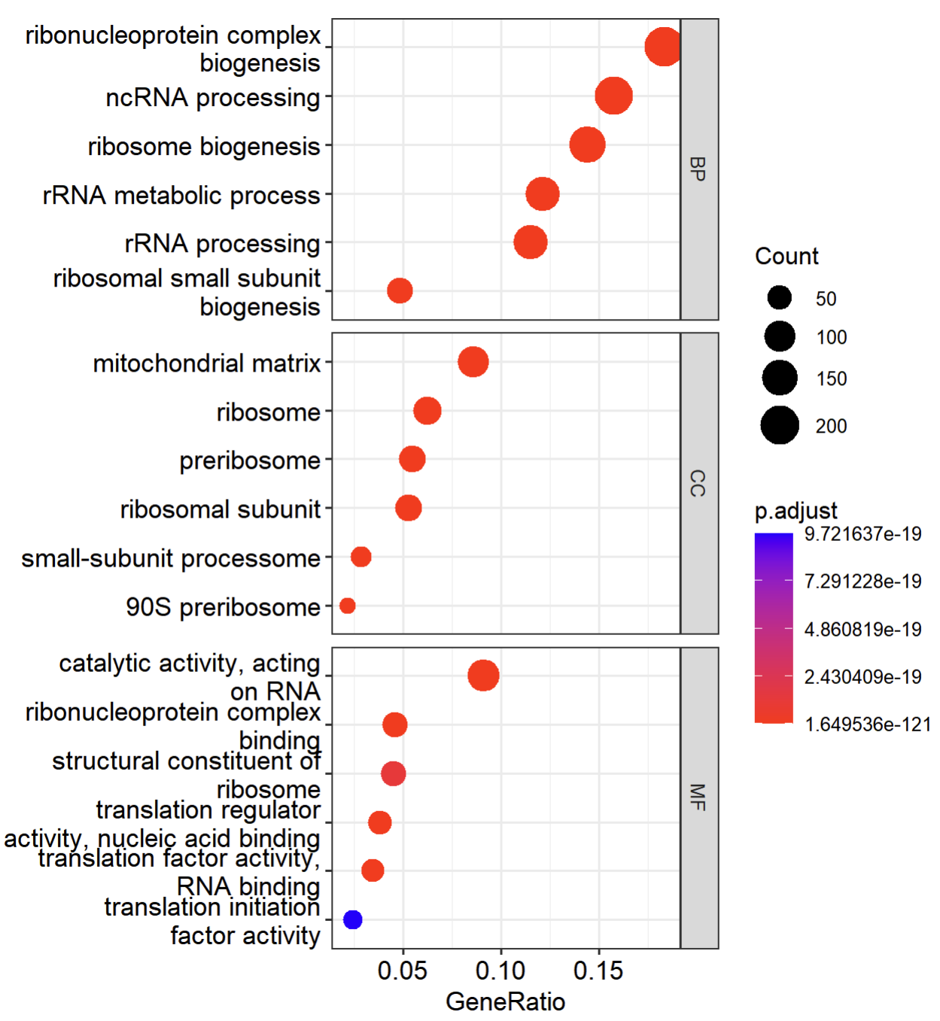
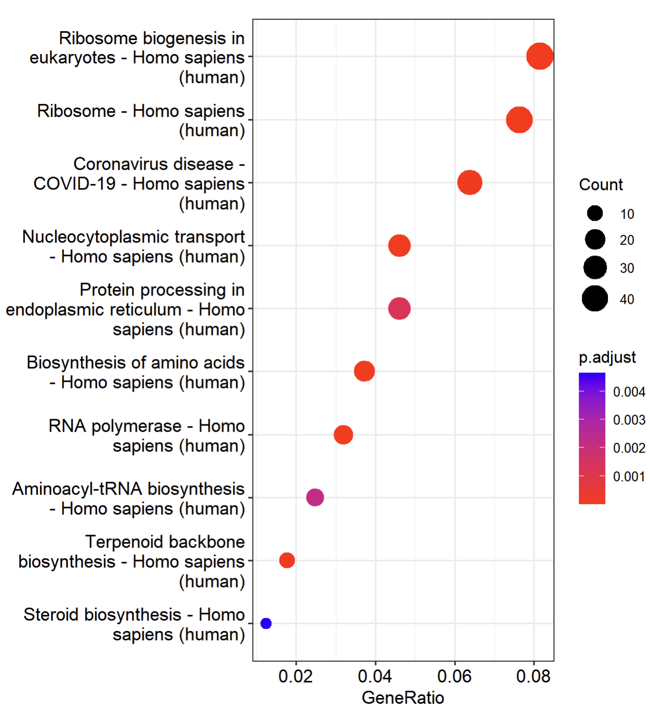
DE analysis
Method: KEGG & GO
Cut off :
· adj.p.value < 0.05
· log2FC < 0
GO
KEGG

Slide 8
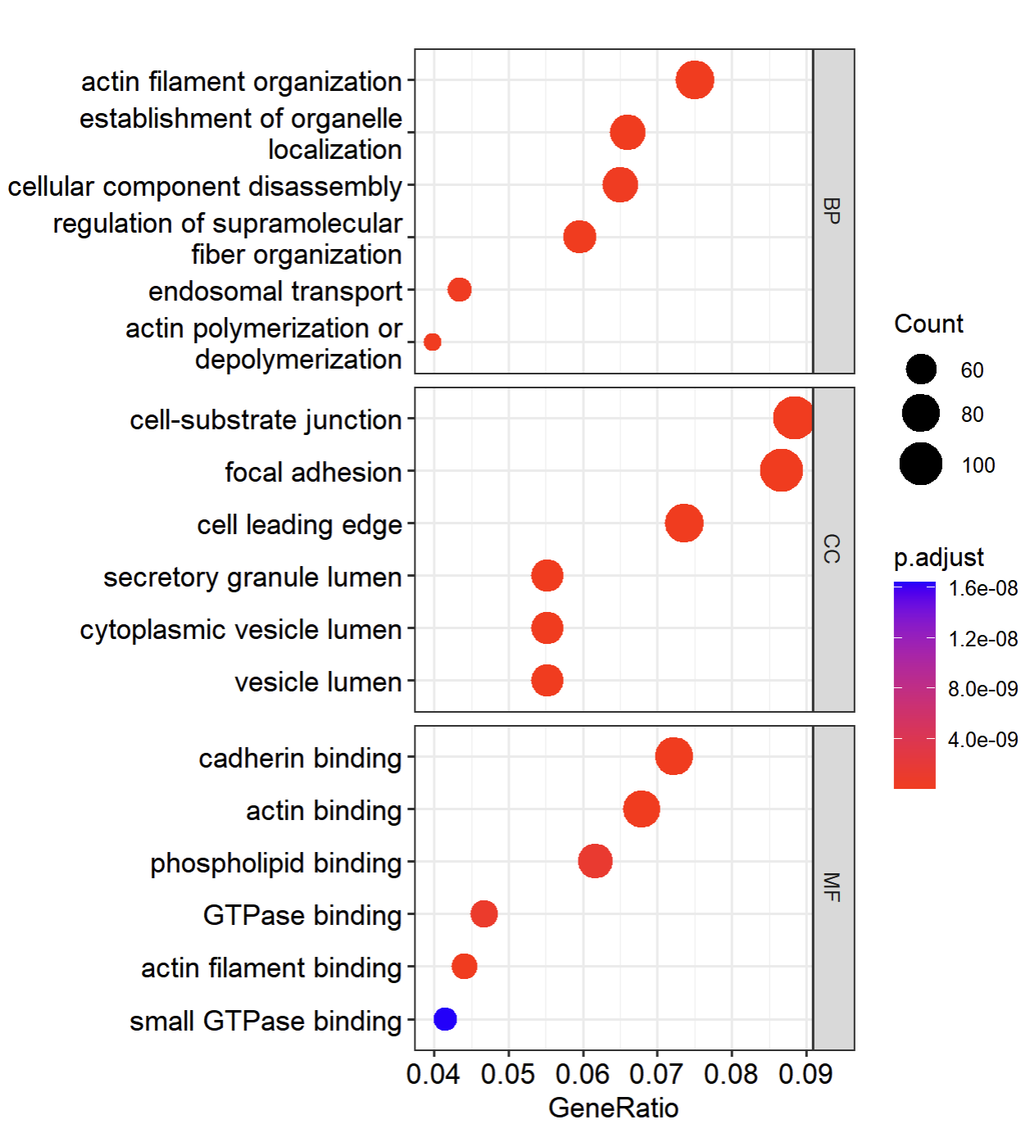
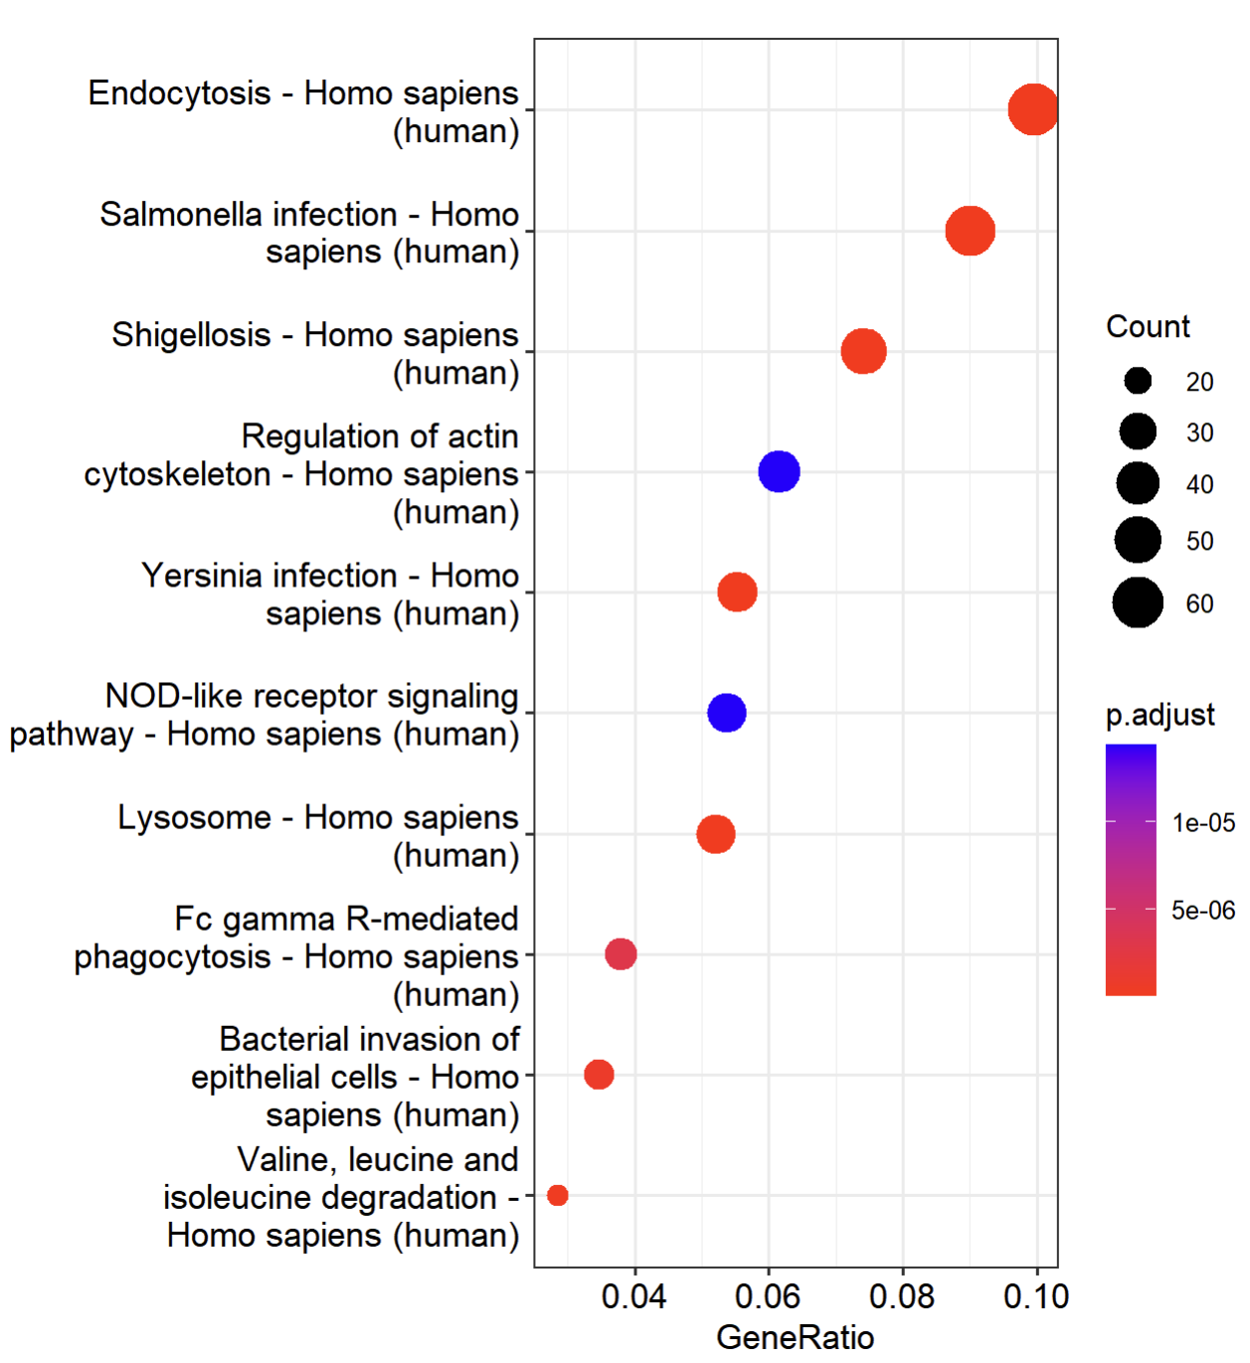
DE analysis
Method: KEGG & GO
Cut off :
· adj.p.value < 0.05
· log2FC > 0
GO
KEGG

