Slide 1
第9课：文件上传
一、图片上传
1. multipart/form-data上传图片
2. file 上传文件
二、附件上传
1. multipart/form-data表单提交
2. 参数关联
3.上传多个附件
三、requests-toolbelt
1. 获取字符串参数
2.请求参数关联

Slide 2
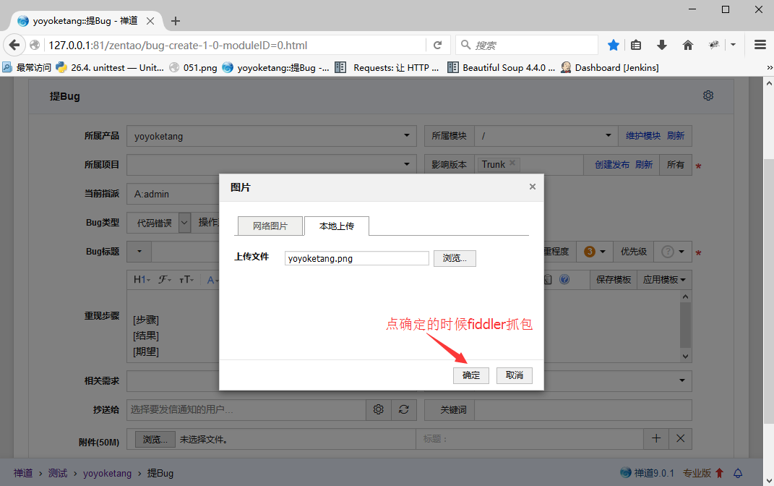
一、图片上传
1. multipart/form-data上传图片
以禅道上提交bug为例，在选择图片时，点确定按钮，就是上传图片了
用fiddler抓包，查看Raw抓到的接口
以下这种接口就是multipart/form-data
- Content-Type: multipart/form-data
- body参数是这种格式：
-----------------------------22165374713946
Content-Disposition: form-data; name="localUrl"
yoyoketang.png
-----------------------------22165374713946
Content-Disposition: form-data; name="imgFile"; filename="yoyoketang.png"
Content-Type: image/png

Slide 3
一、图片上传
2. 上传图片代码
# coding:utf-8 import requests base = 'http://127.0.0.1:81/' # 禅道的服务器地址 loginUrl = base+"/zentao/user-login.html" h = { "User-Agent": "Mozilla/5.0 (Windows NT 10.0; WOW64; rv:44.0) Gecko/20100101 Firefox/44.0", "Accept": "text/html,application/xhtml+xml,application/xml;q=0.9,*/*;q=0.8", "Accept-Language": "zh-CN,zh;q=0.8,en-US;q=0.5,en;q=0.3", "Accept-Encoding": "gzip, deflate", "Referer": "http://127.0.0.1/zentao/user-login.html", # "Cookie": # 头部没登录前不用传cookie，因为这里cookie就是保持登录的 "Connection": "keep-alive", "Content-Type": "application/x-www-form-urlencoded", } body = {"account":"admin", "password":"e10adc3949ba59abbe56e057f20f883e", "keepLogin[]":"on", "referer":"http://127.0.0.1/zentao/my/" } s = requests.session() # 保持会话 r = s.post(loginUrl, data=body, headers=h) print(r.content) # 打印结果看到location='http://127.0.0.1/zentao/my/'说明登录成功了 # 上传图片 url1 = "http://127.0.0.1:81/zentao/file-ajaxUpload-5a26aca290b59.html?dir=image" f ={ "localUrl": (None, "1.png"), "imgFile": ("1.png", open("d:\\1.png", "rb"), "image/png") } r = s.post(url1, files=f) try: jpgurl = base+r.json()["url"] print(u"上传图片后的url地址：%s" % jpgurl) except Exception as msg: print(u"返回值不是json格式：%s" % str(msg)) print(r.content.decode("utf-8"))

Slide 4
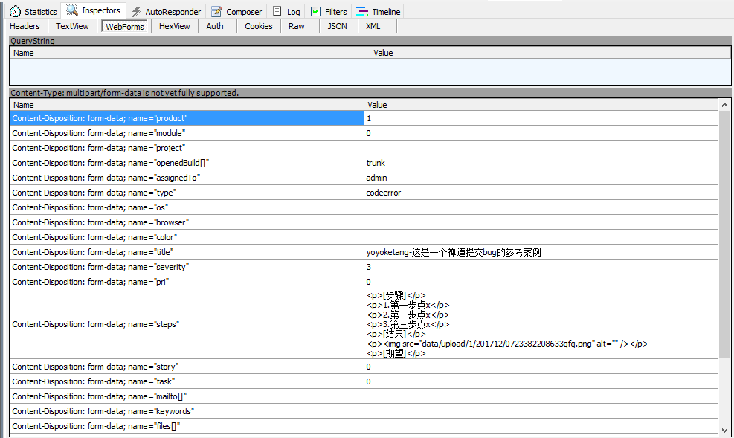
二、附件上传
1. multipart/form-data表单提交
Content-Type: multipart/form-data 在webforms查看参数详情

Slide 5
二、附件上传
2. 参数
img src=“data/upload/1/201712/072254170557cdn.png” 这个地址是上一步图片上传的相对地址
f = { "product": "1", "module": "0", "project": "", "openedBuild[]": "trunk", "assignedTo": "admin", "type": "codeerror", "os": "all", "browser": "all", "color": "", "title": "yoyoketang-这是一个bug描述1122", "severity": "3", "pri": "0", "steps": '<p>[步骤]</p>\ <p>1、第一步点</p>\ <p>2、第二步点</p>\ <p>3、点三步点</p>\ <p>[结果]</p>\ <p><img src="data/upload/1/201712/072254170557cdn.png" alt="" /></p>\ <p>[期望]</p>', "story": "0", "task": "0", "mailto[]": "", "keywords": "", "files[]": "", "labels[]": "", "uid": "5a2955c884f98", "case": "0", "caseVersion": "0", "result": "0", "testtask": "0" }

Slide 6
二、附件上传
3.参考代码
# coding:utf-8 import requests base = 'http://127.0.0.1/' # 禅道的服务器地址 loginUrl = base+"zentao/user-login.html" h = { "User-Agent": "Mozilla/5.0 (Windows NT 10.0; WOW64; rv:44.0) Gecko/20100101 Firefox/44.0", # "Cookie": # 头部没登录前不用传cookie，因为这里cookie就是保持登录的 "Content-Type": "application/x-www-form-urlencoded", } body = {"account": "admin", "password": "e10adc3949ba59abbe56e057f20f883e", "keepLogin[]": "on", "referer": "http://127.0.0.1/zentao/my/" } s = requests.session() # 保持会话 r = s.post(loginUrl, data=body, headers=h) print(r.content) # 打印结果看到location='http://127.0.0.1/zentao/my/'说明登录成功了 # 提交bug url1 = base+"zentao/bug-create-1-0-moduleID=0.html" f = { # 参数 } r = s.post(url1, data=f) print(r.content.decode("utf-8"))

Slide 7
二、附件上传
4.参数关联
# coding:utf-8 import requests host = 'http://127.0.0.1/' # 禅道的服务器地址 s = requests.session() # 保持会话 def login(username='admin', psw='e10adc3949ba59abbe56e057f20f883e'): '''登录禅道 username: 用户名 psw：登录密码，加密后的 ''' loginUrl = host+"zentao/user-login.html" h = { "User-Agent": "Mozilla/5.0 (Windows NT 10.0; WOW64; rv:44.0) Gecko/20100101 Firefox/44.0", # "Cookie": # 头部没登录前不用传cookie，因为这里cookie就是保持登录的 "Content-Type": "application/x-www-form-urlencoded", } body = {"account": username, "password": psw, "keepLogin[]": "on", "referer": host+"zentao/my/" } r = s.post(loginUrl, data=body, headers=h) print(r.content) # 打印结果看到location='http://127.0.0.1/zentao/my/'说明登录成功了 def upload_jpg(path="d:\\1.png", filename='1.png'): '''上传图片 path：上传文件路径 filename： 上传文件名称 ''' url1 = host+"zentao/file-ajaxUpload-5a26aca290b59.html?dir=image" f ={ "localUrl": (None, filename), "imgFile": (filename, open(path, "rb"), "image/png") } r = s.post(url1, files=f) try: jpgurl = r.json()["url"] print(u"上传图片后的url地址：%s" % jpgurl) return jpgurl except Exception as msg: print(u"返回值不是json格式：%s" % str(msg)) print(r.content) return '' def add_bug(title="yoyoketang-这是一个bug描述1224", jpg=''): '''提交bug title: bug描述 jpg：上传图片的相对路径 ''' url1 = host+"zentao/bug-create-1-0-moduleID=0.html" f = { # 参数 } r = s.post(url1, data=f) print(r.content.decode("utf-8")) if __name__ == "__main__": # 1.先登录 login(username='admin', psw='e10adc3949ba59abbe56e057f20f883e') # 2.图片上传，返回图片地址 jpg = upload_jpg(path="d:\\1.png", filename='1.png') # 3.添加bug, 调用上个接口返回的地址作为请求参数 add_bug(title="yoyoketang-这是一个bug描述1225", jpg=jpg)

Slide 8
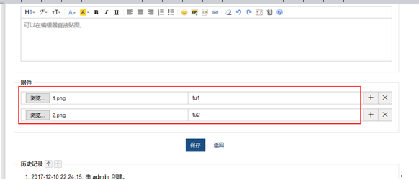
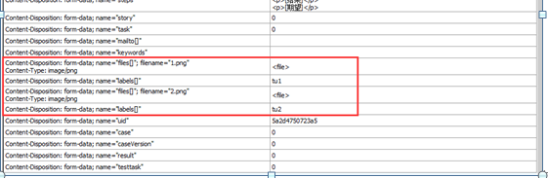
二、附件上传
5.上传多个附件
禅道提交bug上传多个附件

Slide 9
二、附件上传
6.多个附件代码
# 传多个文件的时候如下，这两个参数的name都是一样的，如果用字典去传key值，很显然python的key值是不能重复的 ''' Content-Disposition: form-data; name="files[]"; filename="1.png" Content-Type: image/png Content-Disposition: form-data; name="files[]"; filename="2.png" Content-Type: image/png 2.这时候需要换个格式，传list数据 ''' # file = { # "files[]": ("1.png", open("d:\\1.png", "rb"), "image/png"), # "labels[]": "tu1", # } #-------------多个文件用list类型------------ file = [ ("files[]", ("2.png", open("d:\\1.png", "rb"), "image/png")), ("labels[]", "tu1"), ("files[]", ("2.png", open("d:\\2.png", "rb"), "image/png")), ("labels[]", "tu2"), ]

Slide 10
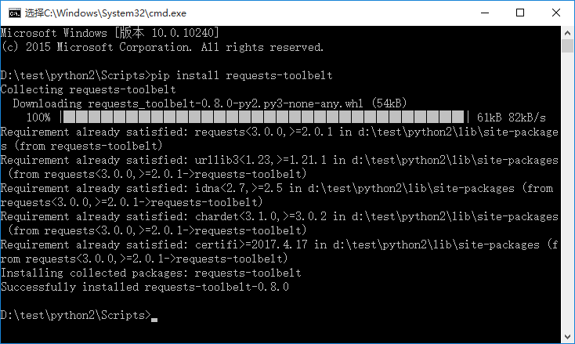
三、requests-toolbelt
1.requests-toolbelt处理multipart/form-data
> pip install requests-toolbelt

Slide 11
三、requests-toolbelt
2. multipart/form-data传文件
from requests_toolbelt import MultipartEncoder import requests m = MultipartEncoder( fields={'field0': 'value', 'field1': 'value', 'field2': ('filename', open('file.py', 'rb'), 'text/plain')} ) r = requests.post('http://httpbin.org/post', data=m, headers={'Content-Type': m.content_type})

Slide 12
三、requests-toolbelt
3. multipart/form-data传非文件表单
from requests_toolbelt import MultipartEncoder import requests m = MultipartEncoder( fields={'field0': 'value', 'field1': 'value', 'field2': ('filename', open('file.py', 'rb'), 'text/plain')} ) r = requests.post('http://httpbin.org/post', data=m, headers={'Content-Type': m.content_type})

Slide 13
三、requests-toolbelt
3. multipart/form-data传多个文件
from requests_toolbelt import MultipartEncoder import requests m = MultipartEncoder( fields = [ ('source', ('f1.ext', f1, 'application/x-example-mimetype'), ('source', ('f2.ext', f2, 'application/x-example-mimetype'), ] ) r = requests.post('http://httpbin.org/post', data=m, headers={'Content-Type': m.content_type})

Slide 14
三、requests-toolbelt
4. 代码参考
# coding:utf-8 import requests from requests_toolbelt import MultipartEncoder host = 'http://127.0.0.1:81' # 禅道的服务器地址 def login(s,user="admin",psw="e10adc3949ba59abbe56e057f20f883e"): u'''登录禅道''' loginUrl = host+"/zentao/user-login.html" h = { "User-Agent": "Mozilla/5.0 (Windows NT 10.0; WOW64; rv:44.0) Gecko/20100101 Firefox/44.0", "Accept": "text/html,application/xhtml+xml,application/xml;q=0.9,*/*;q=0.8", "Accept-Language": "zh-CN,zh;q=0.8,en-US;q=0.5,en;q=0.3", "Accept-Encoding": "gzip, deflate", "Referer": host+"/zentao/user-login.html", # "Cookie": # 头部没登录前不用传cookie，因为这里cookie就是保持登录的 "Connection": "keep-alive", "Content-Type": "application/x-www-form-urlencoded", } body = {"account": user, "password": psw, "keepLogin[]": "on", "referer": host+"/zentao/my/" } try: r = s.post(loginUrl, data=body, headers=h) print(r.content) # 打印结果看到location='http://127.0.0.1/zentao/my/'说明登录成功了 if "/zentao/my/" in r.content: print("登录成功！") return True else: print("登录失败：%s" % r.content) return False except Exception as msg: print("登录失败:%s"%str(msg)) return False def upload_jpg(s): u'''上传图片''' url1 = host+"/zentao/file-ajaxUpload-5a26aca290b59.html?dir=image" m = MultipartEncoder( fields={ "localUrl": (None, "1.png"), "imgFile": ("1.png", open("d:\\1.png", "rb"), "image/png") }) try: r1 = s.post(url1, data=m, headers={'Content-Type': m.content_type}) jpg_url = r1.json()["url"] return jpg_url except Exception as msg: print("上传失败：%s"%str(msg)) return "" def submit_bug(s,jpg_url,title="yoyoketang-这是一个带附件的内容"): # 提交bug, 带上附件 url2 = host+"/zentao/bug-create-1-0-moduleID=0.html" m = MultipartEncoder( fields = [ ("product", "1"), ("module","0"), ("project", ""), ("openedBuild[]", "trunk"), ("assignedTo", "admin"), ("type", "codeerror"), ("os", "all"), ("browser", "all"), ("color", ""), ("title", title), # bug标题参数化 ("severity", "3"), ("pri", "0"), ("steps", u'<p>[步骤]</p>\ <p>1、第一步点</p>\ <p>2、第二步点</p>\ <p>3、点三步点</p>\ <p>[结果]</p>\ <p><img src="%s" alt="" /></p>\ <p>[期望]</p>' % jpg_url), # 正文图片地址参数 ("story", "0"), ("task", "0"), ("mailto[]", ""), ("keywords", ""), # 这里的四个参数就是上传文件附件了 ("files[]", ("1.png", open("d:\\1.png", "rb"), "image/png")), # 附件1 ("labels[]", "tu1"), ("files[]", ("2.png", open("d:\\2.png", "rb"), "image/png")), # 附件1 ("labels[]", "tu2"), ("uid", "5a2955c884f98"), ("case", "0"), ("caseVersion", "0"), ("result", "0"), ("testtask", "0") ]) try: r2 = s.post(url2, data=m, headers={'Content-Type': m.content_type}) print(r2.content.decode("utf-8")) except Exception as msg: print("提交BUG失败：%s"%str(msg)) if __name__ == "__main__": s = requests.session() # 保持会话 login(s, user="admin", psw="e10adc3949ba59abbe56e057f20f883e") # 登录 jpg = upload_jpg(s) # 上传图 # 获取上传图片后用的url地址传给提交bug的正文 submit_bug(s, jpg, title="yoyoketang-这是一个带附件的内容")

Slide 15
大结局！
毕业了！！！！！！！！！！！！！！！！

