Slide 1
DNN推荐模型
汪飞
2017-11-16

Slide 2
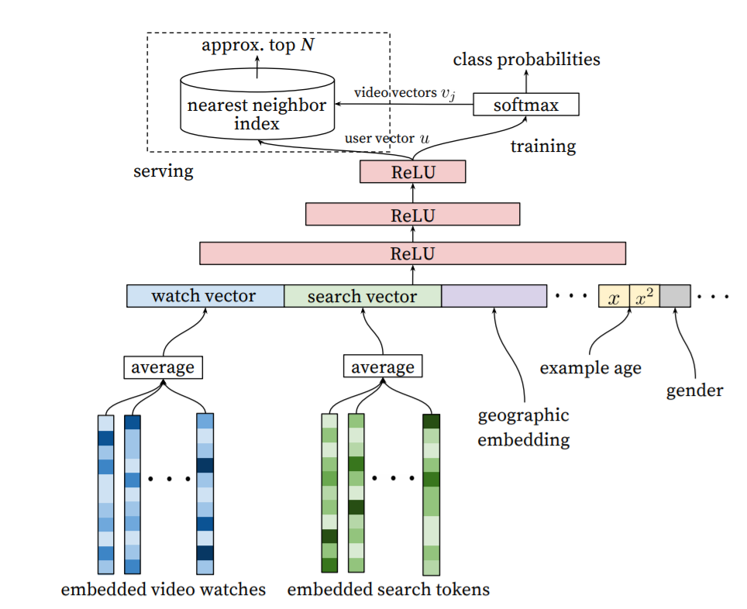
Framework: candidate generation
冷启动
异构数据平滑
User Embedding

Slide 3
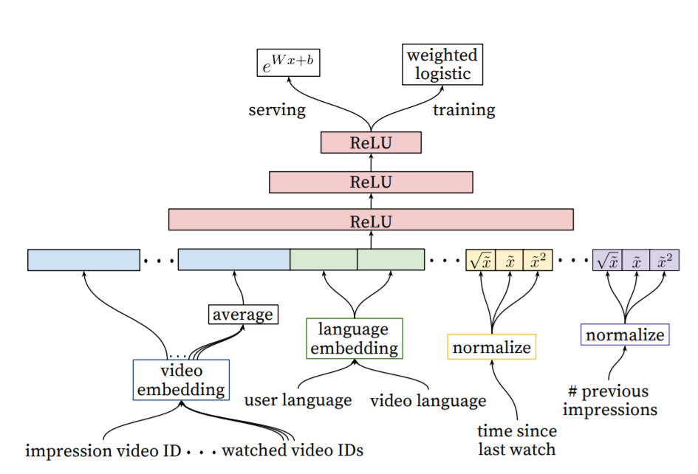

Framework: ranking
$$R_{odds}=\frac{\sum{T_{i}}}{N−k}$$

Slide 4
Feature Engineering
DNN can do Feature Engineering?
Categorical
Binary(性别)
Multiple value(手机型号)
Continuous features（身高）
Univalent（最后观看的item）
Multivalent（最近一个月观看item集合）
Embedding Categorical Features
share underlying emeddings
Normalizing Continuous Features
cumulative distribution
Power(x) and sqrt(x)

Slide 5
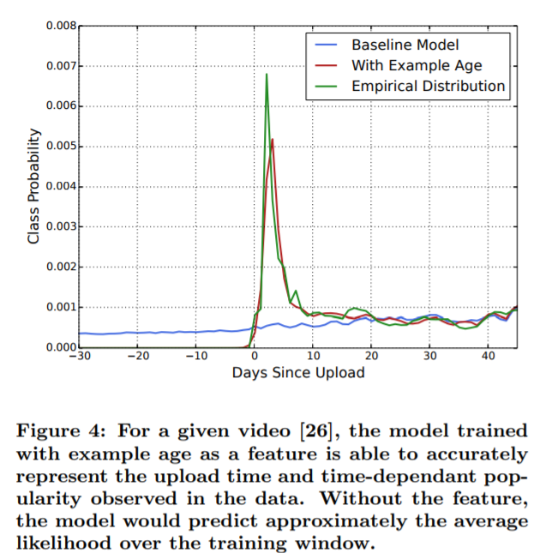
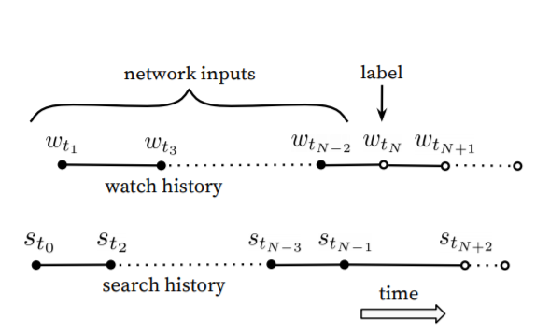

Example Age
$$E_{age}=t_{max}−t_{N}$$

Slide 6
Used Feature
Demography
sex
age
education
family
Watch Sequence
User Tag
iflow-tag
long-tag
not-feed-tag
search-tag
Example age
Phone
City
App

Slide 7
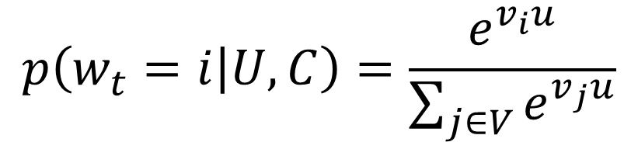
Candidate Sampling
$$p\left(w_{t}=i | U,C\right)=\frac{e^{v_{i}u}}{\sum_{j∈V}{e^{v_{j}u}}}$$
tf.nn.nce
tf.nn.sampled_softmax_loss
https://www.tensorflow.org/versions/r0.12/api_docs/python/nn/candidate_sampling

Slide 8
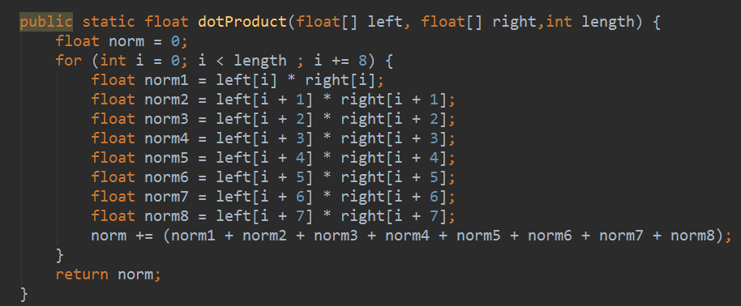
Serving
向量搜索引擎
可以形成一个通用组件，类似于搜索引擎
Hashing
K-MEANS
基本思路是构建一个最优化算法进行聚类
J. Weston, S. Bengio, and N. Usunier. Wsabie: Scaling up to large vocabulary image annotation. In Proceedings of the International Joint Conference on Artificial Intelligence, IJCAI, 2011.
向量减少为128维 120ms
C++ SIMD *8倍

Slide 9
Modification
sample_softmax
remove bias
dropout
A
remove bias
BN
tanh>elu>relu
cnn/rnn
w1
…
w20
m1
m10
play sequence
avg(20)
avg(10)
search
long
ugc
phone
other
iflow

Slide 10
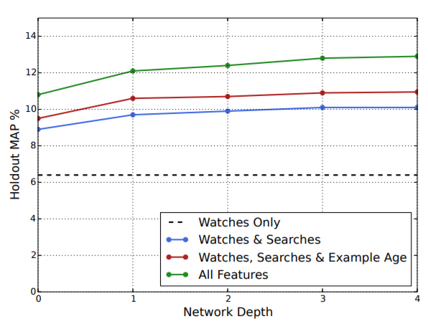
Benchmark
tf.metrics.sparse_average_precision_at_k
离线数据
1.8%~2.7% 依据测试集不同
冷启动用户：5%-6%
全量用户：2%-3%

Slide 11
Understanding
场景外Feature与场景内目标相关性
模型无法解决知识迁移
标签
分词
播放序列bias非常大
推荐结果类似w2v
接入Sequence model对模型提升应该会比较大
Subsampling对结果的影响非常大
实时模型效果会更好（对于重度用户效果更明显）

