Slide 1
Inception Since V3
汪飞
20180309

Slide 2
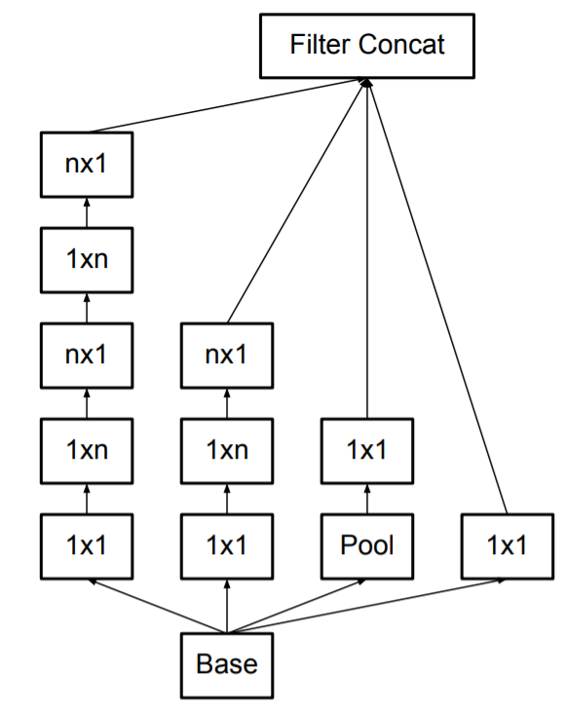
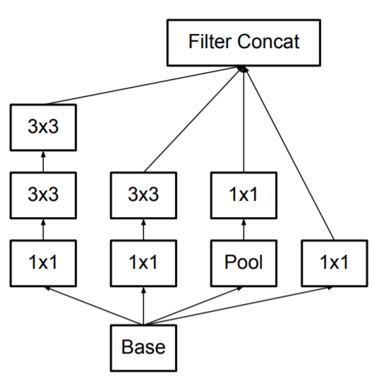
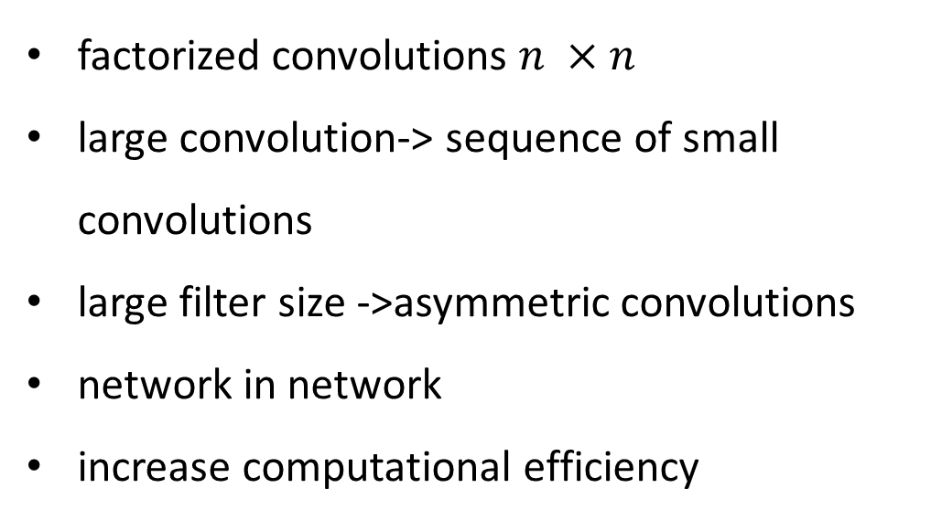
Inception-V3
Rethinking the Inception Architecture for Computer Vision (https://arxiv.org/abs/1512.00567)
factorized convolutions $n ×n$
large convolution-> sequence of small convolutions
large filter size ->asymmetric convolutions
network in network
increase computational efficiency

Slide 3
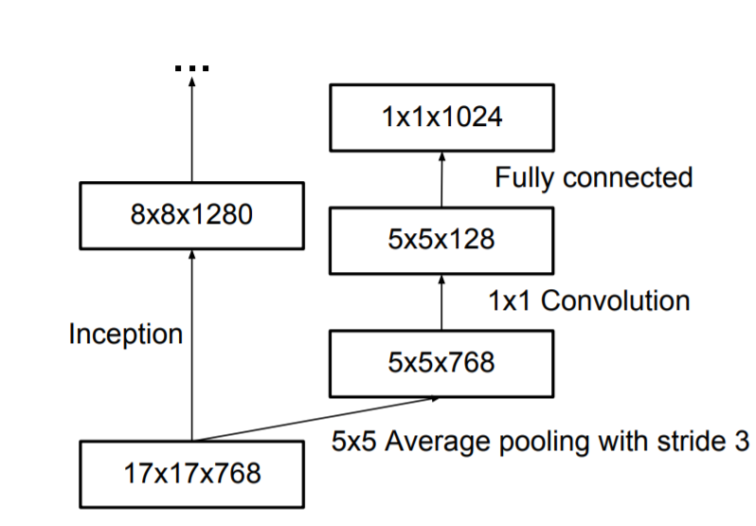
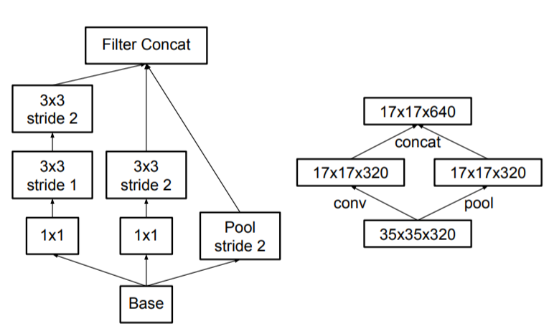
Inception-V3
Grid Size Reduction
Auxiliary Classifiers

Slide 4
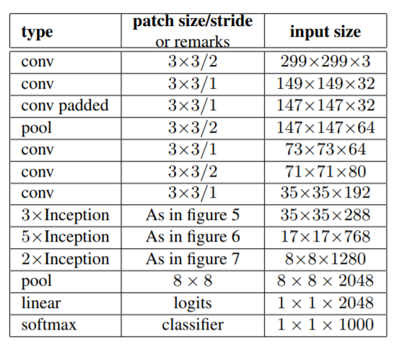
Inception-V3

Slide 5
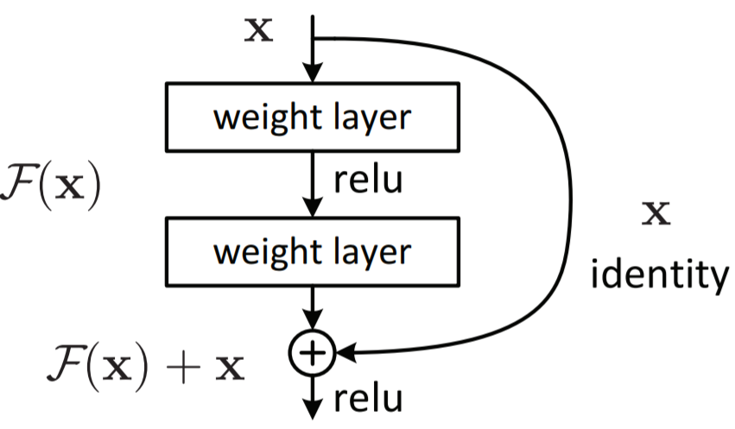


Resnet
Deep Residual Learning for Image Recognition (https://arxiv.org/abs/1512.03385)
when depth increase, accuracy get saturated
high training error
inspired by
highway net
shotcut connection(auxiliary classifier in inception)
not easy to fit an identity mapping by stack of nolinear layer
Gate

Slide 6
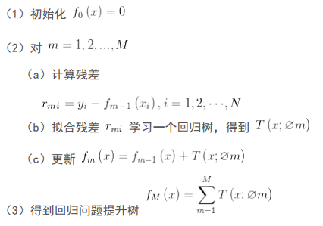
Resnet vs. GBDT
Resnet
Boosting Decision Tree

Slide 7
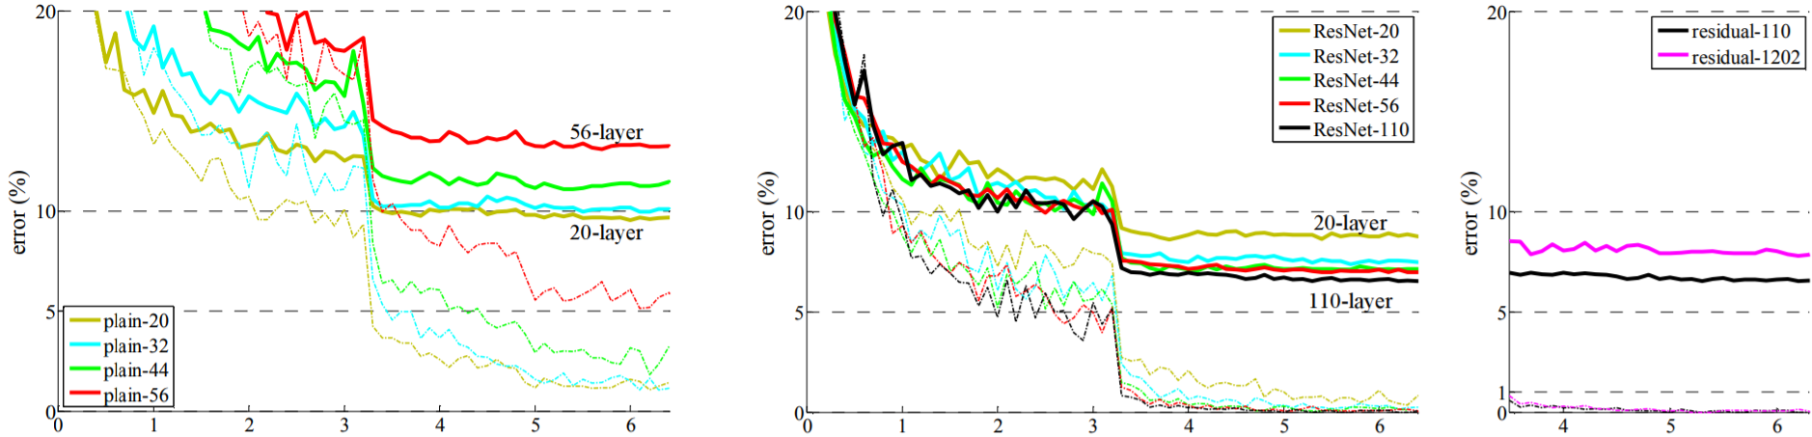
Resnet

Slide 8
Inception-V4 & Inception-Resnet-V2
Inception-v4, Inception-ResNet and the Impact of Residual Connections on Learning (https://arxiv.org/abs/1602.07261)
Inception-V4
more deep
more uniform inception block
Inception-Resnet-V2
inception + resnet

Slide 9
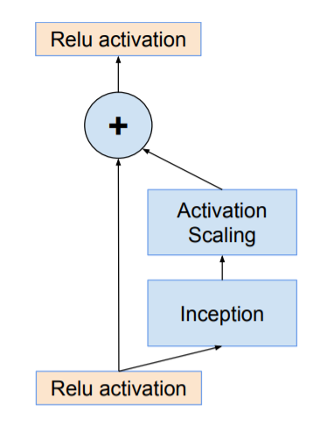
Inception-Resnet-V2
Scaling of the Residuals(constant:0.1)
number of filters > 1000 => net die in early train
resnet suggest two-phase training when train very deep resnet

Slide 10
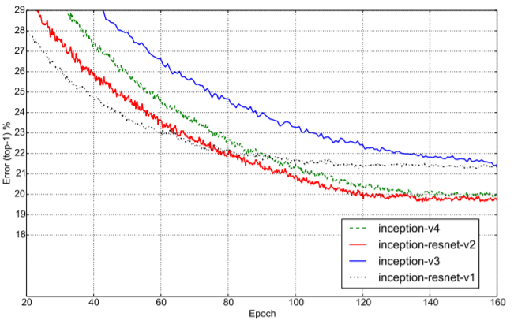
Inception-Resnet-V2

Slide 11
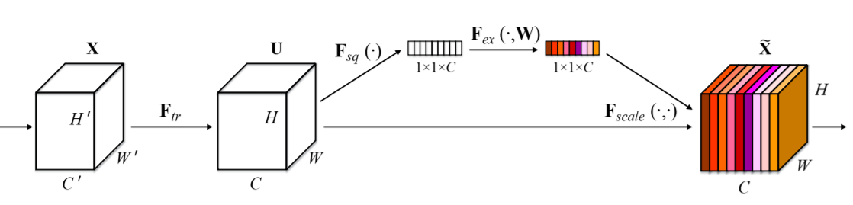
SENet
Squeeze-and-Excitation Networks (https://arxiv.org/abs/1709.01507)
Explicit Channel interdependencies
Attention and Gate
ILSVRC 2017 classification first place, top5 error:2.251%

Slide 12

SENet
Gate
Attention

Slide 13
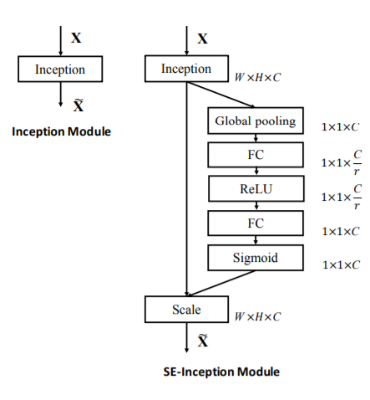
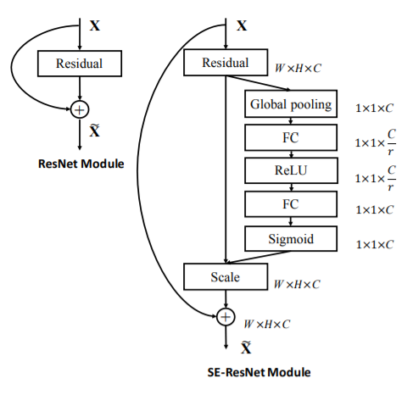
SENet

Slide 14
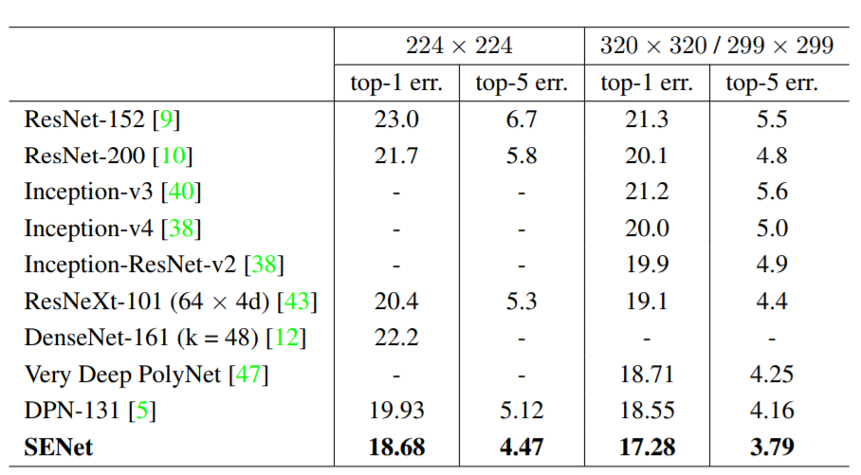
SENet

Slide 15
MobileNets
MobileNets: Efficient Convolutional Neural Networks for Mobile Vision Applications (https://arxiv.org/abs/1704.04861)
balance between latency and accuracy
two hyper-parameter: resolution size and channel num
low latency for mobile device
shrinking and factorization

Slide 16
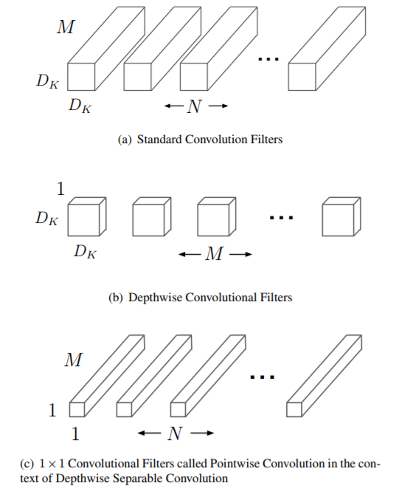

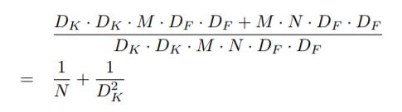

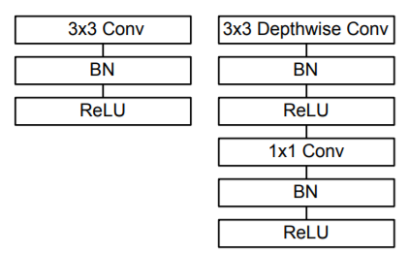

MobileNets
Factorization

Slide 17
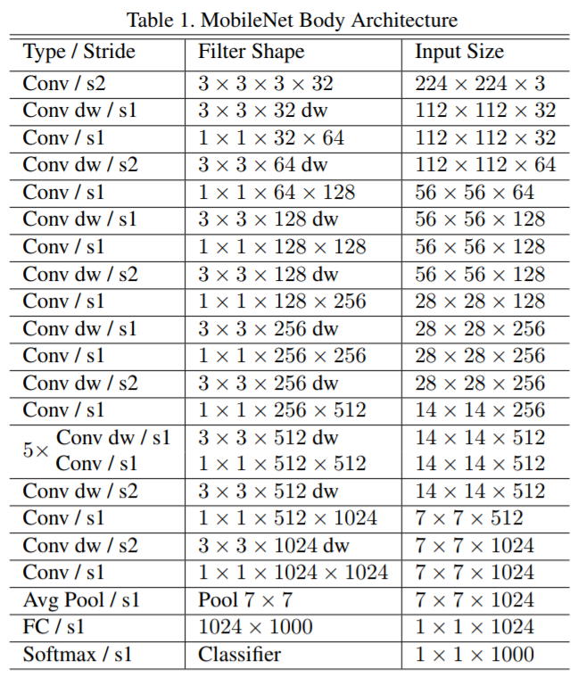
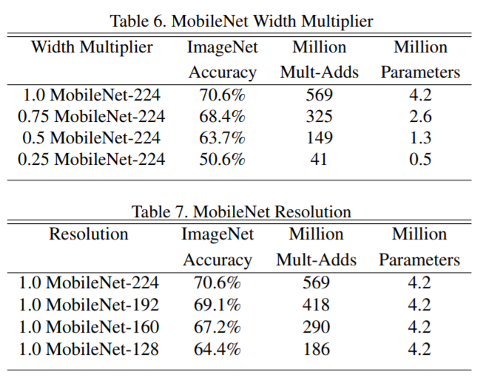
MobileNets

Slide 18
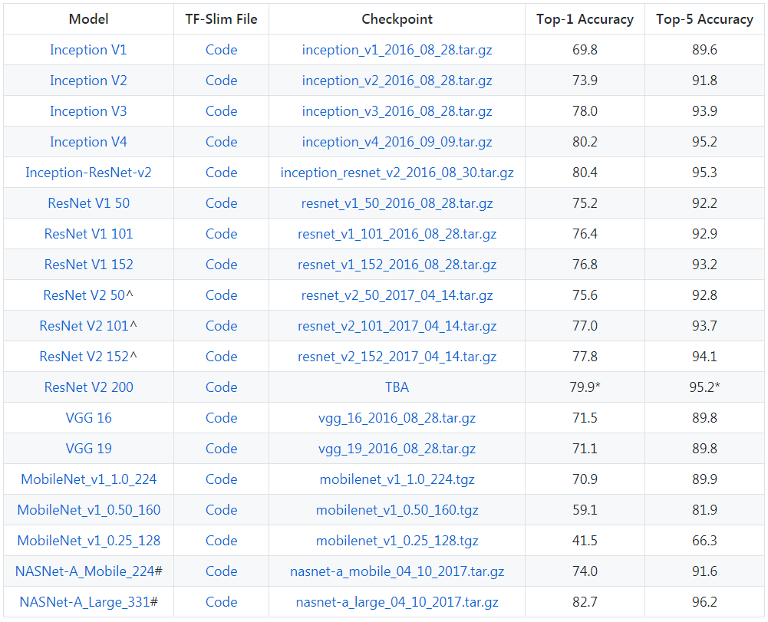
Benchmark

Slide 19
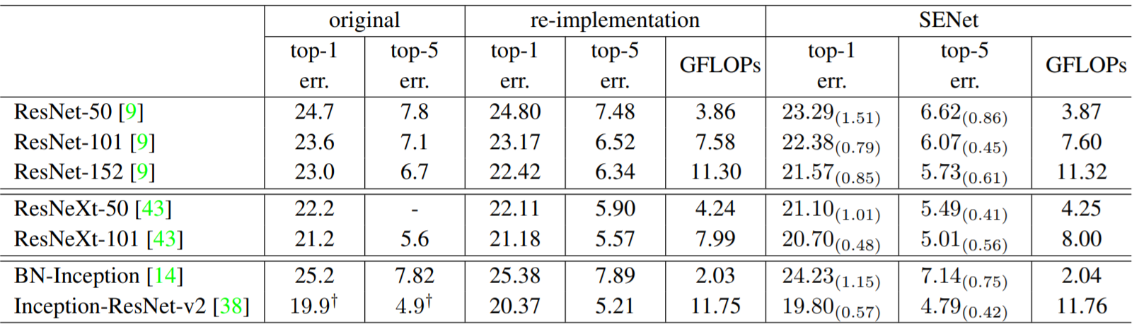
Benchmark

