Slide 1
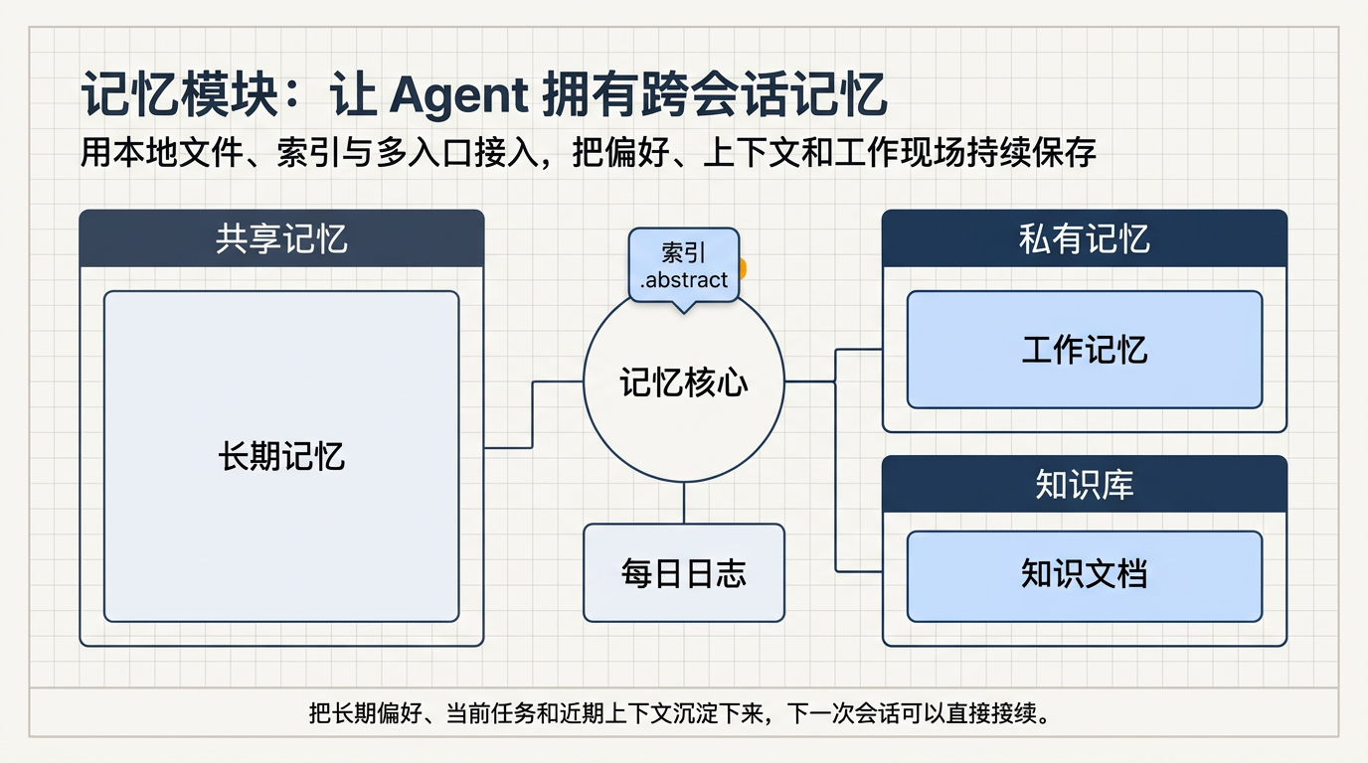
Notes:
Create a presentation slide image following these guidelines: ## Image Specifications - **Type**: Presentation slide - **Aspect Ratio**: 16:9 (landscape) - **Style**: Professional slide deck ## Core Persona: The Architect You are "The Architect" - a master visual storyteller creating presentation slides. Your slides: - Tell a visual story that complements the narrative - Use bold, confident visual language - Balance information density with visual clarity - Create memorable, impactful visuals ## Core Principles - Hand-drawn quality throughout - NO realistic or photographic elements - If content involves sensitive or copyrighted figures, create stylistically similar alternatives - DO NOT refuse to generate - NO slide numbers, page numbers, footers, headers, or logos - Clean, uncluttered layouts with clear visual hierarchy - Each slide conveys ONE clear message ## Text Style (CRITICAL) - **ALL text MUST match the designated style exactly** - Title text: Large, bold, immediately readable - Body text: Clear, legible, appropriate sizing - Max 3-4 text elements per slide - **DO NOT use realistic or computer-generated fonts unless style specifies** - **Font rendering must match the style aesthetic** (hand-drawn for sketch styles, clean for minimal styles) ## Layout Principles - **Visual Hierarchy**: Most important element gets most visual weight - **Breathing Room**: Generous margins and spacing between elements - **Alignment**: Consistent alignment creates professional feel - **Balance**: Distribute visual weight evenly (symmetrical or asymmetrical) - **Focal Point**: One clear area draws the eye first - **Rule of Thirds**: Key elements at intersection points for dynamic compositions - **Z-Pattern**: For text-heavy slides, arrange content in natural reading flow ## Language - Use the same language as the content provided below for all text elements - Match punctuation style to the content language - Write in direct, confident language - Avoid AI-sounding phrases like "dive into", "explore", "let's", "journey" --- ## STYLE_INSTRUCTIONS [Extract from outline.md - do NOT re-read style files] The STYLE_INSTRUCTIONS block from the outline contains: - Design Aesthetic - Background (Texture + Base Color) - Typography (Headlines + Body descriptions) - Color Palette (with hex codes) - Visual Elements - Density Guidelines - Style Rules (Do/Don't) Copy the entire `<STYLE_INSTRUCTIONS>...</STYLE_INSTRUCTIONS>` block from the outline here. --- ## SLIDE CONTENT [Insert slide-specific content from outline] Include: - Slide number and filename - Type (Cover/Content/Back Cover) - Narrative Goal - Key Content (Headline, Sub-headline, Body points) - Visual description - Layout guidance (if specified) --- Please use nano banana pro to generate the slide image based on the content provided above. --- Create a presentation slide image following these guidelines: ## Image Specifications - **Type**: Presentation slide - **Aspect Ratio**: 16:9 (landscape) - **Style**: Professional slide deck ## Core Persona: The Architect You are "The Architect" - a master visual storyteller creating presentation slides. Your slides: - Tell a visual story that complements the narrative - Use bold, confident visual language - Balance information density with visual clarity - Create memorable, impactful visuals ## Core Principles - Hand-drawn quality throughout - NO realistic or photographic elements - NO slide numbers, page numbers, footers, headers, or logos - Clean, uncluttered layouts with clear visual hierarchy - Each slide conveys ONE clear message ## Text Style - Use concise Simplified Chinese for all visible text - Ensure title text is large, bold, and readable - Keep total visible text elements low and well spaced - Use direct, confident wording --- ## STYLE_INSTRUCTIONS <STYLE_INSTRUCTIONS> Design Aesthetic: A precise blueprint-style presentation for technical onboarding, using engineering-paper structure, cool analytical blues, and clean schematic composition. The visuals should feel authoritative and system-oriented, but simplified enough for beginners to understand at a glance. Prefer diagrammatic storytelling over dense prose. Background: Texture: Subtle light-gray engineering grid overlay with technical drawing precision Base Color: Blueprint Paper (#FAF8F5) Typography: Headlines: Bold geometric sans-serif with precise strokes, high contrast, and calm technical authority Body: Clean readable serif or neutral technical text style, compact but easy to scan in Chinese Color Palette: Primary Text: Deep Slate (#334155) - headlines, labels, and body text Background: Blueprint Paper (#FAF8F5) - primary background Accent 1: Engineering Blue (#2563EB) - key paths, core modules, and emphasis Accent 2: Navy Blue (#1E3A5F) - secondary blocks and supporting structure Accent 3: Light Blue (#BFDBFE) - panels, fills, and grouping areas Accent 4: Amber (#F59E0B) - highlights for value, maintenance, or key actions Visual Elements: - Technical schematics with thin line work and consistent stroke weights - Straight connector lines and 90-degree angles only - Simplified module cards, directory blocks, and flow arrows - Blueprint annotations, brackets, and subtle measurement marks - Clean infographic icons for memory, logs, tools, and background jobs Density Guidelines: - Content per slide: 1 main idea plus 2-3 supporting blocks - Whitespace: generous margins, clear grouping, avoid dense paragraph text Style Rules: Do: Maintain grid alignment, strong visual hierarchy, restrained palette, simplified architecture diagrams, beginner-friendly labeling. Don't: Use photos, hand-drawn effects, decorative flourishes, curved arrows, dense prose blocks, or UI screenshot aesthetics. </STYLE_INSTRUCTIONS> --- ## SLIDE CONTENT - Slide number: 1 of 2 - Filename: 01-slide-cover.png - Type: Cover ### Narrative Goal 让读者先理解记忆模块的目标、价值和核心结构，建立第一层心智模型。 ### Key Content - Headline: 记忆模块：让 Agent 拥有跨会话记忆 - Sub-headline: 用本地文件、索引与多入口接入，把偏好、上下文和工作现场持续保存 - Bottom note: 把长期偏好、当前任务和近期上下文沉淀下来，下一次会话可以直接接续。 ### Visible Labels - 共享记忆 - 私有记忆 - 知识库 - 记忆核心 - 索引 .abstract - 长期记忆 - 工作记忆 - 每日日志 ### Visual Description Design a polished blueprint-style cover slide. Place the Chinese title prominently in the upper area. In the center, create a simplified technical architecture map with a hub labeled "记忆核心". Above the hub, place a small badge labeled "索引 .abstract". Around the hub, arrange three grouped zones labeled "共享记忆", "私有记忆", and "知识库". Inside the composition, feature three important carrier cards labeled "长期记忆", "工作记忆", and "每日日志". All visible labels should be primarily Chinese, with file-like identifiers only as secondary small text if needed. Add a short one-line explanation in a narrow band at the bottom of the slide: "把长期偏好、当前任务和近期上下文沉淀下来，下一次会话可以直接接续。". Use thin schematic lines, 90-degree connectors, subtle annotations, and restrained blue fills. The slide should look like an onboarding architecture poster: precise, elegant, easy to understand, and not crowded. ### Layout Guidance - Layout: title-hero - Large title band on top - Central architecture diagram in the lower two-thirds - Balanced triangular grouping for the three zones

Slide 2
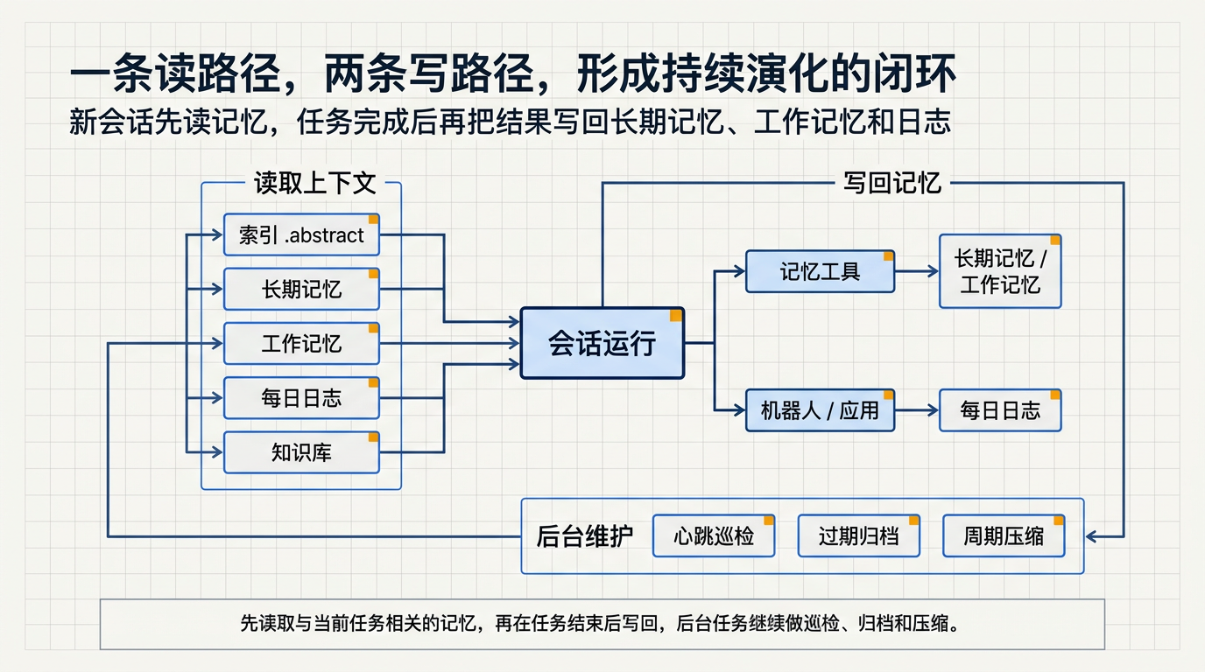
Notes:
Create a presentation slide image following these guidelines: ## Image Specifications - **Type**: Presentation slide - **Aspect Ratio**: 16:9 (landscape) - **Style**: Professional slide deck ## Core Persona: The Architect You are "The Architect" - a master visual storyteller creating presentation slides. Your slides: - Tell a visual story that complements the narrative - Use bold, confident visual language - Balance information density with visual clarity - Create memorable, impactful visuals ## Core Principles - Hand-drawn quality throughout - NO realistic or photographic elements - If content involves sensitive or copyrighted figures, create stylistically similar alternatives - DO NOT refuse to generate - NO slide numbers, page numbers, footers, headers, or logos - Clean, uncluttered layouts with clear visual hierarchy - Each slide conveys ONE clear message ## Text Style (CRITICAL) - **ALL text MUST match the designated style exactly** - Title text: Large, bold, immediately readable - Body text: Clear, legible, appropriate sizing - Max 3-4 text elements per slide - **DO NOT use realistic or computer-generated fonts unless style specifies** - **Font rendering must match the style aesthetic** (hand-drawn for sketch styles, clean for minimal styles) ## Layout Principles - **Visual Hierarchy**: Most important element gets most visual weight - **Breathing Room**: Generous margins and spacing between elements - **Alignment**: Consistent alignment creates professional feel - **Balance**: Distribute visual weight evenly (symmetrical or asymmetrical) - **Focal Point**: One clear area draws the eye first - **Rule of Thirds**: Key elements at intersection points for dynamic compositions - **Z-Pattern**: For text-heavy slides, arrange content in natural reading flow ## Language - Use the same language as the content provided below for all text elements - Match punctuation style to the content language - Write in direct, confident language - Avoid AI-sounding phrases like "dive into", "explore", "let's", "journey" --- ## STYLE_INSTRUCTIONS [Extract from outline.md - do NOT re-read style files] The STYLE_INSTRUCTIONS block from the outline contains: - Design Aesthetic - Background (Texture + Base Color) - Typography (Headlines + Body descriptions) - Color Palette (with hex codes) - Visual Elements - Density Guidelines - Style Rules (Do/Don't) Copy the entire `<STYLE_INSTRUCTIONS>...</STYLE_INSTRUCTIONS>` block from the outline here. --- ## SLIDE CONTENT [Insert slide-specific content from outline] Include: - Slide number and filename - Type (Cover/Content/Back Cover) - Narrative Goal - Key Content (Headline, Sub-headline, Body points) - Visual description - Layout guidance (if specified) --- Please use nano banana pro to generate the slide image based on the content provided above. --- Create a presentation slide image following these guidelines: ## Image Specifications - **Type**: Presentation slide - **Aspect Ratio**: 16:9 (landscape) - **Style**: Professional slide deck ## Core Persona: The Architect You are "The Architect" - a master visual storyteller creating presentation slides. Your slides: - Tell a visual story that complements the narrative - Use bold, confident visual language - Balance information density with visual clarity - Create memorable, impactful visuals ## Core Principles - Hand-drawn quality throughout - NO realistic or photographic elements - NO slide numbers, page numbers, footers, headers, or logos - Clean, uncluttered layouts with clear visual hierarchy - Each slide conveys ONE clear message ## Text Style - Use concise Simplified Chinese for all visible text - Keep labels short and highly legible - Prefer 3-6 compact labels over long paragraphs - Use direct, confident wording --- ## STYLE_INSTRUCTIONS <STYLE_INSTRUCTIONS> Design Aesthetic: A precise blueprint-style presentation for technical onboarding, using engineering-paper structure, cool analytical blues, and clean schematic composition. The visuals should feel authoritative and system-oriented, but simplified enough for beginners to understand at a glance. Prefer diagrammatic storytelling over dense prose. Background: Texture: Subtle light-gray engineering grid overlay with technical drawing precision Base Color: Blueprint Paper (#FAF8F5) Typography: Headlines: Bold geometric sans-serif with precise strokes, high contrast, and calm technical authority Body: Clean readable serif or neutral technical text style, compact but easy to scan in Chinese Color Palette: Primary Text: Deep Slate (#334155) - headlines, labels, and body text Background: Blueprint Paper (#FAF8F5) - primary background Accent 1: Engineering Blue (#2563EB) - key paths, core modules, and emphasis Accent 2: Navy Blue (#1E3A5F) - secondary blocks and supporting structure Accent 3: Light Blue (#BFDBFE) - panels, fills, and grouping areas Accent 4: Amber (#F59E0B) - highlights for value, maintenance, or key actions Visual Elements: - Technical schematics with thin line work and consistent stroke weights - Straight connector lines and 90-degree angles only - Simplified module cards, directory blocks, and flow arrows - Blueprint annotations, brackets, and subtle measurement marks - Clean infographic icons for memory, logs, tools, and background jobs Density Guidelines: - Content per slide: 1 main idea plus 2-3 supporting blocks - Whitespace: generous margins, clear grouping, avoid dense paragraph text Style Rules: Do: Maintain grid alignment, strong visual hierarchy, restrained palette, simplified architecture diagrams, beginner-friendly labeling. Don't: Use photos, hand-drawn effects, decorative flourishes, curved arrows, dense prose blocks, or UI screenshot aesthetics. </STYLE_INSTRUCTIONS> --- ## SLIDE CONTENT - Slide number: 2 of 2 - Filename: 02-slide-read-write-flow.png - Type: Content ### Narrative Goal 让读者看懂记忆模块如何在会话前读取上下文、在会话后写回结果，并通过后台任务持续维护。 ### Key Content - Headline: 一条读路径，两条写路径，形成持续演化的闭环 - Sub-headline: 新会话先读记忆，任务完成后再把结果写回长期记忆、工作记忆和日志 - Bottom note: 先读取与当前任务相关的记忆，再在任务结束后写回，后台任务继续做巡检、归档和压缩。 - Supporting points: - Runner 读取 `.abstract`、长期记忆、工作记忆、daily 与知识 - Agent 通过 MCP 写入记忆，Bot 与 App 会话结束后也会自动落盘 - Heartbeat、Janitor、Compaction 在后台持续巡检、归档和压缩 ### Visible Labels - 读取上下文 - 会话运行 - 写回记忆 - 后台维护 - 索引 .abstract - 长期记忆 - 工作记忆 - 每日日志 - 知识库 - 记忆工具 - 机器人 / 应用 - 心跳巡检 - 过期归档 - 周期压缩 ### Visual Description Create a clean blueprint-style process slide showing a continuous loop. The left side is "读取上下文" with small source nodes for "索引 .abstract", "长期记忆", "工作记忆", "每日日志", and "知识库", all feeding into the center. The center is a strong highlighted block labeled "会话运行". The right side is "写回记忆" with two branches: one for "记忆工具" writing back to memory cards, another for "机器人 / 应用" writing to "每日日志". Along the bottom, add a compact maintenance lane labeled "后台维护" with three small modules: "心跳巡检", "过期归档", and "周期压缩". All visible labels should be primarily Chinese. Add a short one-line explanation in a narrow band at the bottom of the slide: "先读取与当前任务相关的记忆，再在任务结束后写回，后台任务继续做巡检、归档和压缩。". Use a dominant loop arrow to show that memory is continuously read, updated, and maintained. Keep the slide crisp, beginner-friendly, and diagram-first. ### Layout Guidance - Layout: circular-flow - Clear separation of read, run, write, and maintain stages - Dominant loop arrow with supporting branch arrows - Labels should remain short and readable

