Slide 1




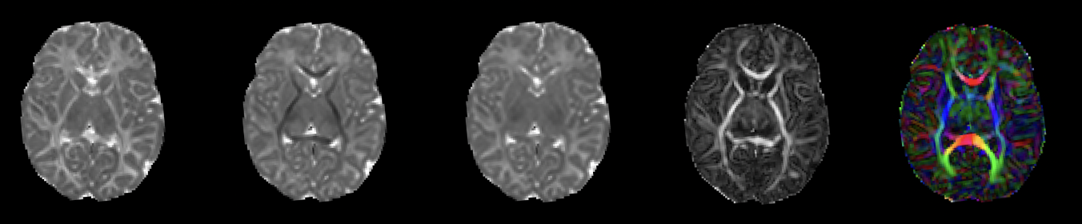
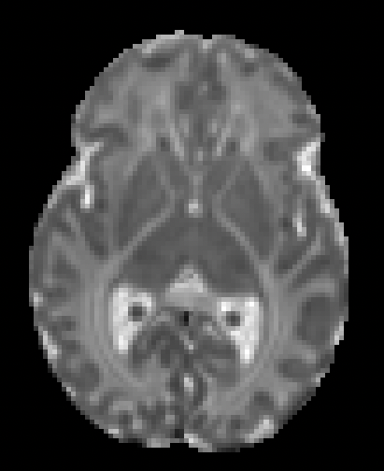
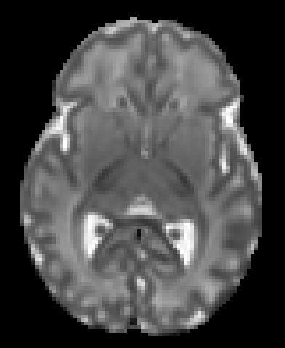
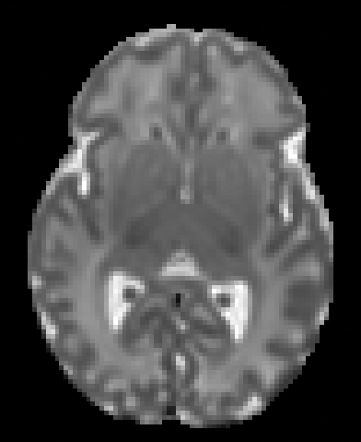
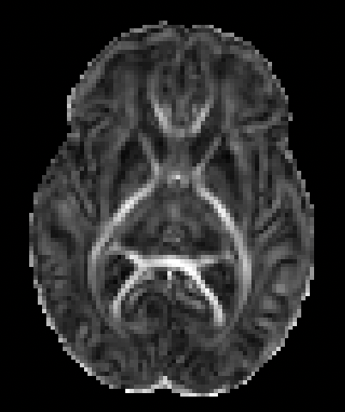
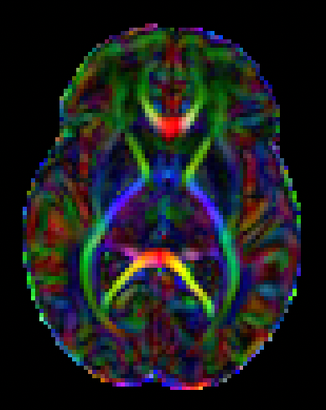
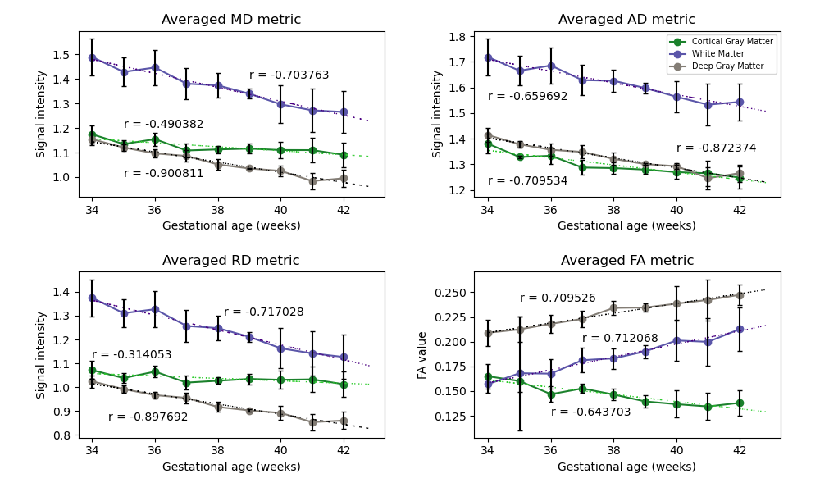
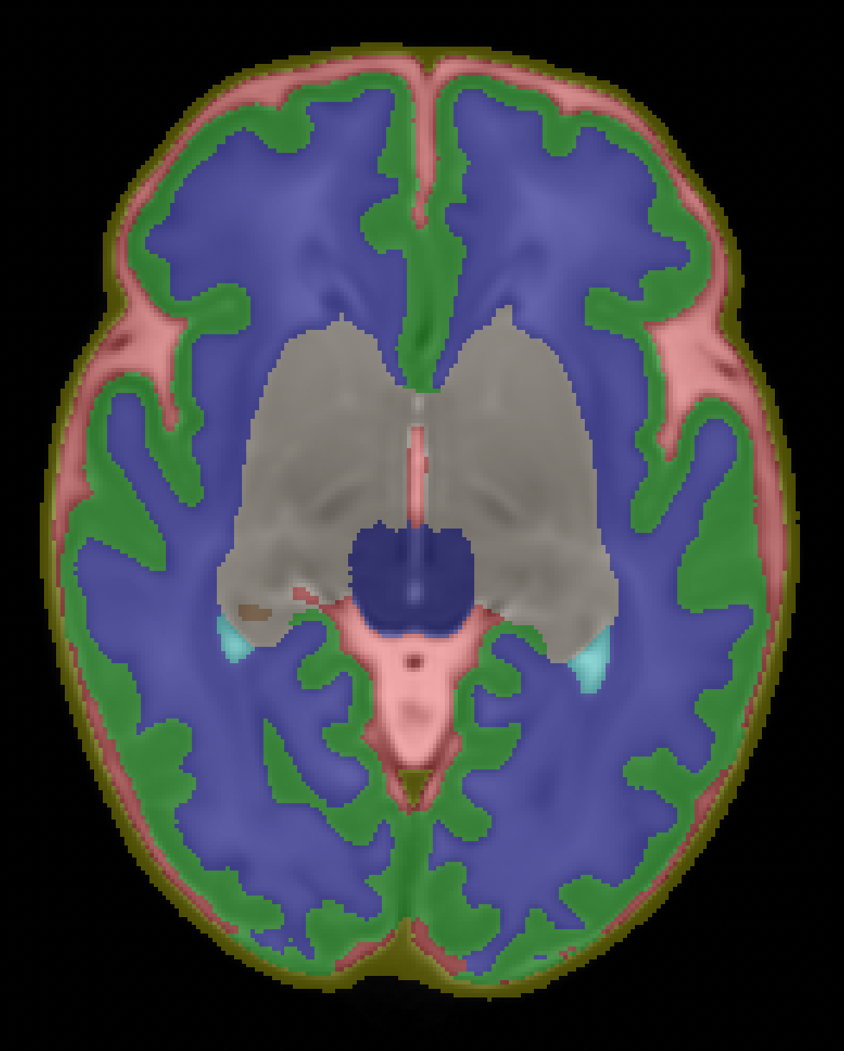




Evaluation of Neonatal Brain Tissue Development Using Diffusion MRI
Kylie Xu^{1*}, Sara Hernandez^{1*}, Erjun Zhang^{2,3}, Dr. Benjamin De Leener^{2,3}, Dr. Lodygensky³, Dr. Hélène Nadeau⁴, Dr. Sylvia Cox⁴
¹Dawson College Health Science Students, Montreal, QC, Canada, ²NeuroPoly Lab, Institue of Biomedical Engineering, Polytechnique Montréal, ³Research Center, Ste-Justine Hospital University Center, Montreal, QC, Canada, ⁴Department of Physics, Dawson College, QC, Canada
MD metric
FA metric
RGB metric
AD metric
RD metric
Introduction
Results
40-week baby
Between 18 and 39 weeks of gestational age, infants experience significant brain volume growth due to the development of white matter (WM) and gray matter (GM) tissues [1].
It is known that infants born prematurely are at higher risk of developing neurological conditions [2].
Internal structures of the WM and GM can be studied at a microscopic level with diffusion MRI, allowing the characterization of the brain’s anatomy in a non-invasive way.
35-week baby
Goal and Hypothesis
Tissue brain development have clear differences between gestational ages:
Differences can be observed from solely observing the DTI metrics of a 35-week baby compared to a 40 week-baby
Axial diffusivity (AD metric) decreases as gestational age increases. Similar results are seen in RD and MD metrics
That suggest a decrease in water content, hence important tissue growth
The FA value increase in WM and DGM
That suggests a tendency for anisotropic diffusion, caused by myelination development
This study aims to use diffusion tensor imaging (DTI) metrics, derived from dMRI scans, to characterize the diffusivity differences in different stages of babies' development.
We expect to see:
A decrease in axial, radial and mean diffusivity (AD, RD and MD metrics)
An Increase in fractional anisotropy (FA metric)
Material & Methods
45 babies were acquired from The
Developing Human Connectome
Project
The babies' gestational age ranges
from 34 to 43 weeks (34 ≤ x < 43).
The diffusivity and fractional
anisotropy metrics were extracted
using DIPY.
The signal intensities were compared in three regions of interest: cortical gray matter (CGM), white matter (WM) and deep gray matter (DGM).
Conclusion
dMRI can be used to understand brain development in neonates
The results of this study are useful in identifying developmental differences in CGM, WM and DGM between infants
Future directives
Open access
Acknowledgements
We thank Erjun Zhang, Dr. Benjamin De Leener and Dr. Lodygensky from the CHU Saint-Jusinte Hospital and TransMedTech research center for their guidance during this summer as well as Dr. Hélène Nadeau and Dr. Sylvia Cox for their support for this project. Thanks to Quebec Bio-imaging Network for supporting this summer internship 2023.
*Equal contribution from the two first authors of the project
References
[1] Knickmeyer, R. C., et al. (2008). A structural MRI study of human brain development from birth to 2 years. The Journal of neuroscience : the official journal of the Society for Neuroscience, 28(47), 12176–12182 ; [2] L., Boardman, J. P., et al. (2008). Specific relations between neurodevelopmental abilities and white matter microstructure in children born preterm. Brain : a journal of neurology, 131(Pt 12), 3201–3208
For a deeper understanding of early tissue development, we could investigate:
Different ROIs
With a larger dataset
GET ACCESS TO OUR REPORT
GET ACCESS TO THE MATERIALS

