Slide 1
Background update in solar neutrino
Jie Zhao, Zeyuan Yu
2019-9-10

Slide 2
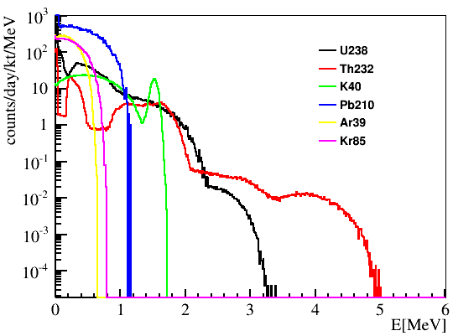
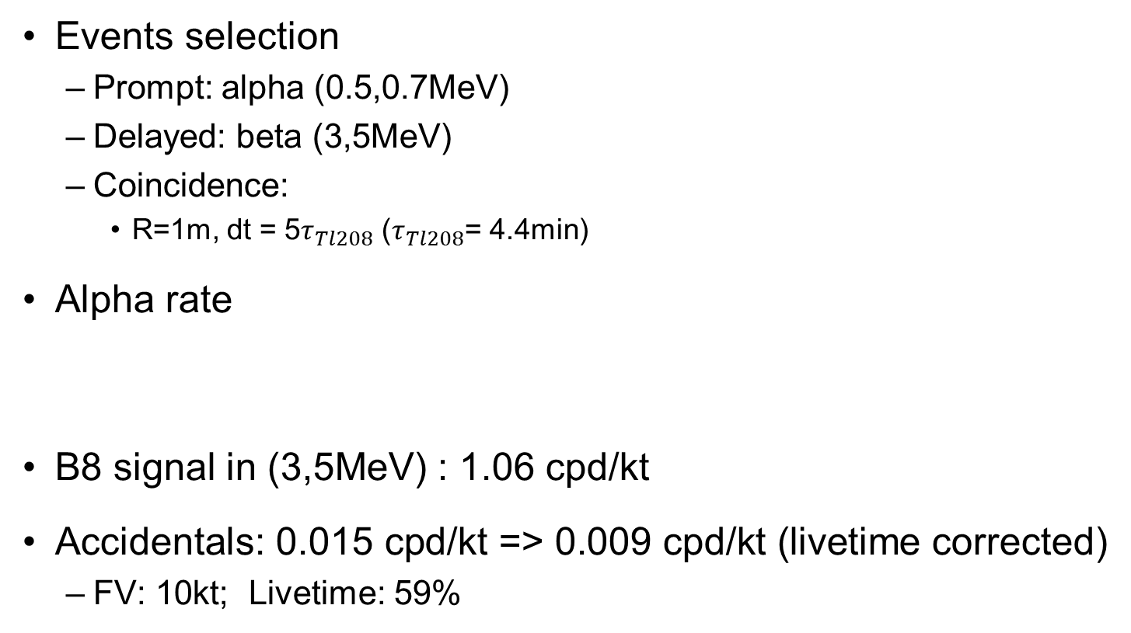
Q1: Tl208 correlated event selection & efficiency
Events selection
Prompt: alpha (0.5,0.7MeV)
Delayed: beta (3,5MeV)
Coincidence:
R=1m, dt = 5$τ_{Tl208}$ ($τ_{Tl208}$= 4.4min)
Alpha rate
B8 signal in (3,5MeV) : 1.06 cpd/kt
Accidentals: 0.015 cpd/kt => 0.009 cpd/kt (livetime corrected)
FV: 10kt; Livetime: 59%
LS
Assume 99% Tl208 efficiency
(0.5,0.7MeV) | U238 | Th232 | Pb210
Alpha rate (cpd/kt) | 31.0 | 10.3 | 219

Slide 3
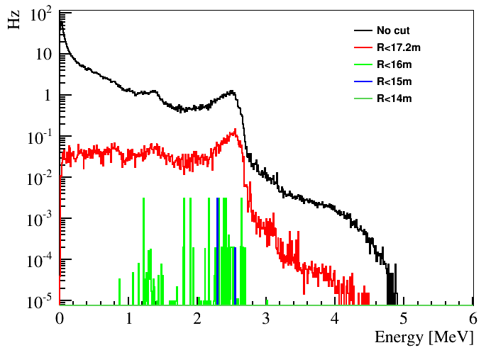
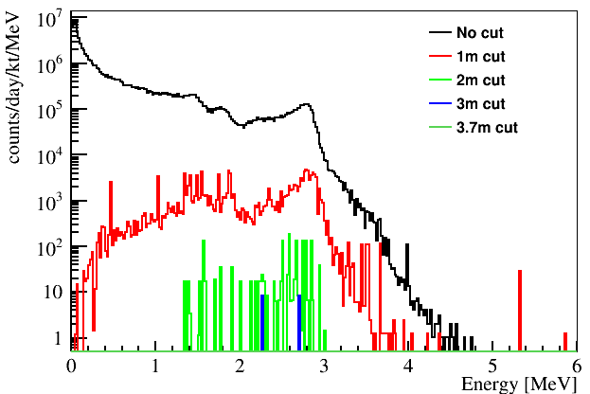
Q2：updated external radioactivity MC (correlation time set)
 | LS最外围10cm | Acrylic | Acrylic外围1mm | Node | Bar | PMT glass
U238 | 1e6 /14 | 1e7 /14 | 9.9e6 /14 | 1e7 /14 | 9.73e7 /14 | 1e8 /14
Th232 | 1e6 /10 | 9.7e6 /10 | 9.8e6 /10 | 1e7 /10 | 6.86e7 /10 | 9.95e7 /10
K40 | 1e6 | 9.4e5 | 1e6 | 9.8e6 | 9.9e6 | 6.23e7
Co60 |  |  |  | 1e6 | 1e7
>2MeV | 16m | 15m
Rate(Hz) | 0.02 | 0.003
old
Correlation time is set to be 1s
All events are separated

Slide 4
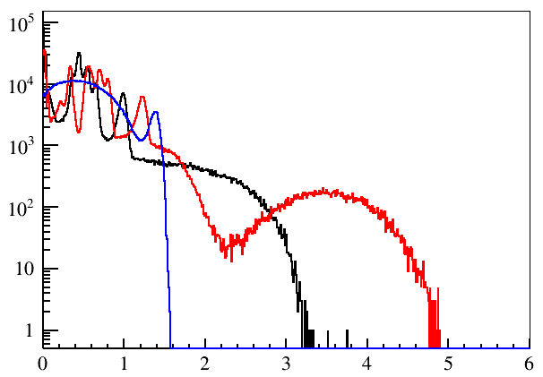
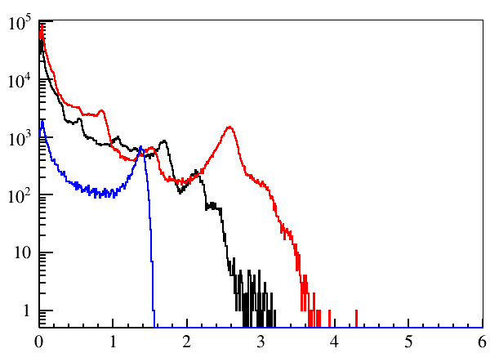
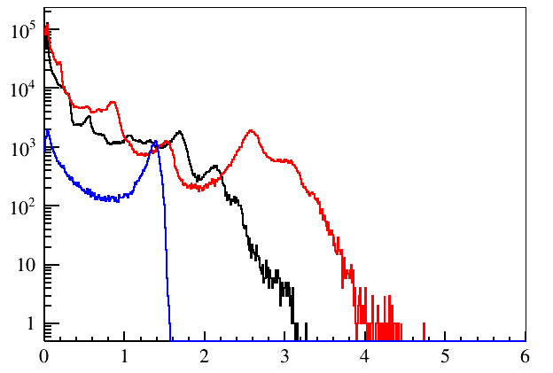
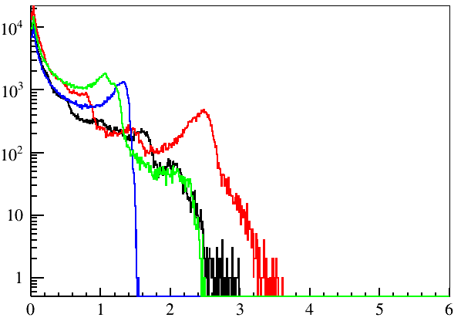
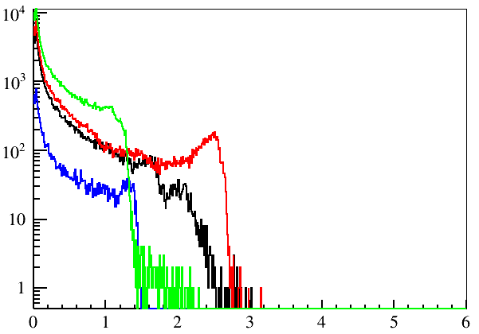
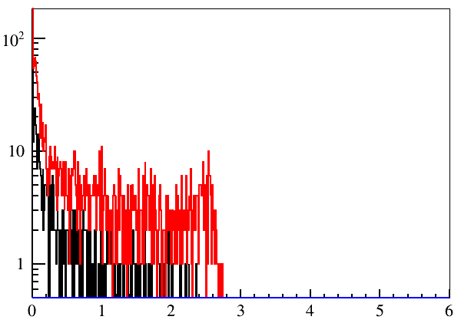
Statistics
Dust inner
Dust outer
Acrylic
Node
Black: U238
Red: Th232
Blue: K40
Green: Co60
Bar
PMT glass

Slide 5
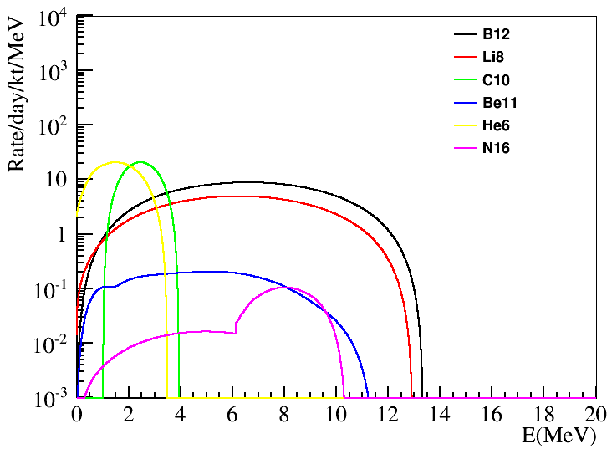
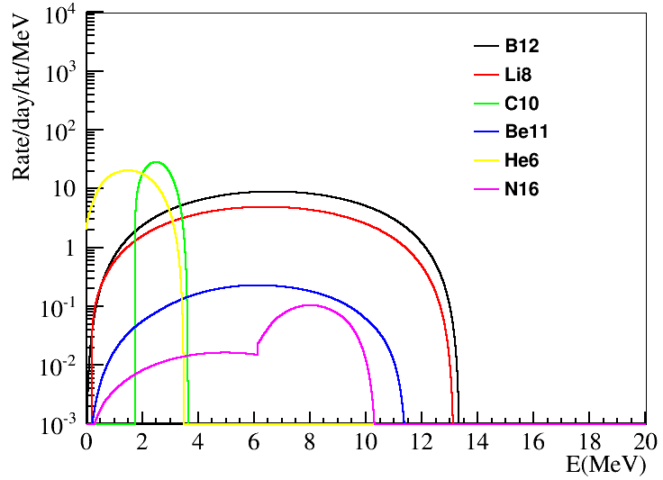
Q3：updated isotope spectra
old
new
Modified:
1. Beta+ spectra from simulation is wrong
2. Add gammas to Be11 beta spectra correctly based on the branch ratio
3. Add alpha to Li8 beta spectra

Slide 6
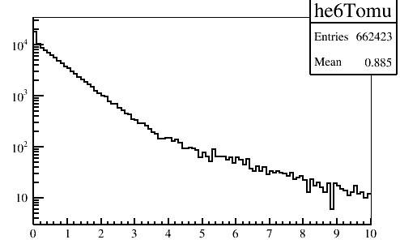
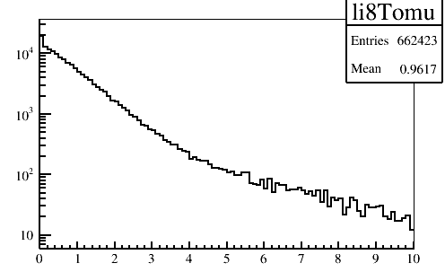
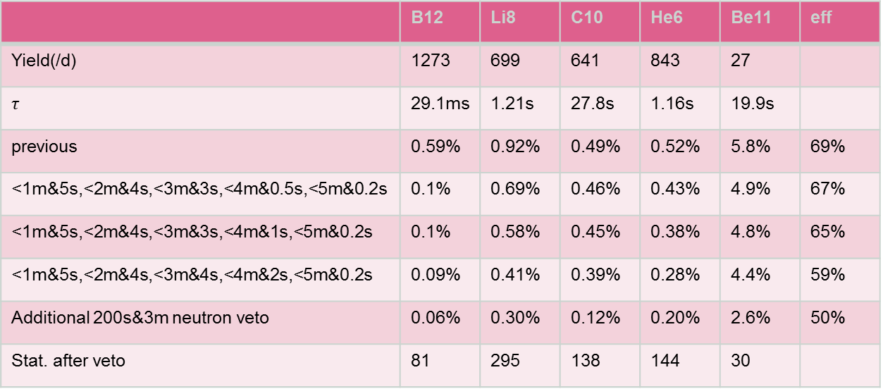
Q4：muon veto optimization (FV=15m)
Ongoing by Zeyuan: trying likelihood method.
 | B12 | Li8 | C10 | He6 | Be11 | eff
Yield(/d) | 1273 | 699 | 641 | 843 | 27
$$τ$$ | 29.1ms | 1.21s | 27.8s | 1.16s | 19.9s
previous | 0.59% | 0.92% | 0.49% | 0.52% | 5.8% | 69%
<1m&5s,<2m&4s,<3m&3s,<4m&0.5s,<5m&0.2s | 0.1% | 0.69% | 0.46% | 0.43% | 4.9% | 67%
<1m&5s,<2m&4s,<3m&3s,<4m&1s,<5m&0.2s | 0.1% | 0.58% | 0.45% | 0.38% | 4.8% | 65%
<1m&5s,<2m&4s,<3m&4s,<4m&2s,<5m&0.2s | 0.09% | 0.41% | 0.39% | 0.28% | 4.4% | 59%
Additional 200s&3m neutron veto | 0.06% | 0.30% | 0.12% | 0.20% | 2.6% | 50%
Stat. after veto | 81 | 295 | 138 | 144 | 30
Will update based on Haoqi’s simulation

Slide 7
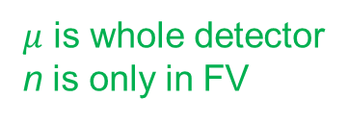

Q5：veto samples for different FV
% | B12 | Li8 | C10 | He6
FV = 17.2m | 0.09 | 0.40 | 0.46 | 0.25
FV = 16m | 0.09 | 0.39 | 0.46 | 0.25
FV = 15m | 0.10 | 0.41 | 0.49 | 0.26
FV = 14m | 0.10 | 0.41 | 0.49 | 0.26
~70 days data
$μ$ and n are whole detector
% | B12 | Li8 | C10 | He6
FV = 17.2m | 0.09 | 0.40 | 0.46 | 0.25
FV = 16m | 0.09 | 0.39 | 0.46 | 0.25
FV = 15m | 0.10 | 0.41 | 0.49 | 0.26
FV = 14m | 0.10 | 0.44 | 0.47 | 0.25
$μ$ is whole detector
n is only in FV
Useful for the event selection criteria in the future data.

Slide 8
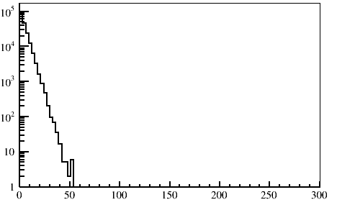
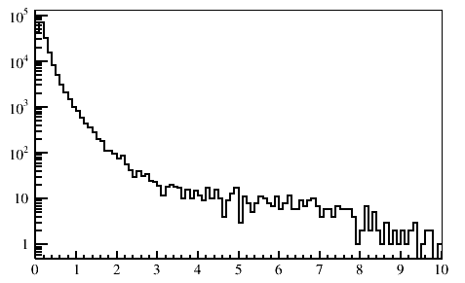
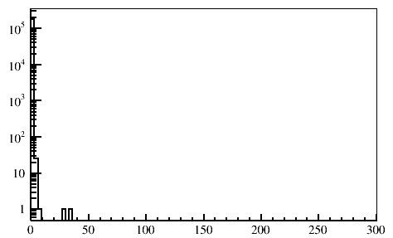
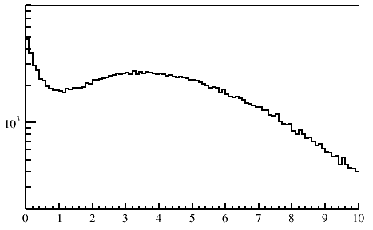
Q6: C10 distribution (other suggestion?)
Time to neutron
Distance to neutron
Time to mu
Distance to mu

Slide 9
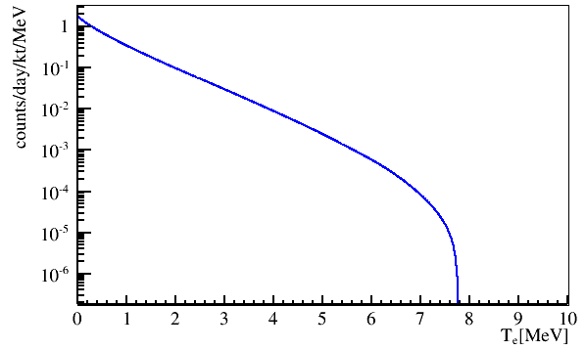
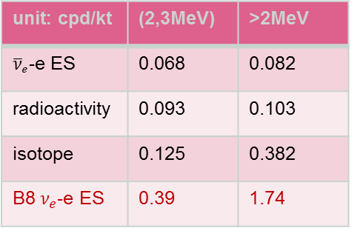

Q7: reactor anti-neutrino
${\overline{ν}}_{e}$-e ES
Small bug has been checked by Zeyuan.
59% efficiency is added.
unit: cpd/kt | (2,3MeV) | >2MeV
${\overline{ν}}_{e}$-e ES | 0.068 | 0.082
radioactivity | 0.093 | 0.103
isotope | 0.125 | 0.382
B8 $ν_{e}$-e ES | 0.39 | 1.74

Slide 10
Q9: FV optimization
External radioactivity
(2-3 MeV) | R<15m
(3-5 MeV) | R<16m
E > 5 MeV | R<17.7m
>2MeV | 16m | 15m
Rate(Hz) | 0.02 | 0.003
Other issue
Water pool muon induced isotopes
Need MC samples to validate, wait for Haoqi’s simulation

Slide 11
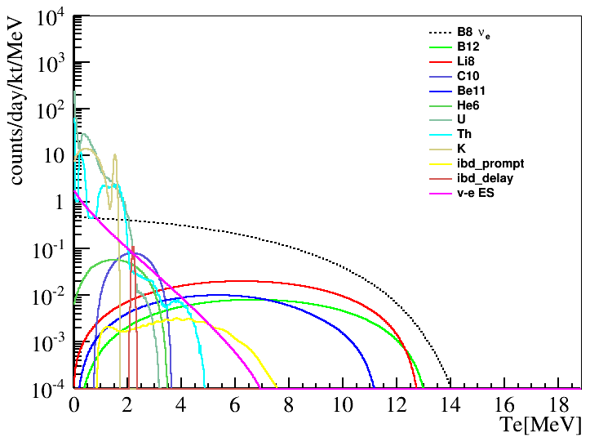
Bkg & signal
Event selection
Optimized isotopes, Th chain with 1% Tl208
cpd/kt | B12 | Li8 | C10 | Be11 | He6 | U238 | Th232 | IBD | v-e ES | Total | B8 signal
(2, 20) | 0.056 | 0.138 | 0.115 | 0.059 | 0.034 | 0.064 | 0.039 | 0.023 | 0.082 | 0.61 | 1.74
(3, 20) | 0.053 | 0.130 | 0.019 | 0.055 | 0.002 | 0 | 0.01 | 0.008 | 0.024 | 0.30 | 1.35
(5, 20) | 0.042 | 0.100 | 0 | 0.041 | 0 | 0 | 0 | 0.003 | 0.002 | 0.19 | 0.73
sys. err | 10% | 10% | 10% | 10% | 10% | 0.3% | 0.3% | 0.3% | 2%

Slide 12
Other issues
Unknown neutron capture
¹³C(α, n)¹⁶O reaction in acrylic, emitted neutron capture
Spontaneous fission from ²³⁸U, emitted neutron capture
High energy gamma from neutron capture on SS
Inefficiency of Bi-Po decays in ²³²Th chain
dead time of FADC, 50ns?
Update muon simulation (done by Haoqi)
Water pool muon induced isotopes,
n-correlation in simulation update
Not good tracking muon in CD?
Correlated events selection cut optimization
Fitter structure
Upturn: how to deal with the coupling of flux and oscillation in fitter
Day-night-asy: two dimension (angle and energy) fitting

