Slide 1








容器化
区块链云化框架
快速评审
策略集
云化管理
挑战
Fabric
命令式部署
原型工具

Slide 2
版本
区块 N
区块头
创世区块
区块 N-1
父区块哈希值
难度
时间戳
随机数
区块 N+1
…
Merkle根
哈希1234
区块体
哈希12
哈希34
哈希1
哈希2
哈希3
哈希4
交易1
交易2
交易3
交易4

Slide 3
区块链部署
平台即服务(PaaS)
BaaS
BaaS
软件即服务
(SaaS)
云服务

Slide 4
区块链应用层
Dashboard
各场景下的应用
接口层
Restful APIs
用户管理
节点管理
合约管理
通道管理
证书管理
日志审计
监控分析
共识机制
区块链服务层
区块链层
Hyperledger Fabric
计算资源管理层
VM
Docker
Swarm
k8s

Slide 5
组织1(Org1)
组织1(Org1)
锚节点
(Anchor Peer)
锚节点
(Anchor Peer)
通道(channel)
1、提交提案
记账节点
(Committing Peer)
提交节点
(Committing Peer)
客户端
2、返回提案响应
链码
(chaincode)
背书节点
(Endorsing Peer)
背书节点
(Endorsing Peer)
SDK
API
CLI
3、检查提案响应
4、生成新区块
排序服务
(Ordering Service)
Membership Service Provider
排序节点
(Orderer Peer)
Ca

Slide 6
世界状态
(World State)
账本
(Ledger)
决定
区块链
(Blockchain)

Slide 7
业务复杂度
汇编
高级语言
方法、库
组件
分布式
微服务
目标
清晰、健壮、易维护
基础设施
业务代码
技术下沉
弹性伸缩
性能
职责明确
设计理念
高内聚、低耦合
容灾防错
低代码
扩展/安全性
无代码

Slide 8
Application definition & Development
Platform
Serverless
Databases
Streaming&
messaging
App definition &
Image building
CI/CD
Distribution
Tools
Hosted
Orchestration & Management
Scheduling&
Orchestraction
Coordination & Service discovery
Remote procedure call
Installer
Security
Service Proxy
API gateway
Service mesh
PaaS
Framework
Runtime
Observability&
Analysis
Cloud native storage
Container runtime
Cloud native
network
Hosted
Platform
Monitoring
Provisioning
Logging
Installable
Platform
Automation & configuration
Container Registry
Security & compliance
Key management
Tracing

Slide 9
注：国内数据来源于云原生社区MeeUp城市站以及Cloud Native + Open Source Virtual Summit China 共131篇workshop
国外数据来源于KubeCon + CloudNativeCon Europe以及KubeCon + CloudNativeCon North America 共311篇workshop

Slide 10
kubectl(user commands)
Internet
Firewall
Master
Node
authentication
authorization
kubelet
proxy
APIs
REST
(pods, services,
rep. controllers)
scheduling
actuator
Pod
Pod
cAdvisor
container
…
Scheduler
controller manager
（replication controller etc.）
Scheduler
Container Runtime
Distributed Watchable
Storage
（implemented via etcd）

Slide 11
设计原则
简单易用
云链结合
灵活扩展
安全可靠
可视运维
合作开放
策略
S2
S3
S1
S6
S7
S8
S10
S11
CRD注入Fabric领域知识
Operator监听helm
复用Fabric容器镜像
PVC+StorageClass存储
RBAC
MSP+Kubernetes密钥存储
Namespace
Prometheus监控体系
命令式透明查询
具体方案
(云化框架)

Slide 12
Use
configs
Helm chart
Ca Resource
Generate
Deployment
Generate
Manager
Role
Orderer Resource
Watches
Secret
Manages
Fabric Network
Peer Resource
Service
kubectl-Command
Service Monitor
Invoke
CURD
PVC
Ca
Orderer
Peer
Channel
Chaincode

Slide 13
Storage
chart
contain chart packages
create chart files
k8s
get/update release
install chart
Helm
Tiller
ApiServer
delete release
Notes:
4-22
version:
port: 7054
cors:
enabled: false
origins:
- "*"
debug: false
crlsizelimit: 512000
tls:
enabled: false
certfile:
keyfile:
clientauth:
type: noclientcert
certfiles:
ca:
name:
keyfile:
certfile:
chainfile:
reenrollIgnoreCertExpiry: false
crl:
expiry: 24h
registry:
maxenrollments: -1
identities:
- name: <<<ADMIN>>>
pass: <<<ADMINPW>>>
type: client
affiliation: ""
attrs:
hf.Registrar.Roles: "*"
hf.Registrar.DelegateRoles: "*"
hf.Revoker: true
hf.IntermediateCA: true
hf.GenCRL: true
hf.Registrar.Attributes: "*"
hf.AffiliationMgr: true
db:
type: sqlite3
datasource: fabric-ca-server.db
tls:
enabled: false
certfiles:
client:
certfile:
keyfile:
ldap:
enabled: false
url: ldap://<adminDN>:<adminPassword>@<host>:<port>/<base>
tls:
certfiles:
client:
certfile:
keyfile:
attribute:
names: ['uid','member']
converters:
- name:
value:
maps:
groups:
- name:
value:
affiliations:
org1:
- department1
- department2
org2:
- department1
signing:
default:
usage:
- digital signature
expiry: 8760h
profiles:
ca:
usage:
- cert sign
- crl sign
expiry: 43800h
caconstraint:
isca: true
maxpathlen: 0
tls:
usage:
- signing
- key encipherment
- server auth
- client auth
- key agreement
expiry: 8760h
csr:
cn: <<<COMMONNAME>>>
keyrequest:
algo: ecdsa
size: 256
names:
- C: US
ST: "North Carolina"
L:
O: Hyperledger
OU: Fabric
hosts:
- <<<MYHOST>>>
- localhost
ca:
expiry: 131400h
pathlength: <<<PATHLENGTH>>>
idemix:
rhpoolsize: 1000
noncesweepinterval: 15m
bccsp:
default: SW
sw:
hash: SHA2
security: 256
filekeystore:
# The directory used for the software file-based keystore
keystore: msp/keystore
cacount:
cafiles:
intermediate:
parentserver:
url:
caname:
enrollment:
hosts:
profile:
label:
tls:
certfiles:
client:
certfile:
keyfile:
cfg:
identities:
passwordattempts: 10
operations:
# host and port for the operations server
listenAddress: 127.0.0.1:9443
# TLS configuration for the operations endpoint
tls:
# TLS enabled
enabled: false
# path to PEM encoded server certificate for the operations server
cert:
file:
# path to PEM encoded server key for the operations server
key:
file:
# require client certificate authentication to access all resources
clientAuthRequired: false
# paths to PEM encoded ca certificates to trust for client authentication
clientRootCAs:
files: []
metrics:
# statsd, prometheus, or disabled
provider: disabled
# statsd configuration
statsd:
# network type: tcp or udp
network: udp
# statsd server address
address: 127.0.0.1:8125
# the interval at which locally cached counters and gauges are pushed
# to statsd; timings are pushed immediately
writeInterval: 10s
# prefix is prepended to all emitted statsd metrics
prefix: server

Slide 14
Register
CRD
Manager
ApiServer
Scheduler
Ca Resource
Ca Controller
Scheme
Reconcile
Watch
Orderer Resource
Orderer Controller
Cache
List
Watch
R
Peer Resource
Peer Controller
Clients
RW
W
Node
Node
Node
Peer Pod
Orderer Pod
Ca Pod
peer
orderer
ca
couchdb
Notes:
4-22
version:
port: 7054
cors:
enabled: false
origins:
- "*"
debug: false
crlsizelimit: 512000
tls:
enabled: false
certfile:
keyfile:
clientauth:
type: noclientcert
certfiles:
ca:
name:
keyfile:
certfile:
chainfile:
reenrollIgnoreCertExpiry: false
crl:
expiry: 24h
registry:
maxenrollments: -1
identities:
- name: <<<ADMIN>>>
pass: <<<ADMINPW>>>
type: client
affiliation: ""
attrs:
hf.Registrar.Roles: "*"
hf.Registrar.DelegateRoles: "*"
hf.Revoker: true
hf.IntermediateCA: true
hf.GenCRL: true
hf.Registrar.Attributes: "*"
hf.AffiliationMgr: true
db:
type: sqlite3
datasource: fabric-ca-server.db
tls:
enabled: false
certfiles:
client:
certfile:
keyfile:
ldap:
enabled: false
url: ldap://<adminDN>:<adminPassword>@<host>:<port>/<base>
tls:
certfiles:
client:
certfile:
keyfile:
attribute:
names: ['uid','member']
converters:
- name:
value:
maps:
groups:
- name:
value:
affiliations:
org1:
- department1
- department2
org2:
- department1
signing:
default:
usage:
- digital signature
expiry: 8760h
profiles:
ca:
usage:
- cert sign
- crl sign
expiry: 43800h
caconstraint:
isca: true
maxpathlen: 0
tls:
usage:
- signing
- key encipherment
- server auth
- client auth
- key agreement
expiry: 8760h
csr:
cn: <<<COMMONNAME>>>
keyrequest:
algo: ecdsa
size: 256
names:
- C: US
ST: "North Carolina"
L:
O: Hyperledger
OU: Fabric
hosts:
- <<<MYHOST>>>
- localhost
ca:
expiry: 131400h
pathlength: <<<PATHLENGTH>>>
idemix:
rhpoolsize: 1000
noncesweepinterval: 15m
bccsp:
default: SW
sw:
hash: SHA2
security: 256
filekeystore:
# The directory used for the software file-based keystore
keystore: msp/keystore
cacount:
cafiles:
intermediate:
parentserver:
url:
caname:
enrollment:
hosts:
profile:
label:
tls:
certfiles:
client:
certfile:
keyfile:
cfg:
identities:
passwordattempts: 10
operations:
# host and port for the operations server
listenAddress: 127.0.0.1:9443
# TLS configuration for the operations endpoint
tls:
# TLS enabled
enabled: false
# path to PEM encoded server certificate for the operations server
cert:
file:
# path to PEM encoded server key for the operations server
key:
file:
# require client certificate authentication to access all resources
clientAuthRequired: false
# paths to PEM encoded ca certificates to trust for client authentication
clientRootCAs:
files: []
metrics:
# statsd, prometheus, or disabled
provider: disabled
# statsd configuration
statsd:
# network type: tcp or udp
network: udp
# statsd server address
address: 127.0.0.1:8125
# the interval at which locally cached counters and gauges are pushed
# to statsd; timings are pushed immediately
writeInterval: 10s
# prefix is prepended to all emitted statsd metrics
prefix: server

Slide 15
Current CR State
spec:
size: 3
Desired CR State
spec:
size: 4
Triggers
Reconciliation
Controller
Compare
k8s
Watch
Reconcile
Desired State
Reconciled
Helm chart
config
New CR State
spec:
size: 4
Notes:
4-22
version:
port: 7054
cors:
enabled: false
origins:
- "*"
debug: false
crlsizelimit: 512000
tls:
enabled: false
certfile:
keyfile:
clientauth:
type: noclientcert
certfiles:
ca:
name:
keyfile:
certfile:
chainfile:
reenrollIgnoreCertExpiry: false
crl:
expiry: 24h
registry:
maxenrollments: -1
identities:
- name: <<<ADMIN>>>
pass: <<<ADMINPW>>>
type: client
affiliation: ""
attrs:
hf.Registrar.Roles: "*"
hf.Registrar.DelegateRoles: "*"
hf.Revoker: true
hf.IntermediateCA: true
hf.GenCRL: true
hf.Registrar.Attributes: "*"
hf.AffiliationMgr: true
db:
type: sqlite3
datasource: fabric-ca-server.db
tls:
enabled: false
certfiles:
client:
certfile:
keyfile:
ldap:
enabled: false
url: ldap://<adminDN>:<adminPassword>@<host>:<port>/<base>
tls:
certfiles:
client:
certfile:
keyfile:
attribute:
names: ['uid','member']
converters:
- name:
value:
maps:
groups:
- name:
value:
affiliations:
org1:
- department1
- department2
org2:
- department1
signing:
default:
usage:
- digital signature
expiry: 8760h
profiles:
ca:
usage:
- cert sign
- crl sign
expiry: 43800h
caconstraint:
isca: true
maxpathlen: 0
tls:
usage:
- signing
- key encipherment
- server auth
- client auth
- key agreement
expiry: 8760h
csr:
cn: <<<COMMONNAME>>>
keyrequest:
algo: ecdsa
size: 256
names:
- C: US
ST: "North Carolina"
L:
O: Hyperledger
OU: Fabric
hosts:
- <<<MYHOST>>>
- localhost
ca:
expiry: 131400h
pathlength: <<<PATHLENGTH>>>
idemix:
rhpoolsize: 1000
noncesweepinterval: 15m
bccsp:
default: SW
sw:
hash: SHA2
security: 256
filekeystore:
# The directory used for the software file-based keystore
keystore: msp/keystore
cacount:
cafiles:
intermediate:
parentserver:
url:
caname:
enrollment:
hosts:
profile:
label:
tls:
certfiles:
client:
certfile:
keyfile:
cfg:
identities:
passwordattempts: 10
operations:
# host and port for the operations server
listenAddress: 127.0.0.1:9443
# TLS configuration for the operations endpoint
tls:
# TLS enabled
enabled: false
# path to PEM encoded server certificate for the operations server
cert:
file:
# path to PEM encoded server key for the operations server
key:
file:
# require client certificate authentication to access all resources
clientAuthRequired: false
# paths to PEM encoded ca certificates to trust for client authentication
clientRootCAs:
files: []
metrics:
# statsd, prometheus, or disabled
provider: disabled
# statsd configuration
statsd:
# network type: tcp or udp
network: udp
# statsd server address
address: 127.0.0.1:8125
# the interval at which locally cached counters and gauges are pushed
# to statsd; timings are pushed immediately
writeInterval: 10s
# prefix is prepended to all emitted statsd metrics
prefix: server

Slide 16
Inspect
Top
Commit
Register
AddOrg
Approve
Enroll
Join
Join
Query
透明查询
Delete
Delete
Delete
Generate
Delete
Invoke
Create
Create
Create
Create
Add
Install
核心流程
Ca
Peer
Orderer
通道
锚节点
链码
中枢控制
CRD注入Fabric领域知识
Operator监听helm
Namespace资源隔离
RBAC
Prometheus监控体系
基础能力
PVC+StorageClass存储
MSP+Kubernetes密钥存储
底层支撑
Kubernetes云原生支撑平台
复用Fabric容器镜像
易用性
可迁移性
安全性
可视运维
透明性

Slide 17
Enroll
Generate
Inspect
DeleteAnch
Invoke
Commit
透明查询
Delete
Join
Top
AddAnch
QuInstalled
Approve
Create
Register
AddOrg
JoinChan
Install
Query
核心流程
Ca
Peer
Orderer
通道
锚节点
链码
中枢控制
CRD注入Fabric领域知识
Operator监听helm
Namespace资源隔离
RBAC
Prometheus监控体系
基础能力
MSP+Kubernetes密钥存储
PVC+StorageClass存储
底层支撑
Kubernetes云原生支撑平台
复用Fabric容器镜像

Slide 18
Enroll
Generate
Inspect
Invoke
Commit
命令操作
Delete
Join
Top
Install
Approve
Create
Register
Add
DeleteAnch
Query
核心流程
Ca
Peer
Orderer
通道
链码
中枢控制
CRD注入Fabric领域知识
Operator监听helm
Namespace
资源隔离
RBAC
Prometheus监控体系
基础能力
MSP+Kubernetes密钥存储
PVC+StorageClass
底层支撑
Kubernetes云原生支撑平台
复用Fabric容器镜像

Slide 19
Enroll
Generate
Inspect
DeleteAnch
Invoke
Commit
命令操作
Delete
Join
Top
AddAnch
QuInstalled
Approve
Create
Register
AddOrg
JoinChan
Install
Query
核心流程
Ca
Peer
Orderer
通道
锚节点
链码
中枢控制
CRD注入Fabric领域知识
Operator监听helm
Namespace资源隔离
RBAC
Prometheus监控体系
基础能力
MSP+Kubernetes密钥存储
PVC+StorageClass存储
底层支撑
Kubernetes云原生支撑平台
复用Fabric容器镜像

Slide 22
Notes:
4-22
version:
port: 7054
cors:
enabled: false
origins:
- "*"
debug: false
crlsizelimit: 512000
tls:
enabled: false
certfile:
keyfile:
clientauth:
type: noclientcert
certfiles:
ca:
name:
keyfile:
certfile:
chainfile:
reenrollIgnoreCertExpiry: false
crl:
expiry: 24h
registry:
maxenrollments: -1
identities:
- name: <<<ADMIN>>>
pass: <<<ADMINPW>>>
type: client
affiliation: ""
attrs:
hf.Registrar.Roles: "*"
hf.Registrar.DelegateRoles: "*"
hf.Revoker: true
hf.IntermediateCA: true
hf.GenCRL: true
hf.Registrar.Attributes: "*"
hf.AffiliationMgr: true
db:
type: sqlite3
datasource: fabric-ca-server.db
tls:
enabled: false
certfiles:
client:
certfile:
keyfile:
ldap:
enabled: false
url: ldap://<adminDN>:<adminPassword>@<host>:<port>/<base>
tls:
certfiles:
client:
certfile:
keyfile:
attribute:
names: ['uid','member']
converters:
- name:
value:
maps:
groups:
- name:
value:
affiliations:
org1:
- department1
- department2
org2:
- department1
signing:
default:
usage:
- digital signature
expiry: 8760h
profiles:
ca:
usage:
- cert sign
- crl sign
expiry: 43800h
caconstraint:
isca: true
maxpathlen: 0
tls:
usage:
- signing
- key encipherment
- server auth
- client auth
- key agreement
expiry: 8760h
csr:
cn: <<<COMMONNAME>>>
keyrequest:
algo: ecdsa
size: 256
names:
- C: US
ST: "North Carolina"
L:
O: Hyperledger
OU: Fabric
hosts:
- <<<MYHOST>>>
- localhost
ca:
expiry: 131400h
pathlength: <<<PATHLENGTH>>>
idemix:
rhpoolsize: 1000
noncesweepinterval: 15m
bccsp:
default: SW
sw:
hash: SHA2
security: 256
filekeystore:
# The directory used for the software file-based keystore
keystore: msp/keystore
cacount:
cafiles:
intermediate:
parentserver:
url:
caname:
enrollment:
hosts:
profile:
label:
tls:
certfiles:
client:
certfile:
keyfile:
cfg:
identities:
passwordattempts: 10
operations:
# host and port for the operations server
listenAddress: 127.0.0.1:9443
# TLS configuration for the operations endpoint
tls:
# TLS enabled
enabled: false
# path to PEM encoded server certificate for the operations server
cert:
file:
# path to PEM encoded server key for the operations server
key:
file:
# require client certificate authentication to access all resources
clientAuthRequired: false
# paths to PEM encoded ca certificates to trust for client authentication
clientRootCAs:
files: []
metrics:
# statsd, prometheus, or disabled
provider: disabled
# statsd configuration
statsd:
# network type: tcp or udp
network: udp
# statsd server address
address: 127.0.0.1:8125
# the interval at which locally cached counters and gauges are pushed
# to statsd; timings are pushed immediately
writeInterval: 10s
# prefix is prepended to all emitted statsd metrics
prefix: server

Slide 23
Notes:
4-22
version:
port: 7054
cors:
enabled: false
origins:
- "*"
debug: false
crlsizelimit: 512000
tls:
enabled: false
certfile:
keyfile:
clientauth:
type: noclientcert
certfiles:
ca:
name:
keyfile:
certfile:
chainfile:
reenrollIgnoreCertExpiry: false
crl:
expiry: 24h
registry:
maxenrollments: -1
identities:
- name: <<<ADMIN>>>
pass: <<<ADMINPW>>>
type: client
affiliation: ""
attrs:
hf.Registrar.Roles: "*"
hf.Registrar.DelegateRoles: "*"
hf.Revoker: true
hf.IntermediateCA: true
hf.GenCRL: true
hf.Registrar.Attributes: "*"
hf.AffiliationMgr: true
db:
type: sqlite3
datasource: fabric-ca-server.db
tls:
enabled: false
certfiles:
client:
certfile:
keyfile:
ldap:
enabled: false
url: ldap://<adminDN>:<adminPassword>@<host>:<port>/<base>
tls:
certfiles:
client:
certfile:
keyfile:
attribute:
names: ['uid','member']
converters:
- name:
value:
maps:
groups:
- name:
value:
affiliations:
org1:
- department1
- department2
org2:
- department1
signing:
default:
usage:
- digital signature
expiry: 8760h
profiles:
ca:
usage:
- cert sign
- crl sign
expiry: 43800h
caconstraint:
isca: true
maxpathlen: 0
tls:
usage:
- signing
- key encipherment
- server auth
- client auth
- key agreement
expiry: 8760h
csr:
cn: <<<COMMONNAME>>>
keyrequest:
algo: ecdsa
size: 256
names:
- C: US
ST: "North Carolina"
L:
O: Hyperledger
OU: Fabric
hosts:
- <<<MYHOST>>>
- localhost
ca:
expiry: 131400h
pathlength: <<<PATHLENGTH>>>
idemix:
rhpoolsize: 1000
noncesweepinterval: 15m
bccsp:
default: SW
sw:
hash: SHA2
security: 256
filekeystore:
# The directory used for the software file-based keystore
keystore: msp/keystore
cacount:
cafiles:
intermediate:
parentserver:
url:
caname:
enrollment:
hosts:
profile:
label:
tls:
certfiles:
client:
certfile:
keyfile:
cfg:
identities:
passwordattempts: 10
operations:
# host and port for the operations server
listenAddress: 127.0.0.1:9443
# TLS configuration for the operations endpoint
tls:
# TLS enabled
enabled: false
# path to PEM encoded server certificate for the operations server
cert:
file:
# path to PEM encoded server key for the operations server
key:
file:
# require client certificate authentication to access all resources
clientAuthRequired: false
# paths to PEM encoded ca certificates to trust for client authentication
clientRootCAs:
files: []
metrics:
# statsd, prometheus, or disabled
provider: disabled
# statsd configuration
statsd:
# network type: tcp or udp
network: udp
# statsd server address
address: 127.0.0.1:8125
# the interval at which locally cached counters and gauges are pushed
# to statsd; timings are pushed immediately
writeInterval: 10s
# prefix is prepended to all emitted statsd metrics
prefix: server

Slide 24
开始
是否退出
N
N
finalizers
Y
DT
N
Y
finalizers
Y
结束
N
删除finalizers字段
添加finalizers字段
helm release
N
更新
Y
复制已有证书文件
生成config
结束
helm chart安装/更新
Notes:
4-22
version:
port: 7054
cors:
enabled: false
origins:
- "*"
debug: false
crlsizelimit: 512000
tls:
enabled: false
certfile:
keyfile:
clientauth:
type: noclientcert
certfiles:
ca:
name:
keyfile:
certfile:
chainfile:
reenrollIgnoreCertExpiry: false
crl:
expiry: 24h
registry:
maxenrollments: -1
identities:
- name: <<<ADMIN>>>
pass: <<<ADMINPW>>>
type: client
affiliation: ""
attrs:
hf.Registrar.Roles: "*"
hf.Registrar.DelegateRoles: "*"
hf.Revoker: true
hf.IntermediateCA: true
hf.GenCRL: true
hf.Registrar.Attributes: "*"
hf.AffiliationMgr: true
db:
type: sqlite3
datasource: fabric-ca-server.db
tls:
enabled: false
certfiles:
client:
certfile:
keyfile:
ldap:
enabled: false
url: ldap://<adminDN>:<adminPassword>@<host>:<port>/<base>
tls:
certfiles:
client:
certfile:
keyfile:
attribute:
names: ['uid','member']
converters:
- name:
value:
maps:
groups:
- name:
value:
affiliations:
org1:
- department1
- department2
org2:
- department1
signing:
default:
usage:
- digital signature
expiry: 8760h
profiles:
ca:
usage:
- cert sign
- crl sign
expiry: 43800h
caconstraint:
isca: true
maxpathlen: 0
tls:
usage:
- signing
- key encipherment
- server auth
- client auth
- key agreement
expiry: 8760h
csr:
cn: <<<COMMONNAME>>>
keyrequest:
algo: ecdsa
size: 256
names:
- C: US
ST: "North Carolina"
L:
O: Hyperledger
OU: Fabric
hosts:
- <<<MYHOST>>>
- localhost
ca:
expiry: 131400h
pathlength: <<<PATHLENGTH>>>
idemix:
rhpoolsize: 1000
noncesweepinterval: 15m
bccsp:
default: SW
sw:
hash: SHA2
security: 256
filekeystore:
# The directory used for the software file-based keystore
keystore: msp/keystore
cacount:
cafiles:
intermediate:
parentserver:
url:
caname:
enrollment:
hosts:
profile:
label:
tls:
certfiles:
client:
certfile:
keyfile:
cfg:
identities:
passwordattempts: 10
operations:
# host and port for the operations server
listenAddress: 127.0.0.1:9443
# TLS configuration for the operations endpoint
tls:
# TLS enabled
enabled: false
# path to PEM encoded server certificate for the operations server
cert:
file:
# path to PEM encoded server key for the operations server
key:
file:
# require client certificate authentication to access all resources
clientAuthRequired: false
# paths to PEM encoded ca certificates to trust for client authentication
clientRootCAs:
files: []
metrics:
# statsd, prometheus, or disabled
provider: disabled
# statsd configuration
statsd:
# network type: tcp or udp
network: udp
# statsd server address
address: 127.0.0.1:8125
# the interval at which locally cached counters and gauges are pushed
# to statsd; timings are pushed immediately
writeInterval: 10s
# prefix is prepended to all emitted statsd metrics
prefix: server

Slide 25
Notes:
4-22
version:
port: 7054
cors:
enabled: false
origins:
- "*"
debug: false
crlsizelimit: 512000
tls:
enabled: false
certfile:
keyfile:
clientauth:
type: noclientcert
certfiles:
ca:
name:
keyfile:
certfile:
chainfile:
reenrollIgnoreCertExpiry: false
crl:
expiry: 24h
registry:
maxenrollments: -1
identities:
- name: <<<ADMIN>>>
pass: <<<ADMINPW>>>
type: client
affiliation: ""
attrs:
hf.Registrar.Roles: "*"
hf.Registrar.DelegateRoles: "*"
hf.Revoker: true
hf.IntermediateCA: true
hf.GenCRL: true
hf.Registrar.Attributes: "*"
hf.AffiliationMgr: true
db:
type: sqlite3
datasource: fabric-ca-server.db
tls:
enabled: false
certfiles:
client:
certfile:
keyfile:
ldap:
enabled: false
url: ldap://<adminDN>:<adminPassword>@<host>:<port>/<base>
tls:
certfiles:
client:
certfile:
keyfile:
attribute:
names: ['uid','member']
converters:
- name:
value:
maps:
groups:
- name:
value:
affiliations:
org1:
- department1
- department2
org2:
- department1
signing:
default:
usage:
- digital signature
expiry: 8760h
profiles:
ca:
usage:
- cert sign
- crl sign
expiry: 43800h
caconstraint:
isca: true
maxpathlen: 0
tls:
usage:
- signing
- key encipherment
- server auth
- client auth
- key agreement
expiry: 8760h
csr:
cn: <<<COMMONNAME>>>
keyrequest:
algo: ecdsa
size: 256
names:
- C: US
ST: "North Carolina"
L:
O: Hyperledger
OU: Fabric
hosts:
- <<<MYHOST>>>
- localhost
ca:
expiry: 131400h
pathlength: <<<PATHLENGTH>>>
idemix:
rhpoolsize: 1000
noncesweepinterval: 15m
bccsp:
default: SW
sw:
hash: SHA2
security: 256
filekeystore:
# The directory used for the software file-based keystore
keystore: msp/keystore
cacount:
cafiles:
intermediate:
parentserver:
url:
caname:
enrollment:
hosts:
profile:
label:
tls:
certfiles:
client:
certfile:
keyfile:
cfg:
identities:
passwordattempts: 10
operations:
# host and port for the operations server
listenAddress: 127.0.0.1:9443
# TLS configuration for the operations endpoint
tls:
# TLS enabled
enabled: false
# path to PEM encoded server certificate for the operations server
cert:
file:
# path to PEM encoded server key for the operations server
key:
file:
# require client certificate authentication to access all resources
clientAuthRequired: false
# paths to PEM encoded ca certificates to trust for client authentication
clientRootCAs:
files: []
metrics:
# statsd, prometheus, or disabled
provider: disabled
# statsd configuration
statsd:
# network type: tcp or udp
network: udp
# statsd server address
address: 127.0.0.1:8125
# the interval at which locally cached counters and gauges are pushed
# to statsd; timings are pushed immediately
writeInterval: 10s
# prefix is prepended to all emitted statsd metrics
prefix: server

Slide 26
I
ClusterRoleBinding
ClusterRole
ServiceAccounts
Rule
fabriccas/status
get,list,watch
II
登记用户
cert, key
x509编码
保存
Secret

Slide 27
Peer Pod
create pod
couchDBPVC
couchDB
管理员
PV
StorageClass

Slide 28
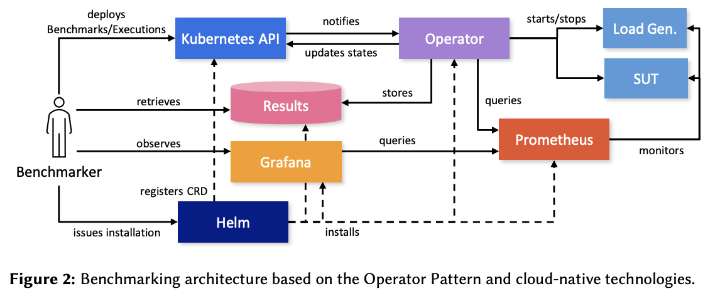
Manager
Notes:
4-22
version:
port: 7054
cors:
enabled: false
origins:
- "*"
debug: false
crlsizelimit: 512000
tls:
enabled: false
certfile:
keyfile:
clientauth:
type: noclientcert
certfiles:
ca:
name:
keyfile:
certfile:
chainfile:
reenrollIgnoreCertExpiry: false
crl:
expiry: 24h
registry:
maxenrollments: -1
identities:
- name: <<<ADMIN>>>
pass: <<<ADMINPW>>>
type: client
affiliation: ""
attrs:
hf.Registrar.Roles: "*"
hf.Registrar.DelegateRoles: "*"
hf.Revoker: true
hf.IntermediateCA: true
hf.GenCRL: true
hf.Registrar.Attributes: "*"
hf.AffiliationMgr: true
db:
type: sqlite3
datasource: fabric-ca-server.db
tls:
enabled: false
certfiles:
client:
certfile:
keyfile:
ldap:
enabled: false
url: ldap://<adminDN>:<adminPassword>@<host>:<port>/<base>
tls:
certfiles:
client:
certfile:
keyfile:
attribute:
names: ['uid','member']
converters:
- name:
value:
maps:
groups:
- name:
value:
affiliations:
org1:
- department1
- department2
org2:
- department1
signing:
default:
usage:
- digital signature
expiry: 8760h
profiles:
ca:
usage:
- cert sign
- crl sign
expiry: 43800h
caconstraint:
isca: true
maxpathlen: 0
tls:
usage:
- signing
- key encipherment
- server auth
- client auth
- key agreement
expiry: 8760h
csr:
cn: <<<COMMONNAME>>>
keyrequest:
algo: ecdsa
size: 256
names:
- C: US
ST: "North Carolina"
L:
O: Hyperledger
OU: Fabric
hosts:
- <<<MYHOST>>>
- localhost
ca:
expiry: 131400h
pathlength: <<<PATHLENGTH>>>
idemix:
rhpoolsize: 1000
noncesweepinterval: 15m
bccsp:
default: SW
sw:
hash: SHA2
security: 256
filekeystore:
# The directory used for the software file-based keystore
keystore: msp/keystore
cacount:
cafiles:
intermediate:
parentserver:
url:
caname:
enrollment:
hosts:
profile:
label:
tls:
certfiles:
client:
certfile:
keyfile:
cfg:
identities:
passwordattempts: 10
operations:
# host and port for the operations server
listenAddress: 127.0.0.1:9443
# TLS configuration for the operations endpoint
tls:
# TLS enabled
enabled: false
# path to PEM encoded server certificate for the operations server
cert:
file:
# path to PEM encoded server key for the operations server
key:
file:
# require client certificate authentication to access all resources
clientAuthRequired: false
# paths to PEM encoded ca certificates to trust for client authentication
clientRootCAs:
files: []
metrics:
# statsd, prometheus, or disabled
provider: disabled
# statsd configuration
statsd:
# network type: tcp or udp
network: udp
# statsd server address
address: 127.0.0.1:8125
# the interval at which locally cached counters and gauges are pushed
# to statsd; timings are pushed immediately
writeInterval: 10s
# prefix is prepended to all emitted statsd metrics
prefix: server

Slide 29
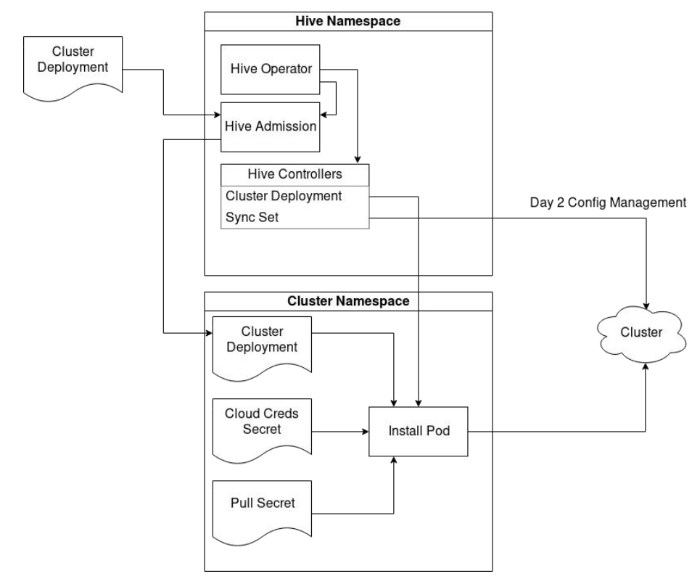
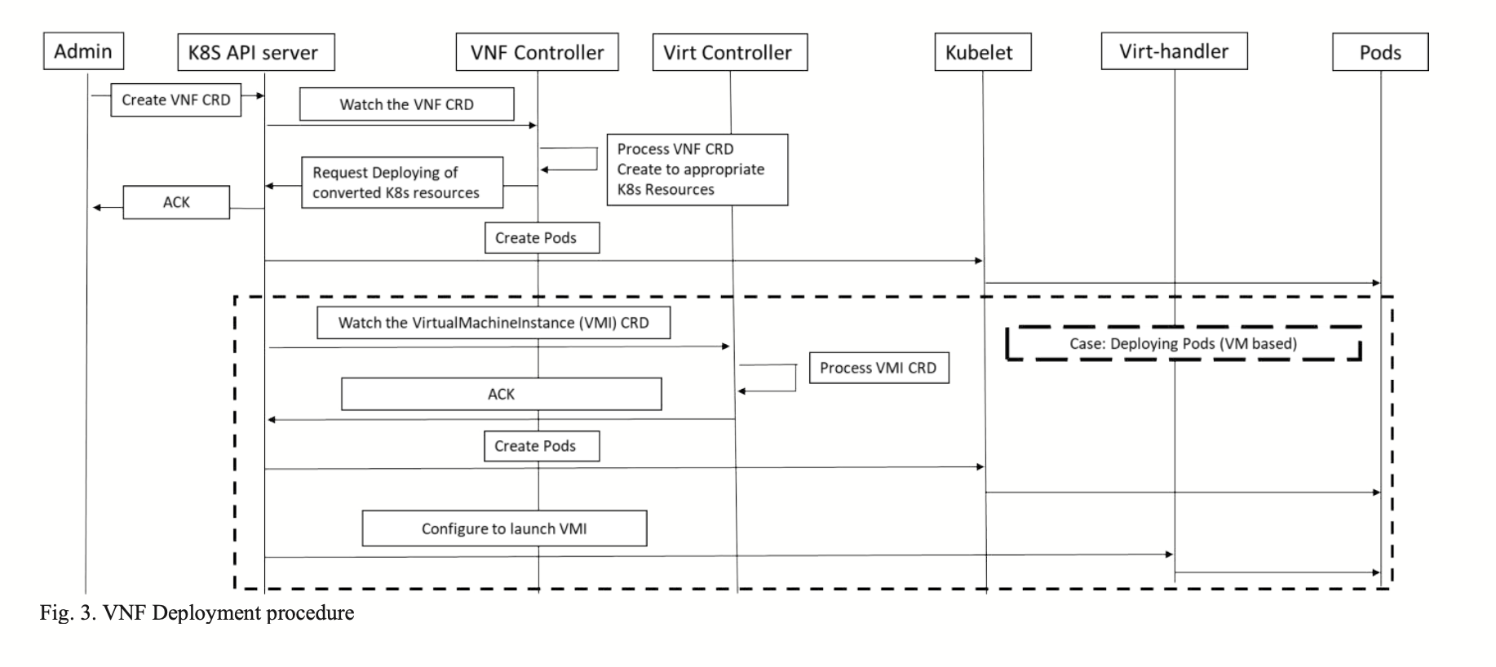
Notes:
4-22
version:
port: 7054
cors:
enabled: false
origins:
- "*"
debug: false
crlsizelimit: 512000
tls:
enabled: false
certfile:
keyfile:
clientauth:
type: noclientcert
certfiles:
ca:
name:
keyfile:
certfile:
chainfile:
reenrollIgnoreCertExpiry: false
crl:
expiry: 24h
registry:
maxenrollments: -1
identities:
- name: <<<ADMIN>>>
pass: <<<ADMINPW>>>
type: client
affiliation: ""
attrs:
hf.Registrar.Roles: "*"
hf.Registrar.DelegateRoles: "*"
hf.Revoker: true
hf.IntermediateCA: true
hf.GenCRL: true
hf.Registrar.Attributes: "*"
hf.AffiliationMgr: true
db:
type: sqlite3
datasource: fabric-ca-server.db
tls:
enabled: false
certfiles:
client:
certfile:
keyfile:
ldap:
enabled: false
url: ldap://<adminDN>:<adminPassword>@<host>:<port>/<base>
tls:
certfiles:
client:
certfile:
keyfile:
attribute:
names: ['uid','member']
converters:
- name:
value:
maps:
groups:
- name:
value:
affiliations:
org1:
- department1
- department2
org2:
- department1
signing:
default:
usage:
- digital signature
expiry: 8760h
profiles:
ca:
usage:
- cert sign
- crl sign
expiry: 43800h
caconstraint:
isca: true
maxpathlen: 0
tls:
usage:
- signing
- key encipherment
- server auth
- client auth
- key agreement
expiry: 8760h
csr:
cn: <<<COMMONNAME>>>
keyrequest:
algo: ecdsa
size: 256
names:
- C: US
ST: "North Carolina"
L:
O: Hyperledger
OU: Fabric
hosts:
- <<<MYHOST>>>
- localhost
ca:
expiry: 131400h
pathlength: <<<PATHLENGTH>>>
idemix:
rhpoolsize: 1000
noncesweepinterval: 15m
bccsp:
default: SW
sw:
hash: SHA2
security: 256
filekeystore:
# The directory used for the software file-based keystore
keystore: msp/keystore
cacount:
cafiles:
intermediate:
parentserver:
url:
caname:
enrollment:
hosts:
profile:
label:
tls:
certfiles:
client:
certfile:
keyfile:
cfg:
identities:
passwordattempts: 10
operations:
# host and port for the operations server
listenAddress: 127.0.0.1:9443
# TLS configuration for the operations endpoint
tls:
# TLS enabled
enabled: false
# path to PEM encoded server certificate for the operations server
cert:
file:
# path to PEM encoded server key for the operations server
key:
file:
# require client certificate authentication to access all resources
clientAuthRequired: false
# paths to PEM encoded ca certificates to trust for client authentication
clientRootCAs:
files: []
metrics:
# statsd, prometheus, or disabled
provider: disabled
# statsd configuration
statsd:
# network type: tcp or udp
network: udp
# statsd server address
address: 127.0.0.1:8125
# the interval at which locally cached counters and gauges are pushed
# to statsd; timings are pushed immediately
writeInterval: 10s
# prefix is prepended to all emitted statsd metrics
prefix: server

Slide 30
Auto Pilot:
Auto-scaling, auto-healing, etc.
Lv. V
Deep Insights:
App monitoring, alerts, log, etc.
Lv. IV
Full Lifecycle:
App lifecycle, Data backup and restoration
Lv. III
Seamless Upgrades:
Patch and minor version upgrades supported
Lv. II
Basic Install:
Basic configuration management
Lv. I
Notes:
4-22
version:
port: 7054
cors:
enabled: false
origins:
- "*"
debug: false
crlsizelimit: 512000
tls:
enabled: false
certfile:
keyfile:
clientauth:
type: noclientcert
certfiles:
ca:
name:
keyfile:
certfile:
chainfile:
reenrollIgnoreCertExpiry: false
crl:
expiry: 24h
registry:
maxenrollments: -1
identities:
- name: <<<ADMIN>>>
pass: <<<ADMINPW>>>
type: client
affiliation: ""
attrs:
hf.Registrar.Roles: "*"
hf.Registrar.DelegateRoles: "*"
hf.Revoker: true
hf.IntermediateCA: true
hf.GenCRL: true
hf.Registrar.Attributes: "*"
hf.AffiliationMgr: true
db:
type: sqlite3
datasource: fabric-ca-server.db
tls:
enabled: false
certfiles:
client:
certfile:
keyfile:
ldap:
enabled: false
url: ldap://<adminDN>:<adminPassword>@<host>:<port>/<base>
tls:
certfiles:
client:
certfile:
keyfile:
attribute:
names: ['uid','member']
converters:
- name:
value:
maps:
groups:
- name:
value:
affiliations:
org1:
- department1
- department2
org2:
- department1
signing:
default:
usage:
- digital signature
expiry: 8760h
profiles:
ca:
usage:
- cert sign
- crl sign
expiry: 43800h
caconstraint:
isca: true
maxpathlen: 0
tls:
usage:
- signing
- key encipherment
- server auth
- client auth
- key agreement
expiry: 8760h
csr:
cn: <<<COMMONNAME>>>
keyrequest:
algo: ecdsa
size: 256
names:
- C: US
ST: "North Carolina"
L:
O: Hyperledger
OU: Fabric
hosts:
- <<<MYHOST>>>
- localhost
ca:
expiry: 131400h
pathlength: <<<PATHLENGTH>>>
idemix:
rhpoolsize: 1000
noncesweepinterval: 15m
bccsp:
default: SW
sw:
hash: SHA2
security: 256
filekeystore:
# The directory used for the software file-based keystore
keystore: msp/keystore
cacount:
cafiles:
intermediate:
parentserver:
url:
caname:
enrollment:
hosts:
profile:
label:
tls:
certfiles:
client:
certfile:
keyfile:
cfg:
identities:
passwordattempts: 10
operations:
# host and port for the operations server
listenAddress: 127.0.0.1:9443
# TLS configuration for the operations endpoint
tls:
# TLS enabled
enabled: false
# path to PEM encoded server certificate for the operations server
cert:
file:
# path to PEM encoded server key for the operations server
key:
file:
# require client certificate authentication to access all resources
clientAuthRequired: false
# paths to PEM encoded ca certificates to trust for client authentication
clientRootCAs:
files: []
metrics:
# statsd, prometheus, or disabled
provider: disabled
# statsd configuration
statsd:
# network type: tcp or udp
network: udp
# statsd server address
address: 127.0.0.1:8125
# the interval at which locally cached counters and gauges are pushed
# to statsd; timings are pushed immediately
writeInterval: 10s
# prefix is prepended to all emitted statsd metrics
prefix: server

Slide 31
Orderer
Org1
Ca
Admin
MSP
Ca
Ca
MSP
Ca
Admin
MSP
Ca
Ca
MSP
TLS
Ca
Ca
CLI
Ca
CLI
Orderer
MSP
Orderer
TLS
Ca
MSP
TLS
Ca
MSP
Peer
CLI
Org1
MSP
Peer

Slide 32
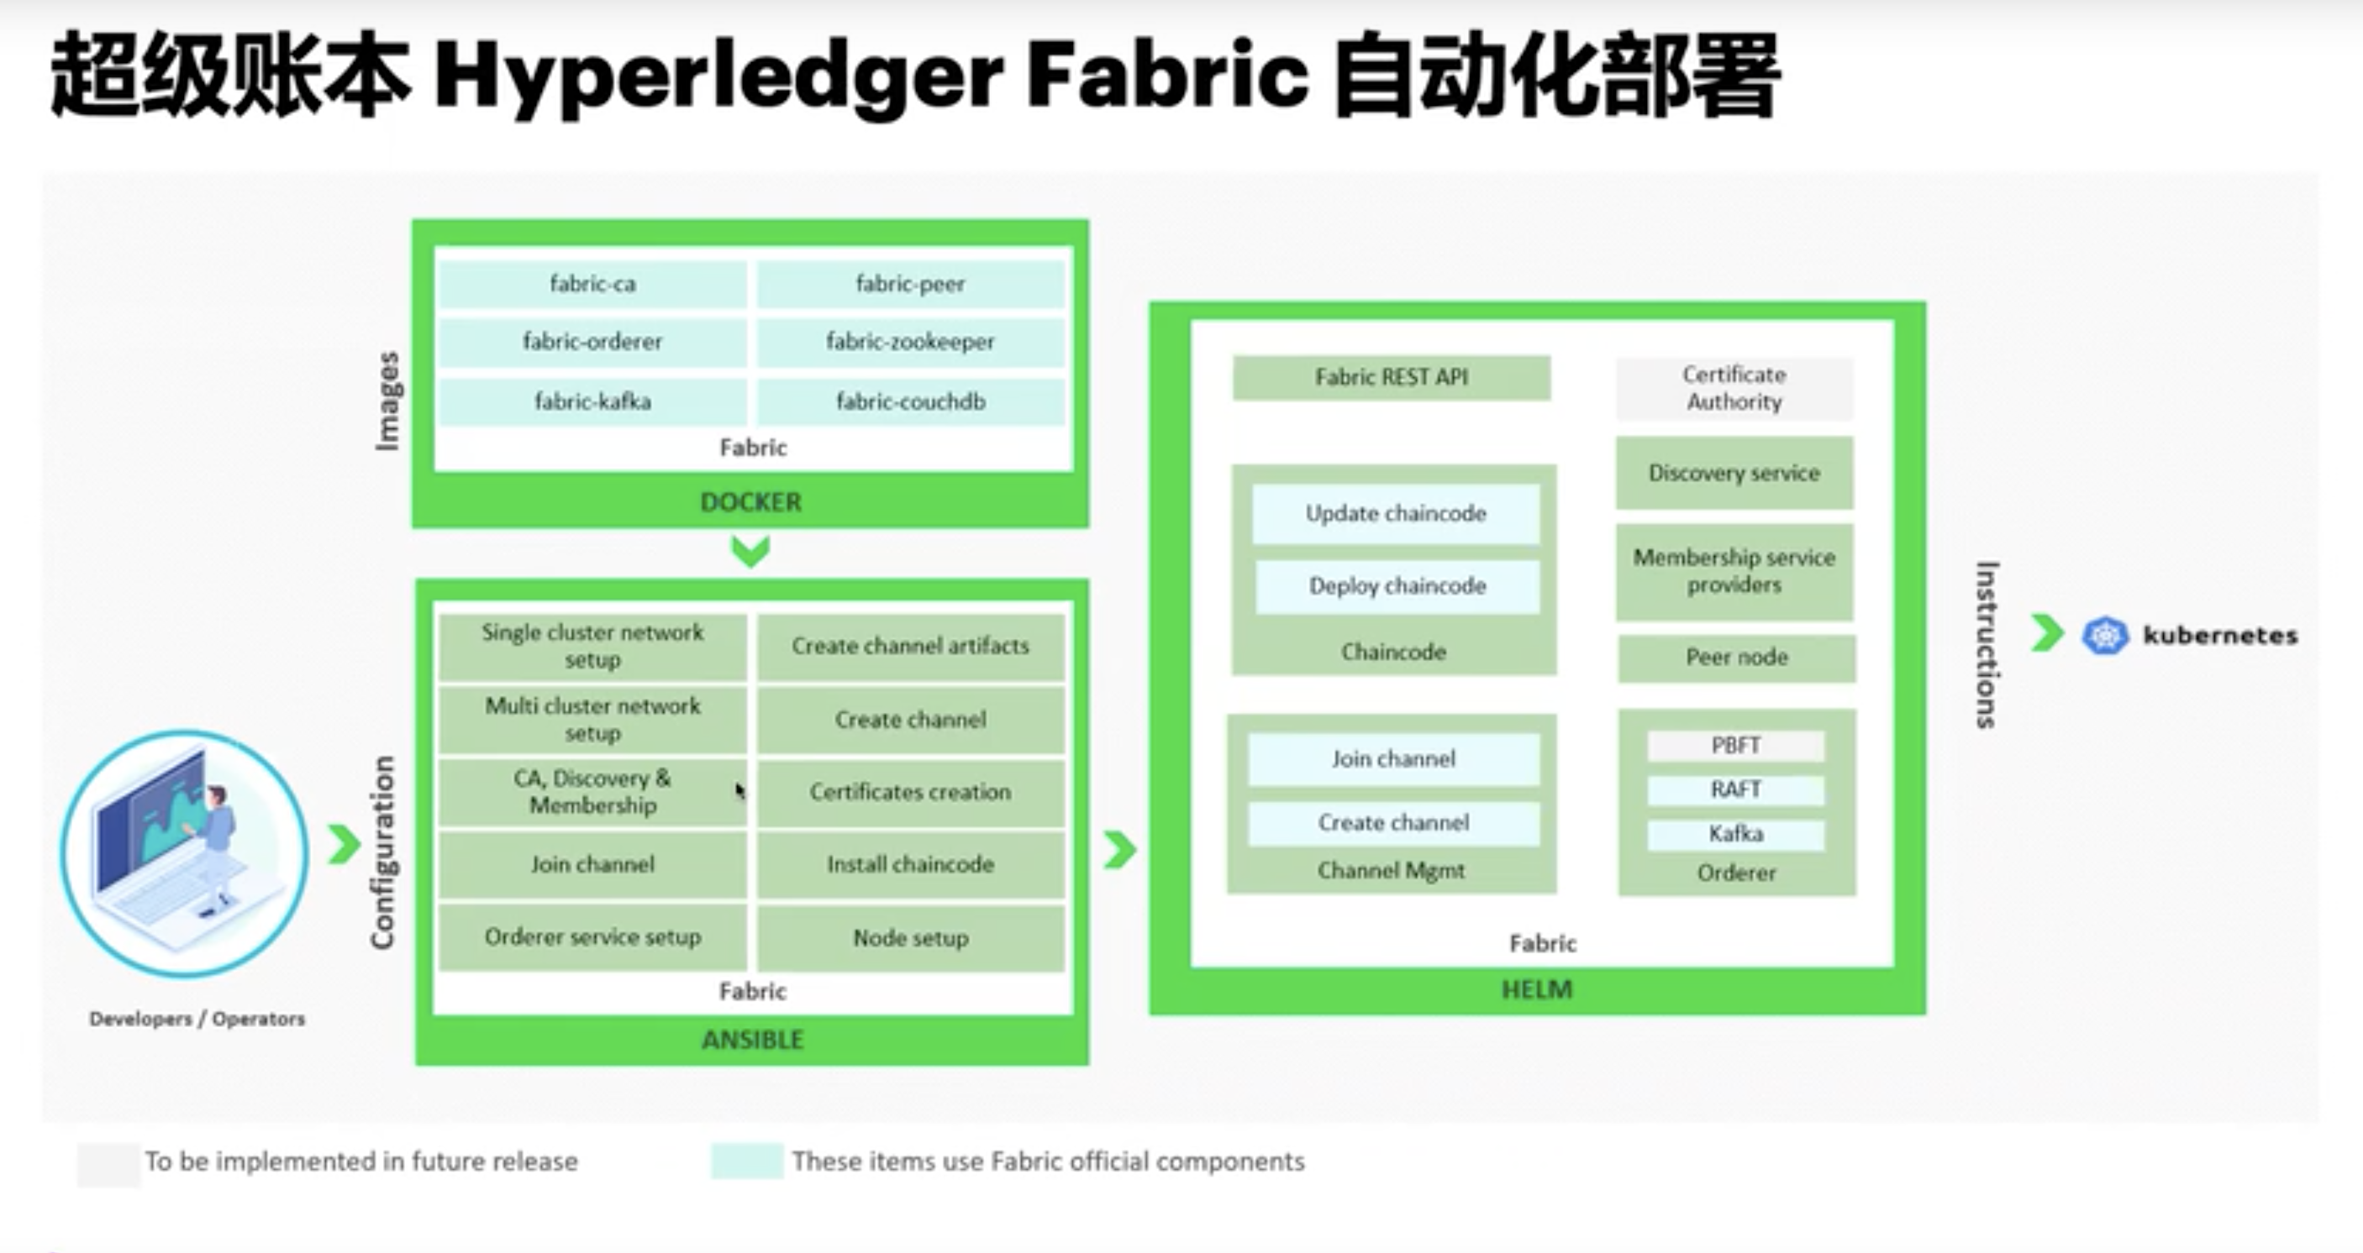
Notes:
4-22
version:
port: 7054
cors:
enabled: false
origins:
- "*"
debug: false
crlsizelimit: 512000
tls:
enabled: false
certfile:
keyfile:
clientauth:
type: noclientcert
certfiles:
ca:
name:
keyfile:
certfile:
chainfile:
reenrollIgnoreCertExpiry: false
crl:
expiry: 24h
registry:
maxenrollments: -1
identities:
- name: <<<ADMIN>>>
pass: <<<ADMINPW>>>
type: client
affiliation: ""
attrs:
hf.Registrar.Roles: "*"
hf.Registrar.DelegateRoles: "*"
hf.Revoker: true
hf.IntermediateCA: true
hf.GenCRL: true
hf.Registrar.Attributes: "*"
hf.AffiliationMgr: true
db:
type: sqlite3
datasource: fabric-ca-server.db
tls:
enabled: false
certfiles:
client:
certfile:
keyfile:
ldap:
enabled: false
url: ldap://<adminDN>:<adminPassword>@<host>:<port>/<base>
tls:
certfiles:
client:
certfile:
keyfile:
attribute:
names: ['uid','member']
converters:
- name:
value:
maps:
groups:
- name:
value:
affiliations:
org1:
- department1
- department2
org2:
- department1
signing:
default:
usage:
- digital signature
expiry: 8760h
profiles:
ca:
usage:
- cert sign
- crl sign
expiry: 43800h
caconstraint:
isca: true
maxpathlen: 0
tls:
usage:
- signing
- key encipherment
- server auth
- client auth
- key agreement
expiry: 8760h
csr:
cn: <<<COMMONNAME>>>
keyrequest:
algo: ecdsa
size: 256
names:
- C: US
ST: "North Carolina"
L:
O: Hyperledger
OU: Fabric
hosts:
- <<<MYHOST>>>
- localhost
ca:
expiry: 131400h
pathlength: <<<PATHLENGTH>>>
idemix:
rhpoolsize: 1000
noncesweepinterval: 15m
bccsp:
default: SW
sw:
hash: SHA2
security: 256
filekeystore:
# The directory used for the software file-based keystore
keystore: msp/keystore
cacount:
cafiles:
intermediate:
parentserver:
url:
caname:
enrollment:
hosts:
profile:
label:
tls:
certfiles:
client:
certfile:
keyfile:
cfg:
identities:
passwordattempts: 10
operations:
# host and port for the operations server
listenAddress: 127.0.0.1:9443
# TLS configuration for the operations endpoint
tls:
# TLS enabled
enabled: false
# path to PEM encoded server certificate for the operations server
cert:
file:
# path to PEM encoded server key for the operations server
key:
file:
# require client certificate authentication to access all resources
clientAuthRequired: false
# paths to PEM encoded ca certificates to trust for client authentication
clientRootCAs:
files: []
metrics:
# statsd, prometheus, or disabled
provider: disabled
# statsd configuration
statsd:
# network type: tcp or udp
network: udp
# statsd server address
address: 127.0.0.1:8125
# the interval at which locally cached counters and gauges are pushed
# to statsd; timings are pushed immediately
writeInterval: 10s
# prefix is prepended to all emitted statsd metrics
prefix: server

Slide 33

需求背景
Hyperledger Fabric Operator
云原生时代下Fabric管理工具
利用Kubernetes
更简单、更原生的
管理Fabric
72%的工程师在云原生生产中使用Kubernetes^{[3]}
使用kubectl命令管理Fabric,
显示于k8s-dashboard
声明式自动化配置静态组件，如: CA、HF网络组件
可以方便的迁移到支持Kubernetes的任何云
复用Kubernetes API公共功能如CRUD、watch、内置认证
命令式创建动态通道、链码
Kubebuilder
Hyperledger Fabric
[3] CNCF Cloud Native Survey China 2019
33

