Slide 1
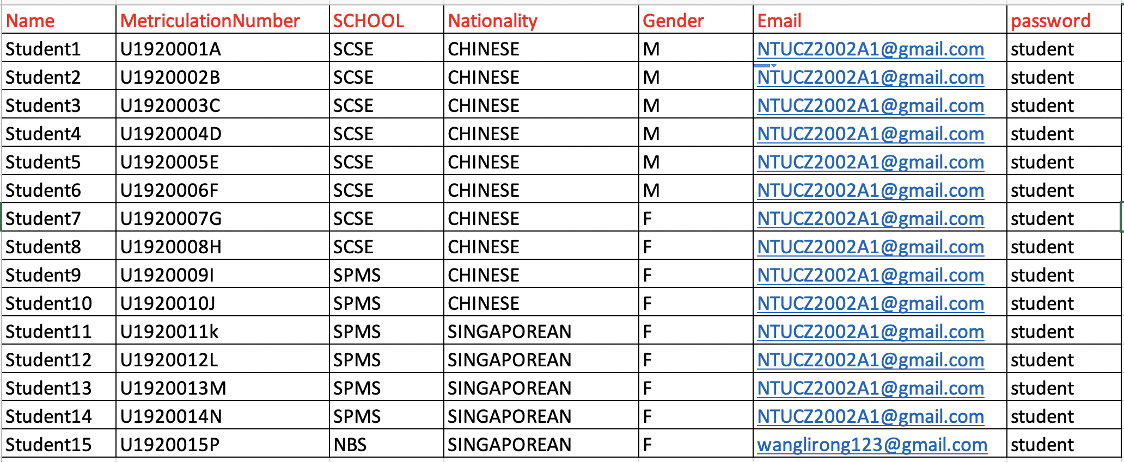

Slide 2
Course Code
CZ2002
CZ2001
LS9001
MH2500
BU8401
Course
Index
10198
19352
10401
10402
13801
13008
10197
Student
Enrolled
Student1-10
Student11--15
Student7-14
Student3-10
Student1-10
Student13-14
Student 5-10

Slide 3
Access Time
SCSE:
Start:
16 Nov 2020 09:00
End: (before the test)
17 Nov 2020 09:00
End: (changed by admin)
28 Nov 2020 09:00
SPMS:
Start:
10 Nov 2020 09:00
Start:
30 Nov 2020 09:00

Slide 4
