Slide 1
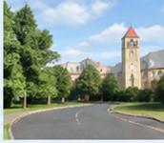

Image encoding
Dual branches
Text-guided screening
Interaction
Fusion & refinement
Offline CBP
Text Prototype
Local Branch
Extraction
Local
Attention
Input image
Text-Guided Proxy
Anchor Generation
Scale-Gated
Feature Fusion
Shared
CLIP
Local
Encoder
Sliding Window
Partition
Stitch Global
Stitch Branch
Lightweight
Token Selection
Global
Hierarchical
Attention
Cross-Modal
Consistency
Refinement
Selected tokens
Output
Segmentation Map
Visual features
Proxy / fusion
Text prototypes

