Slide 1


H5新增
主讲人：kerwin

Slide 2
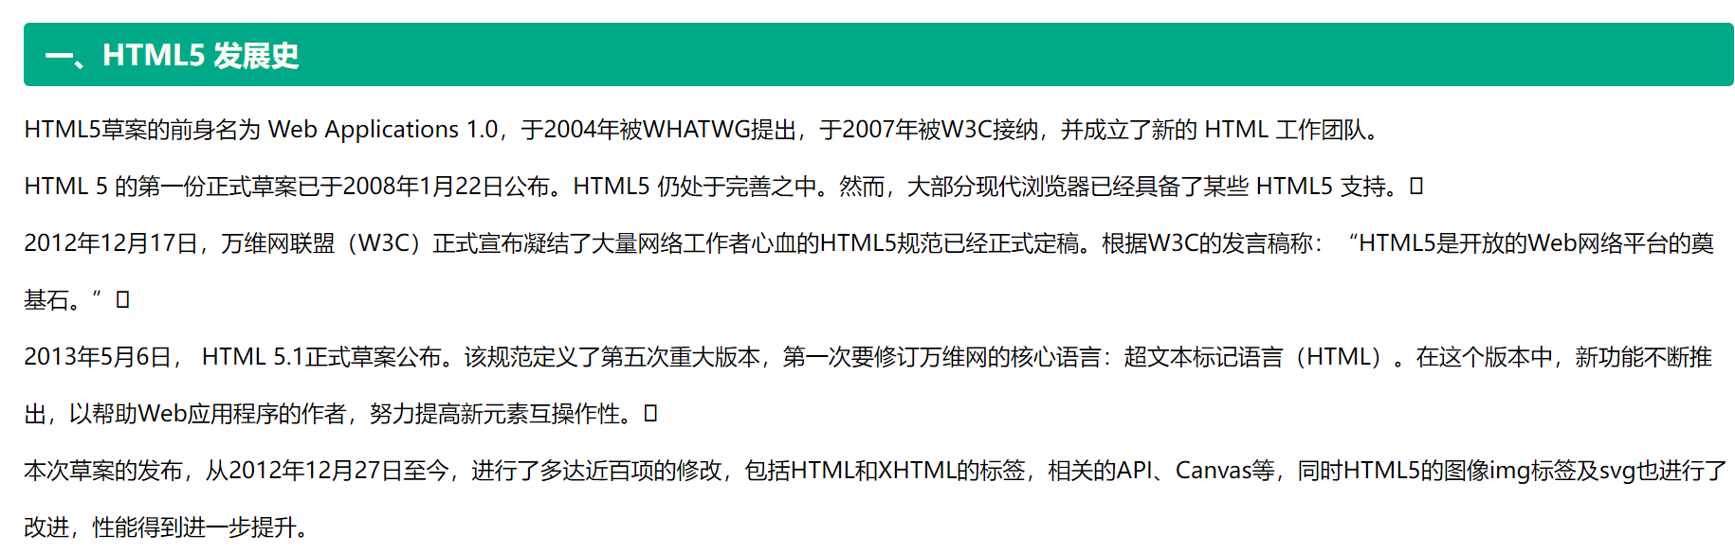
1-H5新增
01

Slide 3
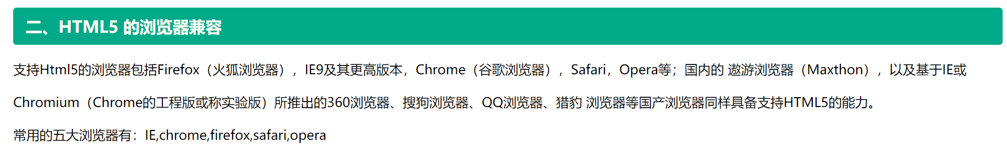
1-H5新增
02

Slide 4
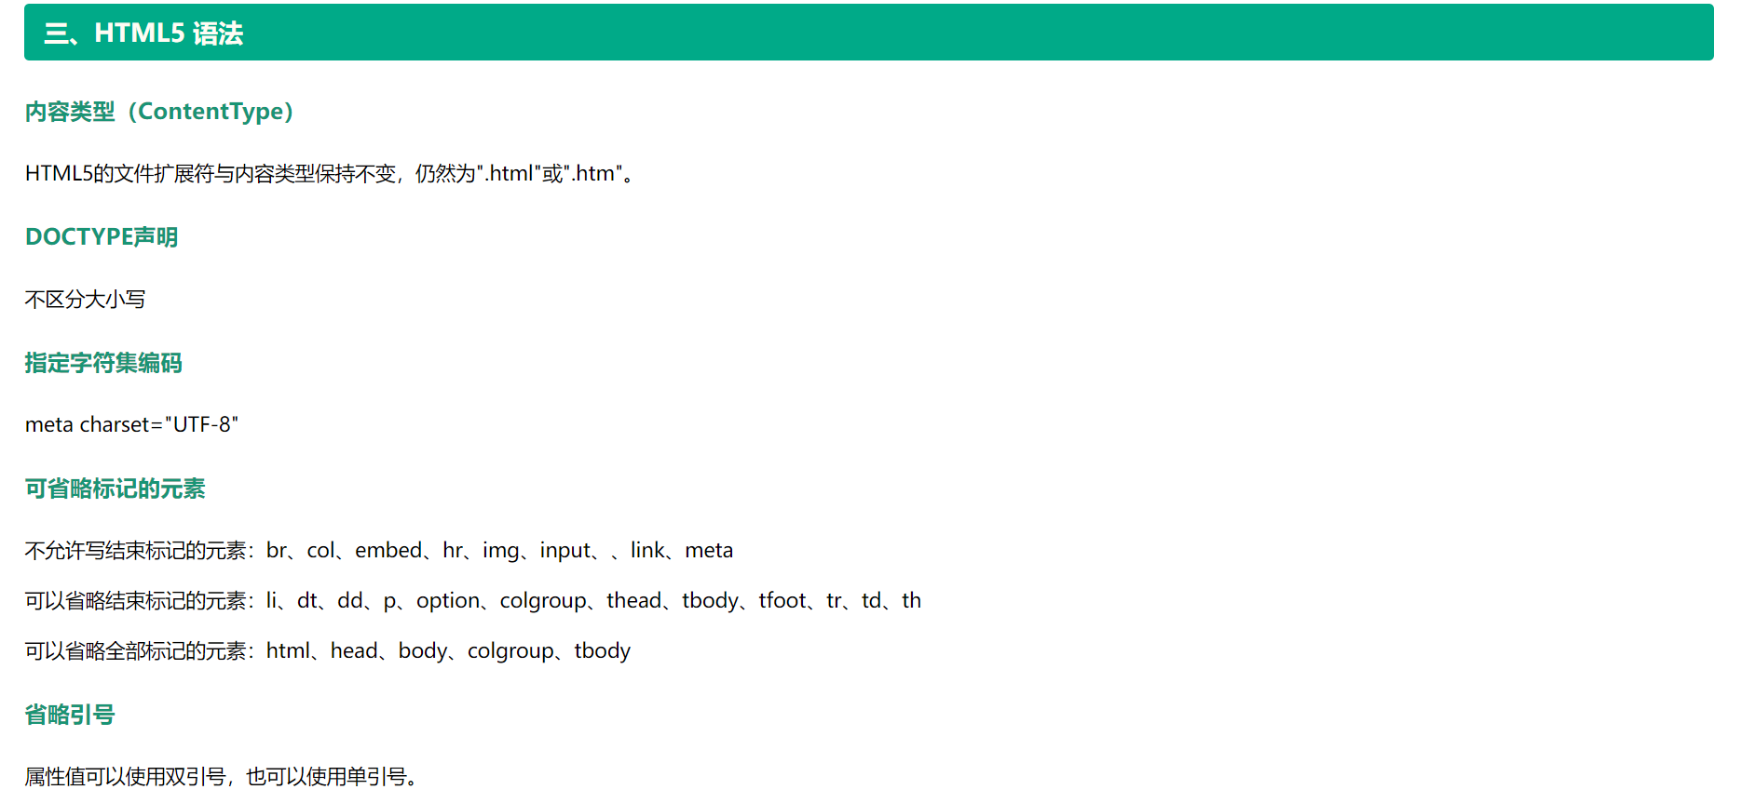
1-H5新增
03

Slide 5
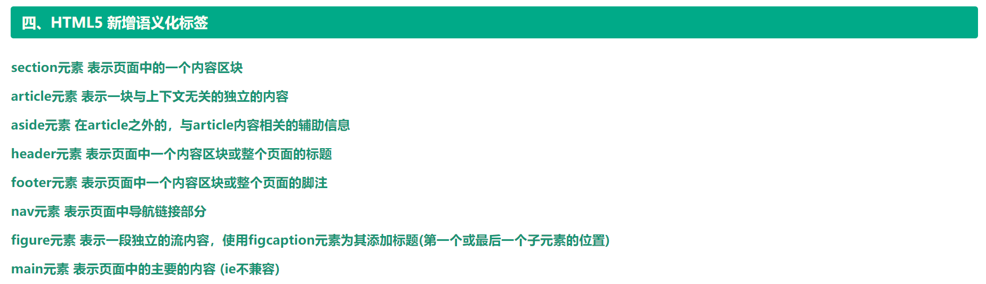
1-H5新增
04

Slide 6
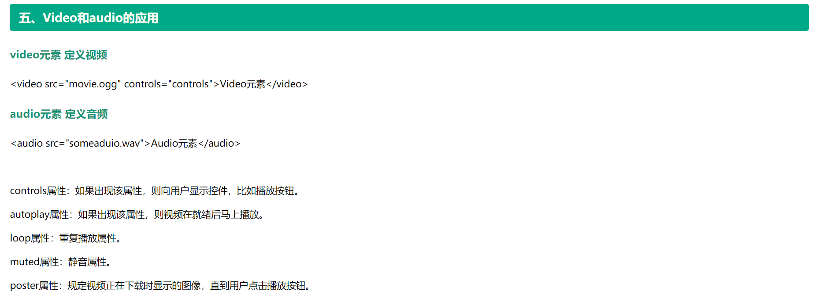
1-H5新增
05

Slide 7
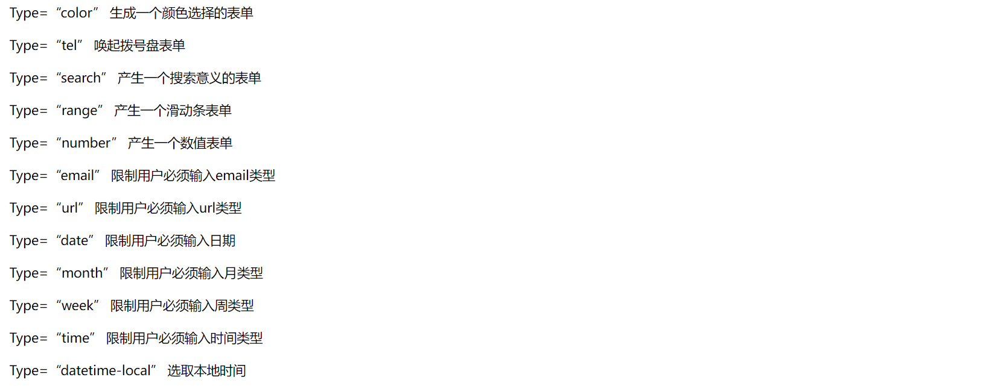
1-H5新增
06

Slide 8
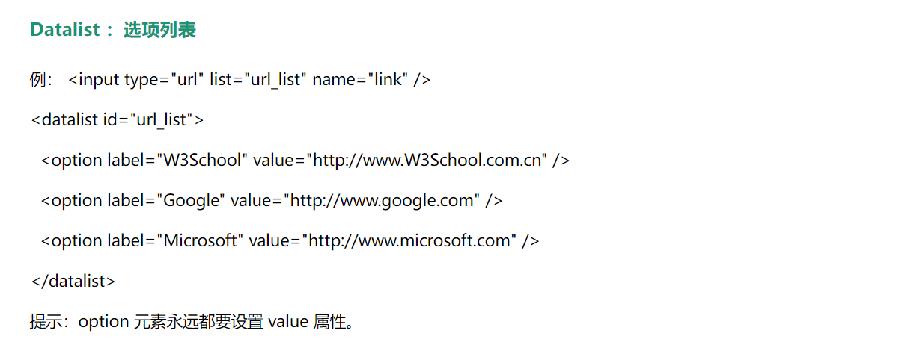
1-H5新增
07

Slide 9

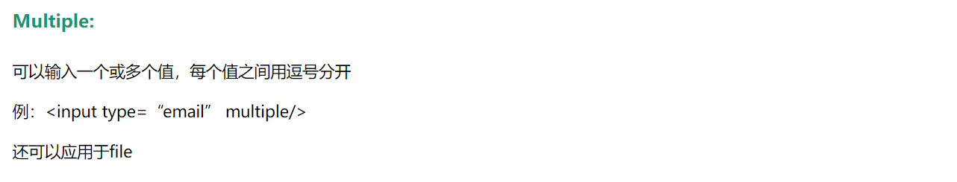
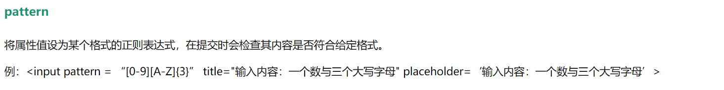
1-H5新增
08

Slide 10
Thank you
谢谢观看

