Slide 1


2D属性-transform
主讲人：kerwin

Slide 2
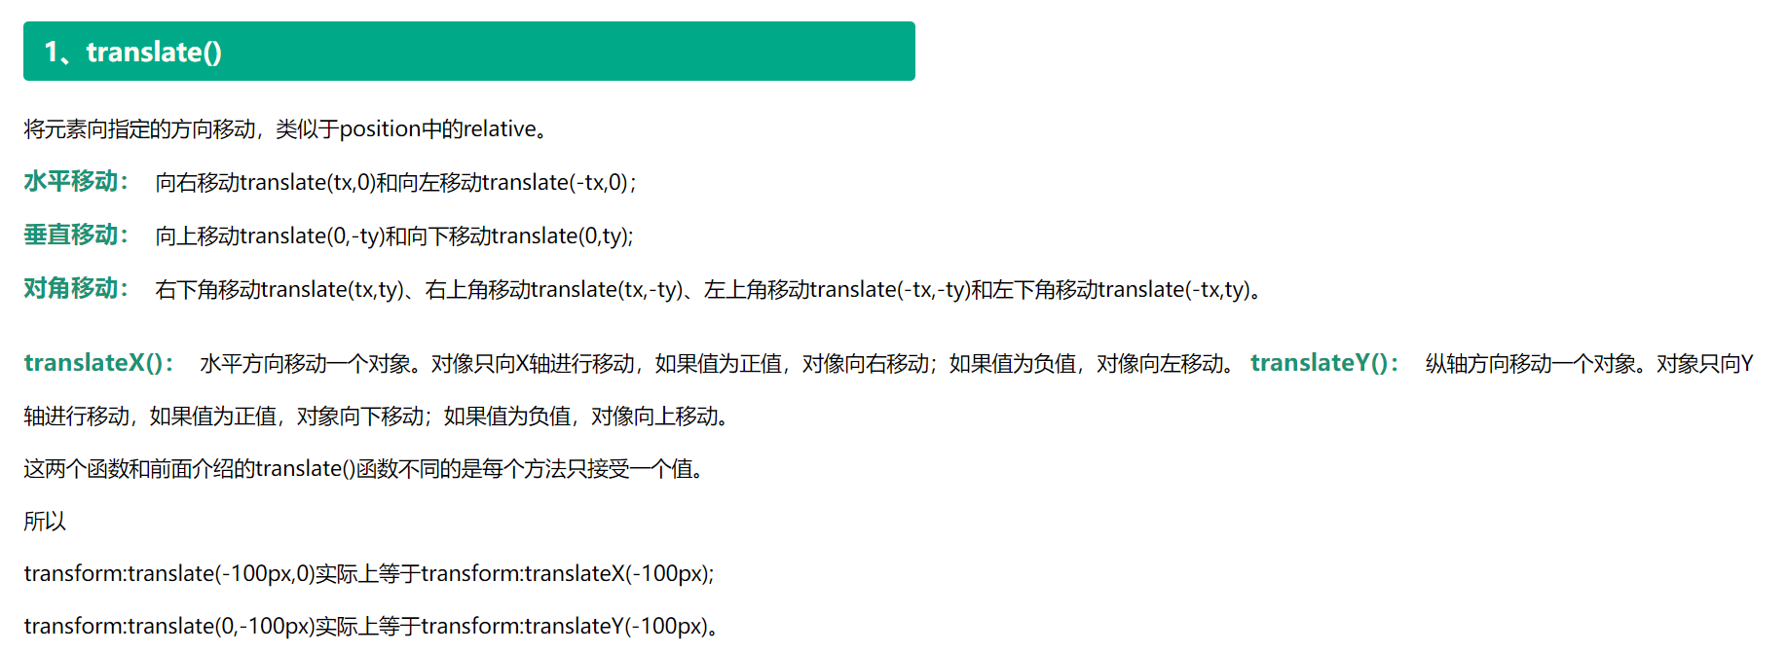
1-2D属性-transform
01

Slide 3
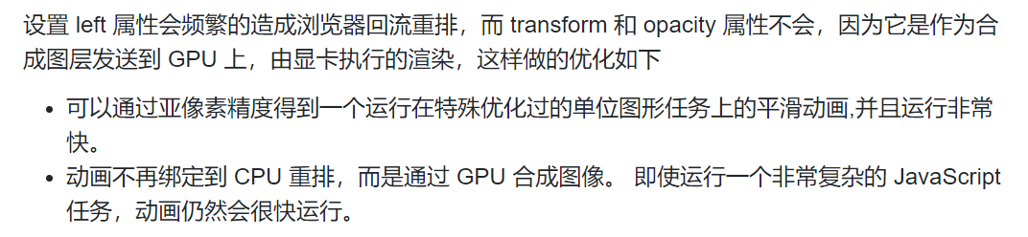
1-2D属性-transform
02

Slide 4
1-2D属性-transform
03
设置left-合成图层

Slide 5
1-2D属性-transform
04
设置translate-独立图层

Slide 6
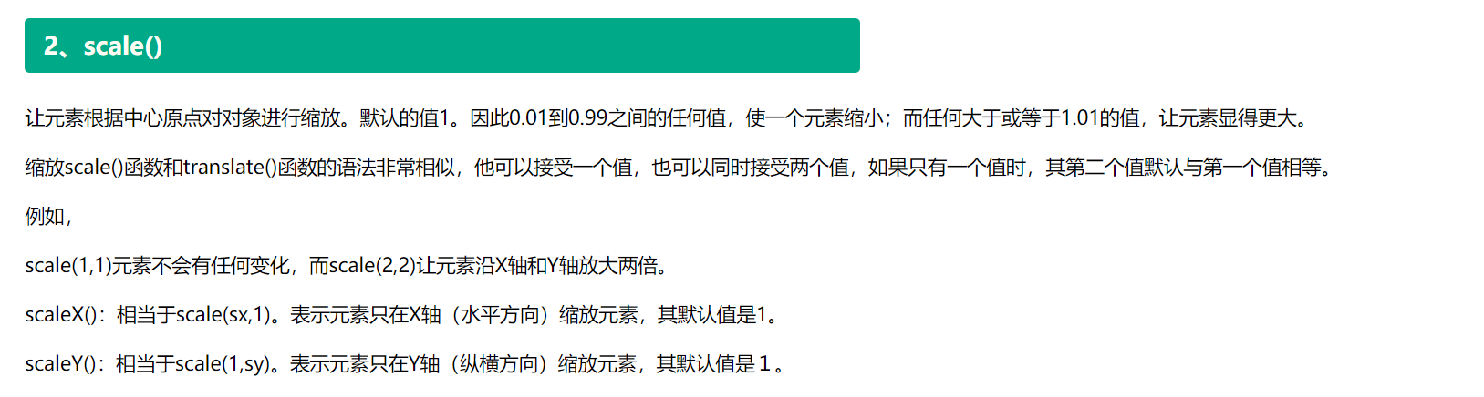
1-2D属性-transform
05

Slide 7
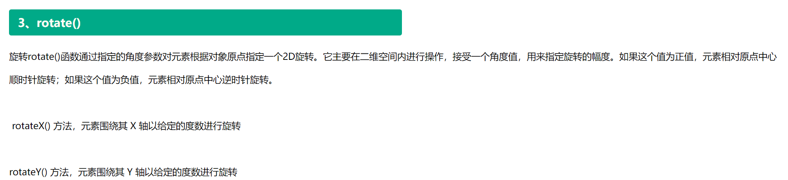
1-2D属性-transform
06

Slide 8
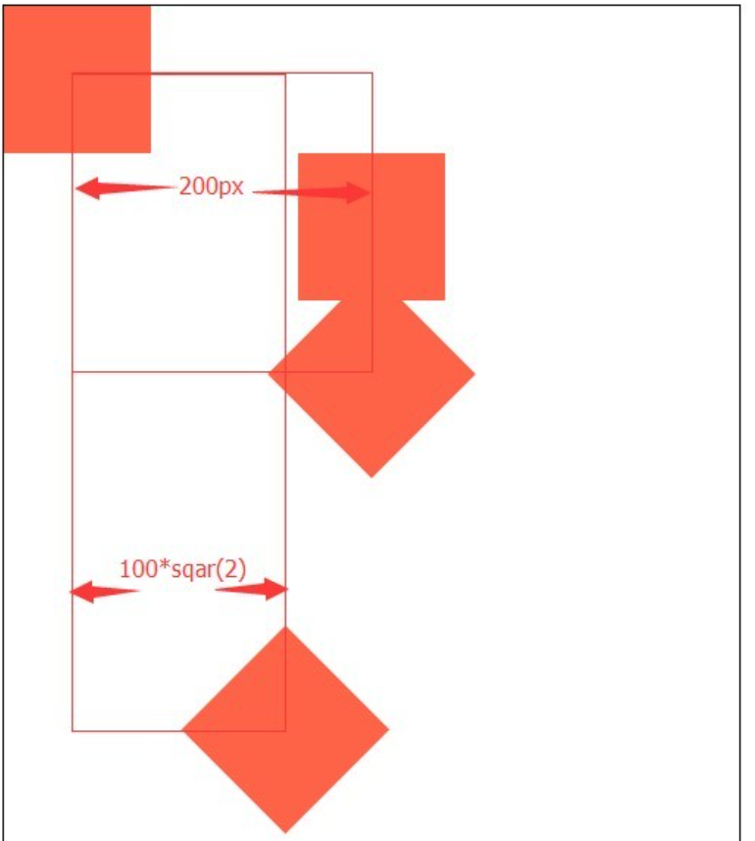
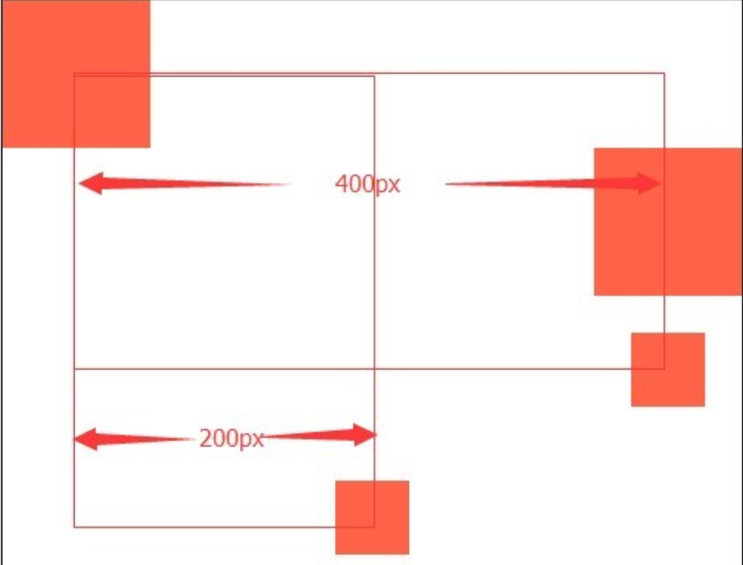
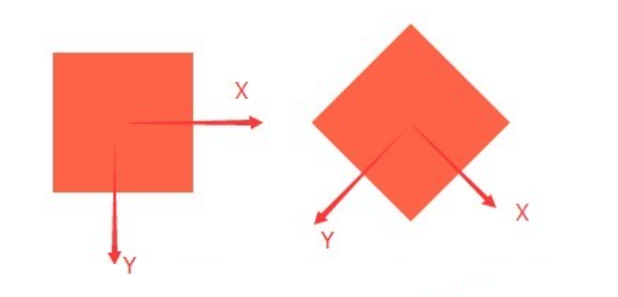
1-2D属性-transform
07

Slide 9
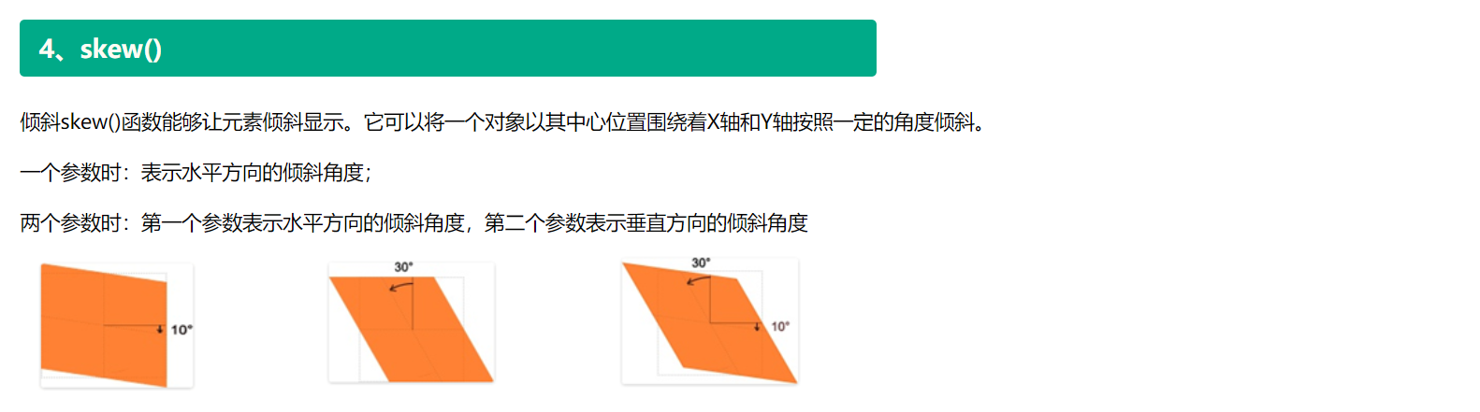
1-2D属性-transform
08

Slide 10
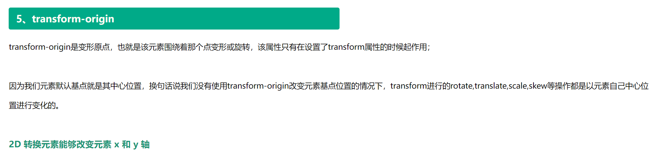
1-2D属性-transform
09

Slide 11
Thank you
谢谢观看

