Slide 1


3D
主讲人：kerwin

Slide 2
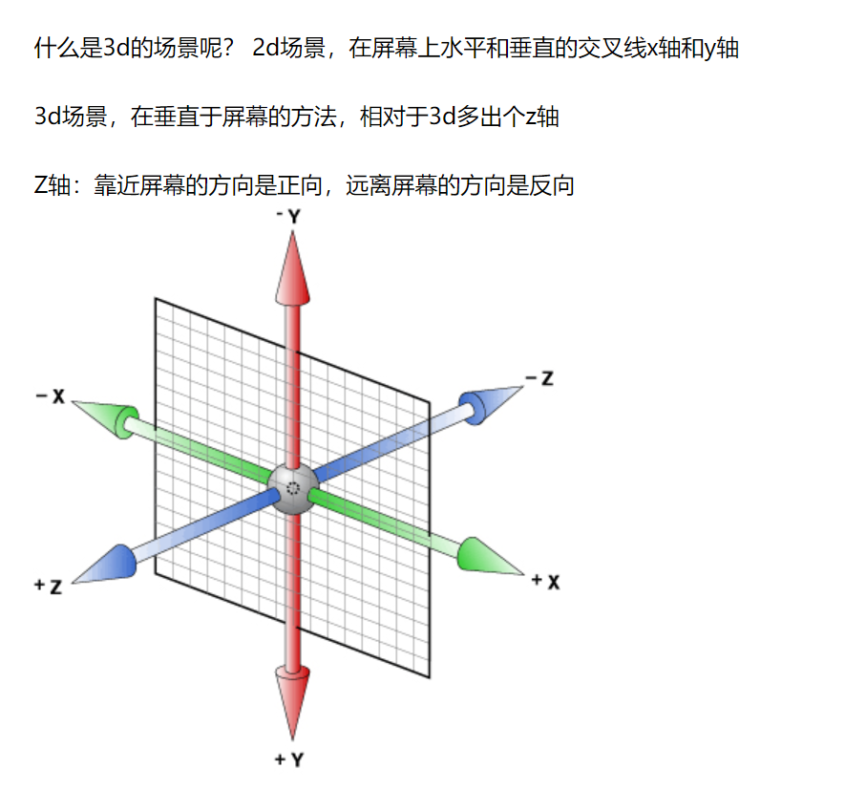
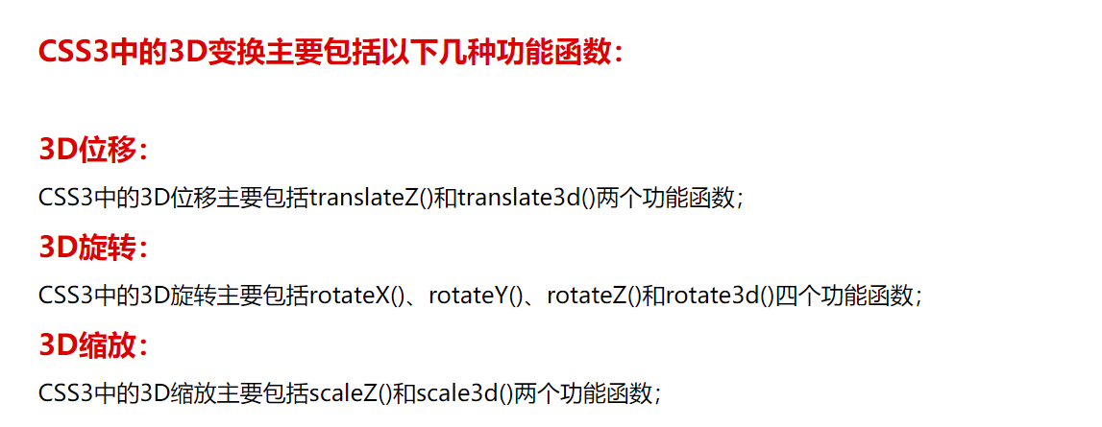
1-3D
01

Slide 3
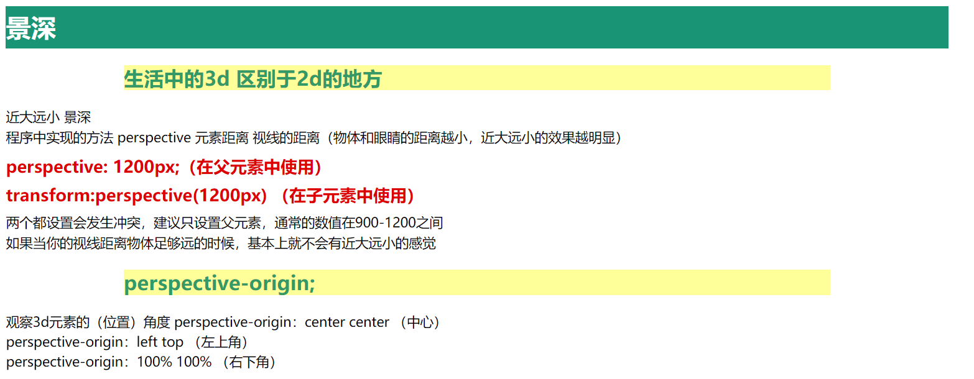
1-3D
02

Slide 4
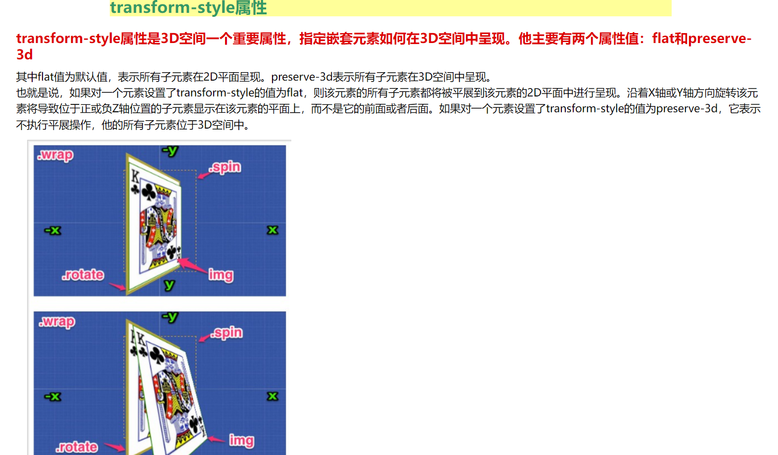
1-3D
03

Slide 5
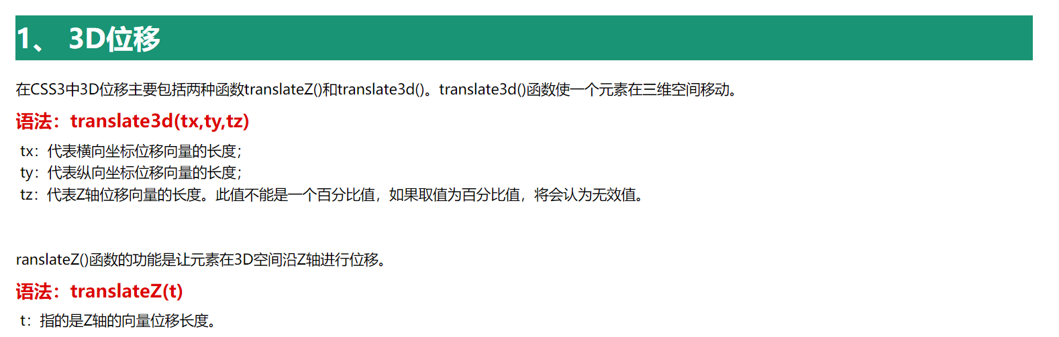
1-3D
05

Slide 6
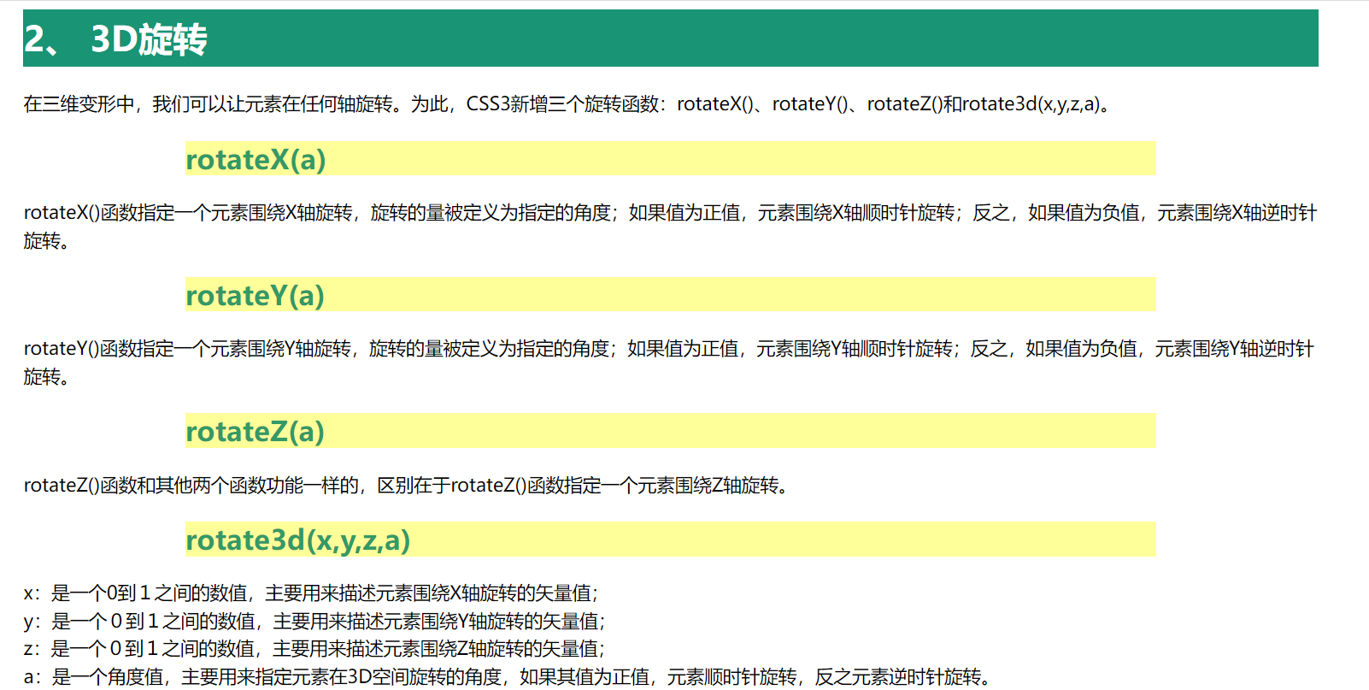
1-3D
06

Slide 7
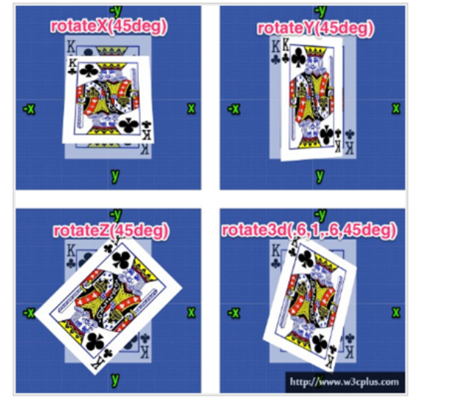
1-3D
07

Slide 8
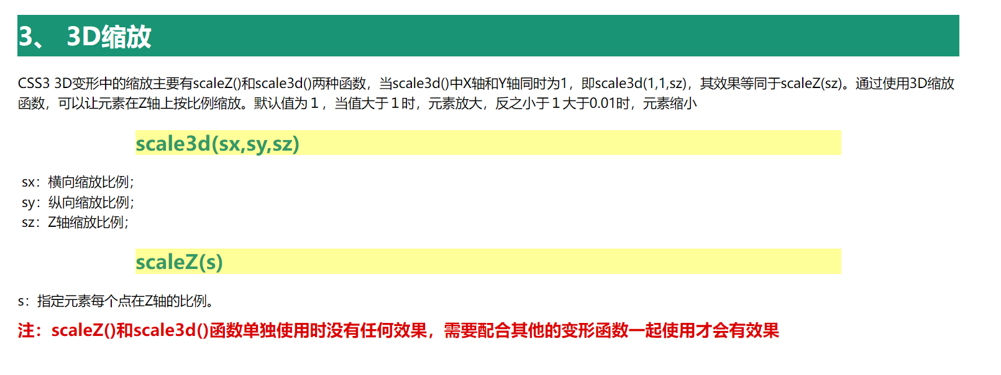
1-3D
08

Slide 9
Thank you
谢谢观看

