Slide 1
A High Accuracy Empirical Temp Controller
& Fun with Kalman Filters

Slide 2

Introduction/Problem Statement
Need was identified for an improved controller for an application requiring high accuracy/high stability thermal control
Maintains very tight temperature stability
Increased bandwidth/response time
Able to reject transient temperature disturbances
Quick turn around time to support program schedule (design/implementation/validation)
Thermal system has:
Active heating & active cooling
Control on heater strip duty cycle
Thermistors few inches away from heater strip

Slide 3
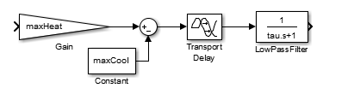

Design/Models
Empirical (data driven) thermal Plant Model used to drive controller design
Went for: “Simple but accurate”
Ran tests to record two parameters: maxHeat (100% Htr Duty Cycle) & maxCool (0% Htr Duty Cycle)
Two additional delays observed which were simply modelled as transport delay & low pass filter
Empirical Plant Model
Controller Cmd
(Htr Duty Cycle 0% to 100%)
$$\dot{T} (°F/s)$$
Max Heat/Cool rate recorded from system. Linearly scaling between 0-100%
2nd Delay observed due to time to reach full heating rate
Delay observed due to heat traveling to sensor (time before any temp change occurs)

Slide 4
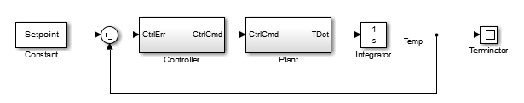




Design/Models (Cont’d)
Simple Feedback Controller Architecture Chosen (Accurate empirical plant model is keystone)
PID and related controllers/control laws considered
Selected controller was PID
Design initially performed in continuous time
Design discretized after continuous controller performance acceptable
Tustin Transform
Discretize Integrators
Discretize Transport Delays
Discretize Low Pass Filter

Slide 5
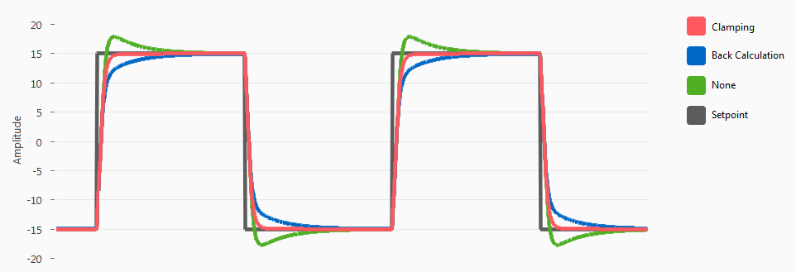
Testing & Iteration
Discrete Simulation used to generate embedded c code and run on target HW w/ softcore processor
Initial results revealed two issues: (Note: Plots of data unavailable/proprietary)
Excessive overshoot (much more than predicted by simulation)
Noisy oscillation at steady state
#1 caused by lack of clamping on PID integrator
Solution was to implement anti-windup clamping on integrator
#2 caused by derivative action amplifying thermistor noise
Solution was to add low pass filtering to derivative branch
Anti-Wind Up Clamping (Generic Example)
Setpoint
With Clamping
Without Clamping
Source: Taylor, David. “PID Anti-windup Techniques.” https://info.erdosmiller.com/blog/pid-anti-windup-techniques

Slide 6
Results
Objectives (Note: Achieved performance parameters unavailable/proprietary)
Objectives met:
Performance better than requirements, delivered on time, at minimal cost
ID | Objective | Result | Comments
1 | Maintain Tight Temperature Stability | Done, 98% improvement | As quantified by std dev of temp over evaluation temp profile
2 | Increase Bandwidth/Response Time | Done, 95% improvement | As quantified by settling time to a non-saturating step input
3 | Able to Reject Transient Temp Disturbances | Done, 75% improvement | As quantified by peak-to-peak temp transient
4 | Quick turn around time to support program schedule | Done, start to finish 2 weeks | Work product accepted into program design. Developed process for design, implementation, validation that is being re-used by team

Slide 7
Fun with Kalman Filters
(Bonus Content)

Slide 8
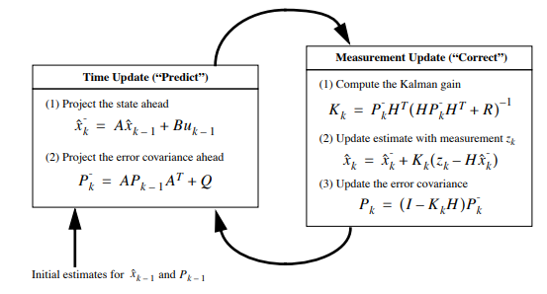

Kalman Filter Refresher
Basic Kalman Filter is a recursive optimal estimator for linear systems (aka Linear-Quadratic-Estimator, LQE)
Linear Systems: The system of differential equations are linear combinations of each other only
Recursive: Only needs information from past time step and current time step
Generic routine involves predict and update which blend real world measurements with an underlying dynamic model
Where:
$X$ = state vector (parameters to be estimated)
$H$ = Observation Matrix (relate measurements to states)
$z$ = Measurement (real world measurement)
$A$ = Dynamics Matrix (relationship between states over time)
$B$ = Control Matrix (relationship between control inputs and states)
$P$ = Covariance Matrix (uncertainty in state estimates)
$R$ = Measurement Matrix (uncertainty in measurements)
$Q$ = Process Noise Matrix (uncertainty in predictions)
$K$ = Kalman Gain Matrix (optimal gain to update state estimates with measurement info)
Source: Welch & Bishop. “An Introduction to the Kalman Filter” pg. 6 Figure 1-2

Slide 9


Kalman Filter Covariance Simulation
Since Kalman Filter inherently implements a plant model for state estimation (propagation), this can be adapted to perform system simulation and analysis if a KF is already being used
Kalman Filter model is limited due to linear nature, but “suboptimal” states can be added to improve fidelity of simulation
Utility: Dual State (Suboptimal) Covariance Simulation has comparable accuracy to monte carlo simulation
Much more efficient (less runs) since it is in covariance domain
Filter Propagate
Architecture of a Dual State (Suboptimal) Covariance Sim Program
n total states
n x n
m states
Filter Update
m Gains
$$K_{m}$$
m x m
Real World Update
Real World Performance
$$0$$
Un-updated covariances
Kalman Filter with m Filter (implementable) states
3
Filter and Real World states are both propagated over time. Resulting accuracy is comparable to monte carlo simulation but requires fewer runs since it is in covariance domain
1
Kalman filter with m “Filter/implementable” states is propagated and updates. These states are directly observable or coupled to observable states
n-m x n-m
n-m real world states
2
n total states exist. There are n-m real world states which affect performance but cant be observed (ex. temp but theres no temp sensor). These are propagated but not updated (K = 0)

Slide 10
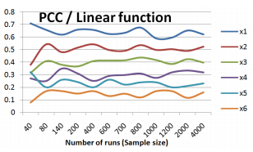
Kalman Filter Sensitivity Analysis
Due to underlying linear assumptions for Kalman Filters & Covariance Analysis, sensitivity of one state to another can be efficiently determined
Ex. Given a KF with Velocity Err state and n other error states
Below example shows what Sensitivity Analysis would look like for our KF. RSSQ is equal to the Vel Err State
High Level Algorithm as follows:
Initialize a “Sensitivity Matrix,” S and propagate at each time step
S contains all information to compute sensitivity of any one state to any other
Only a single run needed for most states
Utility: Objectively quantify primary contributors to performance parameters of interest
Inform efficient team direction
2
x1 is the top contributor. Designer should focus on x1 to reduce vel err
1
RSSQ = Vel Err
Example Sensitivity Analysis Results (Sensitivity of Velocity Err to x1 to x5)
RSSQ
x1
Sensitivity [m/s]
x2
x3
x4
x5
3
x4 is initially #3 contributor but drops below x3 after a short amount of time
Time [s]
4
x5 does not contribute significantly to vel err

Slide 11
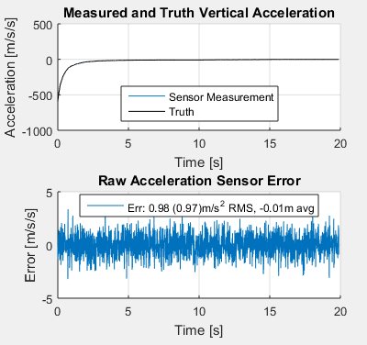
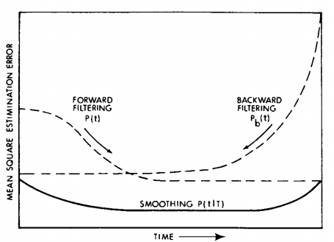

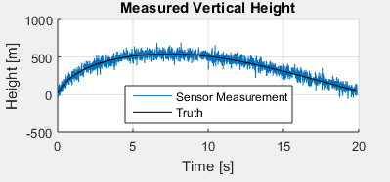
Backwards Kalman Smoothing
Raw sensor data for our catapult example
If post processing is allowed, backwards Kalman Filtering is possible to “squeeze” all the information out of a data set
Utility: Improves state estimation for entire time history (Forward KF has lowest state err at the end only)
Ex. Projectile launched from catapult w/ accelerometer + GPS receiver (noisy acceleration & position measurements)
1
Forward Kalman Filter estimation error decreases over time
Sensors are pretty noisy
2
Combine with a backwards filter to improve state estimation over full time history
Source: Gelb. “Applied Optimal Estimation” pg. 159 Figure 5.1-1

Slide 12
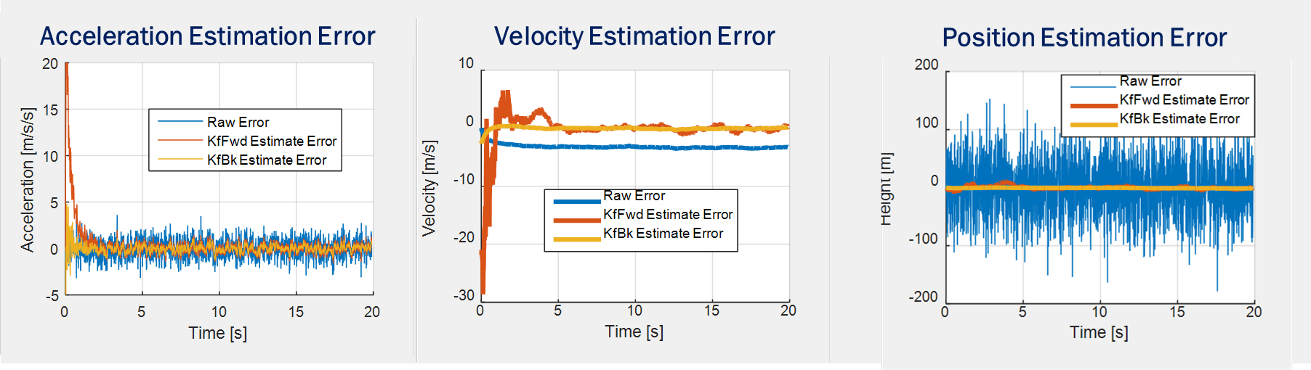
Kalman Smoother Results
Forward Kalman filter improved over raw results
Estimates velocity for free
Backwards Kalman further improves estimation error and reduces large error at beginning
1
Forward Kalman Filter is more accurate than raw sensor, but has significant error at beginning
2
Backwards Smoothed KF has less error overall and especially at the beginning

Slide 13
Fin.

