Slide 1
Simple Optimal Particle Controller

Slide 2
Design

Slide 3

Problem Statement
Control a particle along a desired trajectory
Initial Position: 0m + 0.5 m 1-$σ$
Actuator Noise: Pcmd + (0.2m 1-$σ$) * Pcmd
Measurement Noise: 0.3m
Controller Actuation & Position Measurement at 4 Hz

Slide 4
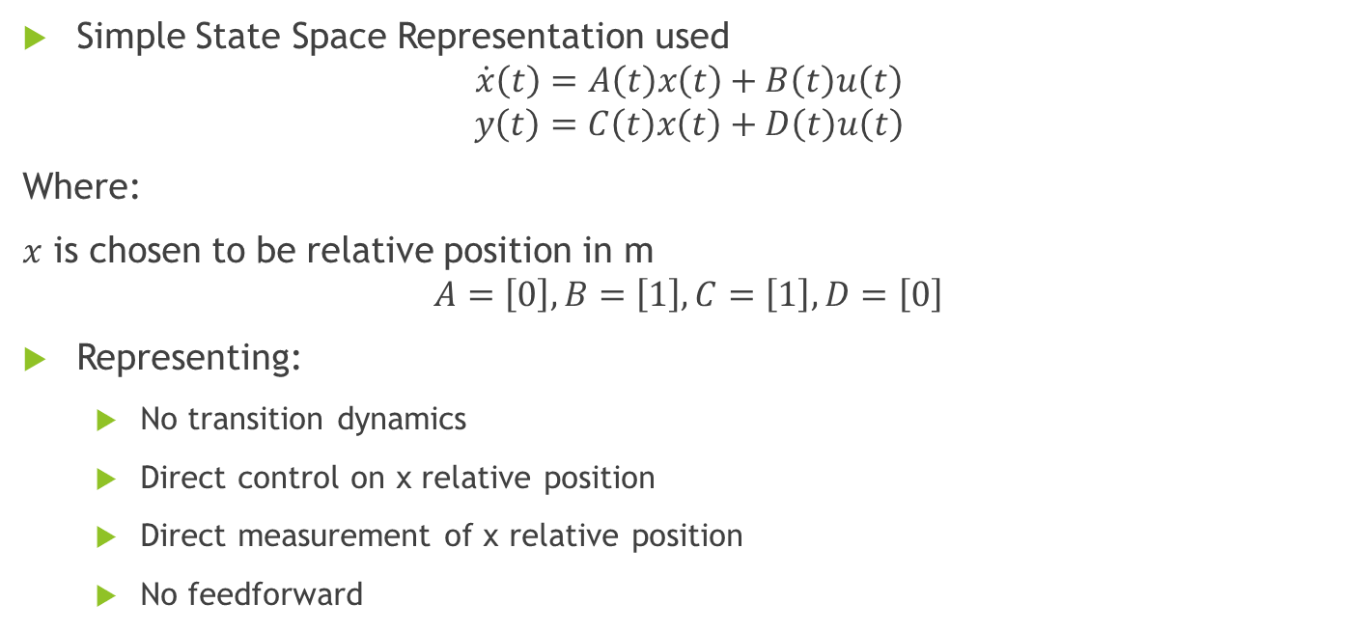
Model
Simple State Space Representation used
$$\dot{x}\left(t\right)=A\left(t\right)x\left(t\right)+B\left(t\right)u\left(t\right)$$
$$y\left(t\right)=C\left(t\right)x\left(t\right)+D\left(t\right)u\left(t\right)$$
Where:
$x$ is chosen to be relative position in m
$$A=\left[0\right], B=\left[1\right], C=\left[1\right],D=\left[0\right]$$
Representing:
No transition dynamics
Direct control on x relative position
Direct measurement of x relative position
No feedforward

Slide 5
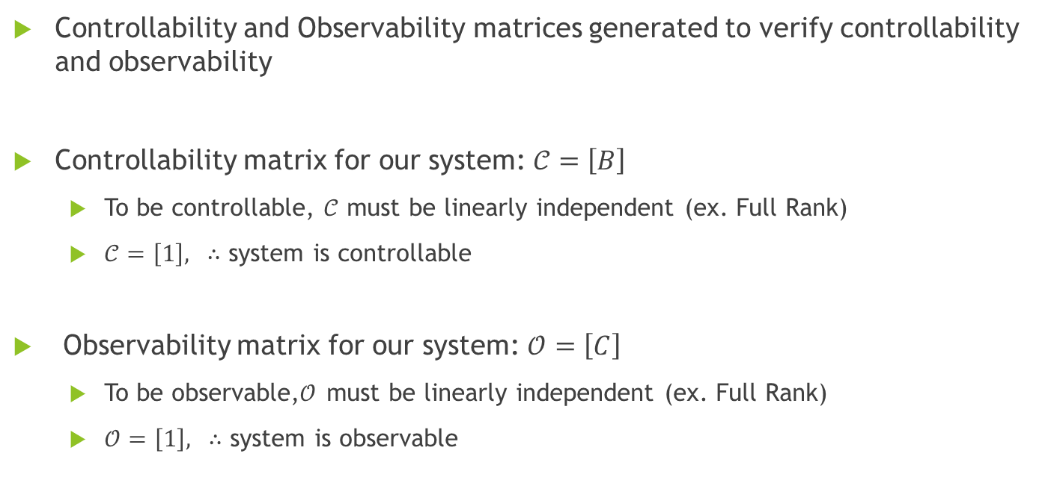
Controllability/Observability
Controllability and Observability matrices generated to verify controllability and observability
Controllability matrix for our system: $𝒞=\left[B\right]$
To be controllable, $𝒞$ must be linearly independent (ex. Full Rank)
$𝒞=\left[1\right], ∴$ system is controllable
Observability matrix for our system: $𝒪=\left[C\right]$
To be observable,$𝒪$ must be linearly independent (ex. Full Rank)
$𝒪=\left[1\right], ∴$ system is observable

Slide 6
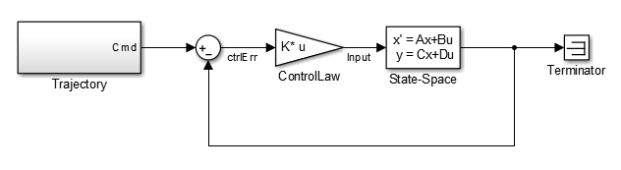
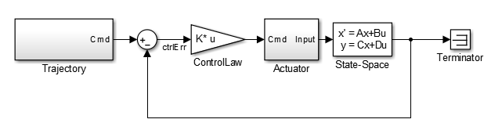
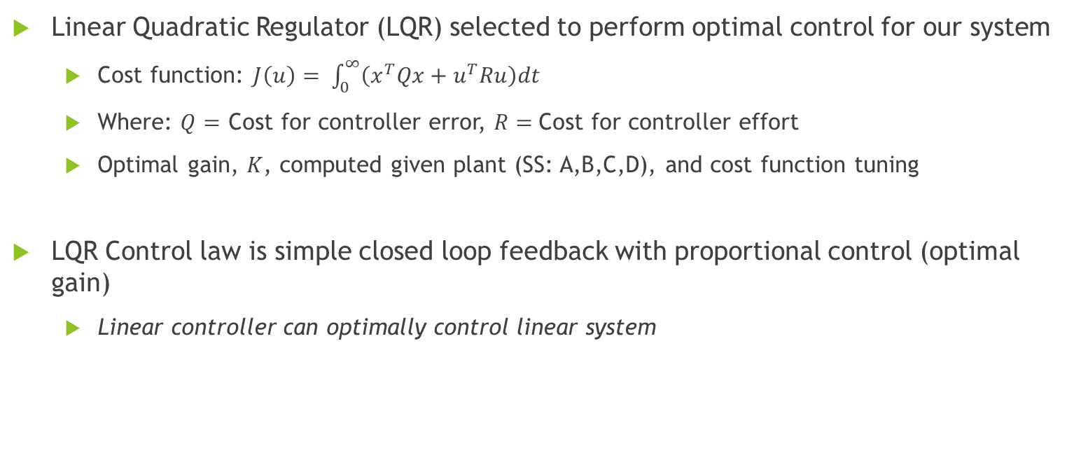
Controller
Linear Quadratic Regulator (LQR) selected to perform optimal control for our system
Cost function: $J\left(u\right)= \int_{0}^{∞}{\left(x^{T}Qx+u^{T}Ru\right)dt}$
Where: $Q=$ Cost for controller error, $R=$Cost for controller effort
Optimal gain, $K$, computed given plant (SS: A,B,C,D), and cost function tuning
LQR Control law is simple closed loop feedback with proportional control (optimal gain)
Linear controller can optimally control linear system
Nominal LQR Controller
LQR w/ Actuator Dynamics

Slide 7
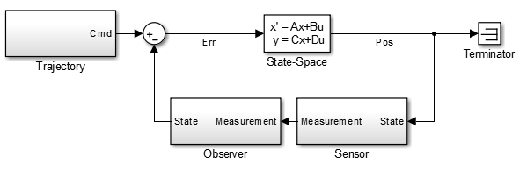
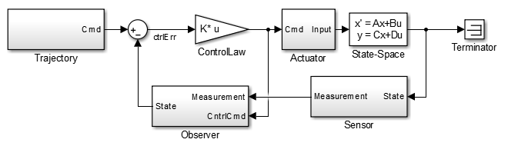
Observer
Problem statement requires gaussian white noise on position measurements
Noise can degrade control law performance
Simple Optimal Estimator (LQE/KF) can be designed to improve position estimation
LQE and LQR can be designed separately and remain optimal per “Separation Principal”
Combined LQR/LQE
CntrlCmd is fed into observer (rather than actuator input) to allow actuator noise to be modelled by KF Process Noise
Nominal LQE/KF Observer

Slide 8
Program Architecture
Python selected due to high quality linear algebra (numpy) and plotting (matplotlib) libraries
Below architecture implements in python 2.7 (Main.py is entry point)
Main.py
Creates Simulation Class (defines observer/controller)
Defines Trajectory & Sim params
Logs data and generates plots
class Controller:
# Implements LQR
…
class Actuator:
# Implements Actuator Dynamics
…
class Realworld:
# Implements state-space model
…
class Observer:
# Implements LQE/KF
…
class Sensor:
# Implements sensor dynamics
…

Slide 9
Results

Slide 10
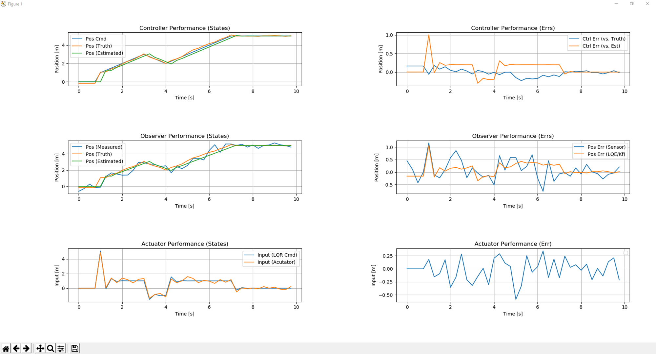
High Err Cost, LQR Only, Q = 100, R = .001
Controller Error is low but Actuator action is high
LQE/KF smoothes/ improves noisy sensor measurement

Slide 11
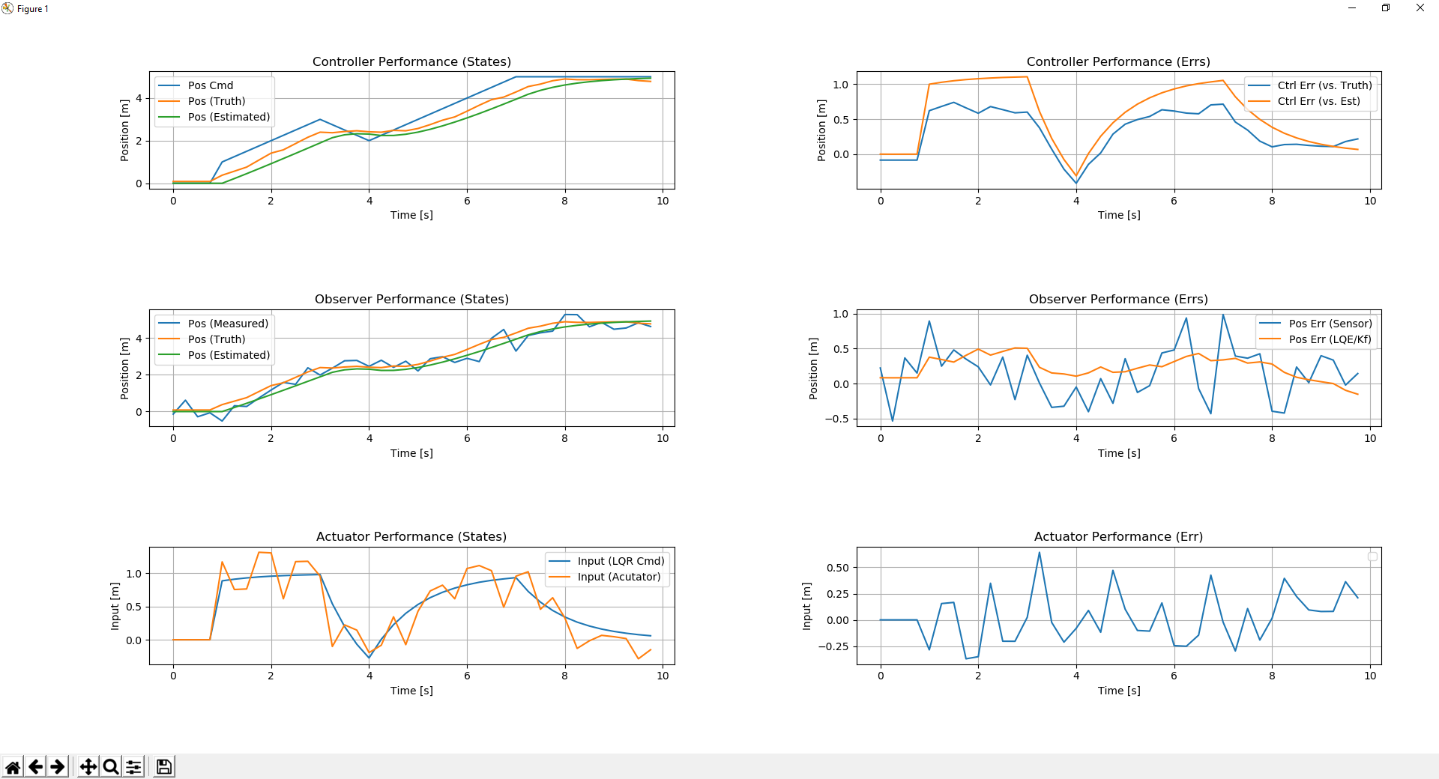
High Ctrlr Cost, LQR Only, Q = 1, R = 1
Controller Error is larger (sluggish) but Actuator action is low
LQE/KF smoothes/ improves noisy sensor measurement

Slide 12
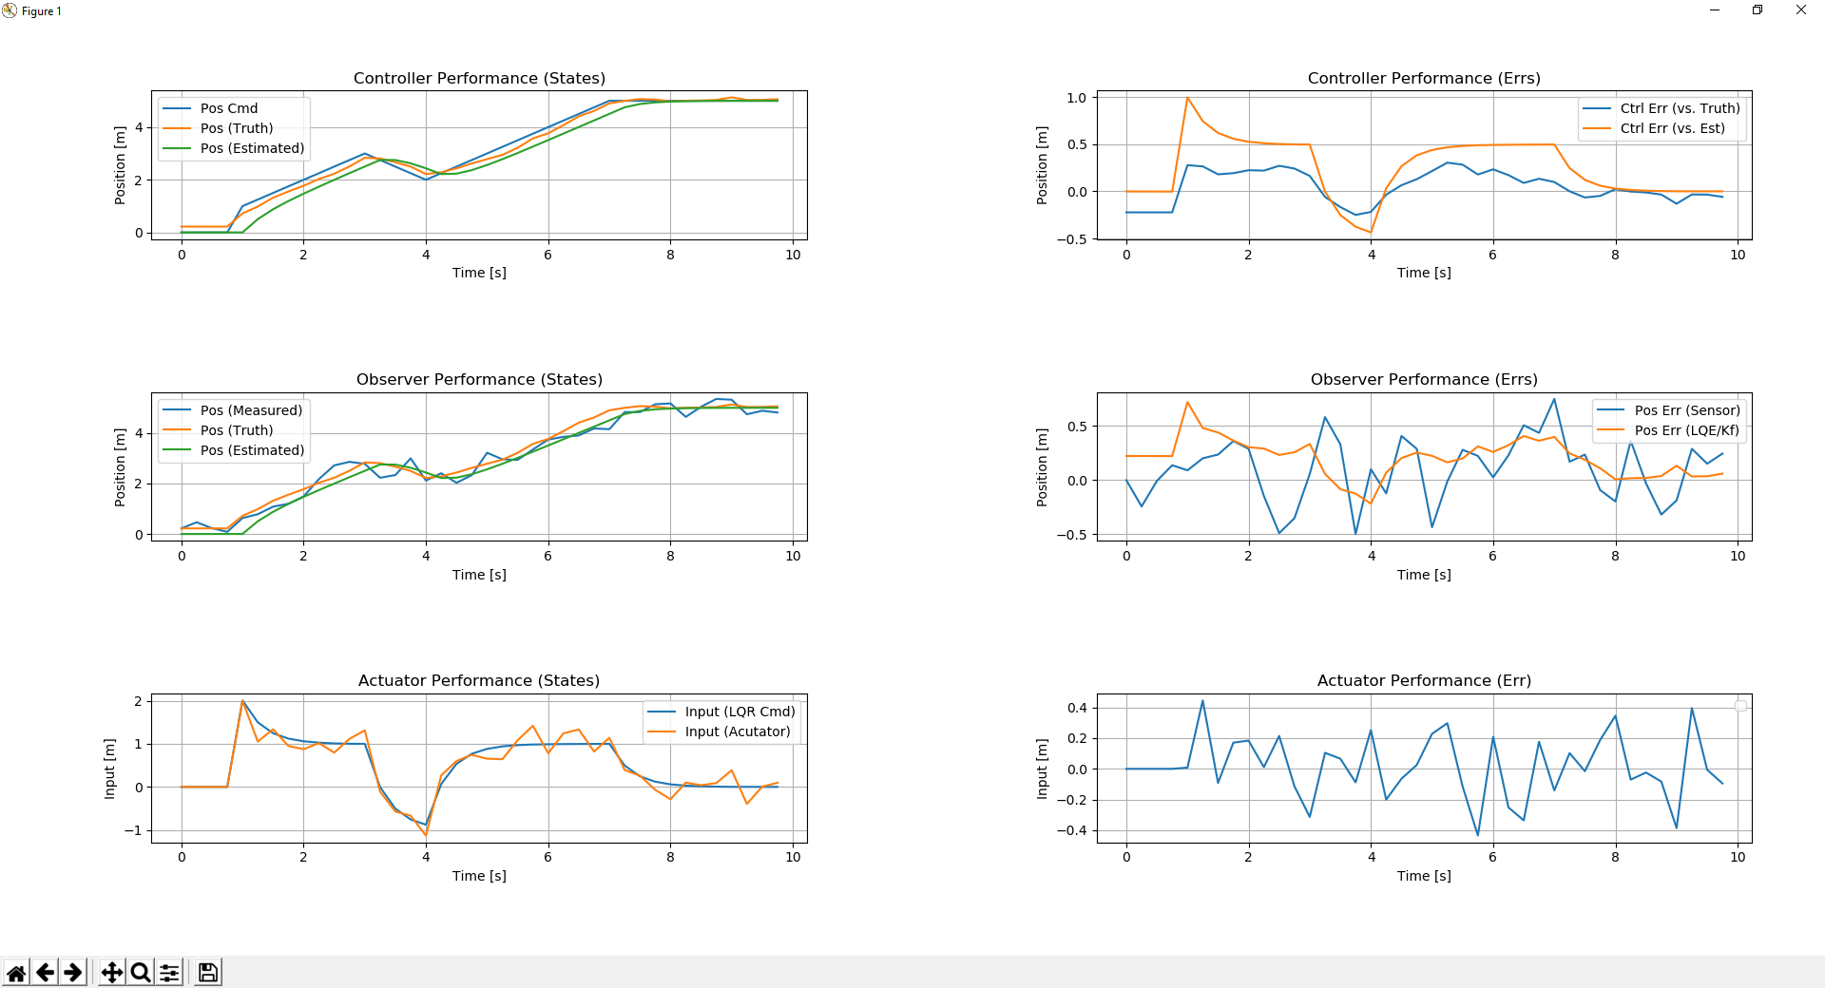
Balanced, Q = 0.75, R = 0.1
Middle Ground reached between position error and Actuator effort
LQE/KF smoothes/ improves noisy sensor measurement

