Slide 1

FlowShadow: Keeping Update Consistency in Software-based OpenFlow Switches
Yi Wang, Dongzhe Tai, Ting Zhang, Bin Liu
† Tsinghua University
‡ Huawei Future Network Theory Lab, Hong Kong

Slide 2
— Outline
1. Introduction
2. Motivation
3. FlowShadow Framework
4. Evaluation Results
5. Conclusion
Introduction
Framework
Results
Conclusion
Motivation

Slide 3
—— Outline
1. Introduction
2. Motivation
3. FlowShadow Framework
4. Evaluation Results
5. Conclusion
Introduction
Framework
Results
Conclusion
Motivation

Slide 4
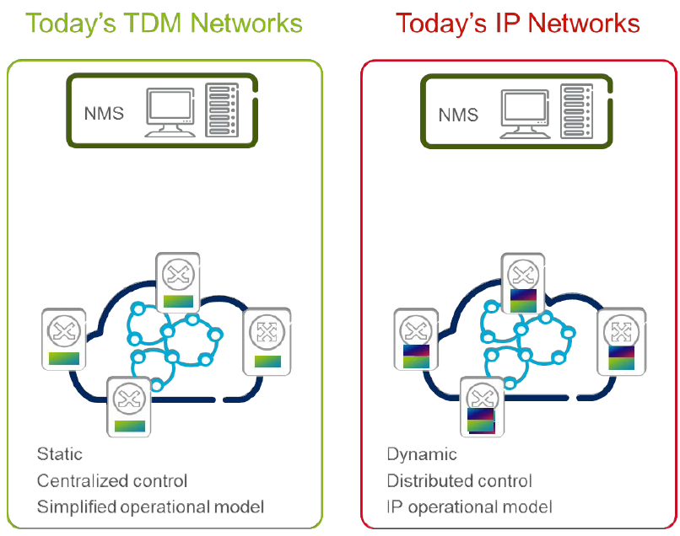
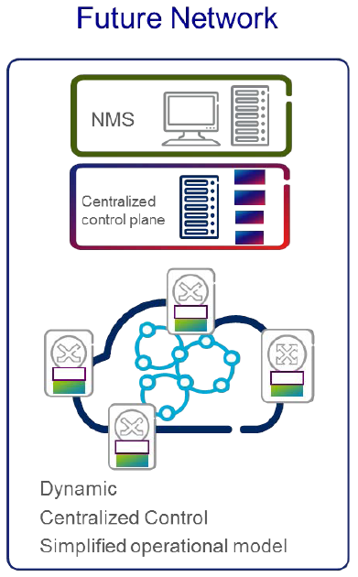

Background
ROA NBI
SDN is a new architecture：
Central Control plane
Efficient Management
High Network utilization: from 30% to 90%
……
Introduction
Framework
Results
Conclusion
Motivation

Slide 5
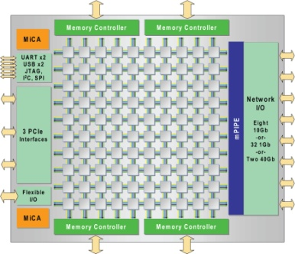

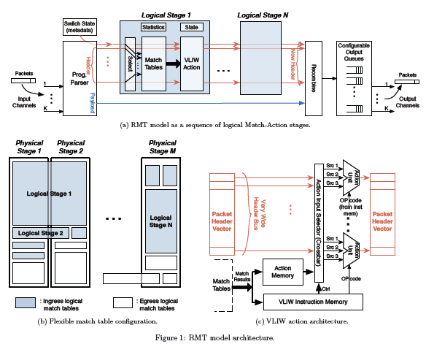

Background
SDN Hardware Switch
No ASIC designed for SDN
Why: SDN iterated too fast to develop a ASIC
Industry
Academia
Many Core
Commercial
ASIC
FPGA/NP
TI&Stanford
Introduction
Framework
Results
Conclusion
Motivation

Slide 6
— Outline
1. Introduction
2. Motivation
3. FlowShadow Framework
4. Evaluation Results
5. Conclusion
Introduction
Framework
Results
Conclusion
Motivation

Slide 7
Motivation
Software-based SDN switch
Two data plane:
Slow Path with rule tables: wildcard match
Fast Path with Microflows: exact match
Microflows in Fast Path is specific flows of rules in Slow Path
Introduction
Analysis
Results
Conclusion
Algorithm

Slide 8
Motivation
Cache: a practical way to improve the performance of software-based OpenFlow switches
Open vSwitch: The most widely used software OpenFlow switches. Points of concern:
Increase the throughput of switch
Keep update consistency
Introduction
Analysis
Results
Conclusion
Algorithm

Slide 9
Motivation
Cache Update Consistency
Definition: A rule in OpenFlow table is changed or removed, the corresponding cache entry should be removed immediately.
The modification of a rule → Modifying the Microflows
One example…
Introduction
Analysis
Results
Conclusion
Algorithm

Slide 10
Motivation
Update consistency
Change Host’s Position
Update rule’s Action Output:1 to Output 2
Dst ip=166.111.8.28
num=x+2
Dst ip=166.111.8.28
num=x+1
Dst ip=166.111.8.28
num=x
Port 3 Input queue
Cache
P3
OpenFlow Table
Dst IP
Action
Dst IP
Action
59.66.*.*
Output:2
59.66.131.51
Output:2
P2
166.111.*.*
Output:1
166.111.8.28
Output:1
Output:2
.
.
.
.
.
.
P1
Host
IP：166.111.8.28
Failed
Succeed
Introduction
Analysis
Results
Conclusion
Algorithm

Slide 11
Motivation
The design goal of this paper
Improve the throughput of OpenFlow switches
Keep cache update consistency in OpenFlow switches
FlowShadow achieve the above objectives by adding additional data structure
Introduction
Analysis
Results
Conclusion
Algorithm

Slide 12
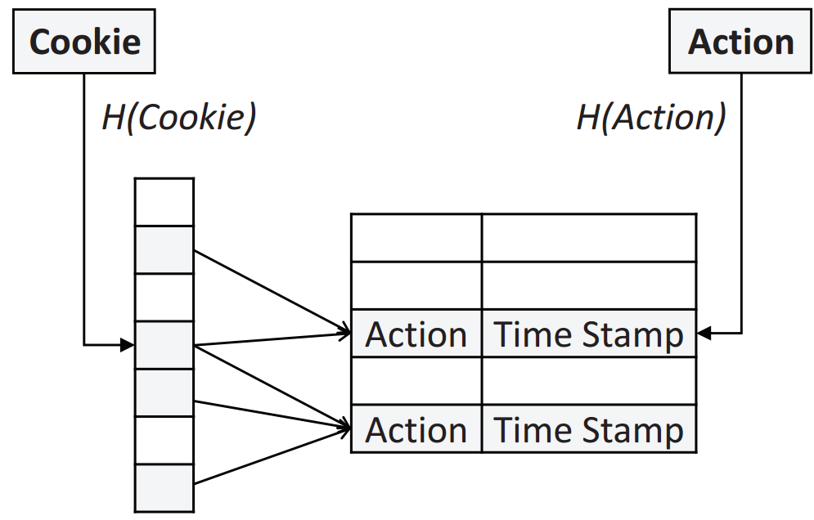
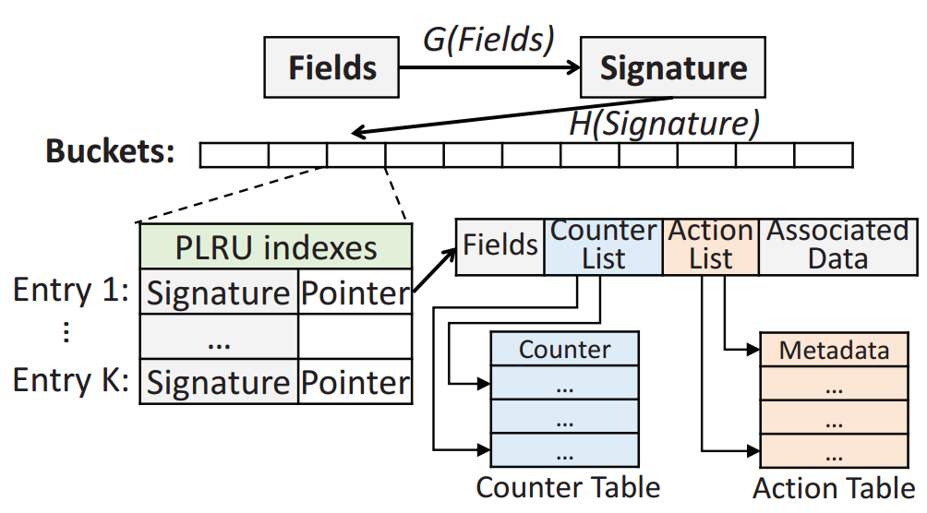
FlowShadow Framework
FlowShadow is a framework for the Fast Path
Applied a new mechanism to keep update consistency
a signature is generated from the fields, signature is hashed into a bucket
The signature is compared with all the signatures stored in this bucket
Find，forward the packet according to the action
Not find，search in openflow table
Introduction
Analysis
Results
Conclusion
Algorithm

Slide 13
FlowShadow Framework
FlowShadow applies Action Table and Cookie Table to keep update consistency
Action table final status of all the final cascade action: valid or invalid.
Cookie table record the relationship between rules and the actions depend on this rule.
Resolve the conflict between the actions have the same value.
Add a new column in Action Table: TimeStamp
TimeStamp is used to mark whether the Microflows’ corresponding rules are modified.
Action table record each rule’s final cascade action.
Introduction
Analysis
Results
Conclusion
Algorithm

Slide 14
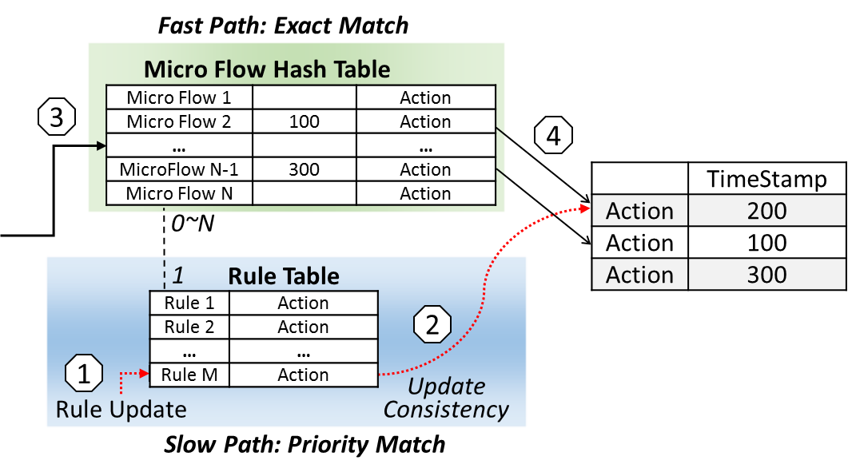
FlowShadow Framework
A single rule table example:
1. Updating the Rule M in flow table;
2. Resetting the TimeStamp of the Action(s) of Rule M;
3. When the packet of a microflow that is one of the Rule M is arrived, looking up the Microflow table. Before executing the action, FlowShadow checks the TimeStamp.
If the Microflow’s TimeStamp is less than the Action’s TimeStamp → Forwarding the packet to slow path;
otherwise, excuting the action.
Introduction
Analysis
Results
Conclusion
Algorithm

Slide 15
— Outline
1. Introduction
2. Motivation
3. FlowShadow Framework
4. Evaluation Results
5. Conclusion
Introduction
Framework
Results
Conclusion
Motivation

Slide 16
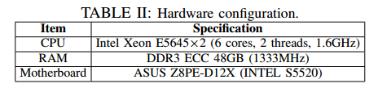
Experience Setup
Open vSwitch (release version 2.1.2)
Linux Operating System in the version 2.6.41.9- 1.fc15.x86 64.
Introduction
Analysis
Results
Conclusion
Algorithm

Slide 17
Experience Setup
Trace: Download form CAIDA
captured from 3 different network: campuse, enterprise and backbone
Each sustains 5 mins
Flow Table: two real table
IP prefix table download from RIPE contains 388344 entries
ACL contains 752 rules
Introduction
Analysis
Results
Conclusion
Algorithm

Slide 18
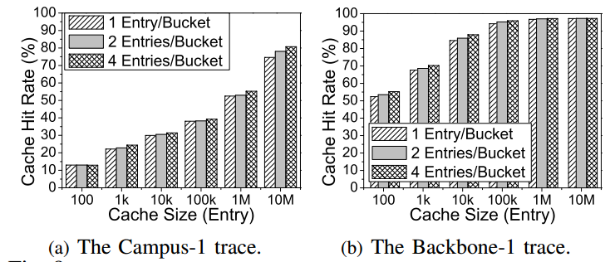
Evaluation Results
Cache hit rate
Cache size = Bucket number * bucket size，bucket size can be 1,2 or 4
Result:
Introduction
Analysis
Results
Conclusion
Algorithm

Slide 19
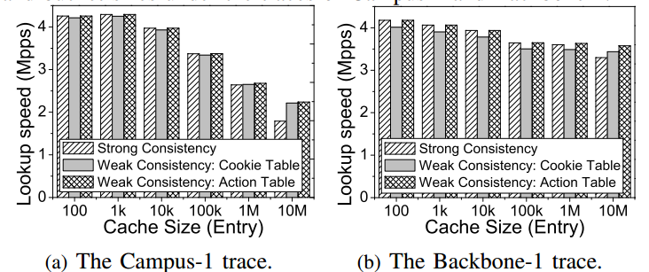
Evaluation Results
Look up speed in different update rate
One flow table
10% rules are modified per second
Result:
Introduction
Analysis
Results
Conclusion
Algorithm

Slide 20
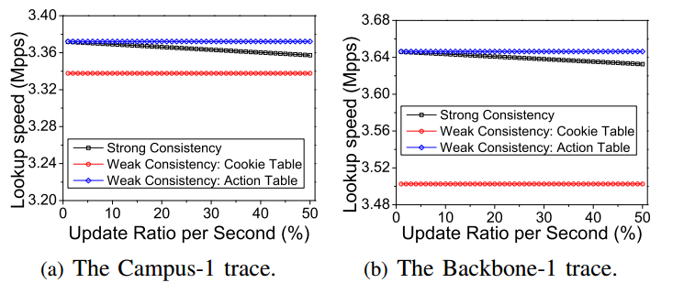
Evaluation Results
Scalability
Cache size =100k
Introduction
Analysis
Results
Conclusion
Algorithm

Slide 21
Evaluation Results
The System performance
1 flow table and cache size=100K, OpenMP API
commodity PC that contains 2 CPUs (total 24 physical threads)
system achieves the highest performance with 24 work threads
Introduction
Analysis
Results
Conclusion
Algorithm
Notes:
Direct replacement strategy when the bucket size is 1
PLRU strategy when the bucket size is 2 or 4
The performance of the direct replacement strategy is close to PLRU
FlowShadow with 100K entries in the cache achieves 94.22% and 95.9% cache hit rates with the direct replacement strategy.

Slide 22
Evaluation Results
The System performance
24 threads
Different cache size and flow table number
Introduction
Analysis
Results
Conclusion
Algorithm

Slide 23
— Outline
1. Introduction
2. Motivation
3. FlowShadow Framework
4. Evaluation Results
5. Conclusion
Introduction
Framework
Results
Conclusion
Motivation

Slide 24
Conclusion
Software-based flow table is a practical method to implement SDN, but need to be further improved:
The throughput of the switch
Update consistency
We proposed FlowShadow and three approach to guarantee update consistency in this paper
Strictly guarantee update consistency
FlowShadow has better update performance and good scalability under different update speeds and different numbers of flow tables
The throughput of FlowShadow can be 3.4X of original OVS
Introduction
Analysis
Results
Conclusion
Algorithm

Slide 25
Thanks
Q & A

