Slide 1
RuleTris: Minimizing Rule Update Latency for TCAM-based SDN Switches
Xitao Wen*, Bo Yang#, Yan Chen*, Li Erran Li$, Kai Bu#, Peng Zheng&, Yang Yang*, Chengchen Hu&
*Northwestern University, #Zhejiang University, $Fudan University, &Xi’an Jiaotong University
Notes:
Let’s dive into the first work

Slide 2
Motivation
Flow table update bottleneck
Limitation of TCAM (Ternary Content-Addressable Memory)
10s to 100s of rule operations per second
Existing controllers generate inflated flow table updates
Unnecessary priority updates
Massive TCAM internal moves
Ultimate Goal: minimizing TCAM update operations to speed up updating
Only update the “diff”
Notes:
FT update is bottleneck to network dynamics. HW limitation, SDN switches process 10s-100s rule updates per second. Unlikely to improve. So, strong incentive to minimize…
How rule updates are generated
SDN modules generate policies in languages. Policy compiler translates static policy to prioritized flowtable. We’d like to have update gen, which compares FTs and update diff

Slide 3
Motivating Example
Update schedule with priority clue
1 rule adds + 4 rule moves

Slide 4
Motivating Example (cont.)
Update schedule with dependency graph
1 rule adds + 2 rule moves
Such redundant moves contribute over 95% in average!

Slide 5
Key Insight
Dependency Graph (DAG) provides two optimality guarantees
Minimum size flow table
Minimum number of TCAM moves for table update

Slide 6
Challenges
Speed, speed, speed!
How to efficiently generate DAG?
O(n²) algorithm to obtain DAG from scratch
Usually takes minutes for a thousand rules
How to efficiently optimize updates with DAG?
Slow processor, limited memory on switches

Slide 7
RuleTris Architecture
Front-end in controller
An incremental SDN policy compiler that preserves DAG
Back-end in switch firmware
Redundancy Eliminator, Update Scheduler…
F/B Interface
Flow table + DAG

Slide 8
Front-end
How to efficiently generate DAG?
Our approach
Track DAG along with flow table compilation
Linear additional time complexity!
Will provide background on composition compiler first

Slide 9
A Bit More Background
Compilers use the composition conﬁguration to guide the recursive composition compilation.
Match | Action
Match | Action
Match | Action
+
(
>>
)

Slide 10
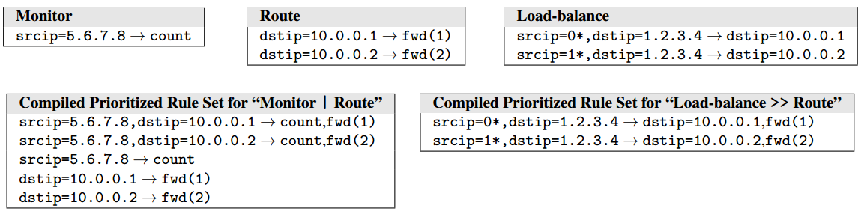
Background: Flow Table Composition
Combine multiple flow tables into one functional equivalent flow table
Two operators: parallel, sequential
Sequential of LB and Route
Parallel of Monitor and Route

Slide 11
Background: Composition Compiler without DAG
Compile multiple flow tables into a single flow table
Monitor
Router
9. srcip=1.0.0.0/24 ➔ count
0. * ➔ drop
7. dstip=2.0.0.0/30 ➔ fwd(1)
0. * ➔ drop
Priority
Match
Action

Slide 12
Background: Composition Compiler without DAG
Compile multiple flow tables into a single flow table
Monitor
Router
9. srcip=1.0.0.0/24 ➔ count
0. * ➔ drop
7. dstip=2.0.0.0/30 ➔ fwd(1)
0. * ➔ drop
16. srcip=1.0.0.0/24, dstip=2.0.0.0/30 ➔ count, fwd(1)

Slide 13
Background: Composition Compiler without DAG
Compile multiple flow tables into a single flow table
Monitor
Router
9. srcip=1.0.0.0/24 ➔ count
0. * ➔ drop
7. dstip=2.0.0.0/30 ➔ fwd(1)
0. * ➔ drop
16. srcip=1.0.0.0/24, dstip=2.0.0.0/30 ➔ count, fwd(1)
9. srcip=1.0.0.0/24 ➔ count
7. dstip=2.0.0.0/30 ➔ fwd(1)
0. * ➔ drop

Slide 14
RuleTris Composition Compiler
A generic composition compiler which features
DAG preservation during composition
Parallel
Sequential
Efficient incremental compilation (see the paper)

Slide 15
DAG Preservation for Parallel Composition
Infer dependency relations via graph cross product
Then eliminate those with empty match

Slide 16
DAG Preservation for Parallel Composition (cont’d)
Special treatment for redundant rules

Slide 17
DAG Preservation for Sequential Composition

Slide 18
Optimality Guarantee
We proved that RuleTris front-end generates optimal DAG that is both complete and minimum
(see the paper for the proof).

Slide 19
Back-end
Update Scheduler
Given delta flow table and delta DAG
Calculate the update schedule with minimum number of TCAM moves
Redundancy Eliminator
CacheFlow Manager

Slide 20
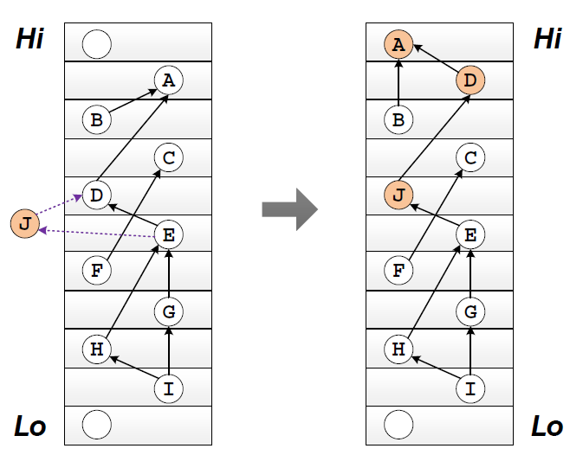
Update Scheduler
Rule Insertion
Step 1: Find TCAM location range for the inserted rule
Step 2: Find nearest upper slot and lower slot
Step 3: Search for shortest moving chain upwards and downwards
Step 4: Use the shorter path for actual update
Shortest Moving Chain Searching
Dynamic programming
Notes:
J -> D -> A
J -> E -> F
Dynamic programming: Iterative searching bounded by # of slots in between

Slide 21
Implementation
RuleTris front-end
Stand-alone composition compiler
5K lines of Java code
Interface with open-source Ryu controller
RuleTris back-end
Implemented in firmware of an FPGA-based hardware switch, ONetSwitch
3K lines of C code
Front-end/back-end communication
Extension to OpenFlow protocol for carrying DAG and DAG updates

Slide 22
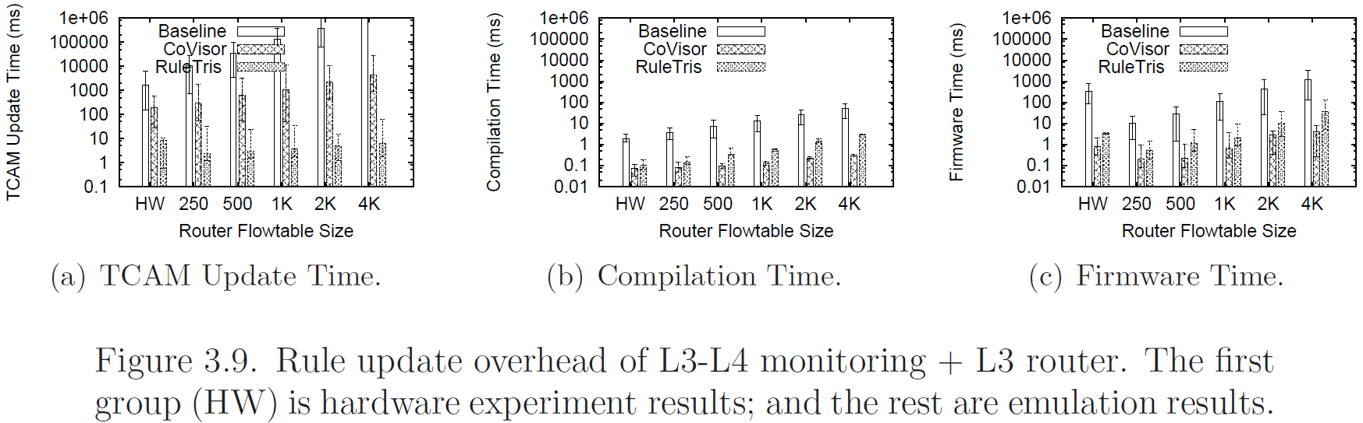
Evaluation Results
Compare with two priority based approaches
Baseline
CoVisor [NSDI 2015]: incremental update
Experiment 1: Parallel composition
Rule update overhead of L3-L4 monitoring + L3 router.
Notes:
Methodology: Small hardware, Large emulation
Metrics: Compilation time, Firmware time, TCAM update time
Comparison: Baseline, priority-based non-incremental compiler + original firmware
CoVisor, priority-based incremental compiler + original firmware
RuleTris

Slide 23
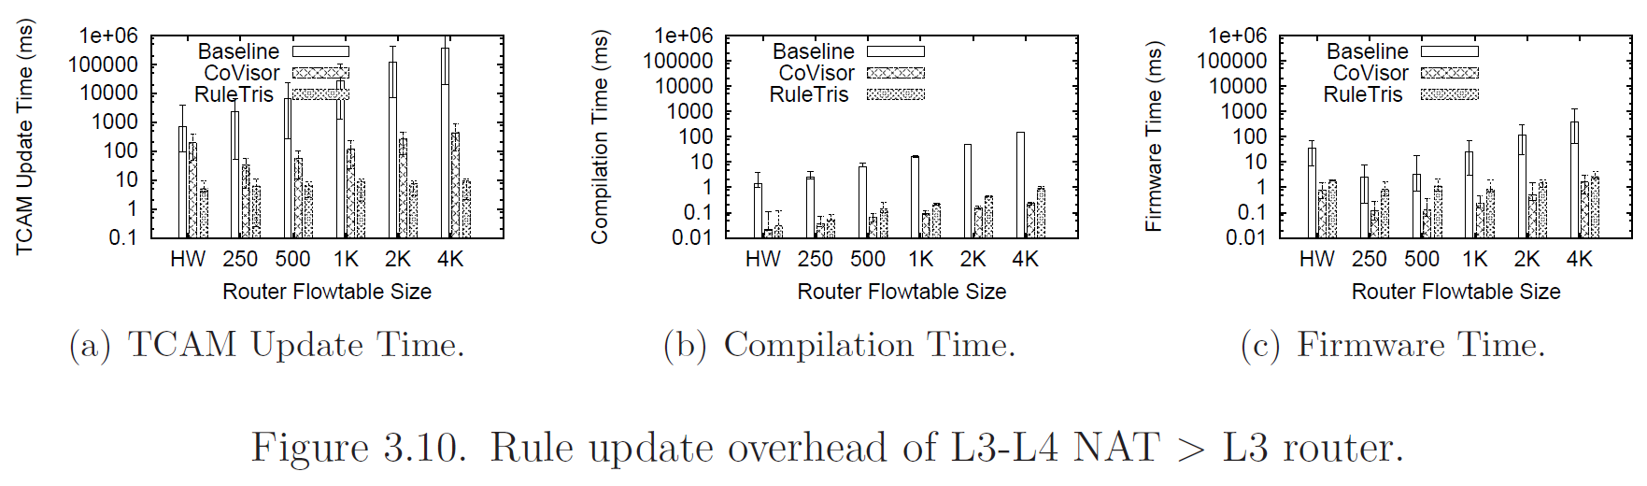
Evaluation Results II
Experiment 2: Sequential composition
Rule update overhead of L3-L4 NAT > L3 router.
RuleTris achieves a median of <12ms and 90-percentile of <15ms for the per-rule update latency
Outperform even CoVisor deployed on the same hardware switch by ∼20x.

Slide 24
Conclusions
RuleTris is a novel SDN policy update optimization framework
It minimizes rule update latency for TCAM-based SDN switches
See our SDN related work at
http://list.cs.northwestern.edu/sdn
Thanks!

