Slide 1
CoPTUA: Consistent Policy Table Update Algorithm for TCAM without Locking
小组成员：张豪、崔浩、钟春蒙、张苏坤

Slide 2
01
SDN流表查询技术背景介绍
CONTENTS
02
SDN中的流表缓存技术
03
ovs中的流表查询技术

Slide 3
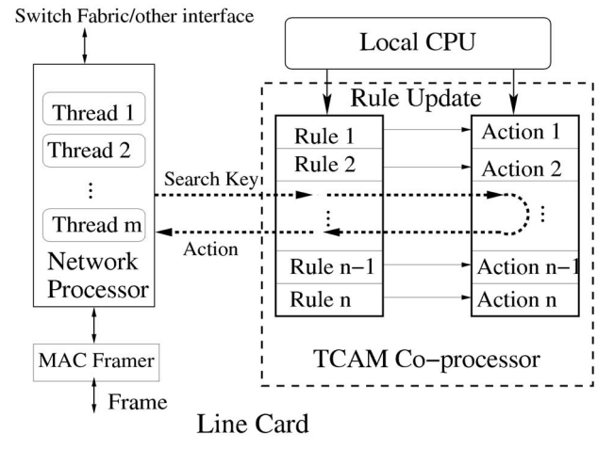
01
Introduction& TCAM COPROCESSOR
PF表规则排列在有序列表中，使得较高优先级的规则被放置在较低的存储器地址中。
使用锁定操作，搜索可以保持一致。但它会影响数据处理性能。
在每个更新时间内，丢失的数据包的数量可达1900个！
Consistent Policy Table Update Algorithm (CoPTUA) 无需TCAM PF表锁定，同时确保规则匹配的正确性!!

Slide 4
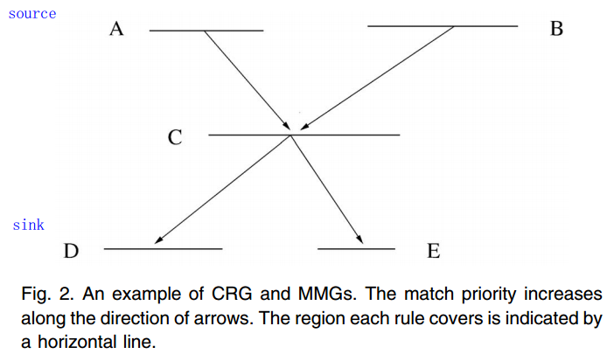
03
COMPLEXITY OF OTCAM POLICY TABLE UPDATE
一些有用的概念和数学符号:
Rule space: b bits is b-dimensional space.
Eg : IPV4 32bit
Rule overlapping:
Eg : A & C
Superset and Subset rules:
Eg： C is superset for E.
Partially overlapping:
Eg:rules 1x and x0 are partially overlapping with a common point 10.
A -> C:
A has a lower match priority than C.
A < E:
A is in a lower match priority memory location.

Slide 5
03
COMPLEXITY OF OTCAM POLICY TABLE UPDATE
Some useful concepts and mathematical notations:
Connected rules:
Eg: A&C&D , B&C&E
Connected Rule Graph (CRG):
Source (sink) leaf rule:
Eg : source A 、B
Eg : sink D 、E
Multiple Match Group(MMG):
any source leaf rule to any sink leaf rule
Independent rules:
Eg： A&B ，D&E

Slide 6
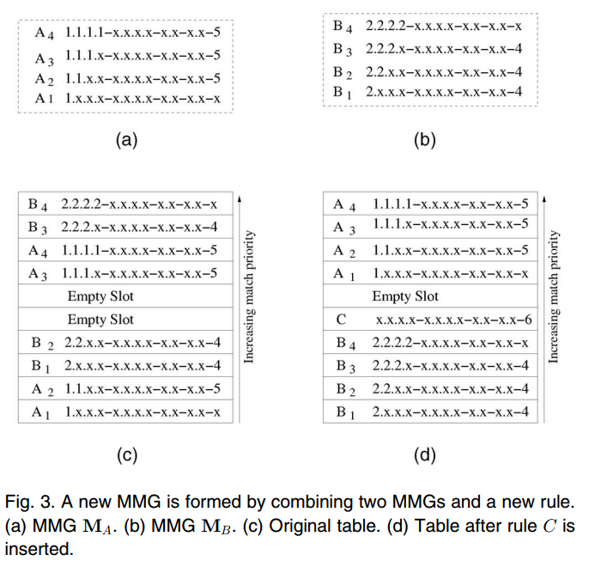
03
COMPLEXITY OF OTCAM POLICY TABLE UPDATE
adding a new rule can cause two MMGs to be merged into one larger MMG.
从这个例子我们可以看出，在表中间放置空的empty slot 并不能减少移动的数量（最坏情况）.

Slide 7
04
PROPOSED SOLUTION FOR TCAM POLICY TABLE UPDATE WITHOUT LOCKING
Consistent Policy Table Update Algorithm:
无需锁定TCAM表
在规则更新过程中确保一致且无错误的规则匹配。
（ensuring consistent and error-free rule matching during a rule update process. ）
Consistency rule matching：对于每个规则移动、添加、删除，搜索关键字匹配的结果与规则移动之前匹配的规则相同。
Error-free rule matching：如果规则更新可以避免直接规则覆盖，则实现无错规则匹配。

Slide 8
04-1
Hardware Capability
The TCAM coprocessor capabilities required :
每个TCAM规则条目都有一个与之关联的有效位。 要激活规则条目，需要设置此有效位。否则，规则条目永远不会被匹配。
the deletion of a rule = resetting the valid bit
adding a rule does not take effect until this valid bit is set.
匹配规则后，重置有效位对操作返回过程没有影响。 换句话说，如果在删除操作之前发生该规则的匹配，则删除规则不能停止将该规则的动作返回。
在两个连续的部分密钥匹配的规则，将优先较高的规则有效位设为无效，会匹配到第二个规则。
4. TCAM是双端口，可同时从本地CPU和网络处理器访问。

Slide 9
04-2
Update without Policy Table Lock
Two incorrect rule matching :
erroneous rule matching
Erroneous rule matching may occur if a rule gets a match while it or its corresponding action is partially updated.
To avoid：
【对一条规则更新】
Step1：删除过程。将原来存在的规则的有效位设为非法。
Step2：写入过程。将要添加的新规则写入其对应的位置。
Step3：将新规则的有效的设为合法。

Slide 10
04-3
Consistent PF Table Update for OTCAM
Move = write to new position + delete from old position
【添加一条新规则】
Step1：删除过程。将原来存在的规则的有效位设为非法。
Step2：写入过程。将要添加的新规则写入其对应的位置。
【对一条规则移动】
Step1：添加过程。按照上述的【添加规则】将该规则写入新的位置。
Step2：删除过程。将旧规则从原有位置上删除。
通过下面定理1，2 可以证明 使用这种方法可以保证规则在移动过程中的一致性。

Slide 11
04-3
Consistent PF Table Update for OTCAM
Move = write to new position + delete from old position
Theorem 1.
After a rule is deleted from a PF table, the consistency for all the remaining rules in the PF table is maintained.
Proof:
When a rule is deleted,
independent rule => independent
original match priority relationship => become independent or keep the relation.

Slide 12
04-3
Consistent PF Table Update for OTCAM
Move = write to new position + delete from old position
前提：when add a new rule,care about it will not be in conflict with the match priority relationship for the existing rules.
Eg:
A -> B. Add C to get B-> C-> A. Need reverse!!
1) One delete process to remove one of the two rules;
2) one add process to add that rule back at a different location which reverses the priority relationship between the two rules.
3) add C between A&B.
Theorem 2.
Adding a new rule does not change the match priority relationship among the existing rules in an MMG.

Slide 13
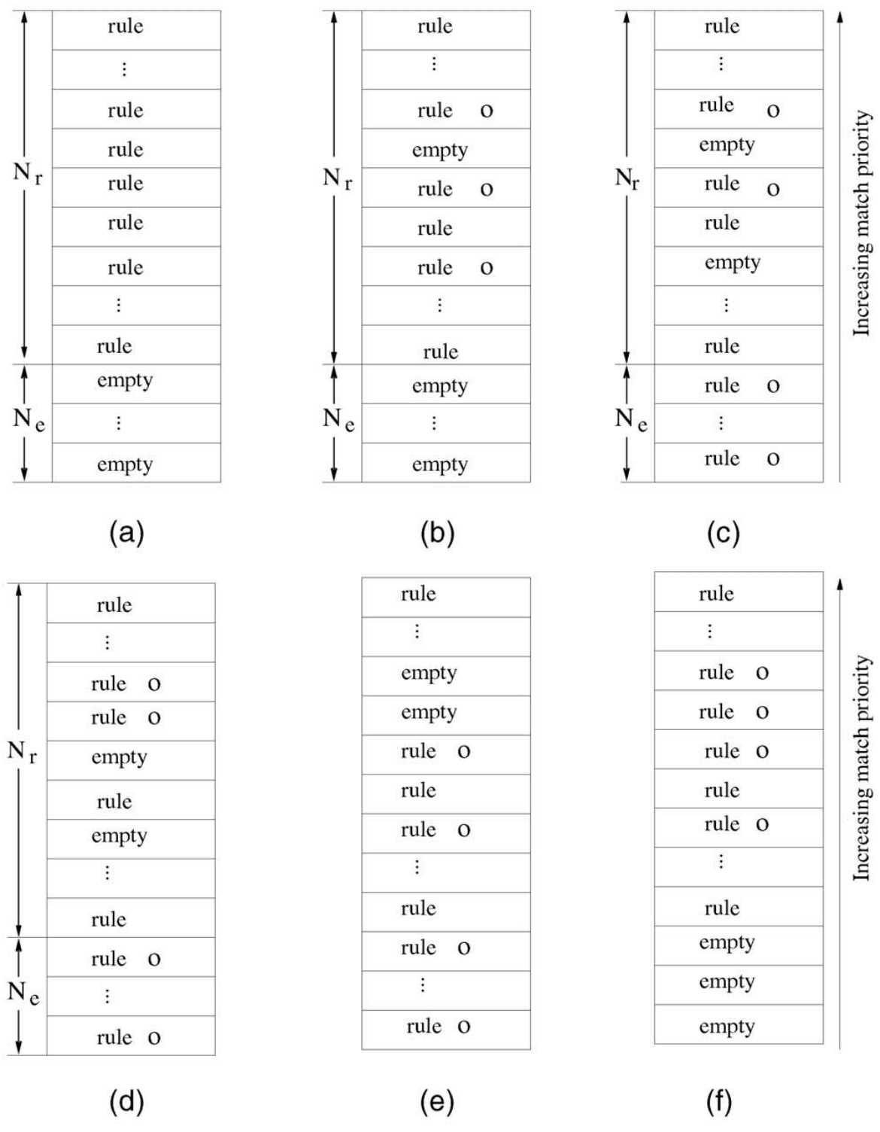
04-3
Consistent PF Table Update for OTCAM
CoPTUA algorithm:
Delete!
(a)具有Nr规则和Ne原始表。
(b)删除所有未出现在最终配置中的规则，所有相关规则都标记为“o”。
(c)Ne个具有最低匹配优先级的相关规则被移动到底部的空条目中。
(d)其余的相关规则被移至顶部。
(e)迭代重新排列top的相关规则，将它们放在所有Ne空条目下面（不包括分配给新规则的条目）。所有相关规则都是有序的。
(f)将相关规则移至顶部（底部）以填充所有可用的空条目并添加所有新的传入规则。
Iterator 2
Iterator 1
No addition

Slide 14
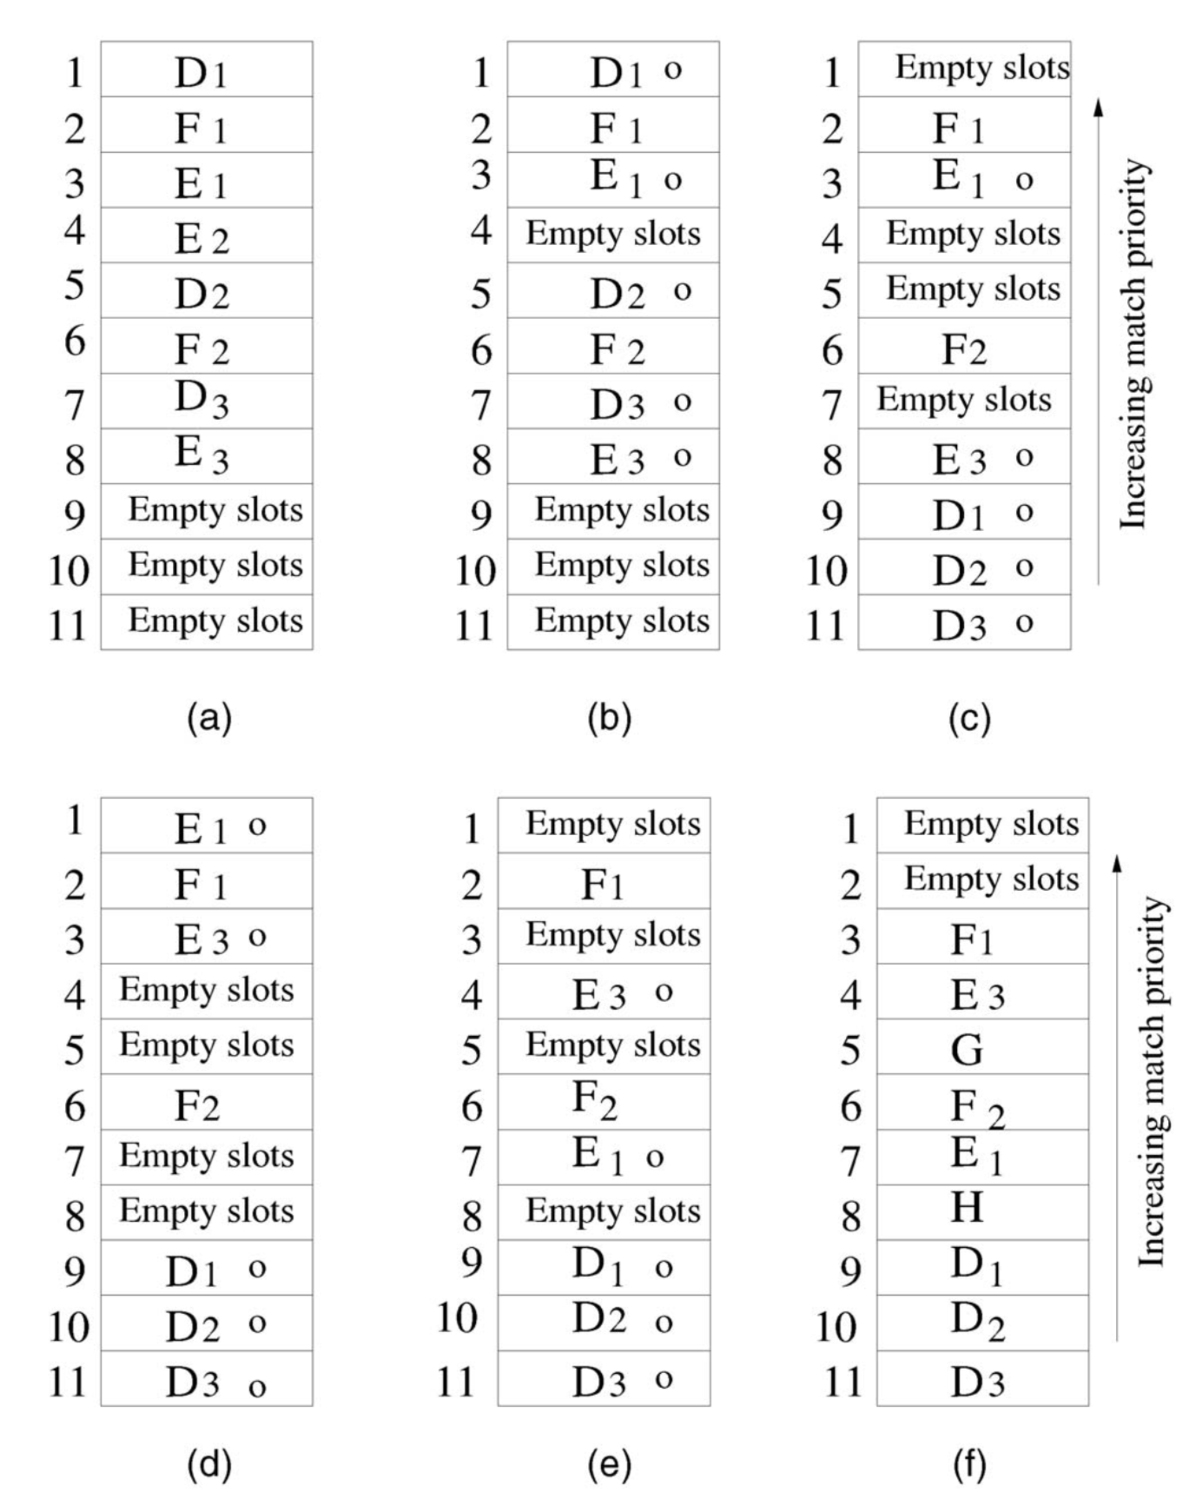




04-3
Consistent PF Table Update for OTCAM
example:
a batch of updates includes the deletion of E2 and additions of G and H.
The deletion of E₂ breaks M_{E} into two separate
single-rule CRGs.
The addition of rule G merges E₃ and E₁ back into one new MMG M_{G}, i.e., E₁ -> G -> E₃.
The addition of rule H merges all the rules in M_{D} and M_{G} into one MMG, i.e.
D₃ -> D₂ -> D₁ -> H -> E₁ -> G -> E₃.

Slide 15
04-3
Consistent PF Table Update for OTCAM
example:
Delete!

Slide 16
04-3
Consistent PF Table Update for OTCAM
example:
D₃ -> D₂ -> D₁ -> H -> E₁ -> G -> E₃.
Lowest relevant rules Move to the bottom !

Slide 17
04-3
Consistent PF Table Update for OTCAM
example:
D₃ -> D₂ -> D₁ -> H -> E₁ -> G -> E₃.
remaining relevant rules are moved toward the top!

Slide 18
04-3
Consistent PF Table Update for OTCAM
example:
iterator2
iterator1
D₃ -> D₂ -> D₁ -> H -> E₁ -> G -> E₃.
Owing to G
rearrange the top relevant rules iteratively,place them below all the empty entries， All relevant rules are in order.
Owing to H
D₁，D₂，D₃ is already in order

Slide 19
04-3
Consistent PF Table Update for OTCAM
example:
D₃ -> D₂ -> D₁ -> H -> E₁ -> G -> E₃.
Insert G
moving relevant rules toward the top(bottom) to fill all the available empty entries and adding all new incoming rules.
insert H

Slide 20
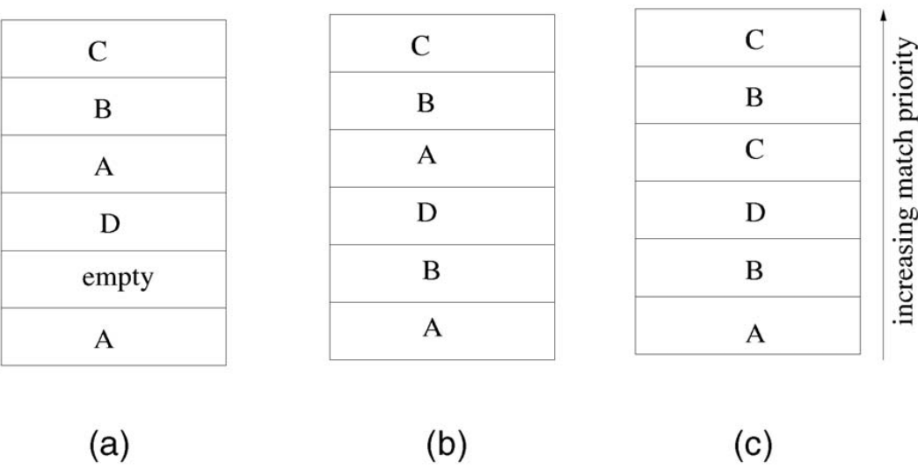
04-4
Proof of Correctness of CoPTUA
Lemma 1.
For any two rules A -> B,
if there is at least one copy of B such that all the copies of A < B,
then the PF table consistency is maintained.

Slide 21
04-4
Proof of Correctness of CoPTUA
Lemma 2.
Assume a search key matching takes n clock cycles.
In a rule move process, the rule in the old location cannot be deleted until the nth clock cycle after the rule has been written to its new location. That to say :
t_{d} – t_{a} = n
t_{me} – t_{ms} = n
t_{ms}: search key starts
t_{me}: search key ends
t_{a}: rule copy to new location
T_{d}: rule deleted from old location

Slide 22
04-4
Proof of Correctness of CoPTUA
Lemma 2.
Assume a search key matching takes n clock cycles.
In a rule move process, the rule in the old location cannot be deleted until the nth clock cycle after the rule has been written to its new location. That to say :
t_{d} – t_{a} = n
t_{me} – t_{ms} = n
t_{ms}: search key starts
t_{me}: search key ends
t_{a}
t_{d}
the rule at the new location is already valid at the beginning of the search key match process,delete do not effect！
t_{a}: rule copy to new location
T_{d}: rule deleted from old location

Slide 23

04-4
Proof of Correctness of CoPTUA
Lemma 2.
Assume a search key matching takes n clock cycles.
In a rule move process, the rule in the old location cannot be deleted until the nth clock cycle after the rule has been written to its new location. That to say :
t_{d} – t_{a} = n
t_{me} – t_{ms} = n
t_{ms}: search key starts
t_{me}: search key ends
t_{a}
t_{d}
Consistency is guaranteed if
t_{a}: rule copy to new location
T_{d}: rule deleted from old location

Slide 24
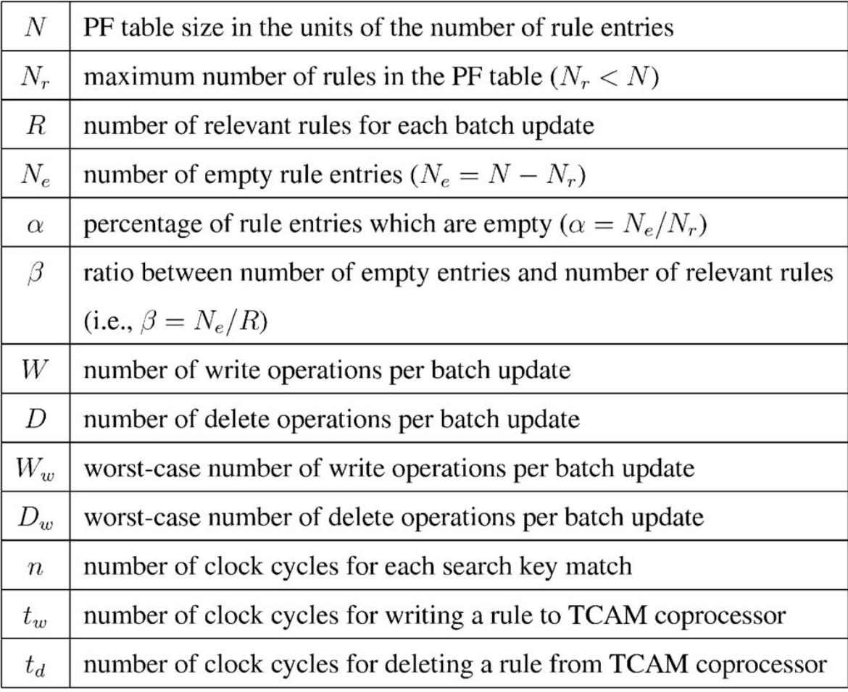
05
PERFORMANCE ANALYSIS AND EVALUATION

Slide 25
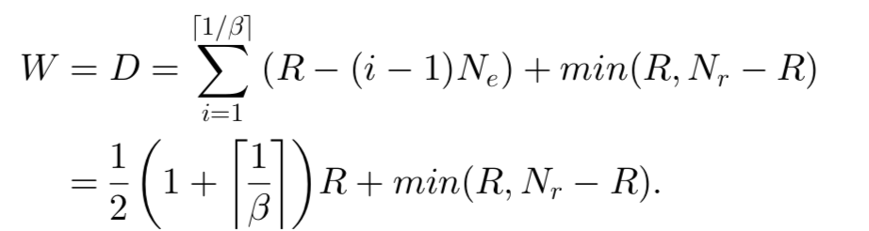
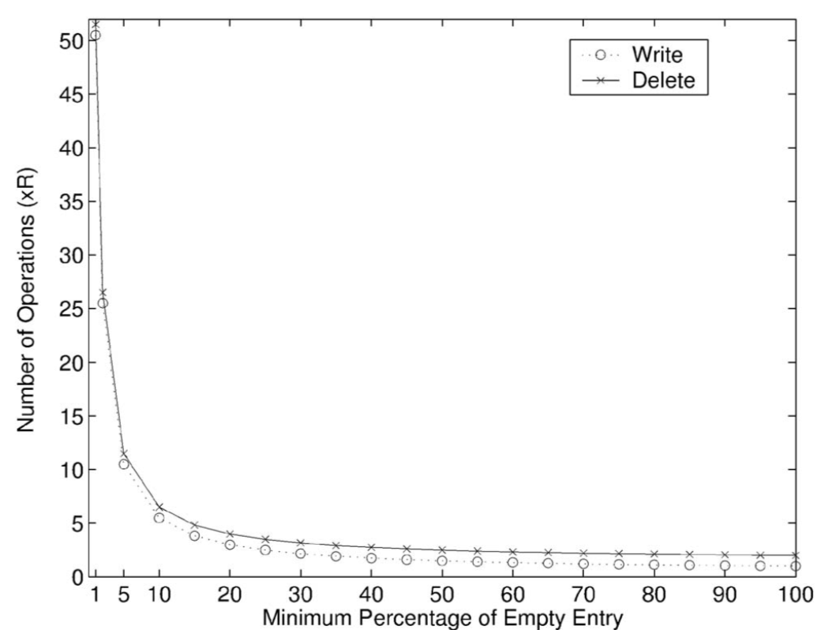
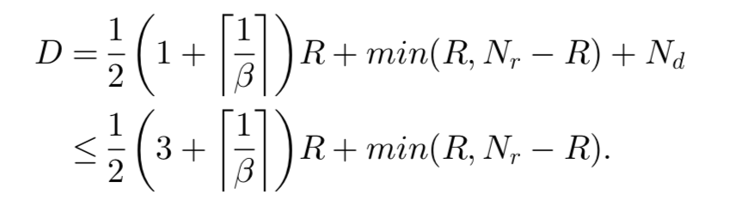

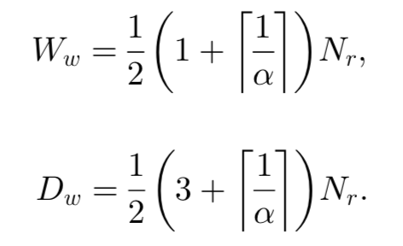
05-1
Number of Write and Delete Operations per Batch Update
For a batch update:
the worst-case upper bounds on the numbers of write and delete operations

Slide 26
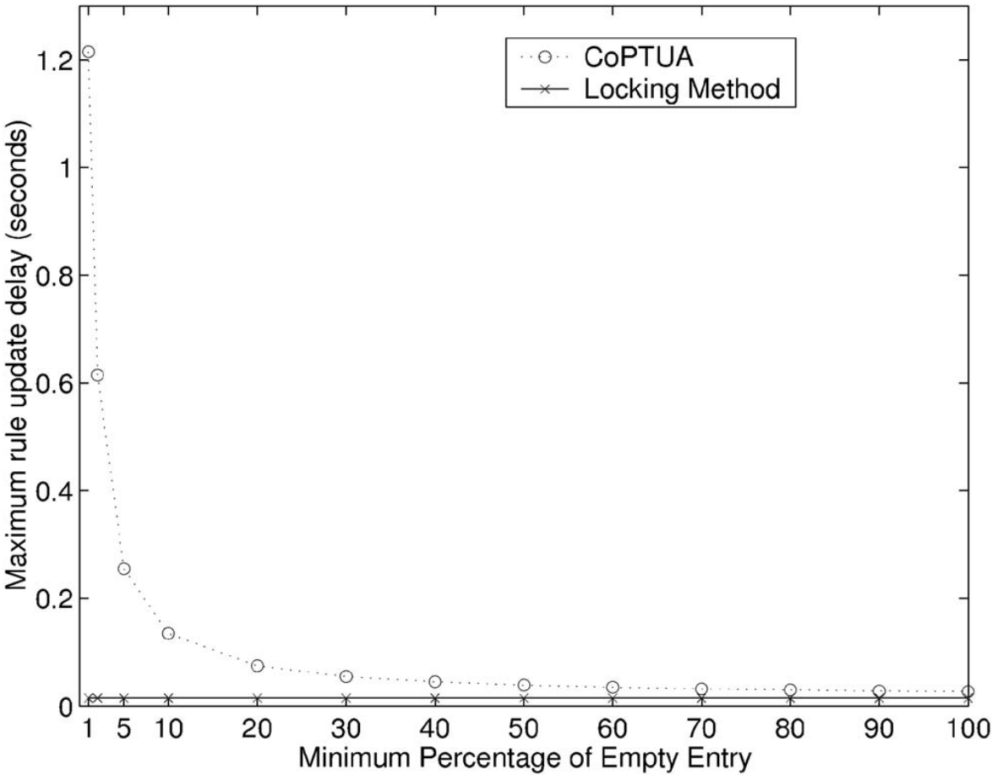

05-2
Upper Bound on Worst-Case Delay per Rule Update
t_{mv:} the lowest N_{e} number of rules are moved into the empty entries
above 1.2 seconds at a=1%.
in the following worst-case analysis, we assume that each move incurs an extra delay of tmv = n-1 clock cycles :
the worst-case delay per rule update at
this batch update interval is 2t_{u}
0.015 seconds, independent of a
During the lock period,however, up to 0.1875 million packets can be droped!

Slide 27
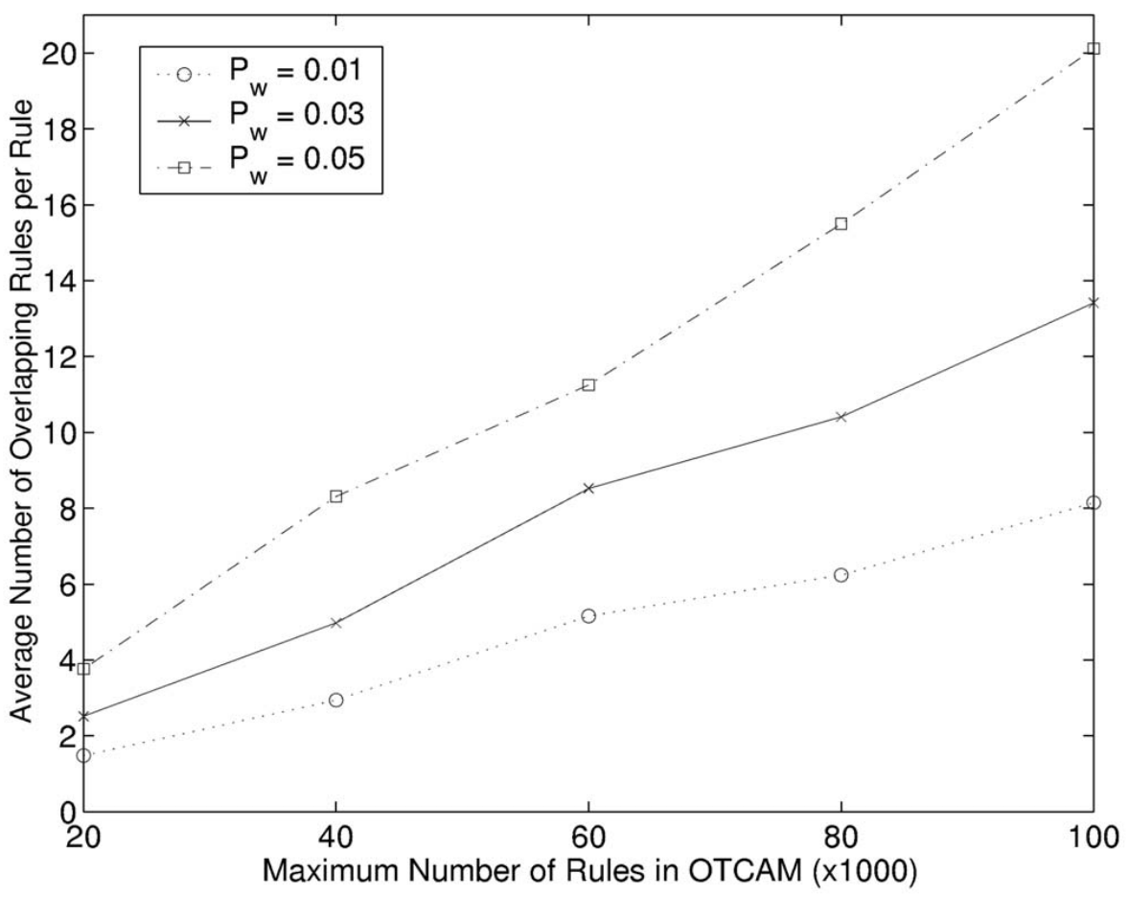
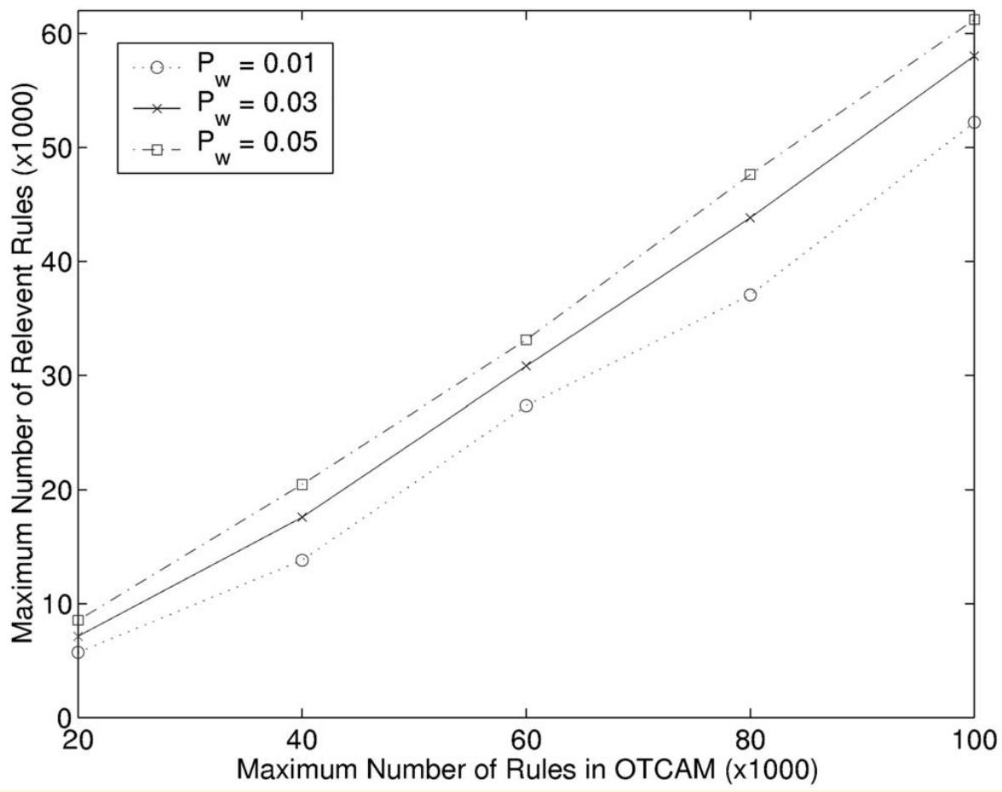
05-3
Performance Evaluation by Simulation
Pw for the protocol subfield to be all-wildcarded between 1% and 5%.
The average number of overlapping rules per rule increases as N_{r} increases.

Slide 28
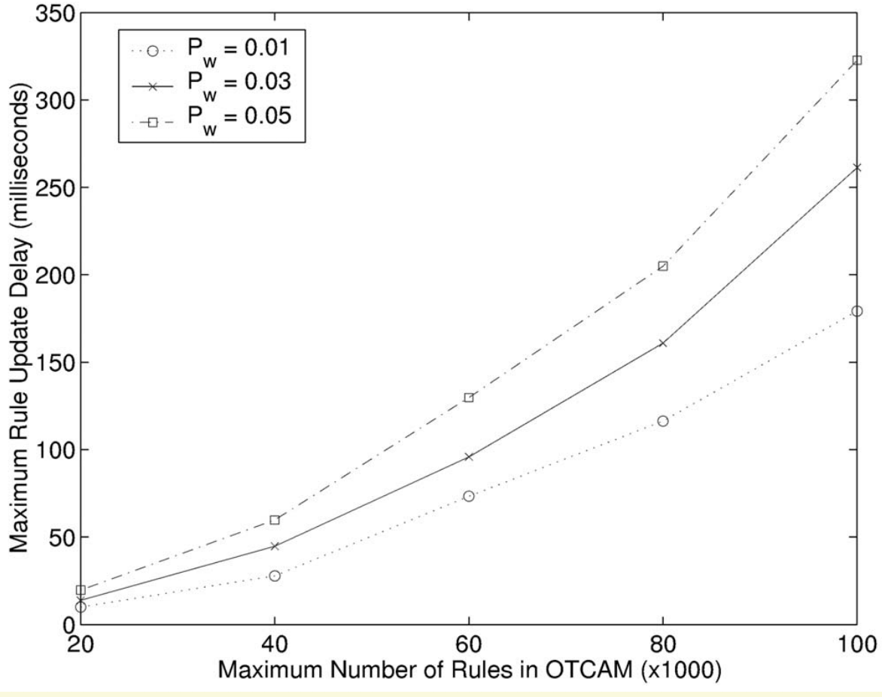
05-3
Performance Evaluation by Simulation
the maximum rule update delay at N_{r} = 100; 000 is about 0.35 seconds, much smaller than the
theoretical upper bound (about 1.2 seconds)

