Slide 1
Fast incremental updates on Ternary-CAMs
for routing lookups and packet classification
小组成员：张豪、崔浩、钟春蒙、张苏坤

Slide 2
01
INTRODUCTION
02
LONGEST-PREFIX MATCHING USING TCAMS
CONTENTS
03
ALGORITHMS
04
SIMULATION RESULTS

Slide 3
01
Introduction
Longest prefix match
Flows： A flow is a set of packets that obey some rule
Classifier: A collection of rules
Packet classification ： Identification of the flow of an incoming packet
Continually increasing link speeds!
However , routers unable to keep the same pace because relatively complex packet processing required at each router .
As a result, the problems of routing lookup and packet classification have recently received considerable attention!
This paper is motivated by the desire to simultaneously achieve fast incremental updates as well as full utilization of the TCAM.

Slide 4
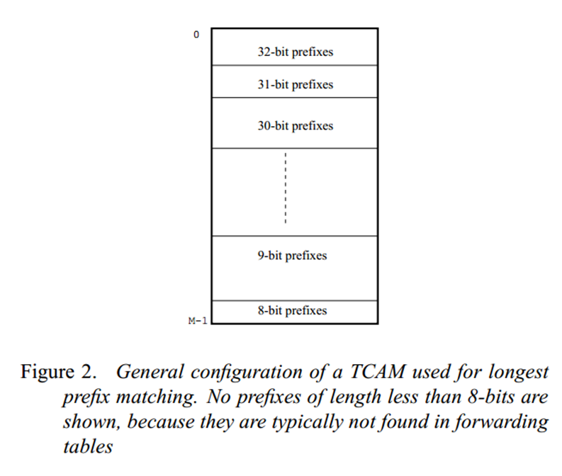
01
Introduction
TCAM
The ternary capability allows the TCAM to store wildcards and variable length
prefixes by storing don’t cares.
Packet classification is carried out similarly by storing classifier rules in order of decreasing priority
Lookups are perfomed in a TCAM by storing forwarding table entries in order of decreasing prefix lengths and choosing the first entry among all the entries that match the incoming packets.

Slide 5
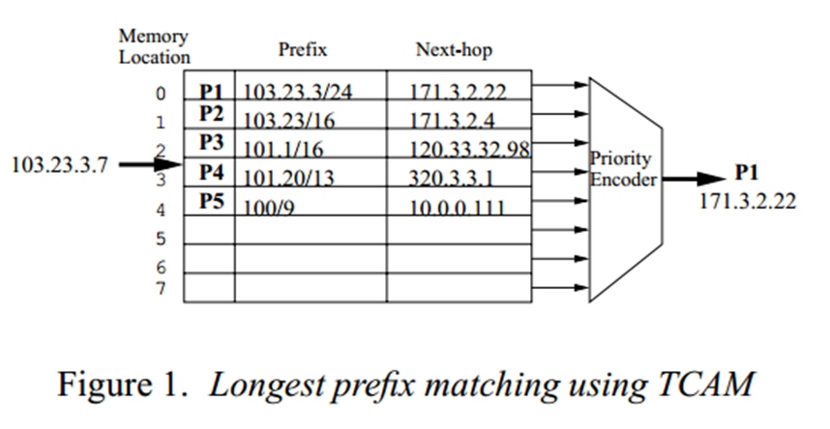
02
LONGEST-PREFIX MATCHING USING TCAMS
The general configuration for storing N prefixes in a TCAM with M memory locations.
Assume that a new prefix 103.23.128/18 is to be added to the forwarding table. It must be stored between prefixes 103.23.3/24 (P1) and 103.23/16 (P2), currently at memory locations 0 and 1.
There is a problem since there is no empty space at that location.
There can be severalways to handle this issue!

Slide 6
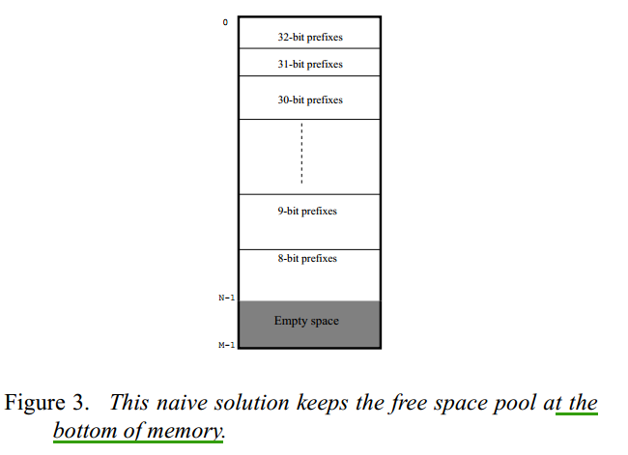
02
LONGEST-PREFIX MATCHING USING TCAMS
Methon 1
The TCAM manager keeps the free space pool (containing all unutilized TCAM entries) at one end of the TCAM,
This has worst-case time complexity O(N ), where N is the number of prefixes in the TCAM of size M, and is clearly expensive.

Slide 7
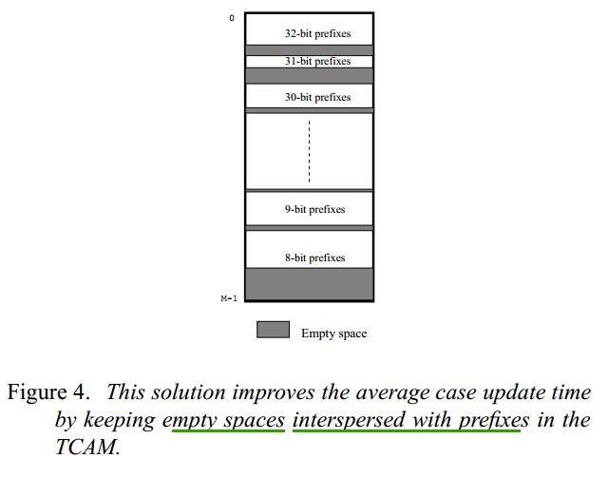
02
LONGEST-PREFIX MATCHING USING TCAMS
Methon 2
The TCAM may keep a few empty memory locations every X non-empty memory locations.
The average case update time improves to O(X ) but degenerates to O(N ) if the intermediate empty spaces are filled up. This solution also wastes precious CAM memory space.

Slide 8
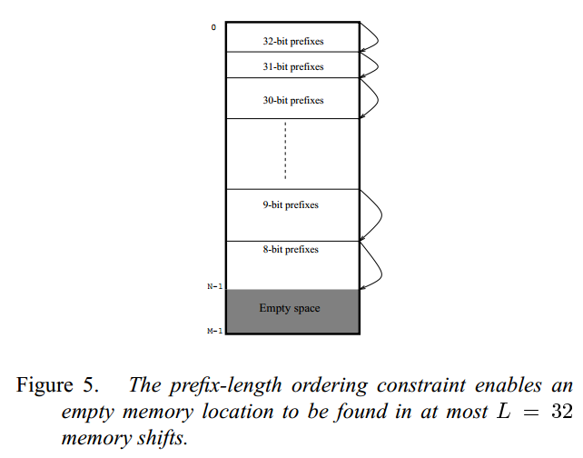
02
LONGEST-PREFIX MATCHING USING TCAMS
Prefix-length ordering constraint :
Two prefixes that are of the same length do not need to be in any specific order. This means that if j > k, all prefixes in the set Pj must appear before those in the set Pk, but prefixes within the set Pj may appear in any order.
L-algorithm :
Create an empty space in a TCAM in no more than L memory shifts .
The average case update time improves to O(L )

Slide 9
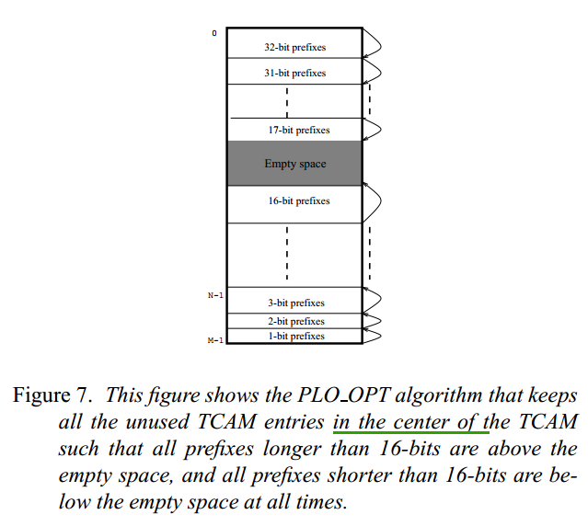
03
ALGORITHMS - PLO OPT for prefix-length ordering constraint
the set of prefixesof length L,L -1,…L/2 are always above the free space pool,
the set of prefixes of length L/2-1,L/2-2,… 1 are always below the free space pool.
Addition of a new prefix will now have to swap at most L=2 memory entries.
The average case update time can be again improved to better than L/2
Algorithm PLO OPT can be proved to be an optimal online algorithm under the prefix-length ordering constraint!

Slide 10
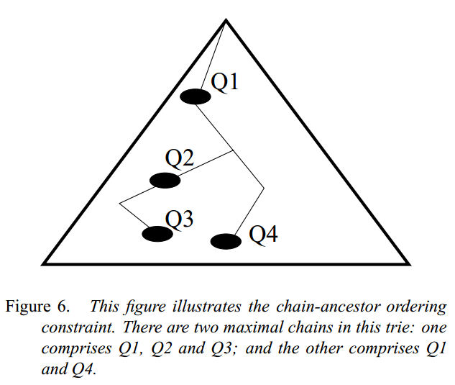
03
ALGORITHMS - CAO OPT for chain-ancestor ordering
constraint
chain-ancestor ordering constraint:
prefixes Q3, Q2 and Q1 must appear in order since they lie on the same chain.
Prefix Q4 can be stored anywhere with respect to Q2 andQ3, but must be stored at a lower memory location than Q1.

Slide 11
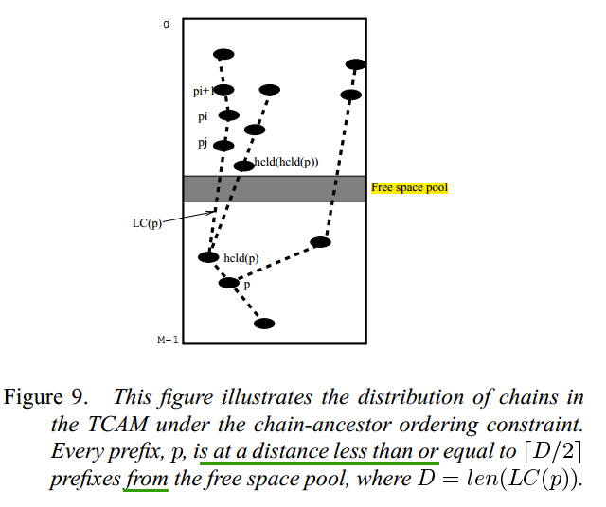
03
ALGORITHMS - CAO OPT for chain-ancestor ordering
constraint
LC (p) = the longest chain comprising prefix p
len(LC (p)) = length of LC (p)
rootpath(p) = the path from the trie root node to node p
ancestor of p = any node in rootpath(p)
prefix-child of p = a child node of p
hcld(p) = highest prefix-child of p — i.e., among the children of p, the node which has the highest memory location in the TCAM
HCN (p) = the chain comprising ancestors of p, prefix p itself, hcld(p), hcld(hcld(p)) and so on — i.e., a descendant node of p is in HCN (p) if it is the highest prefix-child of its ancestor

Slide 12
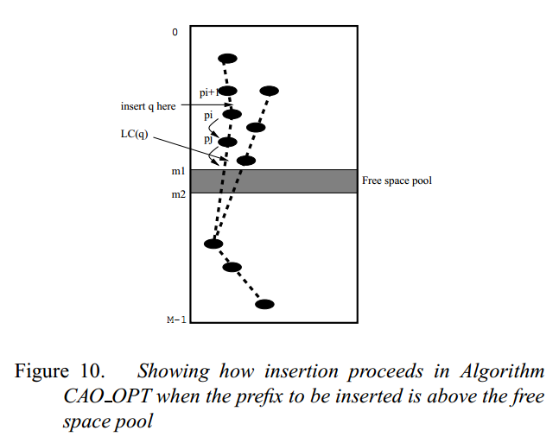
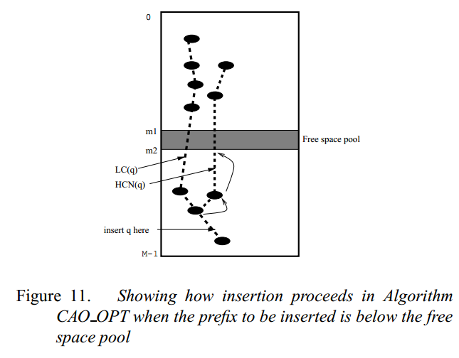
03
ALGORITHMS - CAO OPT for chain-ancestor ordering
constraint
Insert above the free space pool
Insert below the free space pool

Slide 13
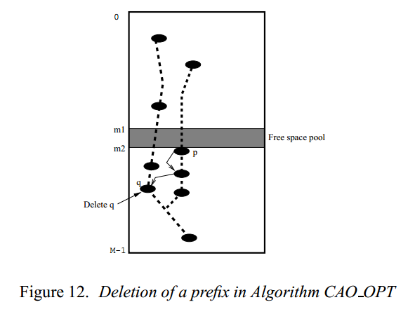
03
ALGORITHMS - CAO OPT for chain-ancestor ordering
constraint
Delete process:
Deletion is similar to insertion, except:
(1) It works in reverse, moving the newly created empty space to the free space pool,
(2) It works on the chain that has the prefix p adjacent to the free space pool — i.e., prefix p is at memory locations m1 1 or m2 + 1.

Slide 14

03
ALGORITHMS - CAO OPT for chain-ancestor ordering
constraint
Auxiliary trie data structure:
more information is needed to be kept in a trie node,p, to determine LC (p) and HCN (p) quickly
wt(p):
wt_ptr(p) : keeps a pointer to the prefix-child which has the highest weight
hcld_ptr(p): keeps a pointer to the prefix-child whichappears at the highest memory location in the TCAM
Auxiliary trie data structure:
The total number of movements is clearly less than D/2, where D = len(LC (q))
Though we have not been able to prove, we conjecture that algorithm CAO OPT is an optimal online algorithm under the chain-ancestor ordering constraint!

Slide 15
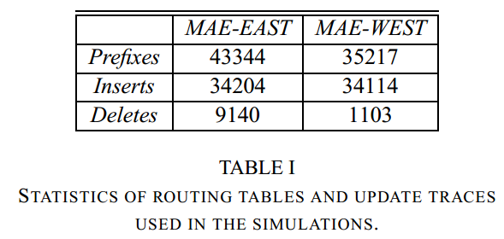
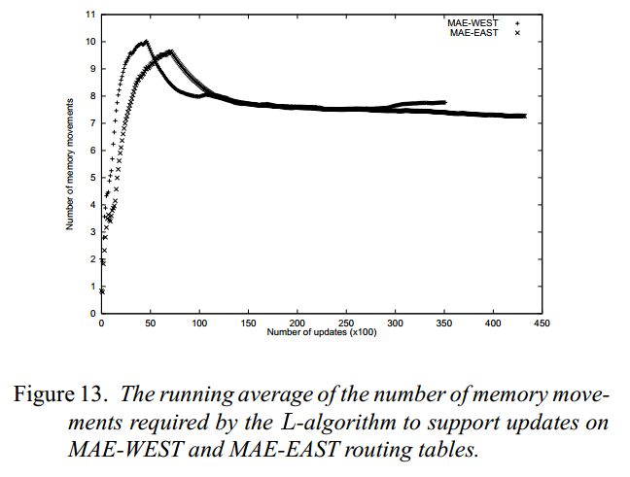
04
SIMULATION RESULTS
L –algorithm:
around 8 memory movements per update operation

Slide 16
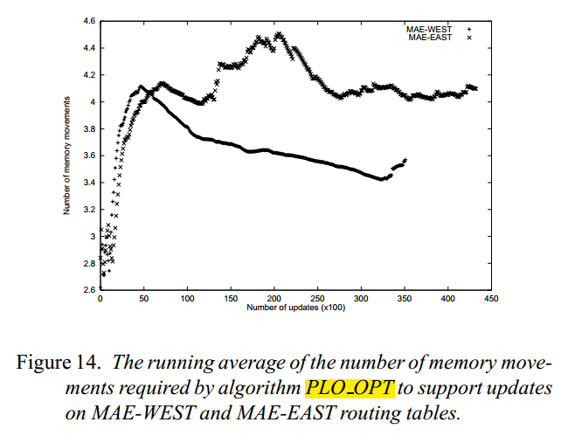
04
SIMULATION RESULTS
PLO OPT :
around 4 memory movements per update operation

Slide 17
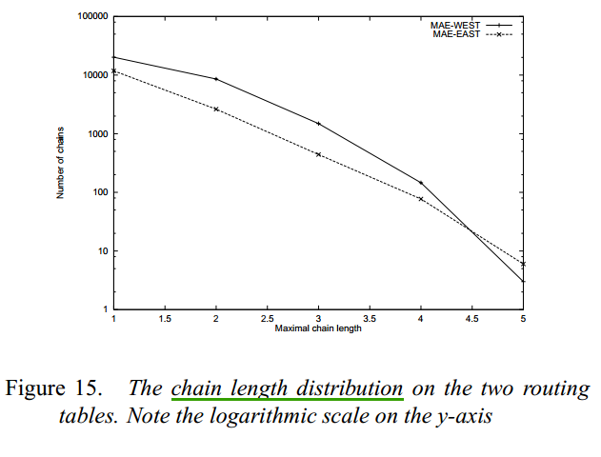
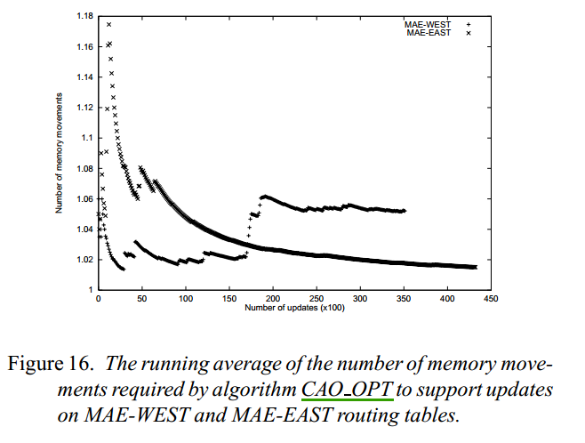
04
SIMULATION RESULTS
CAO-OPT :
the average drops quickly down to 1.02-1.06 for both routing tables

Slide 18
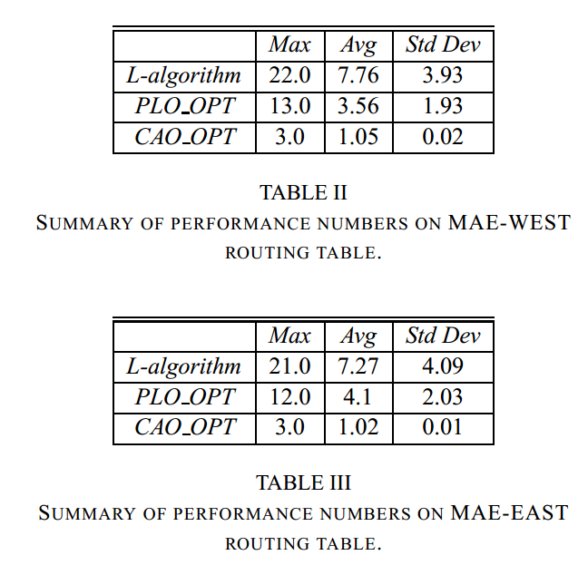
04
SIMULATION RESULTS
Algorithm CAO OPT is quite small—
probably because of the exponentially decreasing chain length distribution.
This should make algorithm CAO OPT even more attractive in practice

