Slide 1
RuleTris: Minimizing Rule Update Latency for TCAM-based SDN Switches
小组成员：张豪、崔浩、钟春蒙、张苏坤

Slide 2
01
Motivation
TCAM流表更新瓶颈
(Ternary Content-Addressable Memory)
10s to 100s of rule operations per second
现有控制器生成膨胀的流表更新
不必要的优先级更新
大规模的TCAM内部移动
Ultimate Goal:最小化TCAM更新操作以加速更新
Only update the “diff”

Slide 3
01
Motivating Example
Update schedule with priority clue
1 rule adds + 4 rule moves
Update schedule with dependency graph
1 rule adds + 2 rule moves
Such redundant moves contribute over 95% in average!

Slide 4
03
Key Insight
Dependency Graph (DAG) provides two optimality guarantees:
Minimum size flow table
Minimum number of TCAM moves for table update
1.How to efficiently generate DAG?
O(n²) algorithm to obtain DAG from scratch
Usually takes minutes for a thousand rules
2.How to efficiently optimize updates with DAG?
Slow processor, limited memory on switches

Slide 5
02
RuleTris Architecture
Front-end in controller
An incremental SDN policy compiler that preserves DAG
Back-end in switch firmware
Redundancy Eliminator, Update Scheduler…
F/B Interface
Flow table + DAG

Slide 6
03
How to efficiently generate DAG?
Our approach
Track DAG along with flow table compilation
（跟踪DAG以及流表编译）
Linear additional time complexity!
Will provide background on composition compiler first !

Slide 7
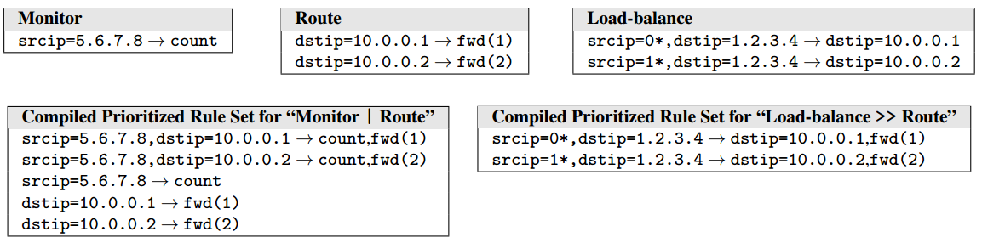
03
Background: Flow Table Composition
Combine multiple flow tables into one functional equivalent flow table
Two operators: parallel, sequential
Sequential of LB and Route
Parallel of Monitor and Route

Slide 8
03
Background: Composition Compiler without DAG
Compile multiple flow tables into a single flow table
Monitor
Router
9. srcip=1.0.0.0/24 ➔ count
0. * ➔ drop
7. dstip=2.0.0.0/30 ➔ fwd(1)
0. * ➔ drop
Priority
Match
Action
16. srcip=1.0.0.0/24, dstip=2.0.0.0/30
➔ count, fwd(1)

Slide 9
03
Background: Composition Compiler without DAG
Compile multiple flow tables into a single flow table
Monitor
Router
9. srcip=1.0.0.0/24 ➔ count
0. * ➔ drop
7. dstip=2.0.0.0/30 ➔ fwd(1)
0. * ➔ drop
Priority
Match
Action
16. srcip=1.0.0.0/24, dstip=2.0.0.0/30 ➔ count, fwd(1)
9. srcip=1.0.0.0/24 ➔ count
7. dstip=2.0.0.0/30 ➔ fwd(1)
0. * ➔ drop

Slide 10
03
RuleTris Composition Compiler
A generic composition compiler which features
DAG preservation during composition
Parallel
Sequential
prioity
Efficient incremental compilation

Slide 11
04-1
DAG preservation for Parallel Composition
Infer dependency relations via graph cross product
Then eliminate those with empty match

Slide 12
04-1
DAG preservation for Parallel Composition
Special treatment for redundant rules:
not delete but indexes with the nested graph data structure

Slide 13
04-2
DAG Preservation for Sequential Composition
Also eliminate empty and redundant rules

Slide 14
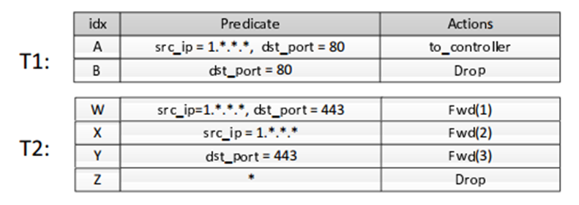
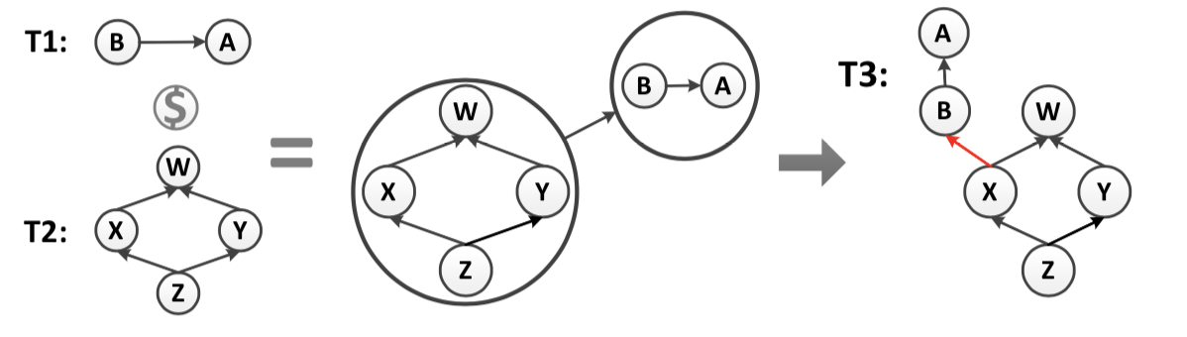
04-3
DAG Preservation for priority Composition
通过找mega dependency 来将两个表缝合起来。

Slide 15
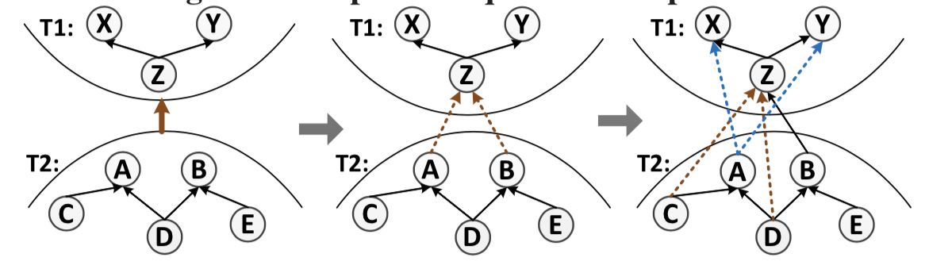
04-3
DAG Preservation for priority Composition
找T2中的每个sink结点到T1种的每个source结点，作为试验边。如A->Z,B->Z;
对于每个试验边r2->r1，检查两个规则r1和r2的匹配是否重叠。如果是，则将边r2->r1放入结果DAG中。 否则，递归地生成试验边：
看每个r2结点的前任r3，如A的前任C,D，如果，r3比r2更通配，且与r1重叠，将r3->r1加入DAG中并设为试验边。（C->Z, D->Z）；
看r1的后任结点r4，如X,Y。如果r1不必r4严格通配。（ ）。则把r2->r4加入试验边。
递归验证每条试验边。

Slide 16
05
Back-end OPTIMIZER
Update Scheduler
Given delta flow table and delta DAG
Calculate the update schedule with minimum number of TCAM moves
Redundancy Eliminator
CacheFlow Manager

Slide 17
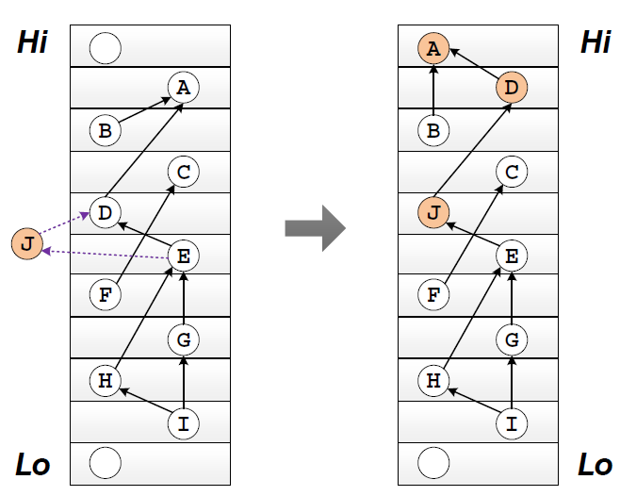
05
Back-end OPTIMIZER
Rule Insertion
Step 1: Find TCAM location range for the inserted rule(eg:d & e)
Step 2: Find nearest upper slot and lower slot
Step 3: Search for shortest moving chain upwards and downwards
Step 4: Use the shorter path for actual update
Shortest Moving Chain Searching
Dynamic programming

Slide 18
06
Implementation
RuleTris front-end
Stand-alone composition compiler
5K lines of Java code
Interface with open-source Ryu controller
RuleTris back-end
Implemented in firmware of an FPGA-based hardware switch, ONetSwitch
3K lines of C code
Front-end/back-end communication
Extension to OpenFlow protocol for carrying DAG and DAG updates

Slide 19
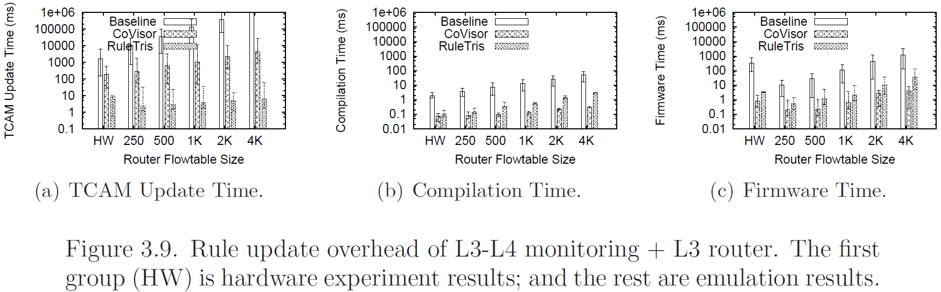
07
Evaluation Results
Compare with two priority based approaches
Baseline
CoVisor [NSDI 2015]: incremental update
Experiment 1: Parallel composition
Rule update overhead of L3-L4 monitoring + L3 router.

Slide 20
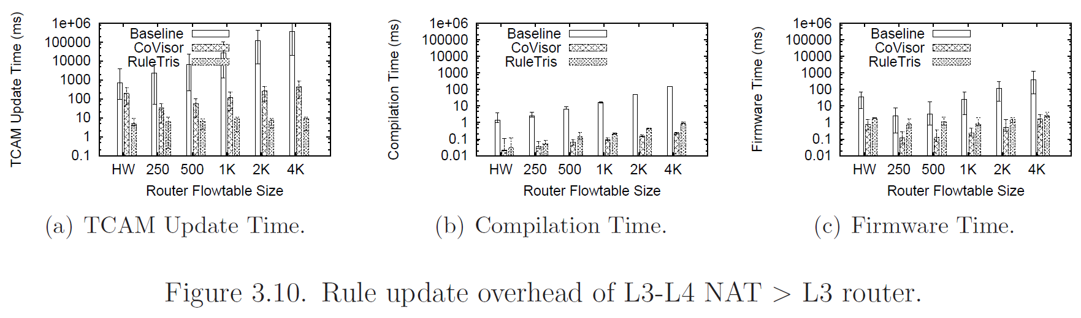
07
Evaluation Results
Compare with two priority based approaches
Baseline
CoVisor [NSDI 2015]: incremental update
Experiment 2: Sequential composition
Rule update overhead of L3-L4 NAT > L3 router.

Slide 21
07
Evaluation Results
对于每规则更新延迟，RuleTris的中位数<12毫秒且90%的结果小于<15毫秒。
甚至超过在同一硬件交换机上部署的CoVisor近20倍。
RuleTris is a novel SDN policy update optimization framework
It minimizes rule update latency for TCAM-based SDN switches

