Slide 1
Advanced Chronos-2 Fine-Tuning: Can Better PEFT Beat Zero-Shot?
1
RESEARCH QUESTION
Can a more advanced fine-tuning strategy consistently outperform Chronos-2 zero-shot for vegetation LAI forecasting under limited-data conditions?
▪ Standard LoRA fine-tuning (original and validation-selected) did not consistently beat zero-shot in our earlier experiments.
▪ This study tests 6 additional, more recent parameter-efficient fine-tuning (PEFT) methods, selected from a literature review of ICLR/ICML/NeurIPS 2022-2025.
▪ Same 3 pixels, same fair validation-only protocol, same pretrained starting weights for every method — an equal-sized hyperparameter budget throughout.
TAKEAWAY
6 mechanistically distinct methods, 90 fine-tuning runs, one fair protocol — does anything beat zero-shot?

Slide 2
2
Literature Review & Method Selection
Method | Venue | Core idea | Trained params
DoRA | ICML'24 Oral | Decompose weight into magnitude + direction; LoRA-update direction | ~1.3M
VeRA | ICLR'24 | One frozen shared random low-rank pair; learn only small scale vectors | ~99K
IA3 | NeurIPS'22 | Learned multiplicative rescaling of K/V/FFN activations | ~74K
LN-Tuning | Chronos precedent (2409.11302) | Unfreeze only normalization affine parameters | 28K
BitFit | ACL'22 | Unfreeze only bias terms | 8.4K
Partial (last block) | Classical | Full-weight unfreeze of only the last transformer block | ~13.1M
▪ Chosen to span mechanistically distinct update types (not 5 near-identical LoRA variants) and a capacity spectrum from 8.4K to 13.1M trainable parameters.
▪ Excluded after investigation: AdaLoRA (needs more gradient signal than our tiny datasets give), FourierFT (overlaps with VeRA), prompt/prefix tuning (real compatibility risk — Chronos-2 isn't a token-sequence LM), PETSA/TimesFM in-context tuning (break comparability with our fixed protocol).
TAKEAWAY
Selection grounded in real compatibility checks against Chronos-2's actual source code, not just fame.

Slide 3
3
Experimental Design
▪ Every method starts from the identical pretrained Chronos-2 weights — verified by reading the actual fit() source; Chronos2Trainer has zero LoRA-specific logic, so any peft.PeftConfig can be substituted via a faithful reimplementation of fit()'s internals.
▪ Same validated protocol as the improved-LoRA study: chronological validation folds (2020, 2021), early stopping, final refit on 2000-2021, evaluated once on real 2022 — test data never touches hyperparameter selection.
▪ Equal-sized 4-config search budget per method per pixel — no method received more tuning effort than another.
DoRA: lr∈{1e-5,1e-4} × rank∈{8,16} VeRA: lr∈{1e-4,1e-3} × rank∈{256,1024}
IA3 / LN-Tuning / BitFit: lr∈{1e-4,1e-3,1e-2,1e-1} Partial: lr∈{1e-6,1e-5,1e-4,1e-3}
→ 72 search runs + 18 final refits = 90 fine-tuning runs, ~85 minutes on one A100
TAKEAWAY
Baselines (zero-shot, original LoRA, improved LoRA) reused directly — never rerun.

Slide 4
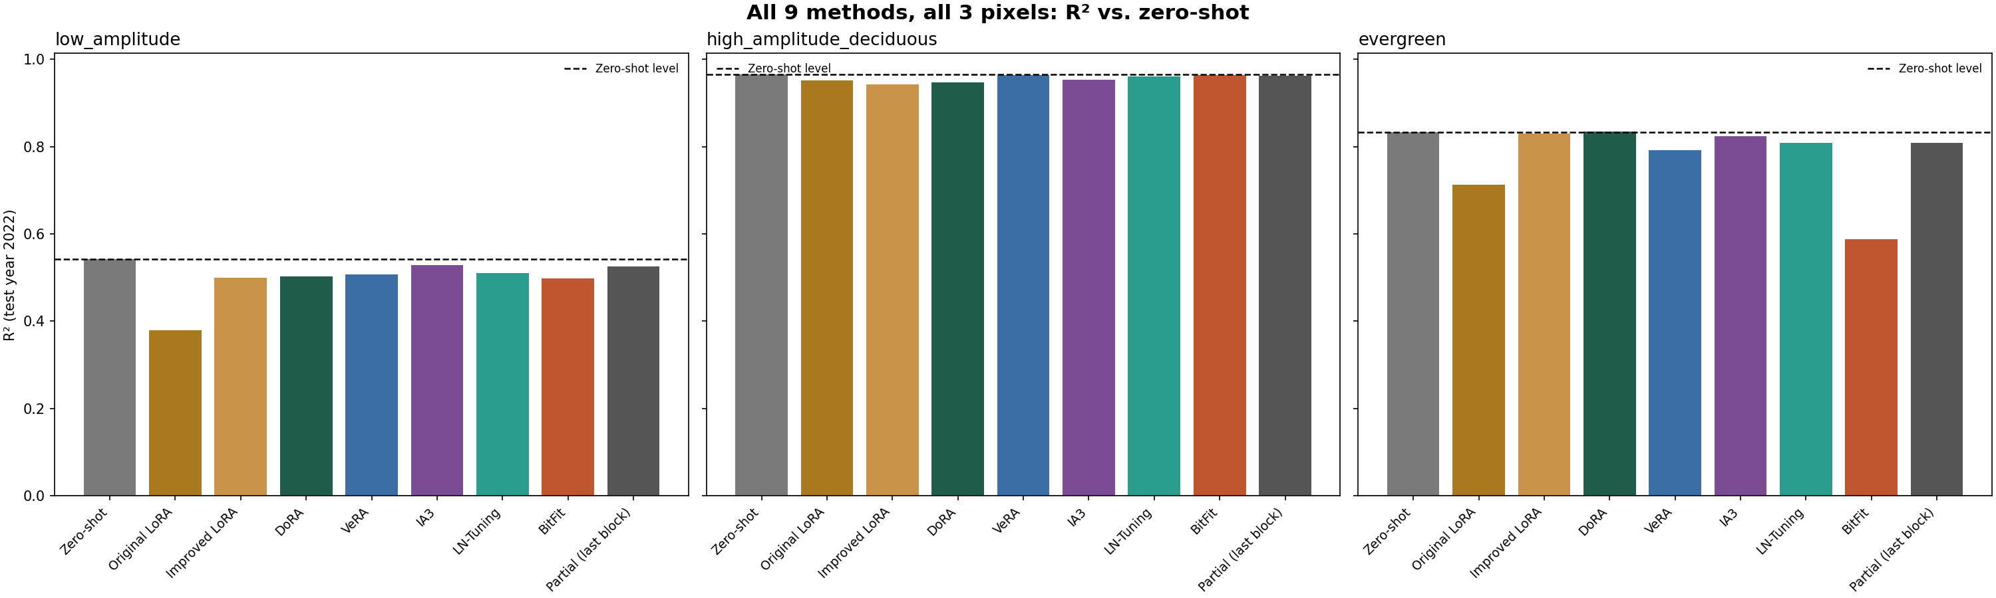
4
Results: R² by Pixel, All 9 Methods
TAKEAWAY
Zero-shot (dashed line) sits at or near the top of every panel — no method consistently clears it.

Slide 5
5
Final Ranking Table
Method | Params | Mean R² | vs. Zero-shot | Pixels beating ZS
Zero-shot | — | 0.780 | — | —
IA3 | 74K | 0.769 | -0.011 | 0/3
Partial (last block) | 13.1M | 0.766 | -0.014 | 0/3
DoRA | 1.3M | 0.761 | -0.019 | 1/3
LN-Tuning | 28K | 0.760 | -0.020 | 0/3
Improved LoRA | — | 0.757 | -0.023 | 0/3
VeRA | 99K | 0.755 | -0.025 | 0/3
BitFit | 8.4K | 0.683 | -0.097 | 0/3
Original LoRA | — | 0.681 | -0.099 | 0/3
TAKEAWAY
Only one method/pixel combination ever beats zero-shot — DoRA on evergreen, by +0.0026.

Slide 6
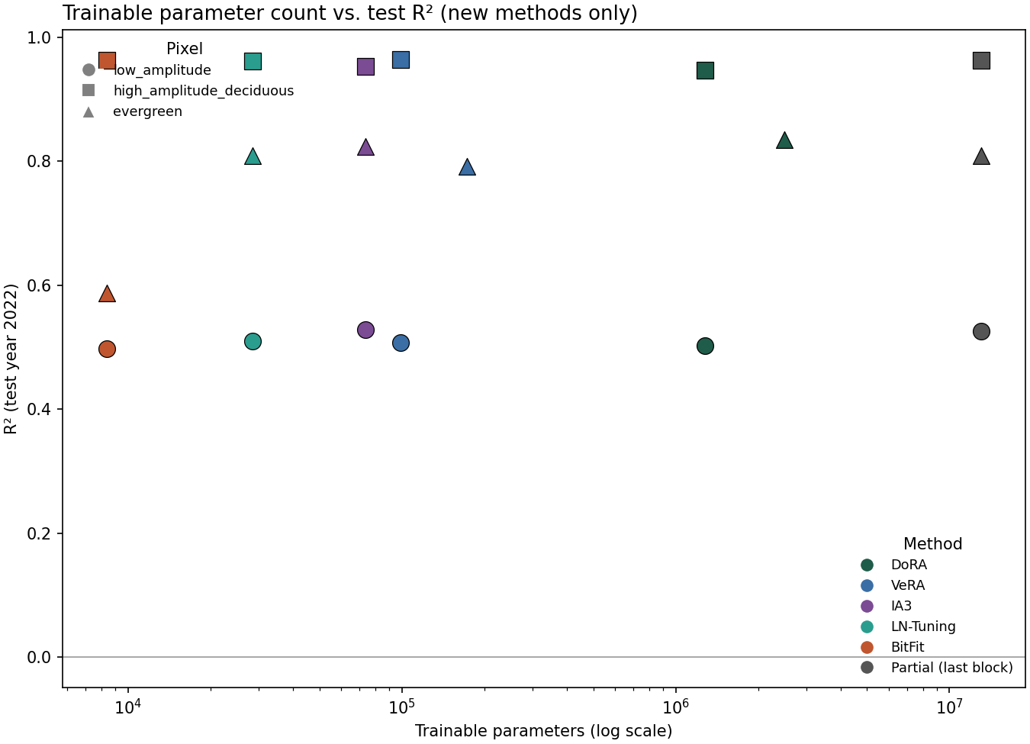
6
Does More Capacity Help?
▪ Overall correlation between log(trainable params) and R² is weak: only +0.10 pooled across all pixels.
▪ Direction flips by pixel: +0.59 (evergreen), +0.45 (low_amplitude), but −0.24 (high_amplitude_deciduous) — more capacity mildly hurts where zero-shot is already near-ceiling.
▪ Which pixel matters far more than how much capacity a method has.
TAKEAWAY
Parameter count is a weak, pixel-dependent predictor — not a reliable guide to which method to pick.

Slide 7
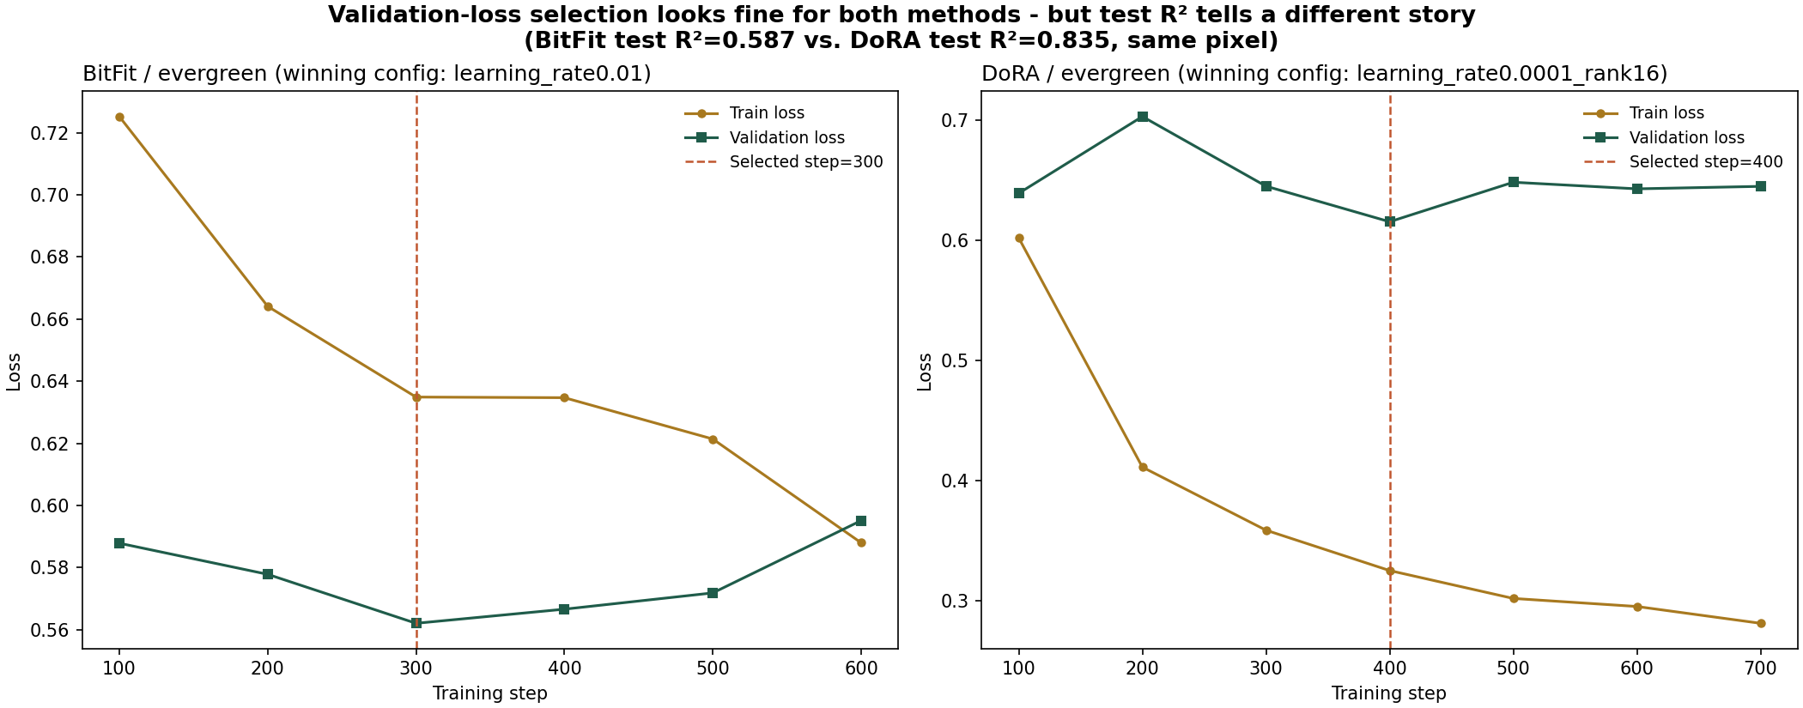
7
Failure Mode: When Validation Loss Lies
▪ BitFit's selected config had the BEST validation loss of all 24 evergreen configs tested (0.562, beating even DoRA's 0.615) — yet the WORST test R² (0.587 vs. DoRA's 0.835).
▪ Not classic overfitting (train/val curves look normal) — BitFit's only lever (a patch-embedding bias shift) helped the 2020/2021 folds but pointed the wrong way for 2022.
TAKEAWAY
Chronos-2's attention/FFN layers have NO bias terms — BitFit can only touch 0.007% of the model.

Slide 8
No — zero-shot Chronos-2 remains the best method overall for this task.
8
▪ Across 6 mechanistically distinct methods (additive low-rank, shared-random-projection, multiplicative rescaling, bias-only, normalization-only, partial full-weight) and 8K-13M trainable parameters, not one consistently beat zero-shot across the 3 pixels.
▪ This corroborates independent literature evidence that Chronos-2 fine-tuning specifically struggles on small datasets, and extends our project's LoRA-specific finding: the result is not about LoRA's particular mechanism — it looks like a property of fine-tuning Chronos-2 at all on data this small.
Practical recommendation
▪ Keep zero-shot Chronos-2 as the default for this task.
▪ If fine-tuning is needed for a structurally different domain, IA3 or last-block-only partial fine-tuning are the safest choices tested — they lose the least relative to zero-shot with no catastrophic single-pixel failure.
TAKEAWAY
Method diversity ruled out LoRA's mechanism as the cause — the ceiling appears to be the data, not the method.

