Slide 1
GPP vs. LAI: Vegetation-Class Breakdown, Data Fix, and First Zero-Shot Comparison
1
▪ Part 1: last week's pooled LAI-anomaly boxplot, redone broken down by dominant vegetation class.
▪ Part 2: why the GPP download previously only returned 2021-2022 - wrong MODIS product, not a request error - and the fix.
▪ Part 3: first zero-shot GPP vs. LAI comparison on real GPP data (same sites, same LOYO-CV protocol).

Slide 2
PART 1 — VEGETATION-CLASS BREAKDOWN
2
Part 1: LAI Anomaly, Broken Down by Vegetation Class
▪ Last week's result pooled every vegetation type into one CONUS boxplot (770 folds) and one Global boxplot (748 folds) - this hides which vegetation types Chronos-2 is actually good at.
▪ Reran the same already-computed fold-level results (no new model calls), grouped by each site's dominant vegetation class instead - using the project's existing ESA-CCI-derived PFT classification, not the informal site-name suffix.
▪ Pseudo-replication fix: grouping at the fold level pools 11 years per site into each class's distribution, which overstates independence (11 years at one site aren't 11 independent draws). The honest sample size per class is its site count, not its fold count.
TAKEAWAY
Fixed two ways, both shown next: collapse each site to its 11-year mean first (one point per site), and check the ranking separately for each of the 11 years.

Slide 3
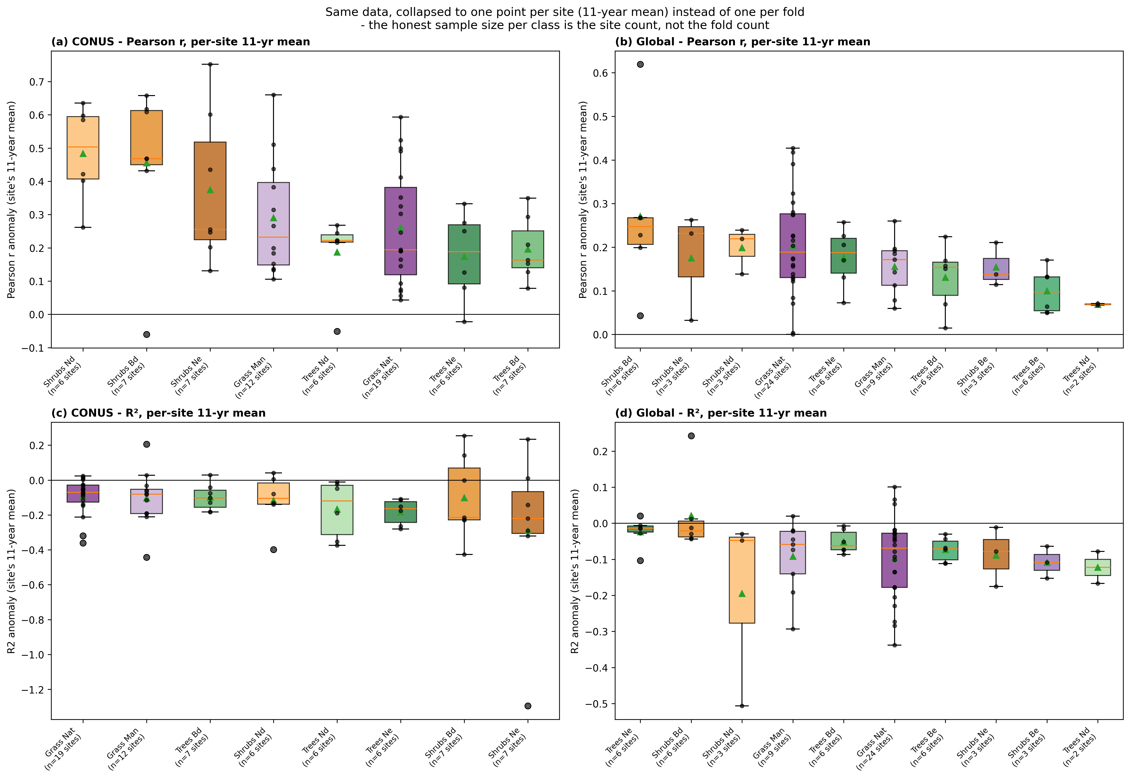
PART 1 — VEGETATION-CLASS BREAKDOWN
3
Shrubs and Grasses Forecast Better Than Trees, in Both Pools
TAKEAWAY
Each site collapsed to its 11-year mean first, then boxplotted (dots = individual sites) - a class with 6 sites shows 6 points here, not 66 pooled folds.

Slide 4
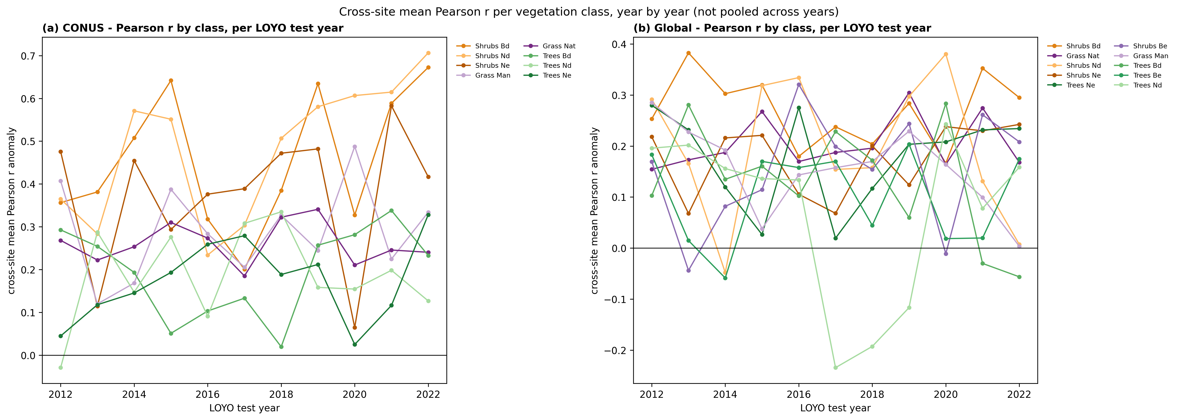
PART 1 — VEGETATION-CLASS BREAKDOWN
4
Robustness Check: Is the Ranking Stable Year by Year?
TAKEAWAY
Shrub-family lines (orange/brown) sit above tree-family lines (green) in most individual CONUS years, not just on average - this isn't one or two outlier years driving the effect.

Slide 5
PART 1 — VEGETATION-CLASS BREAKDOWN
5
Part 1 Summary: Median Pearson r by Class Family (Per-Site)
Class family | CONUS median r | Global median r
Shrubs | 0.26 – 0.50 | 0.14 – 0.25
Grass | 0.19 – 0.23 | 0.17 – 0.19
Trees | 0.16 – 0.22 | 0.07 – 0.19
▪ Ranges computed from per-site 11-year means (honest n), not pooled folds - shrubs > grass > trees still holds; Global's grass/trees ranges now overlap slightly once the inflated fold count is corrected for, so that distinction is less crisp in Global than in CONUS.
▪ Plausible mechanism (a hypothesis prompted by the pattern, not tested directly here): trees have slower, inertia-dominated canopy dynamics, so the year-to-year anomaly signal is small relative to noise; shrubs/grass respond faster to the same interannual weather drivers Chronos-2 sees in context.
TAKEAWAY
CONUS classes all have 6+ sites; a few Global classes have only 2-3 (TREES_ND, SHRUBS_ND/NE/BE) - treat those as suggestive, not definitive.

Slide 6
PART 2 — GPP DATA FIX
6
Part 2: Why GPP Was Reported as “Only 2021-2022”
▪ Not a request error - the original script's date range was correctly specified (startDate 2000-01-01). Not an actual limitation of MODIS GPP data. It was the wrong product.
 | Product requested (wrong) | Product needed (fix)
Product | MOD17A2H.061 | MOD17A2HGF.061 (“GF” = gap-filled)
TemporalExtentStart (AppEEARS catalog) | 2021-01-01 | 2000-01-01
Layers / scale factor | Gpp_500m, Psn_QC_500m, 0.0001 | same layers, same scale factor
TAKEAWAY
Confirmed directly against AppEEARS' own product catalog (GET /api/product), not inferred from behavior - MOD17A2H.061 is a genuinely newer collection LP DAAC only serves from 2021.

Slide 7
PART 2 — GPP DATA FIX
7
Before Trusting the New Data: a Scale Sanity Check
▪ Good-QC Gpp_500m values for forest/grass sites come out in the 0-0.1 kg C/m²/8-day range - looked suspiciously low at first glance, the same kind of place a 10x LAI scale-factor bug hid earlier in this project.
▪ Summed to an annual total per site instead of eyeballing 8-day values: e.g. px005_trees_bd (broadleaf-deciduous forest) comes out to ~0.9–1.0 kg C/m²/year across 2015–2018.
▪ This lines up with published typical annual GPP for temperate forest/grassland - confirming the scale factor is correct, not a repeat of the earlier bug.
TAKEAWAY
Verified empirically before using the data, rather than assuming either way.

Slide 8
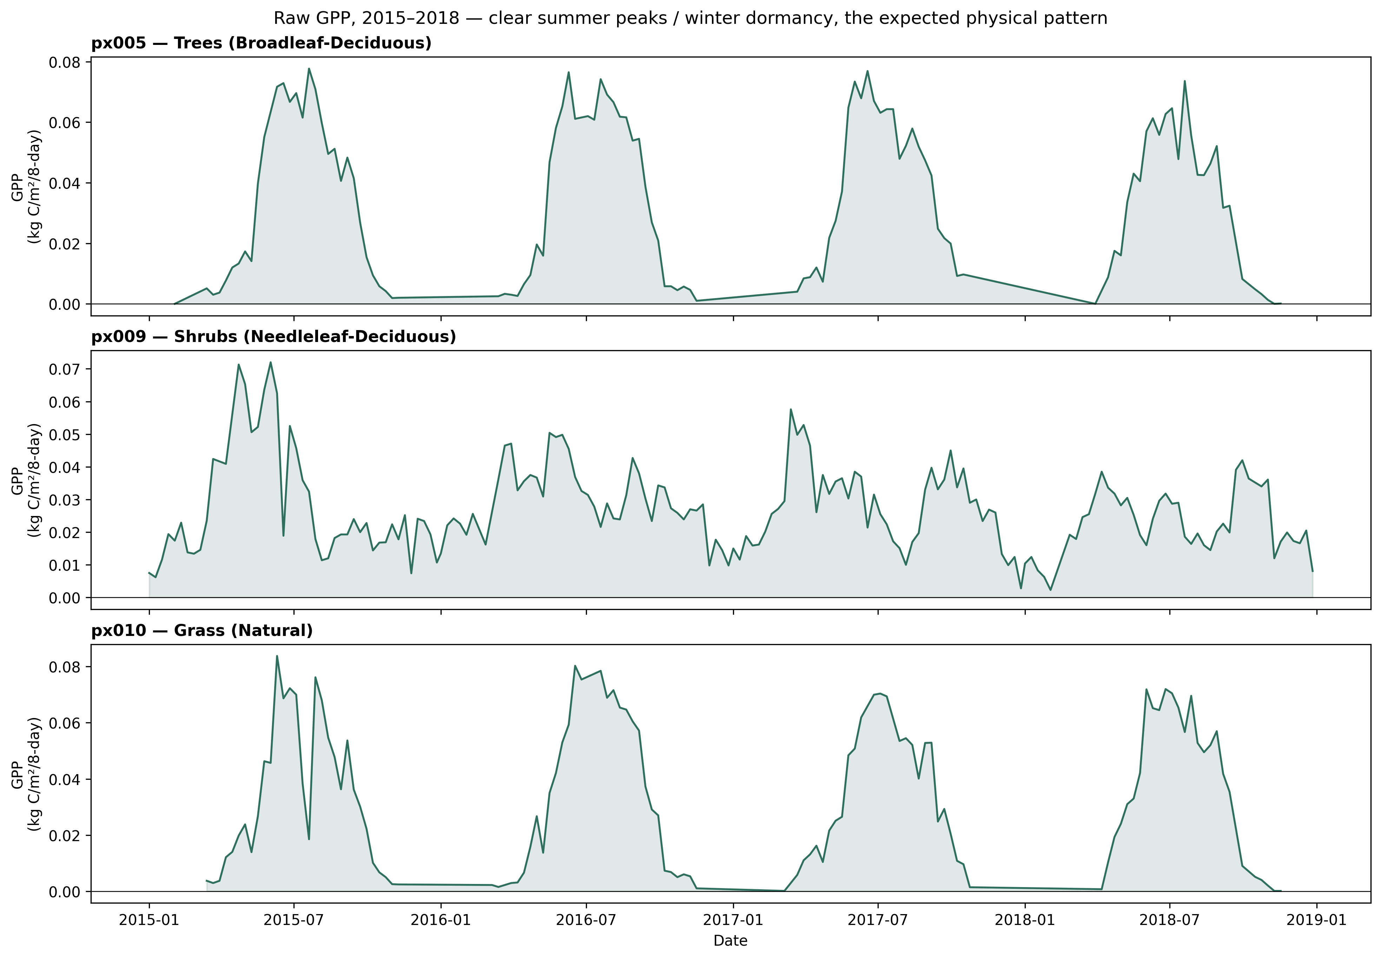
PART 2 — GPP DATA FIX
8
The Annual-Sum Check, Visually: Clear Seasonality
TAKEAWAY
Sharp summer peak / near-zero winter dormancy at all 3 sites - exactly the physical pattern real GPP should show, not an artifact of the scale factor.

Slide 9
PART 3 — GPP vs. LAI, ZERO-SHOT
9
Part 3: First Zero-Shot GPP vs. LAI Comparison
▪ Identical LOYO-CV anomaly protocol already used for LAI (same 12-year rolling window, same no-leakage climatology, same weather covariates) - only the target column changes. Same sites, same folds, same model: apples-to-apples.
 | mean R² | median R² | mean Pearson r | median Pearson r
LAI anomaly (20 sites) | -0.172 | -0.054 | 0.286 | 0.267
GPP anomaly (20 sites) | 0.030 | 0.045 | 0.358 | 0.380
TAKEAWAY
220 folds (20 sites × 11 LOYO years), all 8 CONUS vegetation classes represented. GPP beats LAI on every metric shown, zero-shot, before any physics guidance.

Slide 10
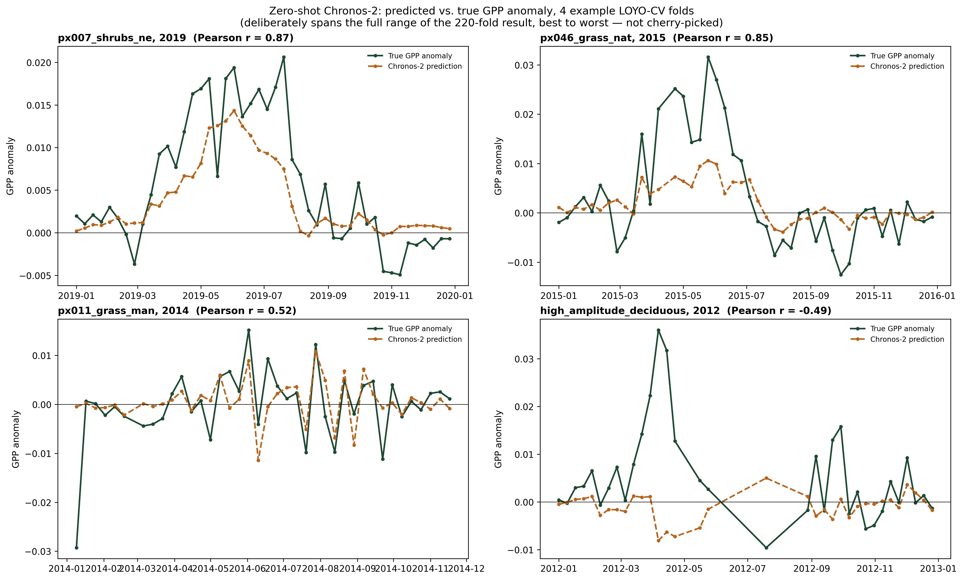
PART 3 — GPP vs. LAI, ZERO-SHOT
10
Not Just Metrics: Actual Predicted-vs-True GPP Anomaly
TAKEAWAY
Spans the full range of the 220-fold result (r = 0.87 down to −0.49), not cherry-picked - the worst fold shows the model missing a spring green-up spike entirely.

Slide 11
PART 3 — GPP vs. LAI, ZERO-SHOT
11
GPP Beats LAI in 7 of 8 Vegetation Classes
Vegetation class | LAI mean r | GPP mean r | n folds
Shrubs Ne | 0.518 | 0.560 | 22
Shrubs Bd | 0.450 | 0.569 | 22
Shrubs Nd | 0.423 | 0.426 | 22
Grass Nat | 0.265 | 0.360 | 33
Trees Nd | 0.233 | 0.293 | 22
Trees Ne | 0.229 | 0.226 | 33
Trees Bd | 0.186 | 0.251 | 44
Grass Man | 0.121 | 0.348 | 22
TAKEAWAY
Grasses show the largest relative gain; needleleaf-evergreen trees is the one class essentially tied (GPP 0.226 vs. LAI 0.229).

Slide 12
NEXT STEPS
12
Interpretation and Next Steps
▪ Consistent with Prof. Wang's expectation that GPP is the more weather-coupled, more directly forecastable target - GPP responds to the same short-term weather drivers Chronos-2 sees in its covariates more directly than LAI, which is a slower-integrating structural/canopy variable. (Interpretation - not yet tested directly.)
▪ This zero-shot result does not yet test whether physics-guided fine-tuning helps GPP more than LAI - it only establishes that the baseline gap between the two targets is real and goes in the expected direction, before spending effort on the fine-tuning comparison.
▪ Next: confirm this result holds at the full 70-site scale (download in progress on AppEEARS).
▪ Then: physics-guided fine-tuning on GPP, using the existing phenology equation and fine-tuning machinery (already supports GPP as --target-col) - deliberately not started yet, per the agreed order of work.
TAKEAWAY
Order of work, as agreed: data first, zero-shot baseline second (done here), physics-guided fine-tuning on GPP last.

