Slide 1
Vegetation LAI Forecasting: Comprehensive Research Summary
1
SCOPE: AUGUST 13 – AUGUST 27, 2026
▪ Rolling-origin LOYO-CV, predictor sensitivity, and validation-based LoRA fine-tuning (8/13)
▪ 2012 leakage diagnostic — does seeing the drought year in training explain the LOYO-CV failure? (8/14)
▪ PFT-aware spatial transfer and cross-location drought training for Georgia's 2012 drought (8/17)
▪ Advanced PEFT fine-tuning: 6 methods vs. zero-shot Chronos-2 (8/25)
▪ PFT architecture investigation: InstanceNorm erasure → FiLM conditioning → multi-pixel study → the decisive shuffled-PFT control (8/26–8/27)
TAKEAWAY
Same 3 core pixels, same model set, and raw-observation scoring underlie every study below.

Slide 2
FOUNDATION
2
Shared Setup Across All Studies
Pixel | Location | Land cover
low_amplitude | 37.53°N, 117.56°W | Natural grassland
high_amplitude_deciduous | 36.23°N, 84.47°W | Broadleaf deciduous forest
evergreen | 30.53°N, 82.43°W | Needleleaf evergreen forest
▪ 8 AELSTM-family models: AELSTM, BiLSTM, LSTM, GRU, RNN, CNN, RF, SVM
▪ Chronos-2 (zero-shot and fine-tuned), using historical LAI + historical climate + known future climate
▪ 7 gridMET predictors: tmmx, tmmn, pr, srad, vpd, sph, vs
▪ Baseline protocol: train 2000–2021, test 2022, scored against raw observed LAI
TAKEAWAY
All 6 studies below build on this identical foundation — differences are isolated to what's being tested.

Slide 3
PART 1
Rolling-Origin LOYO-CV
Is a single 2022 test year enough to trust a model comparison?

Slide 4
PART 1 · LOYO-CV
4
Design: 11 Folds, Fixed 12-Year Window
▪ 2022 turned out not to be an anomalous year at any of the 3 pixels — a single fixed test year gives no evidence about how models behave when a real anomaly occurs.
▪ Fixed 12-year training window immediately before each held-out year (not classic all-other-years LOYO, not an expanding window) — isolates genuine year-to-year difficulty from training-set-size effects.
train 2000–2011
test 2012
fold 1
train 2001–2012
test 2013
fold 2
train ...
test ...
fold 3
train 2010–2021
test 2022
fold 11
TAKEAWAY
11 folds (2012–2022) × same 10 methods × same 3 pixels, scored against raw observed LAI.

Slide 5
PART 1 · LOYO-CV
5
Findings: Stability, Reliable Models, and Two Outlier Folds
▪ high_amplitude_deciduous: all 10 methods score R² 0.89–0.99 across 11 years — stable regardless of method. low_amplitude and evergreen show a much wider spread, each with a severe outlier fold.
▪ RF (mean rank 3.39) and Chronos-2 zero-shot (3.70) are top-3 on ~6 of every 10 folds and rarely worst — the most dependable models across all 33 folds. LoRA fine-tuning is the single most volatile method; AELSTM and CNN are the least reliable overall.
▪ Two outlier folds, two different causes: evergreen/2012 (z=−3.0) is a real, sustained drought; low_amplitude/2018 (z=−2.9) is not a climate anomaly at all, just an erratic year at an already low-signal pixel. No year was difficult at all 3 pixels simultaneously.
TAKEAWAY
A fixed 2022-only test could never have revealed either failure mode — report medians alongside means.

Slide 6
FOLLOW-UP
6
2012 Leakage Diagnostic — Distribution Shift or Model Limitation?
Question: "What happens if you predict 2012 LAI using a model that has already seen 2012 during training?"
▪ AELSTM-family (8 models, full refit): mean RMSE ↓ ~46%, mean R² ↑ +5.17 once 2012 is included in fitting — consistent across very different architectures. RF recovers the most (R²=+0.59, the only model to cross into positive territory); the other 7 improve substantially but stay negative.
▪ Chronos-2 (LoRA, the only way to let it "see" 2012): RMSE ↓ 59.9%, R² −8.29 → −0.50, Pearson r 0.13 → 0.65, ACC −0.63 → 0.88 — the same large-recovery-but-still-short-of-good-fit pattern.
▪ Answer: the dominant cause is distribution shift (2012 was a real drought unlike anything in the training history) — but model-specific limitations still remain, since most models stay negative even after seeing 2012.
TAKEAWAY
Distribution shift explains most, but not all, of the original LOYO-CV failure at evergreen/2012.

Slide 7
PART 2
7
Predictor Sensitivity: Design and Findings
▪ Design: leave-one-predictor-out (7 configs) + 4 grouped ablations (selection rule fixed before Phase 1 ran) — a small, pre-registered design instead of an intractable 2⁷=128-subset search.
▪ Predictor importance is model- and pixel-specific: the same removal helps one model and hurts another at the same pixel; high_amplitude_deciduous is largely insensitive to any single predictor.
▪ srad (solar radiation) is the only predictor that helps at all 3 pixels — the single most consistently important variable. Temperature is critical at low_amplitude but unimportant elsewhere.
▪ Dropping the 2 least-important predictors (vs, pr) improves mean R² at all 3 pixels simultaneously — a leaner 5-predictor set (tmmx, tmmn, srad, vpd, sph) is a validated, better default.
TAKEAWAY
No single predictor-importance ranking applies universally — but srad is consistently valuable, vs/pr are redundant.

Slide 8
PART 3
8
Improved LoRA Fine-Tuning: Validation Recovers Most of the Loss
▪ The original fine-tune had no safety net: fit() was called without validation_inputs, trained a fixed 1000 steps, and kept whatever weights existed at that instant — no way to detect overfitting.
Pixel | Zero-shot | Original LoRA | Improved LoRA
low_amplitude | 0.542 | 0.379 | 0.500
high_amplitude_deciduous | 0.965 | 0.952 | 0.942
evergreen | 0.832 | 0.712 | 0.829
▪ Chronological validation (2020 & 2021 folds, 2022 untouched) + a small search (lr × rank) with early stopping: gap to zero-shot shrinks from −0.163 to −0.042 at low_amplitude, and −0.120 to −0.003 at evergreen — but improved LoRA still does not outright beat zero-shot on any of the 3 pixels.
TAKEAWAY
Most of the original degradation was a training-setup artifact, not fundamental to LoRA itself.

Slide 9
PART 4
PFT-Aware Spatial Transfer
Can other drought-affected locations help predict Georgia's 2012 drought?

Slide 10
PART 4 · SPATIAL TRANSFER
10
First Attempt: PFT-Match Alone Wasn't Enough
▪ 10 needleleaf-evergreen pixels (same PFT as Georgia, fraction ≥70%) selected across 9 US regions — but checking each candidate's 2000–2011 climatology against actual 2012 LAI showed only 2 of 9 carried a real drought anomaly in the same direction as Georgia.
▪ Refined design: A. Local (Georgia 2000–2011 only), B. Single-source (best matched pixel), C. Multi-source (5 pixels: 2 informative + 3 diverse), D. Diagnostic reference (Georgia's own 2012, leaked).
▪ Mean R²: A = −6.56, B = −2.98, C = −1.18, D (leaked reference) = −1.39 — C (no Georgia 2012 data at all) performs essentially as well as D (Georgia's own 2012 leaked into training).
TAKEAWAY
Select source pixels by evidence of the actual anomaly, not by vegetation-type label alone.

Slide 11
PART 4 · REFINED DESIGN
11
Refined: Cross-Location Drought Training
Condition | Mean R² | Mean RMSE
A. Local baseline | -6.56 | 1.58
B. Single source | -2.31 | 0.95
C. Multi-source (5) | -2.32 | 1.05
▪ Selection changed from PFT-label-first to drought-evidence-first: rank candidates by their own 2012 anomaly strength (mean z-score, peak-LAI reduction), with PFT kept only as a constraint — found source pixels with a 5–10x stronger 2012 anomaly than the earlier PFT-only screen's best.
▪ Both B and C cut the local baseline's damage dramatically, without ever using Georgia's own 2012 data.
▪ Secondary analysis — number of source pixels (N=1,2,3,5,10): R² = −2.31, −4.00, −2.78, −2.32, −3.27 — not monotonic. Pooling all 10 candidates performs worse than a well-chosen 5.
TAKEAWAY
Selecting genuinely informative source pixels matters more than simply increasing pixel count.

Slide 12
PART 5
Advanced PEFT Fine-Tuning
Can a more advanced fine-tuning strategy beat zero-shot Chronos-2?

Slide 13
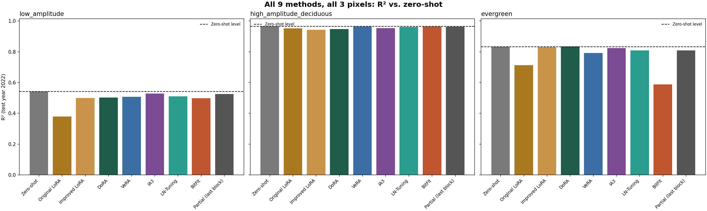
PART 5 · ADVANCED FINE-TUNING
13
Six PEFT Methods vs. Zero-Shot
TAKEAWAY
DoRA, VeRA, IA3, LN-Tuning, BitFit, partial-last-block — literature-grounded, mechanistically diverse methods.

Slide 14
PART 5 · ADVANCED FINE-TUNING
14
No Method Beats Zero-Shot; Capacity Doesn't Predict Performance
Method | Params | Mean R² | vs. Zero-shot
Zero-shot | — | 0.780 | —
IA3 | 74K | 0.769 | -0.011
Partial (last block) | 13.1M | 0.766 | -0.014
DoRA | 1.3M | 0.761 | -0.019
BitFit | 8.4K | 0.683 | -0.097
Original LoRA | — | 0.681 | -0.099
▪ Trainable parameter count does not predict performance: IA3 (74K params) beats partial fine-tuning (13.1M params); BitFit (8.4K, smallest) is the worst performer overall.
▪ BitFit's winning config had the BEST validation loss of all 24 evergreen configs, yet the WORST test R² — a genuine failure mode, not classic overfitting (train/val curves looked normal).
TAKEAWAY
Zero-shot Chronos-2 is already a strong baseline — no PEFT method beat it on this dataset.

Slide 15
PART 6
The PFT Investigation
Does vegetation-composition information improve Chronos-2's LAI forecasts?

Slide 16
PART 6 · PFT
16
Diagnosis: Chronos-2 Was Architecturally Blind to Static PFT
PFT = 0.65
(constant every step)
InstanceNorm
(per-series, std=0)
→ [0, 0, 0, ...]
signal erased
▪ Verified empirically: perturbing PFT across 5 synthetic compositions changed the prediction by exactly 0.00000000 — not a small effect, zero.
▪ Fix: a small trainable FiLM-conditioning module (~12.6K–100.5K params, 0.01–0.08% of the model) injects PFT directly into the model's internal representation, bypassing InstanceNorm entirely — the 119.5M-parameter base model stays completely frozen.
▪ Confirmed working: a smoke test showed a large, structured response to synthetic PFT perturbation.
TAKEAWAY
This was a representation problem, not evidence that PFT is biologically irrelevant.

Slide 17
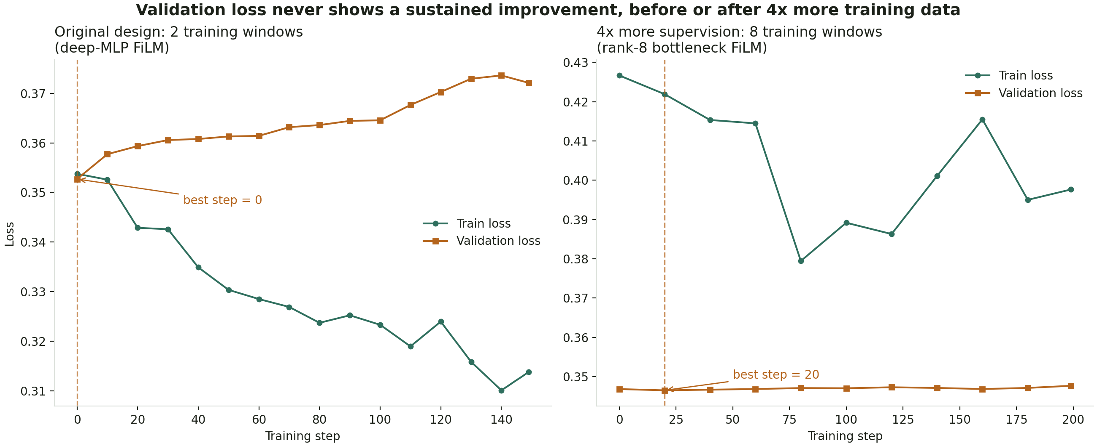
PART 6 · PFT
17
Multi-Pixel Study: Overfitting, Even With 4x More Data
TAKEAWAY
70 PFT-diverse pixels pooled; 3 of 4 conditioning architectures still overfit within one training step.

Slide 18
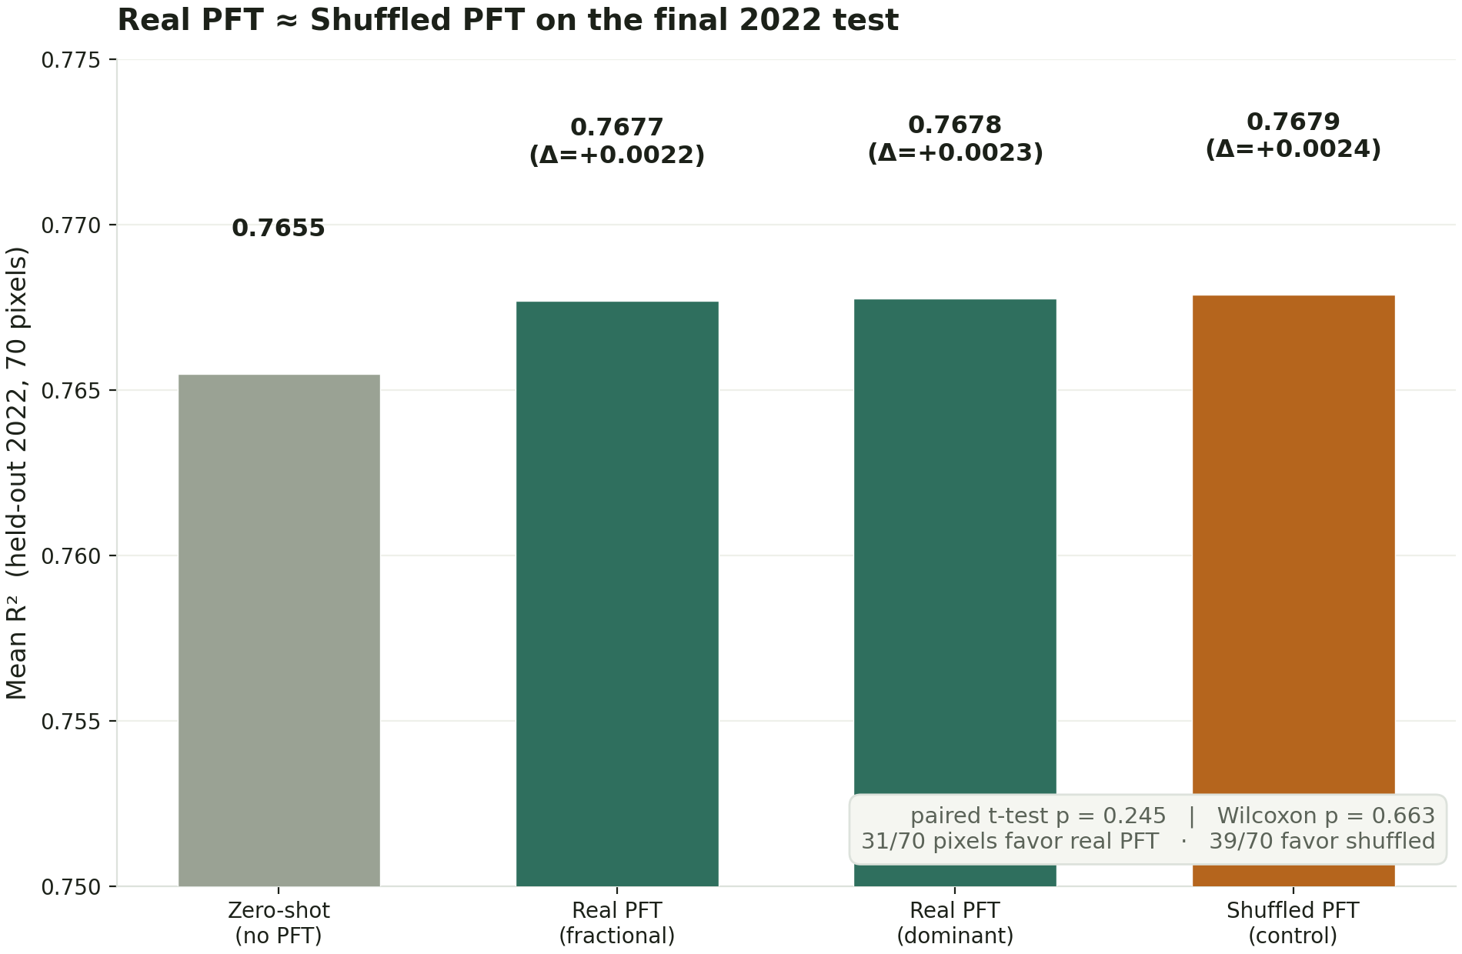
Key Finding: Real PFT ≈ Shuffled PFT
18
TAKEAWAY
A model trained on randomly shuffled PFT performs just as well as one trained on real PFT — p=0.245, not significant.

Slide 19
PART 6 · INTERPRETATION
19
What This Means
No PFT ≈ Real PFT ≈ Shuffled PFT
▪ The small ΔR² most likely comes from adding trainable conditioning capacity itself, not from the biological information the PFT vector carries.
▪ Mixed-vs-pure entropy, seasonal-phase RMSE, and per-dominant-PFT-class breakdowns all reach the same conclusion once compared against the shuffled control.
▪ Precise conclusion (not "PFT is useless"): under the current Chronos-2 + LAI setup and available dataset, explicit PFT information does not provide a measurable, generalizable predictive benefit beyond a shuffled-PFT control.
TAKEAWAY
This is a hypothesis about the current setup and data scale, not a claim of a theoretical ceiling.

Slide 20
SYNTHESIS
20
Cross-Cutting Synthesis: Two Threads, One Observation
▪ Fine-tuning thread: LOYO-CV showed Chronos-2 zero-shot is among the most consistently strong models across 33 folds; the improved-LoRA study and the 6-method advanced PEFT comparison both found no fine-tuning strategy consistently beats zero-shot, regardless of trainable parameter count.
▪ PFT thread: the architecture was fixed so it CAN receive PFT information, and can express a strong response to it — but a properly validated model, and the shuffled-PFT control specifically, found no evidence it learns anything real from it under the current data scale.
▪ Both threads converge on the same empirical pattern: zero-shot Chronos-2 is difficult to improve on this dataset with relatively small amounts of gradient-trained adaptation — whether the adaptation targets general fine-tuning or PFT-specific conditioning.
TAKEAWAY
An empirical observation about this dataset/setup, not evidence of a theoretical performance ceiling.

Slide 21
Overall Conclusions & Next Steps
21
What We Learned
▪ Rolling-origin LOYO-CV is essential — single-year evaluation misses failure modes entirely (RF and Chronos-2 zero-shot are the most consistently strong models across 33 folds).
▪ Source-pixel quality (evidence of the actual phenomenon) matters more than PFT-label match or pixel count for spatial transfer.
▪ Across every fine-tuning method tested and the PFT-conditioning architecture, zero-shot Chronos-2 has been difficult to consistently improve on with the data and methods tried so far.
Next Steps
▪ Extend LOYO-CV / predictor ablation to the remaining selected pixels; adopt the leaner 5-predictor set.
▪ Test PFT with AELSTM-family models, which showed greater (if noisier) sensitivity to explicit PFT.
▪ Revisit Chronos-2 adaptation (fine-tuning and PFT alike) if substantially more training data or stronger supervision becomes available.
TAKEAWAY
Full detail for every study lives in its own report/deck — this deck is the cross-study summary.

