Slide 1
Robustness Update: ERA5 Validation + Leave-One-Year-Out Cross-Validation
1
FOLLOW-UP TO LAST MEETING
▪ Section 1: post-meeting supplement — the cloud-vs-CDS ERA5 visual comparison.
▪ Section 2: addressing Prof. Wang's feedback that a single test year (2022) is not enough evidence — Leave-One-Year-Out Cross-Validation (11 held-out years, 2012–2022) on both the 70-pixel CONUS pool and the 68-pixel global pool, with an average variance statistic for each.
▪ Chronos-2 remains strictly zero-shot throughout: no training or fine-tuning.
TAKEAWAY
Same zero-shot model, same two pixel pools — now evaluated across 11 independent held-out years each, not just one.

Slide 2
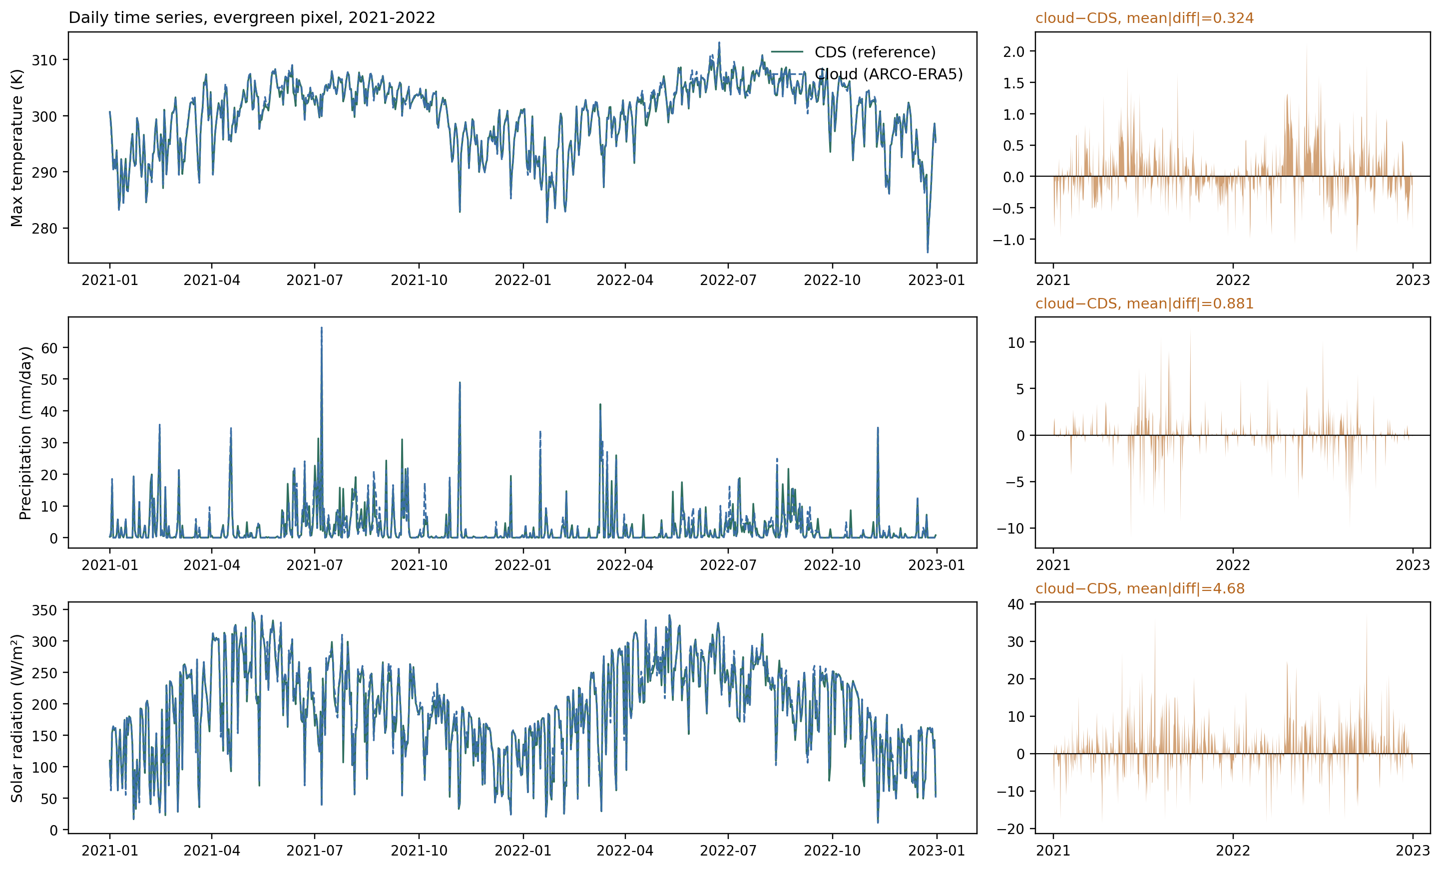
SECTION 1 — POST-MEETING SUPPLEMENT
2
Section 1: ERA5 Equivalence — CDS vs. Cloud, Visualized
Same evergreen pixel, 2021–2022 — actual daily values, not just a correlation coefficient:
TAKEAWAY
Recap: the two ERA5 sources are visually near-indistinguishable for 6 of 7 variables; precipitation shows the one real, diagnosed discrepancy (convective-event spikes).

Slide 3
SECTION 2 — ROBUSTNESS VIA CROSS-VALIDATION
3
Section 2: Why Leave-One-Year-Out Cross-Validation
▪ Prof. Wang's feedback: scoring each pixel against a single test year (2022) is not sufficient evidence of robustness — a model can get lucky (or unlucky) on any one year.
▪ Response: re-evaluate every pixel across 11 independent held-out years (2012–2022), each with its own fixed 12-year context window immediately preceding it — never the same context/test split twice.
▪ This reuses this project's own already-established, already-published LOYO-CV protocol (Code/loyo_cv_chronos2.py, reports/LOYO_CV_FINDINGS.md) unmodified for the CONUS pool, and replicates the identical protocol for the global pool.
70
68
11
Zero-shot
CONUS pixels
Global pixels
held-out years (2012–2022)
no training/fine-tuning
TAKEAWAY
1518 total LOYO folds evaluated (770 CONUS + 748 global) — zero-shot inference is fast enough to make this essentially free.

Slide 4
METHODOLOGY
4
LOYO-CV Protocol (Identical for Both Pools)
▪ For each held-out test year Y ∈ {2012, ..., 2022}: context = years Y−12 .. Y−1 (fixed 12-year rolling window, not all-other-years, and not an expanding window) — this avoids confounding "hard year" with "how much data this fold happened to get."
▪ future_covariates / ground truth = year Y only. Zero-shot Chronos-2 predicts Y from the 12-year context.
Aspect | CONUS pool (70 pixels) | Global pool (68 pixels)
Climate | gridMET (daily, CONUS-only) | Cloud ERA5 (same validated pipeline)
LAI ground truth | HiQ-LAI (8-day, CONUS-only) | MODIS MOD15A2H (8-day, QC-filtered)
Context per fold | ~12 years, regular 8-day cadence | 12-yr window, irregular (MODIS gaps)
Min. fold coverage | n/a (always complete) | ≥20 context obs, ≥4 test obs (else skipped)
Folds run | 770 / 770 (100%) | 748 / 748 (100%, 0 skipped)
TAKEAWAY
Same window length, same held-out years, same metrics (RMSE/MAE/MAPE/R²/Pearson r) for both pools — only the data source differs.

Slide 5
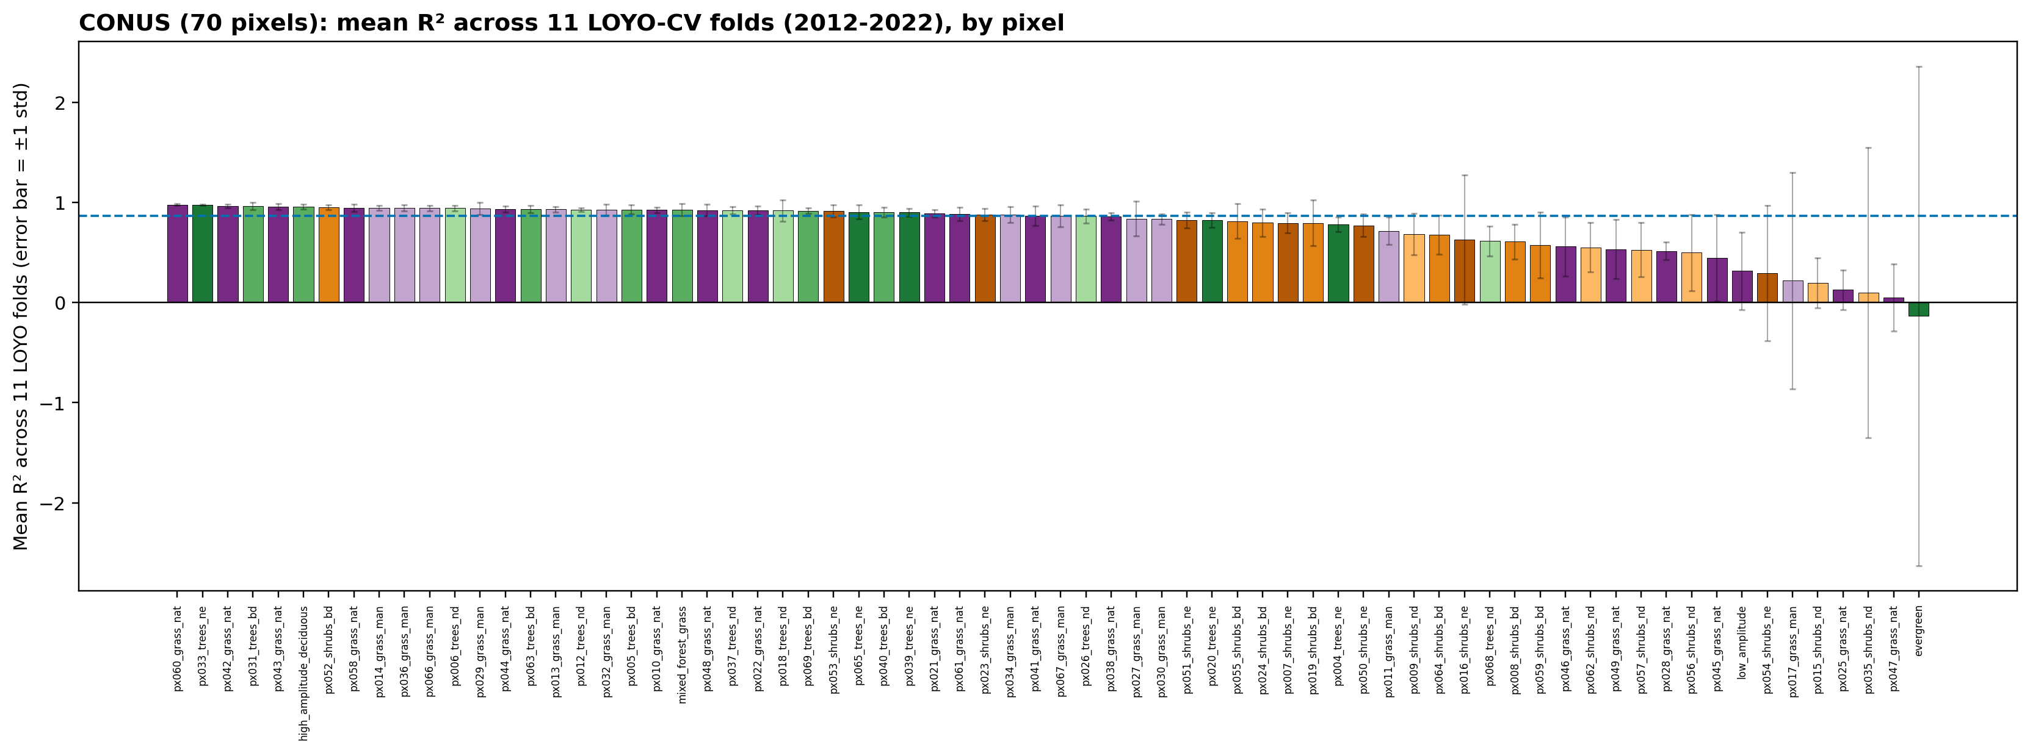
SECTION 2 — CONUS ROBUSTNESS CHECK
5
CONUS 70-Pixel Pool: LOYO-CV Results
0.749
0.805
0.170
0.005
mean R² (across pixels × folds)
mean of per-pixel median R²
average variance (per-pixel)
median variance (robust)
TAKEAWAY
2022-only median was 0.904; the 11-year picture is more conservative (mean R²=0.749) — variance concentrated in a few known-outlier pixels, not spread evenly across all 70.

Slide 6
SECTION 2 — GLOBAL (NON-CONUS) EXPERIMENT
6
Global Pool: How the Data Was Processed
Climate:
Google ARCO-ERA5
(cloud Zarr, 0.25°, validated pipeline).
LAI:
MODIS MOD15A2H.061
via NASA AppEEARS (gridMET/HiQ-LAI don't exist outside CONUS).
Step | Detail
Pixel selection | 70 pixels, farthest-point sampling on global ESA CCI PFT, 14 world regions, purity 0.44–1.00
Climate variables | 7 Chronos-2 variables (tmmx, tmmn, pr, srad, vpd, sph, vs) — same mapping as CONUS ERA5
LAI acquisition | MOD15A2H.061 Lai_500m, 8-day, 500m, Terra-only (2000 onward)
LAI quality filter | MODLAND-good-quality only (FparLai_QC bit 0 == 0) — keeps 68.1% of pixel-dates
LAI-climate alignment | ERA5 daily values averaged over each LAI 8-day window (identical to CONUS pipeline)
Coverage result | 68/70 pixels usable (2 excluded: Arctic polar night, SE Asia monsoon cloud)
TAKEAWAY
Same 7-variable ERA5 mapping and LAI-alignment logic as CONUS — only the raw data sources changed to genuinely global products.

Slide 7
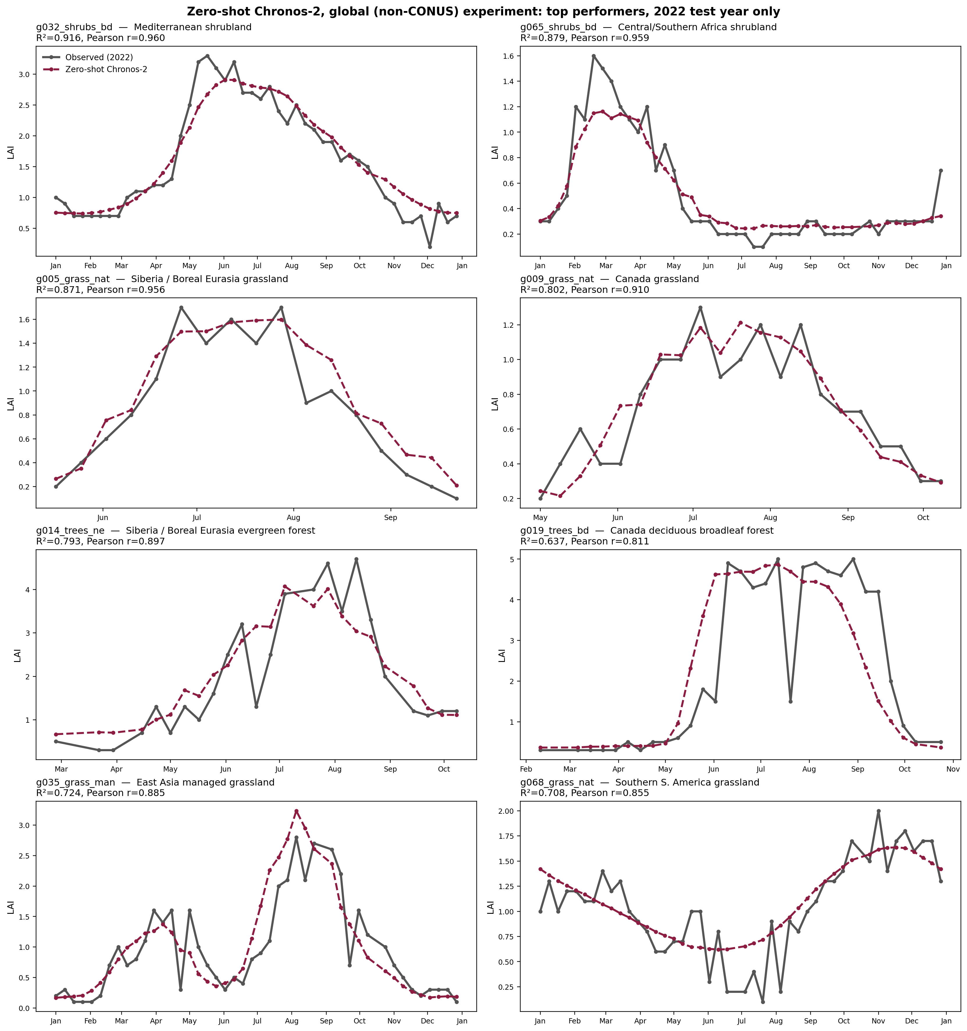
SECTION 2 — GLOBAL (NON-CONUS) EXPERIMENT
7
Global Pool: Best Zero-Shot Results, Diverse Regions
TAKEAWAY
8 pixels spanning the Mediterranean, Africa, Siberia, Canada, East Asia, and South America — R²=0.64–0.92 on the single 2022 test year.

Slide 8
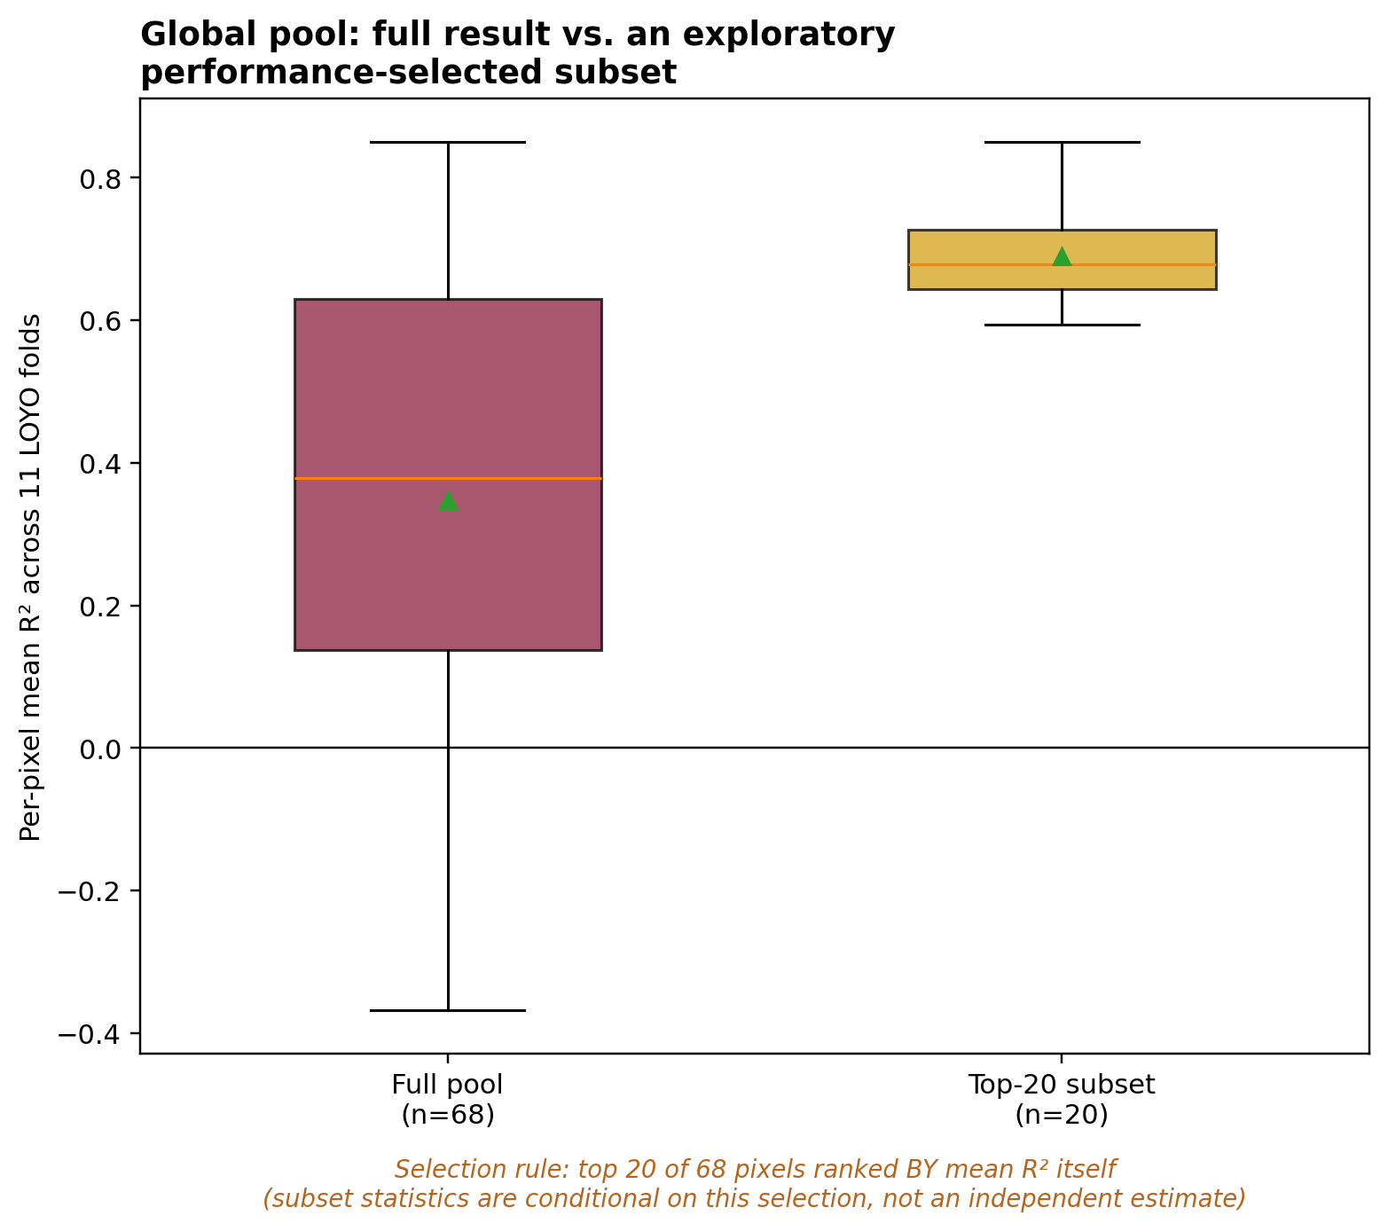
SECTION 2 — GLOBAL (NON-CONUS) EXPERIMENT
8
Full Pool vs. an Exploratory Performance-Selected Subset
Question: how much does performance improve in a best-case subset? Answered transparently — this is exploratory, not a second estimate of the overall result.
Group | n | Mean R² | Median R² | Avg. variance | Median variance
Full global pool — PRIMARY RESULT | 68 | 0.348 | 0.393 | 0.106 | 0.030
Top-20 by mean R² — EXPLORATORY | 20 | 0.690 | 0.710 | 0.022 | 0.016
Selection rule: top 20 of 68 pixels ranked BY mean LOYO-CV R² itself (2012–2022, 11 folds). Threshold: mean R² ≥ 0.594.
▪ These 20 pixels are drawn from the same top-performer showcase on the previous slide — this is the same success cases, now quantified as a group.
▪ Selecting on the outcome metric itself means this subset's statistics cannot be read as "what a typical non-CONUS pixel achieves" — that is what the full-pool row (and every other report/slide in this project) reports.
TAKEAWAY
Subset statistics are conditional on performance-based selection and are NOT representative of the full global pool. The full-pool result remains the primary, reported finding.

Slide 9
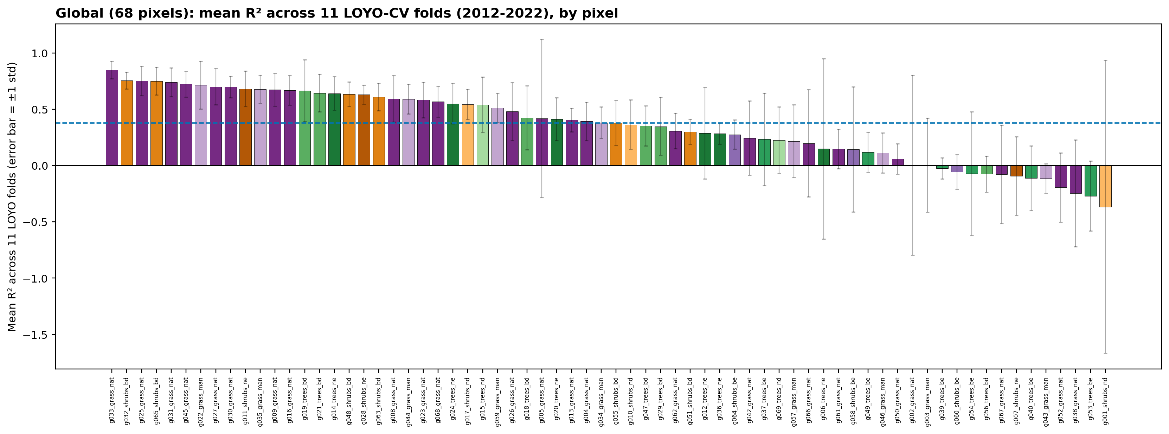
SECTION 2 — GLOBAL ROBUSTNESS CHECK
9
Global 68-Pixel Pool: LOYO-CV Results
0.348
0.400
0.106
0.030
mean R² (across pixels × folds)
mean of per-pixel median R²
average variance (per-pixel)
median variance (robust)
TAKEAWAY
Single-year (2022) median was 0.353; the 11-year mean R²=0.348 is consistent with it — the global result is weaker than CONUS but not a single-year artifact.

Slide 10
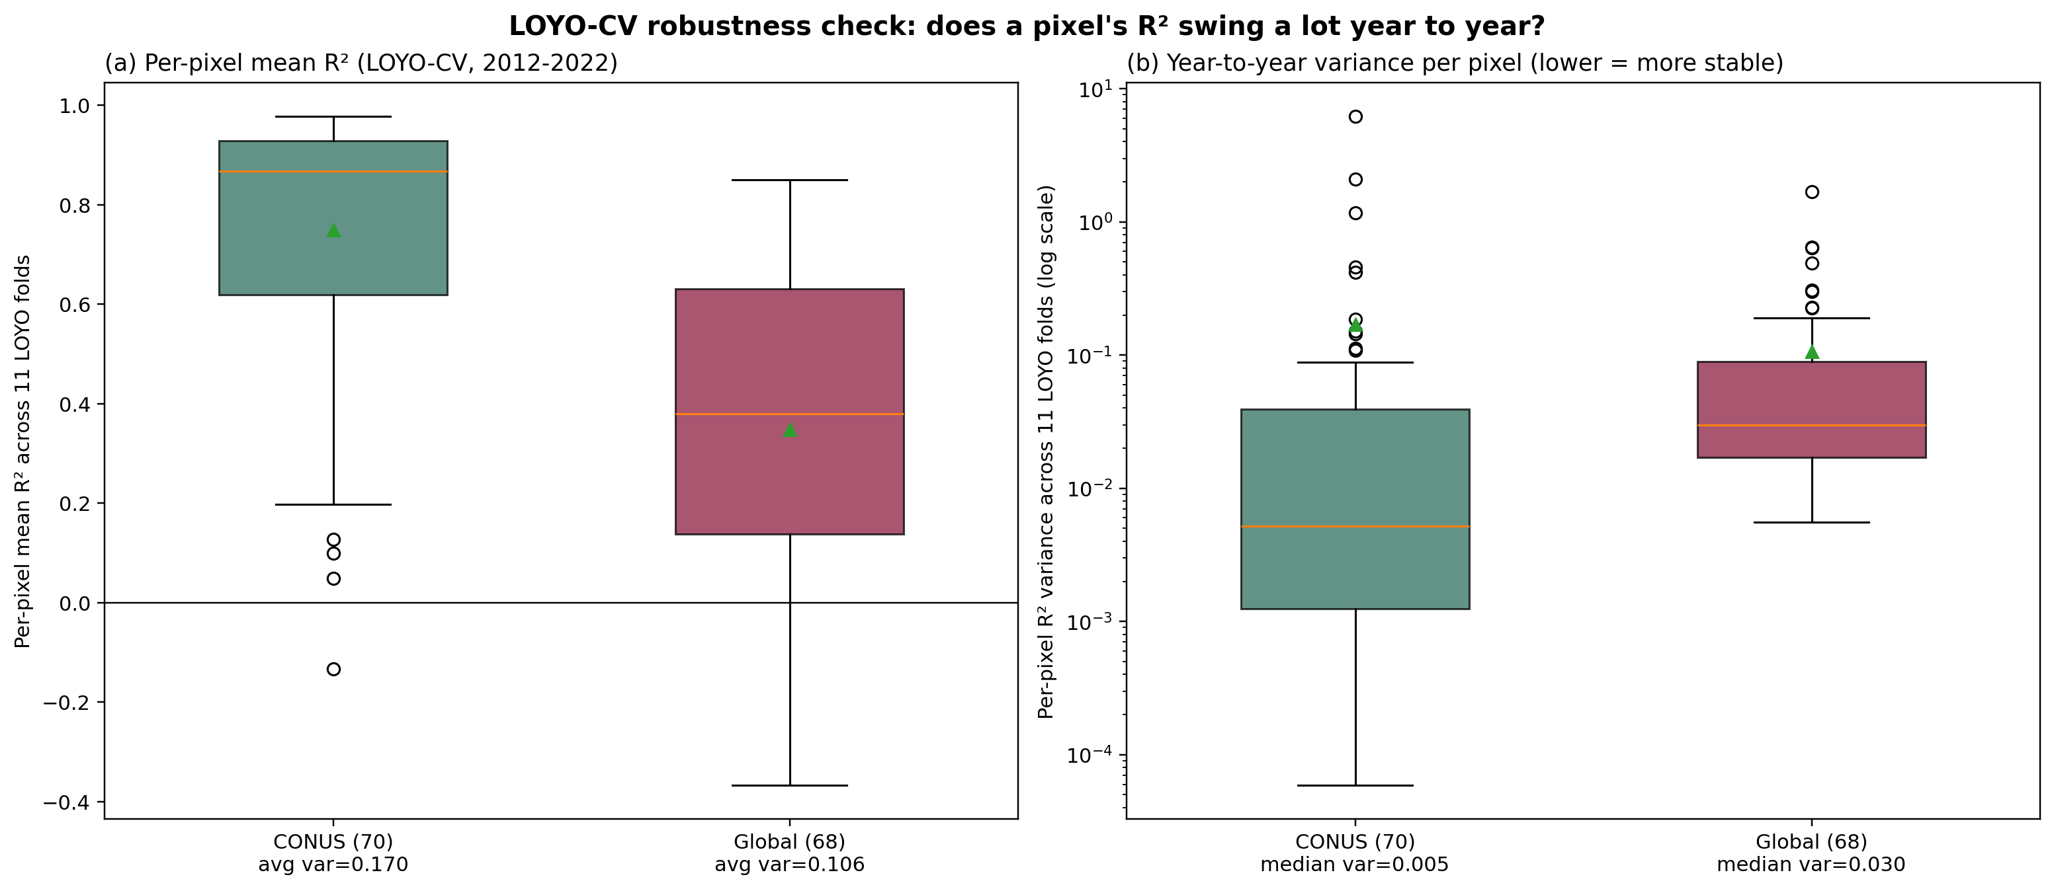
INTEGRATING BOTH POOLS
10
CONUS vs. Global: Variance Comparison
TAKEAWAY
Typical variance is lower for CONUS (0.005 vs. Global's 0.030) — but CONUS has a longer extreme-outlier tail (e.g. evergreen's 2012 drought fold).

Slide 11
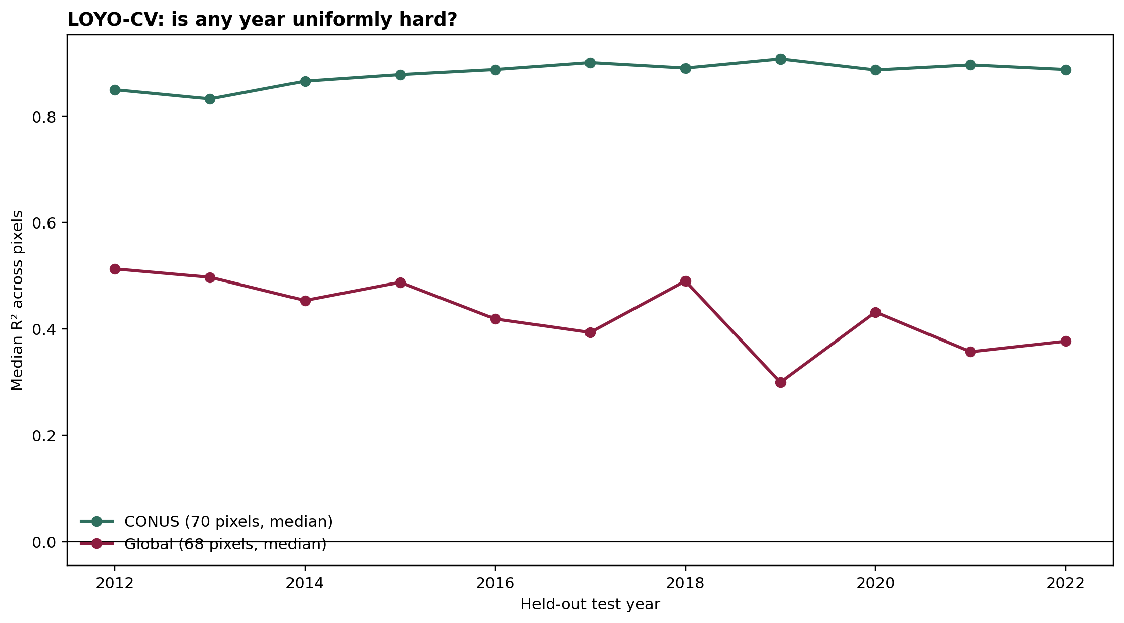
INTEGRATING BOTH POOLS
11
Is Any Single Year Uniformly Hard?
TAKEAWAY
No — median R² across pixels stays consistently high in every one of the 11 held-out years for both pools. Individual-pixel bad folds (e.g. droughts) don't show up as population-wide crashes.

Slide 12
PROF. WANG'S FOLLOW-UP QUESTION
12
Follow-Up: Does This Actually Capture Inter-Annual Variability?
▪ Concern: the per-fold R² above is computed ACROSS TIME within one held-out year — both actual and predicted LAI follow the same strong seasonal cycle, so this R² is largely "did the model get the seasonal shape right," not "did it capture real year-to-year differences."
▪ Fix: fix the CALENDAR POSITION (e.g. the 1st 8-day composite of the year) and compute R² ACROSS the 11 held-out years at that position, per pixel — this removes the seasonal cycle entirely, isolating genuine inter-annual variability.
RESULT: with only ≤11 points per pixel-position, R² itself is unstable (mean turns negative — a known small-sample failure mode); Pearson r is far more robust at this sample size:
Metric (mean of per-position, per-pixel value) | CONUS | Global
R² (unstable at n≤11 — shown for completeness) | -0.344 | -0.431
Pearson r (robust — the informative number here) | 0.288 | 0.176
TAKEAWAY
Genuine inter-annual signal is real but modest (Pearson r≈0.29 CONUS, ≈0.18 Global) — much weaker than the within-year R² suggested. Prof. Wang's concern was well-founded.

Slide 13
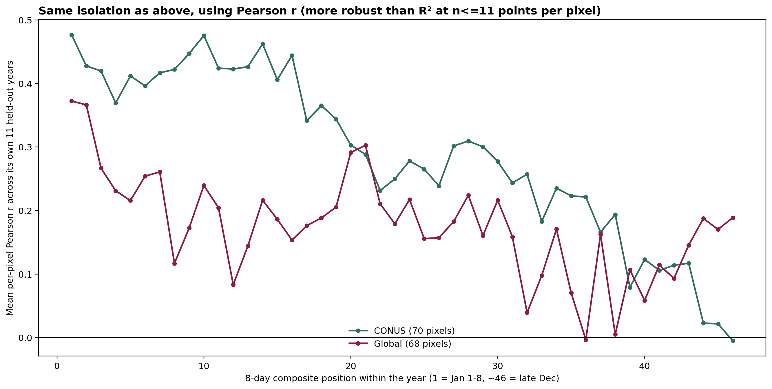
PROF. WANG'S FOLLOW-UP QUESTION
13
Inter-Annual Signal Weakens Over the Forecast Horizon
TAKEAWAY
Both pools show the same pattern: correlation with true inter-annual variation is highest early in the forecast (r≈0.4-0.5) and steadily declines toward the far end of the 45-step horizon (r≈0.0-0.2) — consistent with forecast skill degrading over lead time, not a pool-specific issue.

Slide 14
SUMMARY
14
Summary: What LOYO-CV Adds
RESULT
▪ CONUS (70 pixels, 770 folds): mean R²=0.749, average per-pixel variance=0.170 (median variance=0.005 — most pixels are very stable; a handful of outliers dominate the mean).
▪ Global (68 pixels, 748 folds): mean R²=0.348, average per-pixel variance=0.106 (median variance=0.030).
INTERPRETATION
▪ The single-year (2022) results were not a fluke: 11-year cross-validation confirms the same overall pattern — CONUS robustly strong, global weaker but not collapsing — at a more conservative, defensible confidence level than a one-year test can provide.
▪ Both pools show the SAME structure: most pixels are stable year to year; a small minority of outlier pixels (often already diagnosable, e.g. a drought year) account for most of the variance.
▪ Follow-up (Prof. Wang): within-year R² mostly reflects seasonal-shape matching, not true inter-annual tracking — isolating the latter gives a modest positive signal (Pearson r≈0.29/0.18) that weakens over the forecast horizon.
NEXT STEPS
▪ Investigate the highest-variance pixels in each pool individually (CONUS: evergreen, px035_shrubs_nd, px017_grass_man; Global: g001_shrubs_nd, g006_trees_ne, g002_grass_nat).
TAKEAWAY
Prof. Wang's concern addressed directly: both experiments now stand on 11 years of held-out evidence, not one.

