Slide 1
RESEARCH GROUP UPDATE
Vegetation LAI Forecasting:
Robustness, Predictors, and Fine-Tuning
AELSTM + Chronos-2 vegetation forecasting project
Rolling-Origin LOYO Cross-Validation
Predictor Sensitivity / Ablation Study
Improved Chronos-2 LoRA Fine-Tuning
August 2026
Notes:
Thanks everyone — today I want to walk through three follow-up studies I ran this week on top of our AELSTM and Chronos-2 vegetation forecasting work. The short version: we now have a much more robust evaluation, a clearer picture of which climate variables actually matter, and a fix for something that was quietly hurting our fine-tuning results. Let's dive in.

Slide 2
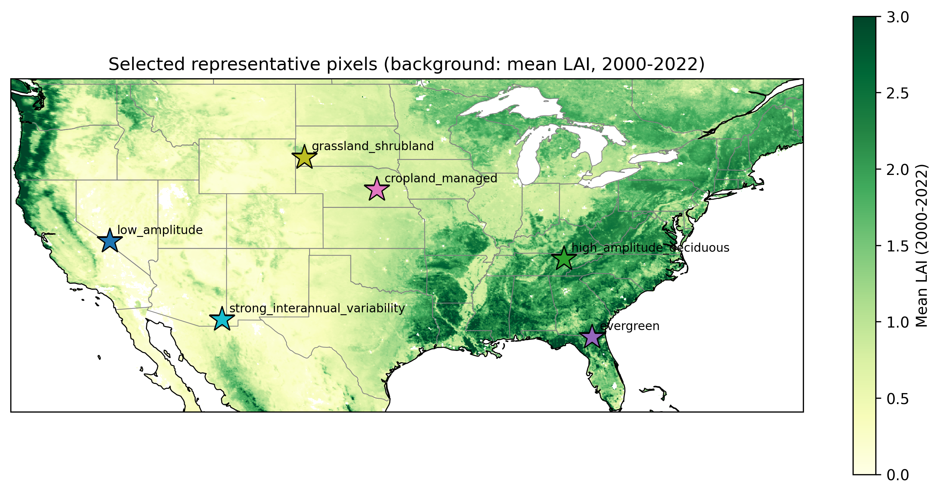
2
Recap: Pixels and Baseline Setup
Pixel | Location | Land cover
low_amplitude | 37.53°N, 117.56°W | Natural grassland
high_amplitude_ deciduous | 36.23°N, 84.47°W | Broadleaf deciduous forest
evergreen | 30.53°N, 82.43°W | Needleleaf evergreen forest
▪ 8 AELSTM-family models: AELSTM, BiLSTM, LSTM, GRU, RNN, CNN, RF, SVM
▪ Chronos-2 (zero-shot and LoRA fine-tuned), using historical LAI + historical climate + known future climate
▪ 7 gridMET predictors: tmmx, tmmn, pr, srad, vpd, sph, vs
▪ Baseline protocol: train 2000–2021, test 2022, scored against raw observed LAI
TAKEAWAY
Same 3 pixels, same 8+2 methods, and raw-observation scoring underlie all 3 studies below.
Notes:
Quick reminder before we get into the new stuff — we're still working with the same three pixels representing very different vegetation types, from a sparse grassland to a dense evergreen forest, and the same set of models: eight AELSTM-family baselines plus Chronos-2. Everything I'm about to show builds directly on this same foundation, so nothing here changes the setup, just how we evaluate it.

Slide 3
PART 1 — ROLLING-ORIGIN LOYO-CV
3
Motivation: Is One Test Year Enough?
▪ The baseline protocol trains on 2000–2021 and tests on exactly one year: 2022.
▪ A single test year cannot separate “good model” from “model that got a lucky (or unlucky) year.”
▪ 2022 turned out not to be an anomalous year at any of the 3 pixels — so single-year evaluation gives no evidence about how models behave when a real anomaly (drought, noisy year) occurs.
TAKEAWAY
We need evidence across many held-out years, not confidence built on one.
Notes:
So here's the problem I wanted to address first. Up to now, every result we've reported was based on training through 2021 and testing on exactly one year, 2022. That's fine as far as it goes, but it only tells us how the model did on one particular year — it doesn't tell us whether that year was typical, lucky, or unlucky. And as it turns out, 2022 was actually a pretty uneventful year at all three pixels, so we've never seen how these models handle a real anomaly.

Slide 4
PART 1 — ROLLING-ORIGIN LOYO-CV
4
Rolling-Origin LOYO-CV: Design
▪ Fixed 12-year training window immediately before each held-out year (not classic all-other-years LOYO, and not an expanding window).
▪ 11 folds: held-out years 2012–2022. Same 10 methods, same 3 pixels, scored against raw observed LAI.
train 2000–2011
train 2001–2012
train ...
train 2010–2021
test 2012
test 2013
test ...
test 2022
fold 1
fold 2
fold 3
fold 11
TAKEAWAY
A fixed window isolates genuine year-to-year difficulty from training-set-size effects.
Notes:
So the fix is what I'm calling rolling-origin LOYO cross-validation. Instead of one fixed split, we slide a 12-year training window forward one year at a time and test on whatever year comes right after it — fold one trains on 2000 to 2011 and tests on 2012, fold two shifts forward a year, and so on through 2022. That gives us 11 independent tests instead of one, and keeping the window length fixed means we're isolating genuine year-to-year difficulty rather than just seeing an effect of more or less training data.

Slide 5
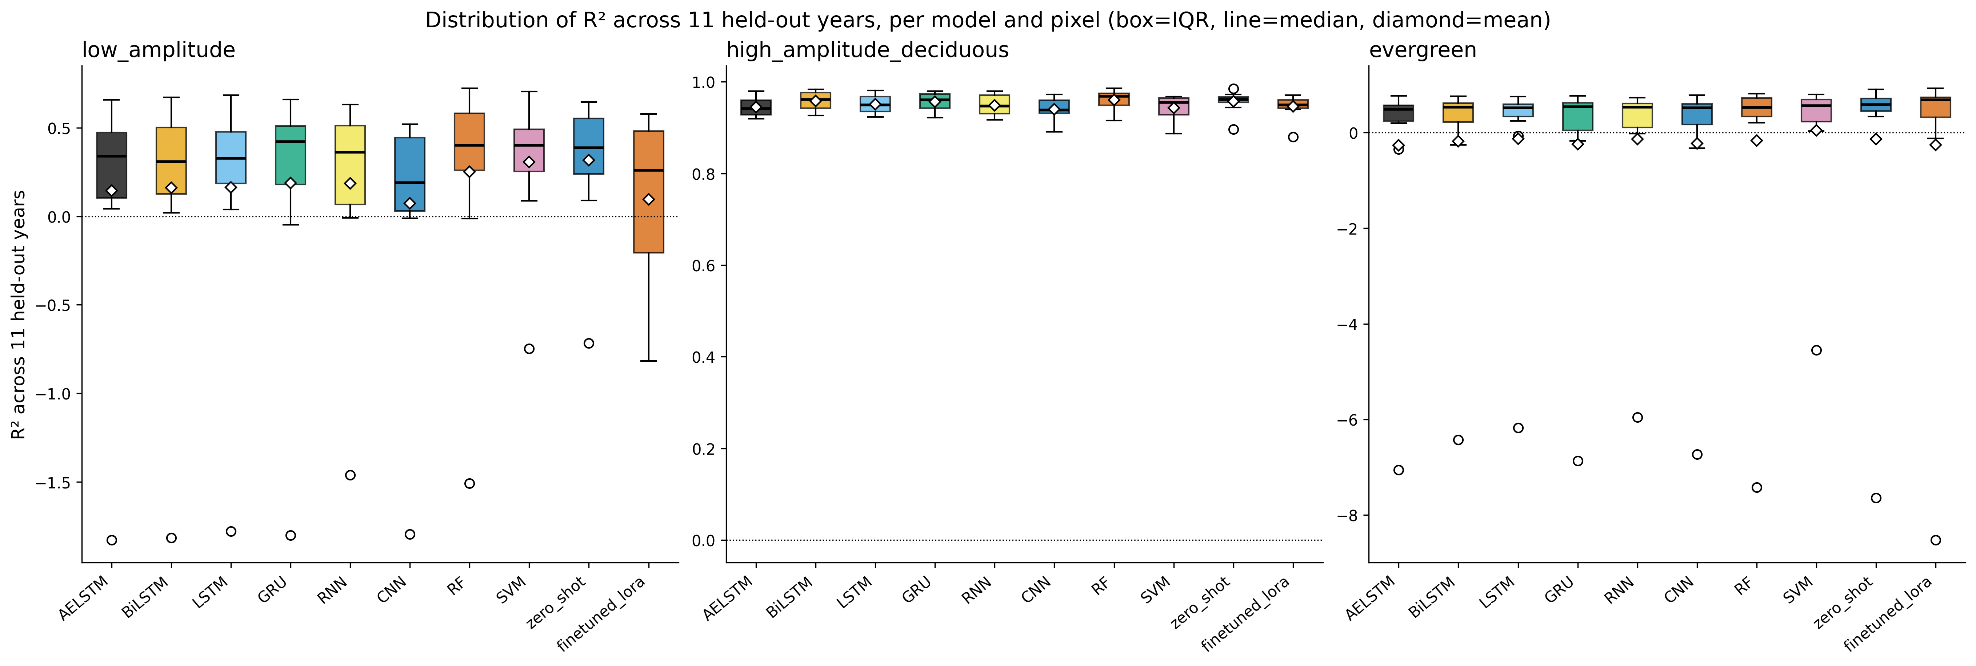
PART 1 — ROLLING-ORIGIN LOYO-CV
5
Model Performance: Stable at Some Pixels, Volatile at Others
▪ high_amplitude_deciduous: all 10 methods score R² 0.89–0.99 across 11 years — stable regardless of method.
▪ low_amplitude and evergreen: much wider spread, and every method has one severe outlier fold.
▪ At evergreen, every method’s mean R² is near zero or negative — but every median is a healthy 0.48–0.68.
TAKEAWAY
Report median alongside mean — a single anomalous fold can dominate the average.
Notes:
Here's what that looks like in practice. Each box is one model's spread of R² across those 11 years. At the deciduous forest pixel, every method is tightly clustered near the top — real agreement across models. But look at the grassland and evergreen pixels — much wider spread, and notice those isolated dots hanging way below every box. Those are single bad years, and they're dragging the average down hard, which is exactly why we should be looking at the median, not just the mean.

Slide 6
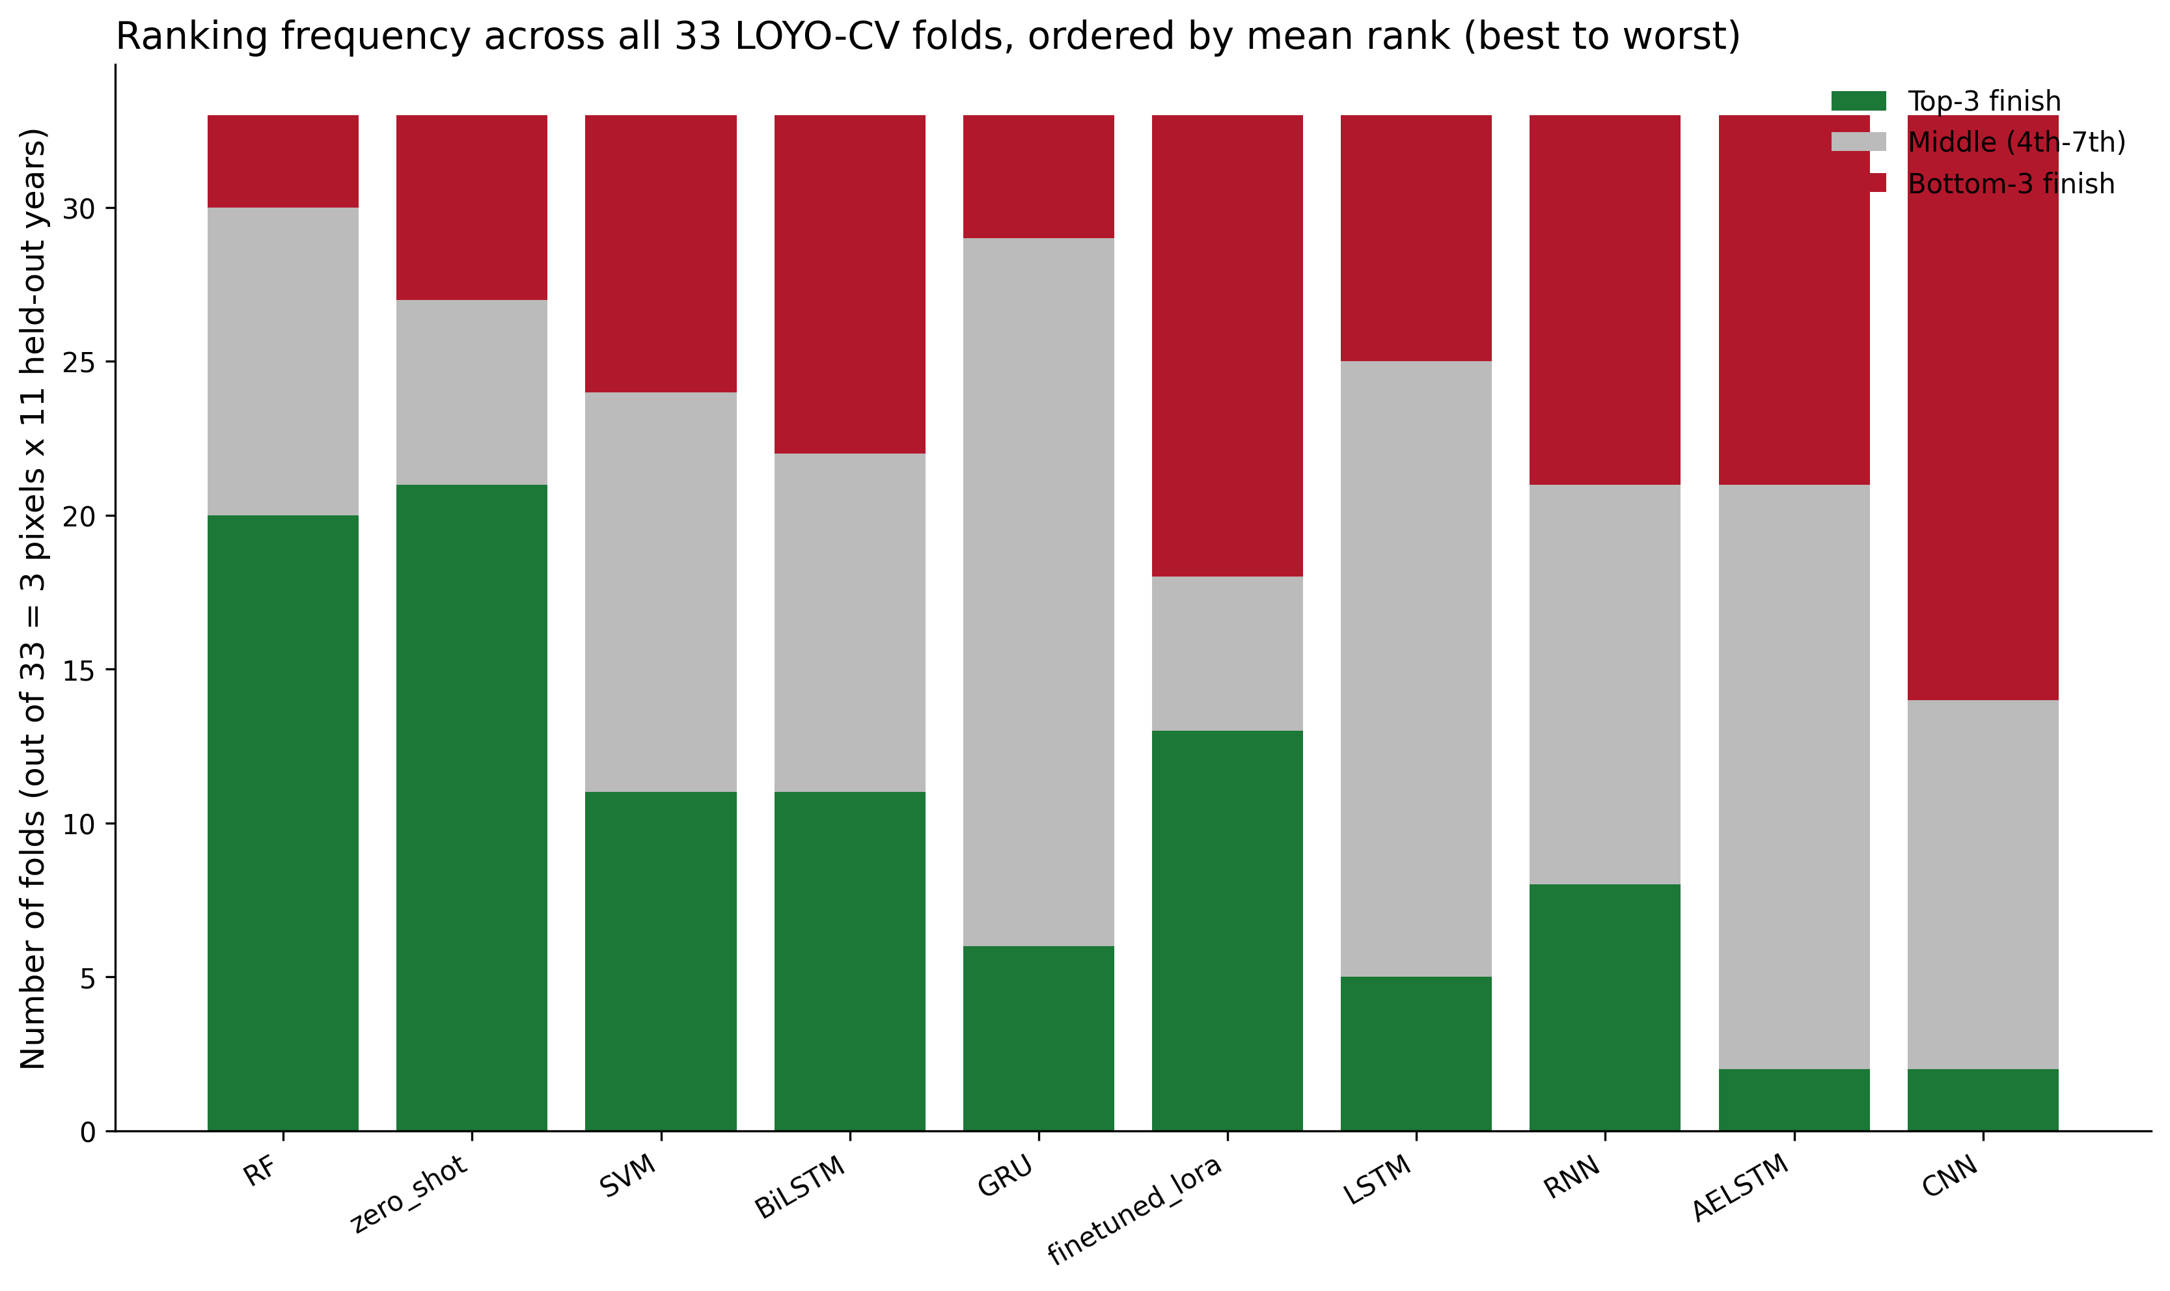
PART 1 — ROLLING-ORIGIN LOYO-CV
6
Which Models Are Consistently Strong?
▪ RF (mean rank 3.39) and Chronos-2 zero-shot (3.70) are top-3 on ~6 of every 10 folds, and rarely worst.
▪ LoRA fine-tuning is the single most volatile method — frequent top-3 AND frequent bottom-3 finishes.
▪ AELSTM (bottom-3 on 36% of folds) and CNN (58%) are the least reliable methods overall.
TAKEAWAY
Random Forest and Chronos-2 zero-shot are the most dependable models across all 33 folds.
Notes:
This chart answers a slightly different question — not how good is a model, but how consistently good is it. Green is a top-three finish, red is bottom-three. Random Forest and Chronos-2 zero-shot are the two bars on the left, and they're mostly green with very little red — just reliably solid. The fine-tuned LoRA model is the interesting one — lots of green, but also a lot of red. It's not consistently bad, it's just unpredictable, which matters later in the talk.

Slide 7
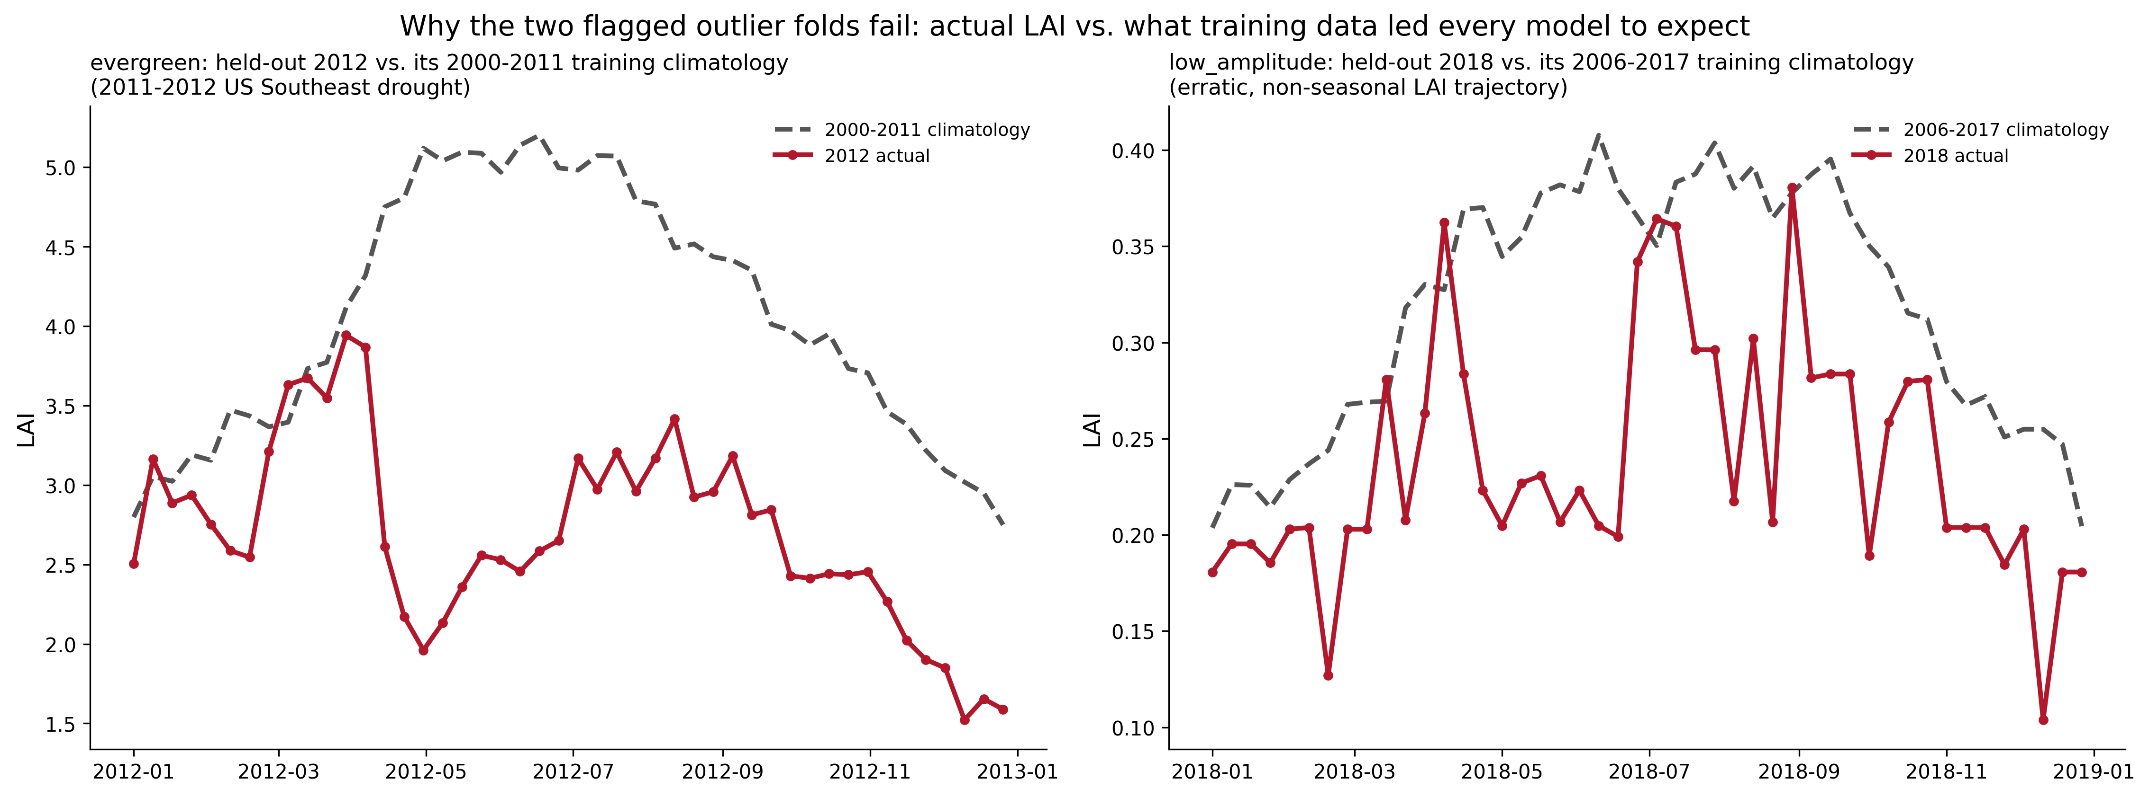
PART 1 — ROLLING-ORIGIN LOYO-CV
7
Two Outlier Folds, Two Different Failure Modes
▪ evergreen / 2012 (z = −3.0): a real, sustained drought — LAI never reaches its expected seasonal peak for months.
▪ low_amplitude / 2018 (z = −2.9): not a climate anomaly — an erratic, noisy year at an already low-signal pixel.
▪ No year was difficult across all 3 pixels at once — difficulty is pixel-specific, not a shared climate signal.
TAKEAWAY
A single fixed 2022 test year could never have revealed either failure mode.
Notes:
I wanted to understand what was actually happening in those worst years, so I went back to the raw satellite data. Turns out we have two completely different stories here. The evergreen forest in 2012 was a real drought — the canopy never greened up the way it normally would, and every model got fooled because none of them had seen a drought like that in training. The grassland pixel in 2018 is different — climate was totally normal that year, but the vegetation response was just erratic and noisy, which is easy to miss if you only look at one test year.

Slide 8
PART 1 — ROLLING-ORIGIN LOYO-CV
8
Part 1 Takeaway: LOYO-CV
▪ Rolling-origin LOYO-CV gives a far more robust, realistic evaluation than a single fixed test year.
▪ Model performance varies substantially across pixels and years — there is no universal winner.
▪ Random Forest and Chronos-2 zero-shot are the most consistently strong models across 33 folds.
▪ Chronos-2’s advantage comes from normal years, not special resilience to anomalous ones — it was among the worst methods on the evergreen drought fold.
TAKEAWAY
LOYO-CV reveals failure modes that single-year (2022-only) evaluation completely misses.
Notes:
So stepping back — the headline here is that a single test year can hide a lot. Performance really depends on which pixel and which year you happen to look at, and the two models that came out looking most dependable across the board were Random Forest and Chronos-2 zero-shot. Worth noting though — Chronos-2's advantage shows up in normal years, not the drought year, so it's not magic robustness to anomalies, it's just solid on average.

Slide 9
PART 2 — PREDICTOR SENSITIVITY
9
Predictor Sensitivity: Experimental Design
▪ Baseline: all 7 predictors (tmmx, tmmn, pr, srad, vpd, sph, vs) — reused from already-verified results, not rerun.
▪ Phase 1 — leave-one-predictor-out: 7 configs, each dropping exactly one predictor.
▪ Phase 2 — 4 grouped ablations, selection rule fixed before Phase 1 ran: top-3 essential only, drop the least-important pair, plus two a priori pairs — {tmmx,tmmn} and {vpd,sph}.
▪ 9 methods (8 AELSTM-family + Chronos-2 zero-shot) × 3 pixels; Chronos-2 fine-tuning excluded to keep the search computationally manageable.
TAKEAWAY
A small, pre-registered design instead of an intractable 2⁷ = 128-subset search.
Notes:
Okay, switching gears — the second thing I looked at this week is which of our seven climate variables actually matter. Testing every possible combination would be 128 different subsets, which is neither practical nor interpretable, so I did this in two stages instead: first drop one variable at a time and see what happens, then, based on what that showed us, test a handful of specifically chosen combinations rather than a blind search.

Slide 10
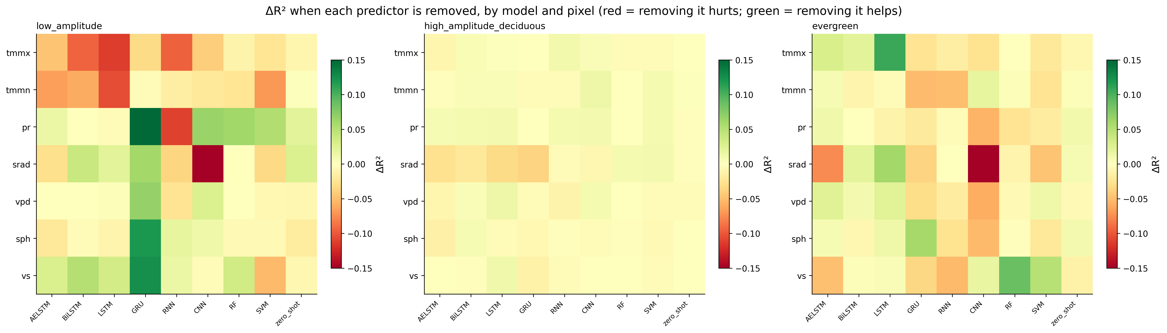
PART 2 — PREDICTOR SENSITIVITY
10
Predictor Importance Is Model- and Pixel-Specific
▪ Same predictor removal helps one model and hurts another at the same pixel (e.g. dropping pr helps GRU, hurts RNN/CNN at low_amplitude).
▪ high_amplitude_deciduous is largely insensitive to any single predictor — near-ceiling performance regardless.
▪ low_amplitude and evergreen show large, heterogeneous ΔR² in both directions.
TAKEAWAY
No single predictor-importance ranking applies to every model or every pixel.
Notes:
This heatmap is really the core result — each cell shows how much a model's R² changes when we remove one predictor, broken out by pixel. The big takeaway is that this is messy in a good way — removing the same variable can help one model and hurt another at the exact same pixel. So there's no single universal ranking of what matters — it depends on both the model and the location.

Slide 11
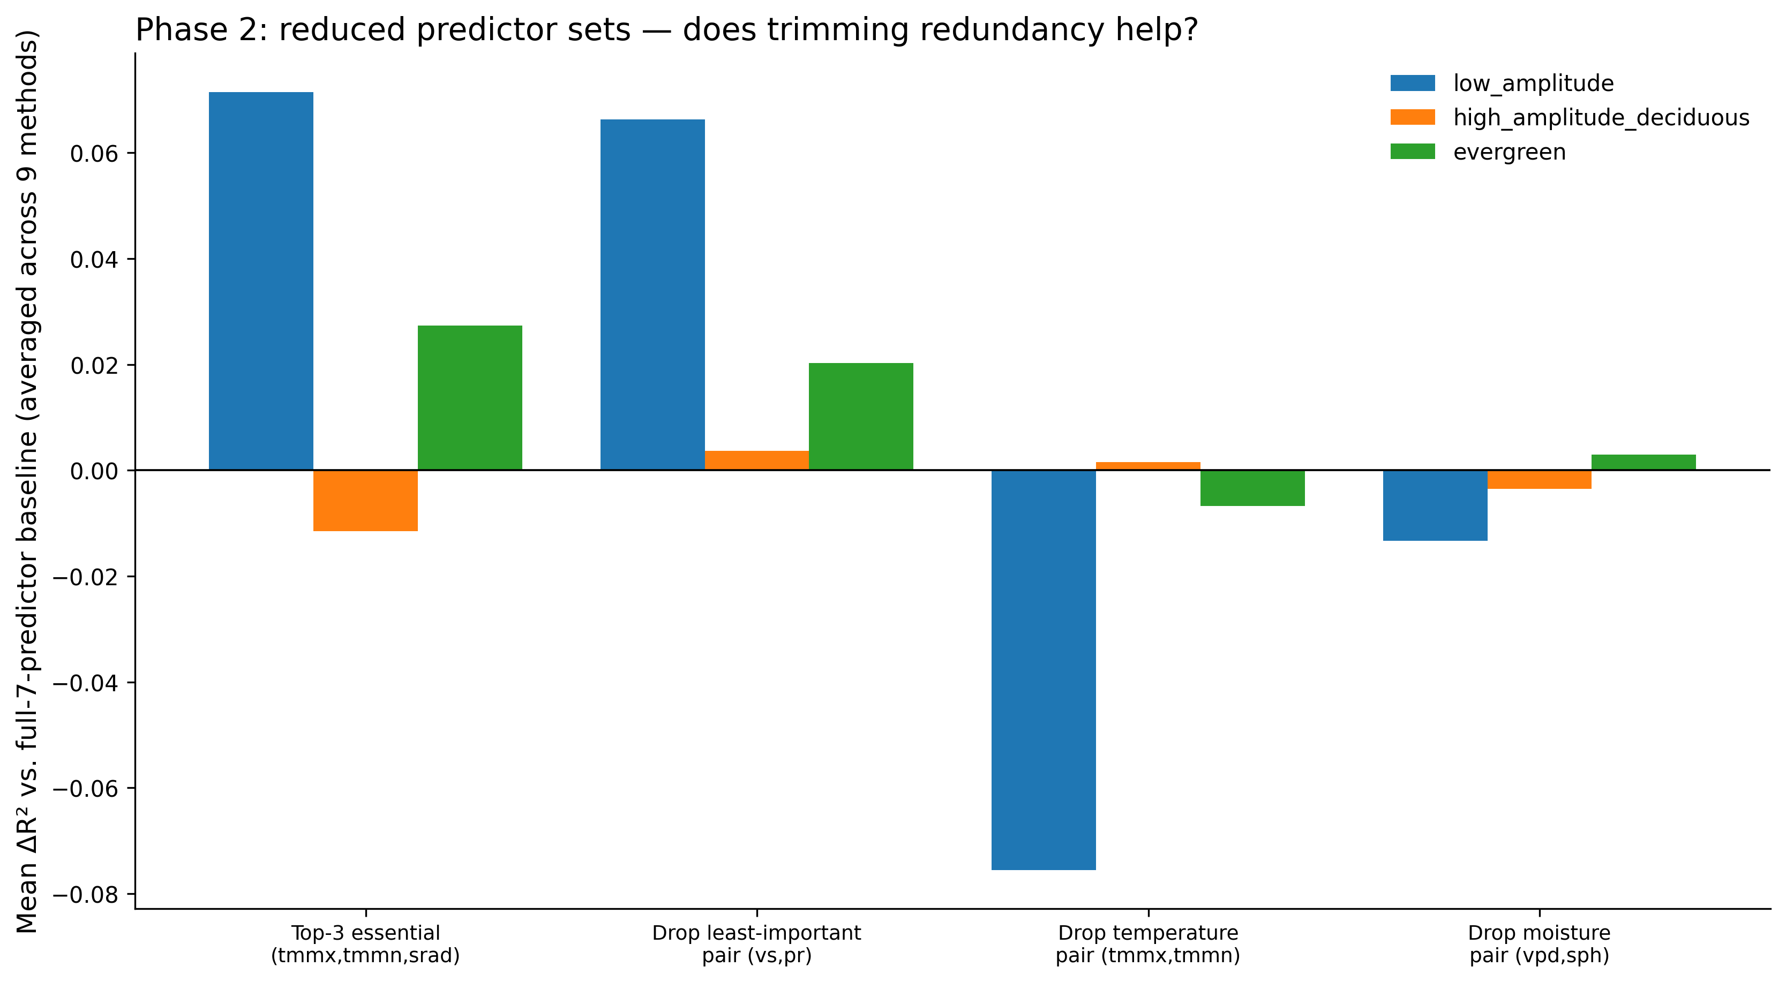
PART 2 — PREDICTOR SENSITIVITY
11
srad Matters Most; vs and pr Are Redundant
▪ srad is the only predictor that helps at all 3 pixels — the single most important variable overall.
▪ Temperature (tmmx/tmmn) is critical at low_amplitude but unimportant — even mildly harmful — elsewhere.
▪ Dropping the 2 least-important predictors (vs, pr) improves mean R² at all 3 pixels simultaneously.
TAKEAWAY
A leaner 5-predictor set (tmmx, tmmn, srad, vpd, sph) is a validated, better default.
Notes:
If I had to boil it down to one number, solar radiation is the one variable that helps everywhere, consistently — the closest thing we have to a universally important predictor. On the other end, wind speed and precipitation turned out to be somewhat redundant — this chart shows that dropping just those two actually improved average performance across all three pixels. So there's a real case for simplifying our feature set.

Slide 12
PART 3 — IMPROVED LoRA FINE-TUNING
12
The Original Fine-Tuning Had No Safety Net
▪ fit() was called without validation_inputs → eval_strategy=“no”, load_best_model_at_end=False.
▪ Trained a fixed 1000 steps and kept whatever weights existed at that instant — no way to detect overfitting.
▪ LoRA hyperparameters (lr=1e-4, r=8, α=16) were taken verbatim from Amazon’s own notebook, never tuned for this dataset.
TAKEAWAY
No validation signal → no way to know whether fine-tuning helped or hurt.
Notes:
Now, the third piece — and this one's a bit of a confession. When we first tried fine-tuning Chronos-2 with LoRA, it consistently made things worse, and I wanted to understand why. Turns out the way we originally set it up, the model just trained for a fixed number of steps with no way to check whether it was still improving or already overfitting — it just used whatever weights it happened to end up with.

Slide 13
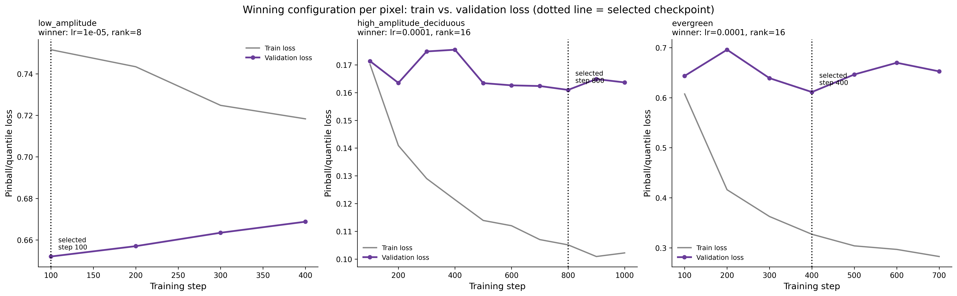
PART 3 — IMPROVED LoRA FINE-TUNING
13
Improved Design: Validation-Based Checkpoint Selection
▪ Chronological validation split from pre-2022 data (2020 & 2021 folds) — 2022 stays completely untouched.
▪ Small search: learning rate ∈ {1e-5, 1e-4} × LoRA rank ∈ {4, 8, 16}, with early stopping; best checkpoint chosen purely by validation loss.
▪ low_amplitude overfits immediately (best step = 100); the other two pixels show genuine interior validation-loss minima.
TAKEAWAY
Confirmed from source: validation_inputs auto-selects the best checkpoint, not the final training step.
Notes:
So I fixed that by holding out some of the pre-2022 data as a proper validation set, and letting the model pick its own best checkpoint based on validation performance instead of stopping at a fixed number. These curves tell a great story — at the grassland pixel, the model overfits almost immediately, right at the first checkpoint, while at the other two pixels you can actually see a clear sweet spot in the middle before it starts overfitting.

Slide 14
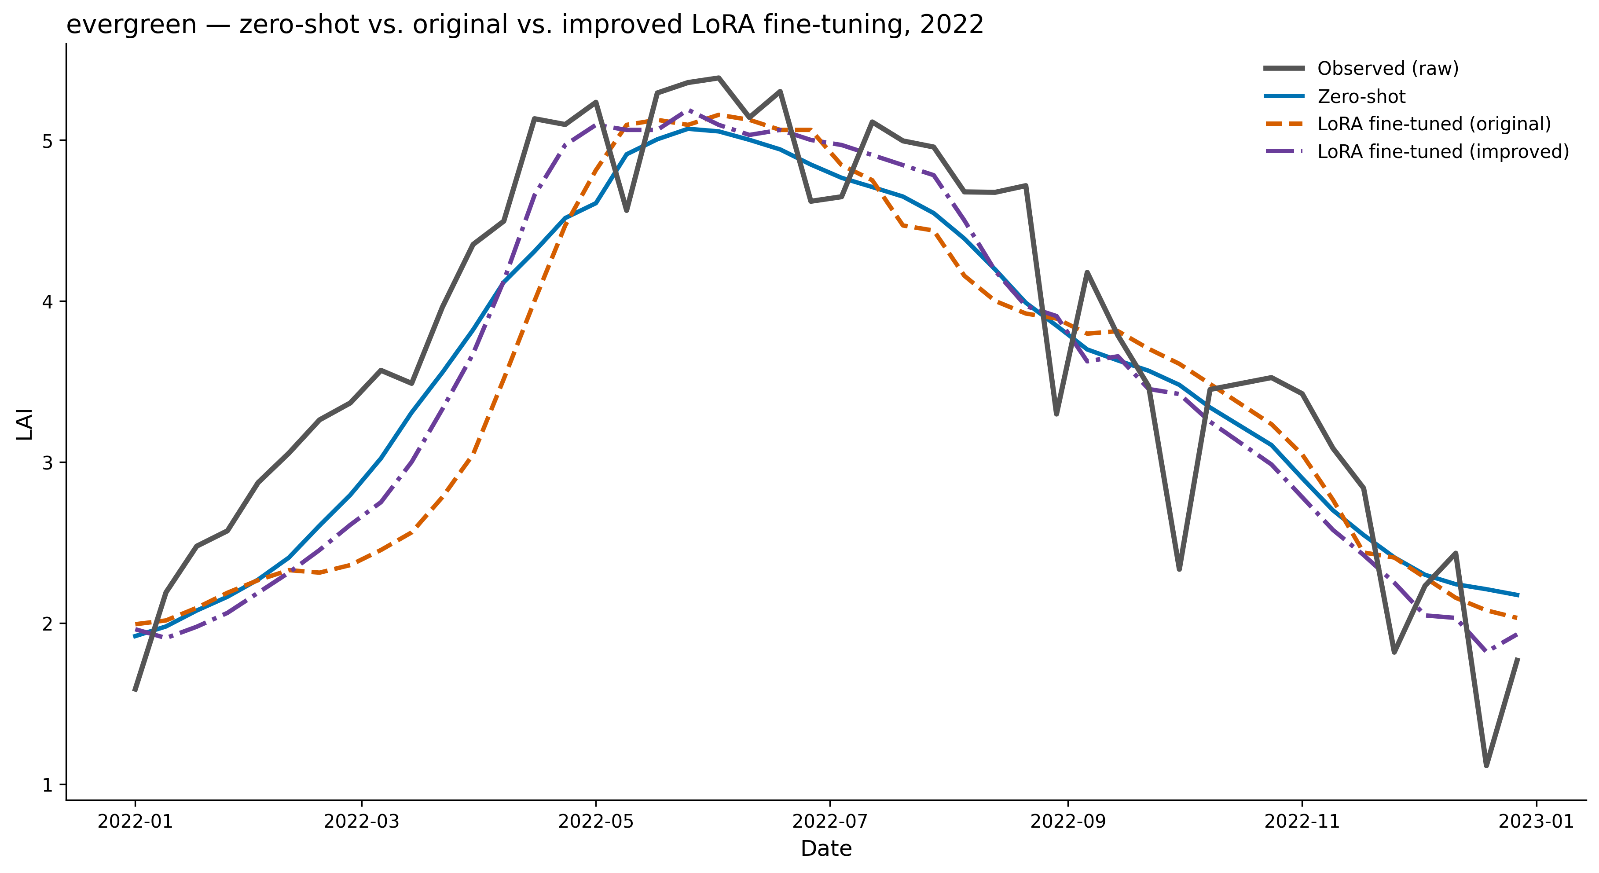
PART 3 — IMPROVED LoRA FINE-TUNING
14
Validation-Based Tuning Recovers Most of the Lost Performance
Pixel | Zero-shot | Original LoRA | Improved LoRA
low_amplitude | 0.542 | 0.379 | 0.500
high_amplitude_ deciduous | 0.965 | 0.952 | 0.942
evergreen | 0.832 | 0.712 | 0.829
▪ Gap to zero-shot shrinks from −0.163 to −0.042 at low_amplitude, and from −0.120 to −0.003 at evergreen.
▪ Improved LoRA still does not outright beat zero-shot on any of the 3 pixels.
TAKEAWAY
Most of the original degradation was a training-setup artifact, not fundamental to LoRA itself.
Notes:
So does this actually fix things? Mostly, yes. Look at the gap to zero-shot before and after — at the grassland and evergreen pixels, the original fine-tuning was way behind zero-shot, and the improved version closes almost all of that gap. It still doesn't quite beat zero-shot outright on any pixel, but the takeaway is that most of what looked like a fundamental weakness in fine-tuning was actually just a missing safety net in how we trained it.

Slide 15
Overall Conclusions & Next Steps
15
What We Learned
Next Steps
▪ Rolling-origin LOYO-CV is essential — it reveals failure modes a single 2022 test year cannot.
▪ Model performance and predictor importance both vary substantially across pixels and years.
▪ srad is the most consistently important predictor; vs and pr are measurably redundant.
▪ Random Forest and Chronos-2 zero-shot are the most consistently strong models across LOYO folds — Chronos-2 zero-shot remains very competitive.
▪ The original LoRA degradation was largely caused by the fine-tuning setup, not LoRA itself; validation-based checkpoint selection recovers most of it — but improved LoRA still doesn’t consistently beat zero-shot.
▪ Extend LOYO-CV and the predictor ablation to the remaining 3 selected pixels (cropland, grassland/shrubland, high-interannual-variability).
▪ Adopt the reduced 5-predictor set (tmmx, tmmn, srad, vpd, sph) as the new default and re-validate across more pixels.
▪ Explore validation-informed fine-tuning further — more validation folds, a wider search — to test whether LoRA can be made to consistently beat zero-shot.
▪ Investigate why Chronos-2 (zero-shot and fine-tuned) underperforms specifically on sustained climate anomalies like the evergreen drought fold.
Notes:
So to wrap up — three things I'd want you to remember. One, don't trust a single test year, it can hide real failure modes. Two, both model performance and predictor importance are very pixel- and model-specific, so we should be cautious about one-size-fits-all conclusions. And three, fine-tuning isn't hopeless, it just needs proper validation — though it's still not our leading approach today. Happy to take questions, or we can dig into any of these in more detail.

