Slide 1
Variation-Based Forecasting + Physics-Equation Fine-Tuning
1
▪ Part 1: forecasting the LAI variation (anomaly) directly, instead of raw LAI - R² computed the current, correct way.
▪ Part 2: fine-tuning Chronos-2 with Prof. Wang's exact growth-mortality equation as a physics loss - does it beat raw zero-shot Chronos-2?

Slide 2
PART 1 — VARIATION-BASED FORECASTING
2
Part 1: Forecast the Variation, Not Raw LAI
▪ Raw-LAI R² mostly reflects seasonal-shape matching (both actual and predicted LAI follow the same strong annual cycle) - not genuine year-to-year skill.
▪ Fix: for each pixel, compute the per-calendar-position climatology from the 11 held-out-year LOYO context ONLY (no leakage - the same climatology machinery already used for this project's ACC metric), subtract it from LAI to get the variation/anomaly, and give Chronos-2 that anomaly directly as BOTH context and forecast target - weather covariates unchanged.
▪ R² and Pearson r are then computed directly on the anomaly itself - the current, correct standard, not a post-hoc decomposition of a raw-LAI forecast.
TAKEAWAY
The model's actual task is now "predict the deviation from normal" - exactly what "capturing inter-annual variability" means.

Slide 3
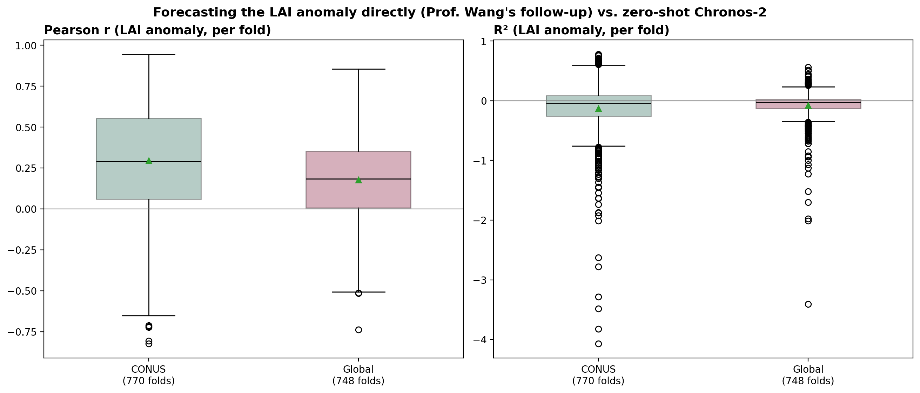
PART 1 — VARIATION-BASED FORECASTING
3
Part 1 Result: Modest, Independently-Confirmed Signal
Pool | R² (anomaly) | Pearson r (anomaly)
CONUS (770 folds) | mean -0.132 / median -0.046 | mean 0.296 / median 0.291
Global (748 folds) | mean -0.078 / median -0.025 | mean 0.178 / median 0.184
TAKEAWAY
R² is unstable at this sample size (same small-sample caveat as the composite-position analysis); Pearson r (≈0.30 CONUS / ≈0.18 Global) is the robust number, and it's modest - this is the result that motivated Part 2.

Slide 4
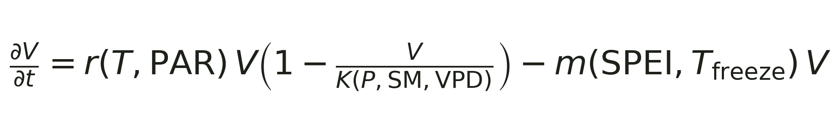
PART 2 — PHYSICS-GUIDED FINE-TUNING
4
Part 2: Fine-Tuning with the Exact Growth-Mortality Equation
Prof. Wang's diagnosis: the earlier ad hoc physics term library undersold the physics - this is the equation she actually meant:
▪ r (light/temperature-limited growth), K (water-limited carrying capacity), and m (drought/freeze-driven mortality) are each fit as their own small network from this equation's structure, then frozen and used as a physics-consistency loss while LoRA fine-tuning Chronos-2.
▪ Validated standalone on LAI first (clean fit, Pearson r mean 0.78) before using it to fine-tune Chronos-2 - see the companion physics-guided-fine-tuning deck for that step.
TAKEAWAY
Same 3 project sites as the earlier validation, now across all 11 LOYO years (33 folds) - a broader test before drawing conclusions.

Slide 5
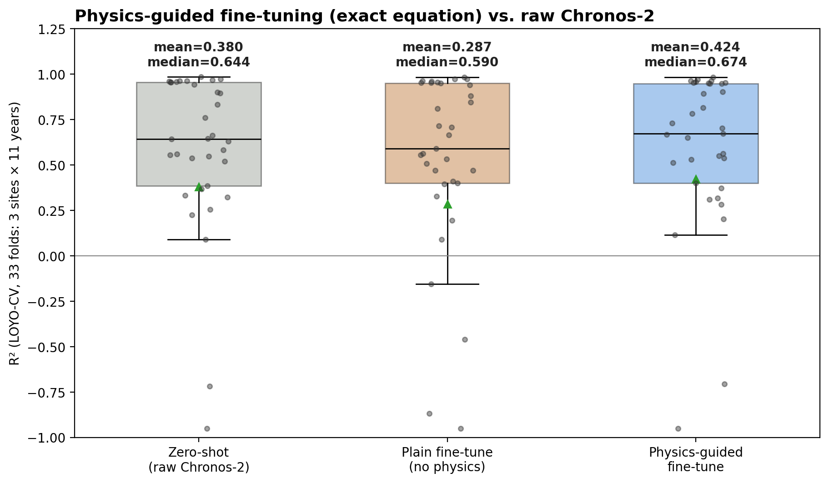
PART 2 — PHYSICS-GUIDED FINE-TUNING
5
Result: Physics-Guided Fine-Tuning Beats Raw Chronos-2
33 LOYO-CV FOLDS
▪ Mean R²: zero-shot 0.380 → physics-guided 0.424.
▪ Median R²: zero-shot 0.644 → physics-guided 0.674.
▪ Plain fine-tuning (no physics) actually UNDERPERFORMS zero-shot (mean 0.287) - small-sample fine-tuning alone tends to overfit. The physics term fixes this AND pushes past zero-shot.
▪ Physics-guided beats plain fine-tuning in 22/33 folds (67%).
WHERE IT HELPS MOST
▪ Biggest gains on the two sites with weaker zero-shot baselines (evergreen, low_amplitude); roughly neutral on the site already near its R² ceiling (high_amplitude_deciduous, R²≈0.96) - little room left to improve there.
TAKEAWAY
A genuine, aggregate improvement over raw zero-shot Chronos-2 - not on every single fold, but consistently in mean and median across 33 independent held-out years.

