Slide 1
Zero-Shot Chronos-2 for LAI Forecasting: From CONUS to the Globe
1
LAB MEETING SUMMARY
▪ Part 1: gridMET zero-shot generalization, expanded to a 32-pixel purity-filtered CONUS subset.
▪ Part 2: does the same zero-shot pattern hold outside the U.S.? 70 pixels spanning 14 world regions, cloud ERA5 climate + MODIS LAI ground truth (no CONUS pixels, no gridMET).
▪ Chronos-2 used strictly zero-shot throughout both parts: no training or fine-tuning.
TAKEAWAY
Part 1 asks whether the original result was cherry-picked within CONUS; Part 2 asks whether it holds at all outside CONUS.

Slide 2
BACKGROUND
2
Motivation & Research Questions
▪ Prior work established strong zero-shot Chronos-2 LAI forecasting on 3 hand-picked CONUS pixels using gridMET — the open question was whether that result generalizes.
▪ Part 1 asks: does the result hold across a larger, independently-selected, diverse CONUS pixel pool — not just 3 favorable locations?
▪ Part 2 asks a harder, independent question: does the result hold at all OUTSIDE the U.S., on a genuinely global pixel pool, using a global climate source (ERA5) and a global LAI product (MODIS) instead of gridMET/HiQ-LAI (both CONUS-only)?
70 → 32
70
Zero-shot
Part 1: purity-filtered CONUS subset
Part 2: non-CONUS global pixels, 14 regions
no training/fine-tuning in either part
TAKEAWAY
Part 1 tests robustness to pixel choice within CONUS; Part 2 tests robustness to geography, climate source, and LAI source all at once.

Slide 3
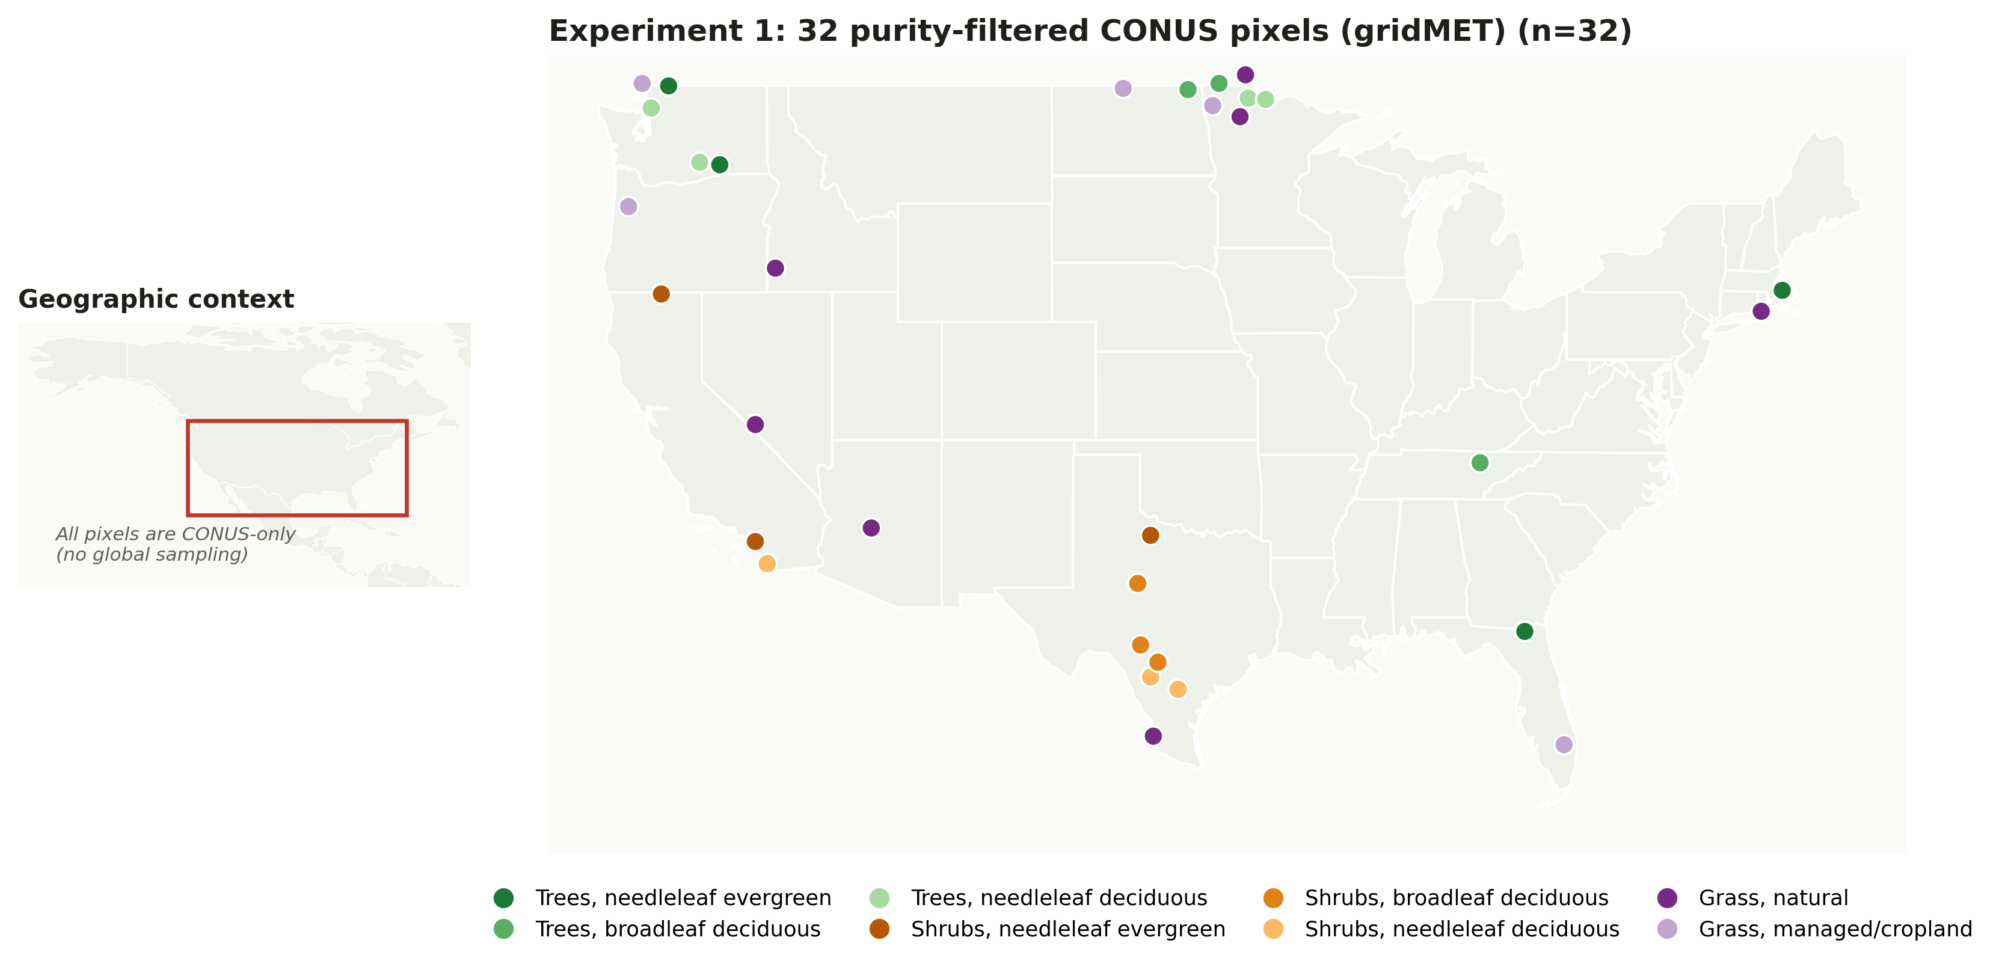
EXPERIMENT 1 — GRIDMET EXPANSION
3
Experiment 1: Design & Pixel Selection
▪ Starting pool: 70 CONUS pixels, farthest-point-sampled across an 8-class vegetation-composition space, spanning 9 U.S. regions (already used for the full 70-pixel gridMET study).
▪ This experiment isolates the 32 pixels with PFT purity ≥ 0.75 — the "clearly one vegetation type" subset, a harder bar than the full mixed-composition pool.
▪ Protocol: context = 2000–2021 (~1,000 8-day LAI composites), forecast = all steps of 2022, zero-shot Chronos-2, scored against raw observed LAI.
▪ No new downloads — this study reuses gridMET/HiQ-LAI data already available locally.
TAKEAWAY
32 pixels, 8 vegetation classes, 9 regions — purity ≥ 0.75 isolates the "unambiguous vegetation type" question.

Slide 4
EXPERIMENT 1 — GRIDMET EXPANSION
4
Experiment 1: Results Overview
0.865
22/32
0.894
1/32
median R²
pixels with R² ≥ 0.8
mean Pearson r
pixels with R² < 0
Metric | Mean | Median | Std | Min | Max
RMSE | 0.215 | 0.213 | 0.127 | 0.036 | 0.485
MAE | 0.160 | 0.162 | 0.096 | 0.028 | 0.426
R2 | 0.757 | 0.865 | 0.281 | -0.348 | 0.973
Pearson_r | 0.894 | 0.951 | 0.156 | 0.142 | 0.989
▪ Only 1/32 pixels scores R² < 0 (px047_grass_nat, R²=-0.348) — a near-flat, low-amplitude grassland series, the same signal-to-noise failure mode already diagnosed in prior LOYO-CV work, not a new problem.
TAKEAWAY
Median R²=0.865 across 32 diverse, purity-filtered pixels — the earlier 3-pixel result was not cherry-picked.

Slide 5
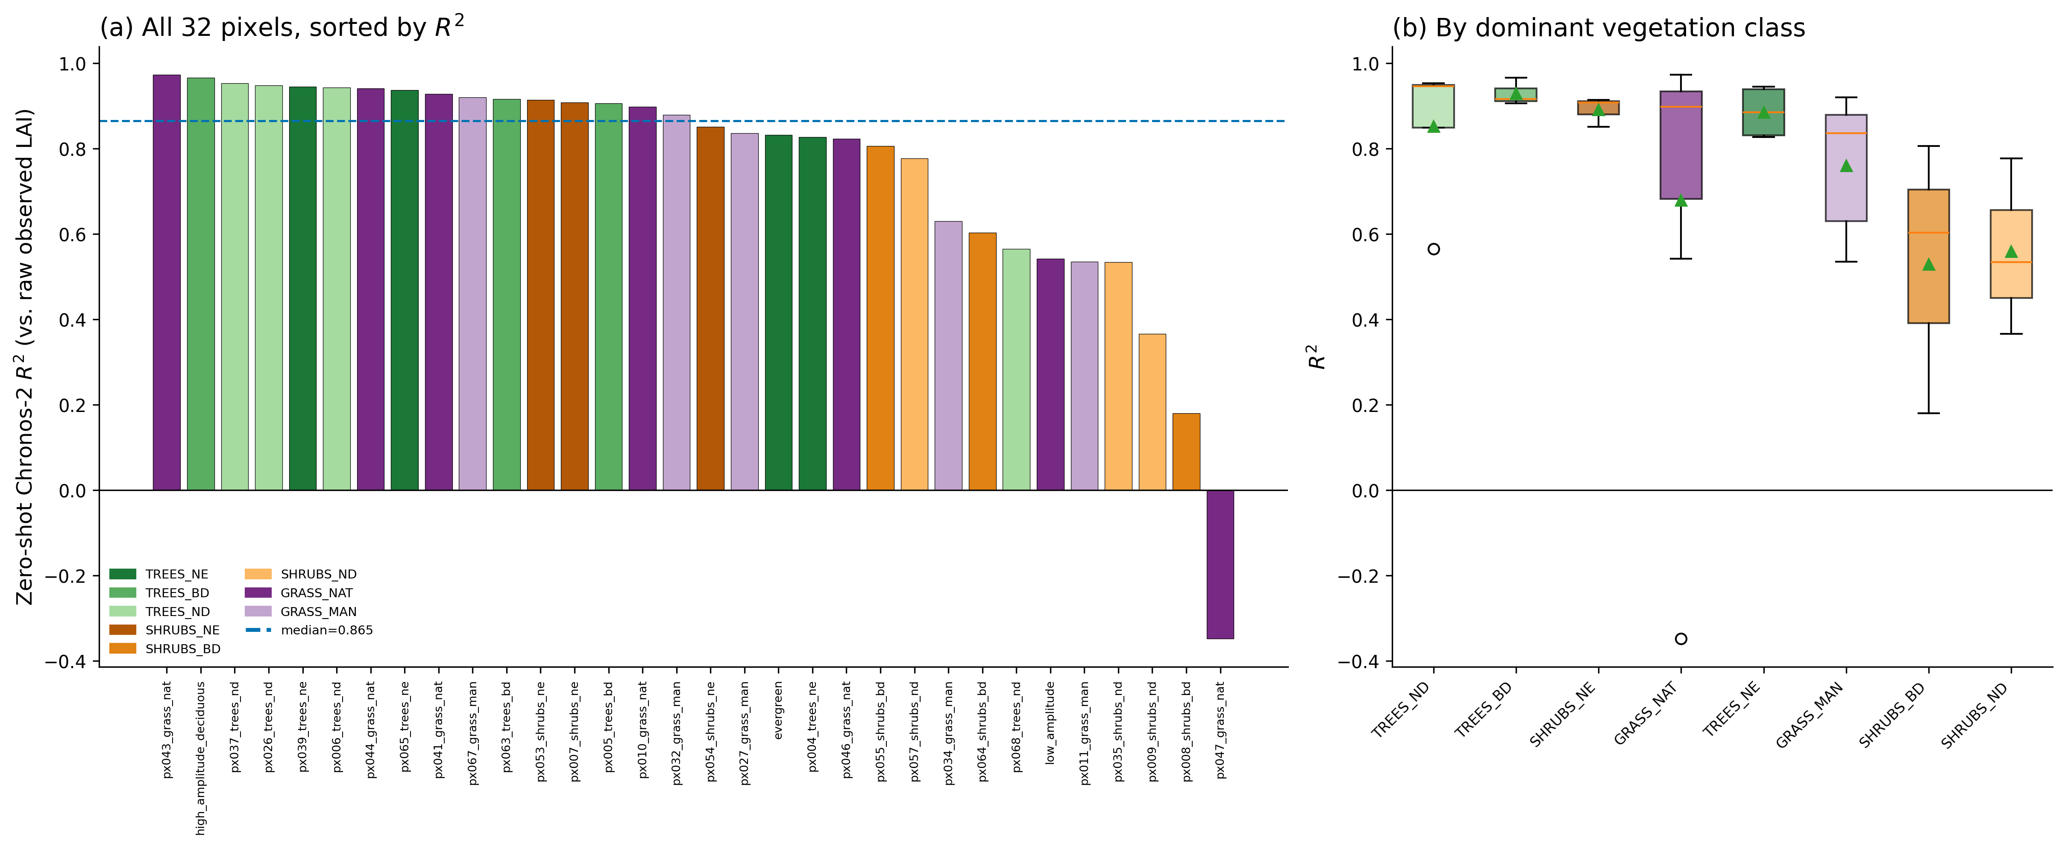
EXPERIMENT 1 — GRIDMET EXPANSION
5
Experiment 1: Performance by Pixel and Vegetation Type
TAKEAWAY
Tree/shrub-evergreen classes are most consistently strong; grassland and deciduous-shrub classes show the widest spread — driven by a handful of low-amplitude pixels, not the vegetation type itself.

Slide 6
PART 2 — NON-CONUS GLOBAL EXPERIMENT
6
Part 2: Global ERA5 + MODIS Dataset & Pipeline
Climate:
Google ARCO-ERA5
(cloud Zarr, 0.25°, same pipeline validated for the CONUS study — see next slide).
LAI:
MODIS MOD15A2H.061
(NEW — gridMET/HiQ-LAI is CONUS-only), fetched via NASA's AppEEARS point API.
Chronos-2 variable | ERA5 source | How it's obtained
tmmx (max temp) | 2m_temperature | direct (daily maximum)
tmmn (min temp) | 2m_temperature | direct (daily minimum)
pr (precipitation) | total_precipitation | direct (daily sum, m → mm)
srad (solar radiation) | surface_solar_radiation_downwards | direct (daily mean, J/m² → W/m²)
vpd, sph | 2m_temperature, dewpoint, surface_pressure | derived (FAO-56 Penman-Monteith)
vs (wind speed) | 10m u/v-wind components | magnitude of daily-mean vector
▪ LAI: MOD15A2H.061 Lai_500m, 8-day, 500m, Terra-only (covers 2000 onward, unlike the Terra+Aqua combined product which only starts mid-2002) — QC-filtered to MODLAND-good-quality retrievals only (68.1% of pixel-dates kept; the rest are dropped, not interpolated over).
▪ Unlike the CONUS study's uniform ~1,000-step context, MODIS data gaps mean context length now varies by pixel (202–1,002 steps, median 696) — reported per-pixel, not hidden.
TAKEAWAY
Same validated ERA5 pipeline; the new piece is a genuinely global LAI source (MODIS via AppEEARS) to replace CONUS-only gridMET/HiQ-LAI.

Slide 7
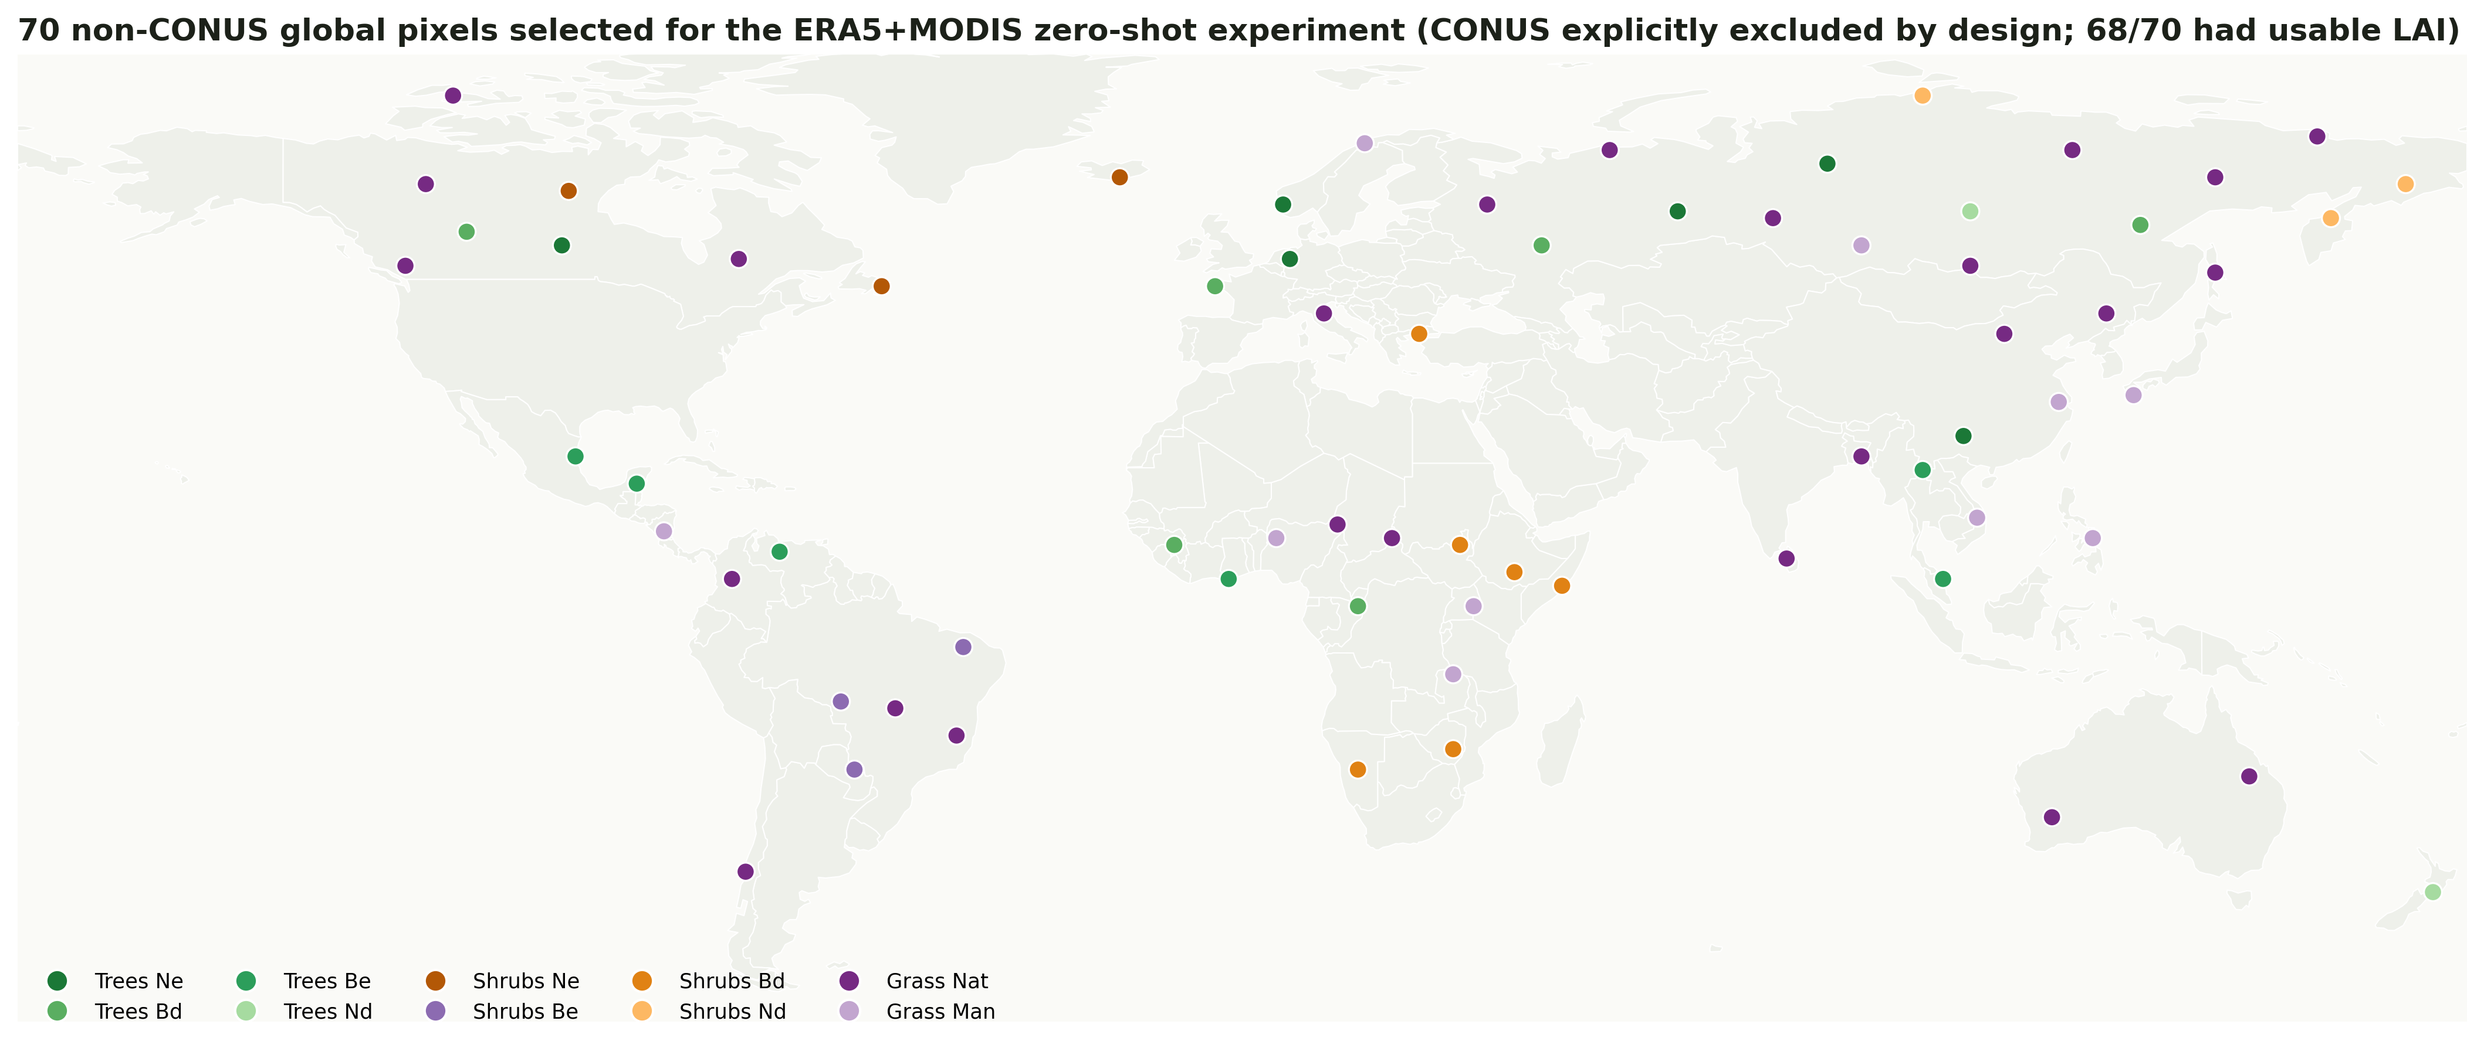
PART 2 — NON-CONUS GLOBAL EXPERIMENT
7
Part 2: Global Pixel Selection & Experimental Design
▪ 70 pixels selected by farthest-point sampling in vegetation-composition space over the global ESA CCI PFT product (same methodology as the CONUS pool, extended to a genuinely global, non-CONUS candidate set) — 10 vegetation classes, 14 world regions, purity 0.44–1.00.
▪ 68/70 had enough usable LAI to run (2 excluded: one high-Arctic pixel with persistent polar night/ice, one Southeast Asia pixel with persistent monsoon cloud cover — both known MODIS limitations).
TAKEAWAY
Protocol otherwise identical to Part 1: context = 2000–2021 (as available), forecast = 2022, zero-shot Chronos-2, no CONUS pixels.

Slide 8
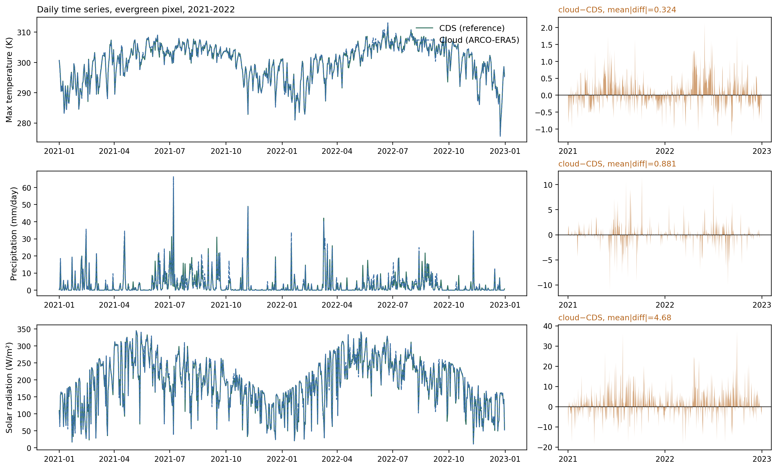
VALIDATION BEHIND BOTH PARTS' ERA5 USE
8
ERA5 Equivalence: CDS vs. Cloud, Visualized
Same evergreen pixel, 2021–2022 — actual daily values, not just a correlation coefficient:
TAKEAWAY
The two sources are visually near-indistinguishable for 6 of 7 variables; precipitation shows the one real, diagnosed discrepancy (convective-event spikes).

Slide 9
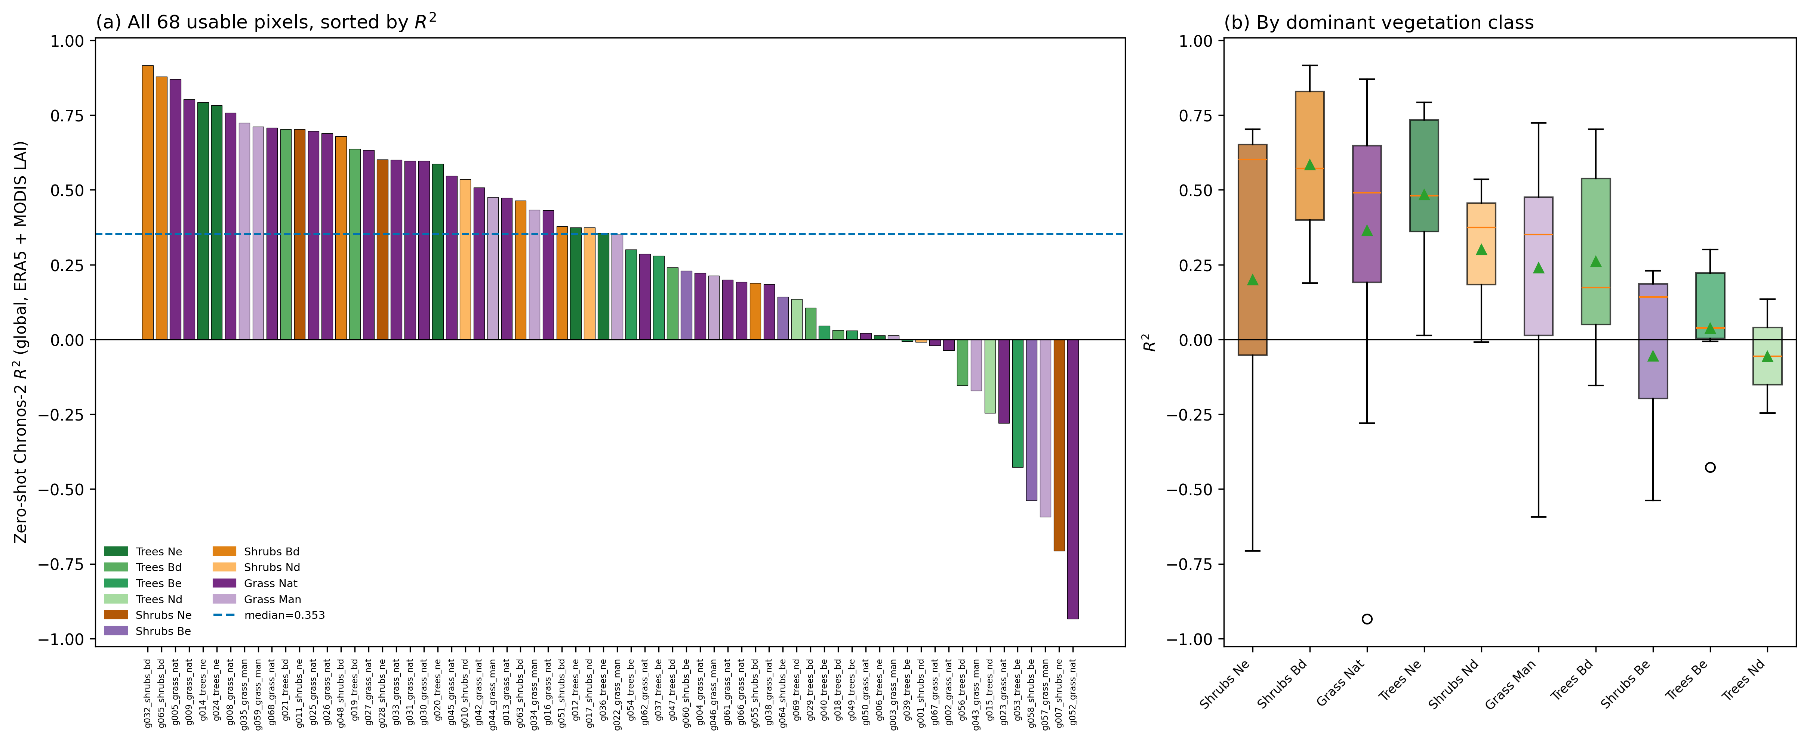
PART 2 — NON-CONUS GLOBAL EXPERIMENT
9
Part 2: Global Results (68 Usable Pixels)
0.353
4/68
0.621
13/68
median R²
pixels with R² ≥ 0.8
mean Pearson r
pixels with R² < 0
Class | n | Mean R² | Median R²
SHRUBS-BD | 6 | 0.584 | 0.571
TREES-NE | 6 | 0.484 | 0.481
GRASS-NAT | 24 | 0.364 | 0.490
SHRUBS-ND | 3 | 0.301 | 0.374
TREES-BD | 6 | 0.261 | 0.173
GRASS-MAN | 9 | 0.240 | 0.351
SHRUBS-NE | 3 | 0.199 | 0.601
TREES-BE | 6 | 0.037 | 0.038
SHRUBS-BE | 3 | -0.055 | 0.143
TREES-ND | 2 | -0.056 | -0.056
TAKEAWAY
Median R²=0.353, only 4/68 pixels ≥0.8 — a real, substantially weaker result than either CONUS study.

Slide 10
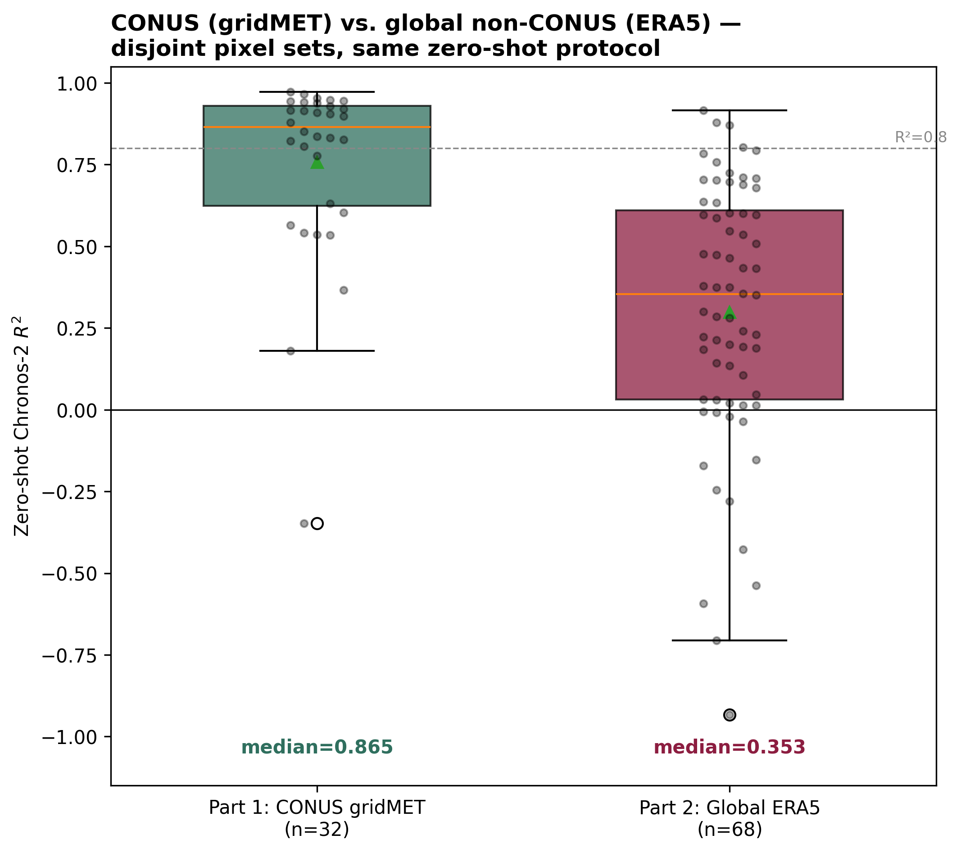
HEAD-TO-HEAD COMPARISON
10
Integrating Part 1 & Part 2: CONUS vs. Global
▪ n=32 (Part 1) vs. n=68 (Part 2) — disjoint pixel sets, not matched pairs, so this is a distributional comparison, not a per-pixel scatter.
▪ context-length vs. R² correlation within Part 2 is only r=0.16 — the gap is not mainly a context-length artifact.
TAKEAWAY
Median R² drops from 0.865 (CONUS) to 0.353 (global) — the strongest CONUS finding does not transfer uniformly worldwide.

Slide 11
WHERE THE GLOBAL EXPERIMENT STRUGGLES
11
Part 2 Failure Cases & Regional Patterns
▪ Two distinct failure modes: genuine anti-correlation (worst case, Amazon, Pearson r=-0.50 — direction, not just magnitude, is wrong) vs. directionally-right-but-miscalibrated (most other negative-R² pixels, e.g. Canada/Siberia pixels with Pearson r > +0.68 despite R² < 0).
Pixel | Class | Region | R² | Pearson r | Context
g052_grass_nat | GRASS-NAT | Amazon / Tropical S. America | -0.934 | -0.495 | 381
g007_shrubs_ne | SHRUBS-NE | Other | -0.706 | 0.169 | 394
g057_grass_man | GRASS-MAN | East Africa / Sahel | -0.593 | 0.254 | 999
g058_shrubs_be | SHRUBS-BE | Other | -0.538 | 0.534 | 955
g053_trees_be | TREES-BE | Other | -0.428 | -0.043 | 328
g023_grass_nat | GRASS-NAT | Canada | -0.280 | 0.682 | 504
g015_trees_nd | TREES-ND | Siberia / Boreal Eurasia | -0.246 | 0.849 | 467
g043_grass_man | GRASS-MAN | Other | -0.171 | 0.227 | 704
TAKEAWAY
13/68 pixels negative, concentrated in tropical (persistent cloud) and remote high-latitude regions — Amazon/Tropical S. America is the single weakest region (mean R²<0).

Slide 12
SUMMARY
12
Main Findings & Next Steps
RESULT
▪ Part 1 (gridMET, 32 CONUS pixels): median R²=0.865, 22/32 pixels ≥ 0.8.
▪ Part 2 (ERA5 + MODIS, 68 global non-CONUS pixels): median R²=0.353, only 4/68 pixels ≥ 0.8, 13/68 negative.
INTERPRETATION
▪ The strong zero-shot generalization repeatedly seen within CONUS does NOT transfer uniformly to a global, more diverse pixel pool — this is the first result in this project to show a real ceiling on zero-shot Chronos-2's LAI generalization.
▪ The gap is not primarily a context-length artifact (r=0.16 within Part 2); genuine regional/ecological difficulty — especially tropical persistent-cloud and remote high-latitude pixels — is the larger factor.
HYPOTHESIS / NEXT STEPS
▪ Not yet distinguished: Chronos-2's own generalization limits vs. noisier/sparser MODIS LAI vs. genuinely different (e.g. tropical) vegetation dynamics — disentangling needs a CONUS pixel re-scored against MODIS LAI as a controlled comparison.
TAKEAWAY
Two integrated experiments: strong, robust generalization within CONUS across two climate sources; a real, unexplained drop when tested globally — an open question, not a closed one.

