Slide 1
Leakage Diagnostic — Evergreen / 2012
1
PROF. WANG'S QUESTION
“What happens if you predict the 2012 LAI using a model that has already seen 2012 during training?”
▪ In LOYO-CV, every one of the 10 methods tested collapses to strongly negative R² (−4.5 to −8.5) on the evergreen pixel's 2012 fold — a real, severe drought year.
▪ Purpose of this diagnostic: find out whether that failure is mainly caused by 2012 being an unseen, out-of-distribution year, or by a limitation of the models themselves.
TAKEAWAY
We test this directly: let each model see 2012 during fitting, and see how much recovers.

Slide 2
2
Experimental Design
ORIGINAL — valid evaluation
DIAGNOSTIC — data leakage
Train: 2000–2011
Train: includes 2012
Test: 2012 (unseen)
Evaluate: 2012 (seen)
2012 never participates in fitting — this is the standard LOYO-CV protocol.
⚠ NOT VALID EVALUATION — DELIBERATE DATA LEAKAGE
▪ 8 AELSTM-family models (full refit) + Chronos-2 via LoRA fine-tuning — zero-shot has no trainable weights, so it cannot “learn” 2012 and is excluded from this condition.
▪ The evaluation forecast call is identical in both conditions — only the fitting data differs.
TAKEAWAY
The only variable that changes is whether 2012 participated in fitting.

Slide 3
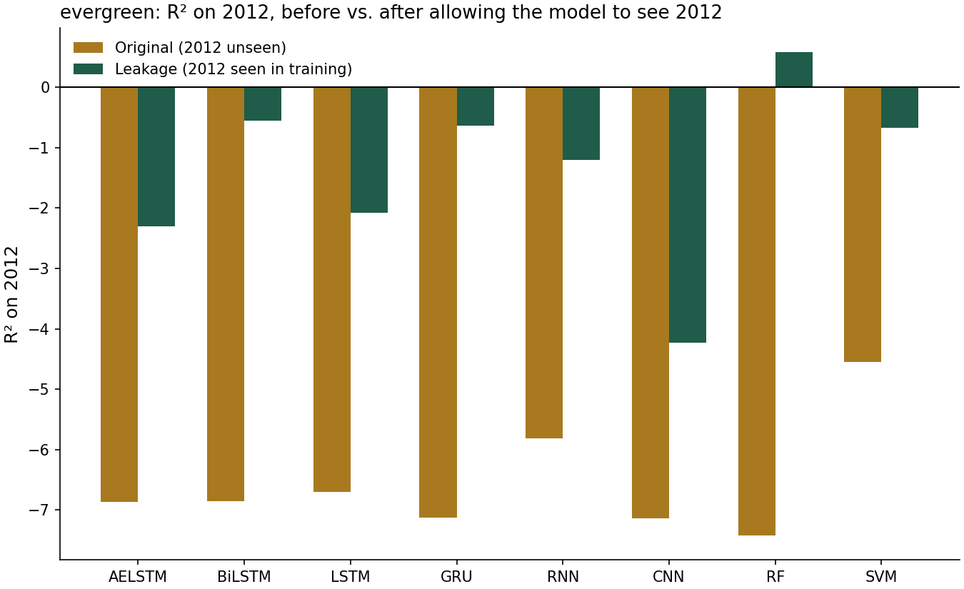
3
AELSTM-Family: Substantial but Incomplete Recovery
▪ Mean RMSE ↓ ~46% across all 8 models once 2012 is included in fitting.
▪ Mean R² ↑ +5.17 — a consistent effect across very different architectures.
▪ RF recovers the most, reaching R² = +0.59 — the only model to cross into positive territory.
▪ The other 7 models improve substantially but remain negative (roughly −0.6 to −4.2).
TAKEAWAY
Every model improves — but only Random Forest crosses into positive R².

Slide 4
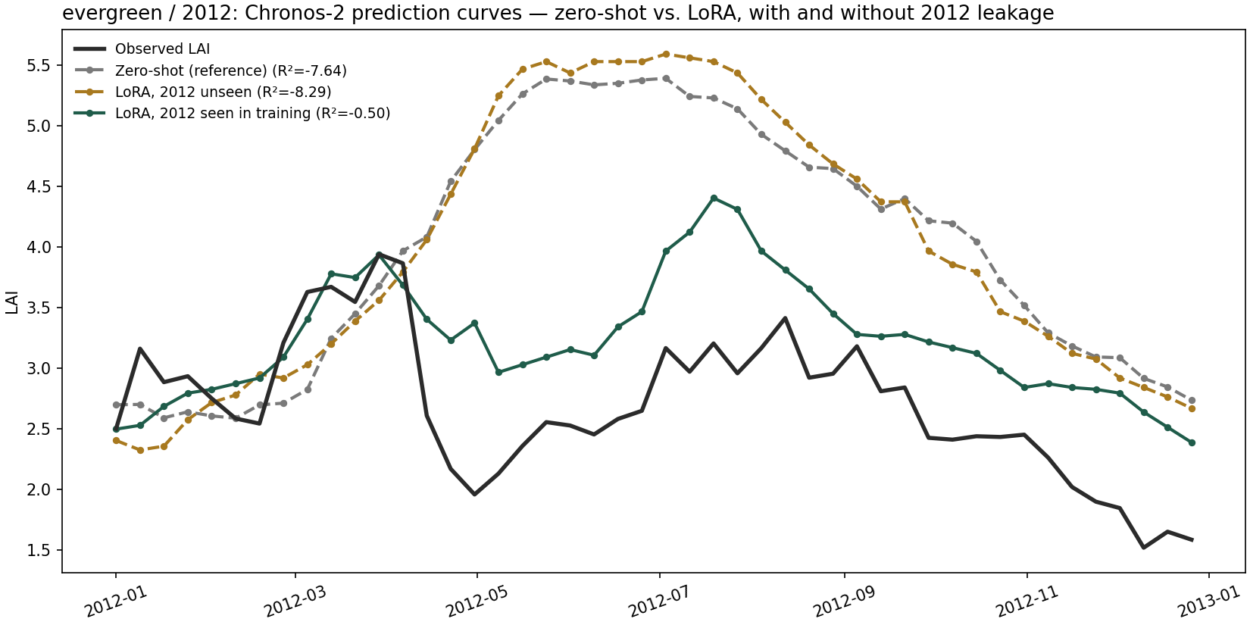
4
Chronos-2: LoRA Fine-Tuning With 2012 Included
▪ RMSE ↓ 59.9% | R²: −8.29 → −0.50 | Pearson r: 0.13 → 0.65 | ACC: −0.63 → 0.88
▪ Zero-shot has no trainable weights, so LoRA fine-tuning is the only way to let Chronos-2 “see” 2012; both conditions reuse the existing, already-validated LoRA hyperparameters.
TAKEAWAY
Chronos-2 shows the same pattern as AELSTM: a large recovery, but still short of a good fit.

Slide 5
ANSWER TO PROF. WANG'S QUESTION
5
Allowing the models to see 2012 substantially improves their ability to reproduce the 2012 LAI dynamics.
1
The dominant cause of the original failure appears to be distribution shift.
2012 was a real drought, unlike anything in the preceding training history.
2
The effect is consistent across very different model architectures, including Chronos-2.
RF, 6 neural sequence models, and a large pretrained transformer all improve substantially once 2012 participates in fitting — the signature of a shared external cause.
3
Model-specific limitations still remain.
Most models — including Chronos-2 — still have negative R² even after seeing 2012, so distribution shift is not the entire explanation.

