Slide 1
Update: Data Corrections + A Physics-Guided Fine-Tuning Experiment
1
SINCE LAST MEETING
▪ Two data-quality issues found in the global-pool figures shown last meeting - root-caused, fixed, and every affected result regenerated.
▪ A new experiment: adapted a physics-guided learning framework (PhyDL-NWP, KDD'25) to LAI forecasting, and used it to fine-tune Chronos-2 - what was built, and what a small-scale validation shows so far.

Slide 2
DATA CORRECTION 1 OF 2
2
Correction 1: Global-Pool LAI Values Were 10x Too Small
▪ Root cause: the global LAI loader re-applied MODIS's 0.1 scale factor on top of values that NASA's AppEEARS API had already scaled to physical units - silently dividing every real LAI value by 10 again.
▪ Caught by inspection: a global forest pixel's plotted LAI never exceeded 1.0 (real forest canopy reaches 3-7). Verified directly against the raw source file before fixing anything.
g014_trees_ne | Before (bug) | After (fixed)
g014_trees_ne max LAI | 0.66 | 6.60
g014_trees_ne mean LAI | 0.21 | 2.13
All 68 global pixels were affected (LAI, context, and the Chronos-2 predictions built from it). R², Pearson r, and MAPE are scale-invariant and came back numerically identical after the fix (verified directly, not assumed) - only RMSE/MAE and the raw LAI values/plots were wrong.
TAKEAWAY
Every R²/variance number reported last meeting for the global pool still stands unchanged - only absolute LAI values and RMSE/MAE needed correcting.

Slide 3
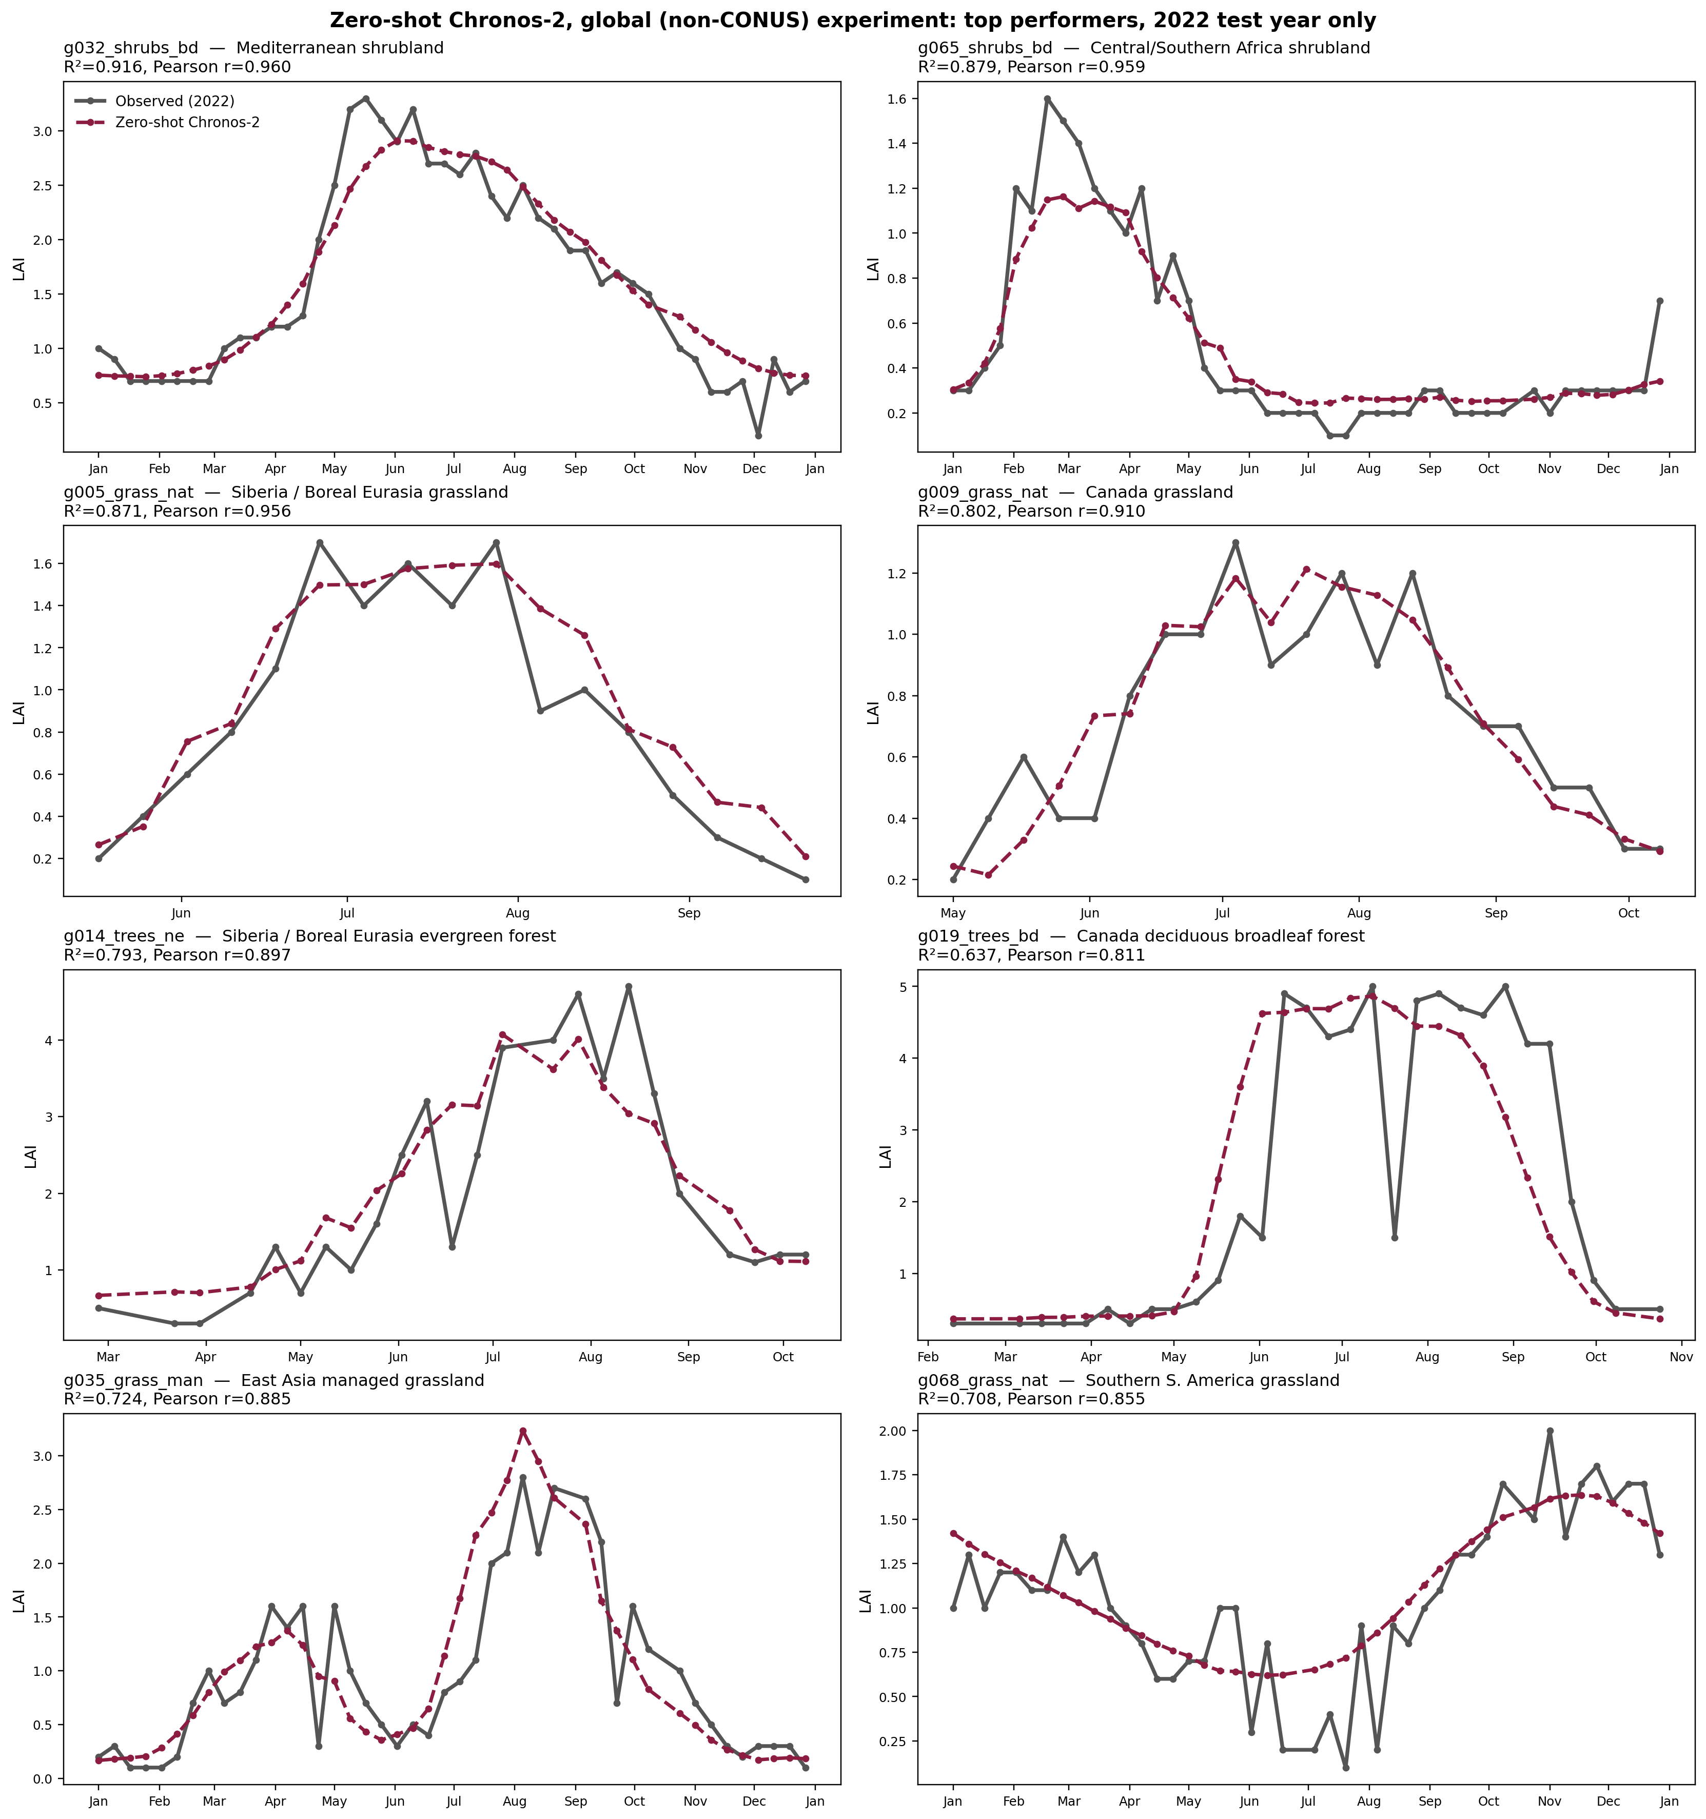
DATA CORRECTION 2 OF 2
3
Correction 2: One "Forest" Example Pixel Was Mislabeled
▪ g024_trees_ne ("Western Europe evergreen forest") was one of the 8 example pixels shown last meeting. Its LAI collapsed to near-zero every winter - not what an evergreen forest does.
▪ Cross-checked against an independent signal: MODIS's own internal biome-classification QC bit. 100% of its 1,047 retrievals were tagged non-forest, contradicting the "trees" label.
▪ Checked all 20 "trees"-labeled pixels in the pool the same way: 7 of 20 disagree with MODIS's biome tag (likely a 300m source-map vs. 500m MODIS footprint mismatch at those specific coordinates, not a pipeline bug) - full list disclosed in the project report so any class-level analysis knows which pixels to treat with caution.
Replaced with g019_trees_bd (Canada, deciduous broadleaf, R²=0.64) - the best-R² pixel among the 13 MODIS-confirmed forest pixels in the pool:
TAKEAWAY
The swapped-in pixel shows the textbook deciduous leaf-out/senescence cycle a forest label should.

Slide 4
PHYSICS-GUIDED FINE-TUNING
4
New Experiment: Physics-Guided Fine-Tuning for Chronos-2
▪ Adapted from PhyDL-NWP (Luo et al., KDD'25): two coordinate-conditioned networks - a field f(x,y,t) and a "latent force" Q - are trained jointly with a sparse set of PDE coefficients Ξ, then the learned physics is used to add a physics-consistency loss when fine-tuning a pretrained forecaster.
▪ That paper's domain is meteorology on a spatial grid (advection/diffusion PDEs). Adapted here for a point-sampled vegetation variable with no canonical governing equation: replaced the PDE with a phenology growth/decay model (standard in the Growing-Season-Index family) built from this project's own ERA5 covariates - radiation-limited growth, temperature/precipitation forcing, VPD water stress, self-decay - with Ξ learned jointly across all 70 CONUS pixels rather than assumed.
▪ Two stages: (1) fit the physics field + Ξ to 23 years of pooled CONUS LAI/climate data; (2) fine-tune Chronos-2 (shared LoRA adapter) with a physics-consistency term added to its loss.
TAKEAWAY
Chronos-2 itself stays strictly zero-shot throughout Stage 1 - the physics model is fit independently, then only used as an extra loss term when Stage 2 fine-tunes Chronos-2.

Slide 5
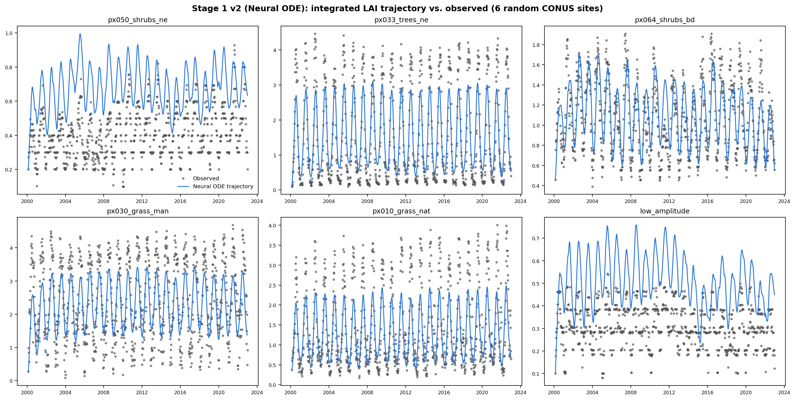
PHYSICS-GUIDED FINE-TUNING
5
Stage 1: A Physics-Constrained LAI Field (Neural ODE)
Learned term | Ξ
radiation-limited growth | +1.89
LAI self-decay | −1.31
temperature forcing | −1.27
precipitation forcing | +0.62
bias | +1.06
VPD water-stress | +0.13
Implemented as a genuine Neural ODE (integrates the learned growth/decay dynamics forward in time, rather than matching a derivative at scattered points) - an early scattered-point version produced jagged, physically implausible curves; integrating fixed it, shown here.
5 of 6 terms point the ecologically expected direction (growth from light/water/temperature, decay from VPD stress and natural turnover).
TAKEAWAY
A clean, site-differentiated seasonal field - built, debugged across several iterations, and validated by inspection before being used in Stage 2.

Slide 6
PHYSICS-GUIDED FINE-TUNING
6
Stage 2: Physics-Guided Chronos-2 Fine-Tuning
▪ A shared LoRA adapter (same target modules as the project's existing fine-tuning scripts) trained pooled across sites, not one adapter per pixel - consistent with Stage 1's own pooled design.
▪ Custom training loop (not the standard HuggingFace trainer): that pipeline doesn't expose a custom-loss hook, and its batches don't retain which site/date each example came from - both needed to evaluate the physics term. Calls Chronos-2's model forward pass directly so gradients flow to the LoRA weights.
▪ Loss = Chronos-2's own forecast loss (on real observed LAI, as in ordinary fine-tuning) + a physics term that penalizes Chronos-2's predicted LAI trajectory for deviating from Stage 1's learned growth/decay dynamics - a soft regularizer, not a hard constraint, and never trained against synthetic targets.
TAKEAWAY
Three conditions compared per fold: zero-shot, plain fine-tuning (no physics term), and physics-guided fine-tuning - isolating what the physics term itself contributes.

Slide 7
PHYSICS-GUIDED FINE-TUNING
7
Small-Scale Validation: 3 Sites × 2 LOYO Folds
Site | Year | Zero-shot R² | Plain fine-tune R² | Physics-guided R²
evergreen | 2012 | −7.64 | −8.44 | −7.39
evergreen | 2022 | 0.832 | 0.865 | 0.761
high_amplitude_deciduous | 2012 | 0.961 | 0.942 | 0.959
high_amplitude_deciduous | 2022 | 0.959 | 0.953 | 0.917
low_amplitude | 2012 | 0.548 | 0.483 | 0.297
low_amplitude | 2022 | 0.560 | 0.613 | 0.462
▪ Scoped as a validation pass before committing to the full 70-pixel × 11-fold comparison - used to catch implementation issues early, and it did: an initial run surfaced a too-strong physics weight and a train/eval feature-scaling mismatch, both found and fixed (see build log in the repo).
▪ After those fixes: 1 of 6 folds now has physics-guided fine-tuning beat both other conditions (high_amplitude_deciduous/2012); the other 5 still favor plain fine-tuning or zero-shot.
TAKEAWAY
The pipeline (Stage 1 + Stage 2 + 3-way comparison) is built, debugged, and runs end to end - the physics term's benefit, at this scale, is not yet consistent.

Slide 8
SUMMARY
8
Summary & Next Steps
WHAT WAS BUILT
▪ Two data-correctness issues from last meeting's figures found, root-caused, fixed, and disclosed (scale bug + pixel mislabeling) - all downstream results regenerated.
▪ An end-to-end physics-guided fine-tuning pipeline for Chronos-2, adapted from a recent (KDD'25) physics-guided learning paper to a vegetation variable with no prior physics-ML precedent in this project.
CURRENT RESULT
▪ In the small-scale validation, the physics term does not yet consistently improve on plain fine-tuning - plausibly because Chronos-2's own pretrained prior, from large-scale time-series pretraining, already captures much of what the hand-built phenology terms encode.
NEXT STEPS
▪ Candidates: use the physics field for gap-filling instead of a training-time loss, or test whether it helps more in the weaker global pool, where Chronos-2's implicit prior may be less saturated.
TAKEAWAY
Both workstreams are now in a clean, documented, reproducible state - ready for discussion.

