Slide 1
Can PFT Improve Chronos-2 LAI Forecasting?
1
HYPOTHESIS
Different vegetation compositions may respond differently to the same climate forcing.
LAI_future = f( historical LAI, climate, PFT composition )
▪ Example: a pixel with 65% forest + 35% grass may not respond to precipitation, VPD, or temperature the same way a 100% forest pixel does.
▪ This deck summarizes a full investigation — from a single-pixel test that failed for an architectural reason, through an architecture fix, to a decisive controlled experiment.
TAKEAWAY
Question: can explicit PFT information give Chronos-2 a measurable, reproducible forecasting edge?

Slide 2
STEP 1 · DIAGNOSIS
2
Why the Initial PFT Approach Failed
▪ Single-pixel experiments fed PFT as a constant covariate (same value at every timestep) — and showed almost no effect.
▪ Source-code inspection of Chronos-2's InstanceNorm explained why:
PFT = 0.65
(constant every step)
InstanceNorm
(per-series, std=0)
→ [0, 0, 0, ...]
signal erased
Verified empirically: perturbing PFT across 5 synthetic compositions changed the prediction by exactly 0.00000000 — not a small effect, zero.
▪ Critically: this did NOT mean PFT is biologically irrelevant — only that a constant-per-pixel value cannot survive this specific normalization step.
TAKEAWAY
Chronos-2 was architecturally blind to static PFT — a mechanism problem, not evidence against PFT itself.

Slide 3
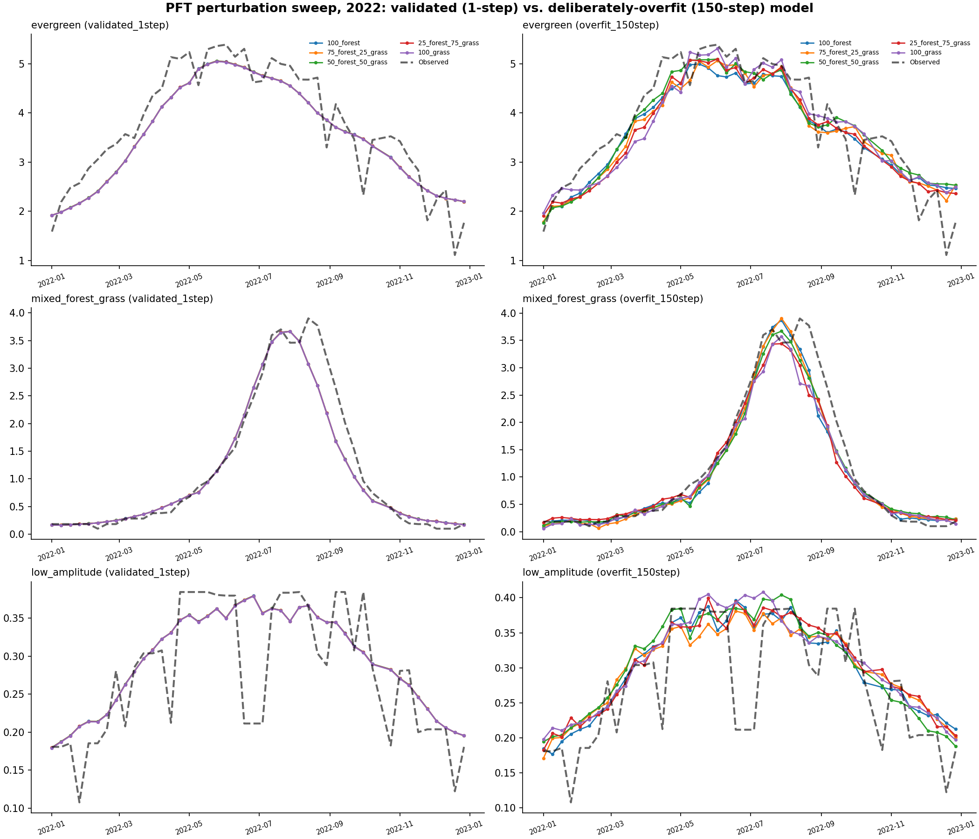
STEP 2 · ARCHITECTURE FIX
3
Making Chronos-2 PFT-Aware
▪ Built explicit PFT conditioning that bypasses InstanceNorm entirely: a small trainable module converts the PFT vector into a FiLM (scale, shift) adjustment applied directly to the model's internal representation — the frozen, 119.5M-parameter pretrained model never changes.
▪ Tested several conditioning designs: deep-MLP FiLM, a regularized variant, a biologically-structured linear mixture of per-vegetation-class response vectors, and a rank-8 bottleneck FiLM.
TAKEAWAY
Smoke test confirmed real PFT sensitivity (e.g. +0.63 LAI units, evergreen vs. grass) — the question became generalization, not visibility.

Slide 4
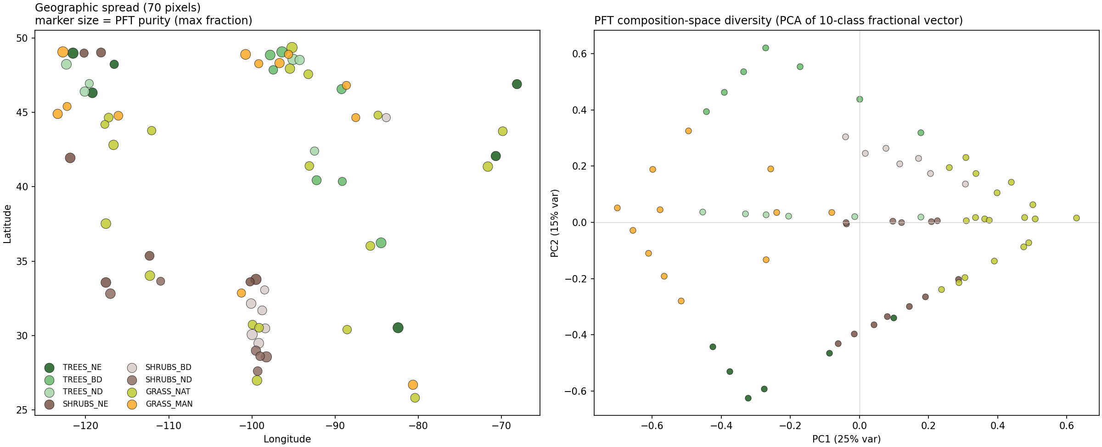
STEP 3 · SCALING UP
4
Multi-Pixel Experimental Design
▪ 70 CONUS pixels selected for genuine PFT diversity (8 dominant classes, purity 0.46–1.00), pooled into one shared training set so PFT actually varies across training rows.
▪ A real data-quality bug was caught and fixed here: 24/70 initially-selected pixels had 100% missing gridMET climate data (a known US coverage gap); the final 70-pixel set was verified complete.
TAKEAWAY
Strict protocol: pre-2022 windows only for training/model selection; 2022 touched exactly once, at the end.

Slide 5
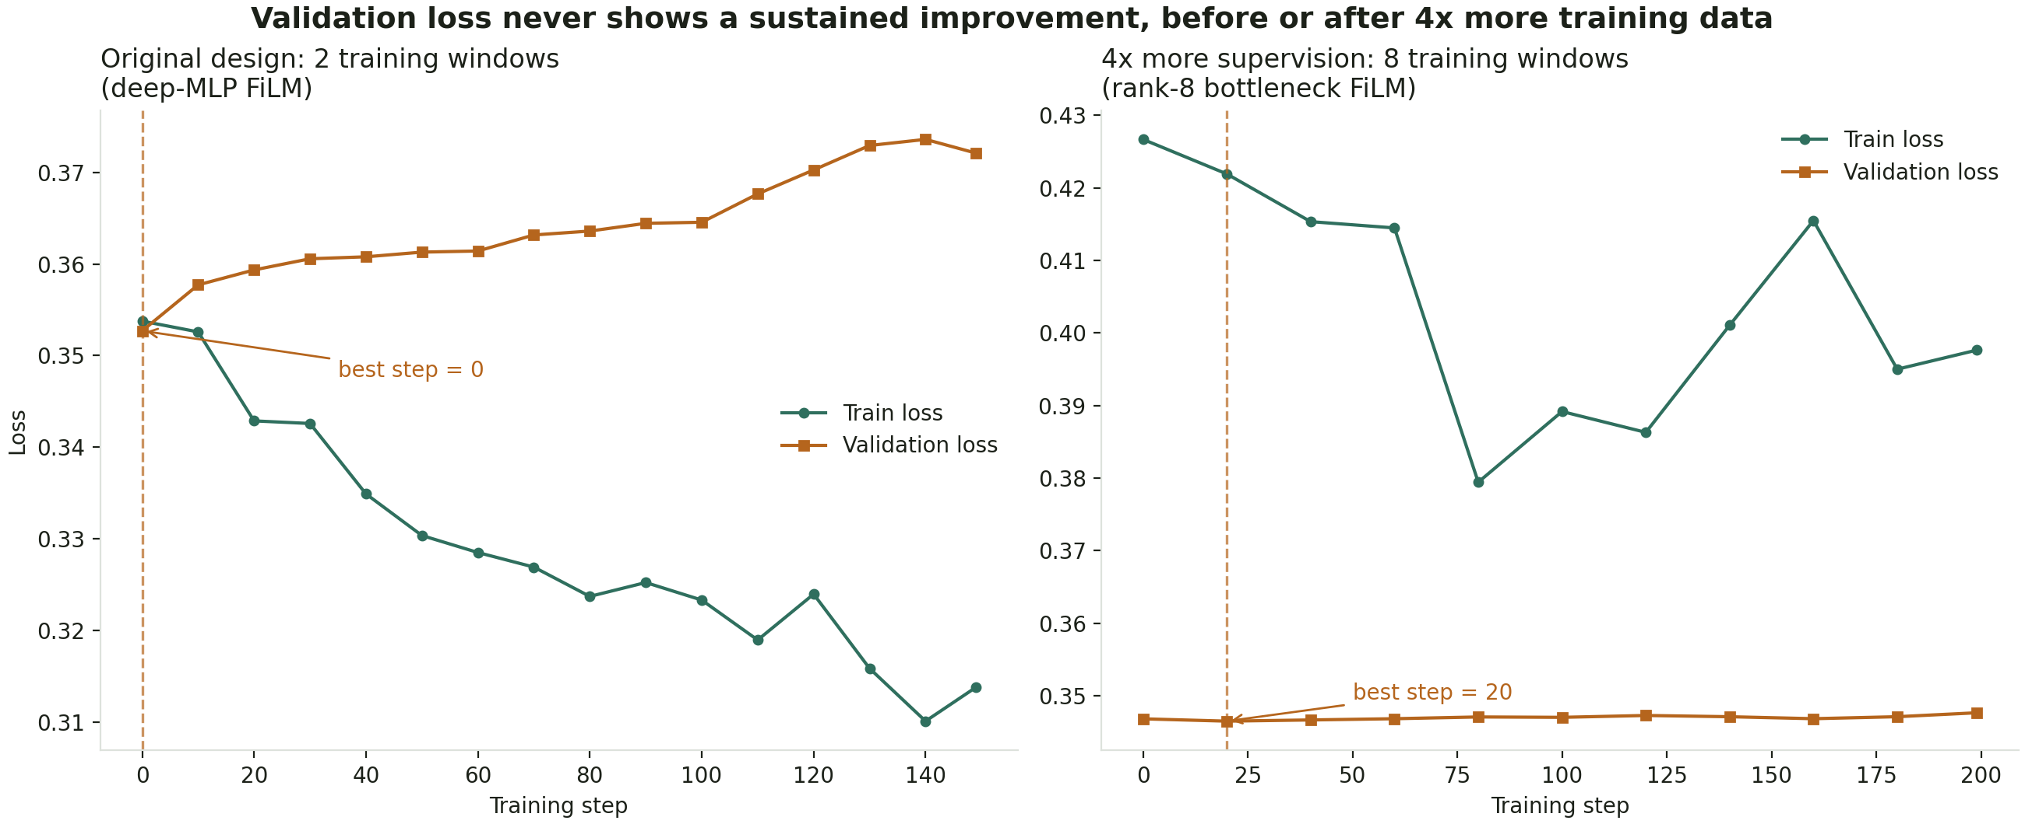
STEP 4 · SCREENING
5
Overfitting Persists Despite More Temporal Supervision
Architecture | Params | Best val_loss | Selected step
deep-MLP FiLM (original) | 100,544 | 0.34664 | 0
Regularized deep-MLP | 51,040 | 0.34667 | 0
Linear per-class mixture | 15,360 | 0.34695 | 0
Rank-8 bottleneck | 12,600 | 0.34653 | 20
TAKEAWAY
8 training windows (4x more) still weren't enough for 3 of 4 architectures — data volume alone isn't the full explanation.

Slide 6
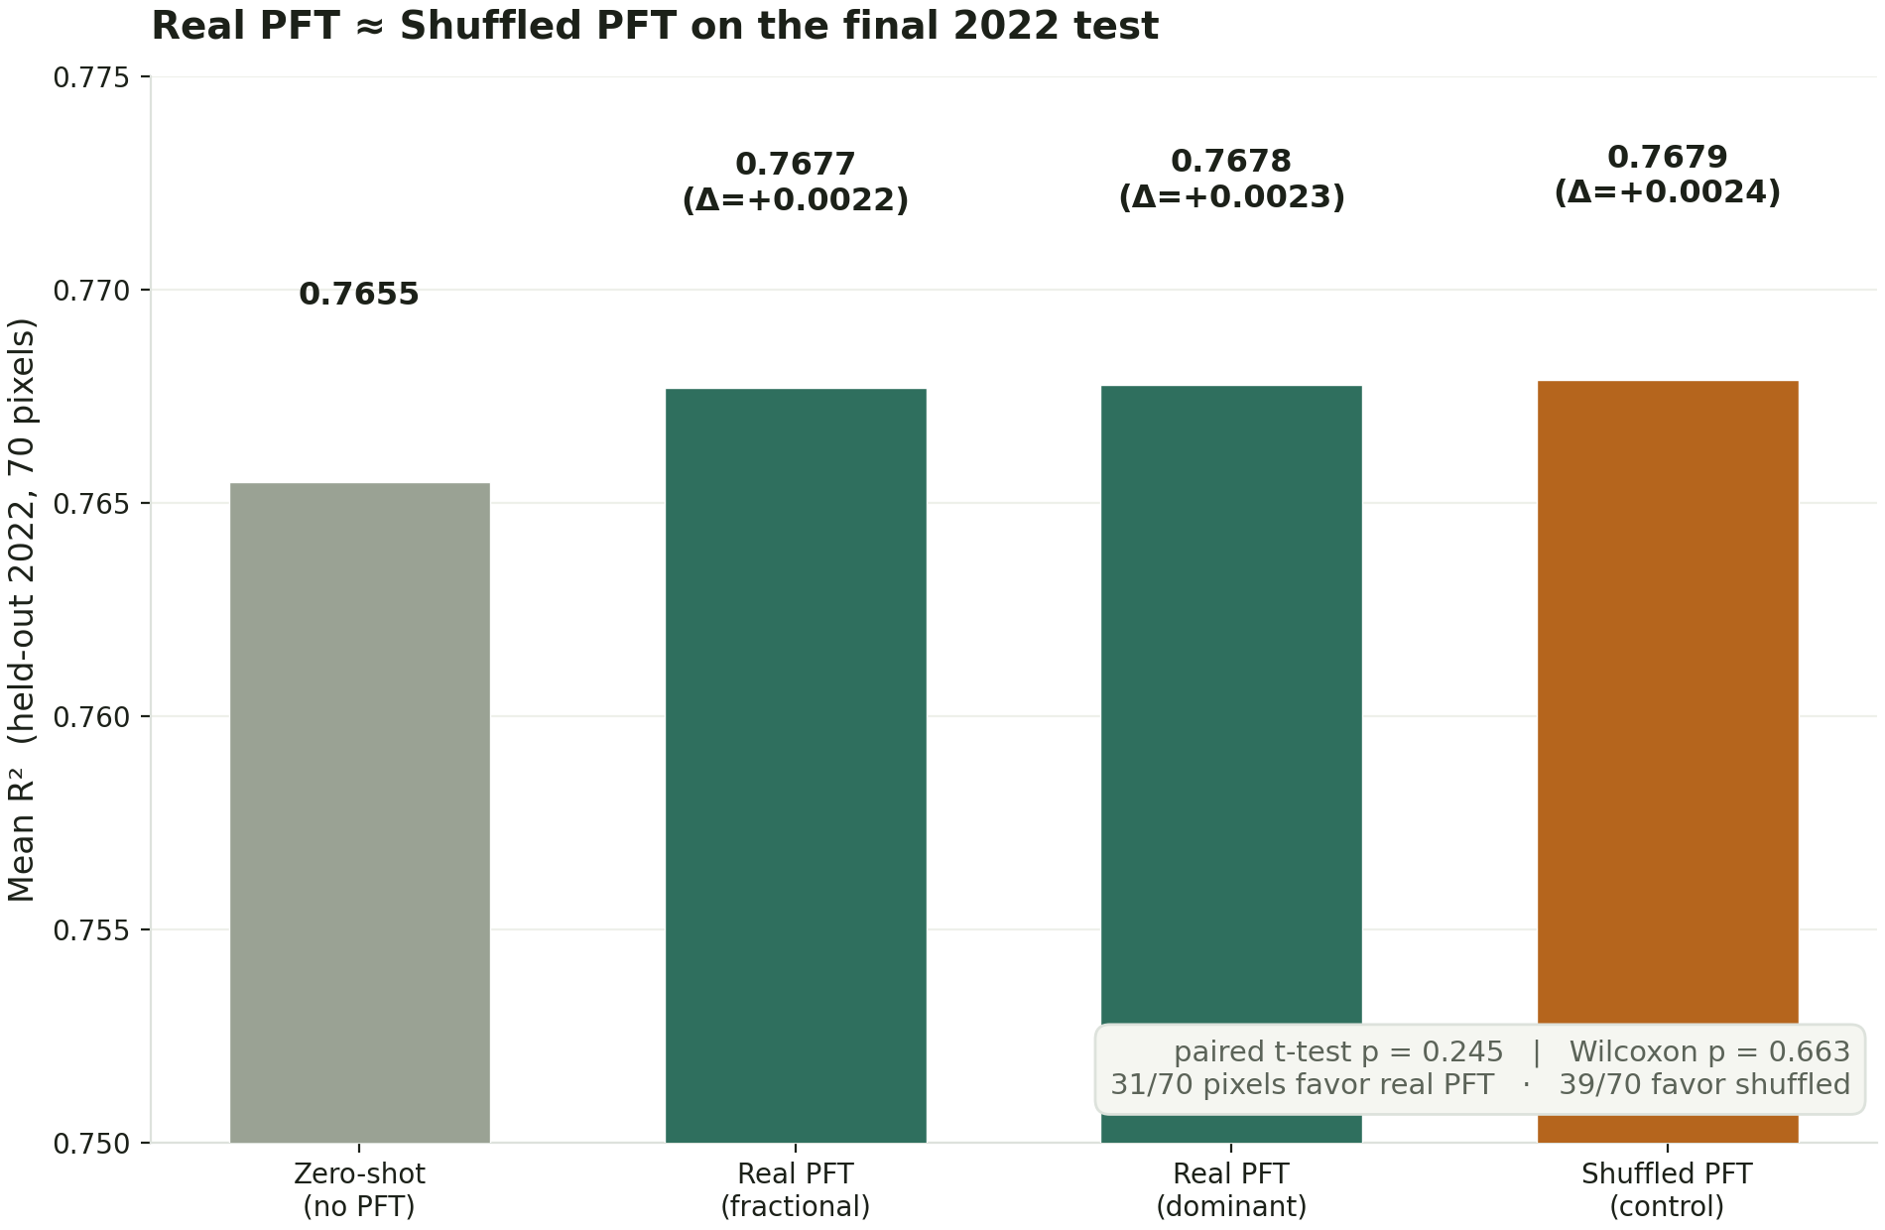
Key Finding: Real PFT ≈ Shuffled PFT
6
TAKEAWAY
A model trained on scientifically meaningless, randomly-shuffled PFT performs at least as well as one trained on real PFT — p=0.245, not significant.

Slide 7
INTERPRETATION
7
What Does This Tell Us?
No PFT ≈ Real PFT ≈ Shuffled PFT
▪ The small ΔR² (~+0.002) most likely comes from adding trainable conditioning capacity itself, not from the biological information the PFT vector carries.
▪ Supporting evidence reaches the same conclusion from four independent angles: mixed-vs-pure pixel entropy (r ≈ −0.13 vs. shuffled), seasonal-phase RMSE (indistinguishable in every phase), and per-dominant-PFT-class breakdown (|Δ| ≤ 0.001 for every class once compared against shuffled).
▪ This is consistent with an earlier, independent finding in this project: no PEFT/fine-tuning method (LoRA, DoRA, VeRA, IA3, LN-Tuning, BitFit) beat zero-shot Chronos-2 on this dataset either.
Precise conclusion (not "PFT is useless"):
Under the current Chronos-2 + LAI setup and available dataset, explicit PFT information does not provide measurable predictive information beyond a shuffled-PFT control.
TAKEAWAY
Hypothesis, not proven ceiling: zero-shot Chronos-2 may already be hard to improve with small gradient-trained modules at this data scale.

Slide 8
SUMMARY
8
Research Progression: What We Ruled Out
INITIAL HYPOTHESIS
FINDING 1
FIX
FINDING 2
RESPONSE
FINDING 3
CONCLUSION
PFT does not help
Chronos-2 architecturally cannot
see static PFT (InstanceNorm erasure)
Explicit FiLM conditioning,
bypassing InstanceNorm
Architecture CAN learn strong
PFT sensitivity — but doesn't generalize
4x more temporal windows +
4 alternative architectures
Real PFT performs no better
than shuffled PFT (p=0.245)
No detectable, generalizable PFT
signal in the current setup
TAKEAWAY
Each step ruled out a specific explanation with direct evidence — this is what makes the final negative result trustworthy.

Slide 9
Conclusion & Next Steps
9
Conclusions
▪ Across 4 conditioning architectures and both PFT representations, no method beat a shuffled-PFT control — the strongest form of evidence this investigation can offer against the current approach.
▪ The negative result is well-diagnosed, not a dead end: the InstanceNorm blindness, the FiLM fix, and the shuffle control each closed off a specific alternative explanation.
Recommended next steps
▪ Test PFT with the AELSTM-family models, which showed greater (if noisier) sensitivity to explicit PFT in the earlier single-pixel study.
▪ Revisit Chronos-2 only if substantially more or different training data become available — do not keep tuning increasingly complex FiLM/adapter variants on the current dataset.
▪ Longer term: investigate PFT as a modifier of drought/climate response specifically, rather than a generic static covariate, if sufficient supervision becomes available to learn that interaction.
TAKEAWAY
Full details: CHRONOS2_PFT_V2_REPORT.md — every number in this deck traces to a saved CSV in outputs/pft_v2/.

