Slide 1
9702 Paper5 Practical
2道题，1小时15分钟
第一题15分的文字大题 Design and describe an experiment
第二题15分的数据处理画图题 Data analysis and process

Slide 2
Question 1
Generally divided into 4 parts
  Defining the problem
  Collecting the data
  Analysis of data
  Safety consideration and other details

Slide 3
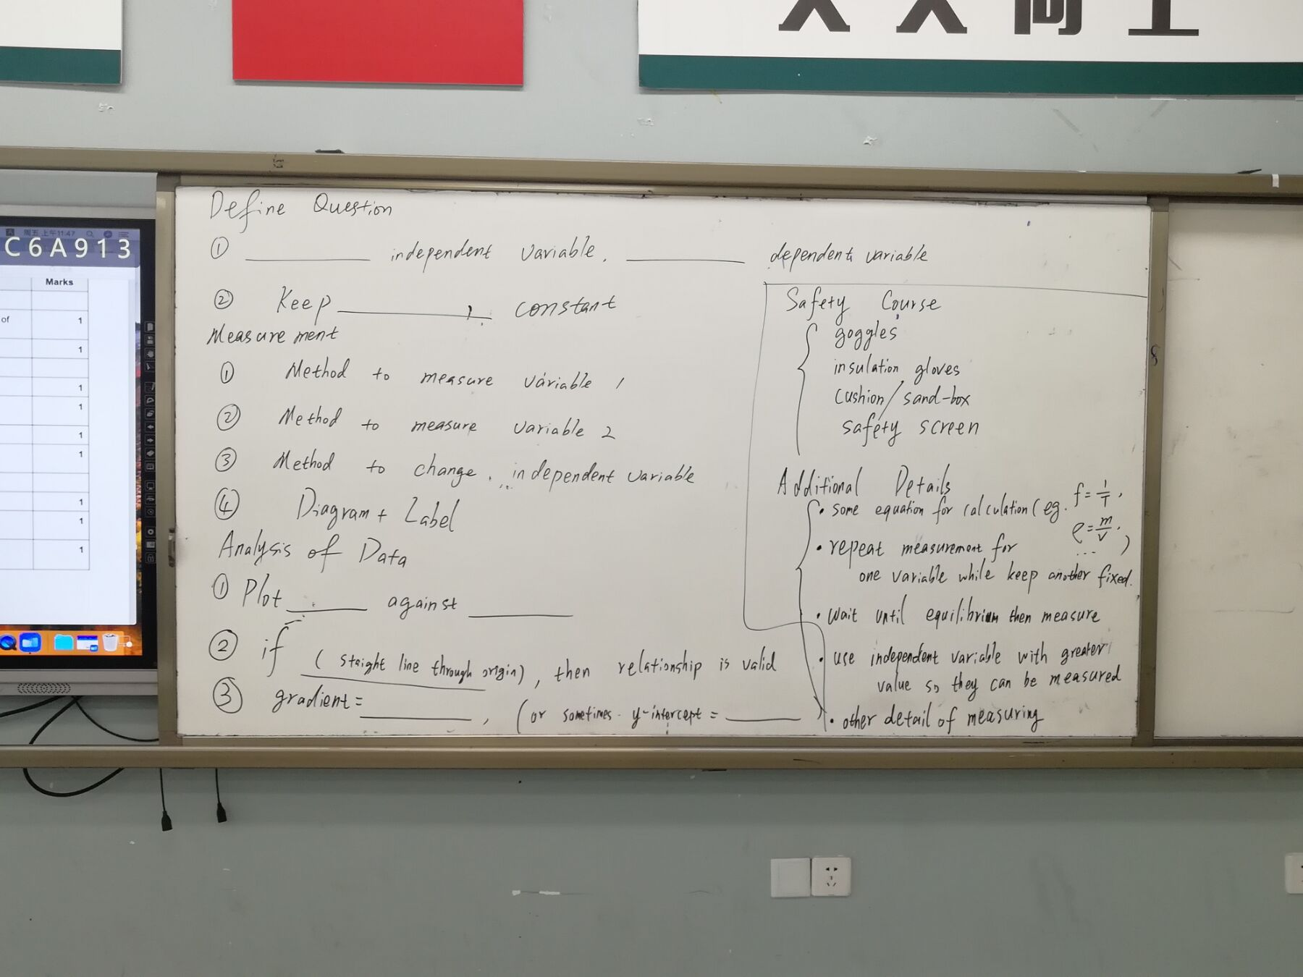

Slide 4
General Template
Define the problem
  ___ is independent variable and ____ is dependent variable
  Keep _____ constant
  Keep _____ constant
Measurements
  Labelled Diagram
  Method to measure variable 1
  Method to measure variable 2
  Method to change independent variable (e.g. change the power supply voltage/ change the distance from wind source or so)
Analysis of Data
  Plot _____ against ______
  Gradient = ________ (sometimes y-intercept = ________)
  If (it is a straight line through origin), then relationship is valid
Hall probe, Motion sensor/light gates, pressure gauge, C.R.O

Slide 5
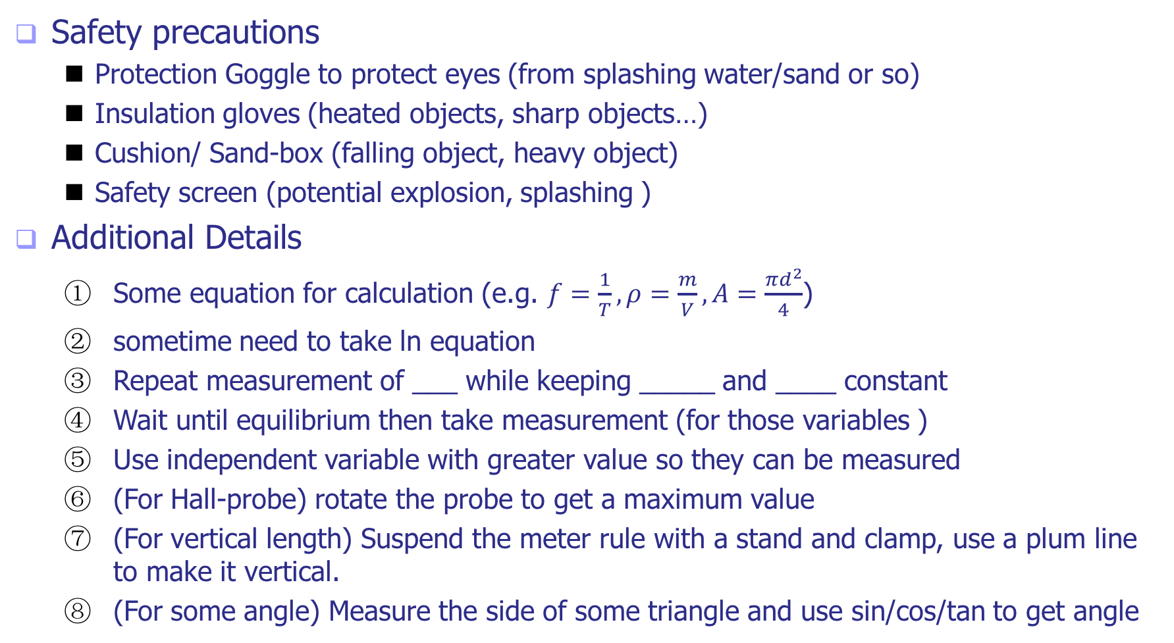
General Template
Safety precautions
  Protection Goggle to protect eyes (from splashing water/sand or so)
  Insulation gloves (heated objects, sharp objects…)
  Cushion/ Sand-box (falling object, heavy object)
  Safety screen (potential explosion, splashing )
Additional Details
  Some equation for calculation (e.g. $f=\frac{1}{T}, ρ=\frac{m}{V}, A=\frac{πd^{2}}{4}$)
  sometime need to take ln equation
  Repeat measurement of ___ while keeping _____ and ____ constant
  Wait until equilibrium then take measurement (for those variables )
  Use independent variable with greater value so they can be measured
  (For Hall-probe) rotate the probe to get a maximum value
  (For vertical length) Suspend the meter rule with a stand and clamp, use a plum line to make it vertical.
  (For some angle) Measure the side of some triangle and use sin/cos/tan to get angle

Slide 6
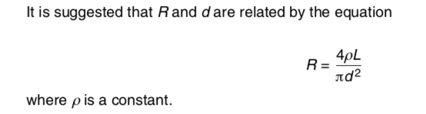
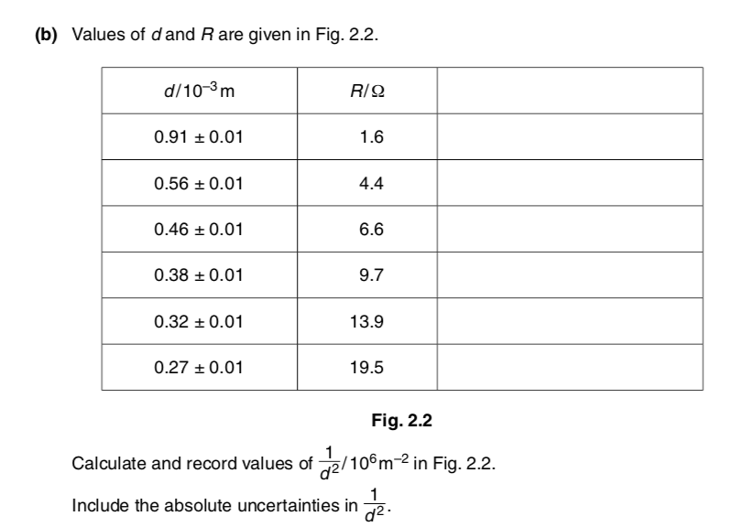
Question 2
Given an equation+ a table of data
Complete the table (calculated data, s.f., uncertainty)

Slide 7


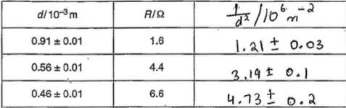
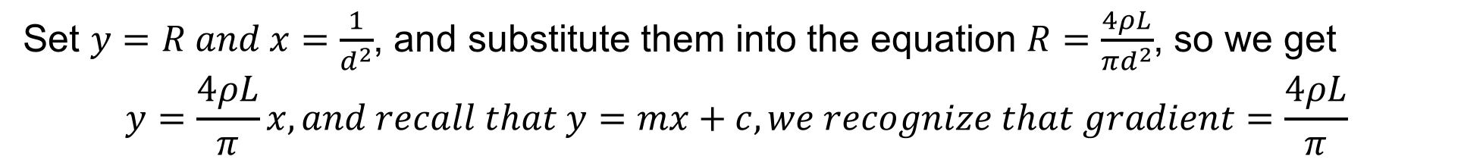
use substitution to rearrange the equation
Complete the table
Set $y=R and x=\frac{1}{d^{2}}$, and substitute them into the equation $R=\frac{4ρL}{πd^{2}}$, so we get
$$y=\frac{4ρL}{π}x, and recall that y=mx+c, we recognize that gradient=\frac{4ρL}{π}$$
headings with units (sometimes including power of ten)
correct calculation of mean value with correct s.f. 乘除法计算所得保留到参与计算的数据中拥有最少有效数位的那个量一样的有效数位或者多1位，比如这里参与计算的只有d，那么计算后保留2位或者3位。
uncertainty (可以计算最大值-平均值，平均值-最小值，（最大值-最小值）/2 等方法求得平均值，一般保留1~2位 s.f.)

Slide 8
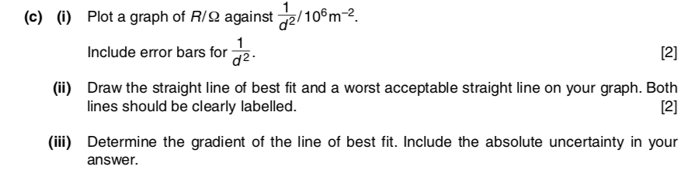
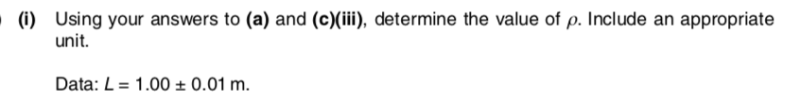
Question 2
Plot a graph
Best/worst line + Determine gradient(uncertainty)
Calculate some constant with uncertainty (related to gradient or intercepts)

Slide 9

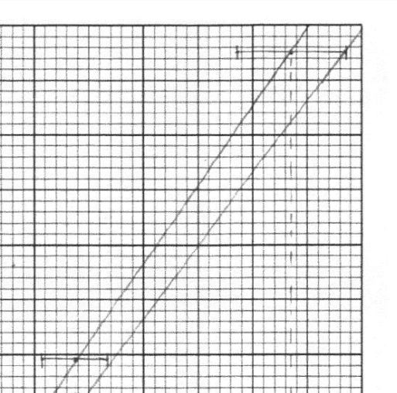
Question 2
Plot points accurately + error bar(注意下是y方向还是x方向)
plot best fine line + worst acceptable line and label them!
worst那条不要简单以为第一个点的最左端
连到最后一个点的最右端
both should be within each error bar

Slide 10
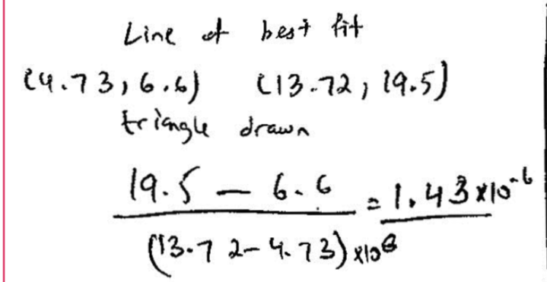
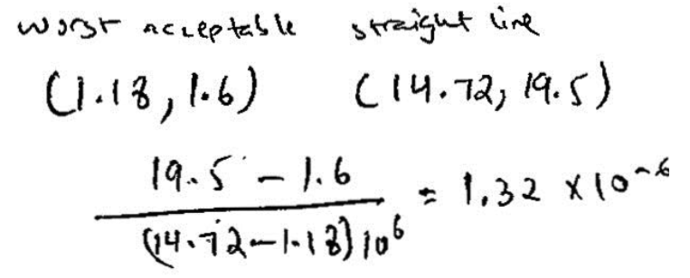
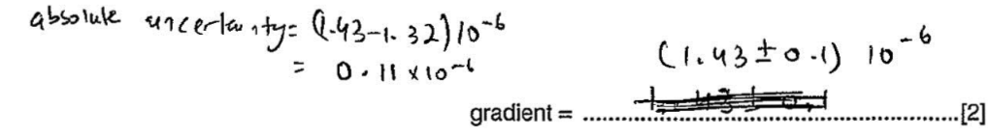
Question 2
Determine gradient of best fit line 注意使用的两点超过图的一半，还要注意坐标轴的数量级，并且写出过程。
Uncertainty of gradient, we need also gradient of
worst acceptable line. 注意点同上
The difference between two gradients is the
uncertainty. And you should show the course

Slide 11
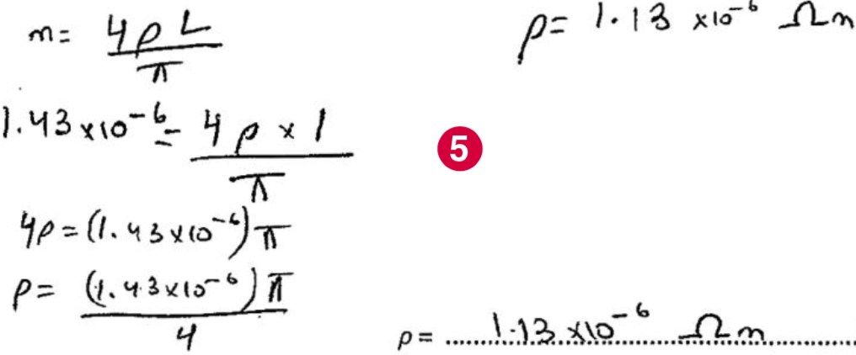
Question 2
Calculate some constant with uncertainty (related to gradient or intercepts)
一般都是和斜率或者截距相关，带入之前的斜率（截距）的mean value来得到这个常数的值，注意单位

Slide 12
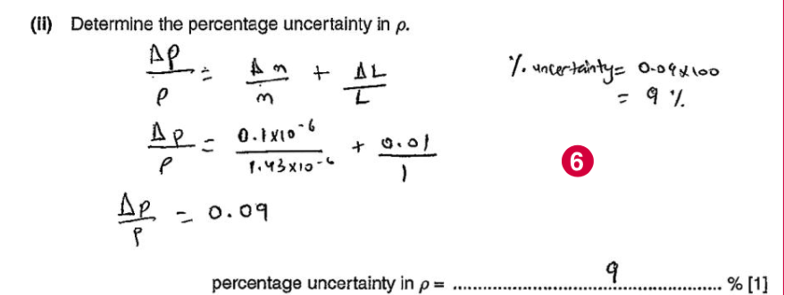

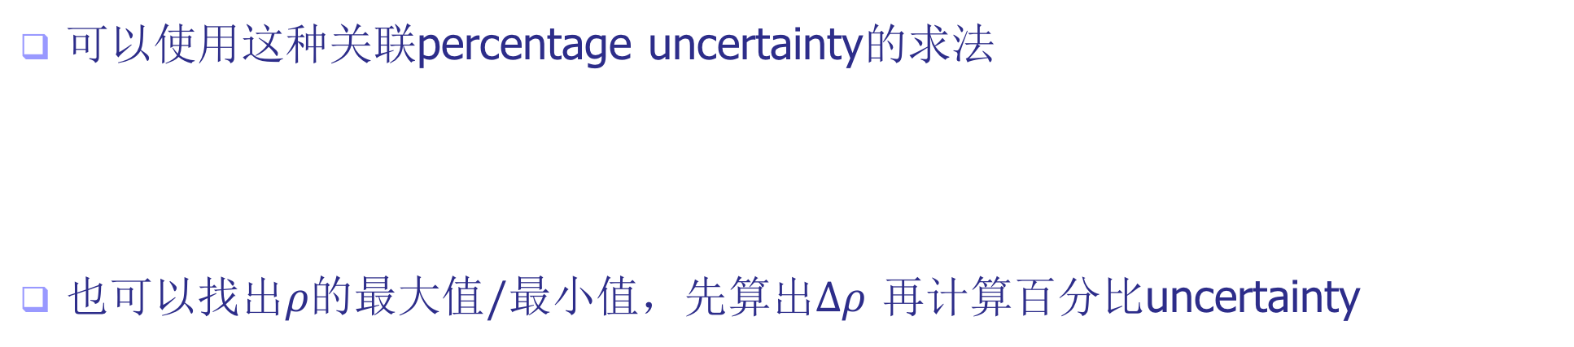
Calculate some constant with uncertainty (related to gradient or intercepts)
可以使用这种关联percentage uncertainty的求法
也可以找出$ρ的最大值/最小值$，先算出$Δρ$ 再计算百分比uncertainty

