Slide 1
Design and Simulation of Multi-tiered Heterogeneous Memory Architecture

Slide 2
outline
Backgroud and Motivation
Architecture and Design
Architecture
Memory Controller
Data Structure and Algorithm
Evaluation
Conclusion
Notes:
Store-nt non-temporal store

Slide 3
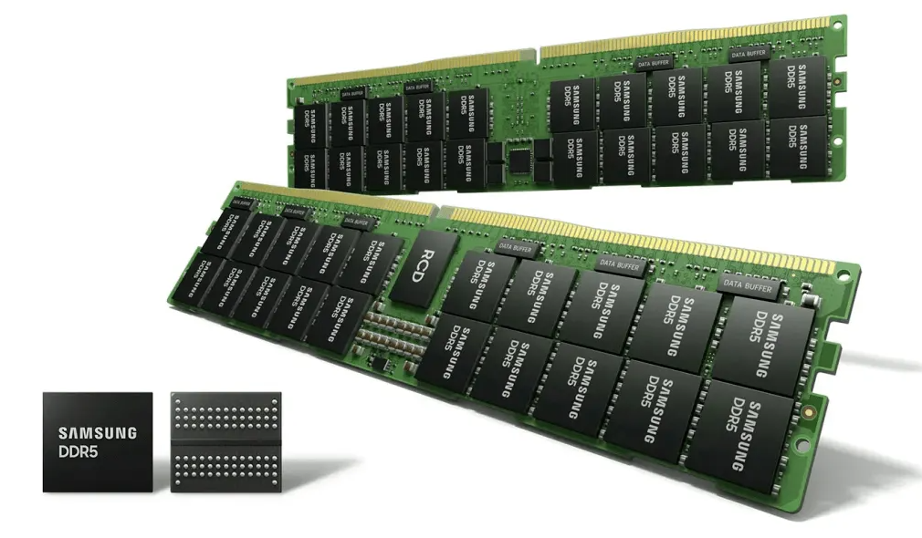
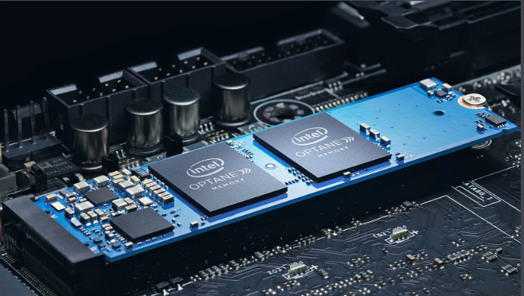
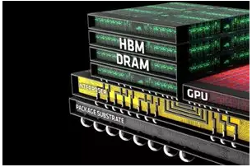
Background
DRAM
Low storage density
High cost
NVM
High storage density
Low cost per byte
Near-zero static power consumption
HBM
High bandwidth
High storage density
Lower power consumption

Slide 4
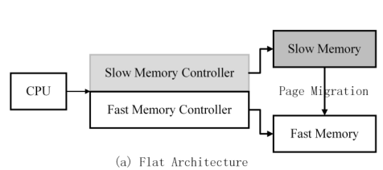
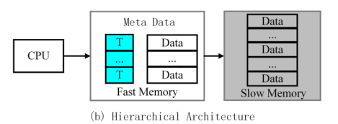
Background
Traditional memory architecture：hierarchical architecture and flat architecture
Defects：
hierarchical architecture：high storage cost and complexity of hardware
flat architecture：high migration cost

Slide 5
Motivation
More abundant and multi-layered heterogeneous memory architecture is required
Take advantage of the characteristics of different memory media
There is a lack of simulation platform that can support three or more memory media
Notes:
With the demand of big data and high bandwidth applications for memory, more abundant and multi-layered heterogeneous memory architecture is required
Different memory media has different characteristic. It is a great challenge how to make the best memory access performance under the unit cost.
At present, the research of heterogeneous memory architecture is mostly carried out on the simulator, but there is a lack of simulation platform that can support three or more memory media

Slide 6
outline
Backgroud and Motivation
Architecture and Design
Architecture
Memory Controller
Data Structure and Algorithm
Evaluation
Conclusion
Notes:
Store-nt non-temporal store

Slide 7
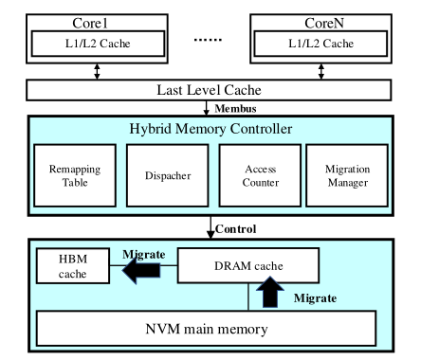
Architecture
CPU,TLB and Cache come with GEM5
Hybrid controller is based on GEM5 including four key components
NVM,DRAM, HBM are based on DRAMsim3

Slide 8
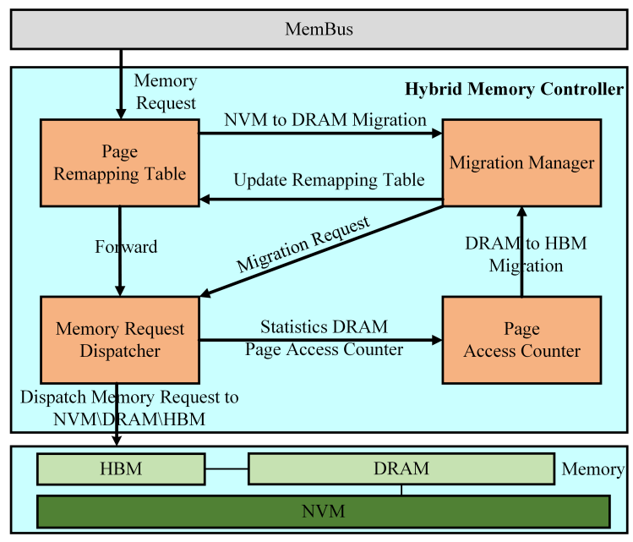
Hybrid controller
Four key parts:
Page Remapping Table
Memory Request Dispatcher
Migration Manager
Page Access Counter
Notes:
Manage NVM,DRAM and HBM,including remapping,dispatching,monitoring and migriation

Slide 9
Remapping Table
MemBus
Bus Req
Bus Resp
NVM to DRAM Req
Remapping Table
Migration
Manager
Block or Update
Bus Req
Bus Resp
Dispatcher
check whether a memory request is hit in the remapping table
trigger page migration from NVM to DRAM
update and maintain the remapping table

Slide 10
Dispatcher
Remapping Table
Migration
Manager
Migration
Req
Bus Req
Bus Resp
Access Counter
Dispatcher
Update
Req
Read/write
Req
Read/write
Resp
memroy
HBM
DRAM
NVM
dispatch memory access requests to different memory media
extract memory access requests to DRAM and sends them to the AC module

Slide 11
Access Counter
Access Counter
Update
Req
Dispatcher
DRAM to HBM
Req
Migration
Manager
manage page hotness
pick up the hottest pages according to the counters and trigger page migration from DRAM to HBM

Slide 12
Migration Manager
NVM to DRAM Req
Migration
Manager
Remapping Table
Block or Update
DRAM to HBM
Req
Migration
Req
Access Counter
Dispatcher
receive migration request from Remapping Table and Access Counter
send several read and write packets to the Dispatcher module

Slide 13
Remapping Table
NVM Page | Page No. of Cache Hit (DRAM or HBM) | Page No. After Migration (DRAM or HBM)
0x0001 | 0x1000
0x0002 | 0x1001
0x0003 | 0x2000 | 0x1002
…… | …… | ……
NVM-to-DRAM address mapping: the first column is NVM page, the second column is DRAM page, the third column is empty
NVM-to-HBM address mapping: the first column is NVM page, the second column is HBM page, the third column is DRAM

Slide 14
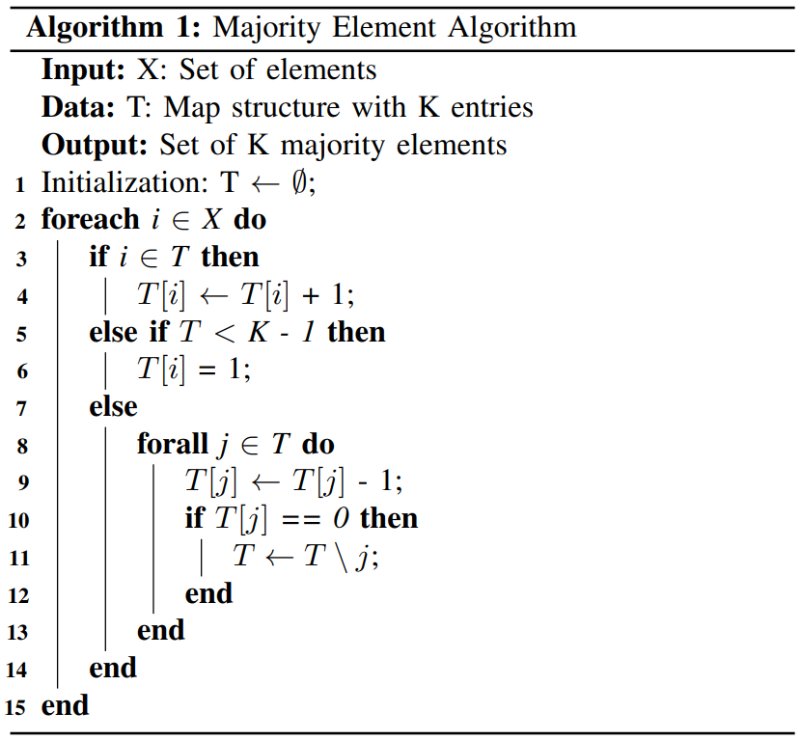
Hot Page Monitoring Mechanism
efficient to track hot pages
significantly reducing the hardware cost

Slide 15
outline
Backgroud and Motivation
Architecture and Design
Architecture
Memory Controller
Data Structure and Algorithm
Evaluation
Conclusion
Notes:
Store-nt non-temporal store

Slide 16
Evaluation
Simulator :
GEM5+DRAMsim3
Five memory systems :
A pure NVM system: 4 GB NVM,
A pure DRAM system: 4 GB DRAM
A pure HBM system: 4 GB HBM,
A flat heterogeneous memory system : 4 GB DRAM and 256 MB HBM
Multi-tier heterogeneous memory system : 4 GB NVM main memory, 1 GB DRAM, and 256 MB HBM cache
Workload :
Standard Performance Evaluation Corporation CPU2017 (SPEC CPU2017)

Slide 17
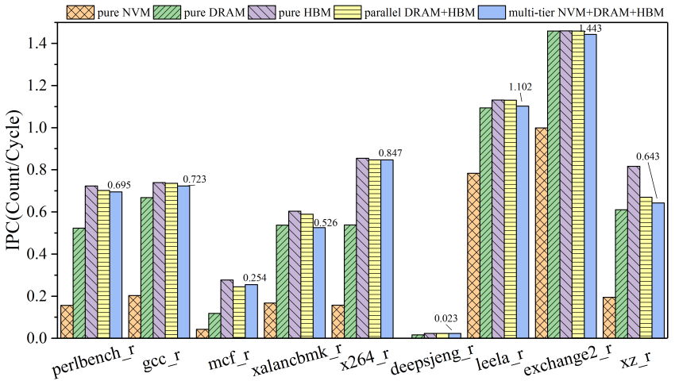
Evaluation Results
IPC of applications in a multi-core scenario
Our system can improve the performance of gcc_r and x264_r by about 2.5× and 4.4× compared with the pure NVM system, respectively.
Our system can also improve the performance of x264_r by 57.4% compared with the pure DRAM system, and the performance gap between the pure HBM system is even less than 10%.

Slide 18
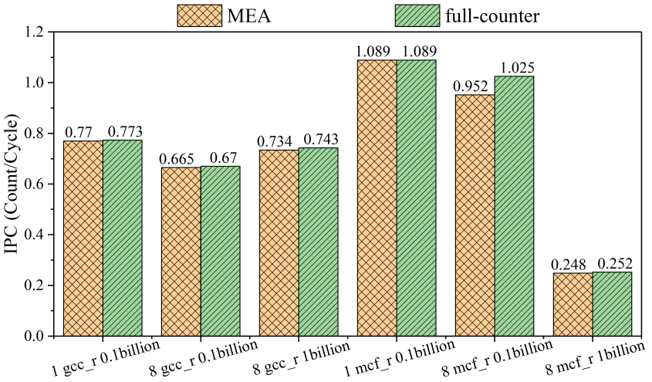
Evaluation results
Application IPC using MEA algorithm and full counters
The performance gap between MEA and full-counter algorithms is less than 1%.
MEA offers rather high accuracy for hot page monitoring, while significantly reducing the hardware overhead.

Slide 19
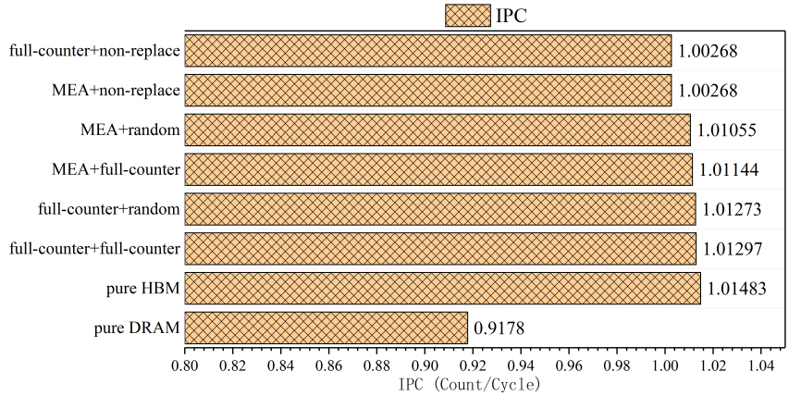
Evaluation results
Application IPCs using different replacement algorithms
The combination of our random replacement algorithm and MEA-based hot page monitoring algorithm can achieve similar performance compared with the pure HBM system.

Slide 20
outline
Backgroud and Motivation
Architecture and Design
Architecture
Memory Controller
Data Structure and Algorithm
Evaluation
Conclusion
Notes:
Store-nt non-temporal store

Slide 21
Conclusion
We design a multi-tier heterogeneous memory architecture.
composed of NVM, DRAM, and HBM
design a MEA-based hot page monitor algorithm
a random HBM page replacement algorithm
implement it based on GEM5 and DRAMsim3 simulators
Our multi-tiered hybrid memory architecture significantly improves application performance.
improve application performance by an average of 2.5× compared with an NVM-only architecture, and up to 57.4% compared with a DRAM-only architecture
the performance gap between our architecture and a HBM-only architecture is less than 10%

Slide 22
Thank you
&
Questions?

