Slide 1
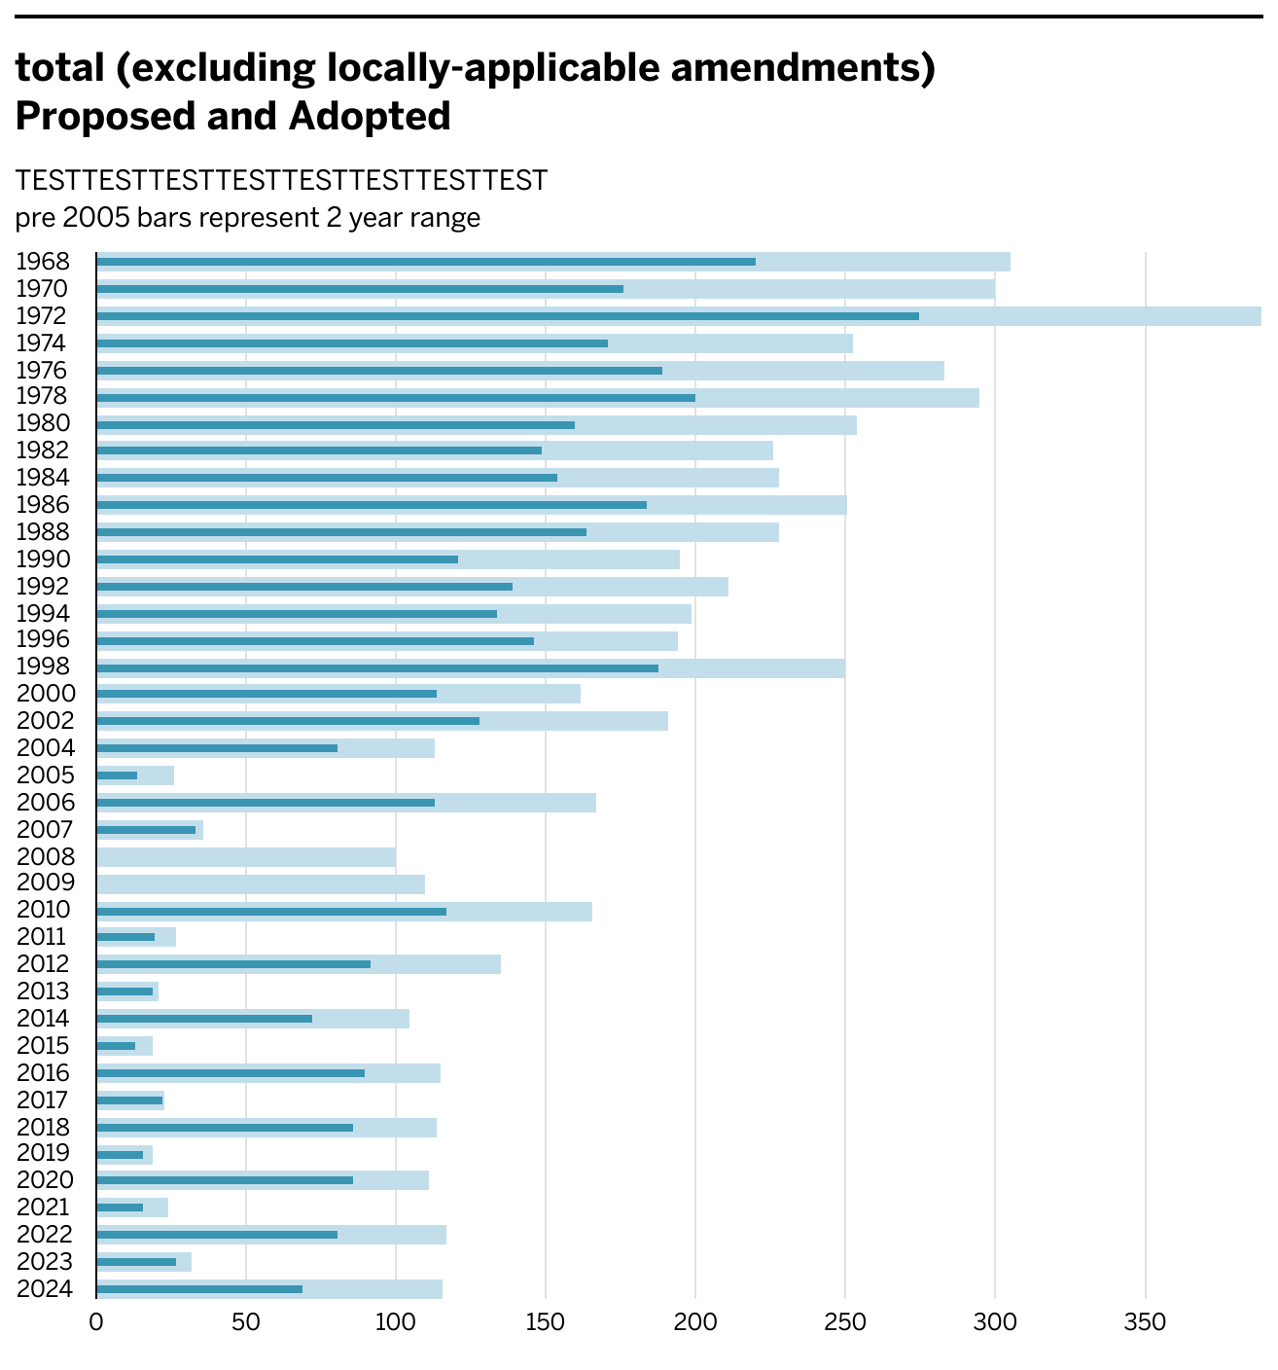
Preliminary charts using
Amendment Topic Summaries
1968-2024

Slide 2

General data from
Book of states

