Slide 1
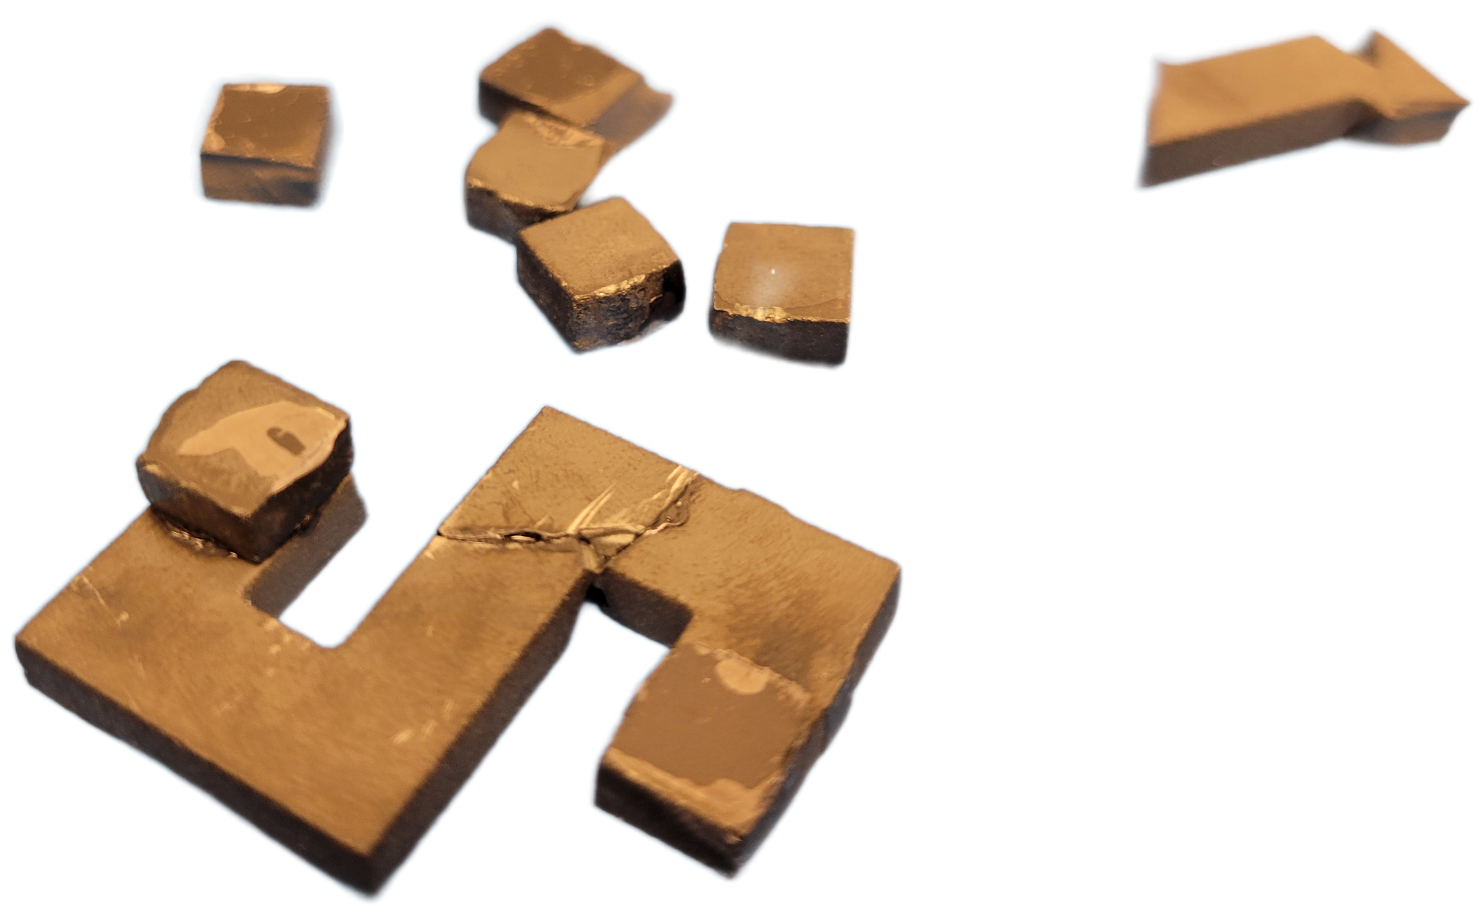
Figure 8 Mag-Core

Slide 2


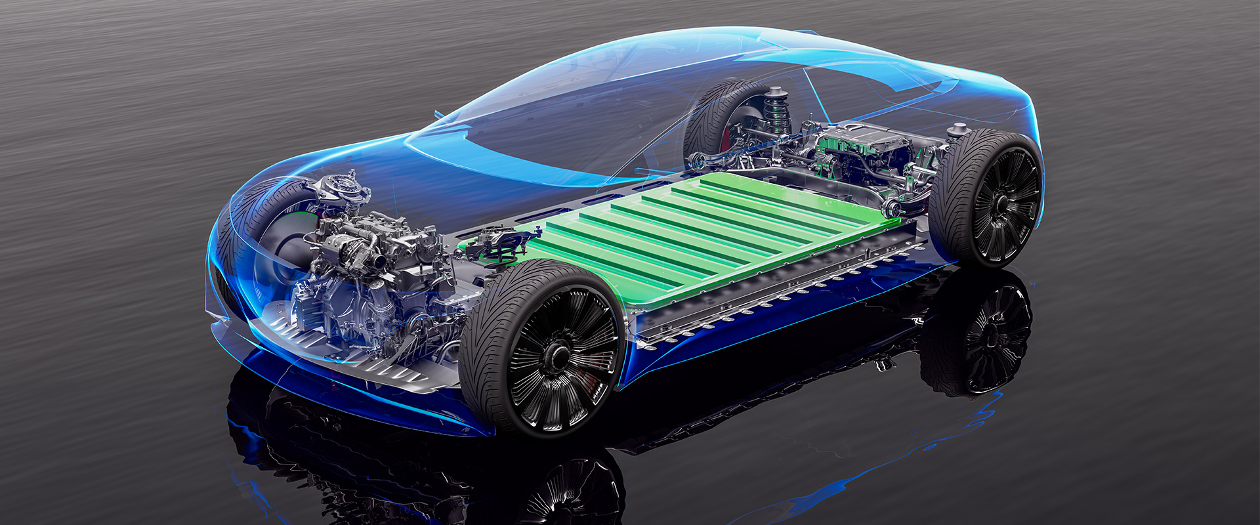
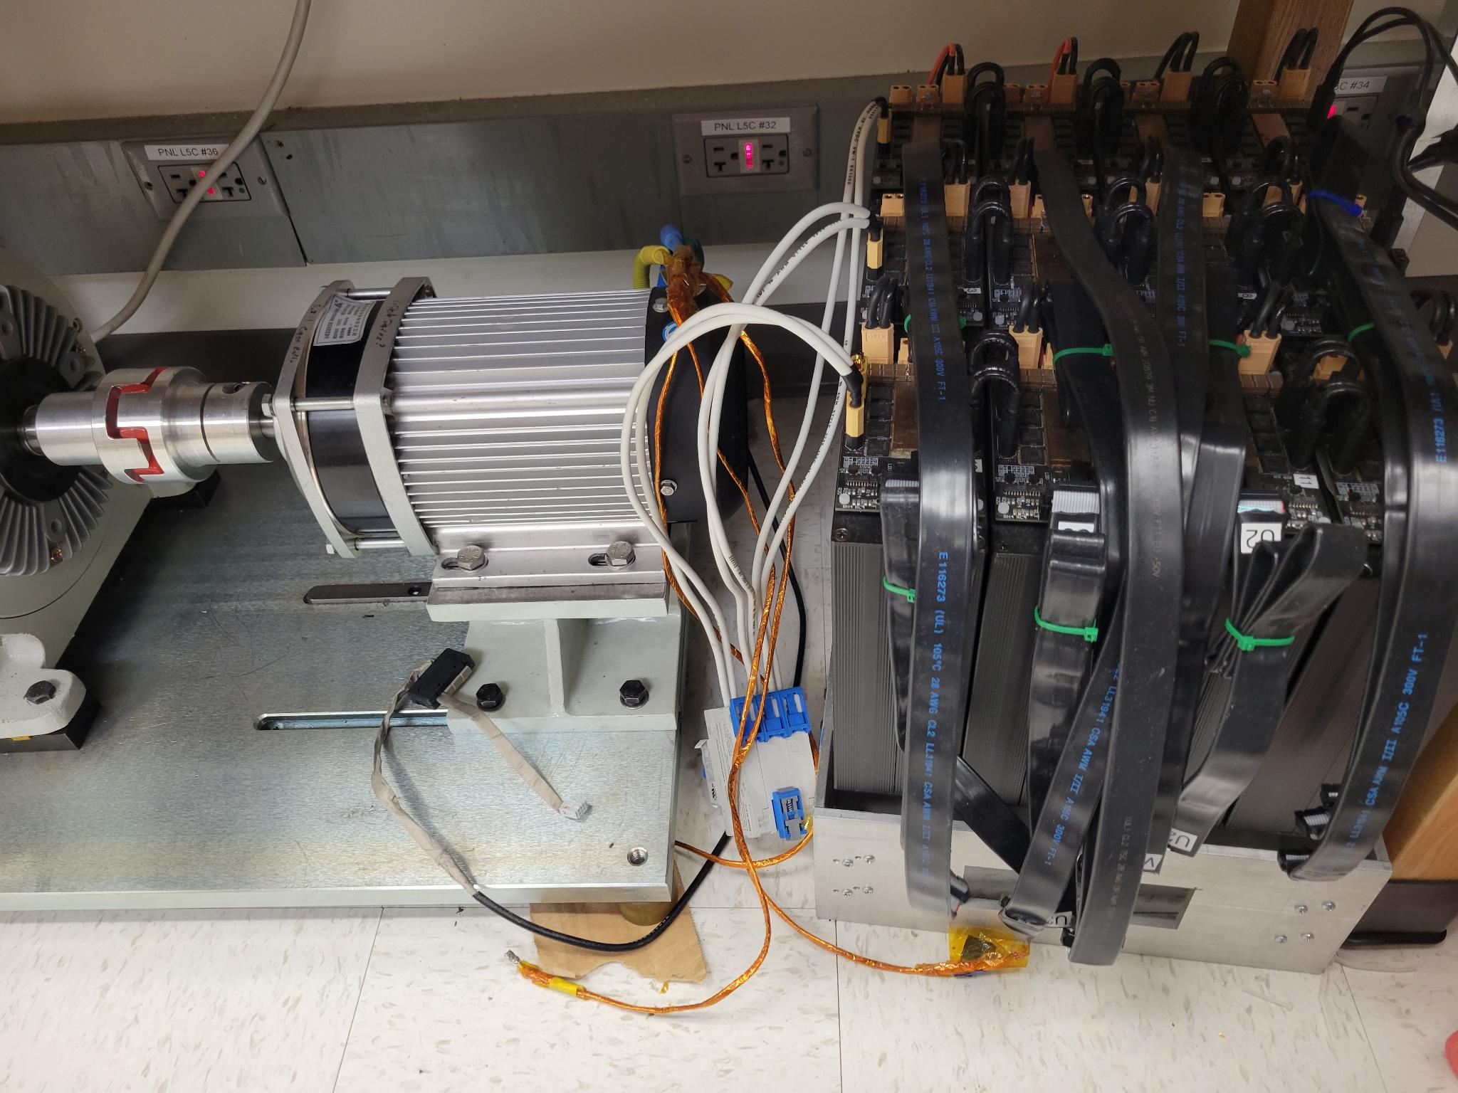

Background-Applications

Slide 3
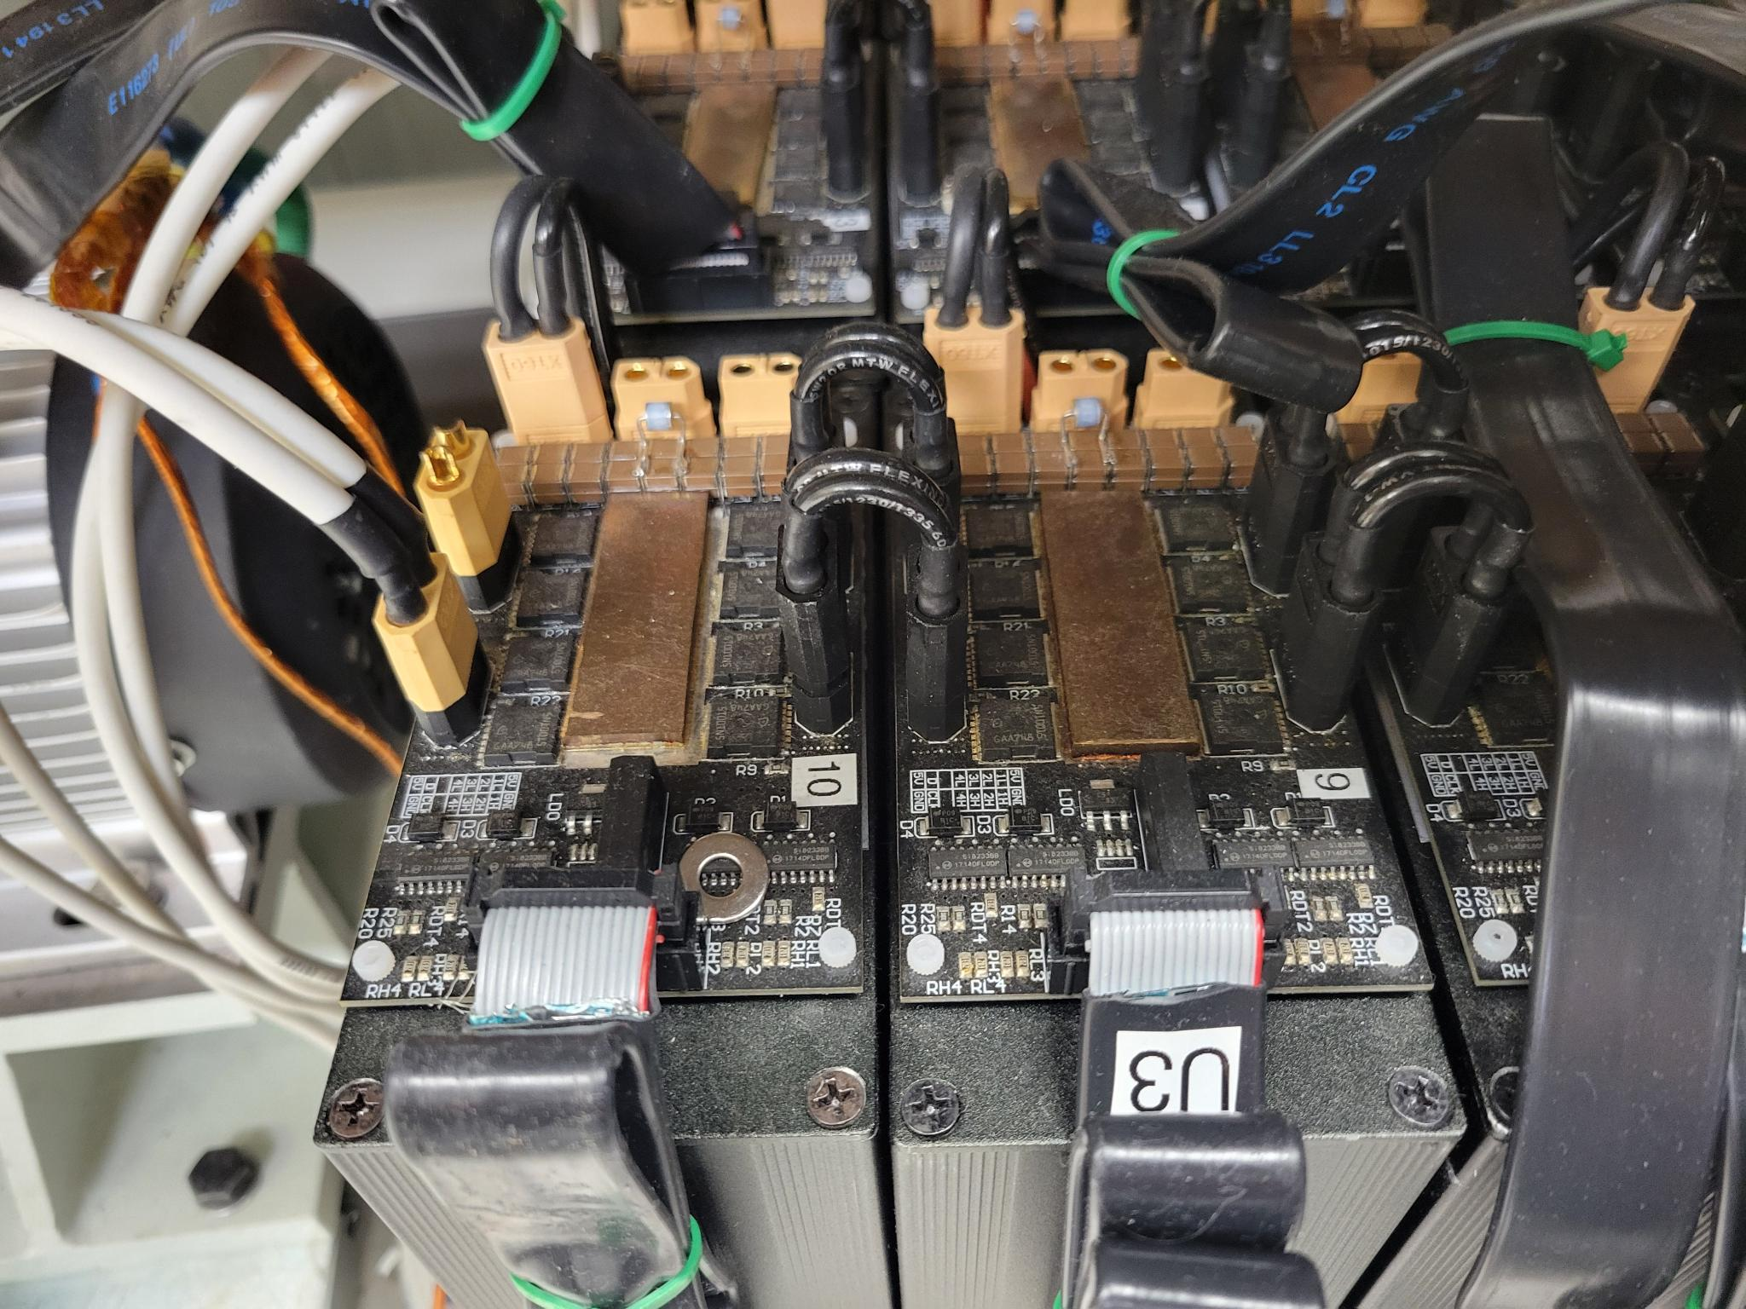
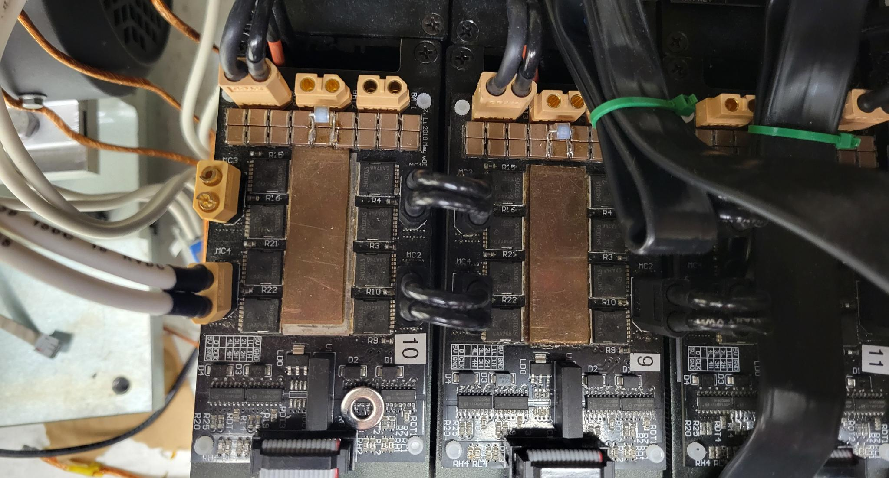
Background:Issue

Slide 4
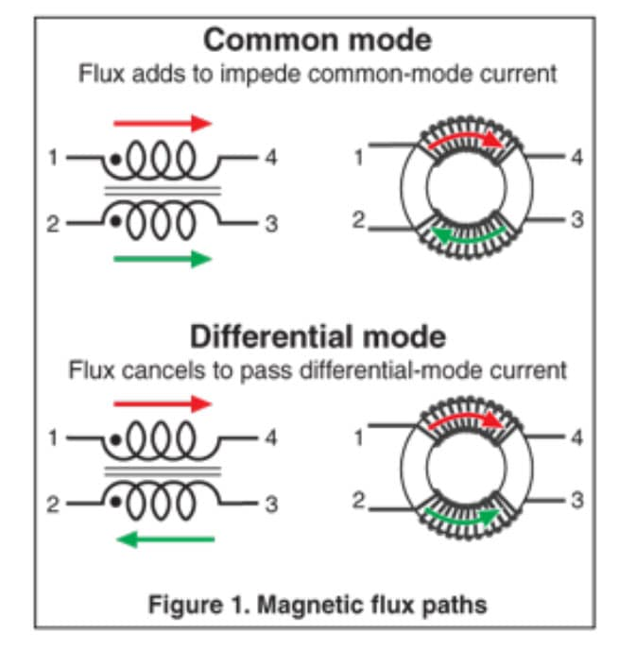
General Solution
Solution: Transformer (Differential mode choke / Coupled inductor)
Objective: Cheap, small, and efficient forms of transformer

Slide 5
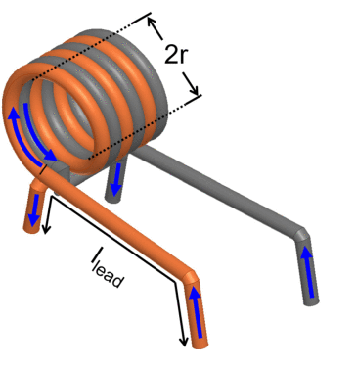
Solution：Twisted conductor
Cons:
Bulky
complicated to make
Extra conductor (loss)
mao2017balancing

Slide 6
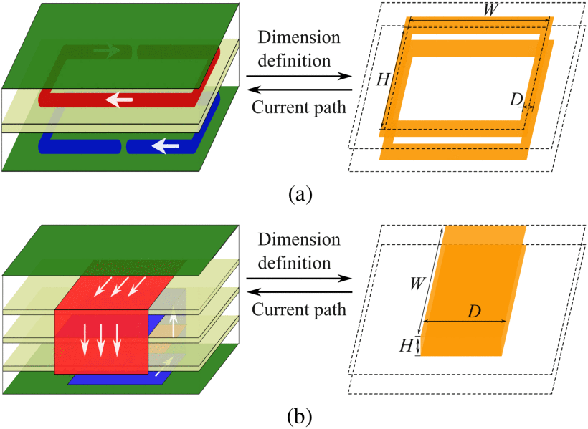
Solution：PCB inductor
Cons:
Not efficient enough
zhang2024analytical

Slide 7
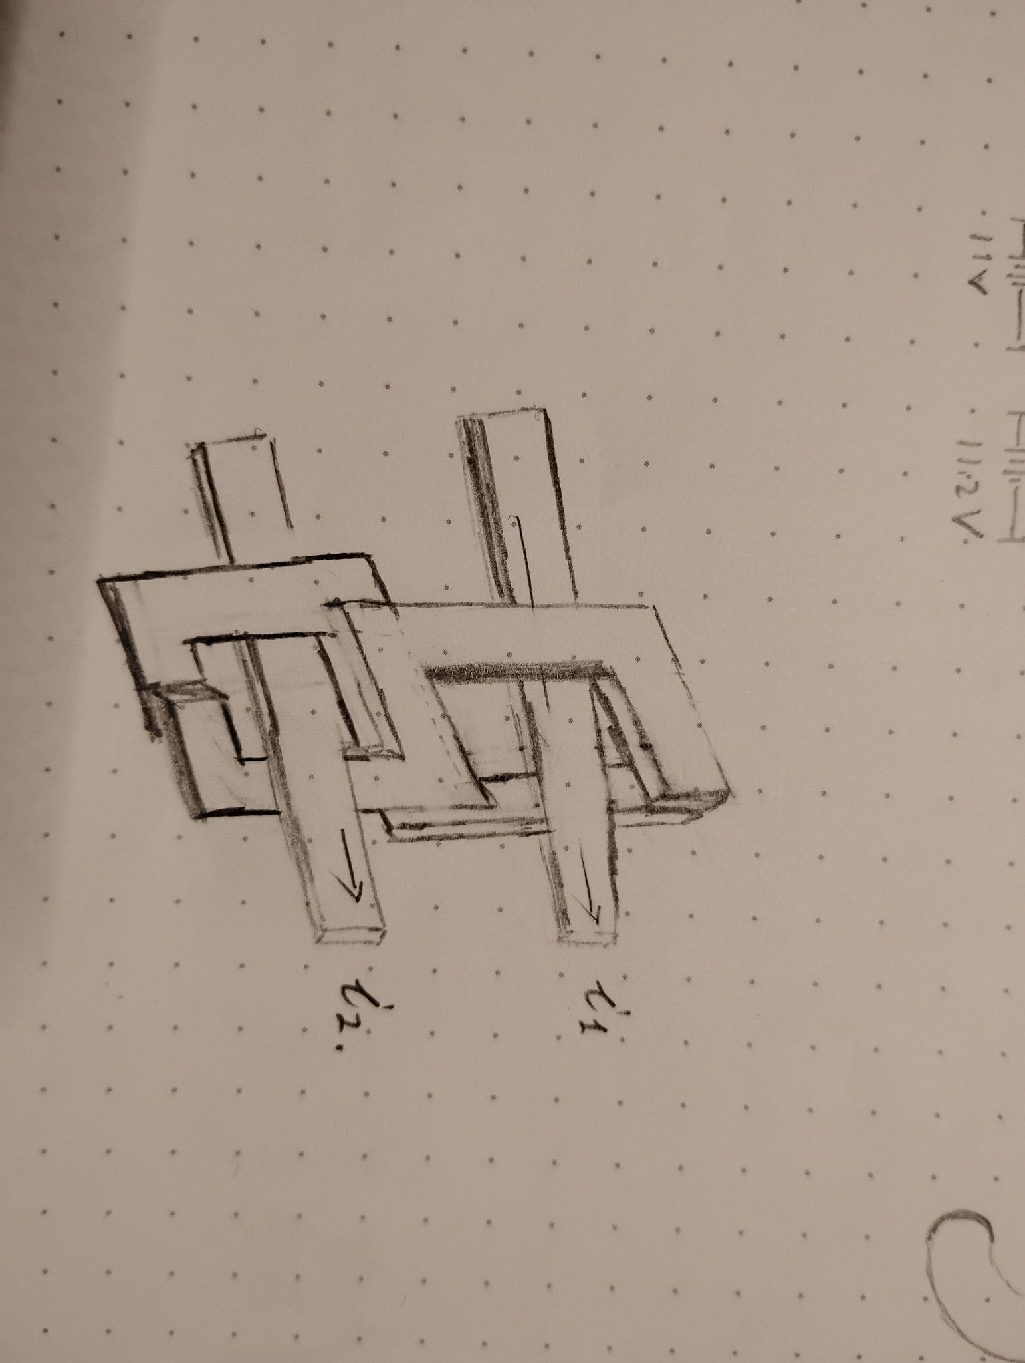
Solution: Figure 8 Mag-Core
Twisting conductor (x)
Twisting magnetic field (!)

Slide 8
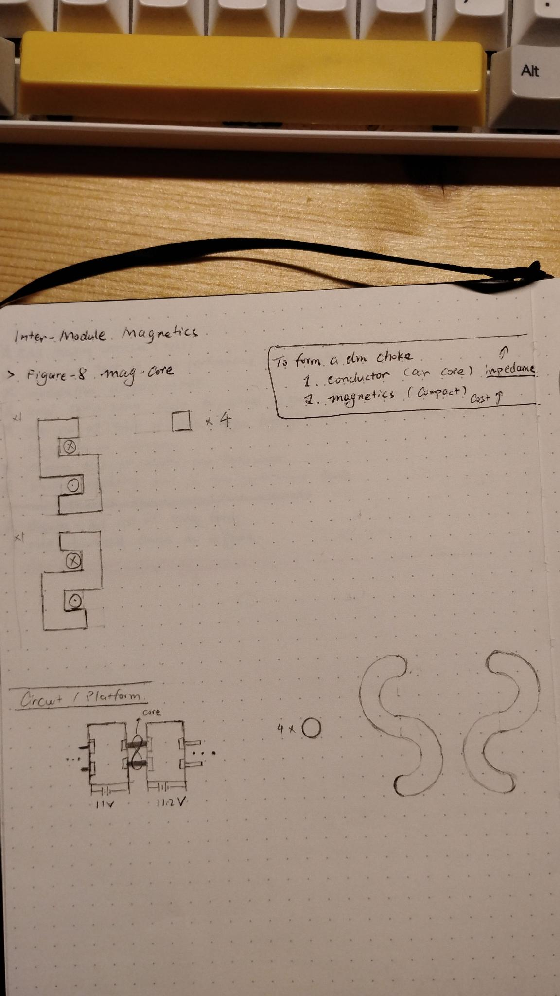

Slide 10
Process
Production: cutting (water jet) ferrite plates and assembling to desired shape
Packaging: 3D printing cases for the core (drop-protection)
Simulation: to understand how the magnetic field is distributed and how to optimize the shape

