Slide 1
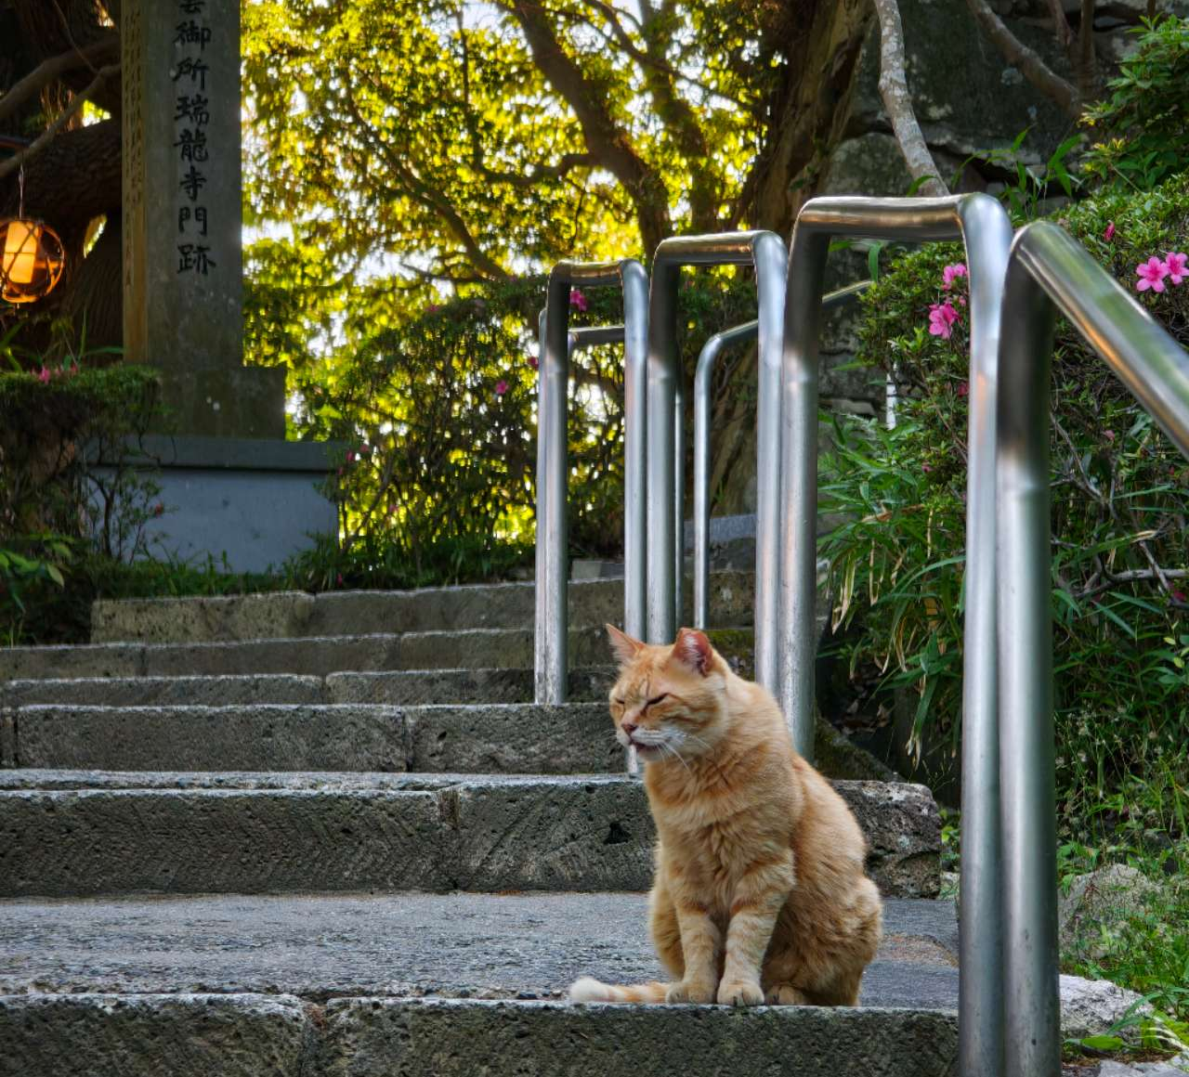
FINAL WEB SERVICE PROJECT
Campus
Flow
日常のページ、作品の場所。
A PERSONAL EXHIBITION WEB SERVICE
ZHU FUXIN / M25W7195
KYOTO · 2026
01 / A small web service told as a visual diary.
Notes:
Good afternoon. My name is Zhu Fuxin. This is CampusFlow, my final web service project. It is a desktop-first personal exhibition service. I designed it to feel like a small visual diary while still implementing a complete client, backend service, secure account system, persistent data, external APIs, Docker delivery, and Azure deployment.

Slide 2
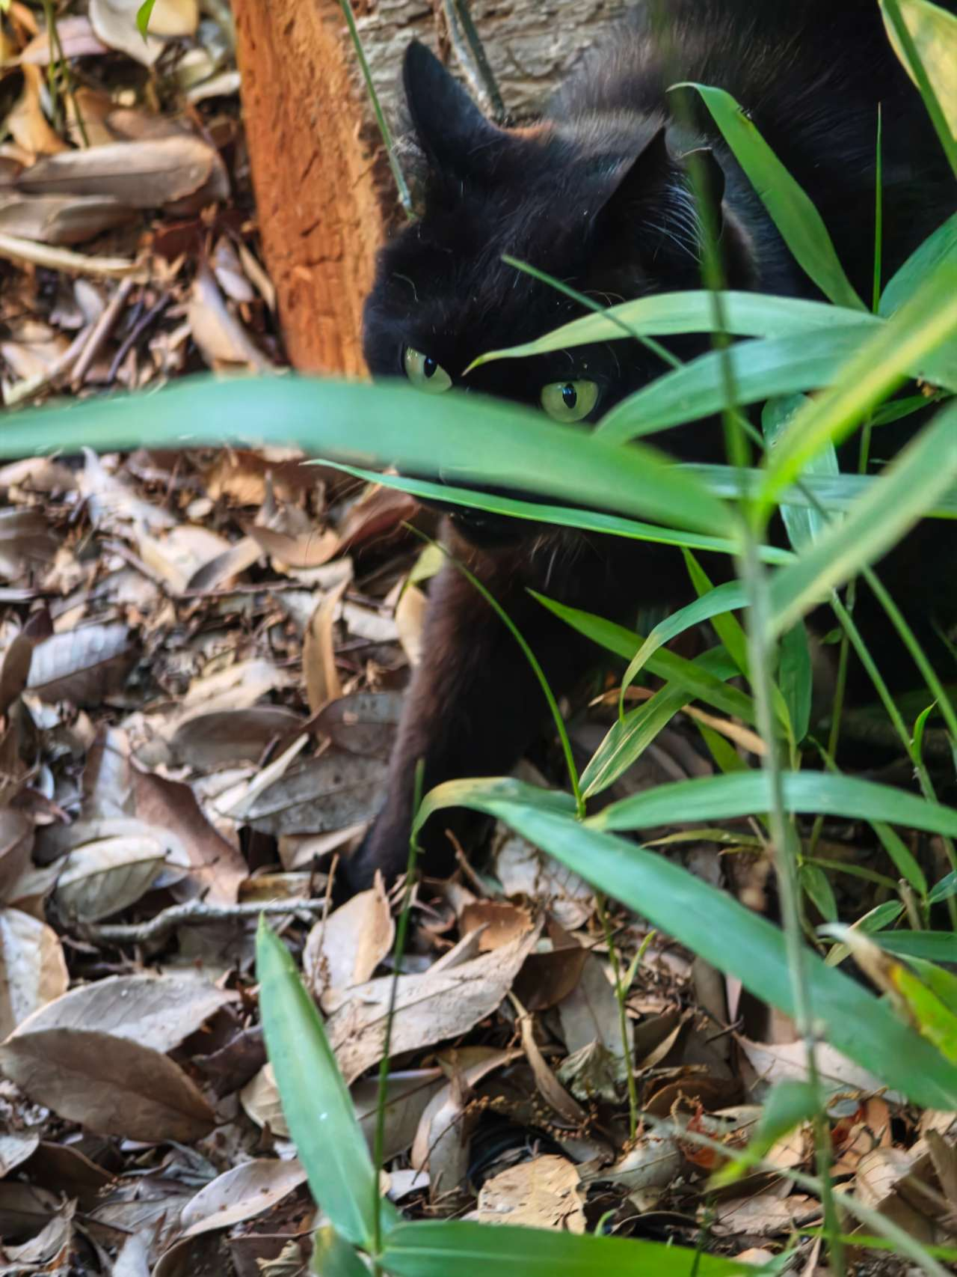
PREMISE
GUEST / OPEN
The service begins
before sign-in.
A visitor can read the day, see a public collection,
and understand the project without creating an account.
USEFUL
PUBLIC
PERSONAL
The guest state is a real page,
not an empty waiting room.
02
Notes:
CampusFlow begins in guest mode. The default state is deliberately complete rather than empty. A visitor can use Today and view the public portfolio before signing in. Registration becomes an invitation to personalize the service, not a barrier placed in front of the content.

Slide 3
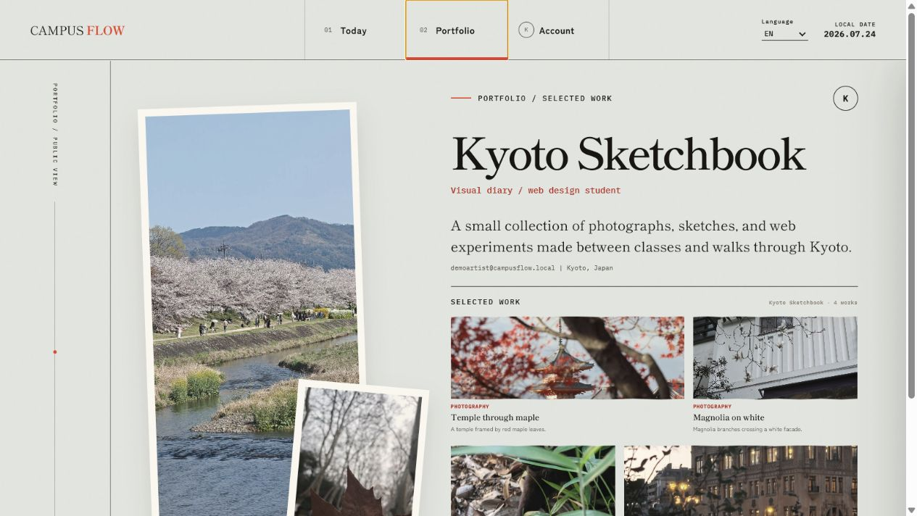
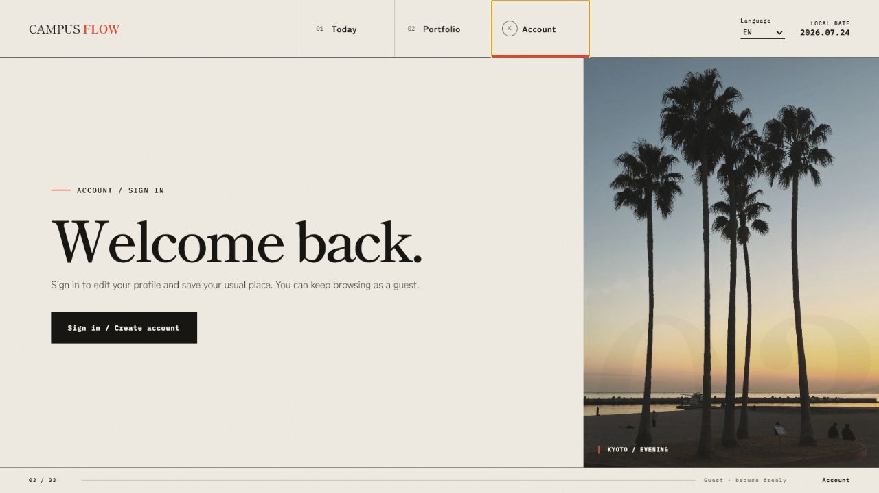
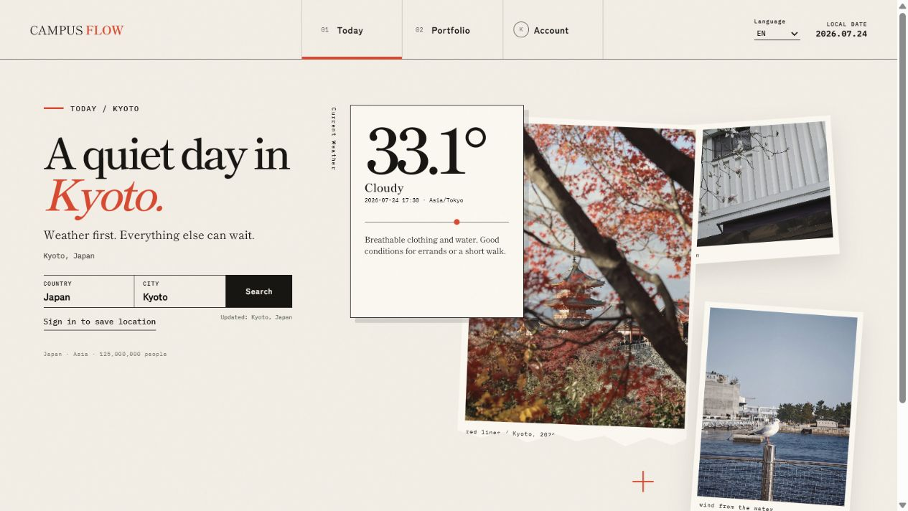
THREE PAGES
Three pages form
one quiet journey.
VIEW → COLLECT → OWN
01 / TODAY
02 / PORTFOLIO
03 / ACCOUNT
03
Notes:
The product is organized into three clearly different rooms. Today gives the visitor useful context. Portfolio presents a public body of work. Account turns that public view into an owned and editable space. The pages are visually distinct, but the navigation, typography, language control, and session state keep the experience continuous.

Slide 4
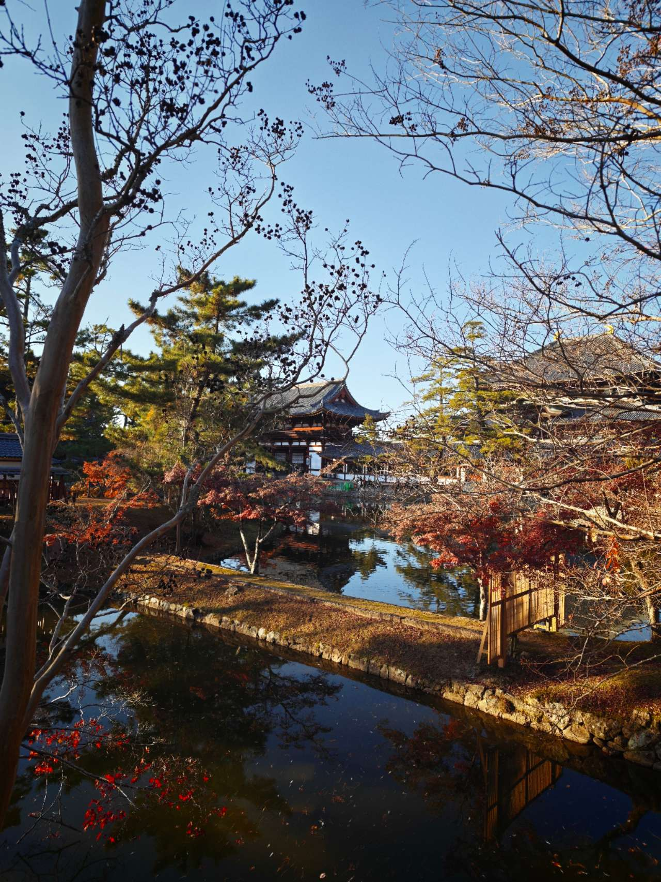
TODAY
Today turns a place
into a daily scene.
KYOTO / JAPAN
33.1°
CLOUDY
Breathable clothing and water.
Good conditions for errands or a short walk.
COUNTRY
CITY
SEARCH
Japan
Kyoto
SEARCH
CURRENT CONDITIONS / 2026.07.24 / ASIA-TOKYO
04
Notes:
Today is the default page. It immediately shows a Kyoto preset so the interface remains useful while live data is loading. The visitor can choose a country and city. The result combines the current weather, country context, local time, and a short piece of weather-aware advice in one calm editorial composition.

Slide 5
EXTERNAL SERVICES
Two external services return
one human answer.
The backend hides the choreography.
REST COUNTRIES
OPEN-METEO
country name
population
region
→
←
geocoding
weather
timezone
ONE RESPONSE
country + city
GET /api/home
weather + country + advice
05
Notes:
The browser does not call two unrelated APIs and assemble the page by itself. It sends the selected country and city to the Spring Boot backend. The backend combines REST Countries with Open-Meteo geocoding, weather, and timezone data, then returns one response designed for the page. This keeps the client simpler and lets the service add its own daily advice.
[Sources]
- Open-Meteo documentation: https://open-meteo.com/en/docs
- REST Countries: https://restcountries.com/

Slide 6
PORTFOLIO
Portfolio makes work
feel exhibited.
The page is public first.
Editing appears only for the owner.
EXHIBITION
PUBLIC PROFILE / FOUR PRESET WORKS / OWNER-ONLY EDITING
06
Notes:
Portfolio is the center of the product idea. The guest page already contains a public profile and four distinct works, so it reads as an exhibition rather than an empty form. After sign-in, edit controls appear only for the owner. The backend also checks ownership, so hiding a button is not the only protection.

Slide 7



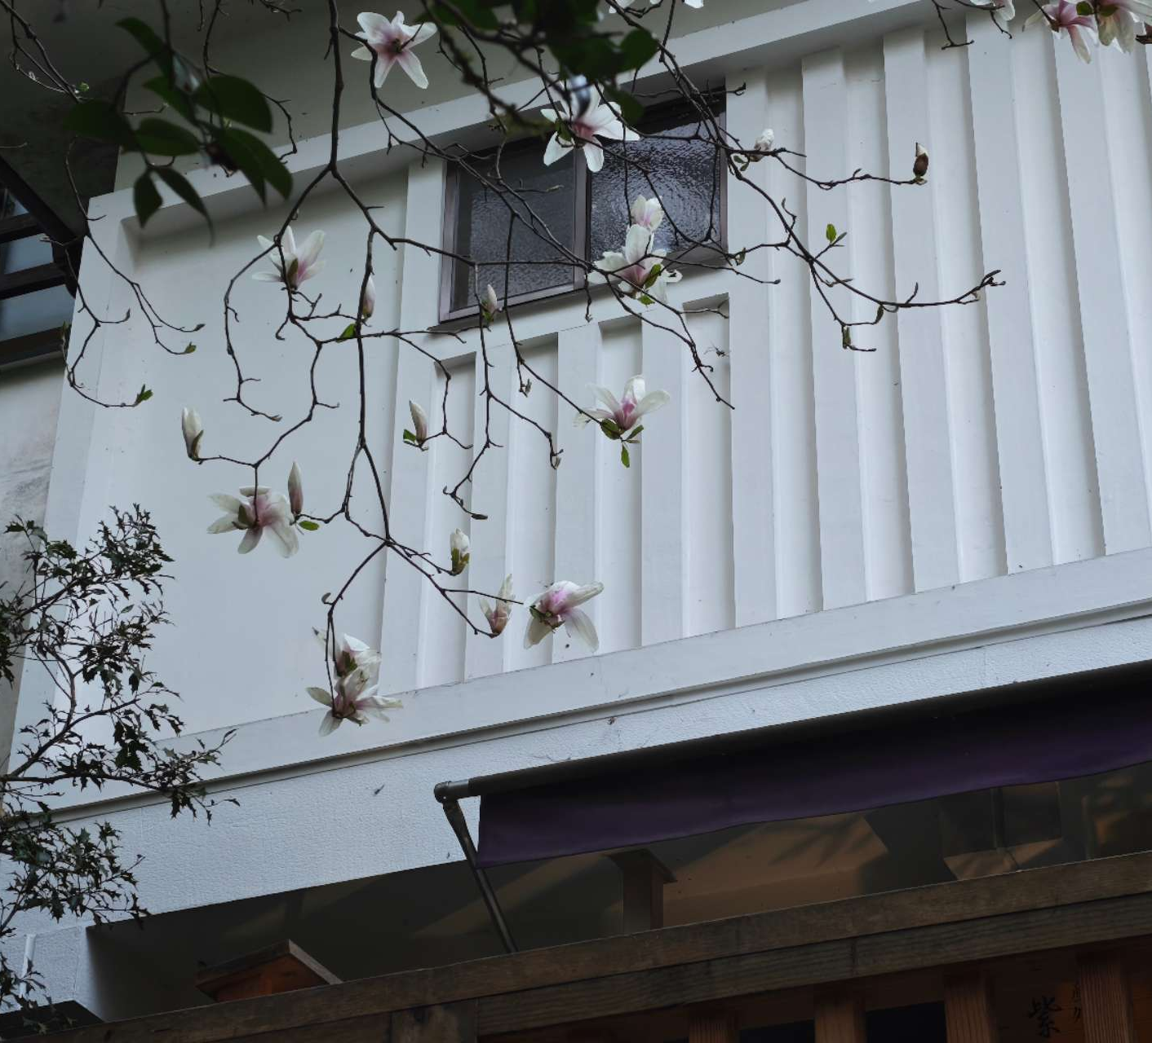
CONTENT
The collection can hold
more than a résumé.
A creator chooses the medium; the layout keeps the voice coherent.
PHOTOGRAPHY
DRAWING
DESIGN
DAILY NOTES
07
Notes:
The content model is intentionally flexible. A user can present a conventional profile, but the same page can become a photography set, an illustration collection, a design archive, daily notes, or a mixed body of work. This makes the project more personal and gives the portfolio page a clear reason to exist beyond a résumé.

Slide 8
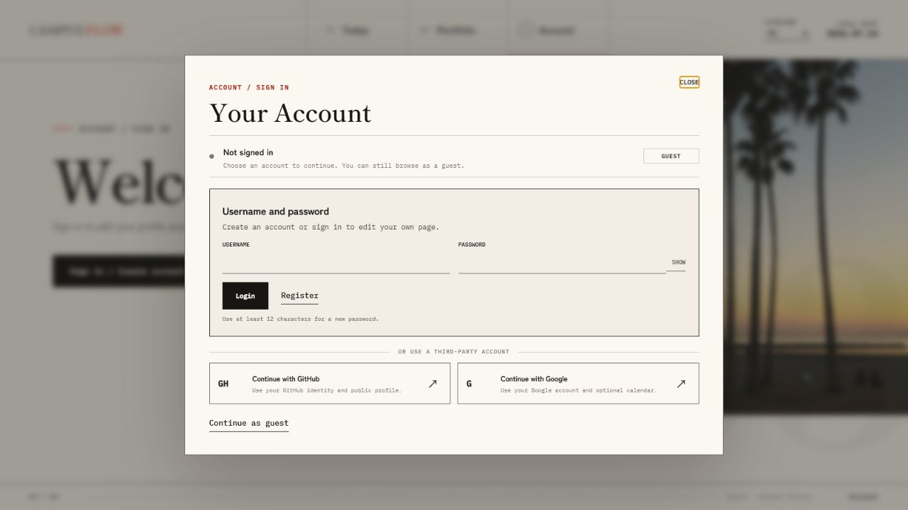
ACCOUNT
Account gives the exhibition
an owner.
Local accounts remain the primary path.
PRIMARY
Username
and password
SECONDARY
Google / GitHub
MASKED PASSWORD / NORMAL USER REGISTRATION / GUEST CONTINUES
08
Notes:
Account keeps the user-facing task simple. Local registration and sign-in are visually primary. The password field is masked. Google and GitHub remain optional third-party paths rather than dominating the page. A public registration always creates a normal user, while an administrator exists only when server-side environment variables define one.

Slide 9

09
Now the service
can speak for itself.
TODAY / PORTFOLIO / ACCOUNT
I will switch to the running application.
LIVE DEMONSTRATION
Notes:
At this point, I will switch from the presentation to the running CampusFlow application. I will show the three pages in their natural order: useful guest content on Today, the public exhibition on Portfolio, and the local account flow that unlocks ownership and editing. After the demonstration, I will return to explain the design system, architecture, security, and delivery.
[Sources]
- PJH, “Evening traffic on a bustling city street,” Unsplash: https://unsplash.com/photos/evening-traffic-on-a-bustling-city-street-J-OLVaKjgAs

Slide 10

DESIGN LANGUAGE
The visual system borrows
the rhythm of print.
PAPER
INK
VERMILION
Warm surfaces remain readable on a projector.
Typography carries the hierarchy.
Red behaves like an editor’s mark.
YU MINCHO / YU GOTHIC / CONSOLAS
10
Notes:
The visual system follows the same idea as the product. Warm paper keeps the interface readable. Mincho typography gives the pages an authored editorial voice. Vermilion behaves like an annotation rather than a decorative theme color. Cinematic crops, slightly uneven printed frames, and manga-like page rhythm make the service memorable without changing the clarity of the controls.
[Sources]
- Suzuki Kiitsu, “Flowering Plum and Camellia,” public-domain artwork: https://commons.wikimedia.org/wiki/File:%27Flowering_Plum_and_Camellia%27,_six-fold_screen_by_Suzuki_Kiitsu,_c._1850s,_ink_and_color_on_paper,_Japanese,_Honolulu_Academy_of_Arts.jpg

Slide 11
ARCHITECTURE
One container carries
the whole experience.
The frontend and REST API ship together.
01
02
03
04
Browser
→
Spring Boot
→
Data
→
Delivery
Today
Portfolio
Account
Static client
REST controllers
services
External APIs
MySQL / H2
owned content
Docker Hub
Azure App Service
port 8080
ONE APPLICATION IMAGE
same interface · same API · reproducible release
11
Notes:
The browser client and the REST API are delivered by the same Spring Boot application. This avoids a separate frontend deployment and keeps the classroom setup simple. The service connects to external APIs and persistent data, then the same immutable application image moves from local Docker to Docker Hub and Azure App Service on port 8080.
[Sources]
- Microsoft Azure App Service custom-container documentation: https://learn.microsoft.com/azure/app-service/configure-custom-container

Slide 12
SECURITY
Every edit is checked
on the server.
A polished interface is not the security boundary.
BCrypt
Local passwords are stored as hashes.
HttpOnly + Secure
The session cookie stays outside browser scripts.
CSRF
State-changing requests require a matching token.
Roles
Public registration cannot create an administrator.
Ownership
Users may change only their own profile and work.
12
Notes:
Security is implemented on the backend. Local passwords are stored as BCrypt hashes and never returned to the browser. The session cookie is HttpOnly, and the Azure version also uses the Secure flag. State-changing requests require CSRF protection. Public registration creates only a normal user. Administrator routes require a server-configured administrator, and profile or portfolio changes are checked against ownership.

Slide 13
CLASSROOM PROOF
The release satisfies
the classroom brief.
✓
CLIENT + SERVICE
Desktop web client and Spring Boot REST API
✓
TWO EXTERNAL APIS
60%
Open-Meteo and REST Countries
✓
ORIGINAL FEATURE
Context-aware daily information and advice
TECHNICAL MERIT
✓
SECURITY + STORAGE
BCrypt, cookies, CSRF, roles, ownership, MySQL / H2
The design invites attention.
The implementation completes the brief.
✓
RUNNABLE DELIVERY
JAR, Docker image, Azure service, and presentation
9 TESTS / 0 FAILURES
13
Notes:
This slide maps the finished release directly to the assignment. It includes a browser client and original Spring Boot service, two external APIs, an original feature built from their data, secure authentication and authorization, persistent storage, source code, a runnable JAR, Docker delivery, one Azure service, and presentation materials. The Java 17 Docker build contains nine passing regression tests with no failures.

Slide 14

NEXT
NEXT, NOT NOW
The next step is discovery
around the work.
01
Shareable creator pages
Stable public links for individual exhibitions.
02
Tags and discovery
Browse by medium, location, season, or topic.
03
Conversation
Collections, comments, and an optional forum layer.
ROADMAP / NOT INCLUDED IN THE CURRENT RELEASE
14
Notes:
The current release completes the personal exhibition workflow. The next development direction is discovery around the work: stable shareable creator pages, tags and search, and later a lightweight conversation layer. I keep these ideas in the roadmap because the forum is not part of the finished release and should not distract from the service that already works.

Slide 15

CAMPUSFLOW / FINAL
Thank you.
I hope you enjoyed this short visit to CampusFlow.
campusflow-final-0724-grbzdrczdqdyhyea.japanwest-01.azurewebsites.net
ZHU FUXIN · M25W7195
Notes:
Thank you very much for listening. I hope you enjoyed this short visit to CampusFlow. The complete project, runnable JAR, Docker image, report, and presentation are included in the submission.
[Sources]
- Japanese Katagami Stencil Abstract Text, public-domain image: https://commons.wikimedia.org/wiki/File:Japanese_Katagami_Stencil_Abstract_Text.jpg

