Slide 1
Random Early Detection Gateways for Congestion Avoidance
Sally Floyd and Van Jacobson,
IEEE Transactions on Networking, Vol.1, No. 4, (Aug 1993), pp.397-413.
ECEN 619, Internet Protocols and Modeling Prof. Xi Zhang

Slide 2
Outline
Introduction
Background: Definitions and Previous Work
The RED Algorithm
RED parameters
RED simulation results
Evaluation of RED
Conclusions and Future Work
ECEN 619, Internet Protocols and Modeling Prof.XiZhang

Slide 3
Introduction
Main idea :: to provide congestion control at the router for TCP flows.
RED Algorithm Goals
  The primary goal is to provide congestion avoidance by controlling the average queue size such that the router stays in a region of low delay and high throughput.
  To avoid global synchronization (e.g., in Tahoe TCP).
  To control misbehaving users (this is from a fairness context).
  To seek a mechanism that is not biased against bursty traffic.
ECEN 619, Internet Protocols and Modeling Prof. Xi Zhang

Slide 4
Definitions
congestion avoidance – when impending congestion is indicated, take action to avoid congestion.
incipient congestion – congestion that is beginning to be apparent.
need to notify connections of congestion at the router by either marking the packet [ECN] or dropping the packet {This assumes a drop is an implied signal to the source host.}
ECEN 619, Internet Protocols and Modeling Prof. Xi Zhang

Slide 5
Previous Work
Drop Tail
Random Drop
Early Random Drop
Source Quench messages
DECbit scheme
ECEN 619, Internet Protocols and Modeling Prof. Xi Zhang

Slide 6
Drop Tail Router
FIFO queuing mechanism that drops packets from the tail when the queue overflows.
Introduces global synchronization when packets are dropped from several connections.
ECEN 619, Internet Protocols and Modeling Prof. Xi Zhang

Slide 7
Random Drop Router
When a packet arrives and the queue is full, randomly choose a packet from the queue to drop.
ECEN 619, Internet Protocols and Modeling Prof. Xi Zhang

Slide 8
Early Random Drop Router
p
Drop level
If the queue length exceeds a drop level, then the router drops each arriving packet with a fixed drop probability p.
Reduces global synchronization
Does not control misbehaving users (UDP)
ECEN 619, Internet Protocols and Modeling Prof. Xi Zhang

Slide 9
Source Quench messages
Router sends source quench messages back to source before the queue reaches capacity.
Complex solution that gets router involved in end-to-end protocol.
ECEN 619, Internet Protocols and Modeling Prof. Xi Zhang

Slide 10
DECbit scheme
Uses a congestion-indication bit in packet header to provide feedback about congestion.
Upon packet arrival, the average queue length is calculated for last (busy + idle) period plus current busy period.
When the average queue length exceeds one, the router sets the congestion-indicator bit in arriving packet’s header.
If at least half of packets in source’s last window have the bit set, decrease the congestion window exponentially.
ECEN 619, Internet Protocols and Modeling Prof. Xi Zhang

Slide 11
RED Algorithm
for each packet arrival
calculate the average queue size avg
if min_{th} ≤ avg < max_{th}
calculate the probability p_{a}
with probability p_{a}:
mark the arriving packet
else if max_{th} ≤ avg
mark the arriving packet.
ECEN 619, Internet Protocols and Modeling Prof. Xi Zhang

Slide 12
RED drop probability ( p_{a} )
p_{b} = max_{p} x (avg - min_{th})/(max_{th} - min_{th}) [1]
where
p_{a} = p_{b}/ (1 - count x p_{b}) [2]
Note: this calculation assumes queue size is measured in packets. If queue is in bytes, we need to add [1.a] between [1] and [2]
p_{b} = p_{b} x PacketSize/MaxPacketSize [1.a]
ECEN 619, Internet Protocols and Modeling Prof. Xi Zhang

Slide 13
avg - average queue length
avg = (1 – w_{q}) x avg + w_{q} x q
where q is the newly measured queue length.
This exponential weighted moving average (EWMA) is designed such that short-term increases in queue size from bursty traffic or transient congestion do not significantly increase average queue size.
ECEN 619, Internet Protocols and Modeling Prof. Xi Zhang

Slide 14
RED/ECN Router Mechanism
1
Dropping/Marking Probability
maxp
0
minth
maxth
Queue Size
Average Queue Length
ECEN 619, Internet Protocols and Modeling Prof. Xi Zhang

Slide 15
‘Gentle’ RED
1
Dropping/Marking Probability
maxp
0
minth
maxth
Queue Size
Average Queue Length
ECEN 619, Internet Protocols and Modeling Prof. Xi Zhang

Slide 16
RED parameter settings
w_{q} suggest 0.001 <= w_{q} <= 0.0042
  authors use w_{q} = 0.002 for simulations
min_{th}, max_{th} depend on desired average queue size
  bursty traffic ➔ increase min_{th} to maintain link utilization.
  max_{th} depends on the maximum average delay allowed.
  RED is most effective when max_{th} - min_{th} is larger than typical increase in calculated average queue size in one round-trip time.
  “parameter setting rule of thumb”: max_{th} at least twice min_{th} . However, max_{th} = 3 times min_{th} is used in some of the experiments shown.
ECEN 619, Internet Protocols and Modeling Prof. Xi Zhang

Slide 17
packet-marking probability
The goal is to uniformly spread out the marked packets. This reduces global synchronization.
Method 1: geometric random variable
When each packet is marked with probability p_{b,}, the packet inter-marking time, X, is a geometric random variable with E[X] = 1/ p_{b.}
This distribution will both cluster packet drops and have some long intervals between drops!!
ECEN 619, Internet Protocols and Modeling Prof. Xi Zhang

Slide 18
packet-marking probability
Method 2: uniform random variable
Mark packet with probability p_{b}/ (1 - count x p_{b}) where count is the number of unmarked packets that have arrived since last marked packet.
E[X] = 1/(2 p_{b}) + 1/2
ECEN 619, Internet Protocols and Modeling Prof. Xi Zhang

Slide 19
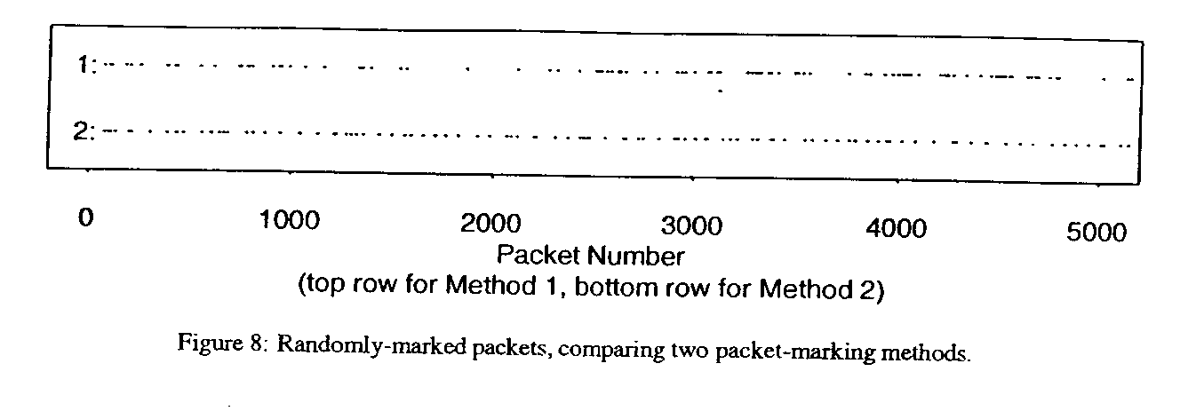
Method 1: geometric p = 0.02
Method 2: uniform p = 0.01
Result :: marked packets more clustered for method 1 ➔ uniform is better at eliminating “bursty drops”
ECEN 619, Internet Protocols and Modeling Prof. Xi Zhang

Slide 20
Setting max_{p}
“RED performs best when packet-marking probability changes fairly slowly as the average queue size changes.”
  This is a stability argument in that the claim is that RED with small max_{p} will reduce oscillations in avg and actual marking probability.
They recommend that max_{p} never be greater than 0.1
{This is not a robust recommendation.}
ECEN 619, Internet Protocols and Modeling Prof. Xi Zhang

Slide 21
RED Simulations
Figure 4: Four heterogeneous FTP sources
Figure 6: Two homogeneous FTP sources
Figure 10: 41 Two-way, short FTP and TELNET flows
Figure 11: Four FTP non-bursty flows and one bursty FTP flow
ECEN 619, Internet Protocols and Modeling Prof. Xi Zhang

Slide 22
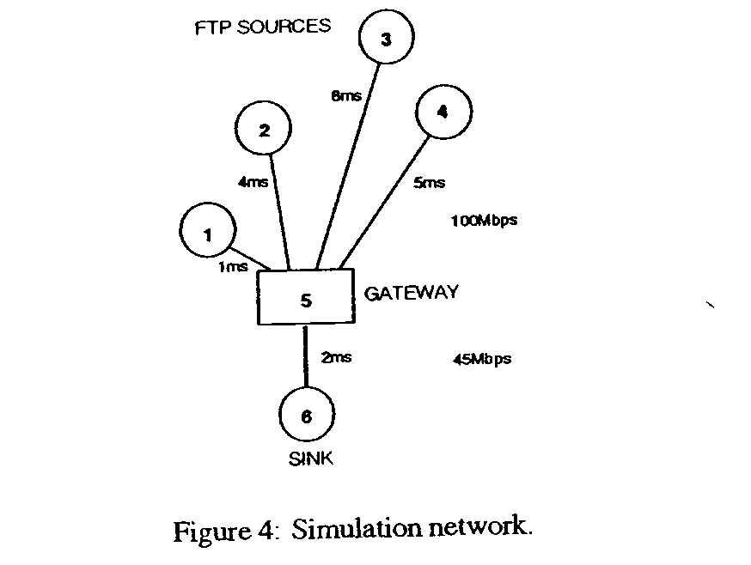
Simple Simulation
Four Heterogeneous FTP Sources
TCP Tahoe
1KB packet size
wq = 0.002
maxp = 1/50
minth = 5
maxth = 15
max cwnd = bdp
Large Buffer with
no packet drops
ECEN 619, Internet Protocols and Modeling Prof. Xi Zhang

Slide 23
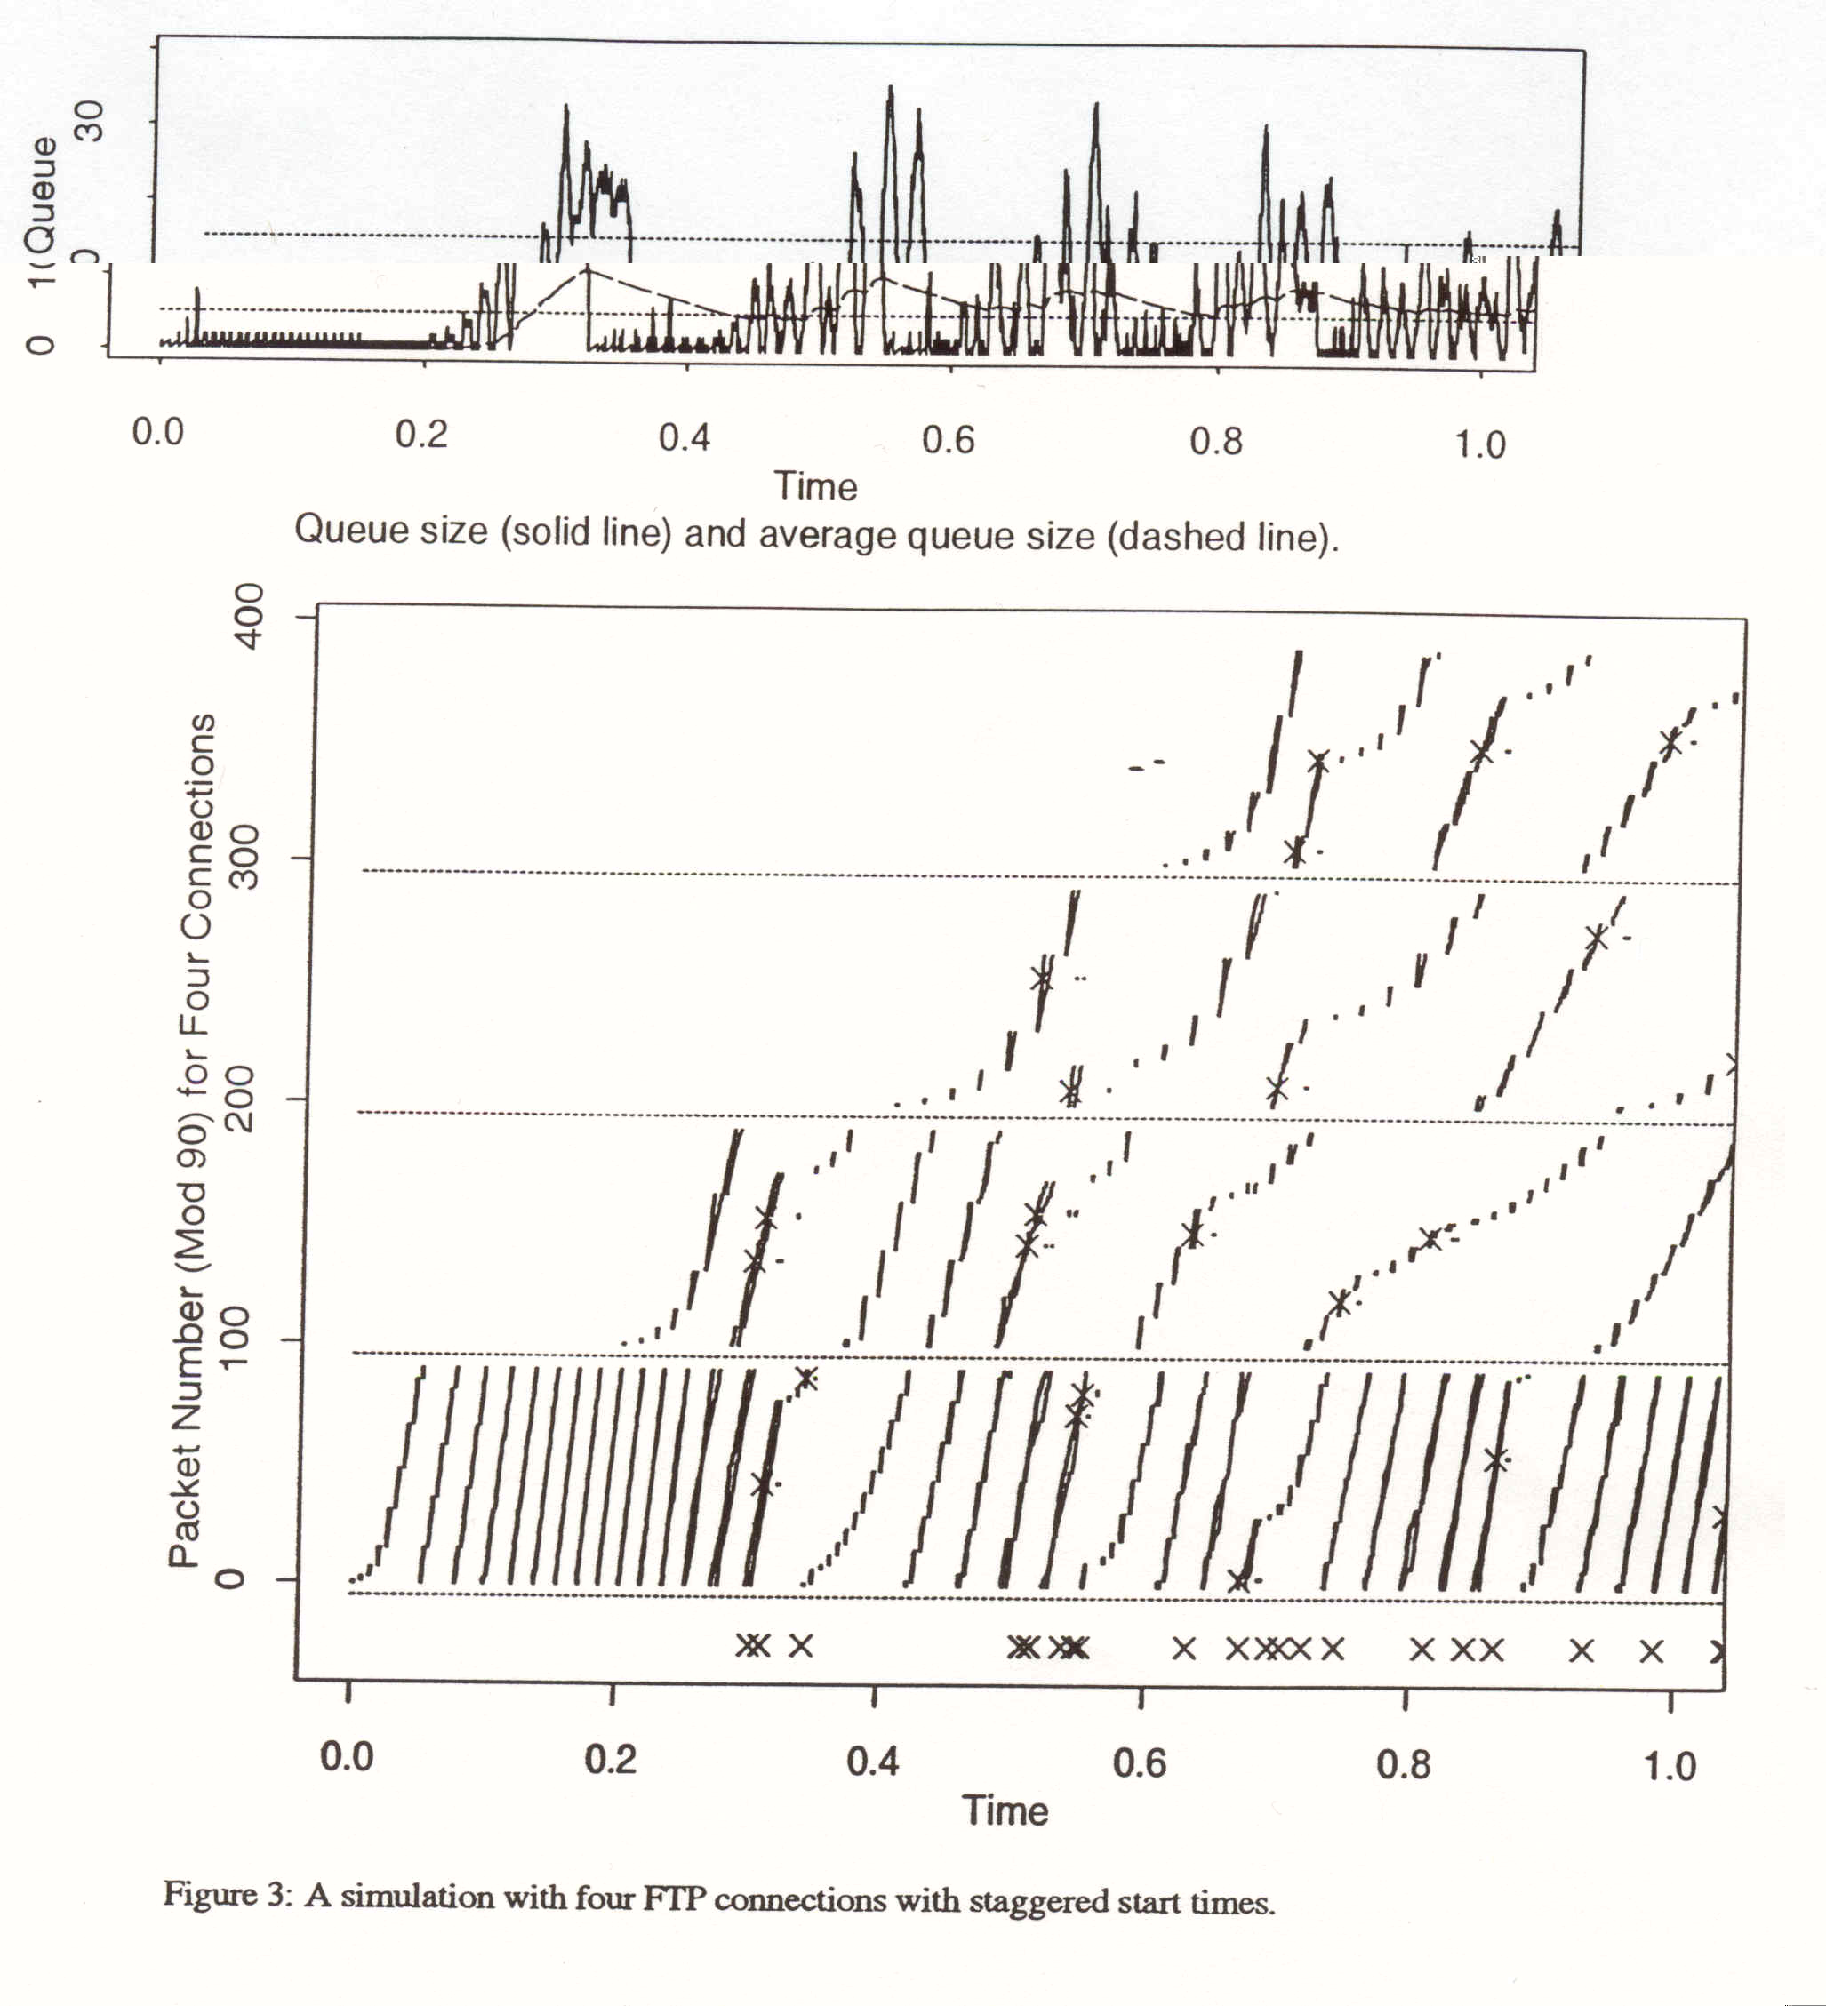
Note:
staggered
start times
and uneven
throughputs
ECEN 619, Internet Protocols and Modeling Prof. Xi Zhang

Slide 24
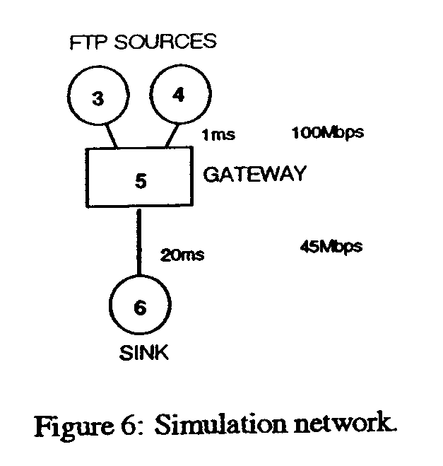
Two Homogeneous FTP Sources
RED varies minth from 3 to 50 packets
Drop Tail varies buffer from 15 to 140 packets
max cwnd = 240 packets
ECEN 619, Internet Protocols and Modeling Prof. Xi Zhang

Slide 25
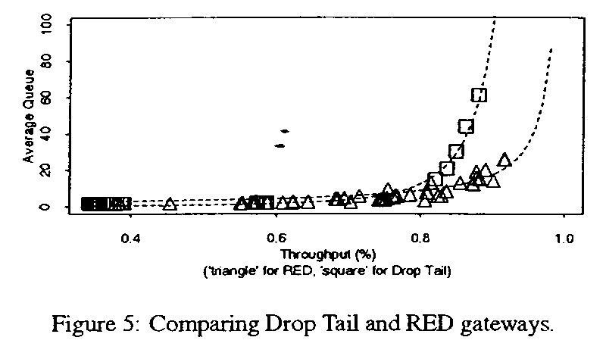
Two Homogeneous FTP Sources
Figure 5 represents many simulation experiments.
RED yields lower queuing delay as utilization improves by increasing minth from 3 to 50 packets.
Drop-tail yields unacceptable delay at high utilization.
The power measure is better for RED !
ECEN 619, Internet Protocols and Modeling Prof. Xi Zhang

Slide 26
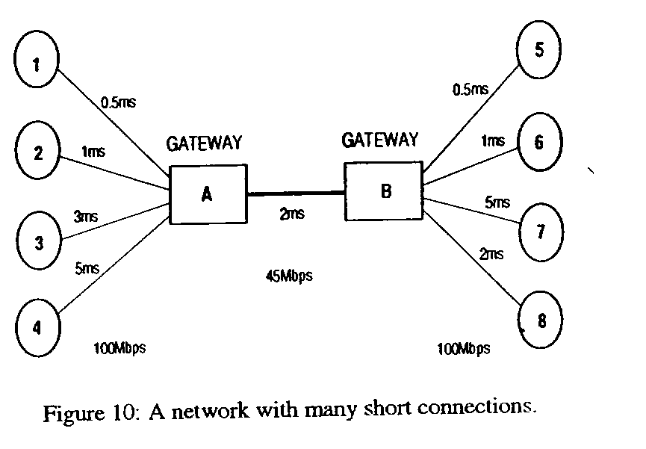
Network with 41 Short Duration Connections
Two-way traffic of FTP and
TELNET traffic .
Total number of packets per
connection varies from 20
to 400 packets.
ECEN 619, Internet Protocols and Modeling Prof. Xi Zhang

Slide 27
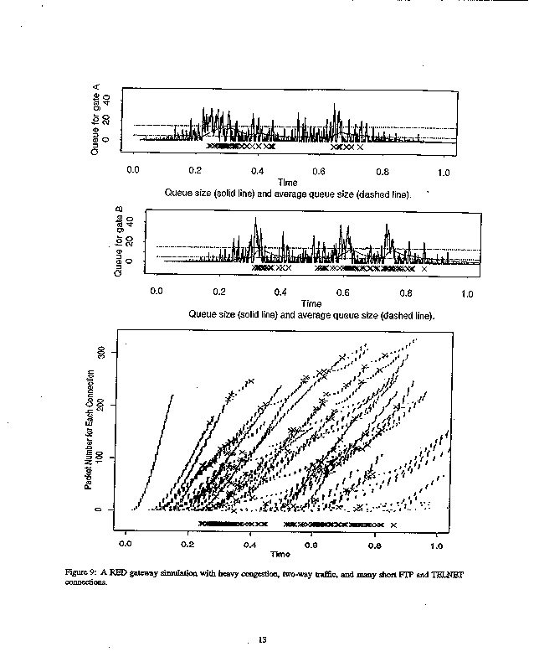
Short, two-way
FTP and TELNET flows
- RED controls the average
queue size.
- Flows have small cwnd
maximums (8 or 16).
- Packet dropping is higher and
bursty.
- Utilization is low (61%).
- Mentions ACK-compression
as one cause of bursty packet
arrivals.
.
Figure 9
ECEN 619, Internet Protocols and Modeling Prof. Xi Zhang

Slide 28
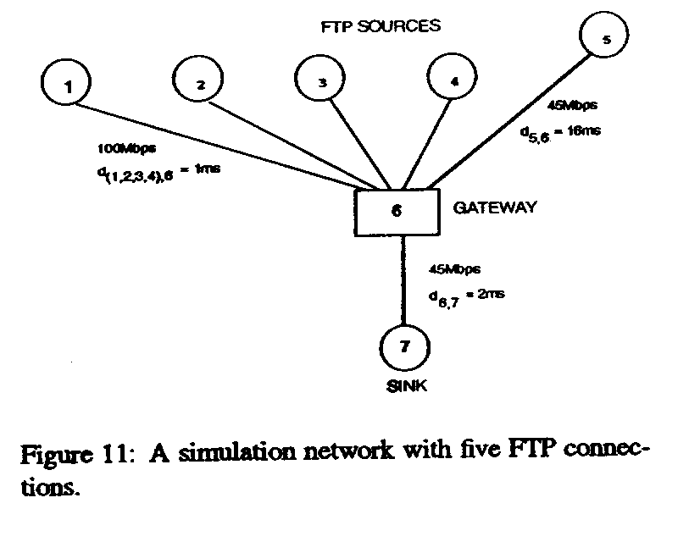
Five FTP Flows
Including One Bursty Flow
ECEN 619, Internet Protocols and Modeling Prof. Xi Zhang

Slide 29
Simulation Details
Bursty traffic == large RTT, small cwnd
Other traffic = small RTT, small cwnd {robust flows}
Node 5 :: the bursty flow cwnd varies from 8 to 22 packets.
Each simulation run for 10 seconds and each mark in the figures represents one second (i.e., 10 throughput data points per cwnd size).
ECEN 619, Internet Protocols and Modeling Prof. Xi Zhang

Slide 30
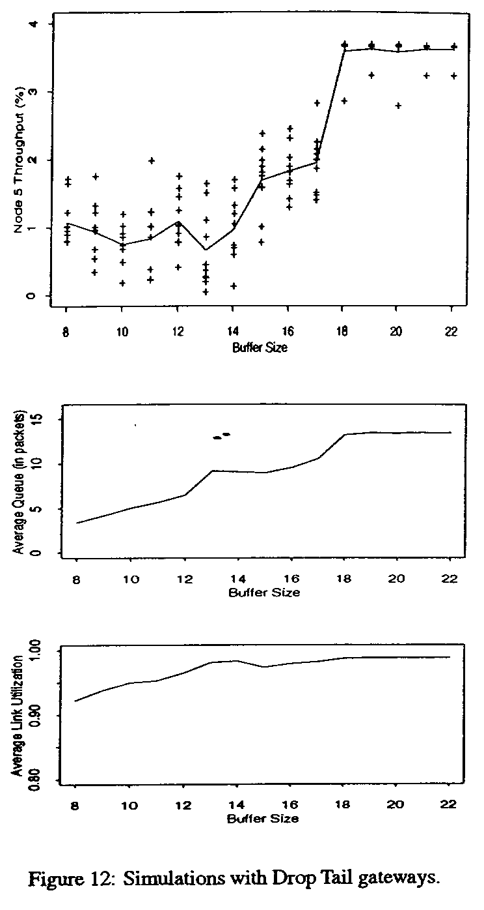
Drop Tail Gateways
ECEN 619, Internet Protocols and Modeling Prof. Xi Zhang

Slide 31
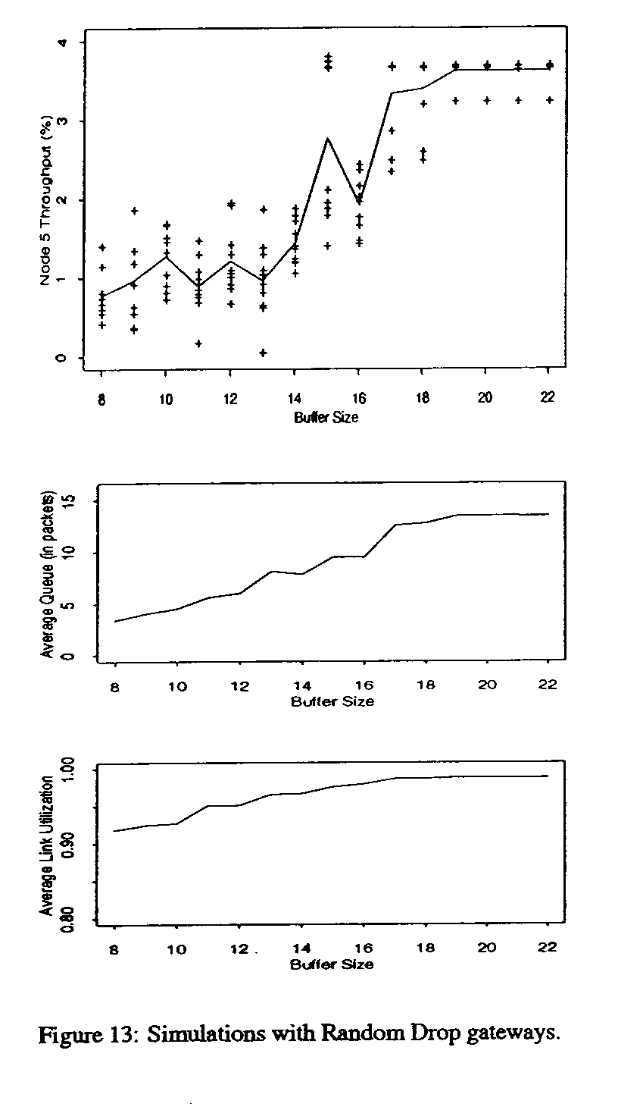
Random Drop Gateways
ECEN 619, Internet Protocols and Modeling Prof. Xi Zhang

Slide 32
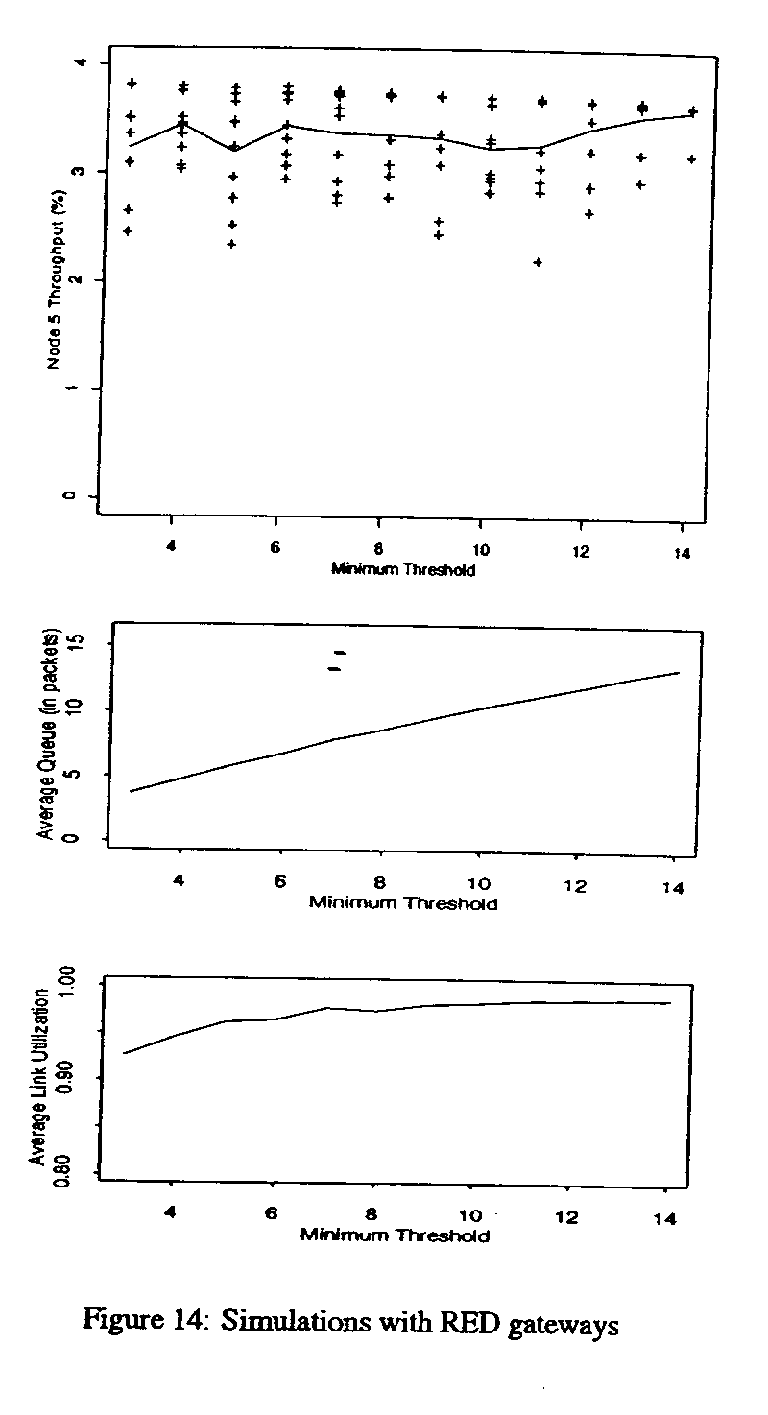
RED Gateways
ECEN 619, Internet Protocols and Modeling Prof. Xi Zhang

Slide 33
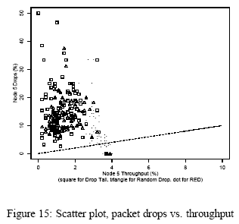
Bursty Flow
Packet Drop Bias
RED
performance
ECEN 619, Internet Protocols and Modeling Prof. Xi Zhang

Slide 34
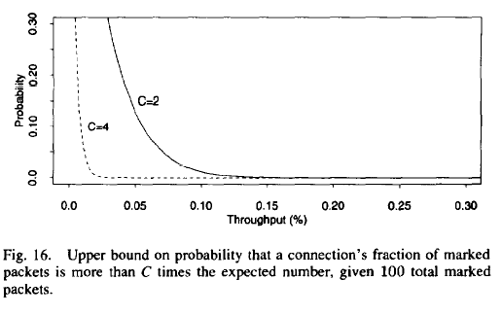
Identifying
Misbehaving Flows
The assumption is
marking matches
the flows’ share
of the bandwidth.
ECEN 619, Internet Protocols and Modeling Prof. Xi Zhang

Slide 35
Evaluation of RED design goals
congestion avoidance
  If RED drops packets, this guarantees the calculated average queue size does not exceed the max threshold. If w_{q} is set properly, RED controls the actual average queue size.
  If RED marks packets when avg exceeds max_{th}, the router relies on source cooperation to control the average queue size. {not part of RED}
ECEN 619, Internet Protocols and Modeling Prof. Xi Zhang

Slide 36
Evaluation of RED design goals
appropriate time scales
  claim:: The detection time scale roughly matches time scale of source’s response to congestion.
  RED does not notify connections during transient congestion at the router.
ECEN 619, Internet Protocols and Modeling Prof. Xi Zhang

Slide 37
Evaluation of RED design goals
no global synchronization
  RED avoids global synchronization by marking at as low a rate as possible with marking distribution spread out.
simplicity
  detailed argument about how to cheaply implement in terms of adds and shifts.
{Historically, the simplicity of RED has been strongly refuted because RED has too many parameters to make it robust.}
ECEN 619, Internet Protocols and Modeling Prof. Xi Zhang

Slide 38
Evaluation of RED design goals
maximizing global power
  power defined as ratio of throughput to delay
  see Figure 5 for comparision against drop tail.
fairness
  The authors’ claim is not well-defined.
  {This is an obvious side-step of this issue.}
  [later this becomes a big deal - see FRED paper.]
ECEN 619, Internet Protocols and Modeling Prof. Xi Zhang

Slide 39
Conclusions
RED is effective mechanism for congestion avoidance at the router in cooperation with TCP.
claim:: The probability that RED chooses a particular connection to notify during congestion is roughly proportional to that connection’s share of the bandwidth.
ECEN 619, Internet Protocols and Modeling Prof. Xi Zhang

Slide 40
Future Work (circa 1993)
Is RED really fair?
How do we tune RED?
Is there a way to optimize power?
What happens with other versions of TCP?
How does RED work when mixed with drop tail routers?
How robust is RED?
What happens when there are many flows?
ECEN 619, Internet Protocols and Modeling Prof. Xi Zhang

