Slide 1
U.S. Accidents A Countrywide Traffic Accident Dataset
Joshua Yu, Anirudh Putrevu, Junda Zhang, Stephen Lee

Slide 2
Project Overview
Raw Data Explanation
Scrubbing the Data
Statistical Models Employed
Discussion on Plots

Slide 3
Raw Data At a Glance
Source: Kaggle
Data characteristics:
4.2 million accident records (2/16-12/20)
Covers 49 in the U.S.
49 variables (e.g., logical, numeric, characters, integers)
Examples of potential predictors: Time of accident, Street, Visibility, and Wind Speed

Slide 4
Raw Data What We Aimed to Extract
Thesis: To establish which variables had predictive power over the severity of an accident
Binary Response Variable: Low Severity/ High Severity

Slide 5
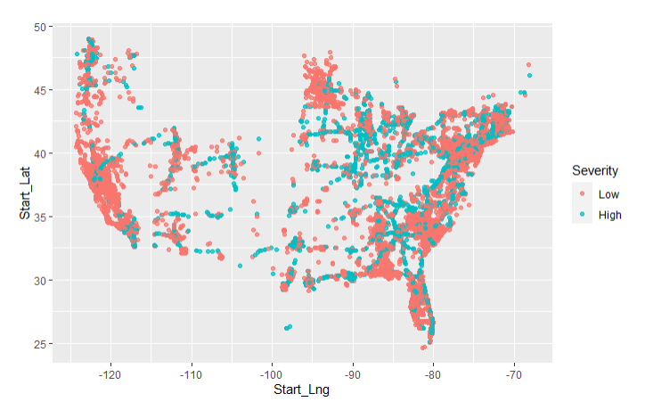
Raw Data Additional Findings

Slide 6
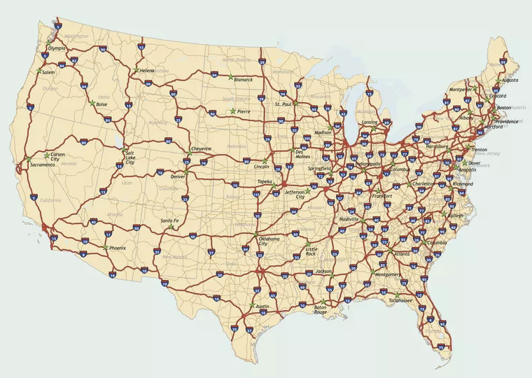

Slide 7
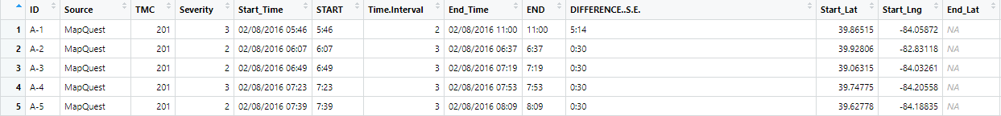
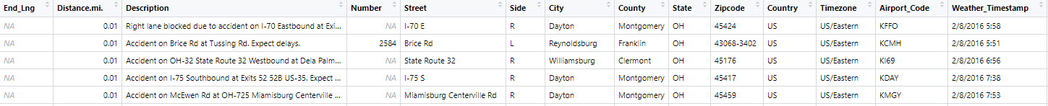
Raw Data
(Head 5)

Slide 8
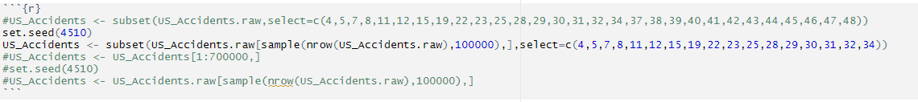
Data Manipulation
(Selecting Columns)
Dataset after selecting columns.

Slide 9
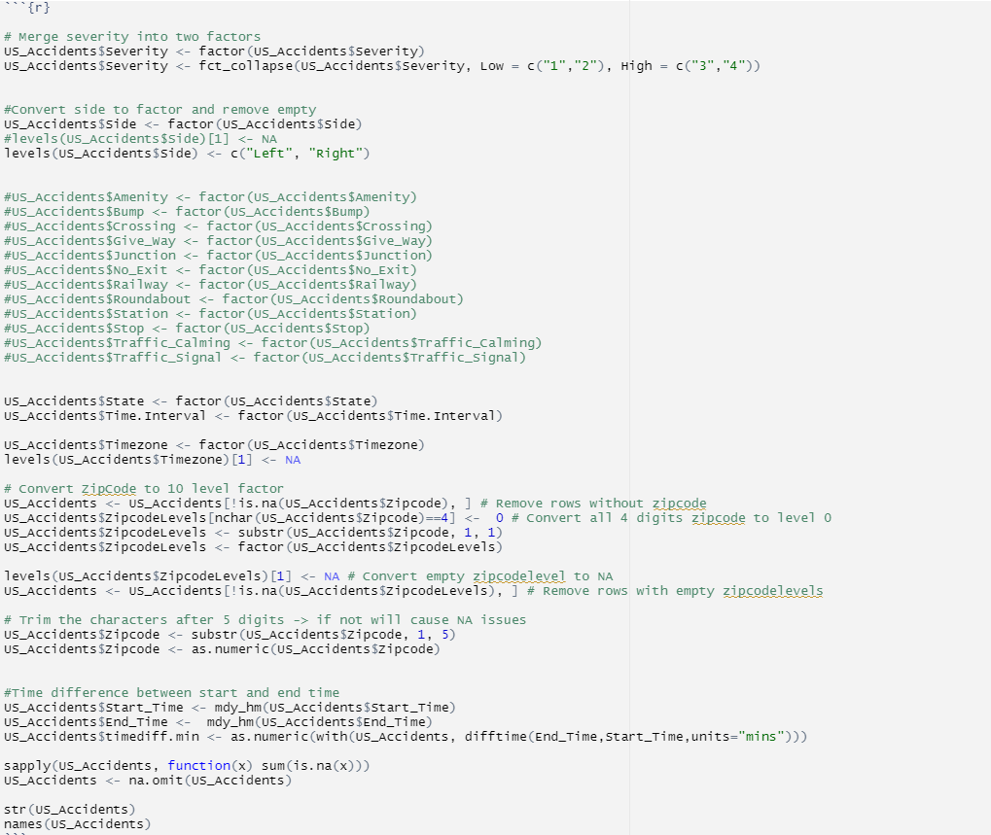
Data Manipulation Coding
(Pre-Processing)

Slide 10
Data after Manipulation

Slide 11
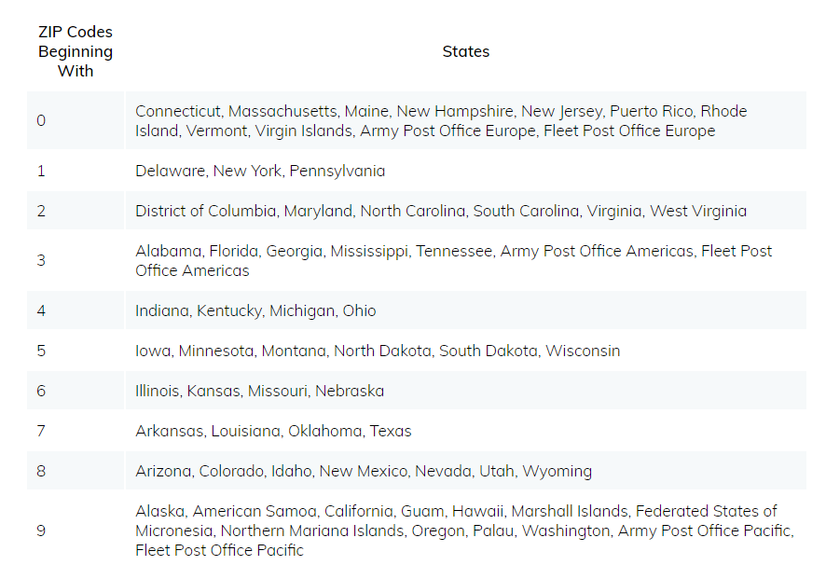
Zip Code level Chart

Slide 12
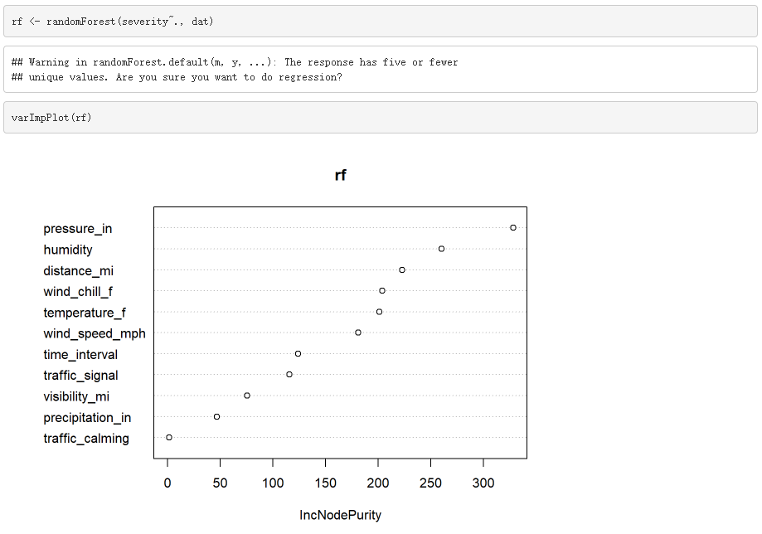
Random Forest
(Selecting 6 best predictors)

Slide 13
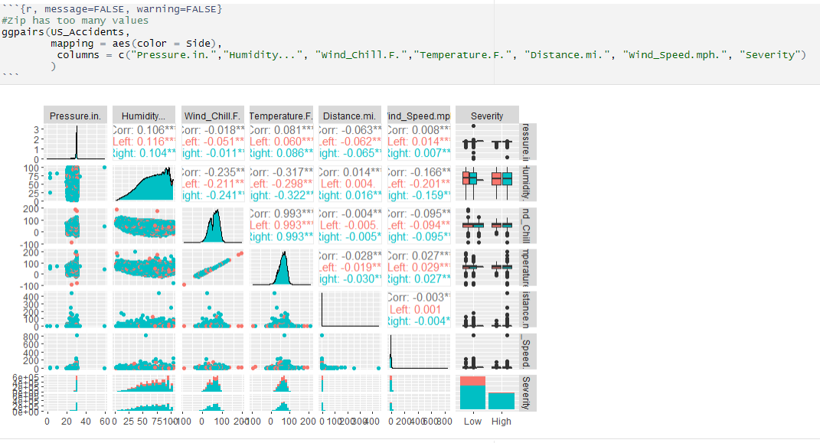

Slide 14
Test Models
multinom(Severity~ Pressure.in. + Wind_Chill.F. + Side + Humidity... + Temperature.F. + Wind_Speed.mph. + Time.Interval + Timezone + Zipcode + Visibility.mi., US_Accidents)
polr(Severity ~ Pressure.in. + Wind_Chill.F. + Side + Humidity... + Temperature.F. + Wind_Speed.mph. + Time.Interval + Timezone + Zipcode + Visibility.mi., Hess=TRUE)

Slide 15
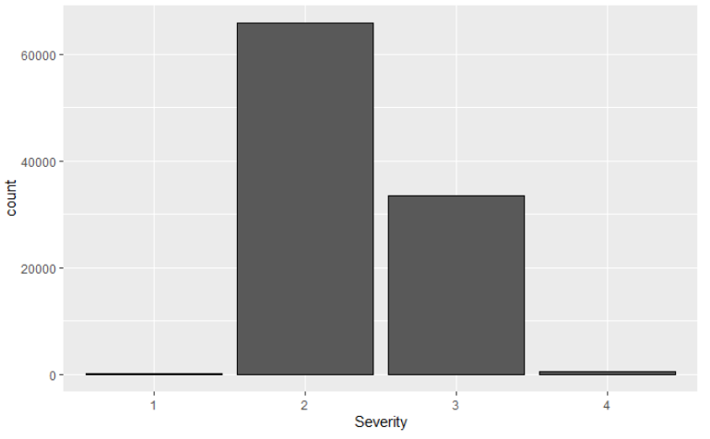
Challenges & Caveats

Slide 16
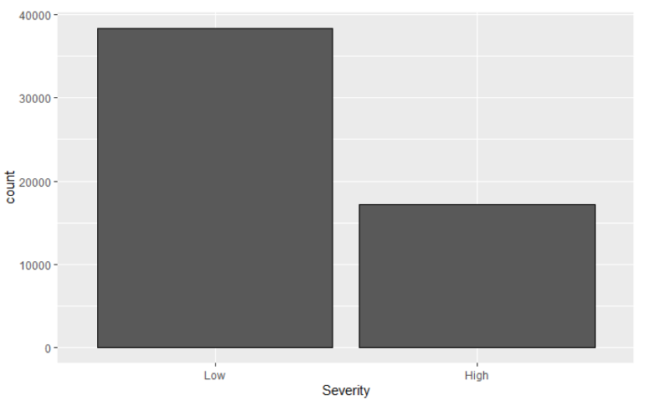
Challenges & Caveats

Slide 17
GLM Model
g2 <- glm(Severity ~ Pressure.in. + Wind_Chill.F. + Side + Humidity... + Temperature.F. + Wind_Speed.mph. + Time.Interval + Timezone + Zipcode + Visibility.mi. ,family=binomial(link='logit'), data = US_Accidents)

Slide 18
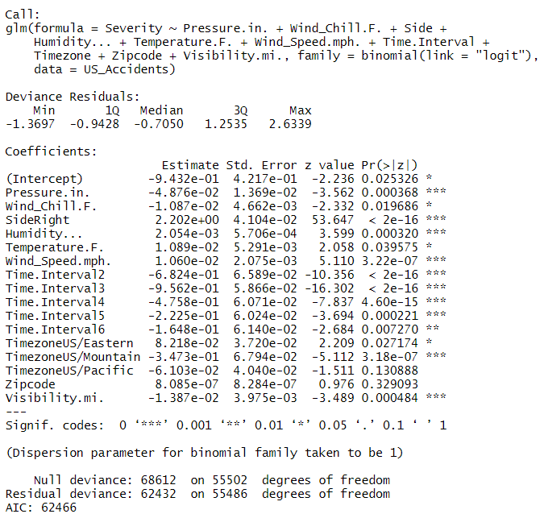
Summary of GLM

Slide 19
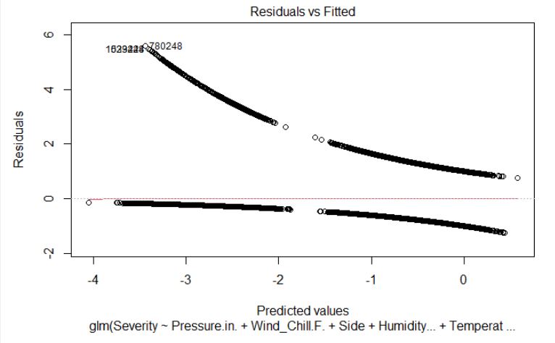
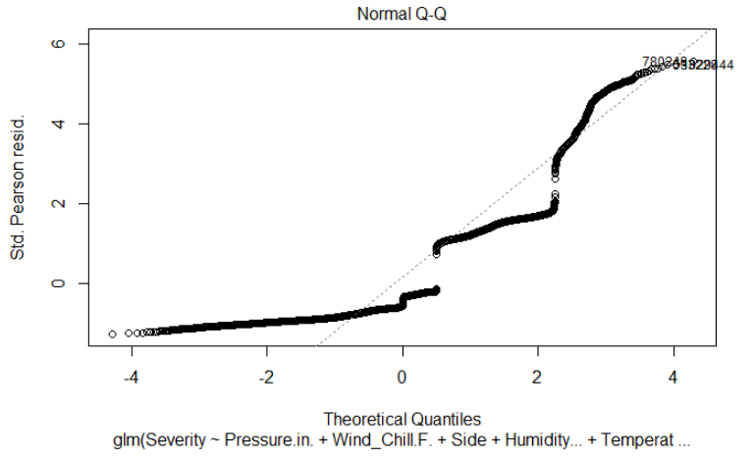
Plots

Slide 20
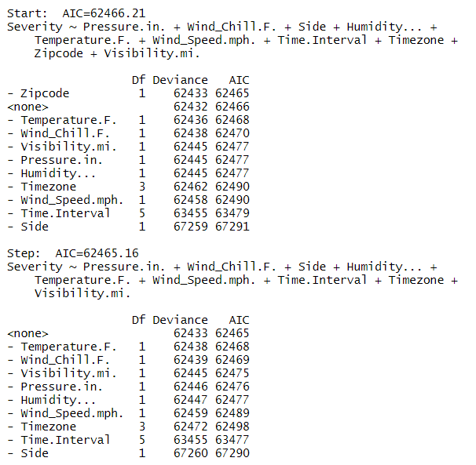
Stepwise Model
g2.step <- step(g2)

Slide 21
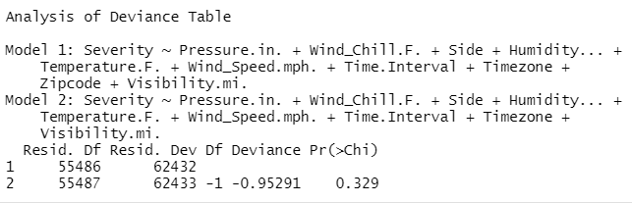
Anova

Slide 22
Improving on Our Original Model
Take aways from prev. model g2:
Wind chill and temperature are correlated
Zipcodelevels, timediff_min variable introduced
McFadden r-sq is low i.e = 0.09
Test out newer models
New model analysis:
stepwise regression and anova tests
Mcfadden r-sq
Cross validating the model / using p- metric for accuracy
checking predictive power of model
residual analysis and outlier removal

Slide 23
g5 Model Wins Out of 7 Models on ANOVA Tests
and Resists Any Stepwise Regression
g5 -> glm(Severity ~ Time.Interval + timediff.min + Side*ZipcodeLevels + Visibility.mi.+ Timezone ,family=binomial(link='logit'), data = US_Accidents)
After fitting the model with new predictor variables we find that our new model g5 on the same d.f as g2 produces a bigger change in deviance.
Our mcFadden r-sq increases to ~ 0.12 from 0.09
Looking at the summary now on the following page

Slide 24
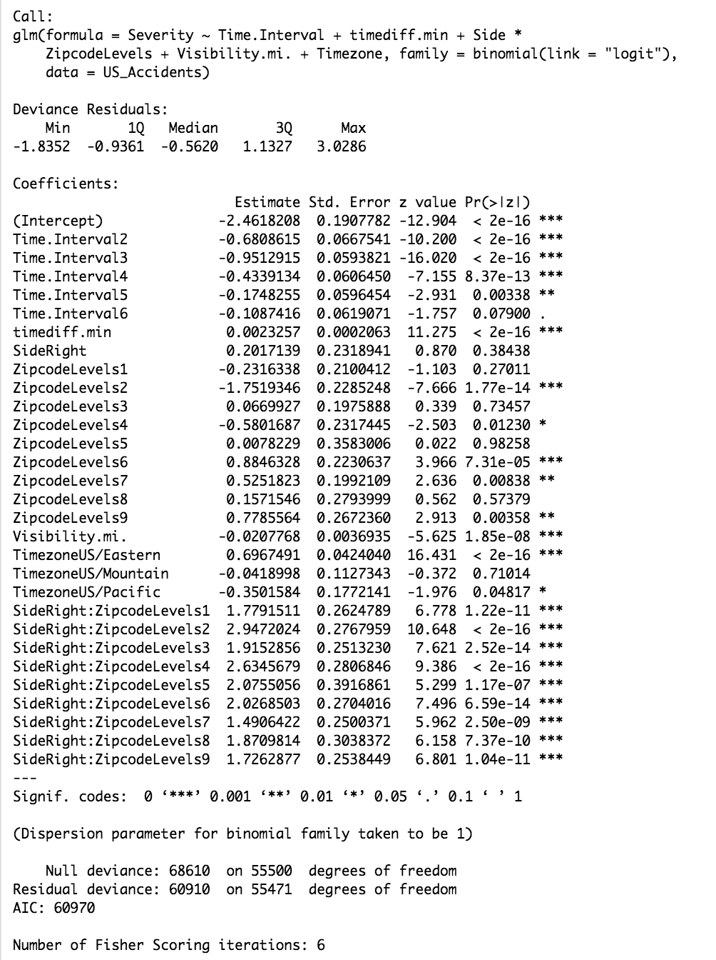
Summary on g5

Slide 25
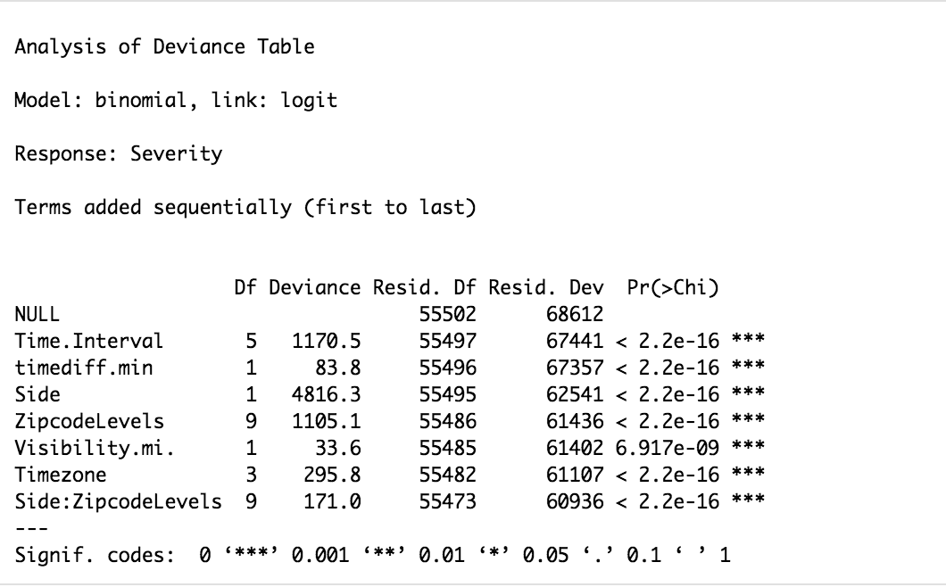
ANOVA on g5

Slide 26
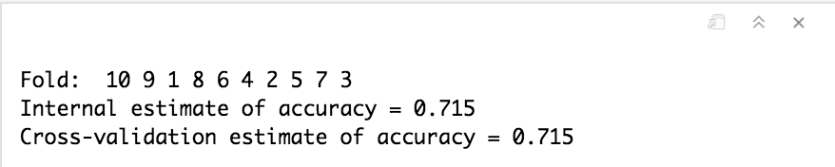
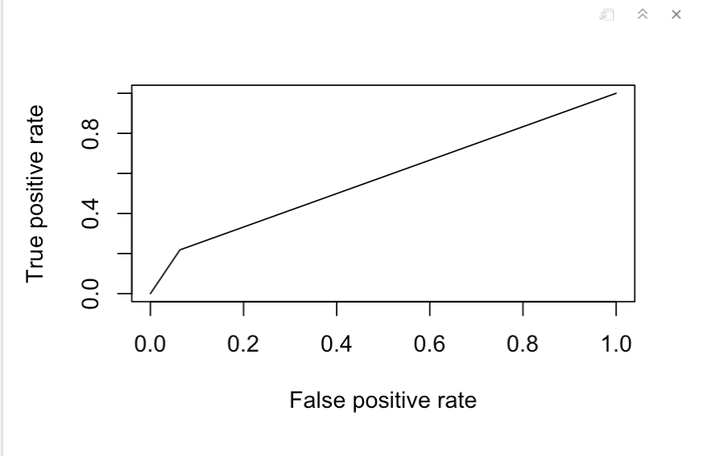
CV and Accuracy Using Arbitrary p
CV using the CVbinary in car:: yields us an accuracy of 0.715
Using p value (0.5) to predict accuracy on train, test data [80:20]
accuracy found to be 71.5 %
auc curve value ~ 0.58 (not good)

Slide 27
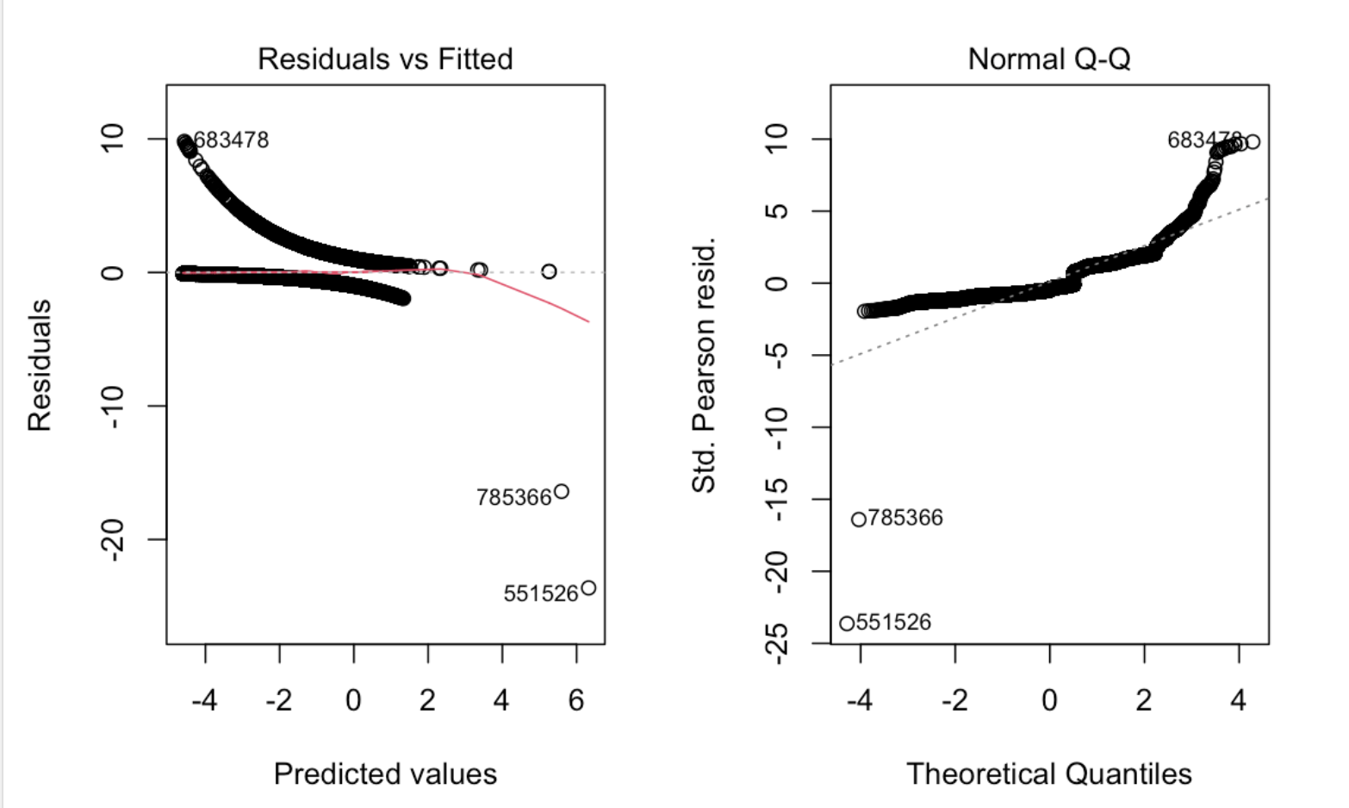
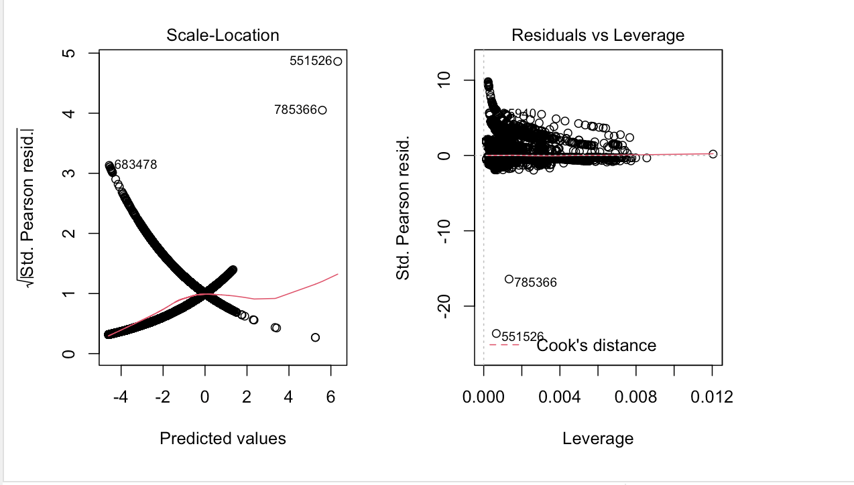
Checking Residuals of Model

Slide 28
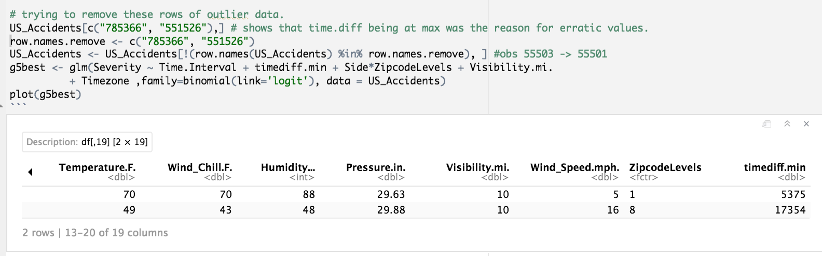
Outlier Removal and Comparison with Model Having Outliers
- Looking at observations which produced outliers we see : time.diffmin and visibility metrics for these data are > p = 0.95
- Removing these outliers and comparing old model

Slide 29
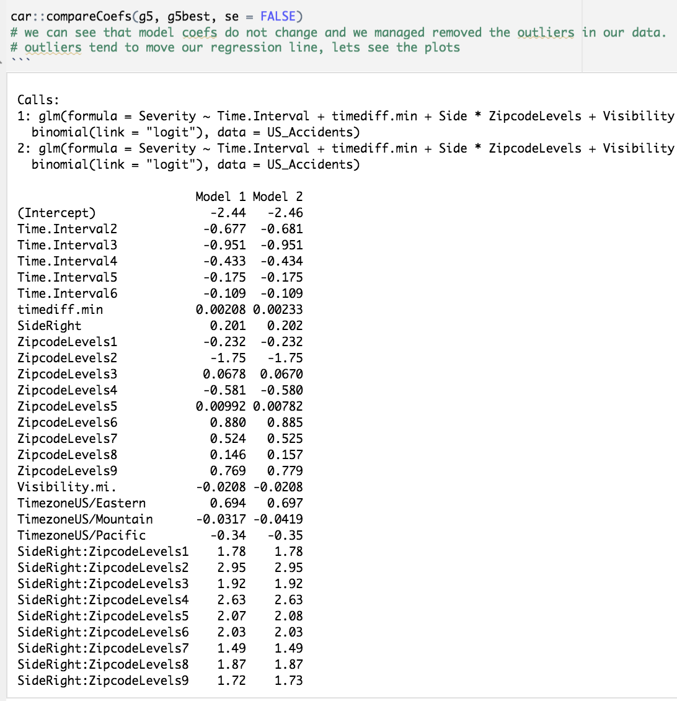
Model Coefficients Don’t Change as We Remove Outliers

Slide 30
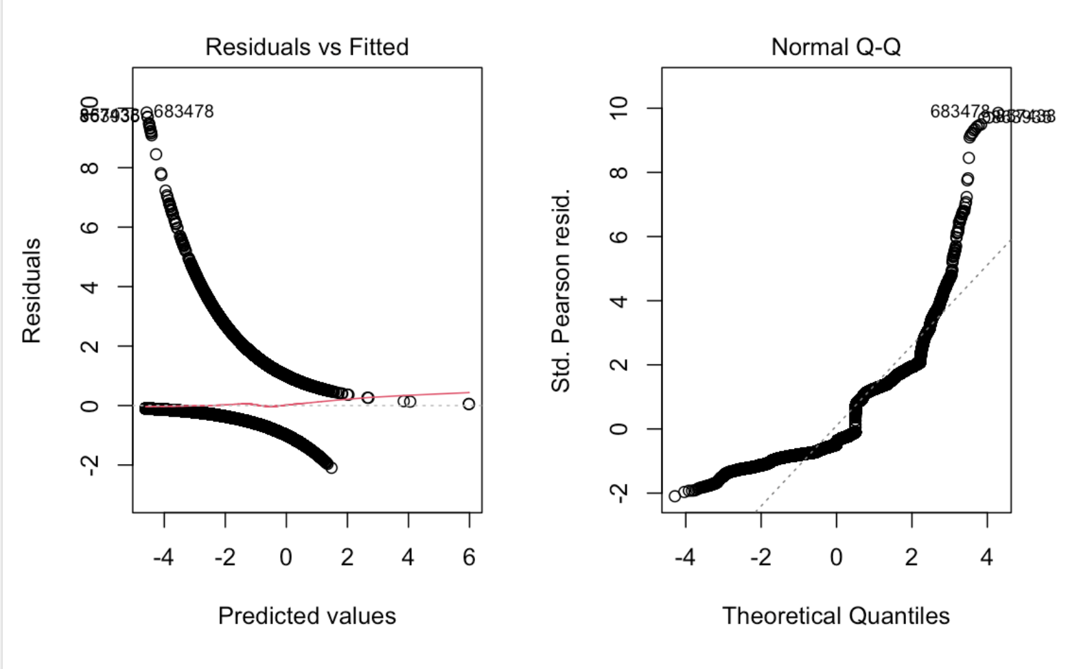
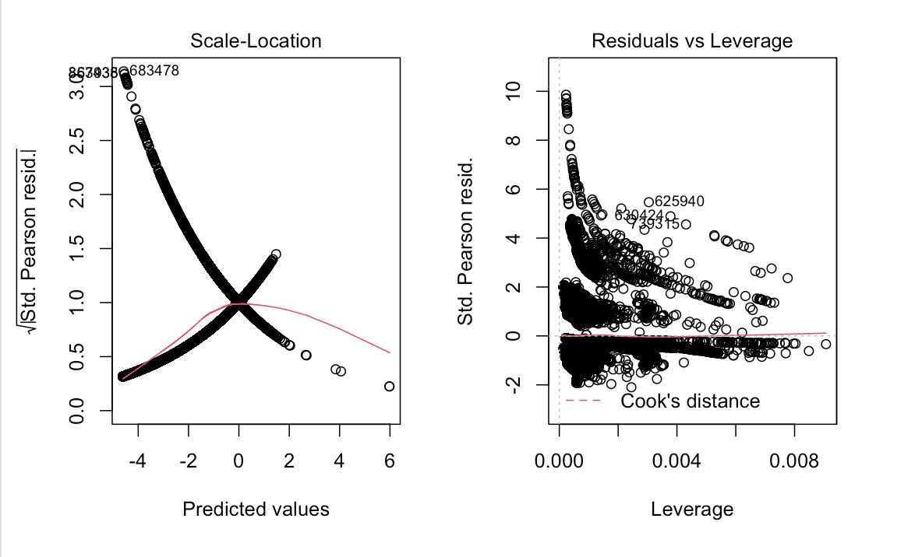
Plots for Our Model g5 Best:

Slide 31
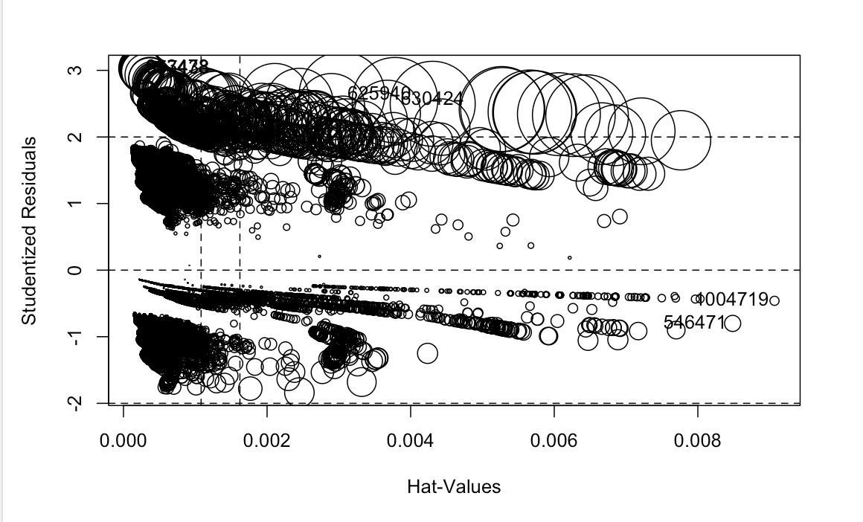
Influence Plot
As observed before, points with high leverage don’t show much influence. Here, we see some fitted values have big cooks distance (size) and high residual value still. Adding weights using cooksd < 4/n sample & res <3 worsens our model values and plots.

Slide 32
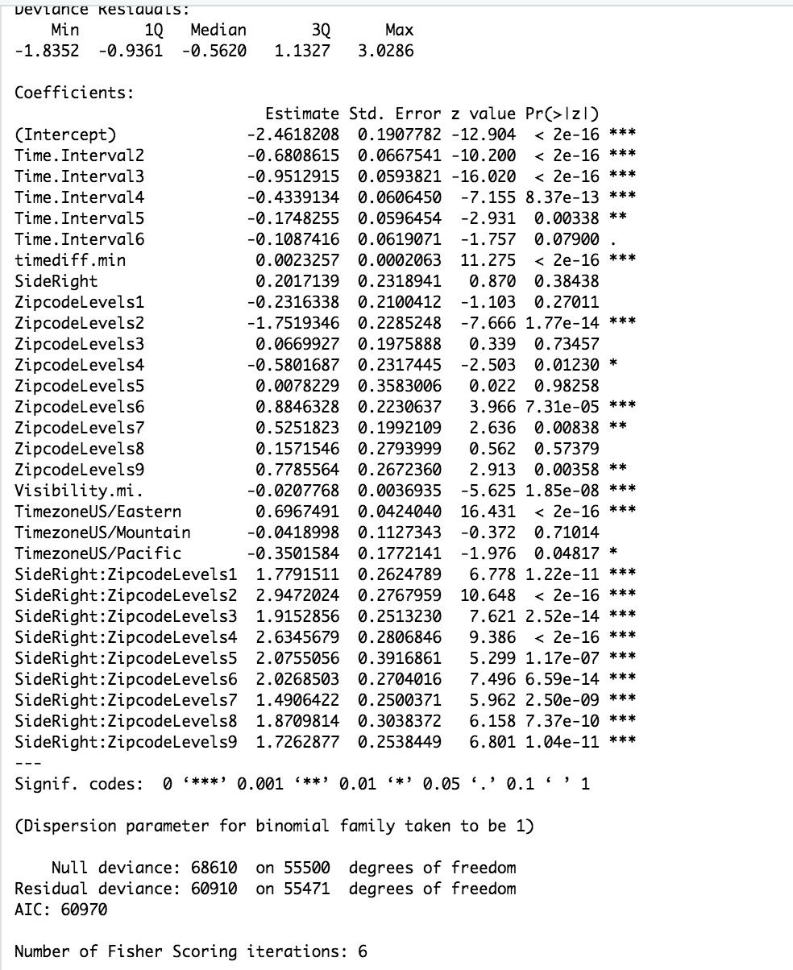
Interpreting results
SUMMARY
Most values in model are significant.
Insignificant in Timezone level coefs could be explained by the timezone distribution.
Values for side & zipcode_levels should be read from interaction terms.

Slide 33
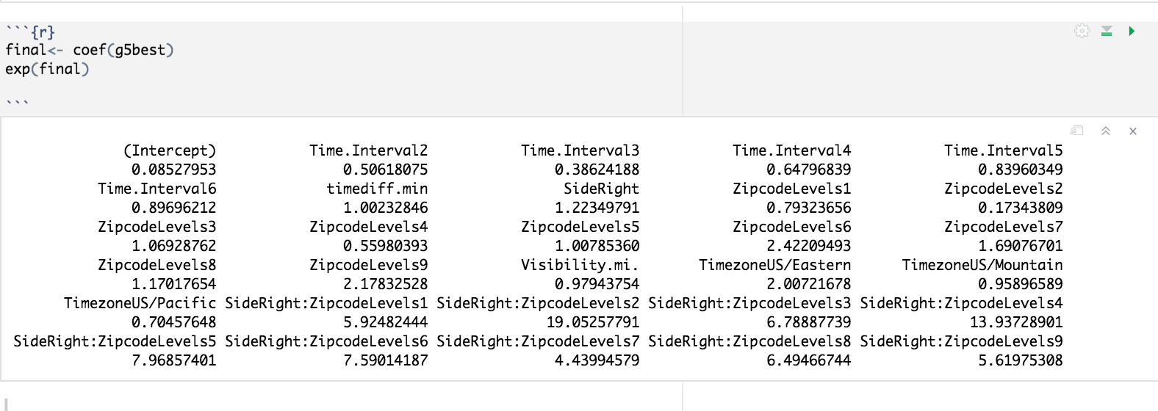
Interpreting Results
Log of odds of an accident increases its level of severity, keeping all other independent variables constant, and can be read from the coefficients.
For categorical data this is in % change between dummy variables.

Slide 34
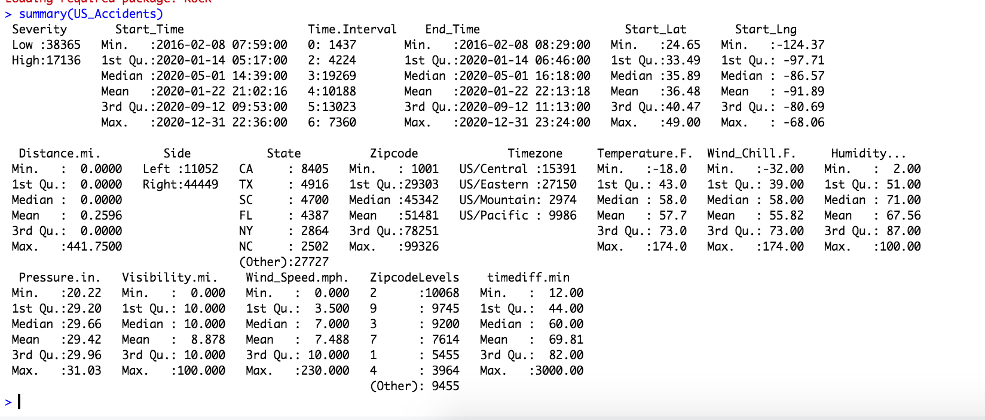
Interpreting Results
Looking at the summary one last time:

Slide 35
Conclusions
Time interval - 4 , 5, 6, i.e 10am - 10 pm have a higher chance of accidents being severe as time interval changes from level ‘0’ i.e (10pm-12am) ,
As Timezone changes from US/Central to US/Eastern chances of severity being high increase by a 100%
1 min increase in time spent (accident) increases severity p by 0.002
Visibility beta is 0.97 i.e, as Visibility increases odds of severity (high) decrease
zipcodelevels * side - high severity cases are more likely in zipcodelevels 2, 4, 5, 6 when side is right. These zipcode levels are found in regions near Maryland(east), Kentucky (S.E) , Iowa (mid-W), Nebraska(mid-W) .

Slide 36
THE END

