Slide 1

Zurich case – auto insurance
Junzhe Zhang
Data Scientist
zhangjunzhe8868@gmail.com

Slide 2
AGENDA
Introduction​
Recommendations
​Approach and Analysis
​Summary​

Slide 3
Introduction
Commercial auto insurance is a business insurance policy that applies to autos owned by or used in your business that protects your business against liability for damages caused by accidents involving your business autos and provides certain compensation to occupants of your business autos injured in accidents.
The cost of this business is the insurance payoff and the revenue of this business is the annual premium.
Targeting the customers with a low probability of having any claims and the customers with the lowest cost per claim, given that a claim occurs.
Making a marketing campaign that engages with potential customers based on their risk profiles.

Slide 4
Recommendations
Segment the potential customers into four groups based on the current risk profiles.
Based on the existing data, the different plans can be applied for the potential customers
The group of customers that has a low probability of having any claims. The premium could be relatively lower than our competitor.
The group of customers that has a low cost per claims with multiple claims. The initial premium could be higher than the previous group. But if they continuously driving safely, a small cash back could be provided.
The group of customers that has a high cost per claims with multiple claims. In order to keep the profit, a rejection could be applied for this group of customers.
The group of customer that has a very high cost per claims but with only one claim. Another model need to be developed to understand the reason of the high cost. More information and a longer pending time are needed for this group of customers.

Slide 5
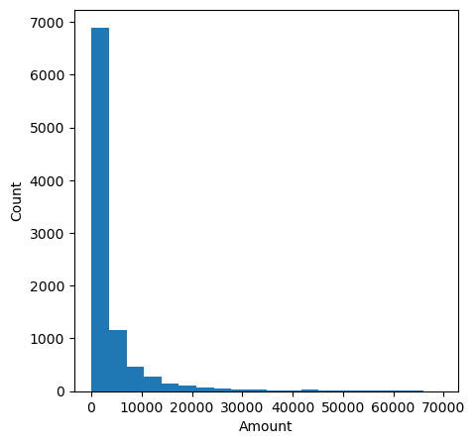
Recommendations
Facts and data-driven Results
The net profit of 2017 auto insurance is -16 M.
84% of existing customers never filed any claims in 2017.
70% of claim cost of the existing customers that filed at least one claim in 2017 is lower than $2880 (4 times of premium).
10% of claim cost of the existing customers that filed at least one claim in 2017 is greater than $7160 (10 times of premium).
The distribution of claim cost of the existing customers that filed at least one claim

Slide 6
Recommendations
Reasons
The existing premium is too low for some customers and the payoff of some customers is too high.
In order to grow the net profit, we need to add more good drivers and remove the bad drivers from the plan.
The customer that never filed any claims is the good drivers, which can increase the expectation of net profit. So a customer acquisition and retention need to be applied.
The customer that filed multi claims with low cost is also one income of the revenue, but the premium need to be adjusted to bring the positive net profit.
The customer that filed multi claims with high cost is the bad driver, which can decrease the expectation of the net profit. So the rejection plan could be applied.
The rest customer that filed only one case with high cost need to be paid more attention by requiring more information and adding a pending time. The reason of the one-time high-cost payoff need to be investigated. The cause may be various, such as fraud, bad weather, hit and run, hit a human being or broken the high-value item. We need to understand the expectation of this group of customer.

Slide 7
Approach and Analysis
Three models were built for analysis (classification, regression, and clustering).
There are four parts to build the classification, regression, and clustering model: load and data cleaning, data exploration and feature engineering, training the model/hyperparameter tuning and model evaluation, and predictive model building.
The pattern differences between policy 2017 data and quote 2018 data was checked. They have the same pattern for each feature.
The logistics regression model was used to differentiate the customer that never filed a claim and filed a claim (it also provide the probability) .
The random forest regression model was used for calculate the claim cost of the customer that has a high probability to file at least one claim.
The k-means clustering model was used to group the customer into 4 groups based on the raw data and also the prediction from the previous two models.

Slide 8
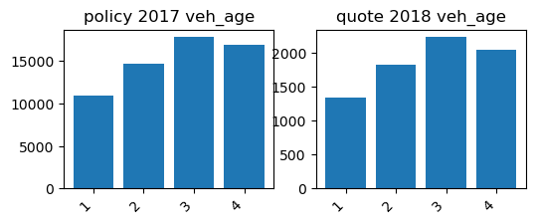
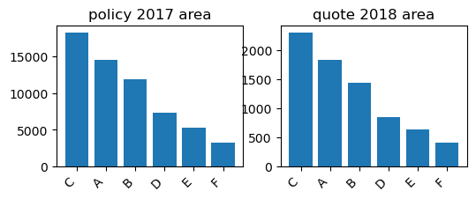
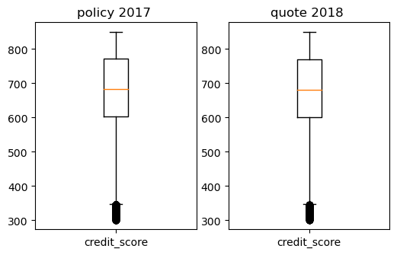
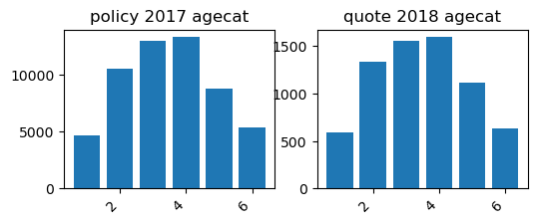
Approach and Analysis
The pattern differences between policy 2017 data and quote 2018 data

Slide 9





Approach and Analysis
The general steps for building the classification, regression, and clustering model
data cleaning
data exploration and feature engineering
training the model/hyperparameter tuning
model evaluation
predictive model building
Handle the missing value and outlier
Scale the continuous feature
Encode the categorical feature
Find or make the features that contributes to the regression, classification, and clustering
Check if it is imbalanced data
Check the distribution of the dependent variable
Split training and testing sets
Resample the training data if the data is imbalanced
Select a fitted model if Y is not normal distribution or if the regression is non-linear
Select the correct metrics for classification with imbalanced data (auc, F1, precision, recall)
Select the correct metrics for regression (R2, rmse)
PCA could be a comparison to the result of clustering
Build multi-stage code
Save multi-stage processed data

Slide 10
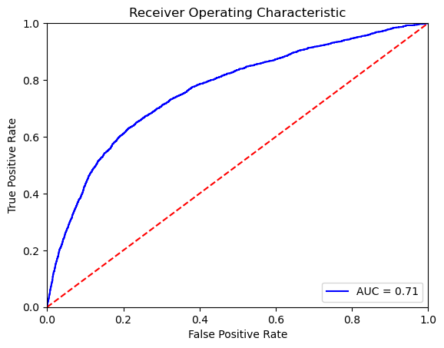
Approach and Analysis
Binary classification model for finding customers with a low probability of having any claims
The class of had filed at least a claim only takes 16%. It is a imbalanced data.
credit_score, traffic_index, veh_age, veh_value, age are the X.
oversampling minority class using random sampling and undersampling majority class using random sampling were used to handle the imbalanced issue.
Random forest and logistic regression were used to build the model
The logistics regression model performs better with auc:0.706, accuracyScore:0.725, precision:0.825, falseAlarmRate:0.323.
The prediction result of has_claim of 2018 data was saved in data\external\auto_potential_customers_2018_claim.csv

Slide 11
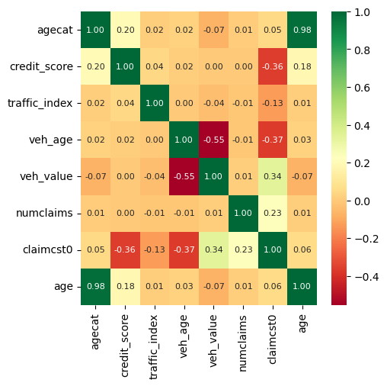
Approach and Analysis
Regression model for finding customers with the lowest cost per claim
The response variable 'claimcst0' is highly right-skewed and is positive across all observations.
credit_score, traffic_index, veh_age, veh_value, age, veh_safe (derived from veh_body) are the X.
Random forest and gamma regression were used to build the model
The regression is not linear. The random forest model performs better with r2:0.48, rmse:0.69.
The prediction result of has_claim of 2018 data was saved in data\external\auto_potential_customers_2018_lowcost.csv

Slide 12
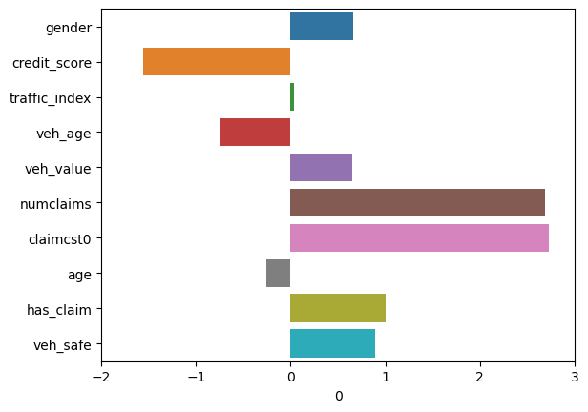
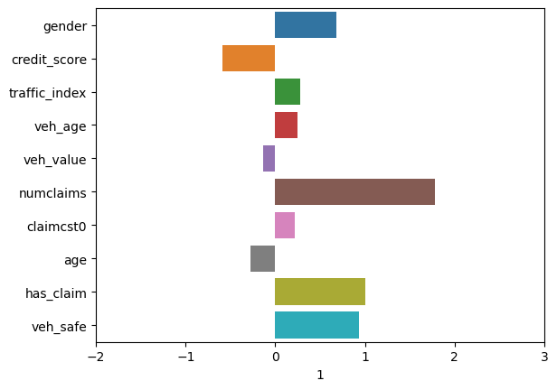
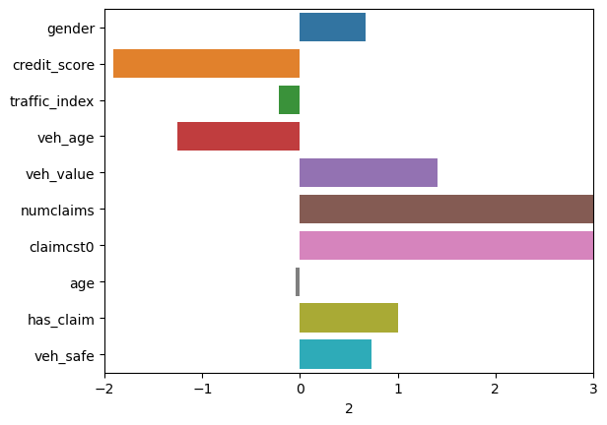
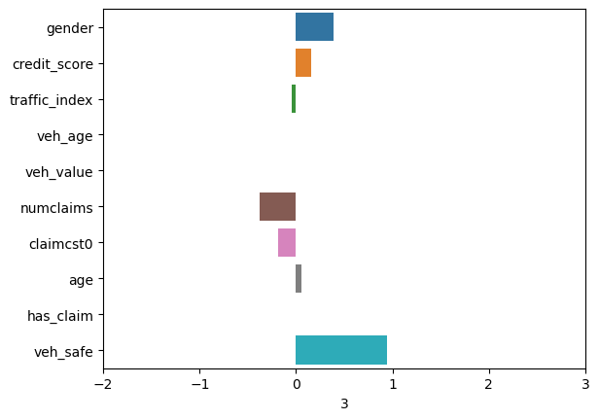
Approach and Analysis
Divide the customer into the different groups by the risk profile
The prediction result (potential file at least a claim and the potential cost of a claim) of previous model on the data 2018 was used for clustering.
credit_score, traffic_index, veh_age, veh_value, age, claimcst0, has_claim, veh_safe are the X.
K-means was used to do the clustering and inertia and silhouette_score were used to find the K.
The prediction result of has_claim of 2018 data was saved in data\external\auto_potential_customers_2018_cluster.csv
Cluster 0: credit score is low, traffic env is relatively safe, multi claims and claim cost is not high
Cluster 1: credit score is low, traffic env is relatively safe, less claims and claim cost is very high
Cluster 2: credit score is low, traffic env is relatively unsafe, multi claims and claim cost is low
Cluster 3: credit score is high, traffic env is safe, no claim

Slide 13
Summary
For personal auto manager:
Segment the potential customers into four groups based on the current risk profiles.
Based on the existing data, the different plans can be applied for the potential customers
For a group of data scientists:
Three models were built for analysis (classification, regression, and clustering).
There are four parts to build the classification, regression, and clustering model: load and data cleaning, data exploration and feature engineering, training the model/hyperparameter tuning and model evaluation, and predictive model building.
Next step: model implementation (big data or on-time) and model monitoring (model retrain)
These models are the starting point but need more models to work together, such as model can investigate the reason of one-time high cost payoff.

Slide 14
THANK YOU
Junzhe Zhang​
zhangjunzhe8868@gmail.com

