Slide 1

Default Credit Card Default Detection

Slide 2



1
Introduction
2
3
4
Data Analysis
Proposed Solution
Result and Discussion

Slide 3
Introduction
1

Slide 4

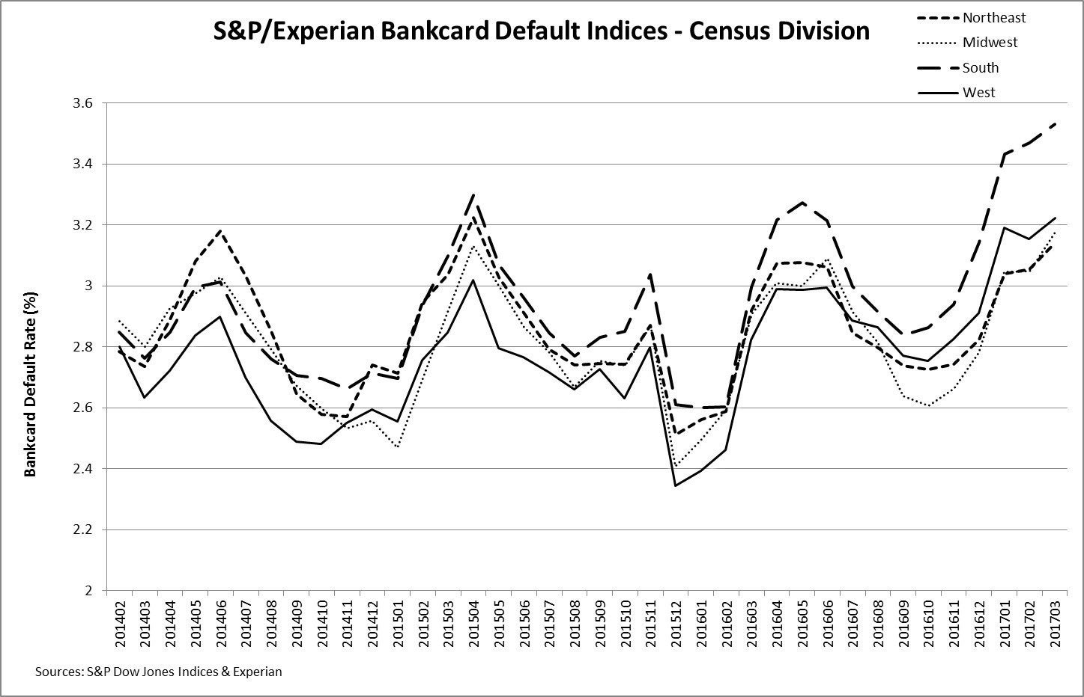
Credit Card Default
Default is to fail to make a payment on a debt by the due date.
If someone miss the minimum card payment six months in a row, their credit card will be an default.
If this happens with a credit card, creditors might raise interest rates to the default (or penalty rate) or decrease the line of credit.

Slide 5
Our Goal
Is to develop a system that detect client is most likely not able to pay in the next billing cycle.

Slide 6

Data Analysis

Slide 7
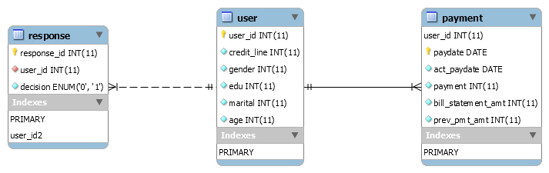
Original tables

Slide 8
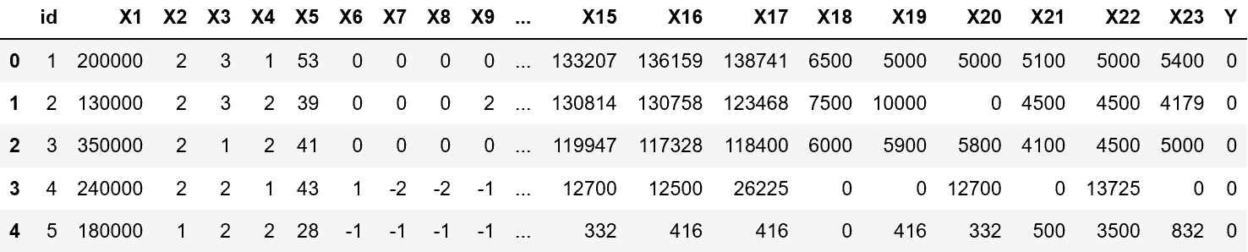
Data Set Overview
Id = A unique Id field which represents a customer
X1 = Credit line
X2 = Gender (1 = male; 2 = female).

Slide 9
Data Set Overview
X3 = Education (1 = graduate school; 2 = university; 3 = high school; 4 = others).
X4 = Marital status (1 = married; 2 = single; 3 = others).
X5 = Age
X6-X11 = Past Payments History (4/2005 to 9/2005)
X12-X17 = Bill Statements (4/2005 to 9/2005)
X18-X23: Amount of previous payment (4/2005 to 9/2005)
Y: Response ( If Default = 1 else 0)

Slide 10
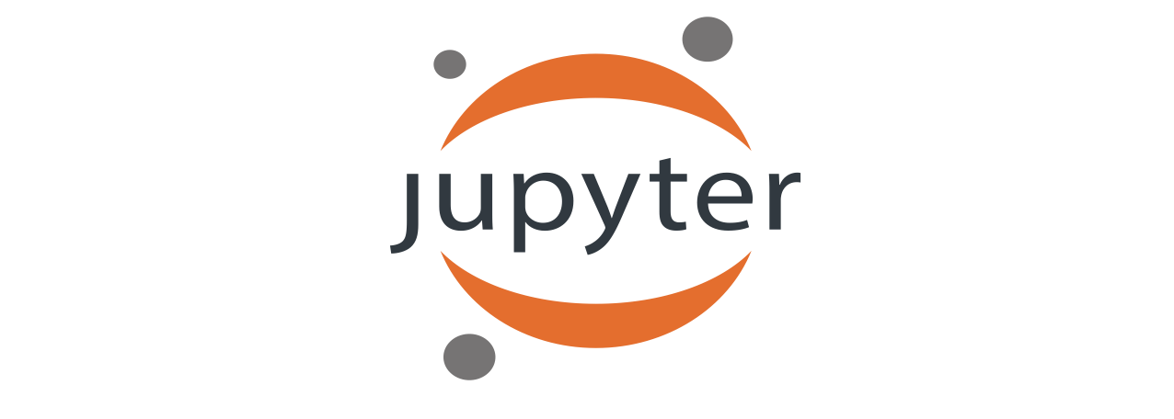
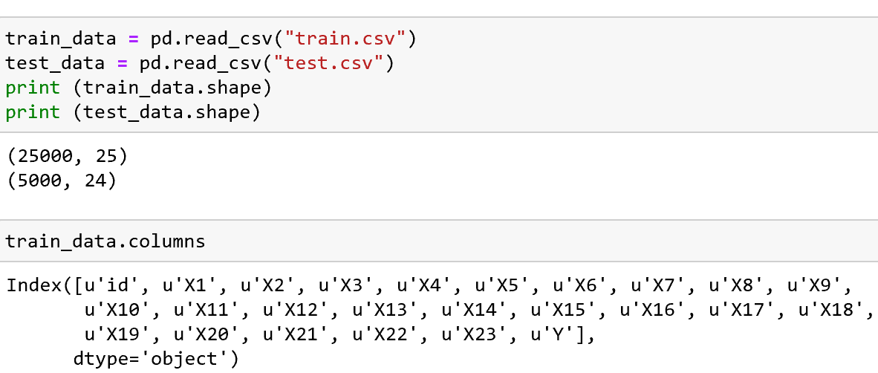
Jupyter notebook

Slide 11
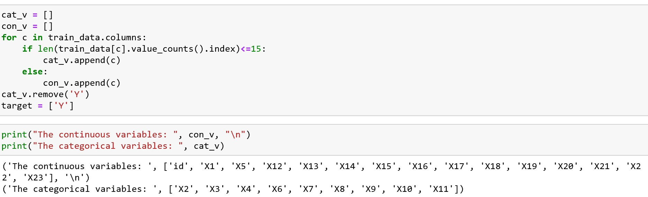
Data Processing

Slide 12
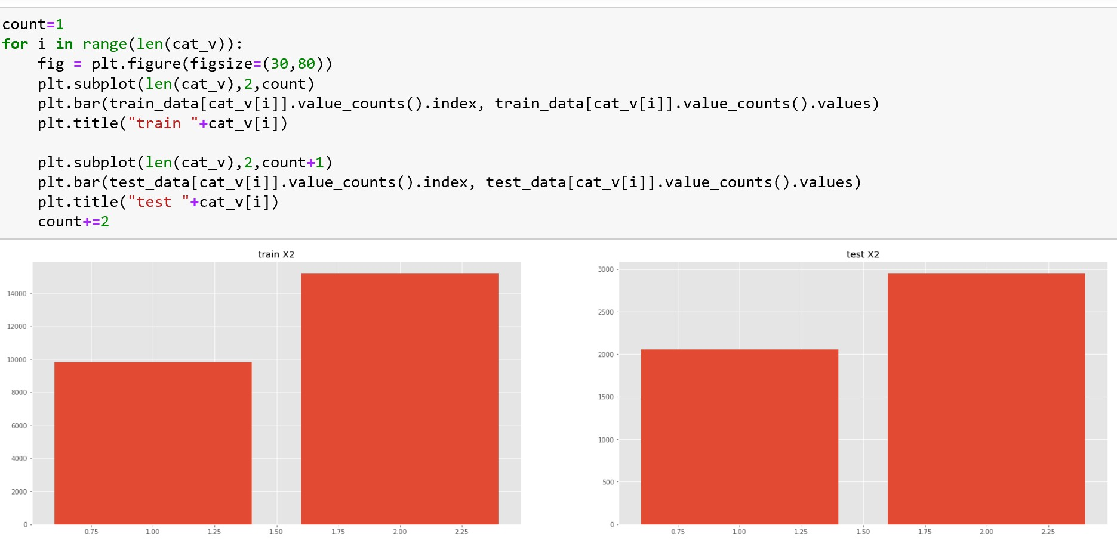
Data Visualization

Slide 13
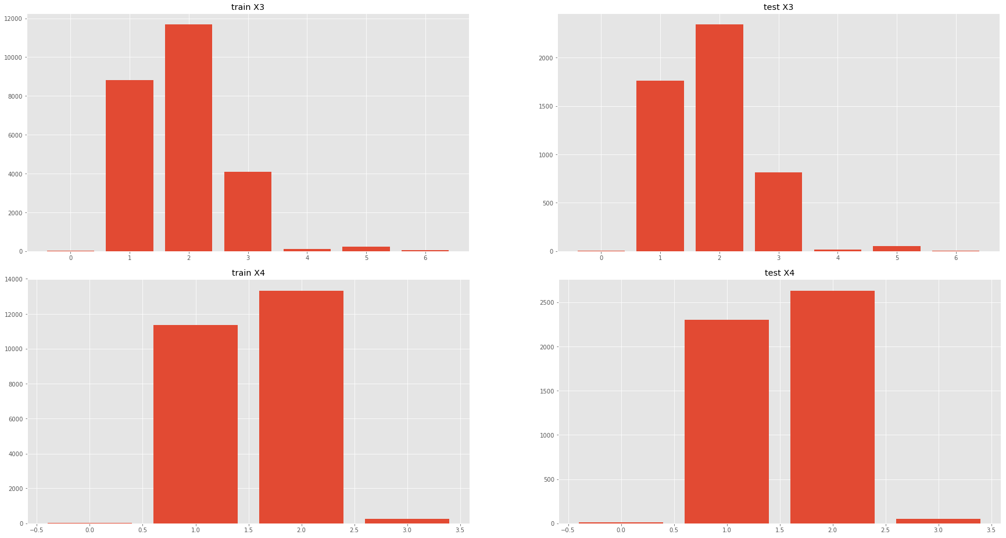
Continue

Slide 14
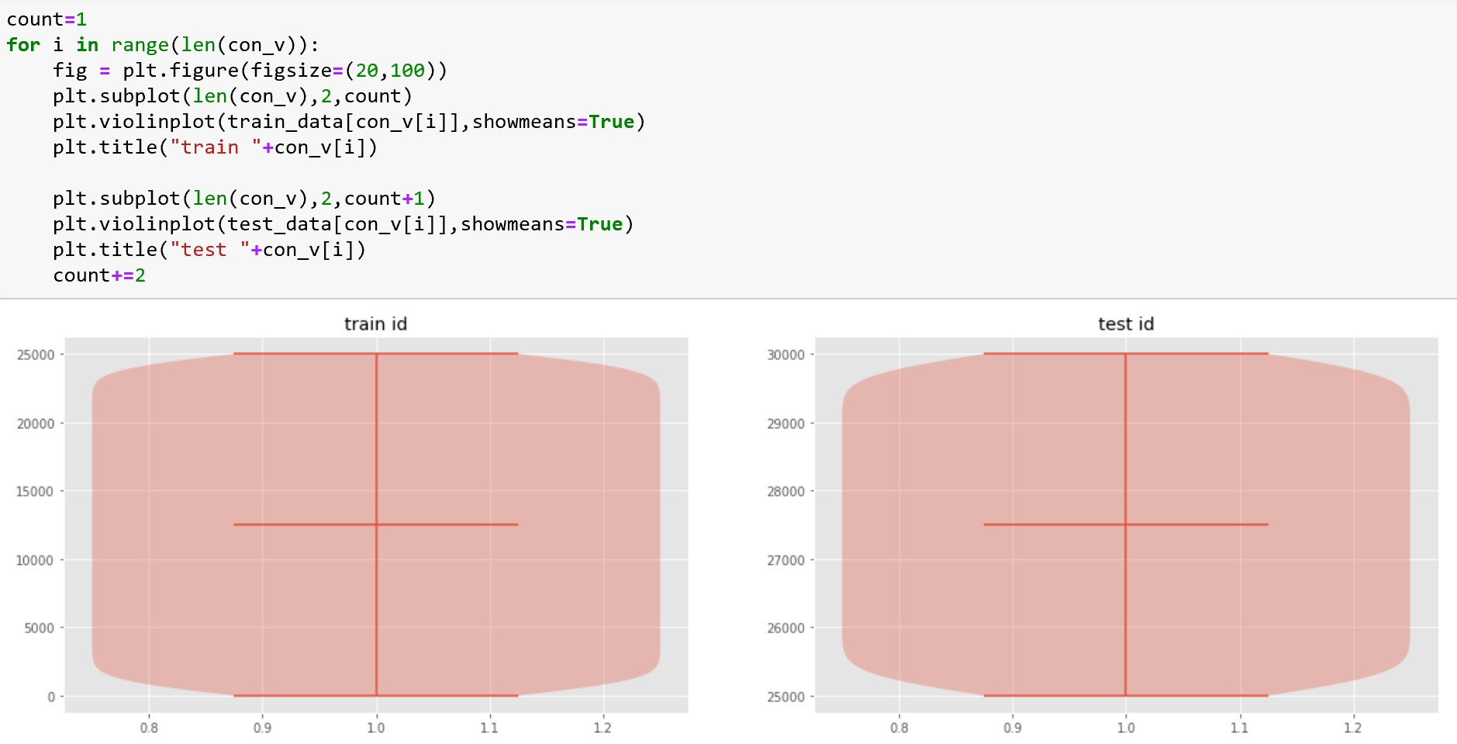
Violin Plot

Slide 15
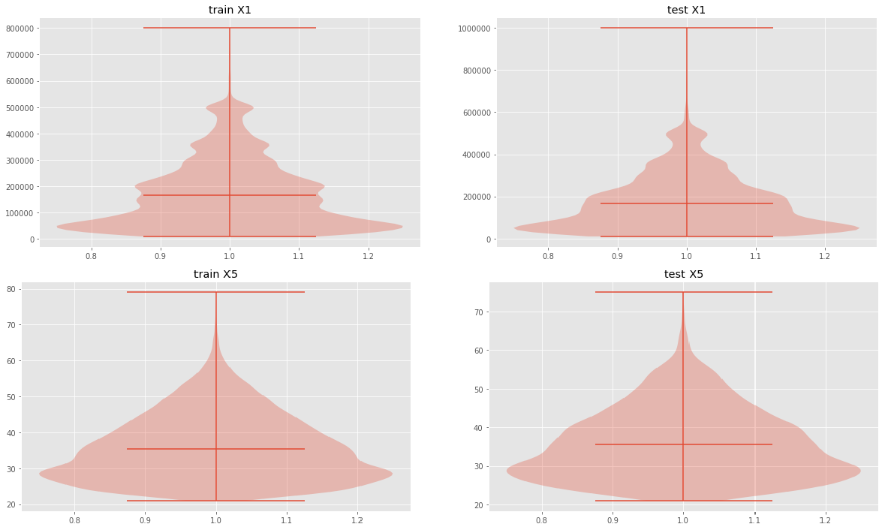
Continuous

Slide 16
Proposed Solution
3

Slide 17
1. Data Processing
Formatting: The data you have selected may not be in a format that is suitable for you to work with.
Cleaning: Cleaning data is the removal or fixing of missing data. For example, replacing zero with the mean value.
Sampling: There may be far more selected data available than you need to work with.

Slide 18
2. Machine Learning Algorithms
Random Forest
KNN
Logistic Regression
Classification
Voting
Supervised
Linear Regression
Naïve Bayes
Machine Learning
Clustering
Support Vector Machine
Unsupervised
Association
Stochastic Gradient Descent

Slide 19
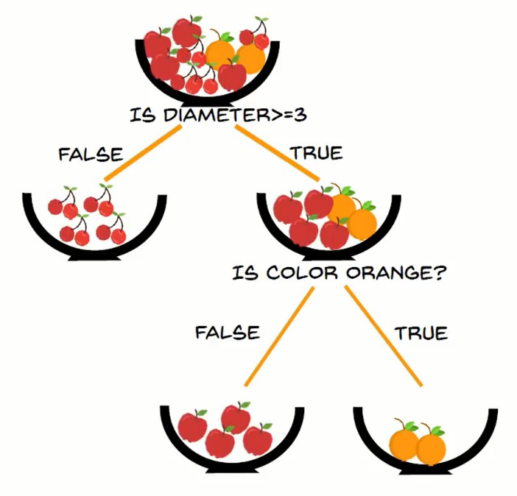
Random Forest Classifier
Constructs multiple decision trees and provides decision based on majority of the trees.
For example, fruit classification.

Slide 20
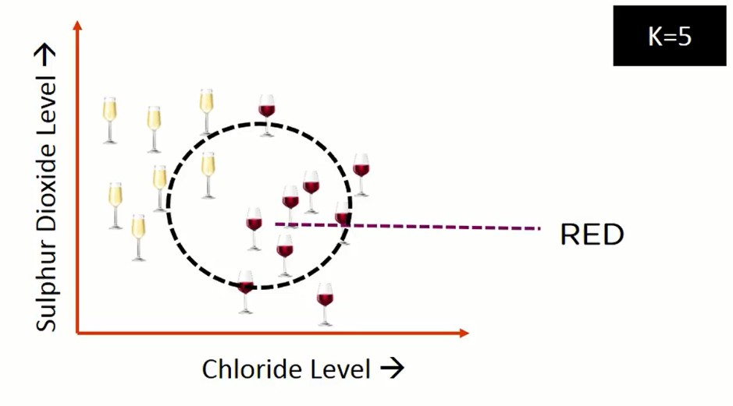
K Nearest Neighbor Classifier
Depending on value of K, KNN decides wine type as 4 out of 5 nearer wine are red. The algorithm will predict wine in that circle as red wine.

Slide 21
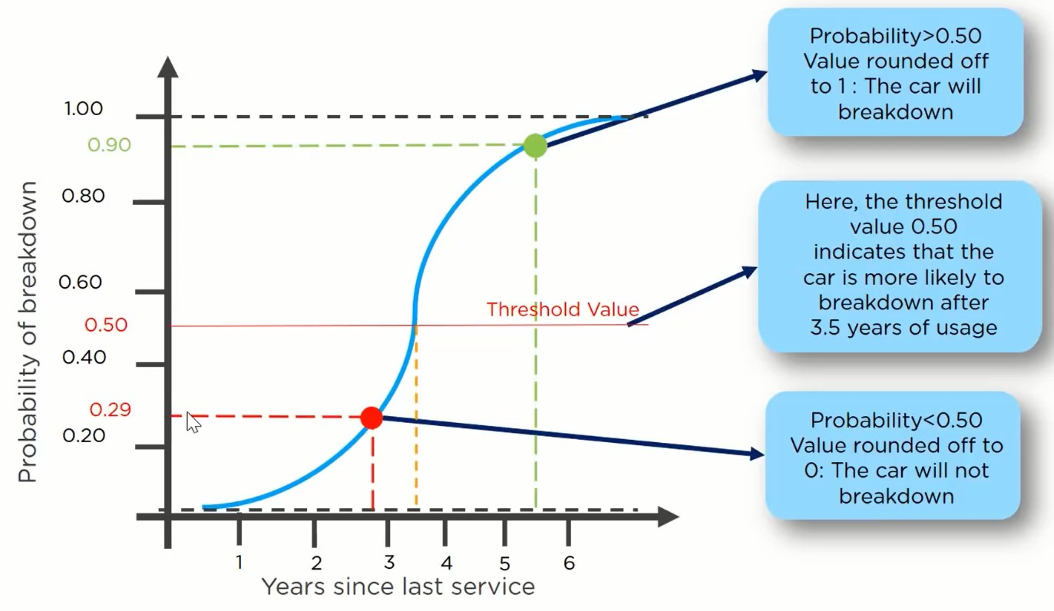
Logistic Regression
Regression model shows behavior based on previous data.
Determine threshold value.
_{Y= !}1 , 𝑃 𝑋
≥ 0.5
< 0.5
0, 𝑃 𝑋

Slide 22
Voting Classifier
Hard Voting: Is simply majority of voting.
Y=Mean{X1,X2,X3} ={1,0,0}= 0
Random Forest Classifier
Soft Voting: Predict probability based on average of other
X
KNN Classifier
Y
classifier's results.
Logistic Regression
Y =(X1+X2+X3)/3= 1/3<threshold
=> Y=0

Slide 23
Result and Discussion
4

Slide 24
Evaluation Metrics
 | NOTDEFAULT PREDICTED | DEFAULT PREDICTED
NOTDEFAULT | TN | FP
DEFAULT | FN | TP
True Positive: Actually Default and Predicted as a Default
True Negative: Actually Not-Default and predicted as a Not-Default False Positive: Actually Not-Default and predicted as a Default False Negative: Actually Default and predicted as a Not-Default

Slide 25
3. Evaluation
Accuracy: Accuracy determines number of Not-Default and Default.
Recall: From all accounts that actually are default accounts.
Recall = ^{+,}
+, - /.
Harmonic
Accuracy= ^{+, - +.}
F1-Score:
mean of
+, - +. - /, - /.
Precision: Amount of actual answers from positive prediction
precision and recall.
F1-Score =2 * ^{, ∗ 1}
,-1
+,
Cross Validation:
K Fold cross validation where K=5.
Precision =
+, - /,

Slide 26
Accuracy Table
Classifier | Accuracy (%)
Random Forest | 79
K Nearest Neighbor | 71
Logistic Regression | 71
Voting | 71

Slide 27
4. Analyses of The Best Model
Random Forest Classifier.
 | Precision | Recall | F1- Score | Support
0 | 0.83 | 0.95 | 0.88 | 3923
1 | 0.60 | 0.30 | 0.40 | 1077
Avg/Total | 0.78 | 0.81 | 0.78 | 5000

Slide 28
Thank You

