Slide 1

Pyston tech talk
November 10, 2015

Slide 2
What is Pyston
High-performance Python JIT, written in C++
JIT: produces assembly “just in time” in order to accelerate the program
Targets Python 2.7
Open source project at Dropbox, started in 2013
Two full time members, plus part time and open source members

Slide 3


The team
Marius Wachtler
Kevin Modzelewski
Lots of important contributors:
Boxiang Sun, Rudi Chen, Travis Hance, Michael Arntzenius, Vinzenz Feenstra, Daniel Agar

Slide 4
Pyston current status
25% better performance than CPython
Compatibility level is roughly the same as between minor versions (2.6 vs 2.7)
Can run django, much of the Dropbox server, some numpy
Next milestone is Dropbox production!

Slide 5
Talk Outline
Pyston motivation
Compatibility
Python performance
Our techniques
Current roadmap

Slide 6
Pyston motivation

Slide 7
Why Pyston
Python is not just “IO-bound”; at scale, Dropbox (and others) have many cores running Python
Many existing Python-performance projects, but not suitable for large Python codebases
Notes:
Other companies that use Python: YouTube, Pinterest, Reddit. (Yelp, Venmo, Digg)

Slide 8
Existing Landscape
Baseline: CPython
If you want more performance:
C extension
Cython
Numba
PyPy
Rewrite (Go? C++?)

Slide 9
How we fit in
Focus on large web-app case (specifically Dropbox):
Require very low required edits per kLOC
Implies good C API support
Good performance scalability to large codebases
Non-goal: crushing microbenchmarks

Slide 10
Compatibility

Slide 11
Compatibility challenges
Some things expected:
Language documentation but no formal spec
C API challenges
Every feature exists because someone wanted it

Slide 12
Compatibility challenges
Some not expected:
Lots of program introspection
Some core libraries (pip) are the most dynamic
Code will break if you fix even the worst warts
Community accepts other implementations, but assumes is_cpython = not is_pypy

Slide 13
Our evolution
Started as a from-scratch implementation, is now CPython-based.
Got to experiment with many things:
showed us several things we can change
and several things we cannot :(
Notes:
sys._getframe, skip type readying; exceptions, GC

Slide 14
Evolution result
We use lots of CPython code to be “correct by default”
We support: - django, sqlalchemy, lxml, many more - most of the Dropbox server - some numpy

Slide 15
Aside: the GIL
I don’t want it either but… it’s not just an implementation challenge.
Removing it is a much bigger compatibility break than we can accept
We have a GIL. And Dropbox has already solved its Python parallelism issue anyway.
Maybe Python 4?

Slide 16
Python performance

Slide 17
What makes Python hard
Beating an interpreter sounds easy (lots of research papers do it!), but:
CPython is well-optimized, and code is optimized to run on it
Hard to gracefully degrade to CPython’s behavior

Slide 18
What makes Python hard
Python doesn’t have static types
But…

Slide 19
What makes Python hard
Python doesn’t have static types
But…
Statically typed Python is still hard!

Slide 20
What makes Python hard
Statically-typed Python is still hard
var_name = var_parser_regex.match(s) setting = getattr(settings, var_name, None)

Slide 21
What makes Python hard
Statically-typed Python is still hard
Knowing the types does not make getattr() easy to evaluate
var_name = var_parser_regex.match(s) setting = getattr(settings, var_name, None)

Slide 22
What makes Python hard
Statically-typed Python is still hard
Knowing the types does not make getattr() easy to evaluate
Many other examples: - len() - constructors - binops
var_name = var_parser_regex.match(s) setting = getattr(settings, var_name, None)

Slide 23
What makes Python hard
Types are only the first level of dynamicism
Functions themselves exhibit dynamic behavior
Traditional “interpreter overhead” is negligible
So what can we get from a JIT?
Notes:
(negligible on web-app workloads) ceval.c is 5k LOC out of 40k in Python/. Cython is about the same speed as CPython when used without annotations.

Slide 24
What makes Python hard
Types are only the first level of dynamicism
Functions themselves exhibit dynamic behavior
Traditional “interpreter overhead” is negligible
So what can we get from a JIT?
We need to understand + avoid the dynamicism in the runtime
Notes:
(negligible on web-app workloads) ceval.c is 5k LOC out of 40k in Python/. Cython is about the same speed as CPython when used without annotations.

Slide 25
Our techniques

Slide 26
Pyston architecture
Parser
Bytecode
Interpreter
Baseline JIT
LLVM JIT
Tracer
Runtime

Slide 27
Our workhorse: tracing
Very low tech tracing JIT:
single operation (bytecode) at a time
no inlining
manual annotations in the runtime

Slide 28
Our workhorse: tracing
Manual annotations
are difficult to write
require less engineering investment
are very flexible
have very high performance potential

Slide 29
Tracing example
def foo(x): pass foo(1)

Slide 30
Tracing example
def foo(x): pass foo(1)
Verify the function is the same
Call it

Slide 31
Tracing example
def foo(x): pass foo(1)
Verify the function is the same
Check if “foo” still refers to the same object
Check if foo() was mutated
Call it
Arrange arguments for C-style function call
Call the underlying function pointer

Slide 32
Tracing example
def foo(x): pass foo(1)
Verify the function is the same
Check if “foo” still refers to the same object
Check if foo() was mutated
Call it
Arrange arguments for C-style function call
Call the underlying function pointer
Can skip hash table lookup
Rare, use invalidation
Can skip *args allocation

Slide 33
Tracing example #2
o = MyCoolObject() len(o)

Slide 34
Tracing example #2
o = MyCoolObject() len(o)
Verify the function is the same
Check if “len” refers to the same object
Call it
len() supports tracing

Slide 35
Tracing example #2
o = MyCoolObject() len(o)
Verify the function is the same
Check if “len” refers to the same object
Call it
len() supports tracing. Decides to:
Call arg.__len__()

Slide 36
Tracing example #2
o = MyCoolObject() len(o)
Verify the function is the same
Check if “len” refers to the same object
Call it
len() supports tracing. Decides to:
Call arg.__len__()
Verify the function is the same
Call it

Slide 37
Tracing example #2
o = MyCoolObject() len(o)
Verify the function is the same
Check if “len” refers to the same object
Call it
len() supports tracing. Decides to:
Call arg.__len__()
Verify the function is the same ...
Call it ...

Slide 38
Why use tracing
We started with a traditional method-at-a-time JIT, but quickly ran into issues, and our tracing system kept being the best way to solve them.
We need a rich way of representing the expected path through the runtime
We want to let C functions specify alternate versions of themselves that are either more specialized or more general
We want to keep the tracing code close to the runtime code it needs to match

Slide 39
PyPy comparison

Slide 40
PyPy
Missing: - C extension support (80k LOC used at Dropbox) - performance scalability and consistency
We’ve been measuring our catch-up in “years per month”
Notes:
80kloc figure was from March ‘15
what do I mean by consistency? they tend to have worse perf on real large programs.

Slide 41
PyPy performance scalability
Their performance degrades quite a lot when run on large “real” (non-numeric) applications, and often ends up slower than CPython
Initial testing of PyPy at Dropbox shows no clear improvement
One indicator: average benchmark size. - PyPy: 36 lines - Pyston: 671 lines

Slide 42
PyPy performance scalability
Simple attribute-lookup example:

Slide 43
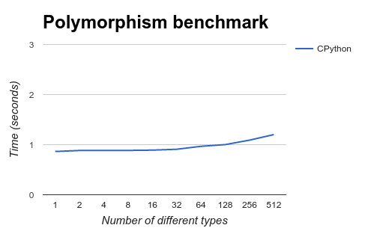
PyPy performance scalability
Simple attribute-lookup example:

Slide 44
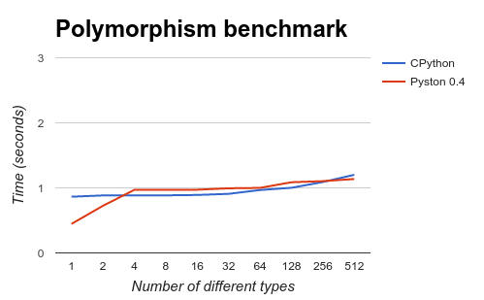
PyPy performance scalability
Simple attribute-lookup example:

Slide 45
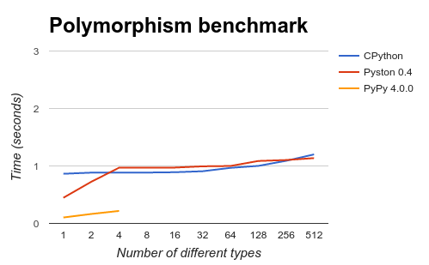
PyPy performance scalability
Simple attribute-lookup example:
8x faster!

Slide 46
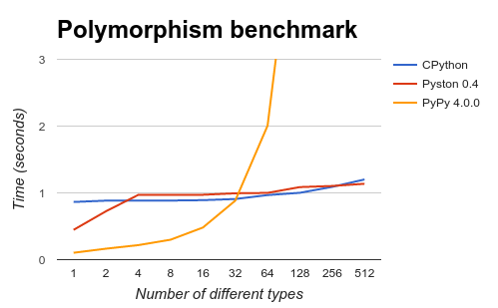
PyPy performance scalability
Simple attribute-lookup example:
38x slower :(
8x faster!
Notes:
There are other dimensions as well. another one I tried is number of different control flow paths. 512 seems like a lot, but studies on open source projects found up to 300-some types, and the Dropbox codebase is much larger. (think: ORM code which will process #types=#prod tables)

Slide 47
Current roadmap

Slide 48
Current roadmap
Focusing on getting ready for Dropbox’s production use. Last “1%” features
Inspecting exited frames
Signals support
Refcounting?

Slide 49
Current roadmap
Continue performance work
Integrate tracing and LLVM JITs
Optimized bytecode interpreter
Function inlining

Slide 50
How to get involved
Just pick something! We have a good list of starter projects
Or just hop on our gitter channel and say hi

Slide 51
Questions?
kmod@dropbox.com marius@dropbox.com
https://github.com/dropbox/pyston https://gitter.im/dropbox/pyston
We’re hiring!

